Slide 1
“Detection and Clustering of Grapevine Varieties via Multispectral Aerial Imagery and Vegetation Indices Analysis”
Olympia Kourounioti and Emmanouil Oikonomou
University of West Attica, Greece

Slide 2
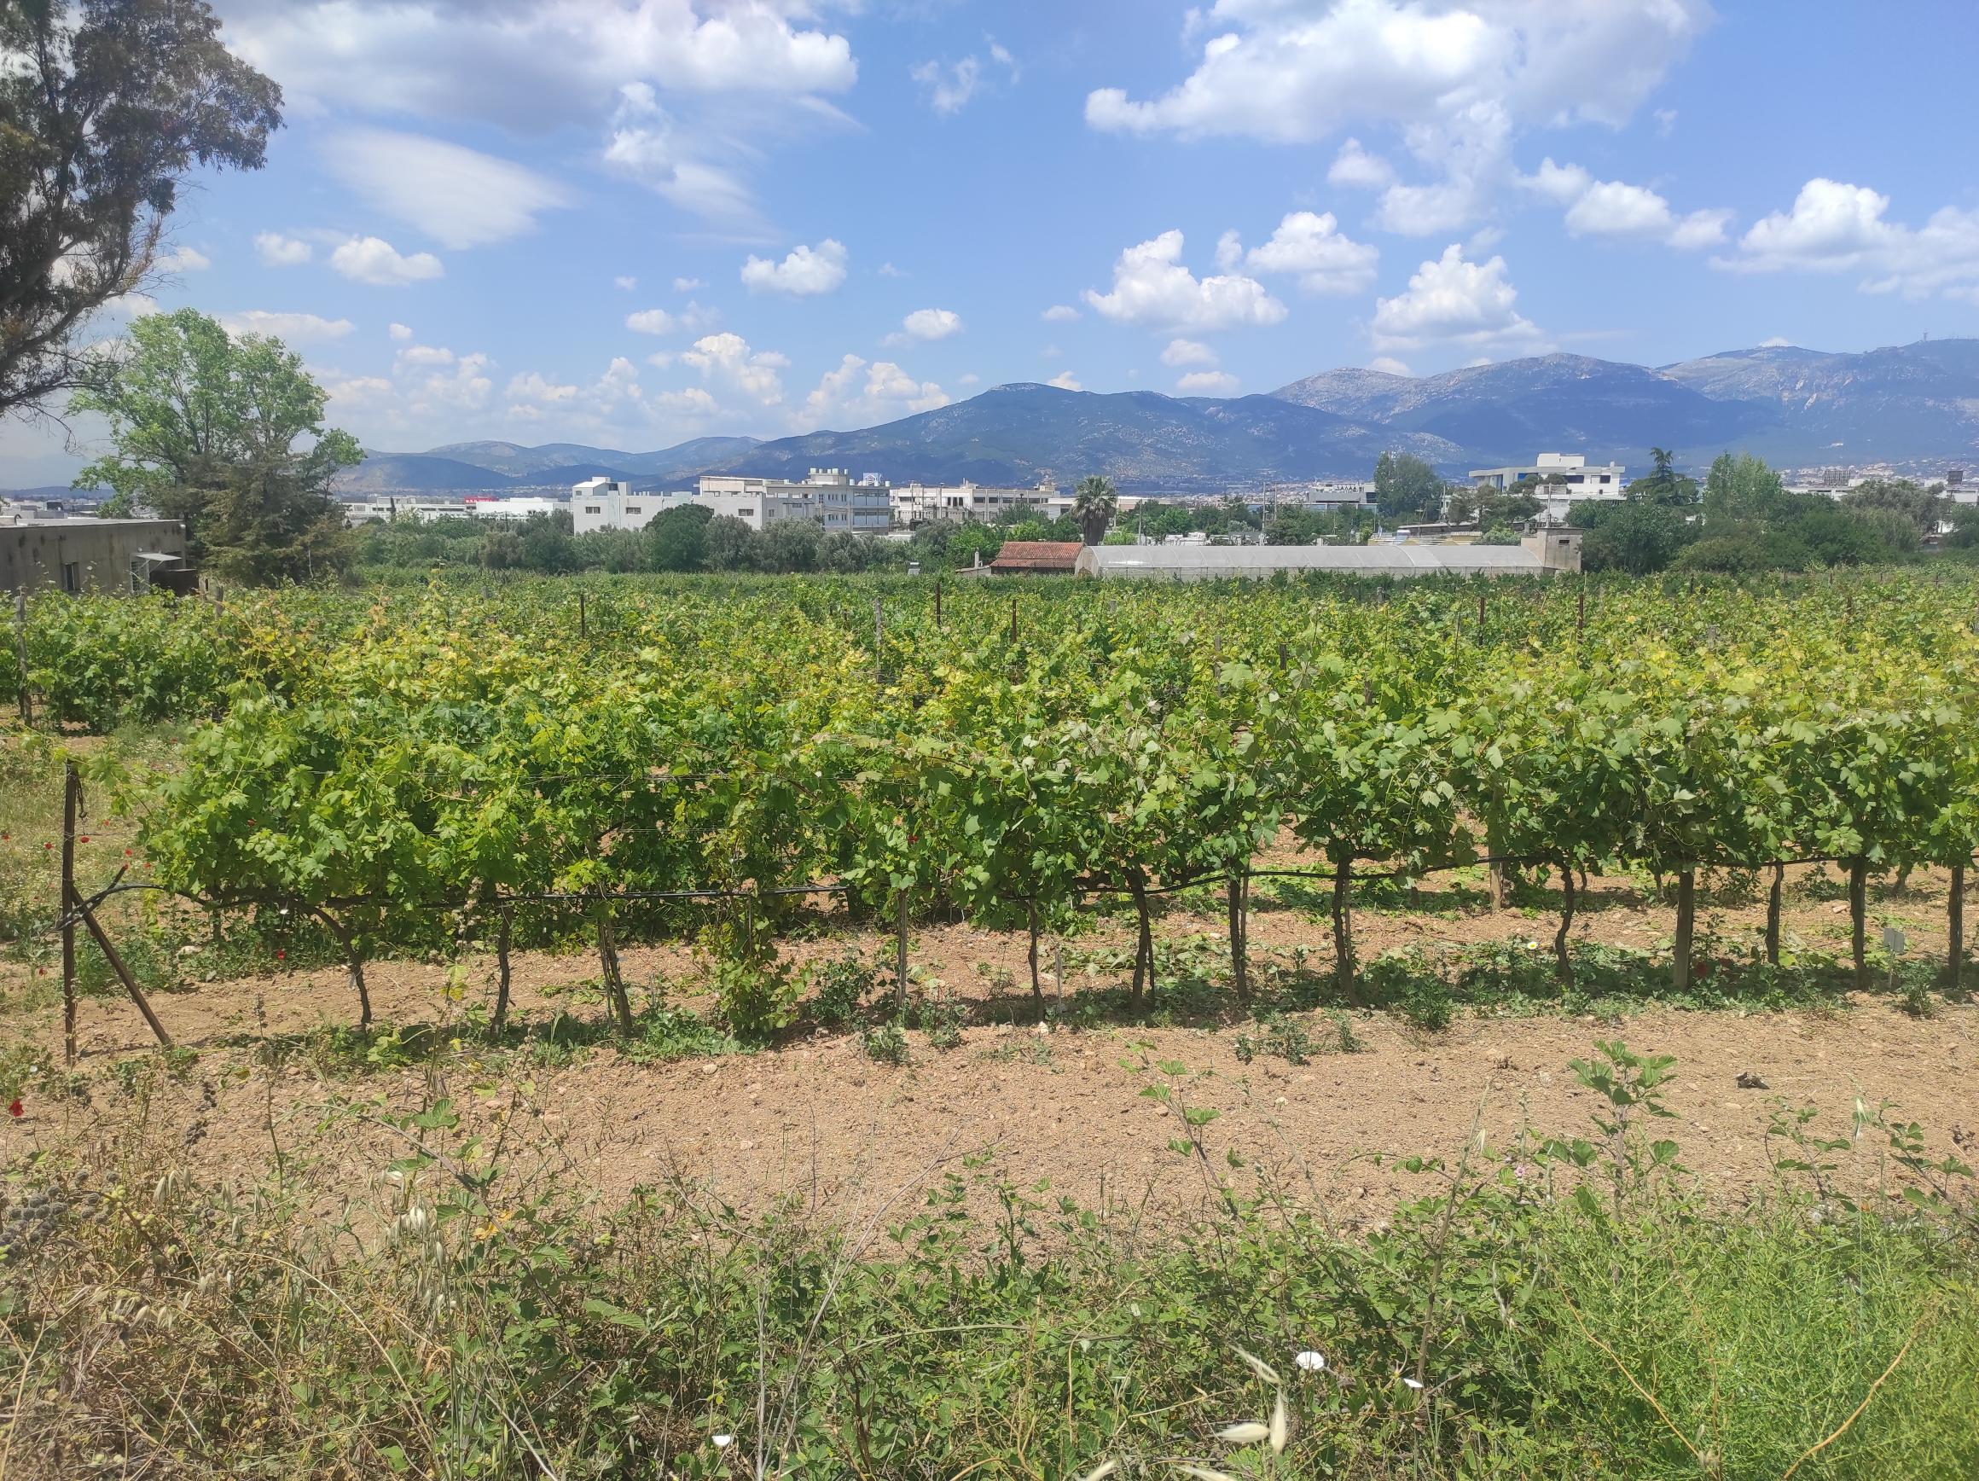
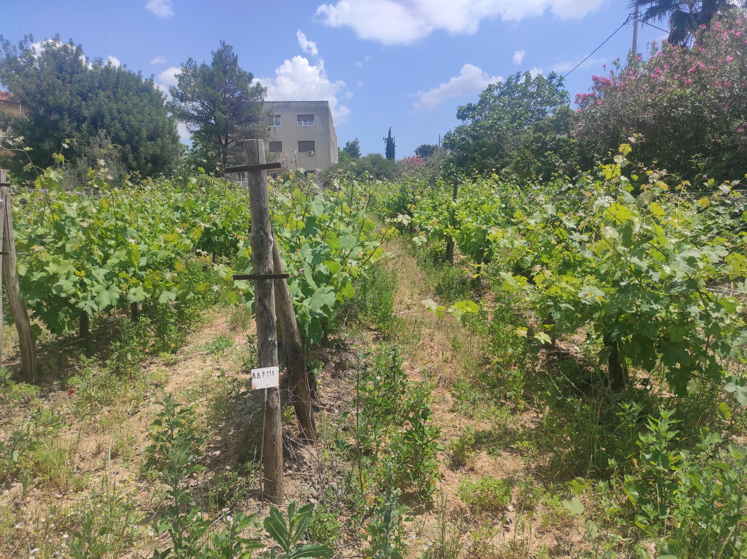
Objective:
Detection and analysis of various vineyard varieties located at the same area
Exploiting the properties of multispectral images
Vegetation indices implementation and analysis
Clustering of vineyards with common properties based on spectral information

Slide 3
Research methodology:
Literature Review
Narrative Literature Review:
vineyard diseases, nutrient elements for growth, image acquisition methods, focus levels and growth stages
Systematic Literature Review:
vegetation varieties classification, Selection of 10 relevant documents
Area of interest: Creation of orthophotos from multispectral images
Clustering of vineyards varieties, Results
Vegetation indices implementation and analysis
Segmentation of vine parts within the orthophoto

Slide 4
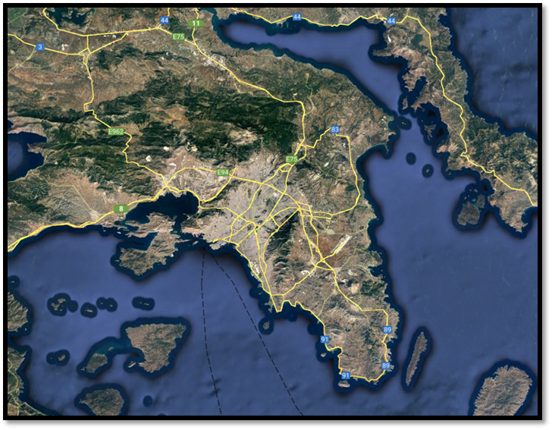
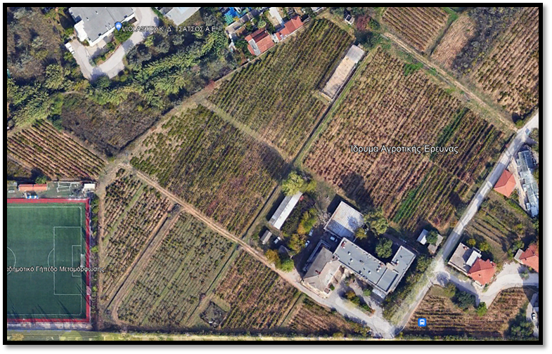
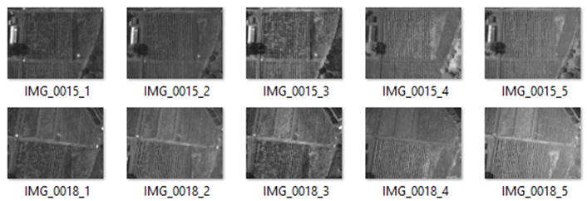
Study area and equipment
Camera used: Micasense Red Edge M
Multispectral camera
5 bands (Blue, Green, Red, NIR, RedEdge)
53 captures in total (5 images each capture)
Lykovrisi area, Attica, Greece
Institute of Agricultural Products Technology
112 different vineyard varieties area

Slide 5
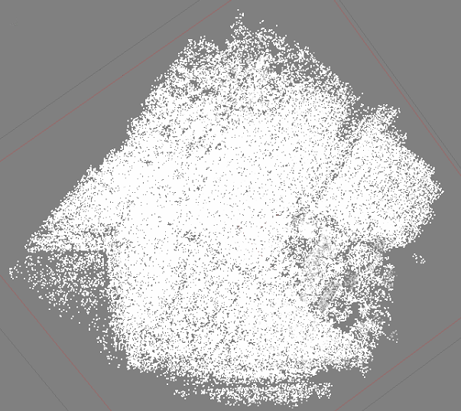
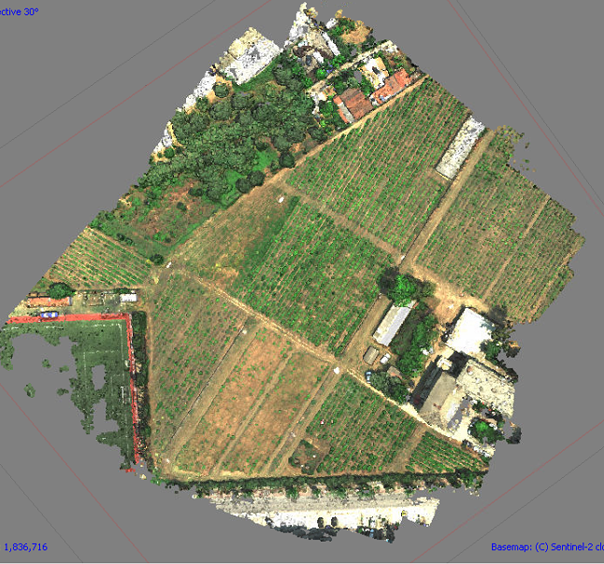
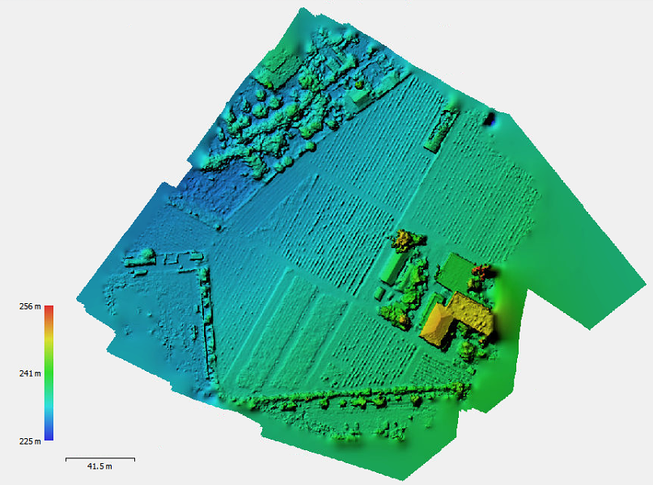
Orthophotomap creation (1)
The steps for the orthophotomap creation:
1) Aligning photos: Sparse point cloud creation
2) Building dense point cloud
3) Building digital elevation model

Slide 6
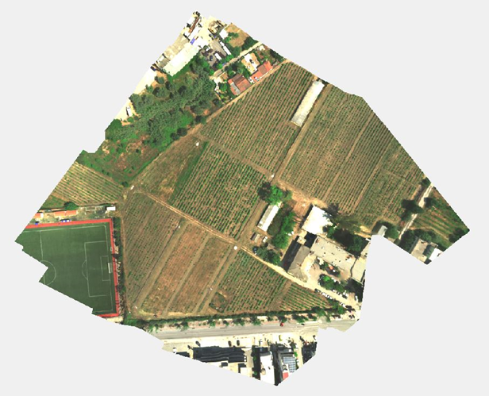
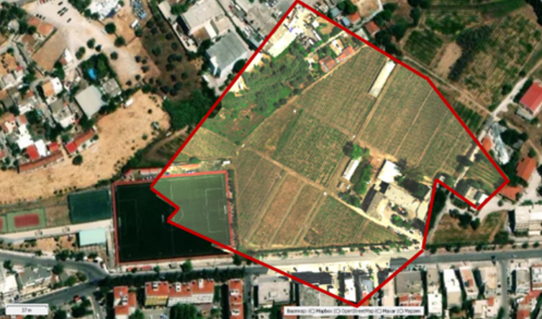
Orthophotomap creation (2)
4) Building orthomosaic
5) Georeferencing orthomosaic

Slide 7
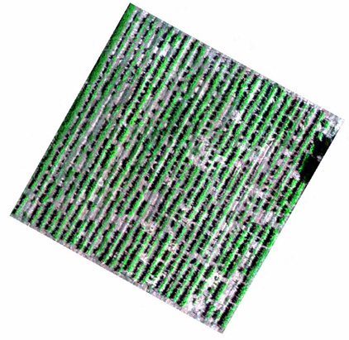
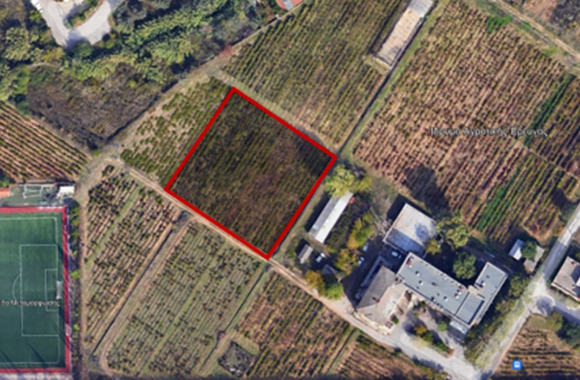
Area of interest
Selection from the area of interest a region about 2000 km2
This part were cropped from the orthophotomap

Slide 8
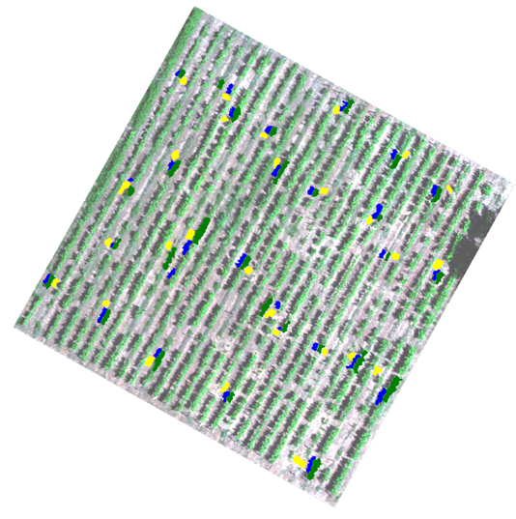
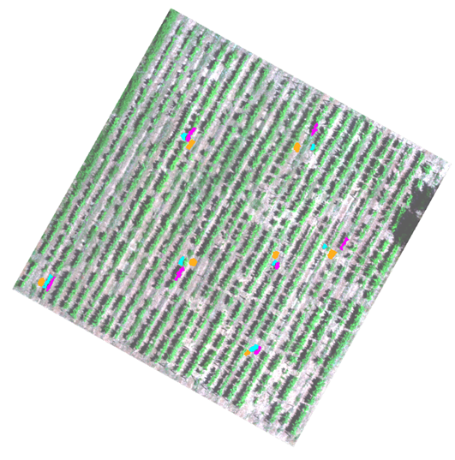
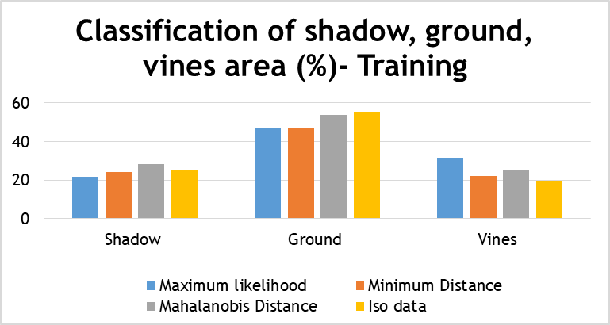
Vegetation indices analysis –
Classification of varieties pixels
Percentage of training results of different classes
Training and testing samples all over the image
80% Training Samples, 20% Testing Samples
Training | Supervised classification % |  |  | Unsupervised classification
 | Maximum likelihood | Minimum Distance | Mahalanobis Distance | Iso data
Shadow | 21.81 | 24.14 | 28.12 | 25.03
Ground | 46.57 | 46.91 | 53.7 | 55.21
Vines | 31.62 | 22.15 | 25.03 | 19.75
Training set Testing set

Slide 9
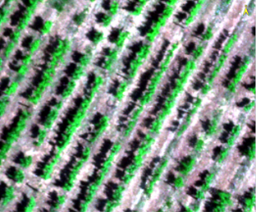
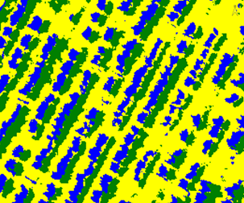
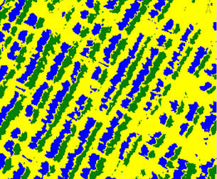
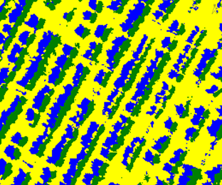
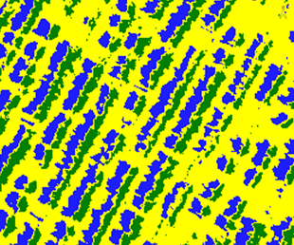
Vegetation indices analysis –
Training classification results
Classification results of each algorithm on the image
RGB Maximum Likelihood Minimum Distance
Mahalanobis Distance Iso Data
Ground
Shadow
Vines

Slide 10
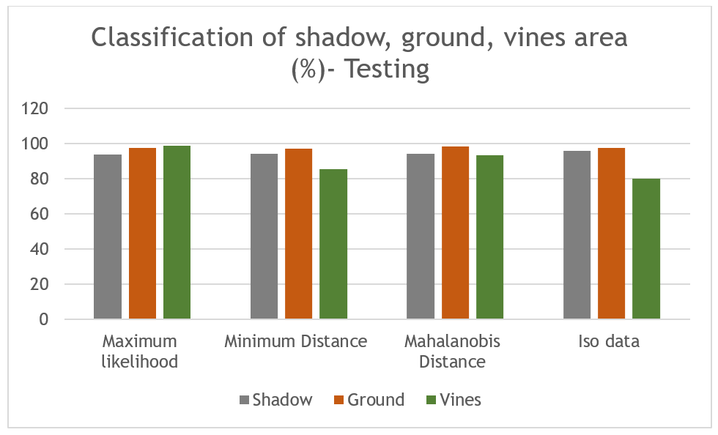
Vegetation indices analysis –
Testing classification results
Percentage of testing results of different classes
Testing | Supervised classification |  |  | Unsupervised classification
 | Maximum likelihood | Minimum Distance | Mahalanobis Distance | Iso Data
Shadow | 93.97 | 94.31 | 94.08 | 95.65
Ground | 97.35 | 97.28 | 98.46 | 97.65
Vines | 98.79 | 85.60 | 93.18 | 80.21
For Vine class, Maximum likelihood algorithm succeeded the higher classification results in testing samples
Maximum likelihood algorithm was selected for next steps

Slide 11
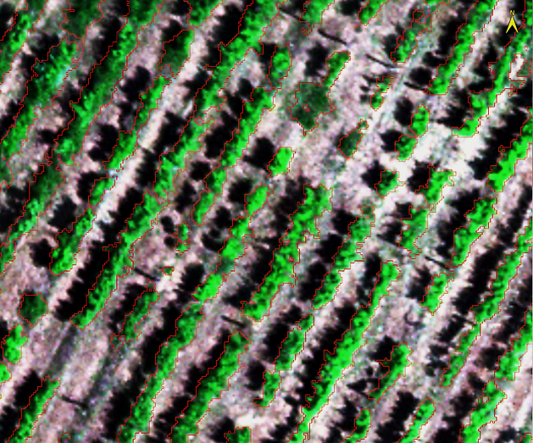
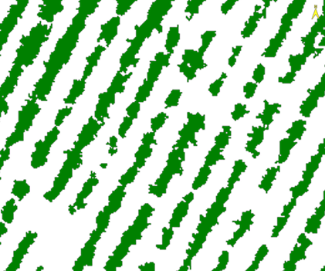
Image noise removal and vine mask creation
Sieve algorithm implemented on image for noise removal
Final mask areas with red line
The vine pixels isolated from ground, shadow and weed areas

Slide 12
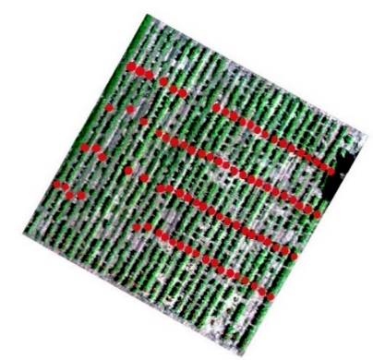
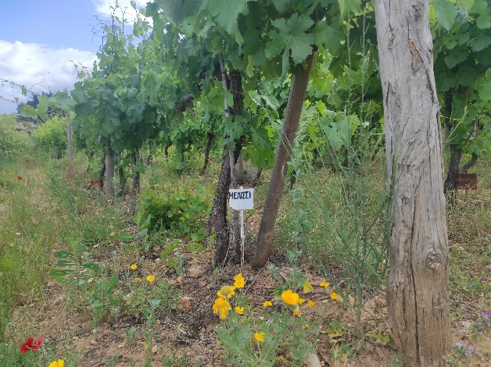
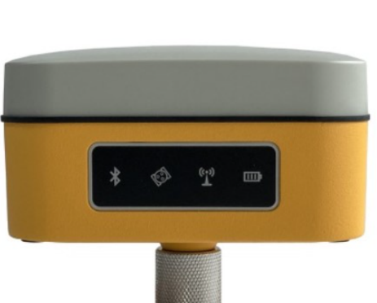
Vegetation indices analysis – Measurement of vineyard varieties
Ground labels with the names of each vineyard were measured via a GNSS receiver
Map shows the position of each different variety
112 different vineyard varieties
Each red dot represent the starting and
ending points between varieties
The vineyard consists of 26 lines of vines and most of rows include about 2 to 5 varieties

Slide 13
Vegetation indices analysis
Index name | Formula | Reference | Detected element
Chlorophyll Index Green (Clgr) | CLGR= (NIR/GREEN)-1 | (Gitelson et al., 2005) | chlorophyll concentration
Chlorophyll Index - Red-Edge (Clre) | CLRE= [(NIR/RedEdge)-1] | (Gitelson et al., 2005) | chlorophyll concentration
CVI (Chlorophyll Vegetation Index) | CVI= (NIR/GREEN)*(RED/GREEN) | (Vincini et al., 2008) | chlorophyll content - leaf health and photosynthetic activity
NDVI (Normalized difference vegetation index) | NDVI= (B5-B3)/(B3+B5) | (Rouse JW, 1974) | health and vigor
GNDVI (Green Normalized difference vegetation index): | GNDVI= (NIR-GREEN)/(NIR+GREEN) | (Gitelson et al., 1996) | areas where the vegetation is denser
EVI 2 (Enhanced vegetation index) | EVI 2= 2.5*(B5-B3)/(B5+2.4*B3+1) | (Clevers, 1999; Kaufman, 1997) | account for atmospheric influences, canopy, and soil - particularly in areas with dense canopies
RVI (Ratio Vegetation Index) | RVI= NIR/RED | (Jordan, 1969) | vegetation health - sensitive to changes in chlorophyll content - indicate plant stress

Slide 14
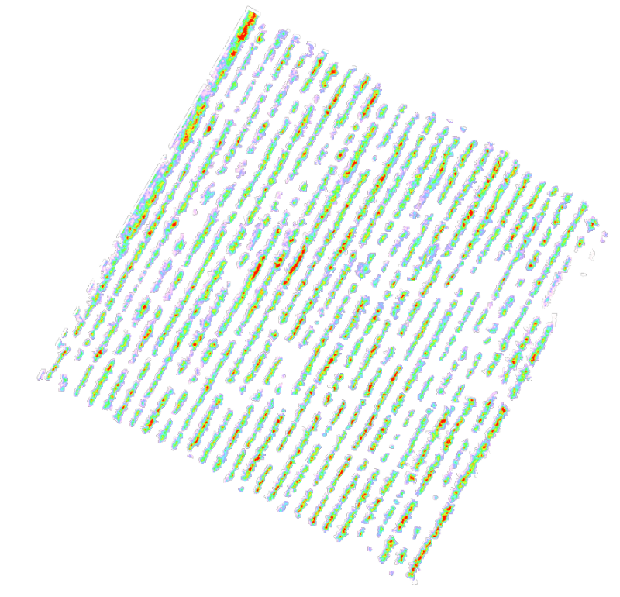
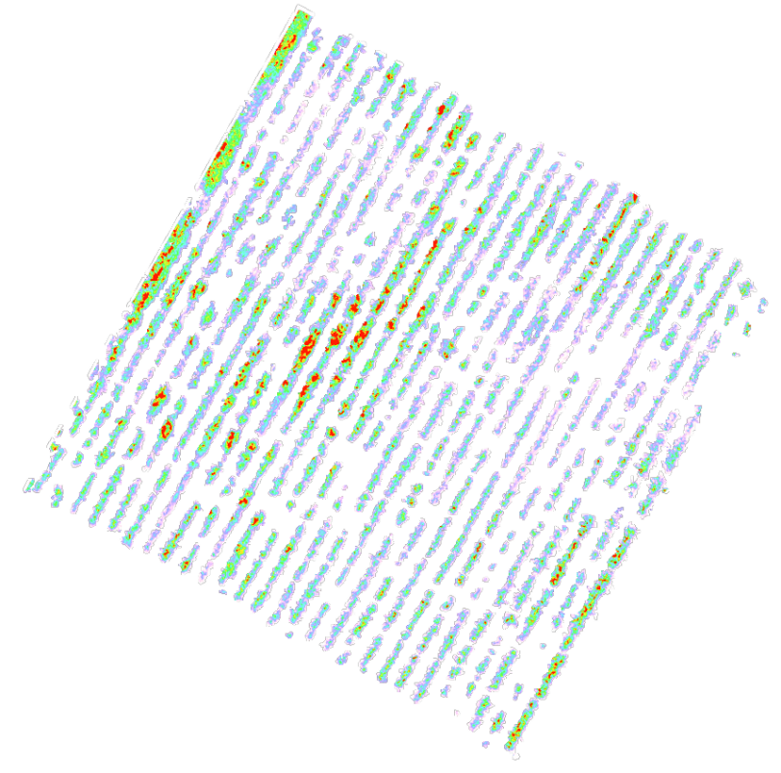
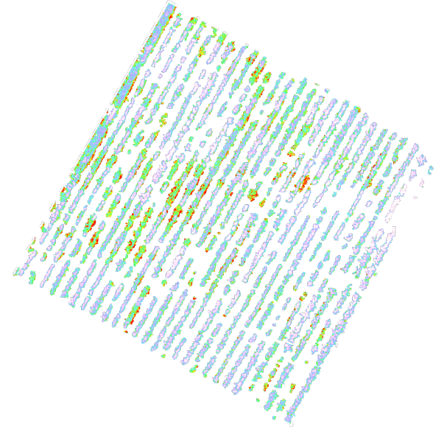
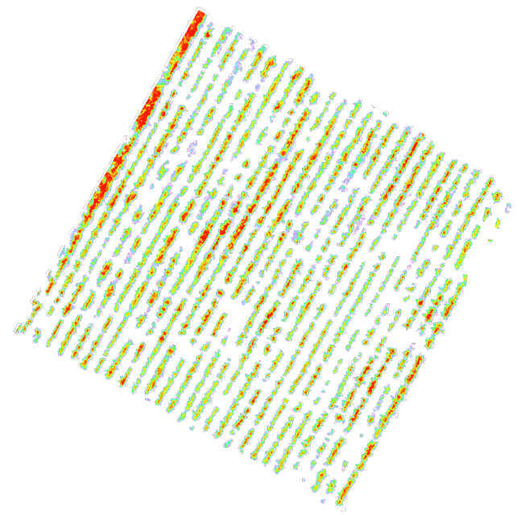
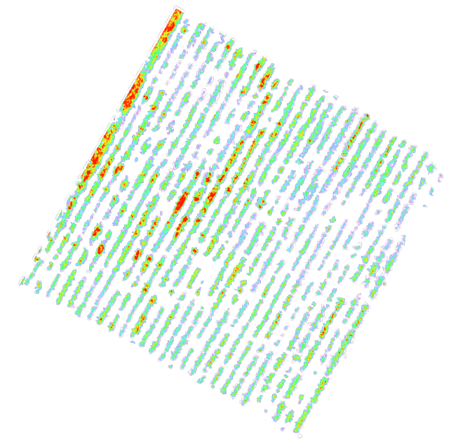
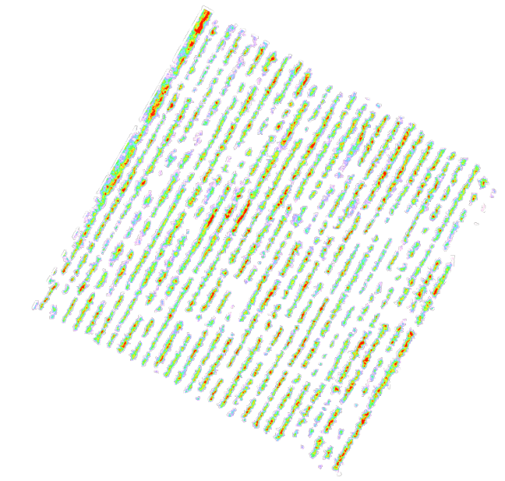
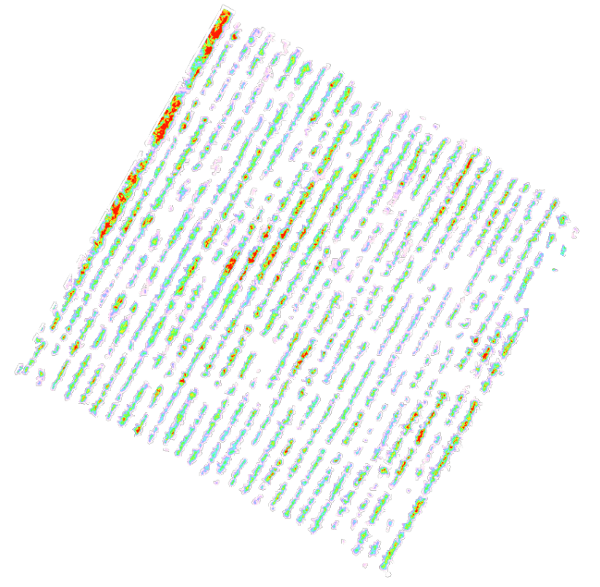
Vegetation indices implementation
The higher the value of colour scale, the higher the concentration of the element each index detects
RGB
CLGR
CLRE
CVI
NDVI
GNVI
EVI2
RVI

Slide 15
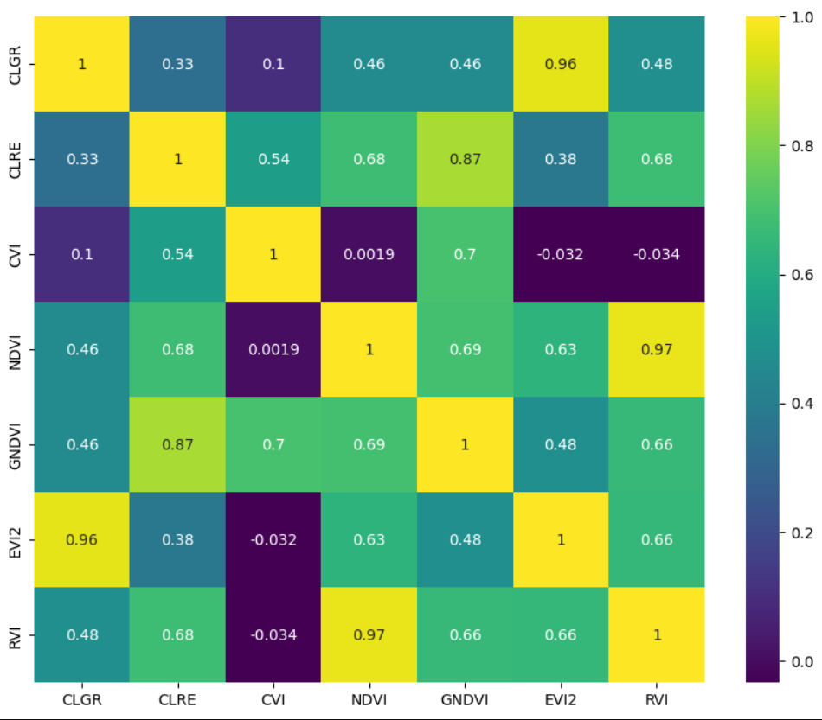
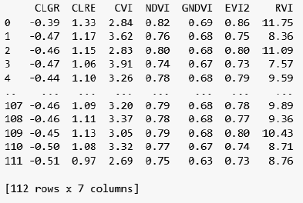
Vegetation indexes analysis
Correlation Matrix of Indices
Values near 0 represent indices with low correlation
Indices with low correlation utilized the maximum of information of indices
CVI – RVI and CLGR – CLRE are the two sets with the lower each other correlation
Indices Values of varieties

Slide 16
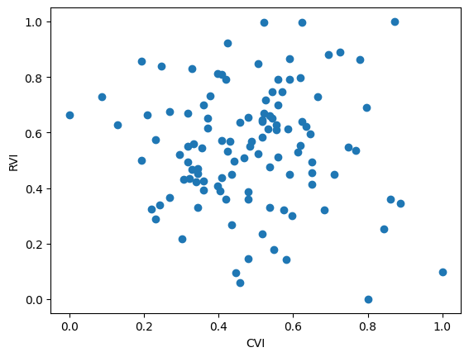
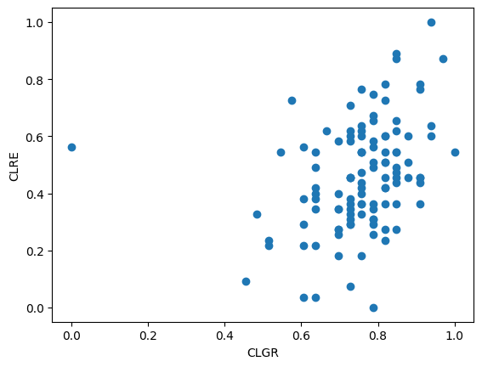
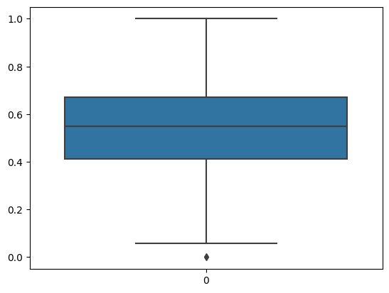
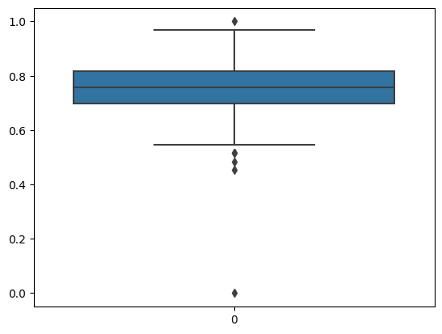
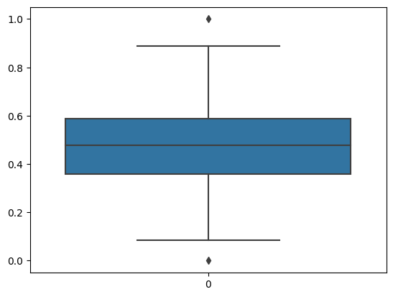
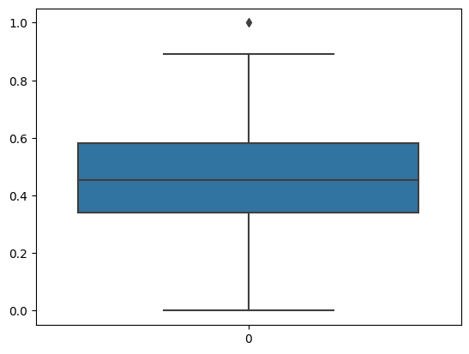
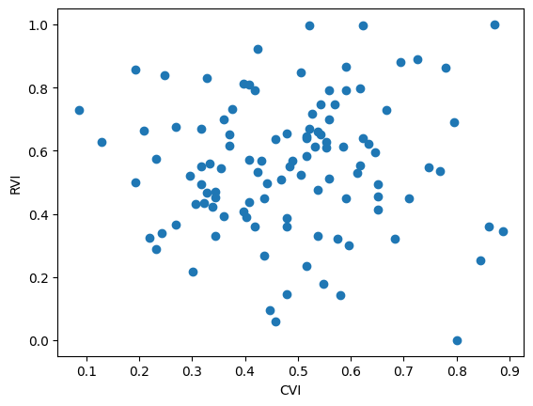
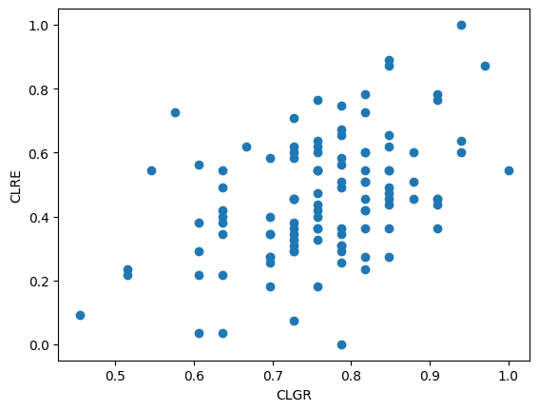
Vegetation indexes analysis
Scatter plot of mean normalized values of indices for 112 varieties before and after the outliers removal
CVI - RVI
CLGR - CLRE
CVI outlier
CLGR outlier
RVI outliers
CLRE outlier
Normalized Values of Indices
Normalized Values of Indices

Slide 17
Selection of appropriate number of clusters
Each algorithm were implemented 10 times in order to calculate the mean value of silhouette score
The mean values showed that 3 clusters is the appropriate number for this type of dataset
CVI - RVI
CLGR - CLRE
 | Silhouette score for each number of clusters
 | 2 | 3 | 4
K-means ++ | 0.34 | 0.35 | 0.32
Gaussian Mixture Model | 0.27 | 0.31 | 0.25
 | Silhouette score for each number of clusters
 | 2 | 3 | 4
K-means ++ | 0.43 | 0.37 | 0.34
Gaussian Mixture Model | 0.25 | 0.32 | 0.28

Slide 18
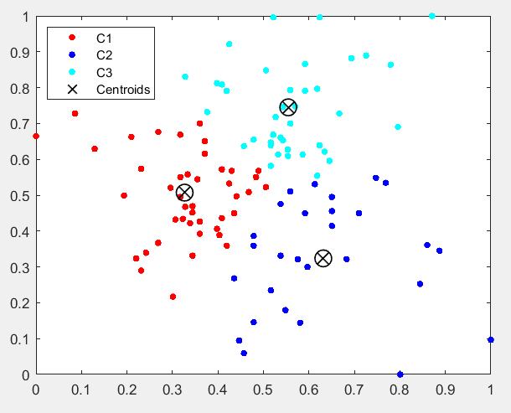
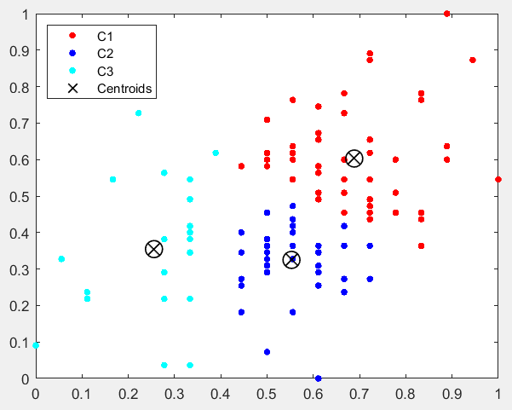
K-means ++ classification
Results for two set of indices after 9 repetitions
Scatter plot shows the indices values for each variety
CVI - RVI
CLGR - CLRE

Slide 19
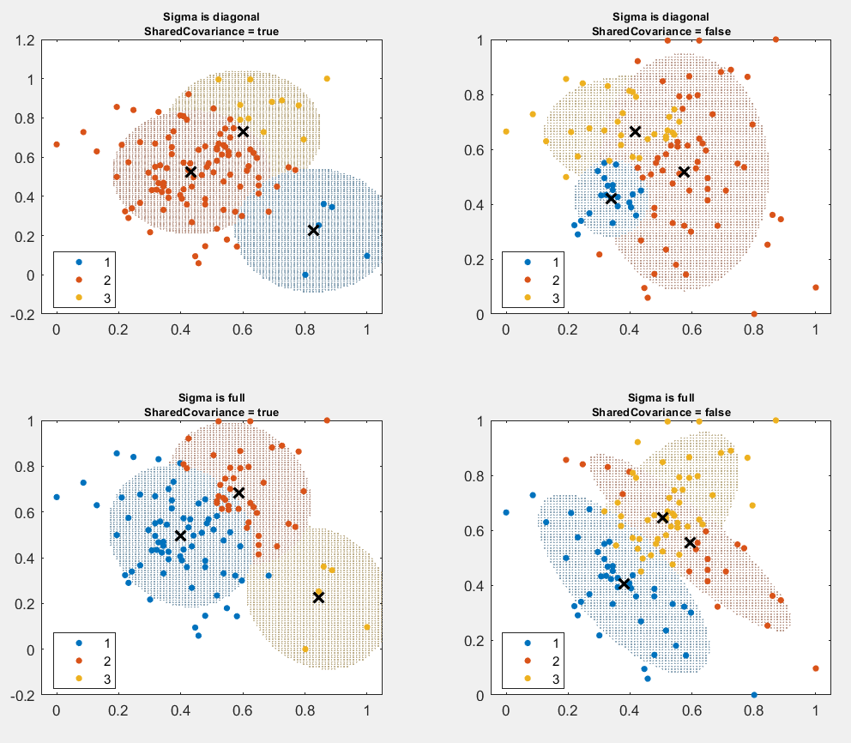
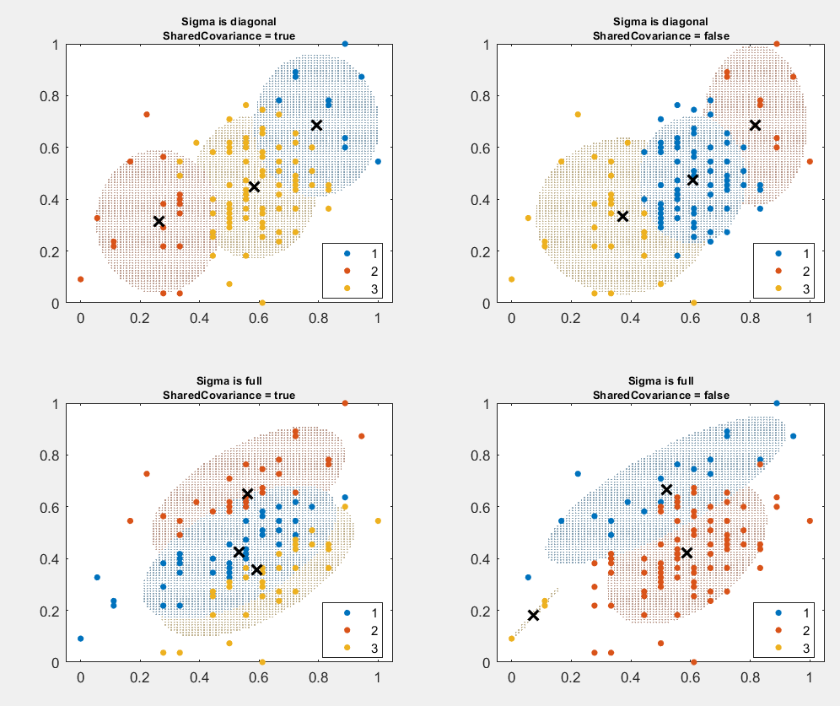
Gaussian mixture model classification
Results for two set of indices after 9 repetitions
Scatter plot shows the indices values for each variety
CVI - RVI
CLGR - CLRE

Slide 20
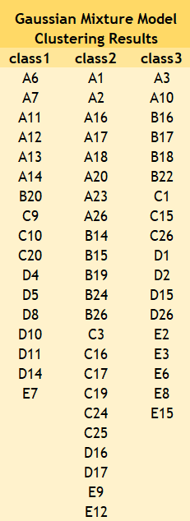
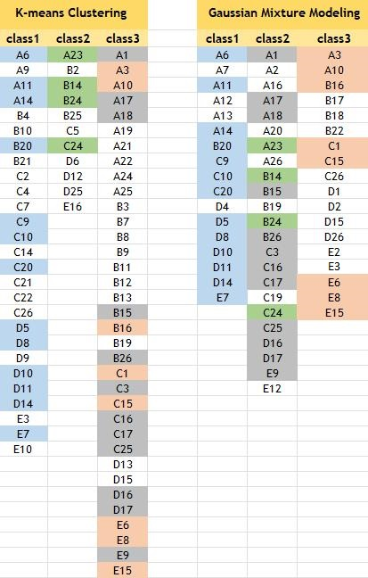
Clustering results (1)
Common varieties between different clustering algorithms are presented with the same color
Varieties belong to each final class

Slide 21
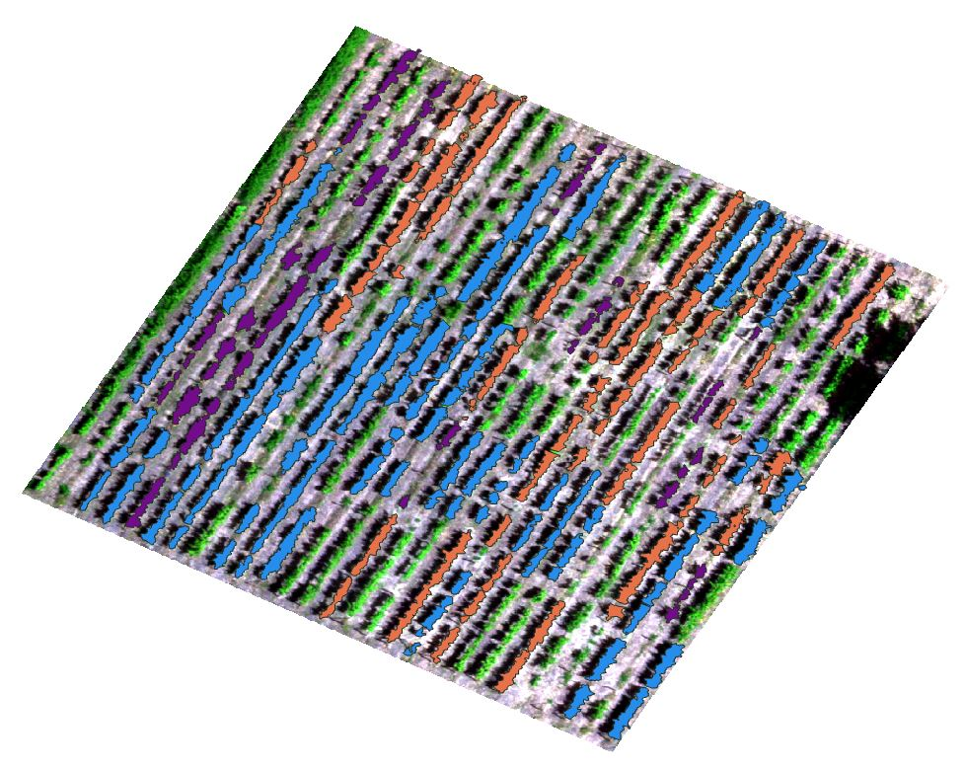
Clustering results (2)
Each color present the varieties which were grouped together in one of the three groups by the algorithms
Some varieties were clustered by both algorithms on the same group
K-means
Gaussian Mixture Model

Slide 22
Clustering results (3)
First map shows varieties that classified on the same group by both algorithms
Second map shows the same results if one more cluster created based the common results between class 2 and 3

Slide 23
Key-points
K-means algorithm: 73 of the 112 varieties into 3 classes.
Gaussian mixture model: 58 of the 112 indices into 3 classes.
Both clustering algorithms, classified some common varieties in the same class which ensures the validity of the method.
The rest of the varieties are characterized as unclassified
Neighbor vines, share the same ground conditions; soil characteristics of an area can influence the vine’s growth
Ground substances are responsible for the condition inside the plant’s tissue and leaves
Spectral values of the plant, apart from the plant’s health status, depend also on its growth stage.

Slide 24
Contribution
The knowledge of the different varieties’ characteristics is very important for the farmers:
they can optimize the yield of the specific variety
they know the time of ripening, disease resistance, and other growth characteristics
proper decisions about planting, pruning, and harvesting, ultimately optimizing their yield and maximizing productivity
each varieties exhibit different levels of resistance on diseases or pests
proper disease management strategies, to minimize crop losses and protect vineyards
For planting grapevines in a new field, selection of the most suitable variety for their specific growing conditions

Slide 25
Further research
How vines inside the same variety are classified taking into consideration the same indices characteristics?
Validation of vine varieties characteristics by ground measurements using spectrometers of other sensor measurements
Comparison of multispectral images (5 bands) with hyperspectral images (more than 200 bands) for difference in the plant’s health

Slide 26
Thank you !!
Olympia Kourounioti
PhD candidate
okourounioti@uniwa.gr

