Slide 1
The orphan regulator Aor1 and its possible histidine kinase in the antibiotic regulation of Streptomyces coelicolor
García-Martín, Javier; Antoraz, Sergio; Santamaría, Ramón I.; Díaz, Margarita
Instituto de Biología Funcional y Genómica (IBFG, CSIC-USAL)/Departamento de Microbiología y Genética (USAL), Salamanca, Spain
gmjavier9@usal.es
Notes:
Hello everyone. I am Javier García Martín, from IBFG in Salamanca, Spain. In this video I will present my work titled “The orphan regulator Aor1 and its possible histidine kinase (KAINEIS) in the antibiotic regulation of Streptomyces coelicolor”.

Slide 2
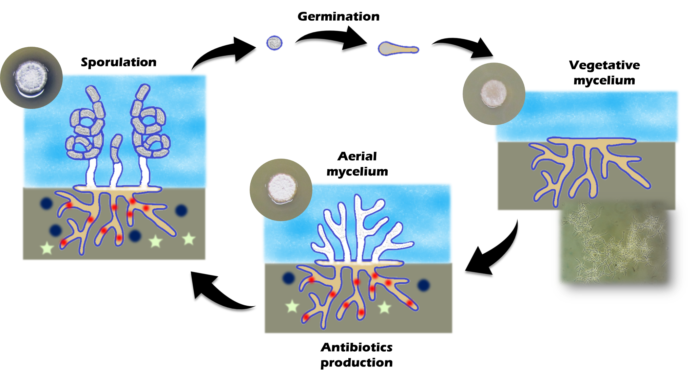
Introduction
Streptomyces
Notes:
Streptomyces is a genus of Gram-positive bacteria with a complex life cycle represented on this slide. Streptomyces produces a vegetative mycelium (MAISILIEM) for growth and an aerial mycelium, which forms spores, for reproduction. This genus is interesting due to its ability to produce natural products, as antibiotics.

Slide 3
Introduction
Two-component systems
Biosynthetic gene clusters
(BGCs)
Histidine kinase
Response regulator
Notes:
This is possible because Streptomyces has several BGCs in its genome. However, most of them are cryptic or silent in laboratory conditions. To control these clusters and other genes, TCS play a crucial role. They are usually made up of on a membrane histidine kinase (KAINEIS) and a cytoplasmic response regulator

Slide 4
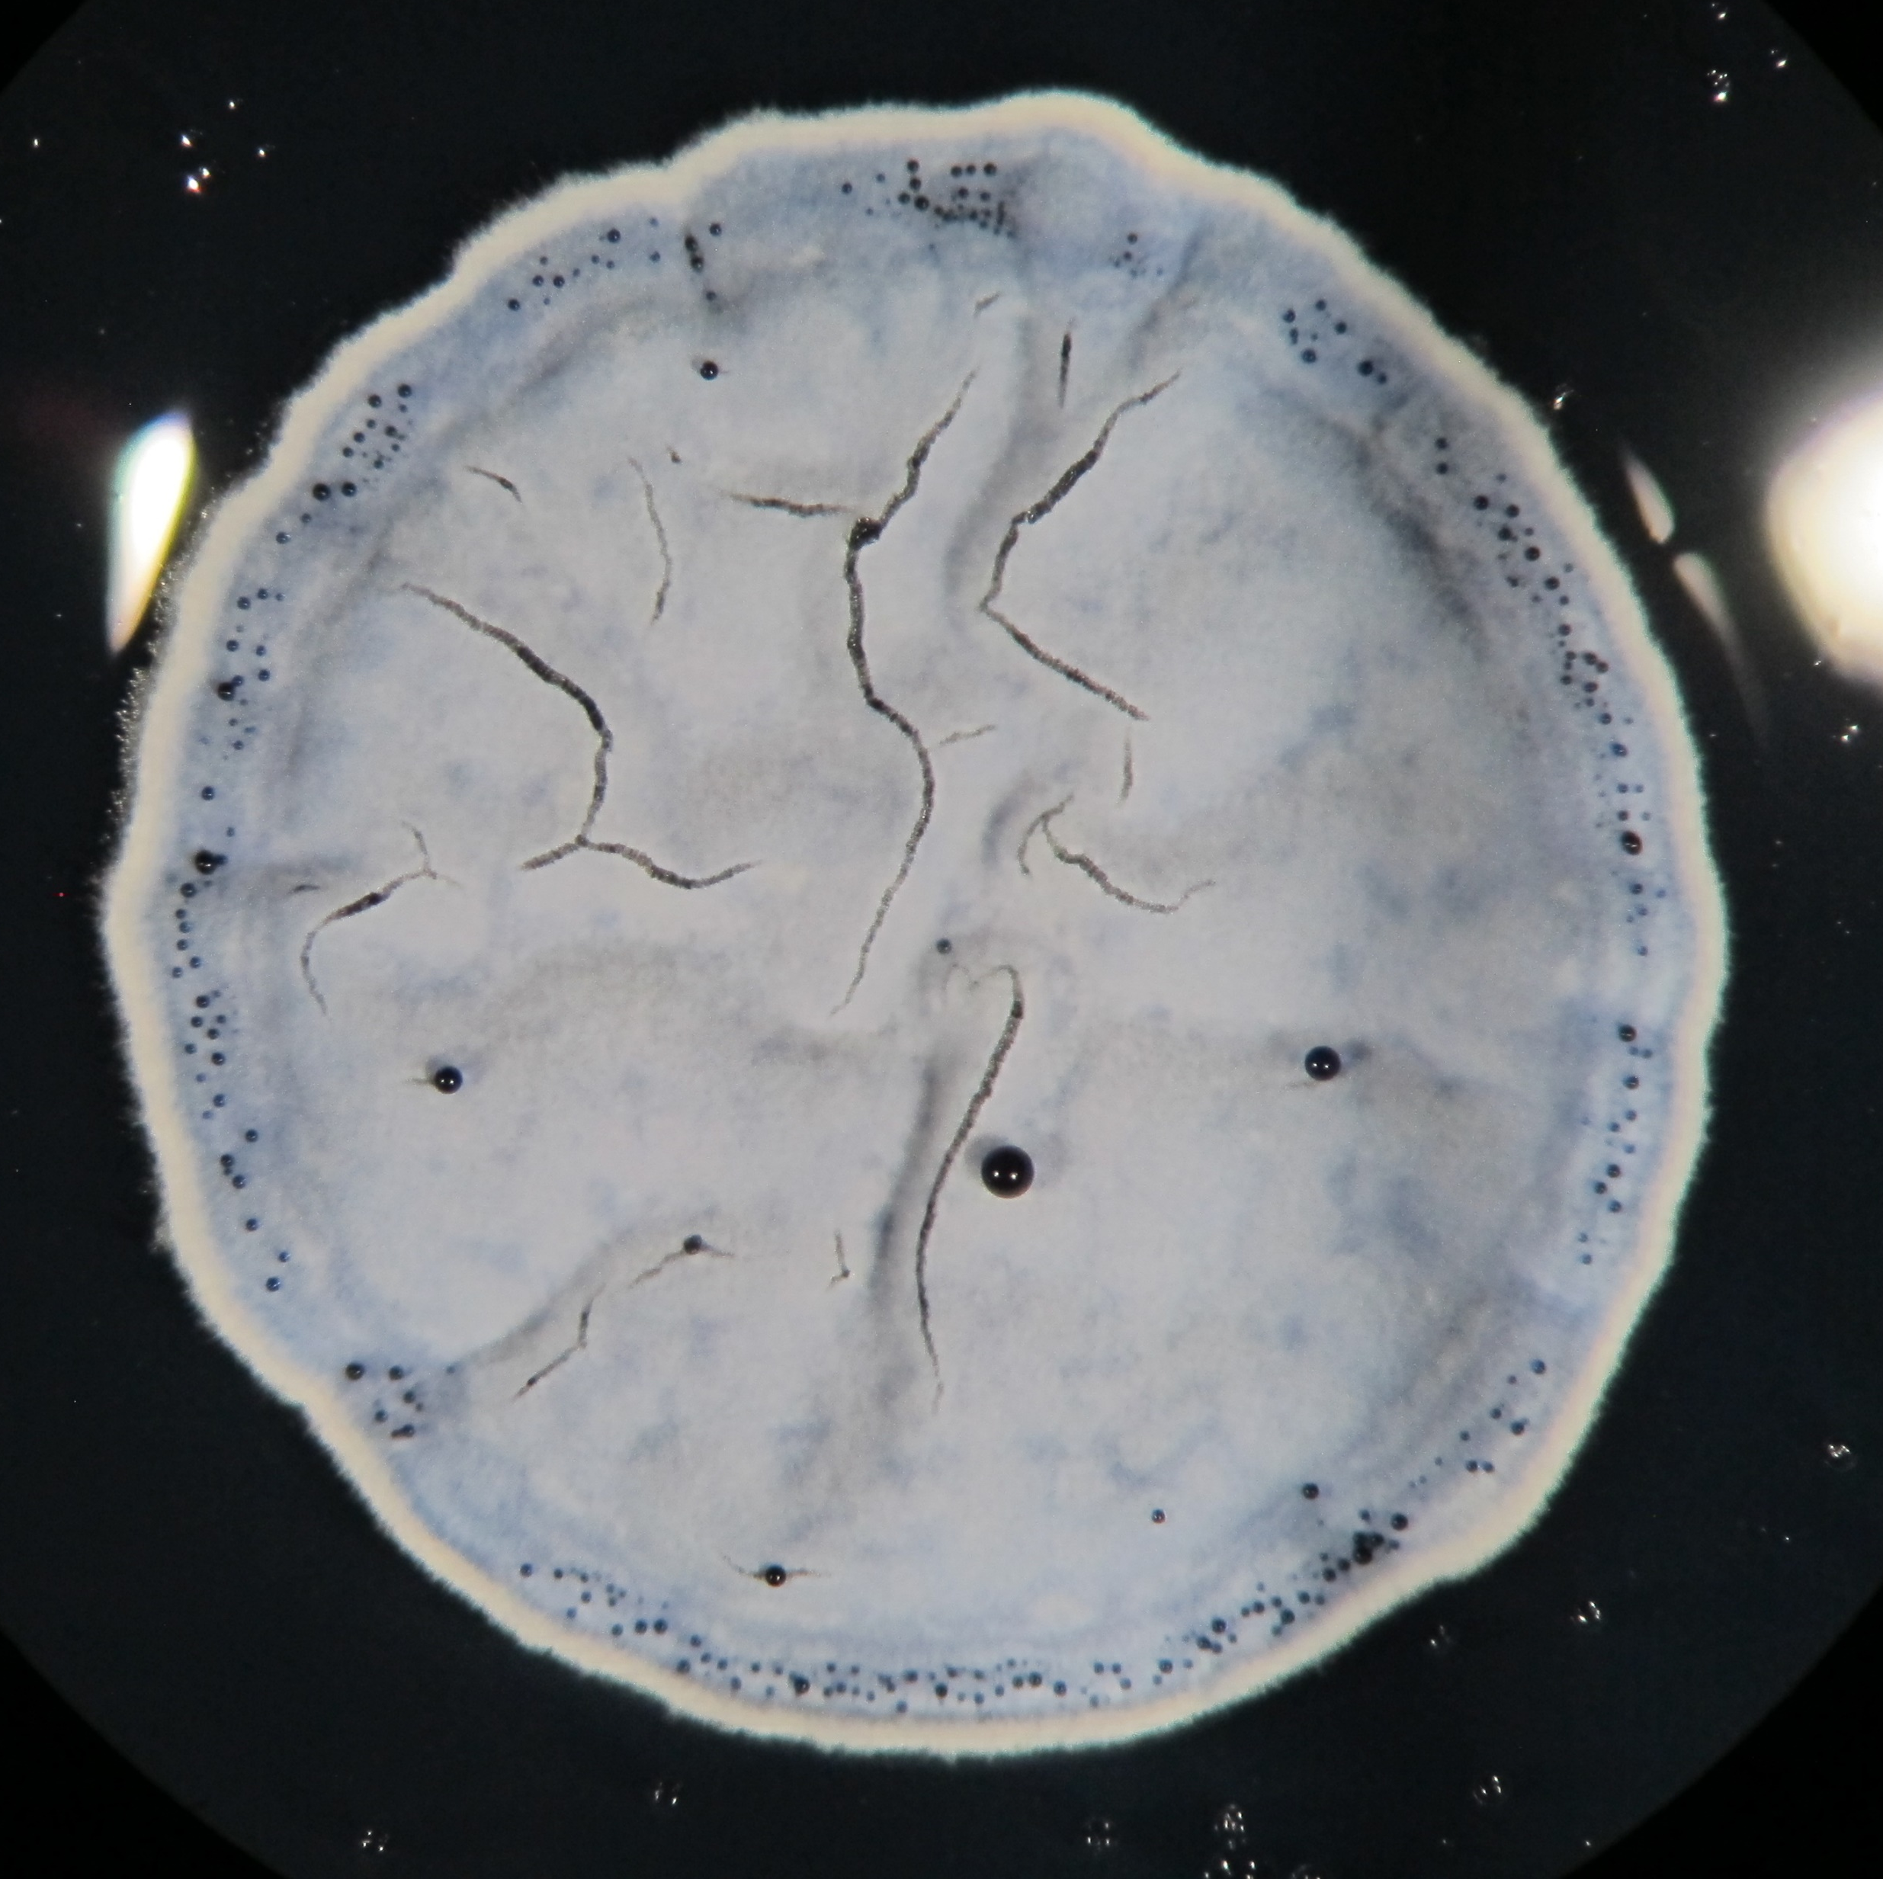
Introduction
Aor1 (SCO2281)
Antibiotic BGCs
Cryptic BGCs
Osmotic stress response genes
Histidine kinases
S. coelicolor
Antoraz S, et al. Front. Microbiol., 2017, 8:2444.
Notes:
Among the TCS studied in the model organism S coelicolor, the orphan regulator Aor1, which does not have an associated HK known, is interesting because it controls many genes involved in antibiotic biosynthesis and cryptic BGCs. It also regulates some kinases and osmotics stress response genes.

Slide 5
Objective
The aim of this work is to identify the kinases that could activate Aor1 in Streptomyces coelicolor, by bioinformatic prediction and the study of mutants lacking the selected genes
Notes:
The aim of this work is to identify the kinases that could activate Aor1 in Streptomyces coelicolor.

Slide 6
Results
Prediction of Interaction Specificity in Two-Component Systems (https://www.swissregulon.unibas.ch/cgi-bin/TCS.pl)
SCO2281 = Aor1
Notes:
By bioinformatic tools, we selected two orphan kinases, sco thirty-seven fifty and sco sixty-four twenty-four, as candidates to activate Aor1.

Slide 7
Results
Notes:
Then, we constructed the two mutants by CRISPR-Cas technology and studied their phenotype on different media.

Slide 8
Results
Notes:
First of all, while the wild type M145 shows white aerial mycelium, a halo of the blue antibiotic actinorhodin and grey spores on LB, the aor1 mutant has a delay in differentiation and antibiotic production.

Slide 9
Results
Notes:
On the one hand, the sco thirty-seven fifty mutant also showed a delay in differentiation on LB, but more actinorhodin production on LB, R2YE and NMMP. Nevertheless, in the red square we can see that its phenotype on YEPD is the same as the aor1 mutant.

Slide 10
Results
Notes:
On the other hand, the sco sixty-four twenty-four mutant showed a similar phenotype to the wild type, with more actinorhodin on YEPD and LB.

Slide 11
Conclusion
The Δ3750 mutant has the same phenotype as the Δaor1 on YEPD medium, while it has a delay in differentiation on LB medium
The first kinase studied, SCO3750, could be the protein which activates Aor1 and its role in antibiotic production seems medium-dependent. The presence of other kinases and the signals which activate them must be further studied.
Notes:
To sum up, as I said before, the sco thirty-seven fifty mutant has the same phenotype as the Δaor1 on YEPD medium, while it has a delay in differentiation on LB medium. The first kinase studied, sco thirty-seven fifty, could be the protein which activates Aor1 and its role in antibiotic production seems medium-dependent. The presence of other kinases and the signals which activate them must be further studied.

Slide 12
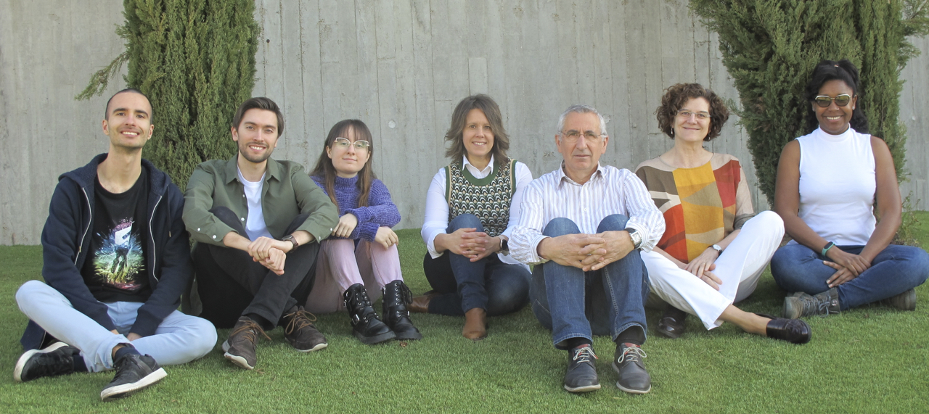
Thank you!
This work has been funded by the project PDI2019-107716RB-100 (MINECO/FEDER).
Javier García Martín has been funded by the call of pre-doctoral contracts USAL 2021, co-funded by Banco Santander, and by the call of “Aid for University Teacher Training FPU 2022” from Ministerio de Universidades (Spain).
Notes:
Thank you all for your attention.

