Slide 1
Burned area mapping based on KazEOSat 1 satellite datasets
The 5th International Electronic Conference on Remote Sensing
Suresh Babu K V
Suresh Babu KV ª*, Swati Singh ^{b,c}, Kabdulova ª, Kabzhanova ª and Baktybekovª
ªThe Joint-Stock Company, Kazakhstan National Company, Kazakhstan
^{b}College of Forestry, Wildlife and Environment, Auburn University, Auburn, AL, USA

Slide 2
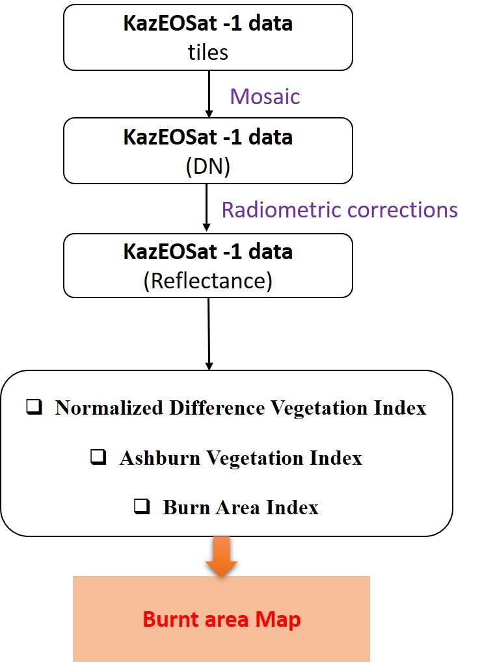
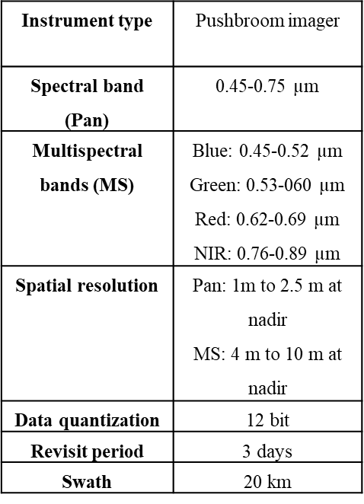
Methodology
Ashburn Vegetation Index $(AVI)=2∗\left(NIR−Red\right)$
$$Burn Area Index (BAI)= \frac{1}{\left[{\left(0.1−Red\right)}^{2}+ {\left(0.06−NIR\right)}^{2} \right]}$$
$$η=\frac{2∗\left({NIR}^{2}− {Red}^{2}\right)+1.5∗NIR+0.5∗Red}{\left(NIR+Red+0.5\right)}$$
$\text{Global} \text{Environmental} \text{Monitoring} \text{Index} (GEMI)= η∗\left[1−\left(0.25∗η\right)\right]−\frac{(Red−0.125)}{(1−Red)}$

Slide 3
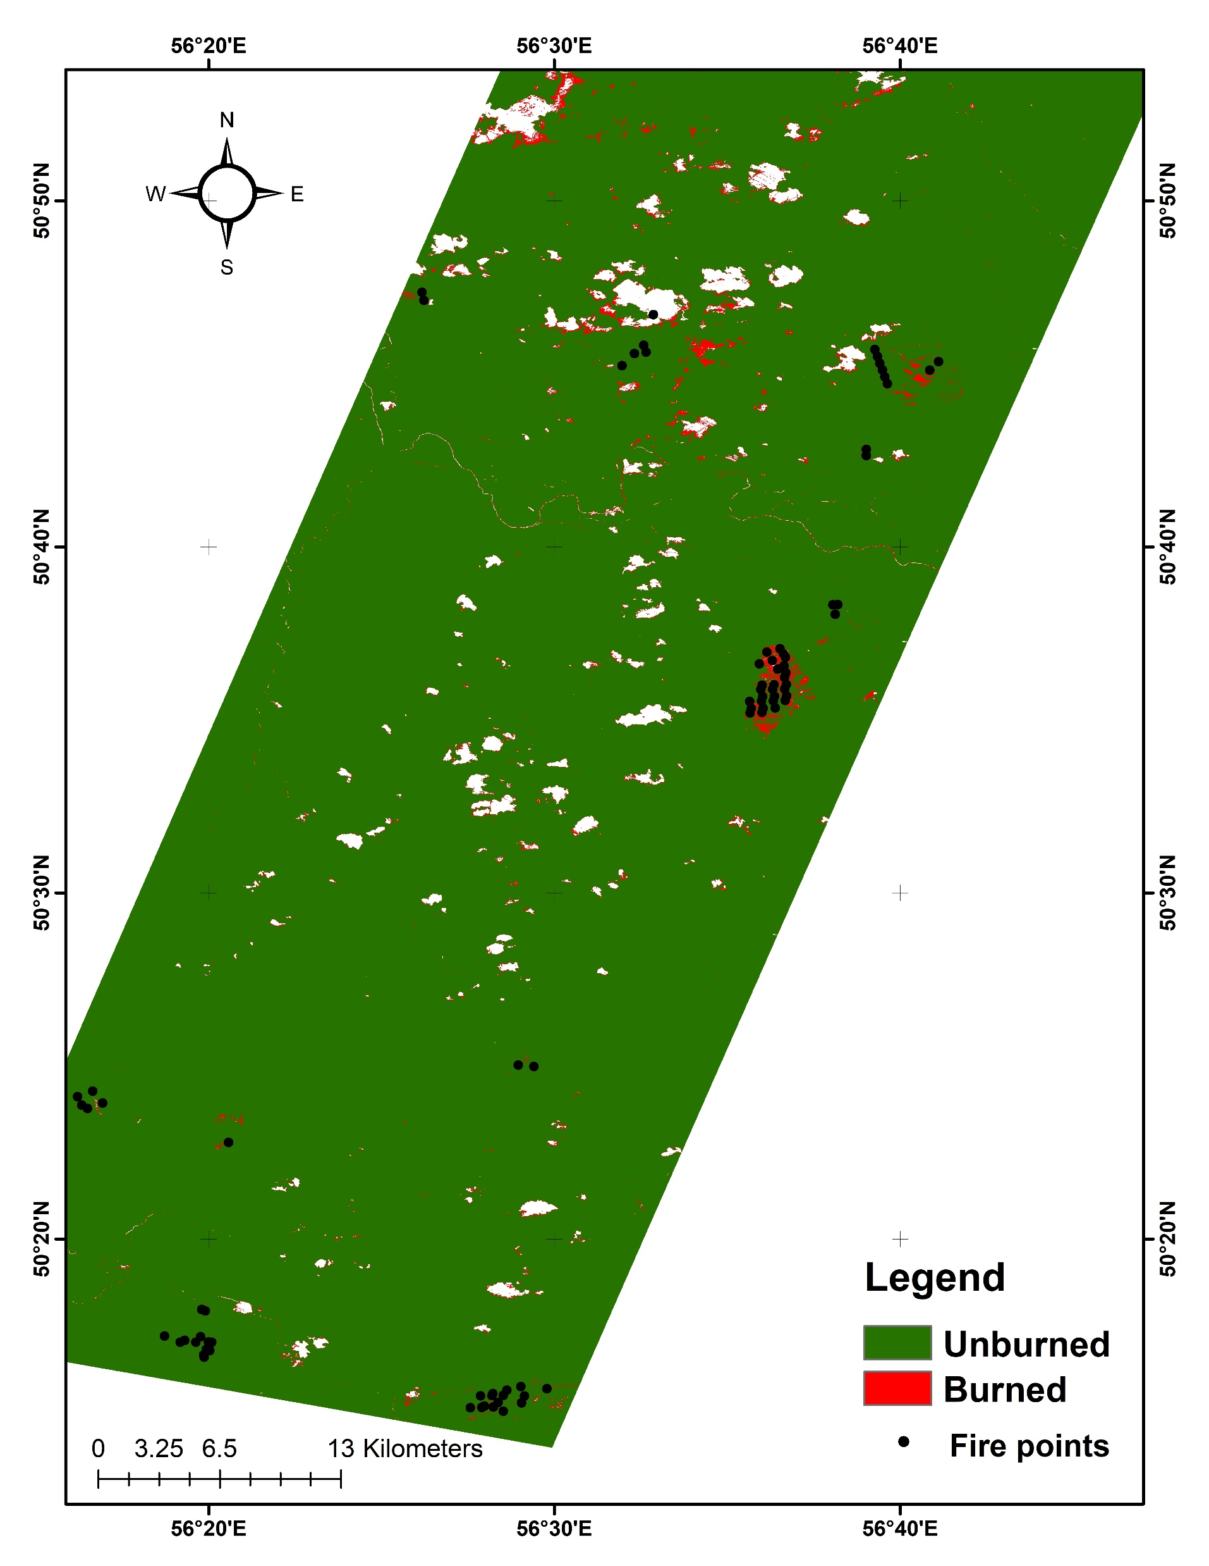
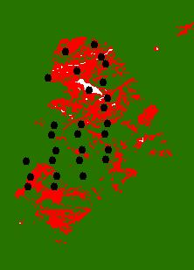
Results
BAI burned area map on September 25, 2018

Slide 4
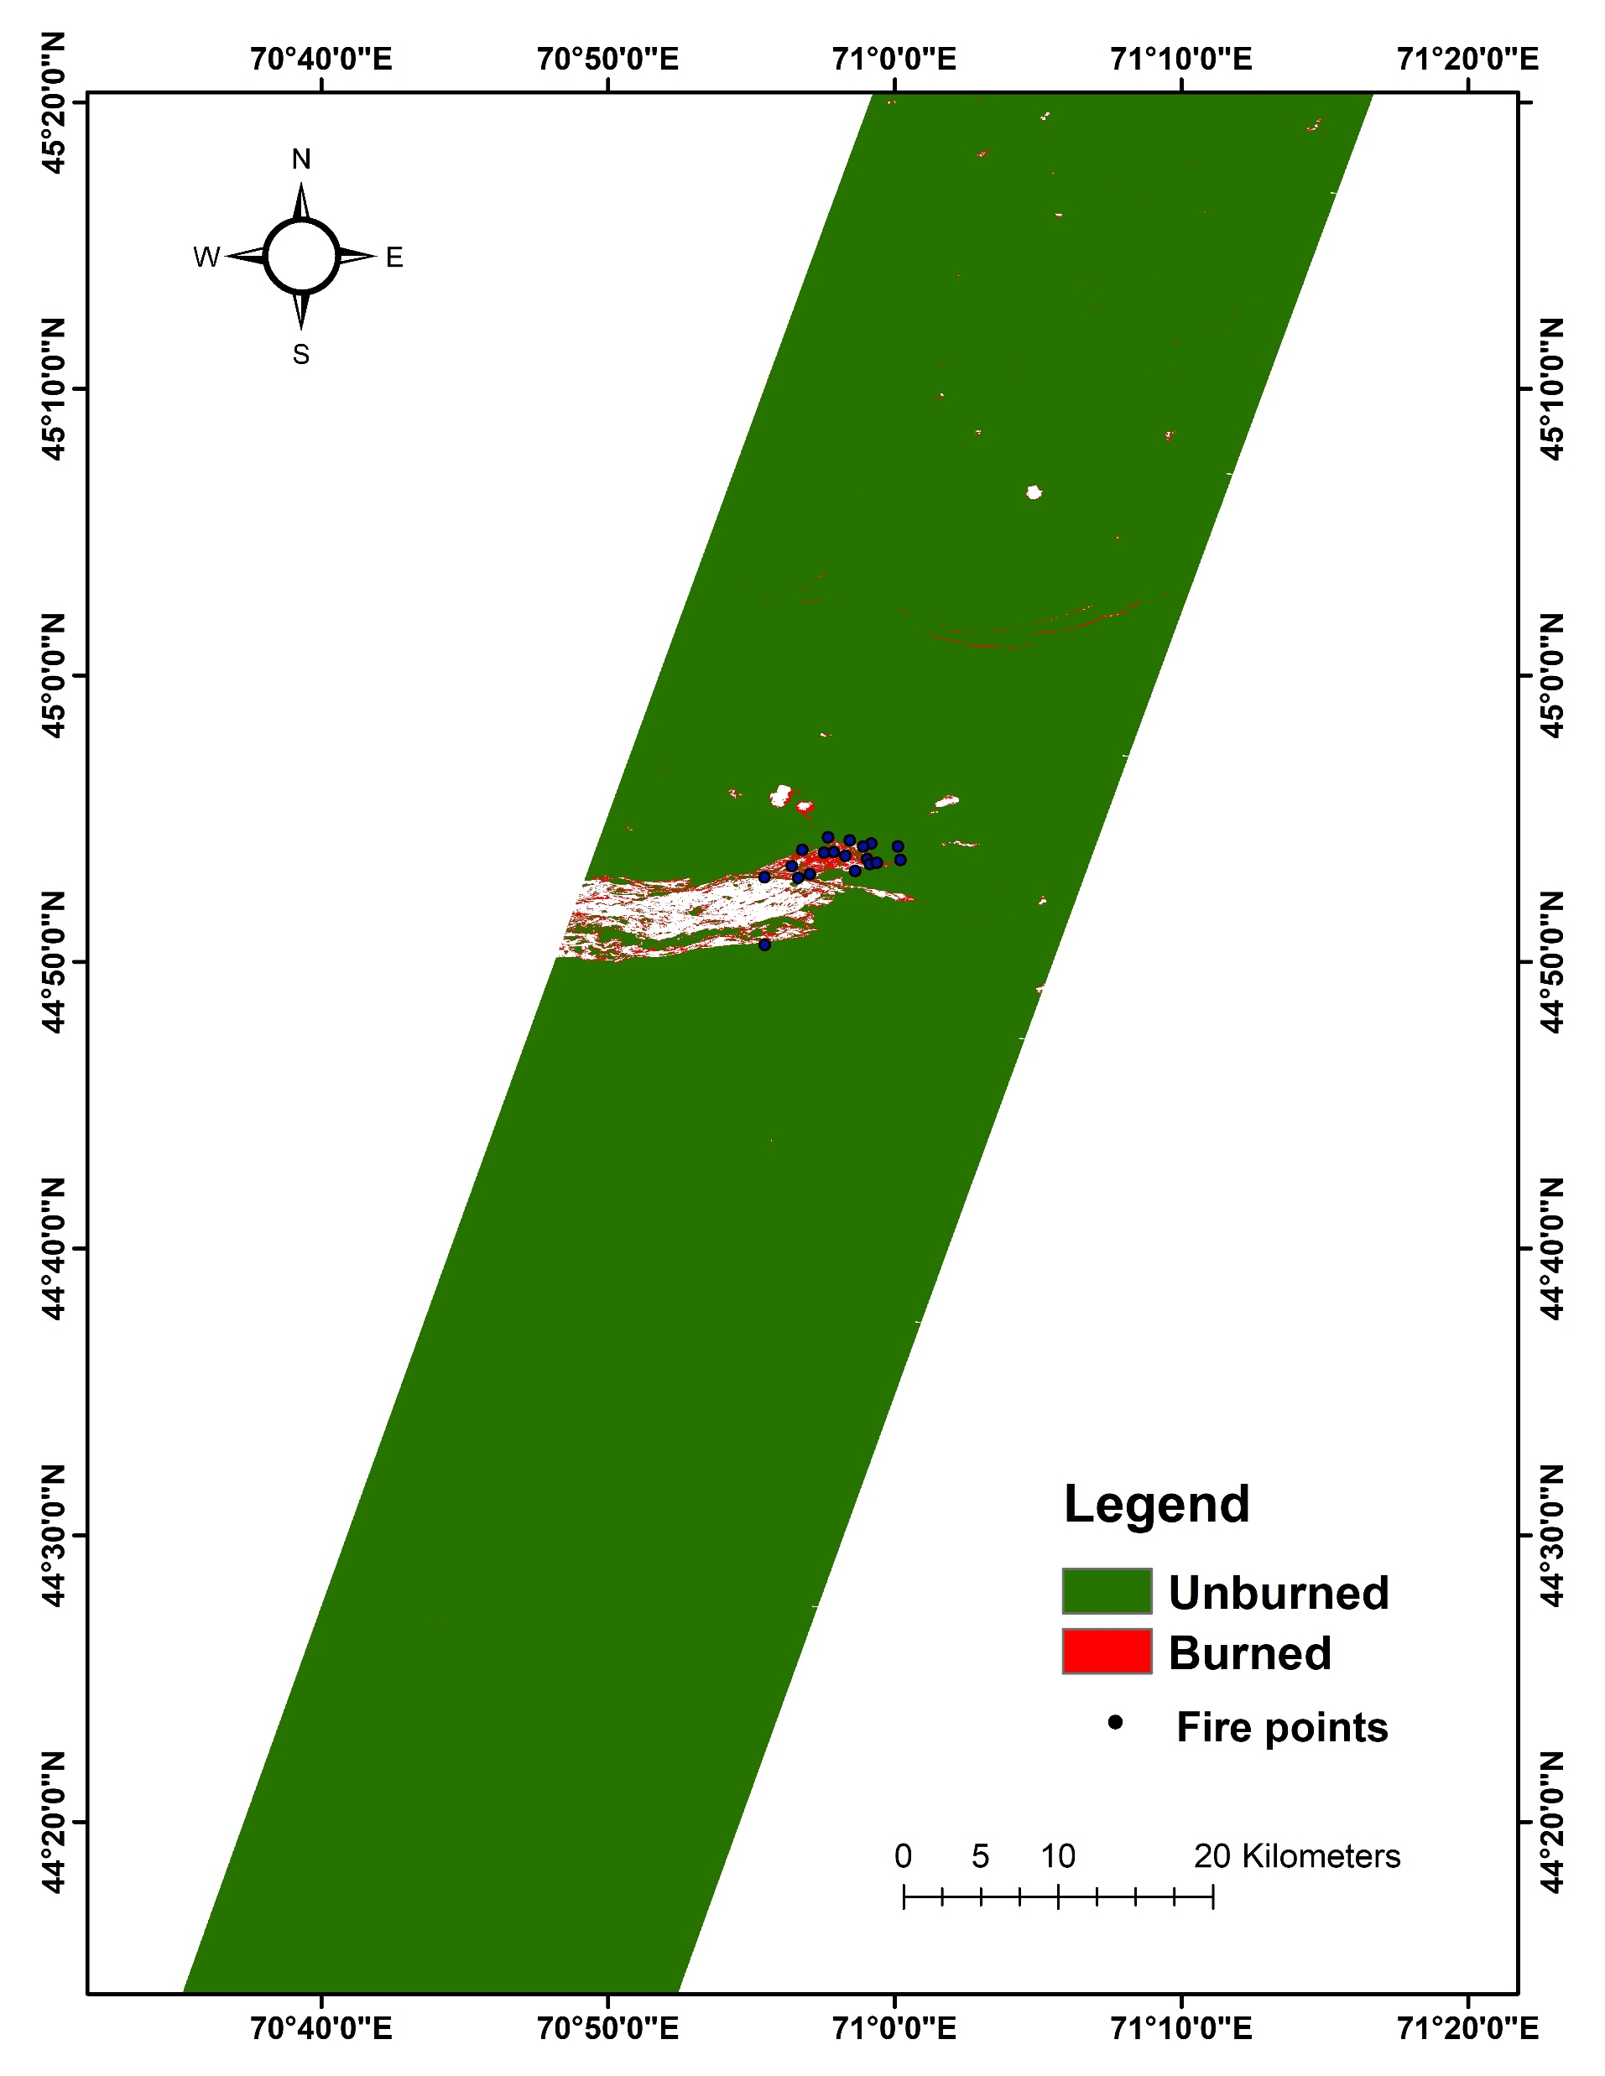
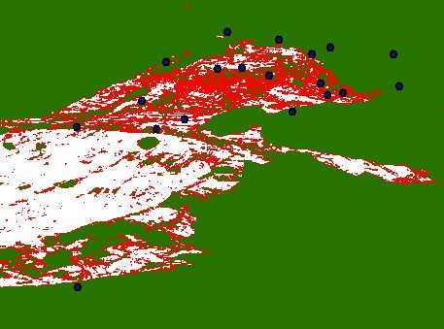
Results
BAI burned area map on October 13, 2018

Slide 5
Results & discussion
Table 2: Accuracy of burned area indices
Table 5 shows the number of fire incidents fell in burned and un-burned areas were counted and the accuracy was calculated based on the percentage of forest fires falling in burned area with respected to the total number of fires occurred.
It was observed from Table 2 that, the BAI show the highest accuracy (81.48%; 86.58%), followed by GEMI (74.07%; 76.83%) and then AVI show the lower accuracy (66.66%; 71.95%).
Date | Spectral Indices | No. fire incidents |  | Accuracy (%)
 |  | Burned area | Un-burned area
September 25, 2018 | AVI | 18 | 9 | 66.66
 | BAI | 22 | 5 | 81.48
 | GEMI | 20 | 7 | 74.07
October 13, 2018 | AVI | 59 | 23 | 71.95
 | BAI | 71 | 11 | 86.58
 | GEMI | 63 | 19 | 76.83

Slide 6
Conclusions
In this study, KazEOsat 1 satellite datasets are utilized to map the burned area in the different regions of Kazakhstan
This study compared three spectral indices namely, AVI, BAI and GEMI for mapping the burnt area based on four spectral bands NIR, blue, red and green of KazEOsat 1 satellite datasets.
The results of spectral indices, AVI, BAI and GEMI are compared based on a discriminative index (M) for quantifying the effectiveness of each index based on burned area.
The spectral index BAI shows higher M values than other indices, therefore, the index BAI has the higher capability to extract the burned area as compared with AVI and GEMI. Accuracy was calculated based on the number of forest fire incidents fell in burned and un-burned areas and results are showing that BAI shows the highest accuracy, while, AVI show the lower accuracy among them.
Therefore, the BAI has the highest ability for extracting the burned area using the KazEOsat 1 satellite datasets. As revisit time period of KazEOsat is 3 days, this study will be useful to map the burnt area and fire progression in Kazakhstan.

Slide 7
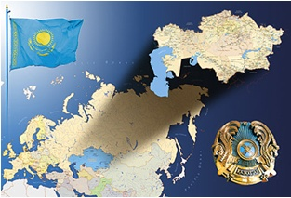
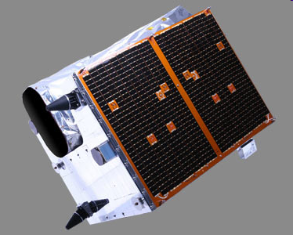
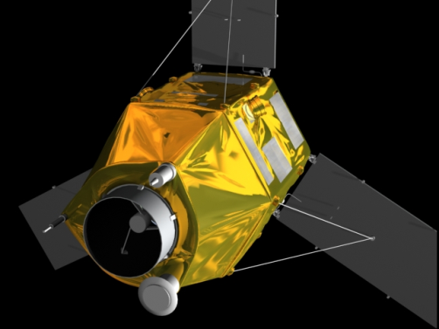
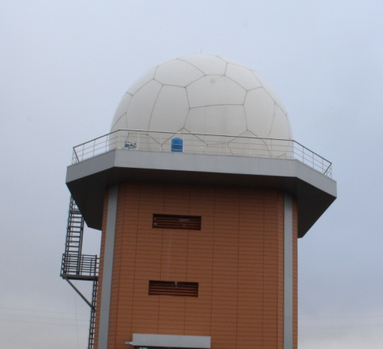
Национальное космическое агентство Республики Казахстан Акционерное общество «Национальная компания «ҚАЗАҚСТАН ҒАРЫШ САПАРЫ»
Thank you

