Slide 1
Forest Cover Change and its impact on ecosystem service value of the Chure and Terai Region of Nepal
Presenter
Er. Anirudra Prasad Koirala | Er. Binita Shahi |Er. Krishna Prasad Sharma |Er. Sanjeevan shrestha

Slide 2
Presentation Outline
Introduction
Problem Statement
Objective
Study Area
Methodology
Data and Software Used
Outcomes
Problem Encountered
Conclusion
References

Slide 3
Introduction
Forest cover in general refers to the relative (in percent) or sure (in square kilometers/square miles) land area that is covered by forests or the forest canopy or open woodland.
Ecosystem provide a wide range of valuable goods and services that contribute to supporting nature and human well-being. These goods and services that are commonly known as ecosystem services(ES).
The ecosystem service value are dominantly influenced by the degradation of the forest.
In total, between 1990 and 2005, Nepal lost 24.5% of its forest cover, or around 1,181,000 hectares. Nepal lost 42,000 hectares of its primary forest cover during that time.
(https://rainforests.mongabay.com/deforestation/archive/Nepal.htm?fbclid=IwAR3fMgr_gqL1GWURIV9DGpXkK1LBvGjNHCq97jB6hRGRvfYSGLNHuPW8PJY)

Slide 4
Problem Statement
Ecosystem services have been degrading due to highly lost of forest cover area.
The decline of biodiversity, pollution and climate change.
Lack of proper planning and policy implementation of forest resources use in scientific ways.
Poor understanding of forest cover change effect on Ecosystem service value.

Slide 5
Objectives
The main objective of the project is to assess the ecosystem service value (ESV) changes corresponding to the forest cover changes of the Terai and Chure belt of Nepal in the period of 1994-2018 using Landsat imageries.
Secondary objectives are:-
To prepare time series forest cover map in the period of 1994-2018 at interval of 5 years.
To assess the forest cover changes in the period of 1994-2018 at interval of 5 years.
To assess the Ecosystem service value(ESV) and its change corresponding to forest cover changes.

Slide 6
Study Area

Slide 7
Methodology
Landsat images(1994 to 2018)
Mosaicing
Subset/Clipping
Forest cover change maps and Area calculation
Accuracy Assessment
Object Based Classification
Calculation of Ecosystem service coefficient
Valuation of ecosystem service
Assessment of Ecosystem service value

Slide 8
Data and Software Used
Data Used
From the USGS website(https://earthexplorer.usgs.gov), we downloaded the temporal image of interval of 5 years from 1994 to 2018 with low cloud cover.
Landsat 8(for 2014 and 2018)
Landsat 4,5 TM(1994,1999,2004 and 2009)
Software Used
ENVI
Ecognition Developer
Arc GIS
Google Earth Pro

Slide 9
Classification Threshold
Forest Cover area is determined by Object based Classification in Ecognition developer using the NDVI index.
Formula
NDVI= NIR - Red
NIR + Red
Segmentation
Assign Class Algorithm
The NDVI threshold used to classify Forest Cover with Non-forest Cover are
Forest cover Non Forest Cover
NDVI>0.25 NDVI<=0.25

Slide 10
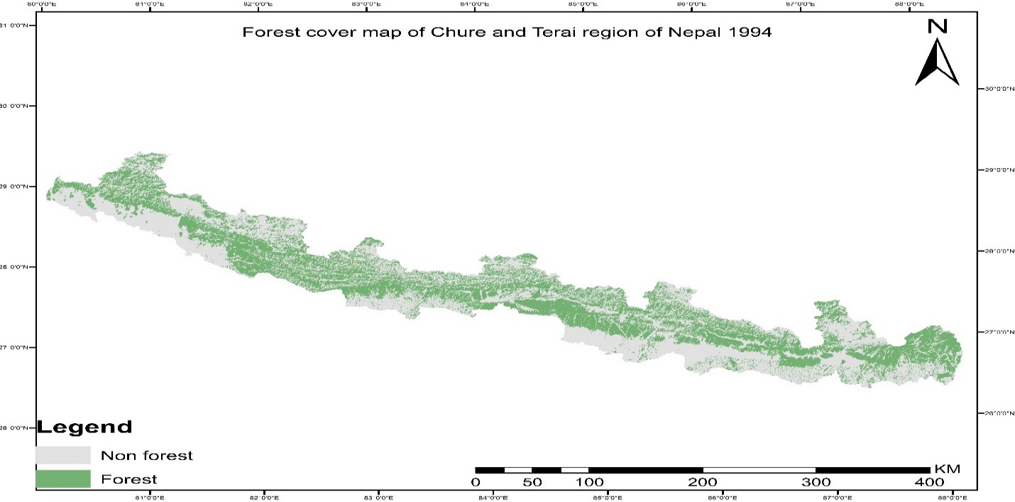
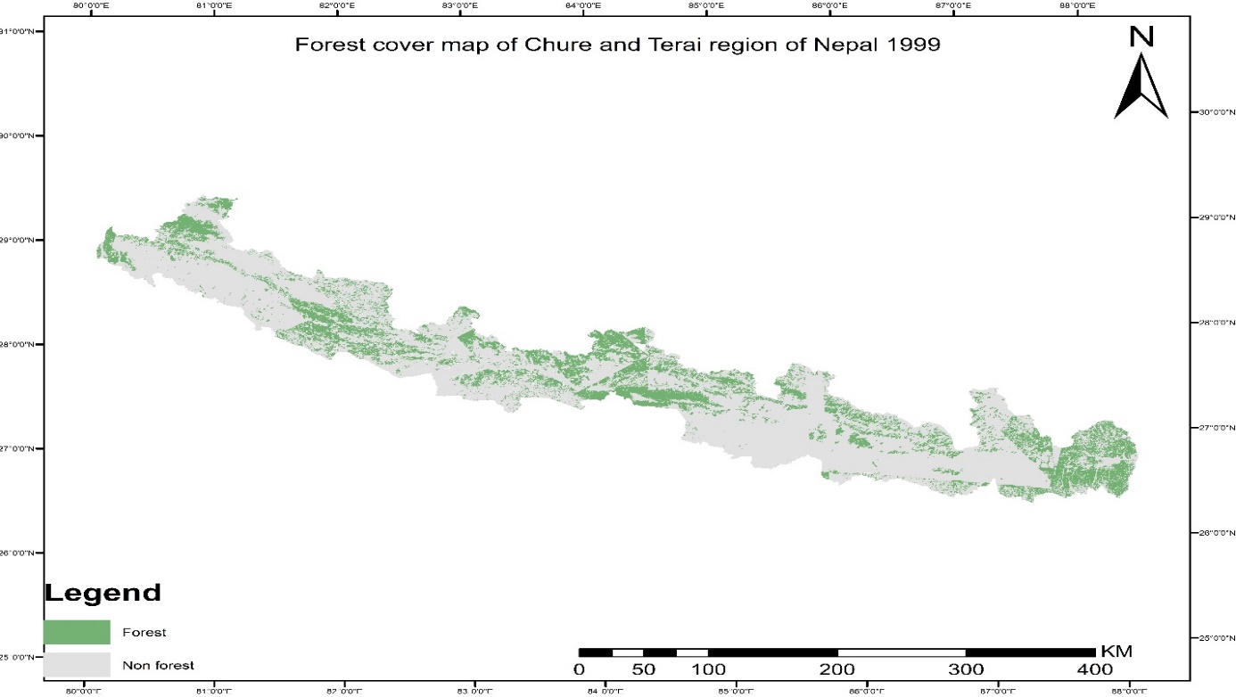
Outcome
Time Series Forest Cover Maps 1994-2018

Slide 11
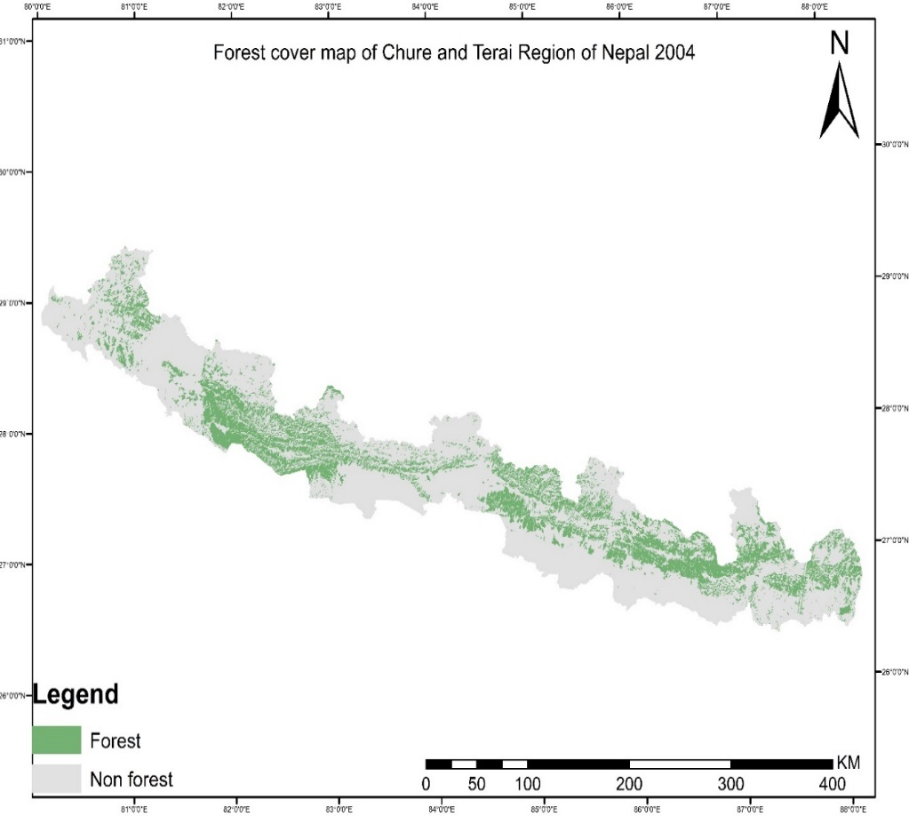
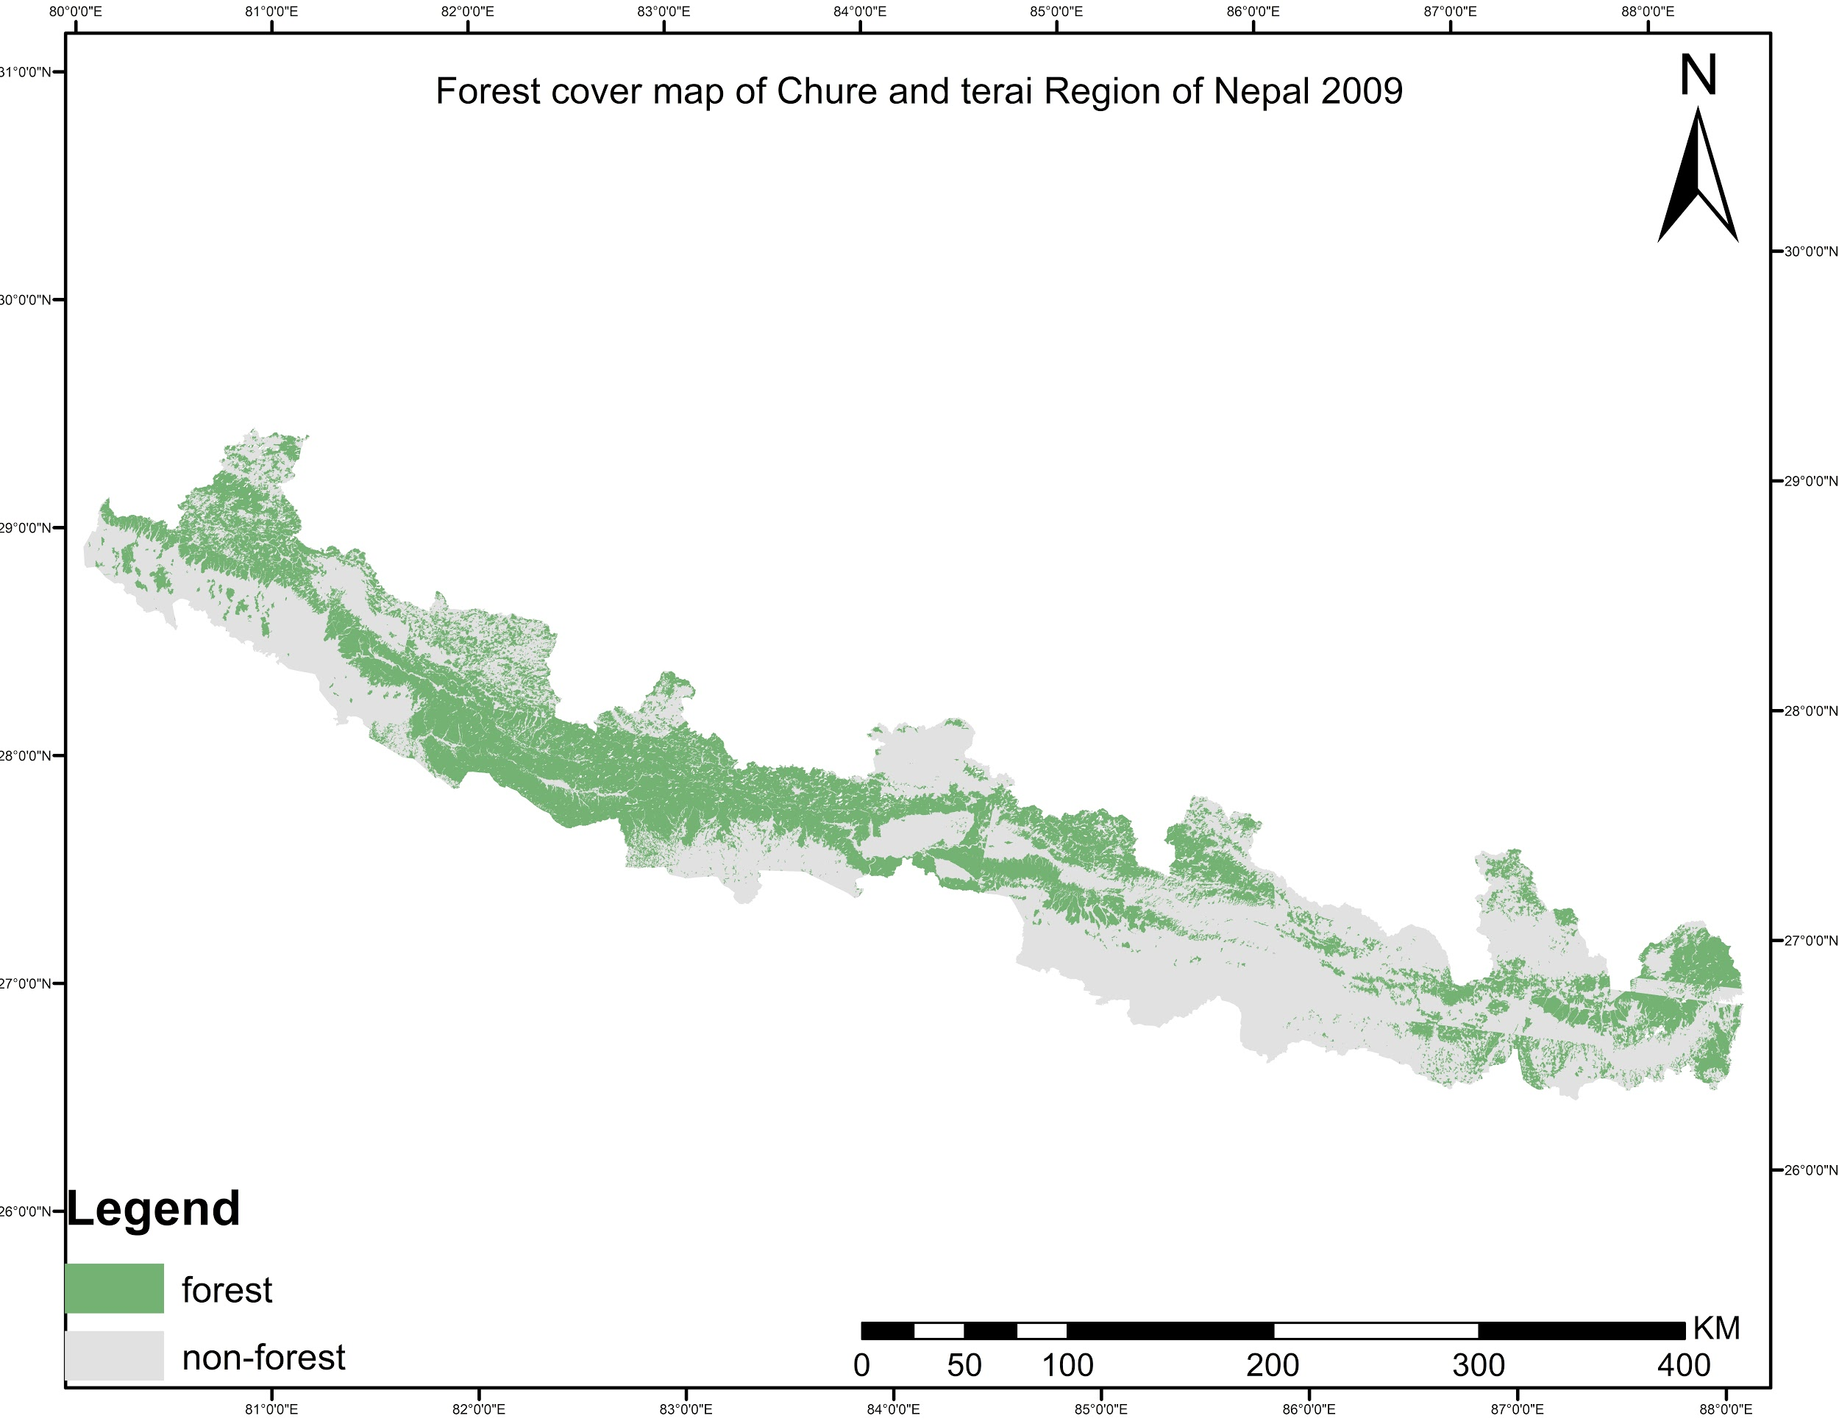
Contd…

Slide 12
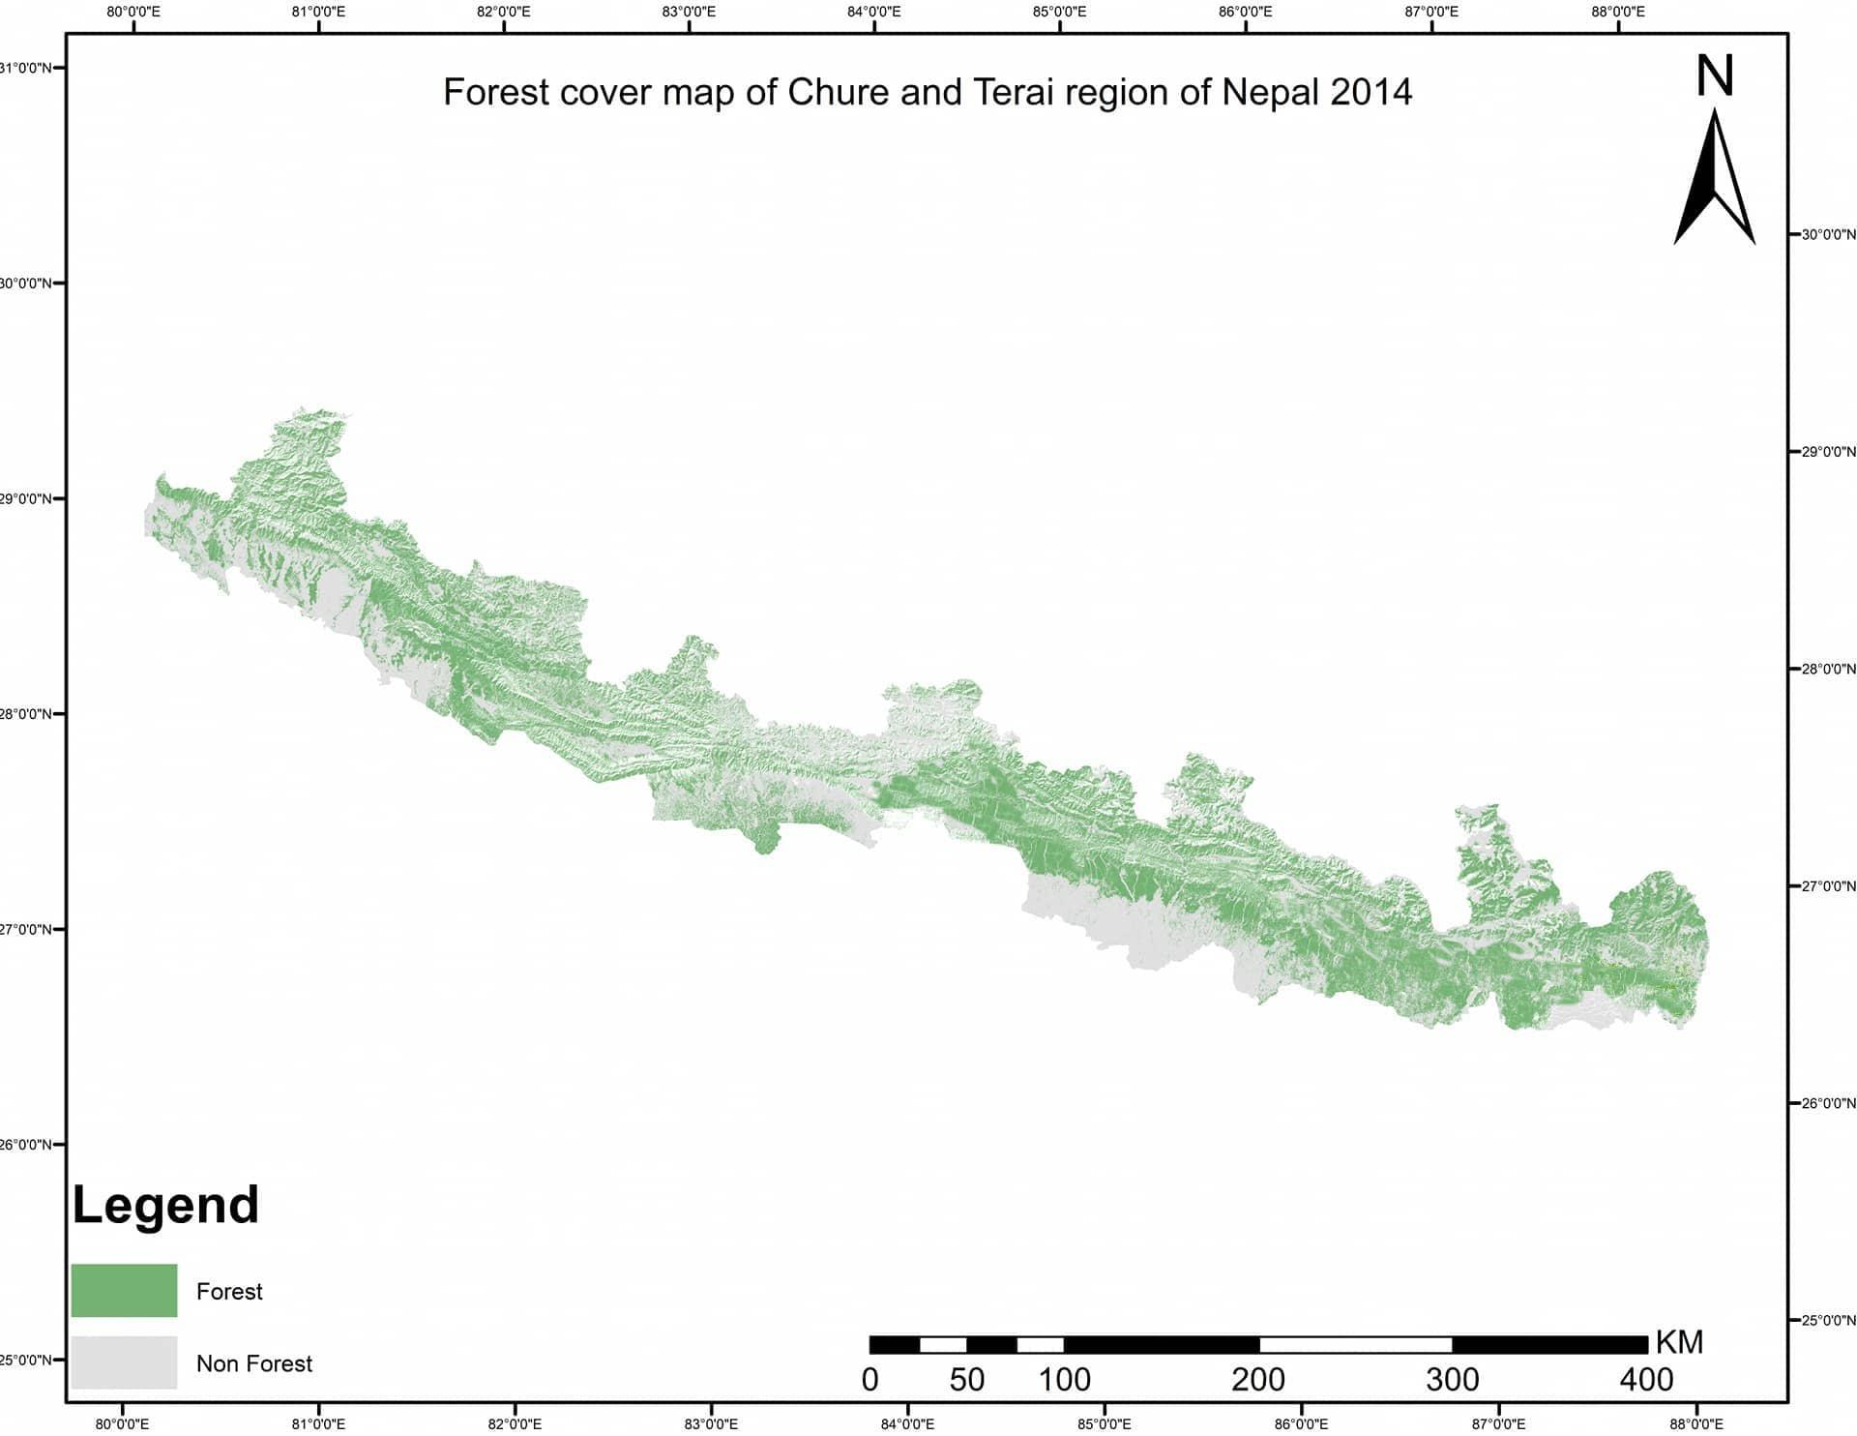
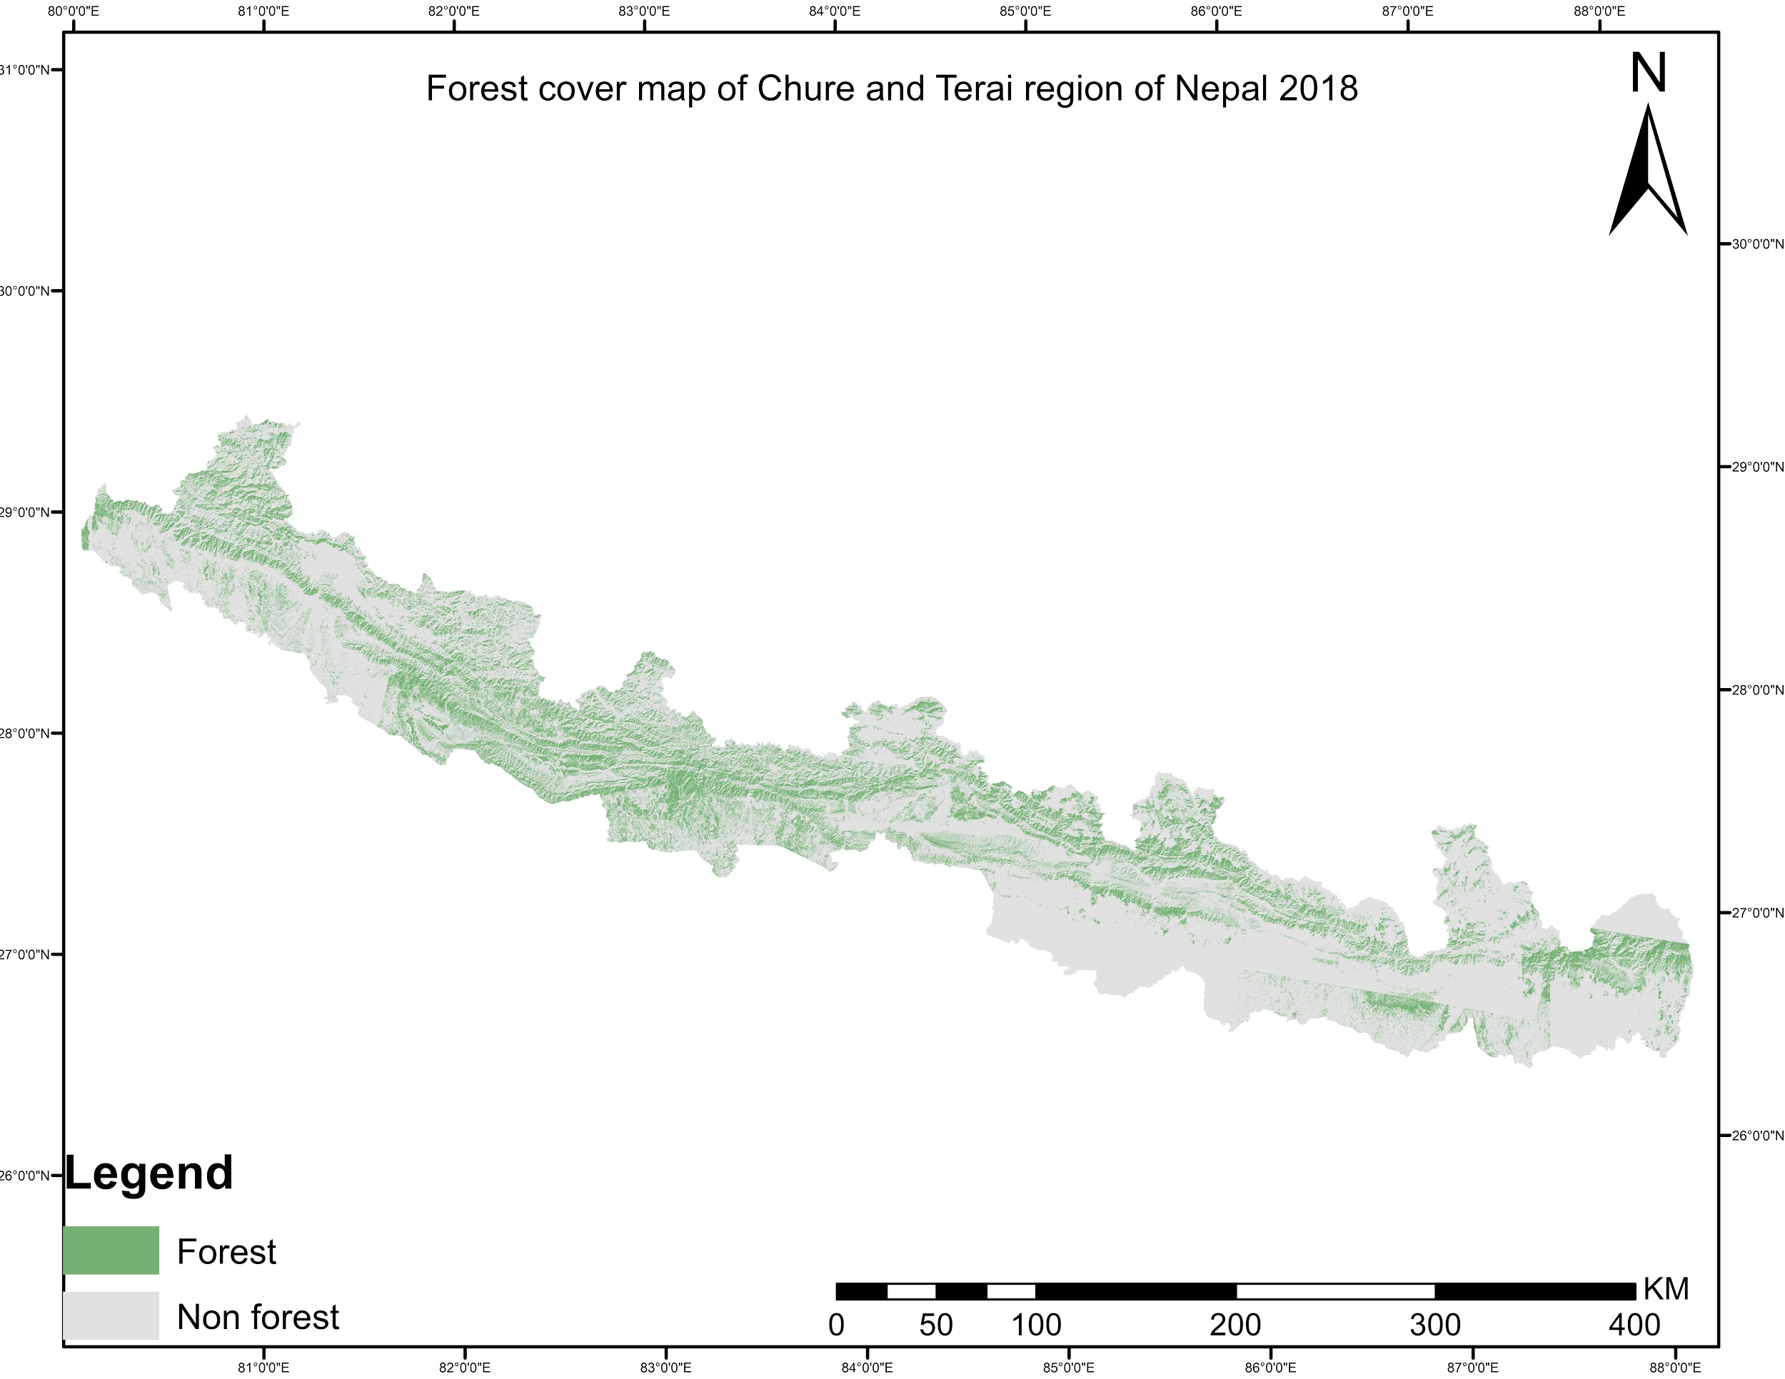
Contd…

Slide 13
Contd…
Image Classification Accuracy Assessment
Images of Year(AD) | Overall Accuracy
1994 | 90%
1999 | 90.83%
2004 | 87.50%
2009 | 85%
2014 | 89.17%
2018 | 86.67%

Slide 14
Contd…
Temporal Forest Cover Statistics of Chure and Terai
year(AD) | Forest cover(hectare) | Total land cover area(hectare) | Percent Forest cover(%)
1994 | 2683357.92 | 5829970.10 | 40.02
1999 | 1904320.50 | 5829970.10 | 32.66
2004 | 1683498.52 | 5829970.10 | 28.87
2009 | 1651903.38 | 5829970.10 | 28.33
2014 | 1569459.96 | 5829970.10 | 26.92
2018 | 1545579.19 | 5829970.10 | 26.52

Slide 15
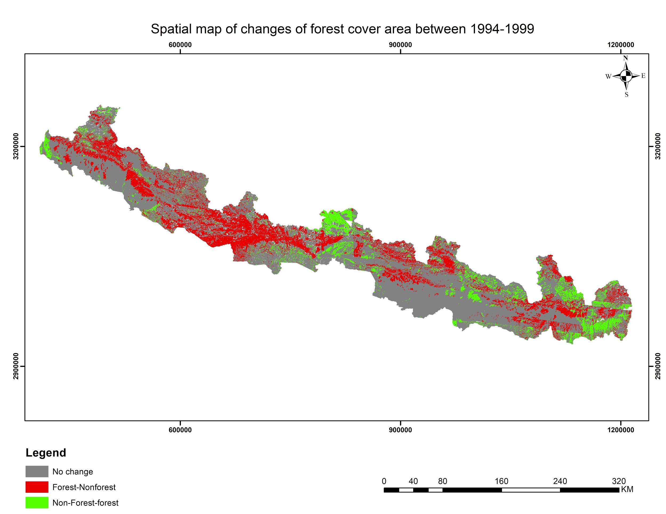
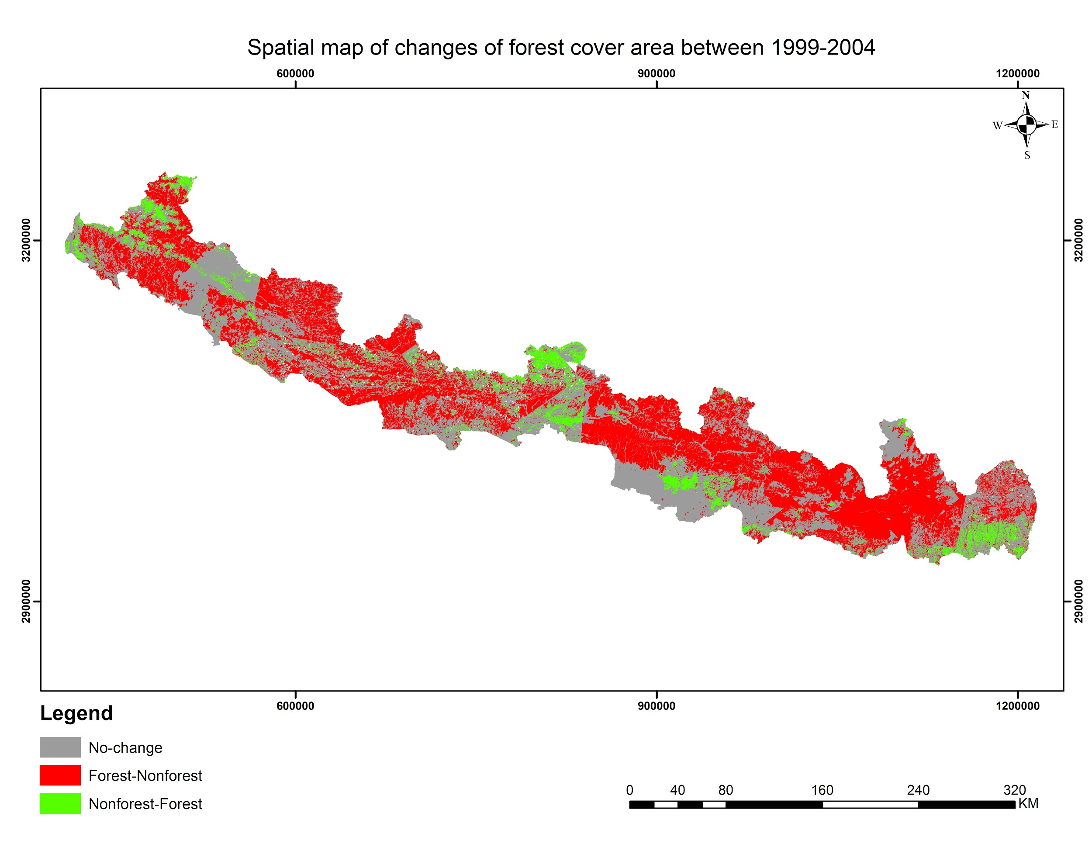
Contd…
Forest Cover Change Map from 1994 to 2018

Slide 16
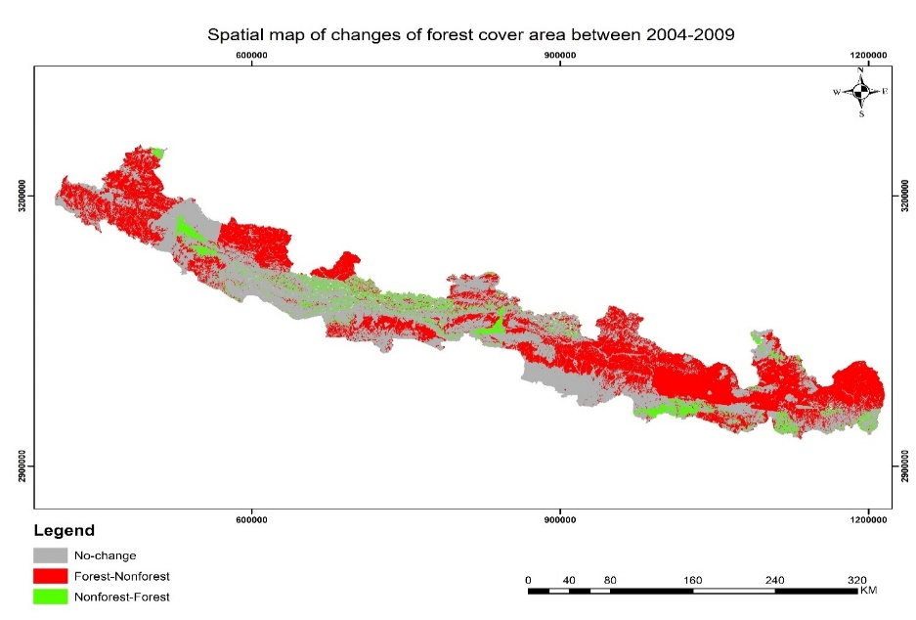
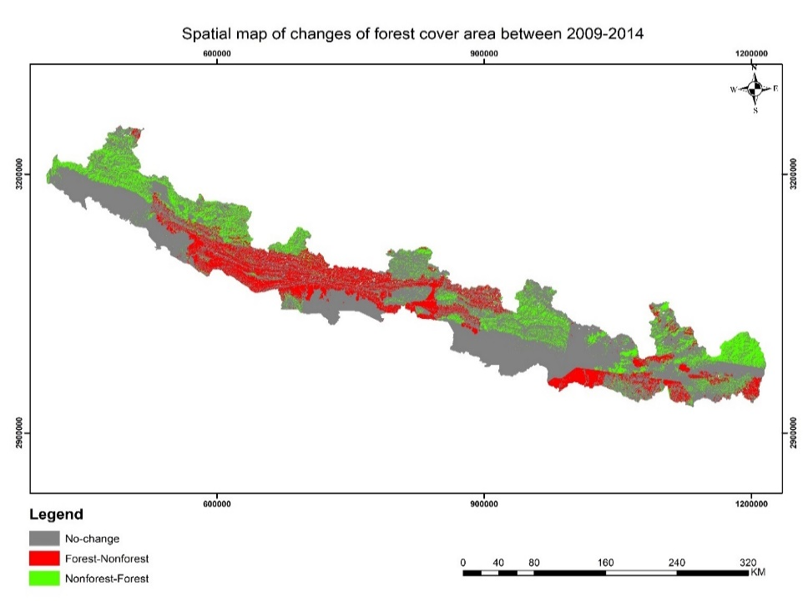
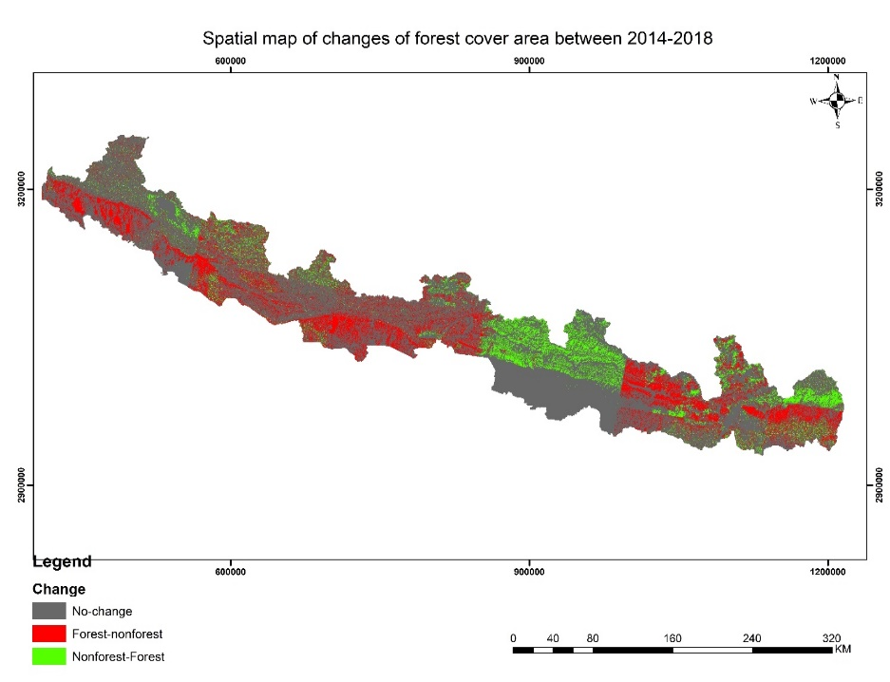
Contd…

Slide 17
Contd…

Slide 18
District-wise Forest Cover Statistics

Slide 19
Contd…
Ecosystem Service Value(ESV) Coefficient Adjustment
Year(AD) | Xie et al.(2003) | 1994 | 1999 | 2004 | 2009 | 2014 | 2018
ESV coefficient($ per ha) | 2168.84 | 1745.1 | 1961.15 | 2210.62 | 2520.28 | 2792.11 | 2792.11

Slide 20
Contd…
Total Ecosystem Service Value
Year(AD) | Total Forest Cover(ha) | ESV coefficient(USD per ha) | Total ESV(10^8USD)
1994 | 2683357.9 | 1745.10 | 46.8
1999 | 1904320.5 | 1961.15 | 37.3
2004 | 1683498.5 | 2210.62 | 37.2
2009 | 1651903.4 | 2520.28 | 41.6
2014 | 1569460 | 2792.11 | 43.82
2018 | 1545579.2 | 2958.63 | 45.7

Slide 21
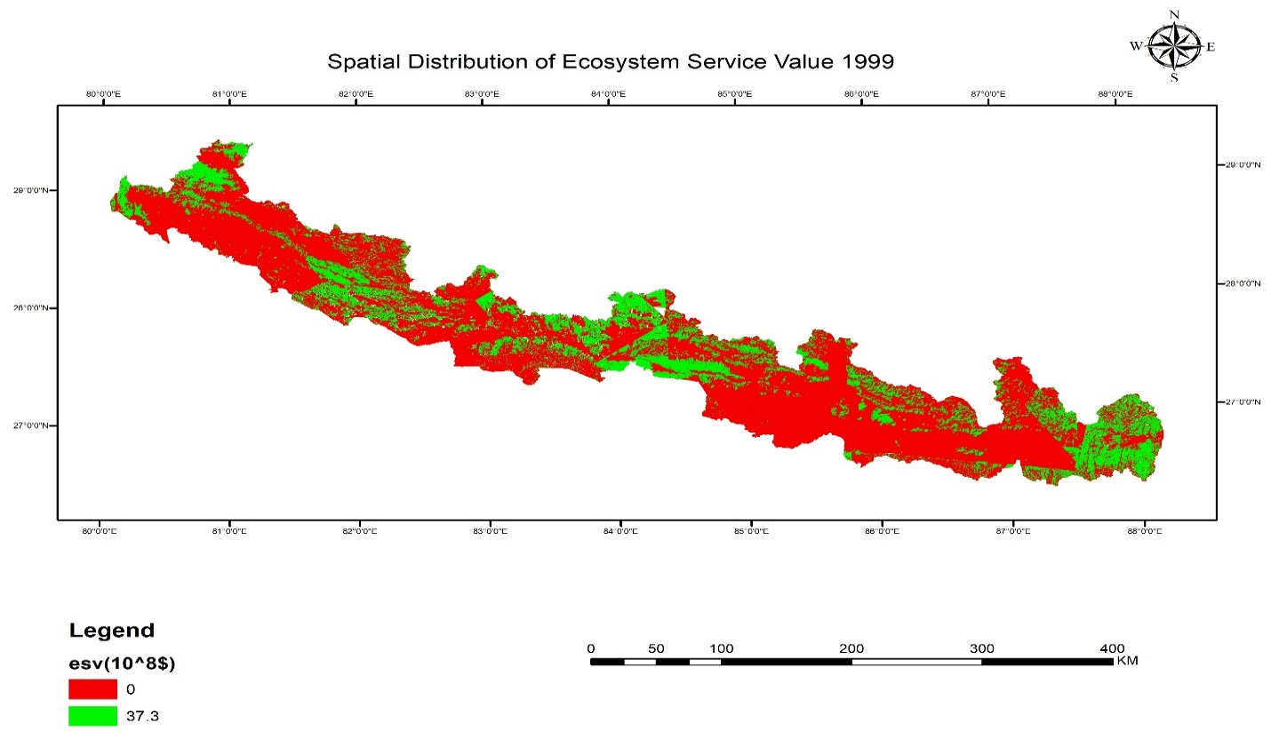
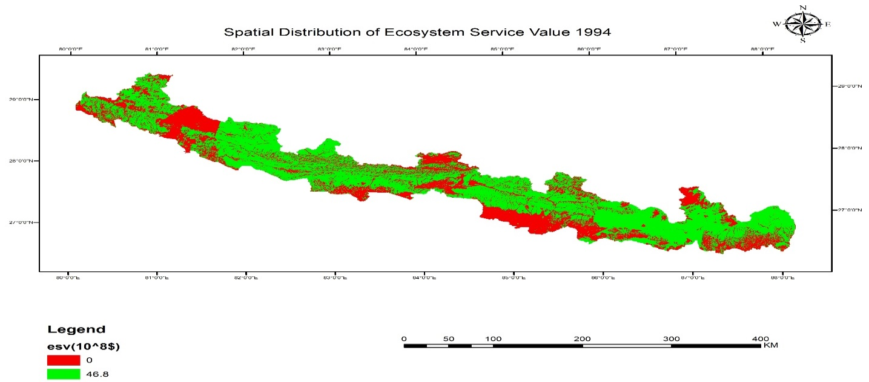
Time Series Map of ESV 1994-2018

Slide 22
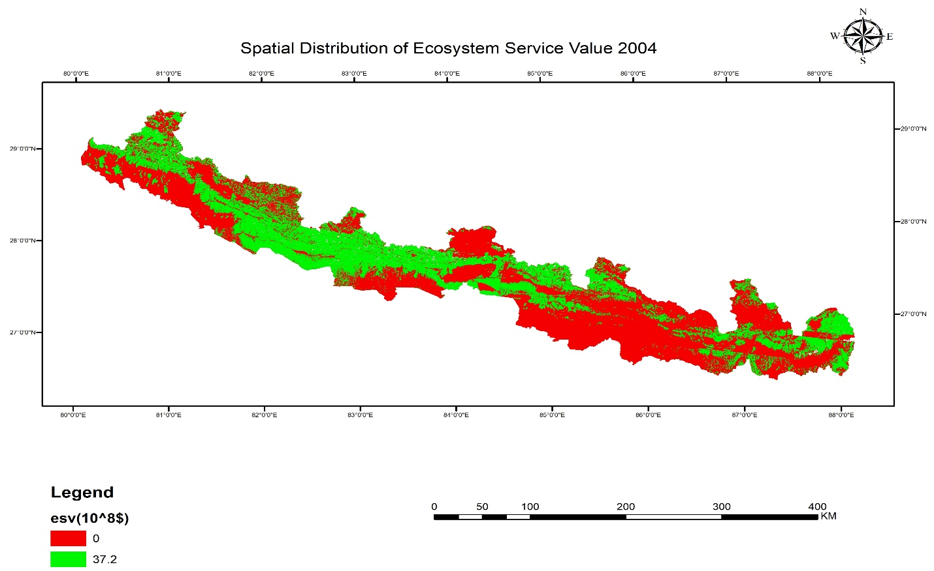
Contd…

Slide 23
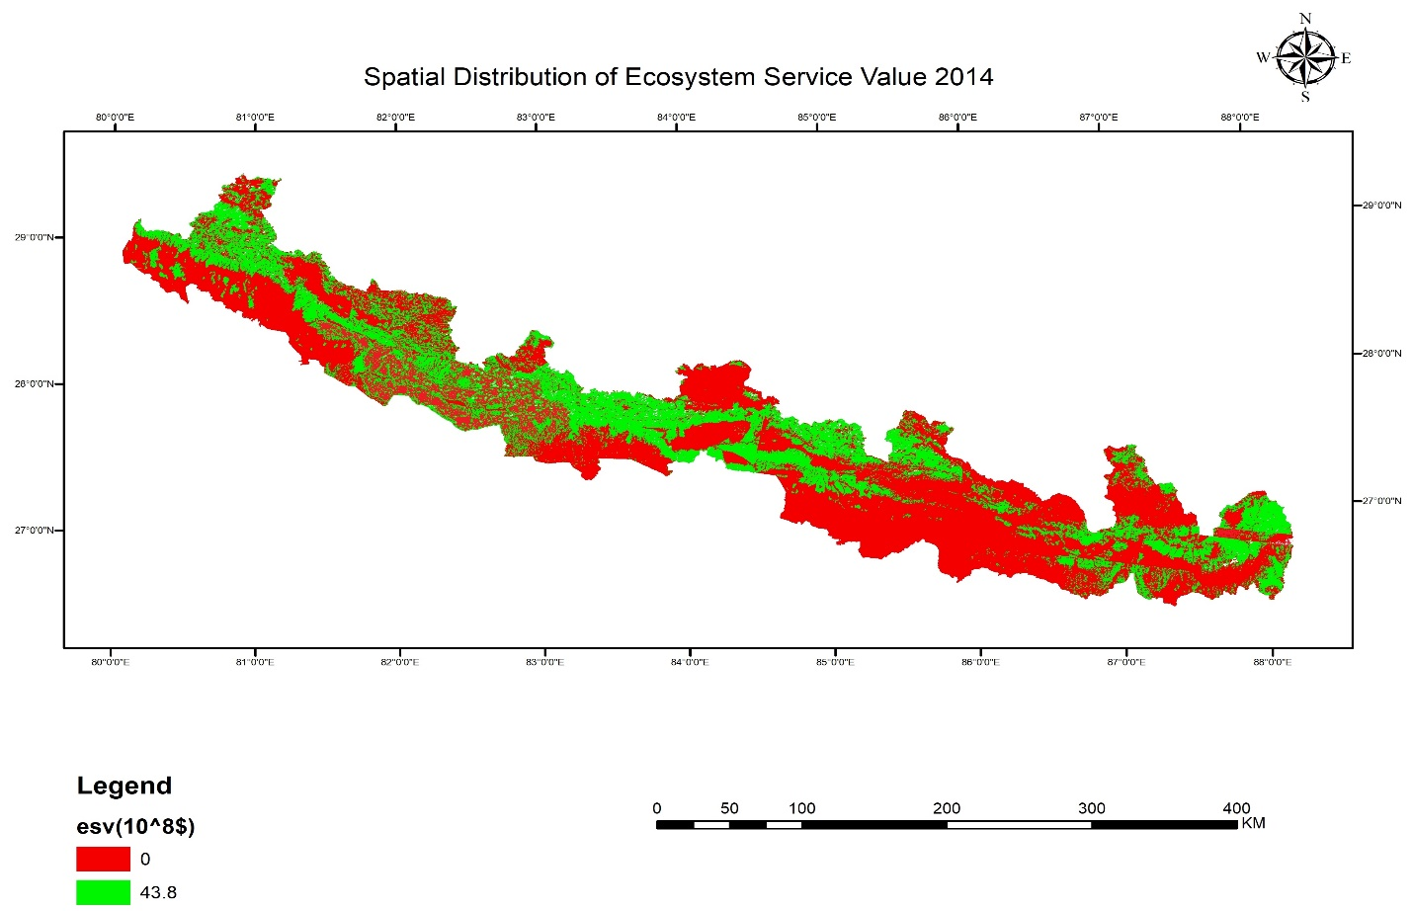
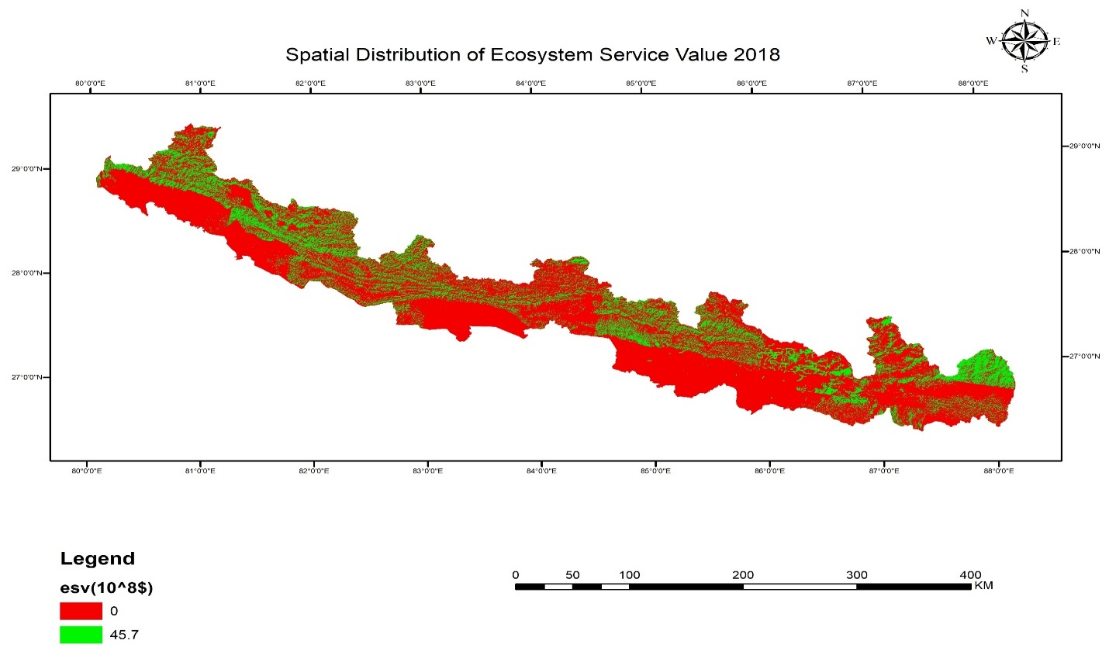
Contd…

Slide 24
Contd…
ESV change in Chure and Terai
Year(AD) | ESV Value(10^8) at 2019 | Year from-to(AD) | ESV Change(10^8USD)
1994 | 78.7 | 1994-1999 | 22.8
1999 | 55.8 | 1999-2004 | 6.6
2004 | 49.2 | 2004-2009 | 0.7
2009 | 48.5 | 2009-2014 | 1.5
2014 | 46.9 | 2014-2018 | 3.7
2018 | 43.2

Slide 25
Comparison of forest cover with existing datasets

Slide 26
Problems Encountered
Cloud cover Images
Inconsistent working of Ecognition Developer software.
Time Consuming in Image Processing

Slide 27
Conclusion and Recommendation
Forest Cover contributes to the ecosystem service value(ESV) and it plays dominant role in both gain as well as loss of ecosystem activities over the time period.
Largest forest cover in 1994 showed highest ESV while smaller forest cover in 2018 showed smallest ESV shows decline of ESV value.
The quantitative measurement and spatial interpretation of ecosystem service value are used to reveal how changes in forest cover is going to impact on ecological activities of study area and further plans to take action accordingly.

Slide 28
References
A.khadka. (n.d.). Mapping deforestation and forest degradation using. Banko Janakari, 17.
Ait-Aoudia, S. (2012). Satellite and Aerial Image Mosaicing - A Comparative Insight. Conference: Information Visualisation (IV).
al, C. e. (1997). The value of the world's ecosystem services and natural capital. Costanza et al Nature.
APFC, A. P. (2009, 05). Nepal Forestry Outlook Study. Working Paper No. APFSOS II/WP/2009/05, pp. 17-18.
Bhandari, A. R. (2018). Valuation of Ecosystem Services: A Case of Panchase Protected Forest in the Mid-hills of Western Nepal.
Bhaskar Shrestha, Q. Y. (2019). Assessment of Ecosystem Services Value Based on Land Use and Land Cover Changes in the Transboundary Karnali River Basin, Central Himalayas. Sustainability, 1-19.

Slide 29
THANK YOU

Slide 30
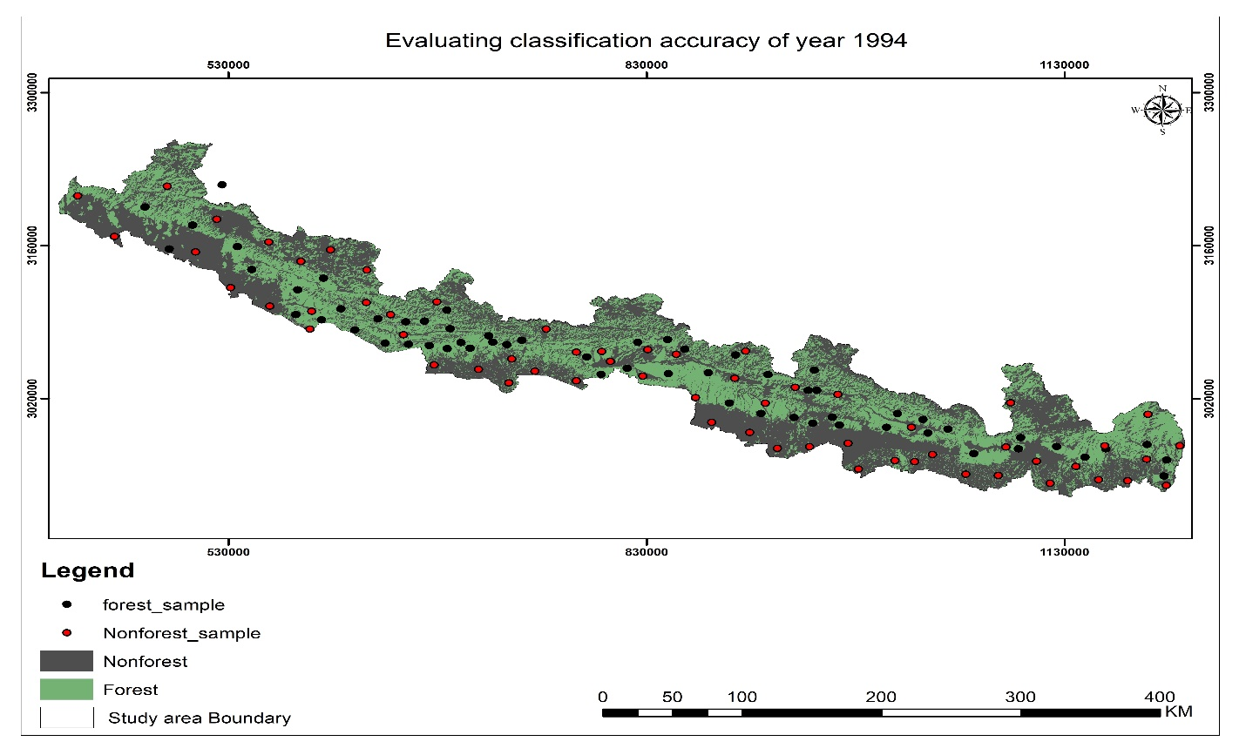
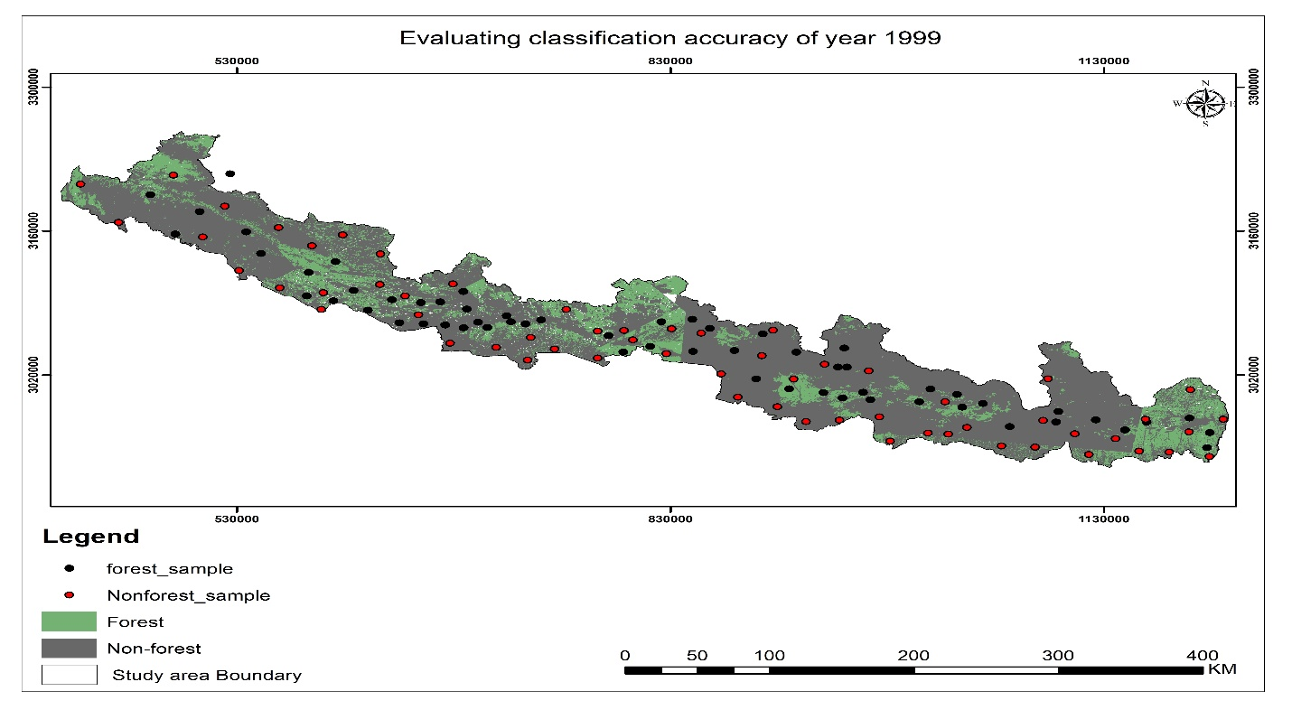
Annex 1

Slide 31
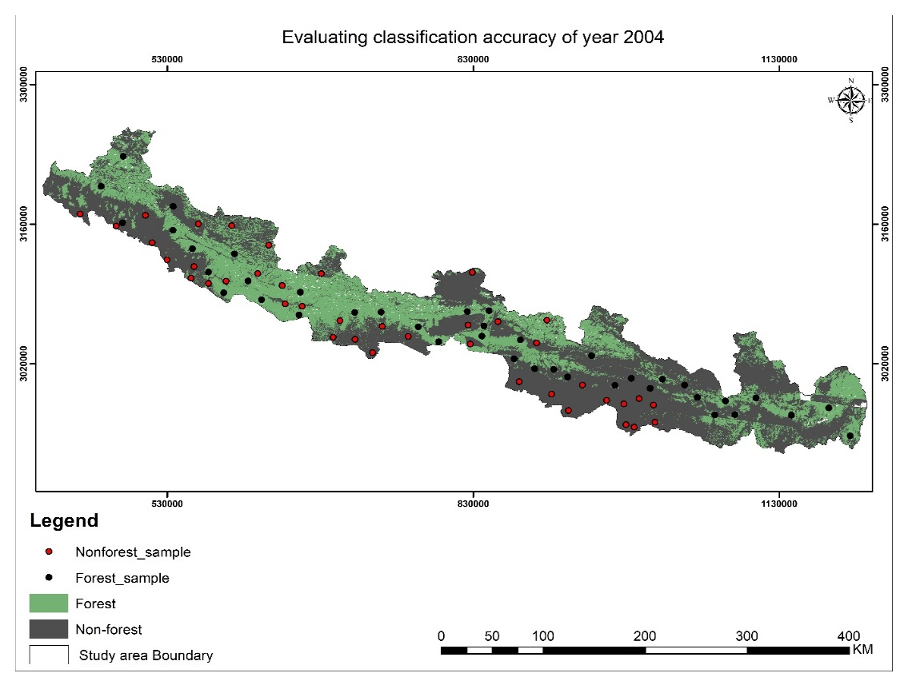
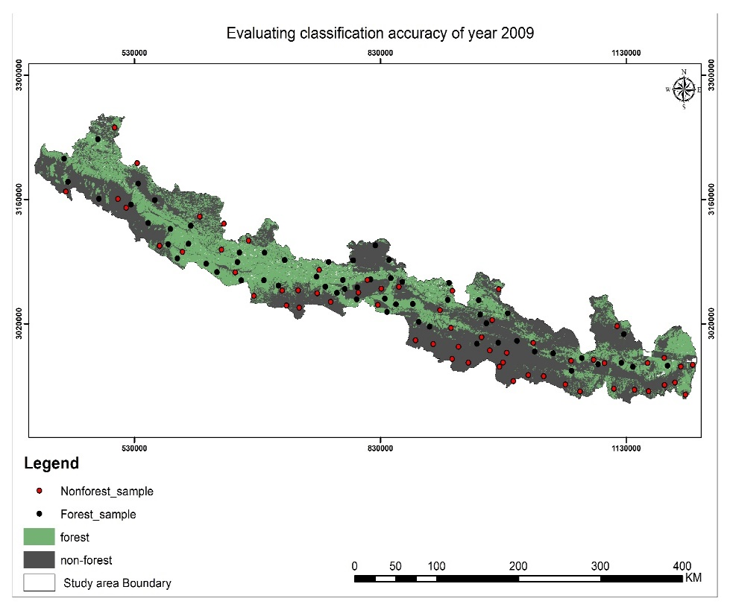
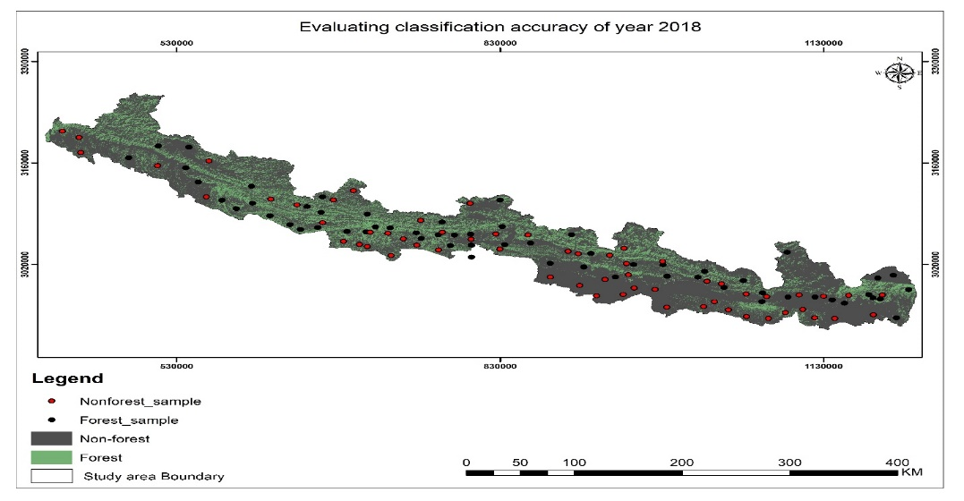
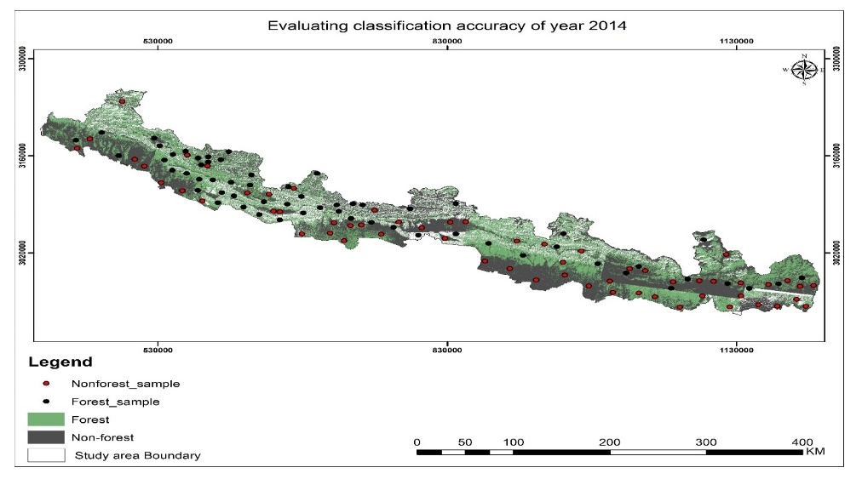

Slide 32
Annex 2 Confusion Matrix of 1994,1999,2004,2009,2014 and 2018
Column1 | Forest | Non-Forest | Total
Forest | 56 | 4 | 60
Non-Forest | 8 | 52 | 60
Total | 64 | 56 | 120
Column1 | Forest | Non-Forest | Total
Forest | 55 | 5 | 60
Non-Forest | 6 | 54 | 60
Total | 61 | 59 | 120
Column1 | Forest | Non-Forest | Total
Forest | 34 | 6 | 40
Non-Forest | 4 | 36 | 40
Total | 38 | 42 | 80

Slide 33
Column1 | Forest | Non-Forest | Total
Forest | 50 | 10 | 60
Non-Forest | 8 | 52 | 60
Total | 58 | 62 | 120
Column1 | Forest | Non-Forest | Total
Forest | 56 | 4 | 60
Non-Forest | 9 | 51 | 60
Total | 65 | 55 | 120
Column1 | Forest | Non-Forest | Total
Forest | 51 | 9 | 60
Non-Forest | 7 | 53 | 60
Total | 58 | 62 | 120

