Slide 1




---------------
Impact of Global Warming on water
height using XGBOOST & MLP
algorithms

Slide 2

Nilufar Makky
Master of Remote sensing & GIS
University of Tabriz

Slide 3
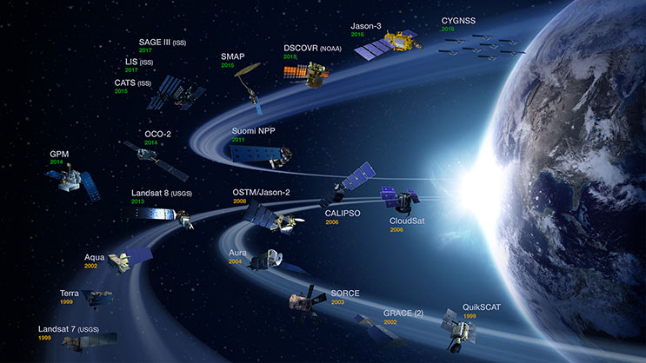
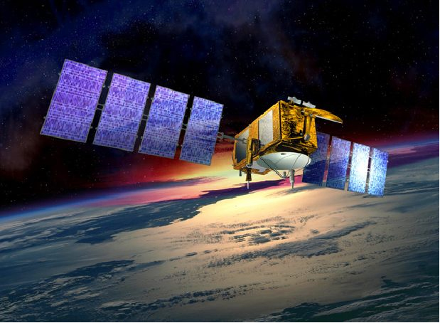

The 5th International Electronic Conference on Remote Sensing

Slide 4



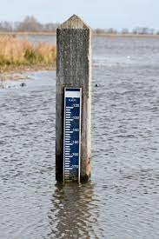
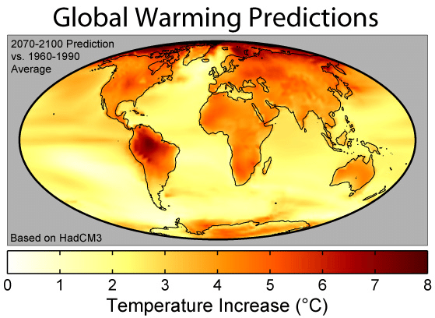

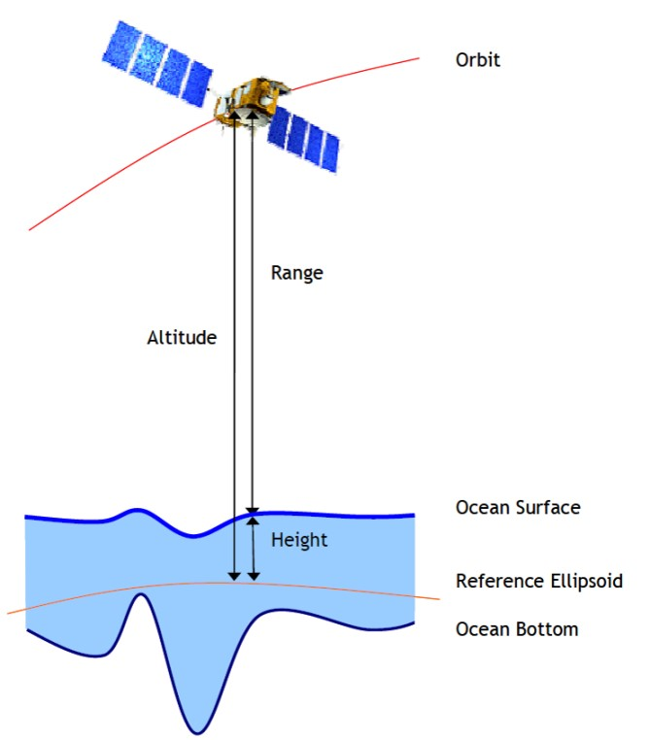
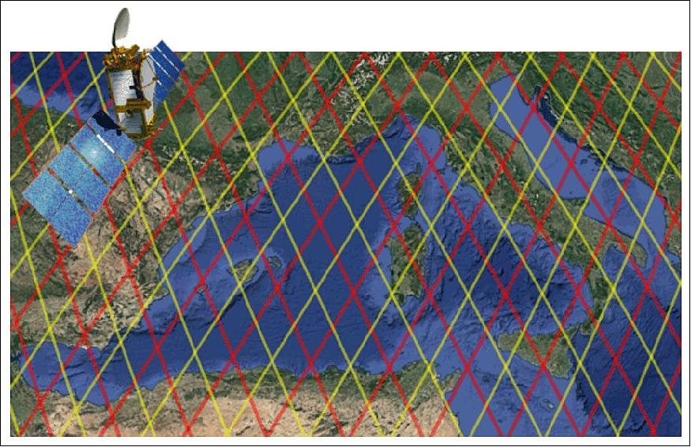
Abstract
Climate change
Sea surface height
Jason2 radar altimetry
SSH
Global warming

Slide 5
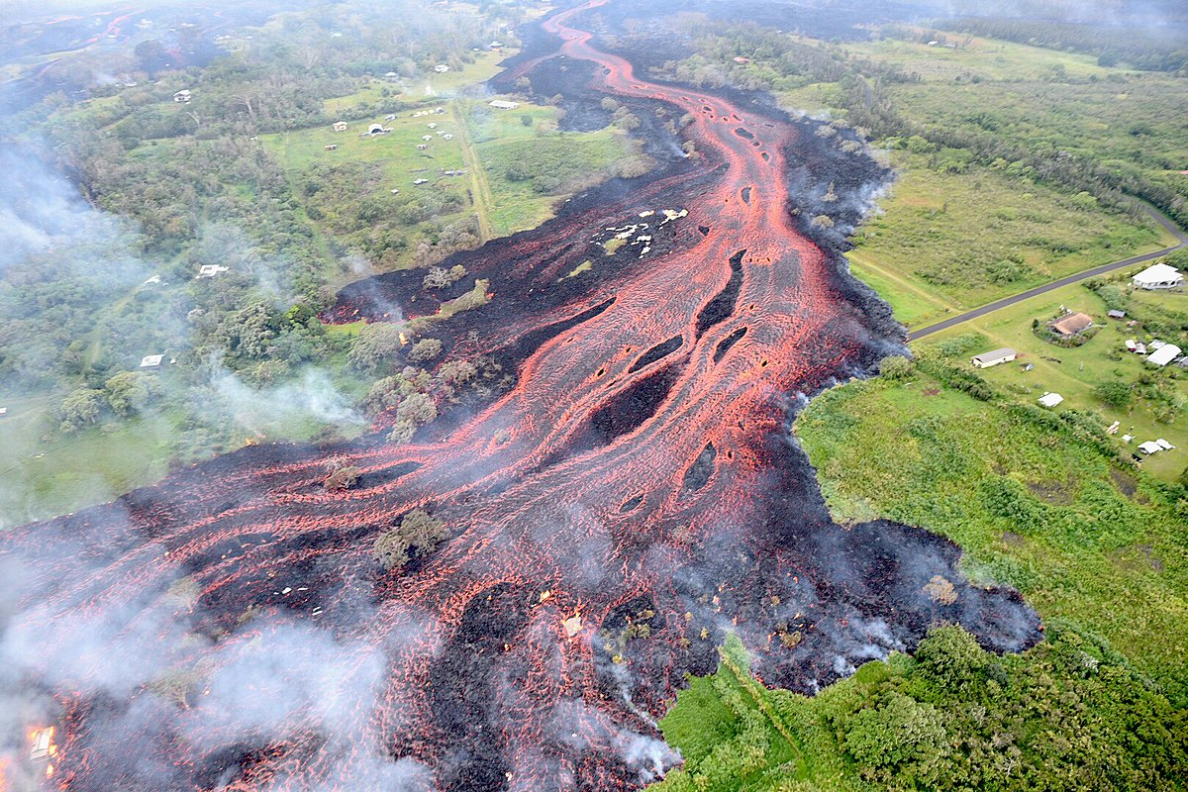
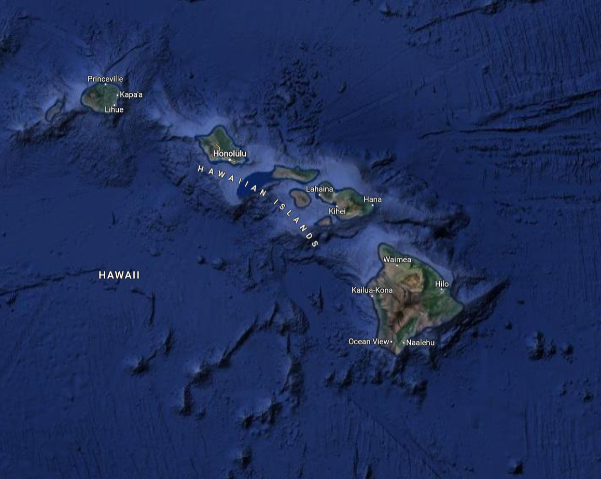

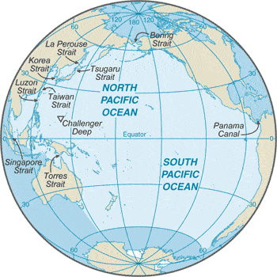
Hawaiian Island
Case study

Slide 6

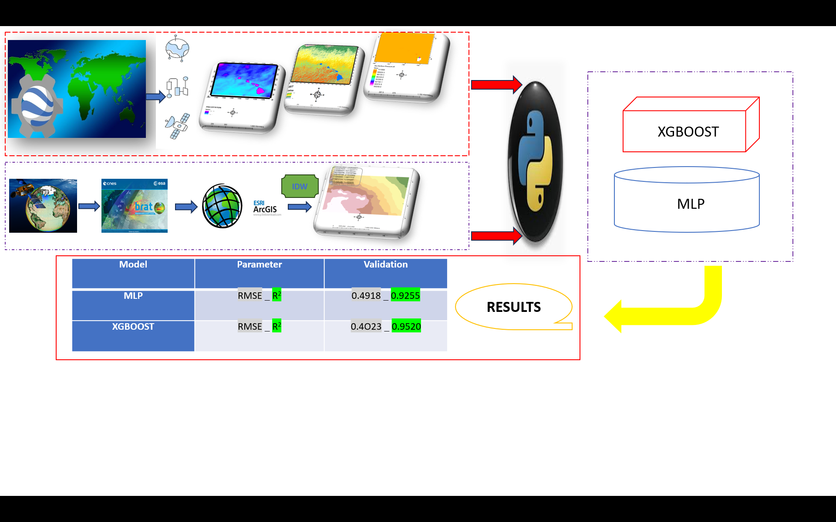
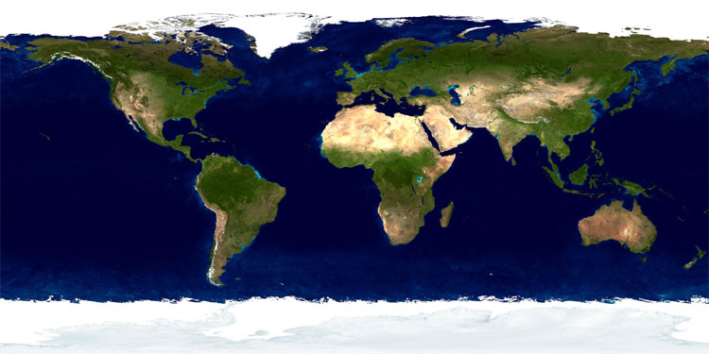
The process of study

Slide 7

SSH

Slide 8

Material
Mission | Band | Year
ECMWF/ERA5/MONTHLY | surface_pressure | 2019
OpenLandMap Precipitation Monthly | Jan Precipitation monthly,…
GCOM-C/SGLI L3 Sea Surface Temperature (V1) | SST_AVE
Jason-2/OSTM | C-band
2019

Slide 9

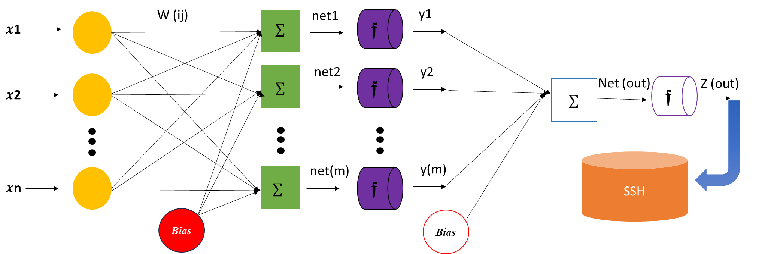
Architecture of MLP

Slide 10
Architecture of XGBOOST
Dataset
Sample data
D1
D2
DN
Reidual
Reidual
Reidual
Tree1
Tree2
Tree(n)
Construction of decision making
Result1
Result2
Result(n)
Sum of results
Final output(SSH)
Final result(SSH)

Slide 11
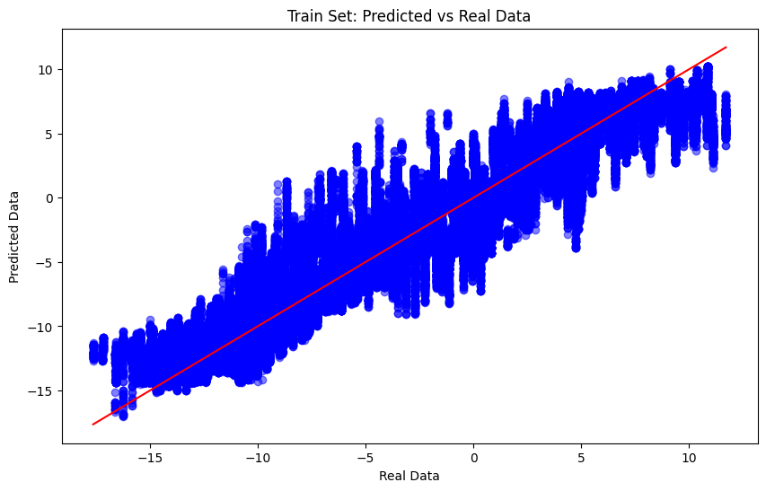
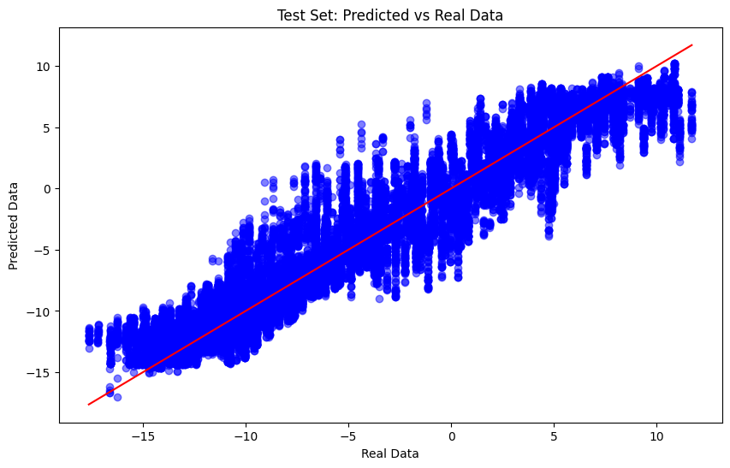
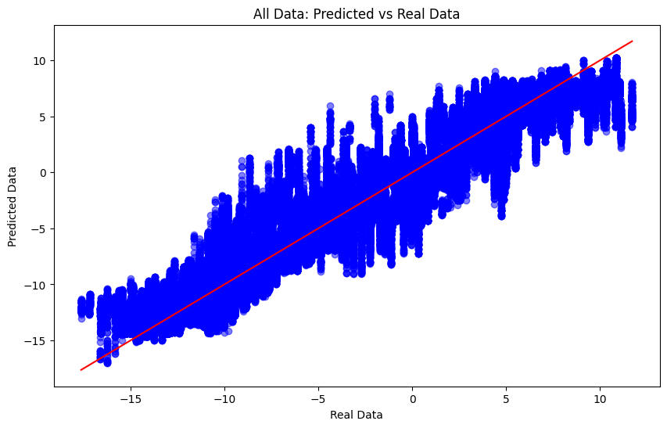
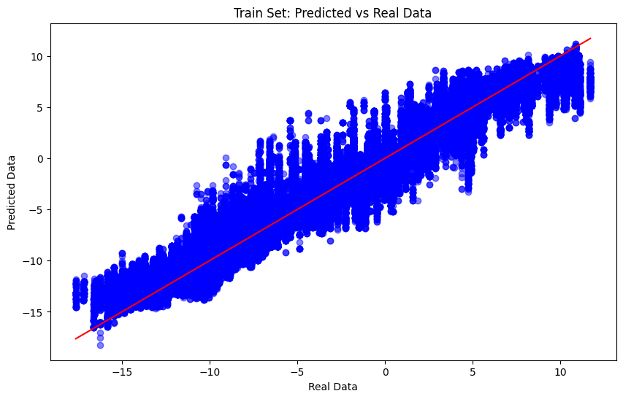
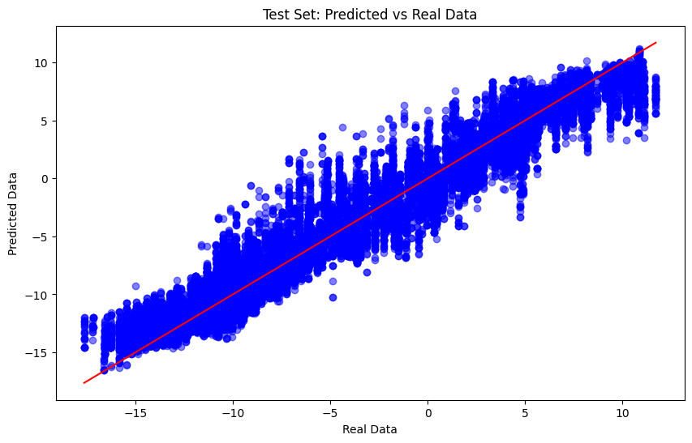

Results &Validation
Model | Parameter | Validation
MLP | RMSE _ R² | 0.4918 _ 0.9255
XGBOOST | RMSE _ R² | 0.4023 _ 0.9520
MLP
XGBOOST

Slide 12


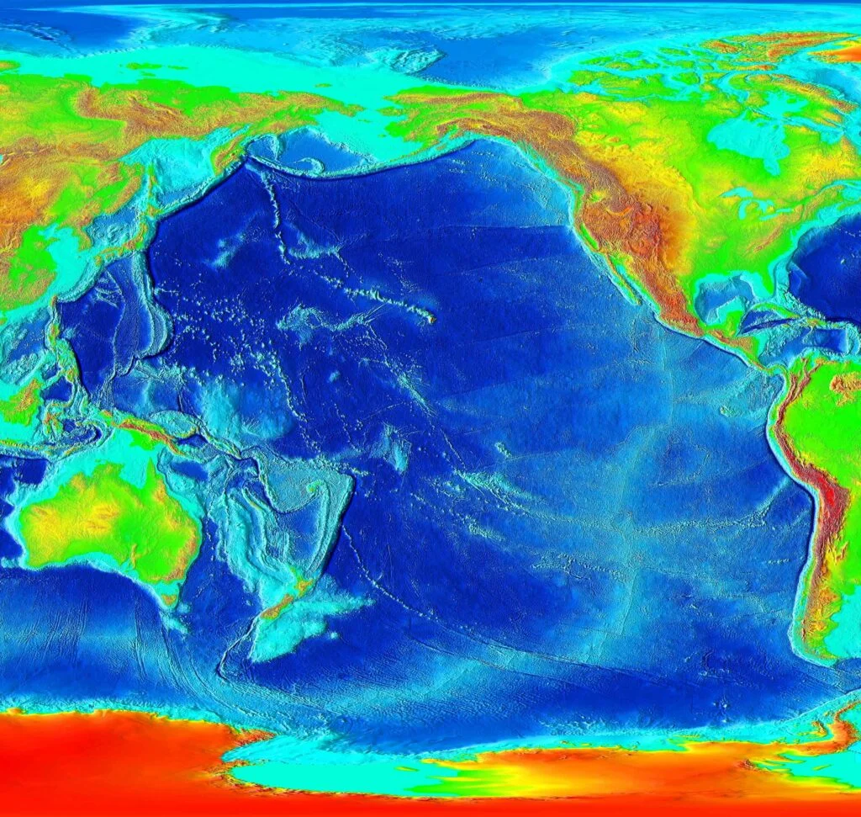
Thank you for your attention
Nilufar Makky
rsgis.nilufarmakki73@gmail.com
--------------------------------------------------------

