Slide 1
How much does location determine the market value of a building according to a multiple econometric analysis?
Massimiliano Scarpa, Laura Gabrielli and Aurora Greta Ruggeri

Slide 2
“There are three things that matter in property: location, location, location”
.. Lord Harold Samuel (Apocryphal)

Slide 3
Topic of interest
Topic
Discuss how fixed effects influence the best estimate of a premise's market value through multi-parametric estimation techniques
Topic Development
Investigate whether (or not) the recent events of the Covid-19 pandemic and the War in Ukraine have changed the influence of the property's location over its market value
RESEARCH QUESTIONS
How much does location determine the market value of a building according
Has a demand shift occurred due to these impactful and significant events?
Does the axiom "location, location, location" remain unchanged?

Slide 4
Research Scope
Even though location is not the only characteristic of a property whose market value depends on, it is undoubtedly one of the most important features, if not the most important one
This investigation is carried out from a market value perspective, and the aim is to study the factors that contribute to the price formation, questioning the demand willingness to pay for certain characteristics of the buildings.
A multivariate regression (MR) is implemented on an illustrative case study to assess a property's market value as a function of its descriptive features, such as
location,
distance from specific points of interest (POI),
construction features,
size,
etc.

Slide 5
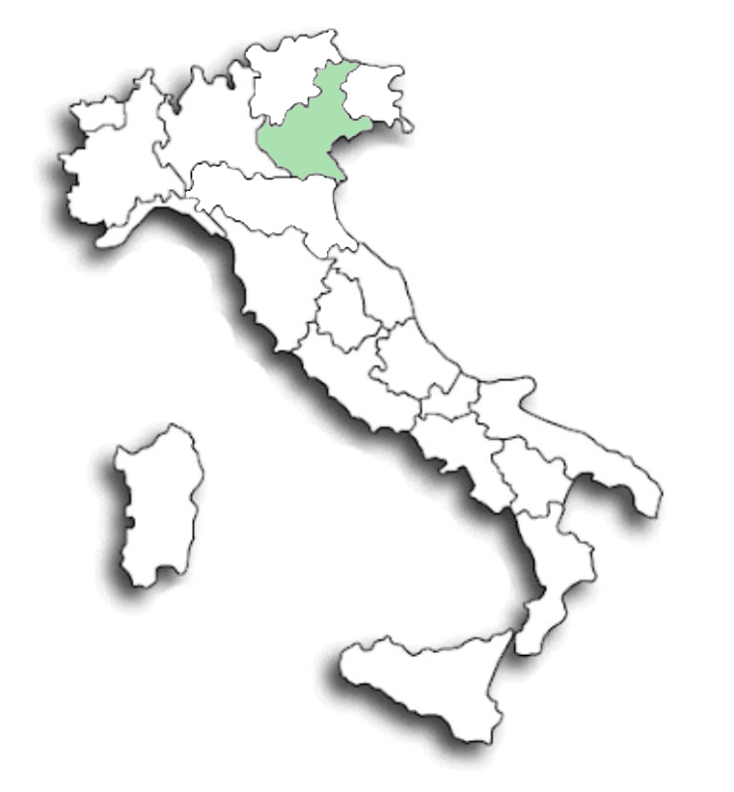
Method: general approach
DOWNLOAD OBSERVATIONS
Web Crawler
Case study
FEAUTURE SELECTION PROCESS
Random forest
SPATIAL-ECONOMETRIC MODEL
Multivariate Regression
Stepwise analysis

Slide 6
The hedonic pricing model
The hedonic price method is founded on the assumption that a property is characterized by a set of elements (the building characteristics), and that the value of the premise can be calculated as a sum of the estimated values of its elements (marginal prices).
This way, a marginal price is given to every building attribute, implicitly understanding how much that characteristic influences the market value.
$Y= a_{0}+ β_{1}X_{1 }+…+ β_{r}X_{r }+…+ β_{R}X_{R }$± 𝜑
Y is the dependent variable (i.e. the market value measured in €/sqm);
a_{o} is the constant;
β_{r} are the coefficients of the regressors X_{r}, 1 ≤ r ≤ R;
X_{r} are the independent variables 1 ≤ r ≤ R (i.e. the characteristics of the buildings);
R is the total number of dependent variables (X_{r});
𝜑 is the error.

Slide 7
A case-study in Italy: construction features
Since the Authors have been monitoring and recording data about the city of Padova during the last years to carry out several research projects, this may represent a good case-study to understand market variations over time after the latest events be-cause of the huge data availability about this City.
Case study
Construction features represent a premise's physical features and are related to the building typology.
CONSTRUCTION Feature | Unit of measure
Energy performance | energy class (1 to 10)
Maintenance | new/good/poor (1 to 3)
Area | sqm
Number of rooms | number
Park spaces | yes or no
Garden areas | yes or no
Number of baths | number
Cellaro or basement | yes or no
Terrace or balcony | yes or no
Building type | yes or no
Plants and installations | number
some variables are measured through continuous scales, such as the floor area (sqm) and the market price (€).
Most of the features are represented by the binary code 0/1, i.e. absence/presence of the feature, like, for instance, lifts, solar panels, building automation, building typology or others.
Qualitative variables are transformed into an ordinal scale.

Slide 8
A case-study in Italy: location features
Location characteristics represent the location of the building, and they describe its external environment and position
The urban attributes and accessibility are studied by analyzing the following POI:
city center,
train station,
bus stop and tram stop,
education facilities,
big shopping malls, big commercial facilities, small supermarkets,
urban parks/public gardens,
sports facilities,
hospitals and pharmacies
LOCATION characteristics
 | Variable | Unit
position | Latitude of the building (observation) | coordinate
 | Longitude of the building (observation) | coordinate
distance | Straight line distance from POI | Km
 | Actual travel distance from POI by car | Km
time | Travel time from POI by car | min
 | Travel time from POI on foot | min
 | Travel time from POI by public transports | min
proximity | N. of POI in the Ped shed (400 m) | n.
 | N. of POI in a 1 Km ring buffer | n.

Slide 9
Random Forest: construction parameters
The construction and localization regressors the market value depends on are a plethora.
This vast amount of information may be hard to synthesise in a regression analysis.
Only some regressors have high impact on price prediction, and the less impactful variables could be excluded from the inferential statistics.
A feature importance analysis allows to understand each independent variable's impact on the forecast. When the less significant variables are excluded (feature selection), it helps reducing the problem's dimensions.
Feature | Unit of measure | RF coefficient
Energy performance | energy class | 9.36%
Maintenance | new/good/poor | 4.33%
Area | sqm | 44.53%
Number of rooms | number | 40.34%
Park spaces | yes or no | 0.25%
Garden areas | yes or no | 0.18%
Number of baths | number | 0.12%
Cellaro or basement | yes or no | 0.04%
Terrace or balcony | yes or no | 0.14%
Building type | yes or no | 0.13%
Plants and installations | number | 0.59%
 |  | 100.00%

Slide 10
Random Forest: location parameters
 | Straight line distance | Actual travel distance by car | Travel time by car | Travel time on foot | Travel time by public transport | N. of POI in 400 m ring buffer | N. of POI in a 1 km ring buffer | TOTAL
Unit of measure | Km | Km | minutes | minutes | minutes | number | number | %
Public transports | 0.263% | 0.000% | 0.083% | 0.046% | 0.062% | 0.146% | 0.130% | 1%
City Center | 0.573% | 2.832% | 0.287% | 0.281% | 0.181% | 0.001% | 0.000% | 4%
Middle School | 0.603% | 1.004% | 0.412% | 1.587% | 1.052% | 0.082% | 0.066% | 5%
Pharmacies | 1.487% | 0.017% | 0.218% | 1.037% | 2.028% | 0.427% | 1.004% | 6%
Primary School | 0.526% | 0.016% | 0.261% | 0.936% | 0.623% | 0.482% | 1.832% | 5%
Nursery | 1.721% | 0.523% | 0.272% | 0.648% | 1.087% | 0.034% | 0.624% | 5%
Hospitals | 1.598% | 0.238% | 0.515% | 0.357% | 0.180% | 0.059% | 0.138% | 3%
Cultural Services | 1.153% | 0.020% | 0.273% | 1.892% | 0.600% | 0.577% | 4.005% | 9%
Small-commercial | 2.597% | 0.643% | 0.418% | 0.686% | 2.321% | 0.027% | 0.074% | 7%
Kindergarten | 0.831% | 0.041% | 2.092% | 0.661% | 1.014% | 0.037% | 0.072% | 5%
Train Station | 0.945% | 1.883% | 0.715% | 2.153% | 3.929% | 0.000% | 0.035% | 10%
Leisure Services | 6.148% | 0.000% | 0.165% | 2.276% | 1.388% | 4.237% | 7.207% | 21%
Medical centres | 0.605% | 0.003% | 1.534% | 0.118% | 0.534% | 0.420% | 3.403% | 7%
Parks and gardens | 0.746% | 0.025% | 0.324% | 0.294% | 0.352% | 0.056% | 0.151% | 2%
Shopping malls | 3.133% | 1.560% | 0.456% | 1.143% | 1.131% | 0.008% | 4.314% | 12%
 |  |  |  |  |  |  |  | 100%

Slide 11
Stepwise analysis and regression model
 |  |  |  | Simulation A |  |  | Simulation B |  |  | Simulation C |  |  | Simulation D |  |  | Simulation E
n.of regressors |  |  |  | 14 |  |  | 12 |  |  | 9 |  |  | 7 |  |  | 5
 |  |  | Unit of measure selected per each regressor | t-student | Coefficient | Keep | t-student | Coefficient | Keep | t-student | Coefficient | Keep | t-student | Coefficient | Keep | t-student | Coefficient | Keep
 | Constant | Constant |  |  | 1997.10 |  |  | 1971.17 |  |  | 2010.66 |  |  | 2180.39 |  |  | 2010.47
 | Area | Area | Square meters | -5.21 | -1.71 | x | -5.22 | -1.72 | x | -7.03 | -1.75 | x | -6.97 | -1.73 | x | -6.94 | -1.73 | x
 | Number of Rooms | Number of Rooms | Total number | -0.08 | -2.16 | x | -0.08 | -2.21
 | Energy Performance | Energy Performance | Energy class from A4 to G | 22.33 | 149.47 | x | 22.45 | 149.55 | x | 22.46 | 149.46 | x | 22.30 | 148.12 | x | 22.14 | 146.84 | x
 | Hospitals | Hospitals | Straight line distance | -1.18 | -99.94 | x | -1.17 | -98.37
 | Leisure Services | Leisure Services | N. in a 1 km ring buffer | -1.55 | -1.80 | x | -1.56 | -1.79 | x | -1.79 | -2.03
 | Cultural Services | Cultural Services | N. in a 1 km ring buffer | 5.04 | 12.78 | x | 5.16 | 12.67 | x | 5.30 | 12.98 | x | 13.32 | 8.14 | x | 13.04 | 7.58 | x
 | Medical Centers | Medical Centers | N. in a 1 km ring buffer | -0.18 | -0.57
 | Pharmacies | Pharmacies | Travel time by public transport | 1.63 | 12.87 | x | 1.64 | 12.92
 | Primary School | Primary School | N. in a 1 km ring buffer | -2.63 | -53.31 | x | -2.66 | -53.62 | x | -2.95 | -58.75 | x | -3.67 | -70.00 | x
 | Nursery | Nursery | Straight line distance | -0.07 | -6.07
 | Shopping Malls | Shopping Malls | N. in a 1 km ring buffer | -3.48 | -45.09 | x | -3.53 | -45.15 | x | -3.28 | -39.99 | x | -4.61 | -50.71 | x | -4.75 | -52.42 | x
 | Small Commercial | Small Commercial facilities | Straight line distance | -2.28 | -178.15 | x | -2.34 | -173.92 | x | -2.23 | -163.77 | x | -2.15 | -158.33
 | City center | City center | Actual travel distance by car | -3.60 | -60.70 | x | -3.77 | -59.80 | x | -4.20 | -65.34 | x | -5.22 | -71.20 | x | -7.41 | -92.52 | x
 | Train Station | Train Station | Travel time by public transport | 1.17 | 2.94 | x | 1.27 | 3.06 | x | 1.26 | 3.04
$$Unitary Price=2010.47−(1.73∗Area)+(146.84∗Energy Performance)+(7.58∗Cultural Services)−(52.42∗Shopping Malls)−(92.52∗ City Centre)$$

Slide 12
Further investigations…

Slide 13
A diachronic analysis
The MR is developed based on three data-bases about the same city but collected at different timings.
The first database represents a pre Covid-19 scenario.
The second database was collected two years after the first Covid-19 alerts, therefore illustrating the first effects that the pandemic has brought to the real estate market in North Italy.
The third database was collected one year after the outbreak of the War in Ukraine.
Database 2019
Database 2021
Database 2023

Slide 14
Diachronic results
$$Y_{2019}= 1766.16−33.29X_{1 }−0.57X_{2 }+ 68.88X_{3 }−25.98X_{4 }+2.65X_{5 }−17.75X_{6 }+ 5.14X_{7 }$$
$$Y_{2021}= 1801.46+ 52.31X_{1 }−6.26X_{2 }+ 74.59X_{3 }−92.83X_{4 }+8.92X_{5 }− 9.89X_{6 }− 27.49X_{7}$$
$$Y_{2023}= 1673.95+ 10.62X_{1 }−2.08X_{2 }+ 144.07X_{3 }−57.79X_{4 }+12.94X_{5 }− 29.38X_{6 }− 27.11X_{7}$$
Class element or Function | RF coefficients
Intrinsic | 2019 | 2021 | 2022
Typology of the building | 1.24% | 0.94% | 0.80%
Building construction characteristics | 31.49% | 38.23% | 74.67%
Building installations | 2.13% | 1.53% | 0.42%
Extrinsic | 2019 | 2021 | 2022
City centre proximity | 35.70% | 12.88% | 4.81%
Transports accessibility | 3.36% | 3.60% | 1.80%
Health services proximity | 4.72% | 4.40% | 2.98%
Urban amenities and leisure | 11.95% | 28.19% | 8.73%
Commercial areas | 3.46% | 4.61% | 2.71%
Education facilities proximity | 5.95% | 5.61% | 3.07%
 | 100.00% | 100.00% | 100.00%
X1 = Building internal services [Ʃ 0/1 of Lift, Garden, Parking Space, Cellar, Terrace, Building Automation, Central Heating, Photovoltaic system, MCV, Air Conditioning, Optical Fiber, Fireplace];
X2 = Floor Area [sqm];
X3 = Energy Class [from 10 to 1, where 10 represents the highest class, and 1 the lowest];
X4 = City center straight line distance [Km];
X5 = Urban Amenities and leisure [total n. of services in 1 km ring buffer of Cultural facilities, Museums, Art galleries, Theatres, Cinemas, Libraries];
X6 = Commercial Services [total n. of services in 1 km ring buffer of Big Shopping malls, big commercial facilities Small-supermarkets];
X7 = Bus and tram stop [total n. of services in the Ped shed of Bus stop and Tram stop].

Slide 15
Results and Contribution
Research Results
Particular attention has been dedicated to the comparison of localization versus construction characteristics inside price formation mechanisms.
The most influential construction characteristics are the floor area and the number of rooms.
The energy class is positively and strongly correlated to the price.
The proximity to the city center increases the market value but it is not the most influential factor.
Leisure and cultural services (urban amenities) are a strong increase to market values.
Research
strengths
Several techniques have been integrated into this research: computer programming in Python language, spatial analysis, Multivariate Regression and Random Forest feature importance analysis.
Research
contribution
The significant result of this research is a deep monitoring of the demand preferences. Location is among the primary drivers in determining market prices, but other building attributes strongly affect the buyer's choices.

Slide 16
Thank You for Your attention

