Slide 1
Predicting maturity of coconut fruit from acoustic signal with applications of deep learning Dr. Farook Sattar Dept. of ECE, Univ. of Victoria, Victoria, BC, Canada Email: fsattar@ieee.org Presented at the 2nd International Electronic Conference on Agriculture – Research Achievements and Challenges, 01-15 Nov. 2023. Available online: https://iocag2023.sciforum.net

Slide 2
Background Problem Defination & Issues
The need to find the right coconut maturity stage is essential since different coconut stages have various benefits.
Characteristics and food usage of coconuts vary accordingly to its maturity stage. For instance, premature coconuts have tender meat and water. Mature coconuts have thicker meat and lesser water than premature coconuts. While overmature coconuts have the hardest meat with lower or no coconut water.

Slide 3
Background Problem Defination & Issues
Thus, the maturity level significantly influences the water composition and physicochemical properties of the coconuts. Moreover, premature coconuts can be used as a refreshing drink while mature coconuts for salads or desserts.
Therefore, maturity prediction plays an important role in deciding the value of the coconut and directly links to the quality of the product.

Slide 4
Background Problem Defination & Issues
Limited effort has been made to develop a predictive and classification system for coconut fruits.
Creating such system can significantly benefit companies with mass exportation of coconut to international market, most notably in terms of time and money.

Slide 5
Objectives
Our aim is to develop an effective AI-driven system to predict maturity level of the coconuts using acoustic signals.
The purpose of this study is to demonstrate the usefulness of various deep learning models to inspect quality of the coconuts by automatically predicting their maturity level into three classes, i.e. premature, mature, and overmature, from a small amount of input acoustic data.

Slide 6
Objectives
The proposed sound-based autonomous approach would eventually exploit various deep learning models including customized CNN, pretrained CNNs such as ResNet50, InceptionV3, MobileNetV2 models in maturity level prediction of the coconuts.

Slide 7
Dataset
We have used an open access dataset consists of a total of 122 raw acoustic signals, which is the result of knocking 122 coconut samples on their ridges. The distribution of the data samples used is as follows:
Types of coconuts | Number of acoustic signals
Premature coconut | 8
Mature coconut | 36
Overmature coconut | 78

Slide 8
Proposed Methodology - Outline
The overall block diagram of our proposed hybrid scheme, which consists of wavelet scattering transform (WST) followed by a deep learning model, is shown below:
Wavelet scattering transform
data_M_OM_coconut
Deep learning model
Type of coconut maturity level
Input
acoustic
signal
$$θ_{B}$$

Slide 9
Illustrative Results
Method | Accuracy (%) ( mean ± std) |  | F1-score ( mean ± std)
WST + Customized CNN | 66.20±2.74 |  | 0.40±0.02
WST + Pretrained CNN | ResNet50 | 84.25 ±8.59 | 0.74±0.19 0.48±0.12
 | InceptionV3 | 77.32±10.28
 | MobileNetV2 | 73.12±6.30 | 0.53±0.10

Slide 10
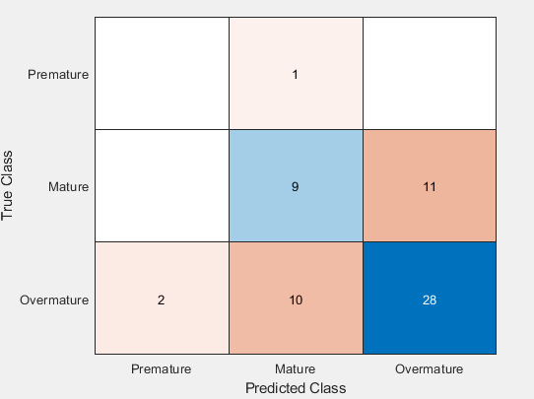
Illustrative Results
Confusion matrix for WST+customized CNN
0
0
Accuracy(%)= 60.65
0
F1 score
= 0.38

Slide 11
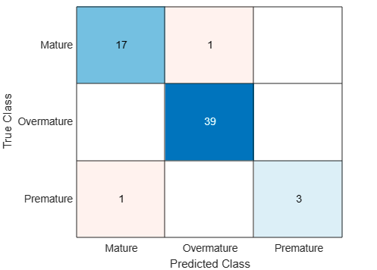
Illustrative Results
Confusion matrix for WST+ResNet50(pretrained CNN)
0
Accuracy(%)
= 96.72
F1 score
= 0.93
0
0
0

Slide 12
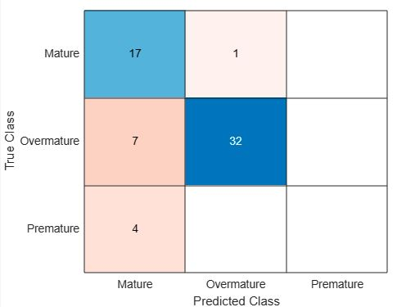
Illustrative Results
Confusion matrix for WST+InceptionV3(pretrained CNN)
0
Accuracy(%)
= 80.32
0
F1 score
= 0.54
0
0

Slide 13
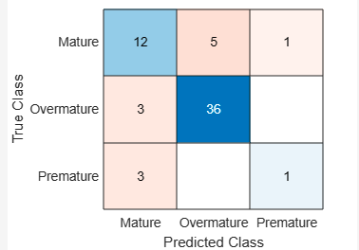
Illustrative Results
Confusion matrix for WST+MobileNetV2(pretrained CNN)
Accuracy(%)
= 80.33
0
0
F1 score
= 0.63
0

Slide 14
Conclusion
An acoustical hybrid method is proposed based on wavelet scattering transform (WST) and deep learning model.
Promising results are achieved by the proposed method for coconut maturity prediction enabling producers to accurately determine the yield and quality of the product using real acoustic data.
This paper also shows usefulness of deep learning in coconut fruit maturity prediction by evaluating different deep learning models including customized CNN, pretrained CNN, LSTM.
The method based on WST and ResNet50 provides the highest performance in terms of classification accuracy (≈ 85%) and F1 score (≈0.75) for a small acoustic dataset.

Slide 15
Conclusion
The proposed scheme can be tested to predict the quality for other types of fruits.
The performance can be improved by further analyzing the deep learning models used in our hybrid scheme.
Different dataset can be utilized for more detail evaluation of the proposed method.

Slide 16
Thank You!

