Slide 1
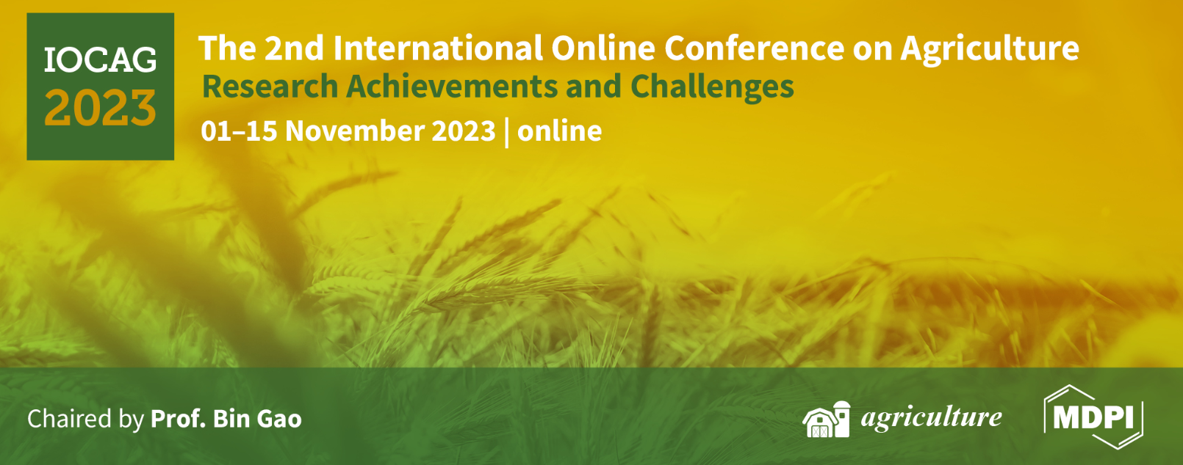







Management and quality of irrigation water in the sustainable Selenium-enriched rice (Oryza sativa L.) production
(Oryza sativa L.)
Ana Coelho Marques ^{1,2,}*, Diana Daccak ^{1,2}, Inês Carmo Luís ^{1,2}, Ana Rita F. Coelho ^{1,2}, Cláudia Campos Pessoa ^{1,2}, Manuela Simões ^{1,2}, Paula Scotti-Campos ^{2,3}, Ana Sofia Almeida ^{2,4}, Paulo Legoinha ^{1,2}, Maria Graça Brito ^{1,2}, José Carlos Kullberg ^{1,2}, Fernando Reboredo ^{1,2}, José C. Ramalho ^{2,5}, José Manuel N. Semedo ^{2,3}, Isabel P. Pais ^{2,3}, Maria Manuela Silva ^{1,2}, Maria Fernanda Pessoa ^{1,2}, Lourenço Palha ⁶, Cátia Silva⁶ and Fernando C. Lidon ^{1,2}
¹ Earth Sciences Department, NOVA School of Science and Technology (FCT NOVA), Campus de Caparica, 2829-516 Caparica, Portugal;
²GeoBioTec Research Center, NOVA School of Science and Technology (FCT NOVA), Caparica, Portugal;
³Instituto Nacional de Investigação Agrária e Veterinária, I.P. (INIAV), Avenida da República, Quinta do Marquês, 2780-157 Oeiras, Portugal;
⁴Instituto Nacional de Investigação Agrária e Veterinária, I.P. (INIAV), Estrada de Gil Vaz 6, 7351-901 Elvas, Portugal;
⁵PlantStress & Biodiversity Lab., Centro de Estudos Florestais (CEF), Associate Laboratory TERRA, Instituto Superior Agronomia (ISA), Universidade de Lisboa (ULisboa), Quinta do Marquês, Av. República, 2784-505 Oeiras and Tapada da Ajuda, 1349-017 Lisboa, Portugal;
⁶Centro de Competências do Arroz (COTArroz), 2120-014 Salvaterra de Magos, Portugal.

Slide 2
Abstract: There is a growing need for strategic actions involving efficient water use, sustainable agricultural production, and food security. Agricultural productivity can be improved through good agricultural practices based on water quality management, new genetically modified resources, and using precision agriculture. This study aimed to monitor the crop water (supply, irrigation, and flooding) of an advanced rice (Oryza sativa L.) line of the breeding program (OP 1509) subjected to Selenium (Se) enrichment. Water lines in paddy rice field were monitored by Unmanned Aerial Vehicles (UAVs). The parameters of pH, pHs, electrical conductivity, temperature, HCO₃⁻, Cl⁻, SO₄²⁻, PO₄³⁻, Na⁺, K⁺, Ca²⁺, and Mg²⁺ were analyzed. According to the Piper diagram, the samples were classified as sodium chloride bicarbonate (supply) and sodium bicarbonate chloride (irrigation and flooding). The Langelier Saturation Index (LSI) was calculated and indicated that waters are good to use in agricultural practices. According to the Wilcox classification, regarding agriculture use, the samples were classified as C2S1 (supply and irrigation) and C3S1 (flooding). The Selenium contents were analyzed by atomic absorption and significant differences were observed in rice grains, with a maximum content of 10 mg.kg⁻¹. In conclusion, water quality is in accordance with the parameters for use in this crop and the workflow used improved the grain quality.
Keywords: Langelier Saturation Index; Oryza sativa L.; Piper and Wilcox diagram; Precision agri-culture; Water Management and Quality

Slide 3
Materials and Methods
In a paddy rice field located at the center of Portugal (Salvaterra de Magos), an advanced rice line (OP 1509) of the breeding program carried out by Instituto Nacional de Investigação Agrária e Veterinéria (INIAV) was tested. The experimental design was a factorial arrangement: 2 concentrations (0 and 300g Se.ha⁻¹), 2 Se forms (sodium selenate and sodium selenite), and 4 replicates in a total of 16 plots. Selenium applications included 3 foliar applications, which occurred at the end of booting, anthesis, and at the milky grain stage.
Precision Agriculture - Characterization of Water Lines
Physical and Chemical parameters - Water Analysis
Atomic Absorption - Quantification of Selenium in Paddy Rice Grains

Slide 4
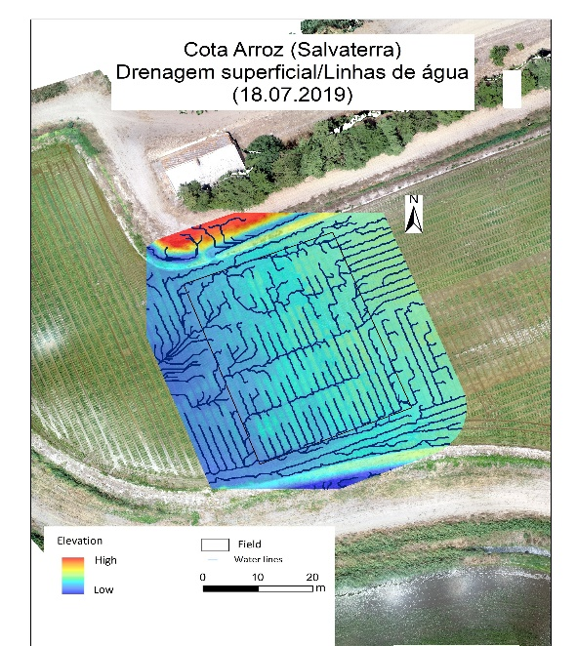
Results and Discussion
The geomorphology of the experimental rice field is characterized by different elevations, the eastern part being higher (Figure 1). Thus, the elevation was measured to determine water drainage trends. Accordingly, the water lines created in the experi-mental field follow a westerly direction (Figure 1).
The geomorphology of the paddy rice field was characterized by orthophotomap where the elevation and the water lines created in the experimental field were observed. The lower elevation zone (west zone) corresponds to the flatter surface and is more favorable to water accumulation and consequently greater infiltration (Figure 1).
4

Slide 5
Results and Discussion
The pH of the water samples ranged from 6.3 – 6.9, while the pHs ranged between 8.4 – 8.9 (Table 1). Electrical conductivity of the water varied from 376 μS/cm to 420 μS/cm, in supply (A), and irrigation (B), respectively. Moreover, the high EC is observed in flooding (C) sample such as 800 μS/cm (Table 1). In sample A, the concentration of bicarbonate (HCO₃⁻), chloride (Cl⁻), and sulphate (SO₄²⁻ ) was 1.1 meq/L, 1.4 meq/L, and 0.9 meq/L, respectively (Figure 2). Regarding B and C samples, the concentration of HCO₃⁻, Cl⁻, and SO₄²⁻ ranged from 0.9 – 1.4 meq/L, 2.1 – 3.7 meq/L, and 0.8 – 1.5 meq/L, respectively. In both water samples, the concentration of phosphate (PO₄³⁻) is low (< 0.04 meq/L). Additionally, the Langelier Saturation Index (LSI) was the same for samples A and C (- 1.8) while that of sample B was -2.6 (Table 1).
A value outside the normal range may cause a nutritional imbalance or may contain a toxic ion [13]. The salinity hazard is measured by the increase in Electrical Conductivity (EC) because most are the most influential in water quality in crops.
5

Slide 6
Results and Discussion
According to the Piper diagram, the chemical composition of the water samples is sodium chloride bicarbonate (A) and sodium bicarbonate chloride (B and C) (Figure 2). By Wilcox classification, water samples A and B are C2S1 while sample C is C3S1. Thus, the Sodium Adsorption Rate Index (SAR) is 1.93, 2.29, and 2.70 for samples A, B, and C respectively (Figure 2).
6

Slide 7
Results and Discussion
According to the Piper diagram, based on the contribution of the cations and anions, the samples were classified as sodium chloride bicarbonate (A) and sodium bicarbonate chloride (B and C) (Figure 2). To classify the water as suitable for irrigation, the Wilcox diagram was plotted [20]. The EC was plotted against the Sodium Adsorption Rate (SAR) index (relative proportion of Na⁺ to Ca²⁺ and Mg²⁺ concentration), which represents the suitability of the water for agricultural use [12].
7

Slide 8
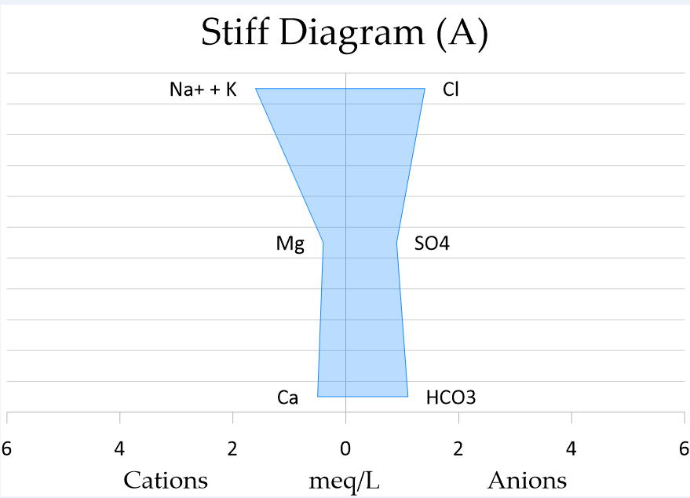
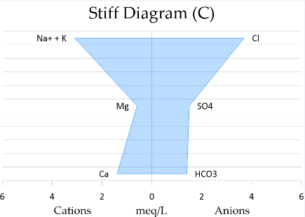
Results and Discussion
The Stiff diagrams show that Cl⁻ is the dominant anion and the same for cation Na⁺ followed by Mg²⁺ and Ca²⁺, in both samples (Figure 3). The highest concentrations (cations and anions) are observed in sample C.
According to the Stiff diagram the evolution of anions and cations from sample A to B is observed (Figure 3). Rice plants are the most sensitive to humidity, temperature, and water conditions [21]. Based on this, breeding techniques ensure the availability of varieties adapted to different environmental conditions [5].
8

Slide 9
Results and Discussion
In the control, Selenium (Se) content was not detected, however, in biofortified grains significant differences were reported (Table 2). Selenite application showed a 10.10 mg.kg⁻¹ of increased while selenate showed a 6.00 mg.kg⁻¹.
The increase of Se depends on the characteristics of each variety, the form of Se used, and concentration [22]. Independently of the foliar pulverization, the results showed a Se increment of 10.10 mg.kg⁻¹ (sodium selenite) and 6.00 mg.kg⁻¹ (sodium selenate) in paddy rice grains (Table 2). Our findings are following the literature that points to selenite as more effective than selenate [23].
9

Slide 10
Conclusion
This study focused on monitoring the water management and quality of an experimental field of an advanced rice (Oryza sativa L.) line of the breeding program (OP 1509) subjected to Selenium (Se) enrichment. The water lines were monitored using Unmanned Aerial Vehicles (UAVs). Water samples were collected from water supply (A), irrigation water (B), and flooding water (C), and physicochemical composition (pH, EC, anions, and cations concentration) were monitored. The pH at the equilibrium point (pHs) and Langelier Saturation Index (LSI) were also considered. According to the Piper diagram, the samples were classified as sodium chloride bicarbonate (sample A) and sodium bicarbonate chloride (samples B and C), and their suitability for agricultural use was classified as C2S1 (samples A and B) and C3S1 (sample C) according to the Wilcox diagram. Thus, the use of quality water contributed to the production of rice grain enriched with Se (up to 10 mg.kg⁻¹).
10

Slide 11



Acknowledgments
The research was funded by PDR2020, grant number 101-030671 and Fundação para a Ciência e a Tecnologia, I.P. (FCT) 2022.10859.BD.
The authors give thanks to Lourenço Palha, Cátia Silva (COTArroz) and Orivárzea (Orizicultores do Ribatejo, S.A.) for technical assistance. We also thank the research centers (GeoBioTec) UIDB/04035/2020, (CEF) UIDB/00239/2020 and Associare Laboratory TERRA (LA/P/0092/2020) for support facilities.
11

