Slide 1
Irrigation water management and quality in two Rocha pear orchards
Cláudia Campos Pessoa ^{1,2,*}, Ana Coelho Marques ^{1,2}, Ana Rita F. Coelho ^{1,2}, Diana Daccak ^{1,2}, Inês Carmo Luís ^{1,2}, Manuela Simões ^{1,2}, Paulo Legoinha ^{1,2}, Maria Manuela Silva ^{1,2}, Fernando H. Reboredo ^{1,2}, Paula Scotti-Campos ^{2,3}, Isabel P. Pais ^{2,3}, José N. Semedo ^{2,3}, José C. Ramalho ^{2,4}, and Fernando C. Lidon ^{1,2}
¹ Departamento de Ciências da Terra, Faculdade de Ciências e Tecnologia, Campus da Caparica, Universidade Nova de Lisboa, 2829-516 Caparica, Portugal.
² Centro de Investigação de Geobiociências, Geoengenharias e Geotecnologias (GeoBioTec), Faculdade de Ciências e Tecnologia, Campus da Caparica, Universidade Nova de Lisboa, 2829-516 Caparica, Portugal.
³ Instituto Nacional de Investigação Agrária e Veterinária, I.P. (INIAV), Quinta do Marquês, Avenida da República, 2780-157 Oeiras, Portugal.
⁴ Plant Stress & Biodiversity Lab, Centro de Estudos Florestais (CEF), Laboratório Associado TERRA, Instituto Superior Agronomia (ISA), Universidade de Lisboa (ULisboa), Quinta do Marquês, Avenida da República, 2784-505 Oeiras, Portugal.
* Corresponding author: c.pessoa@campus.fct.unl.pt

Slide 2
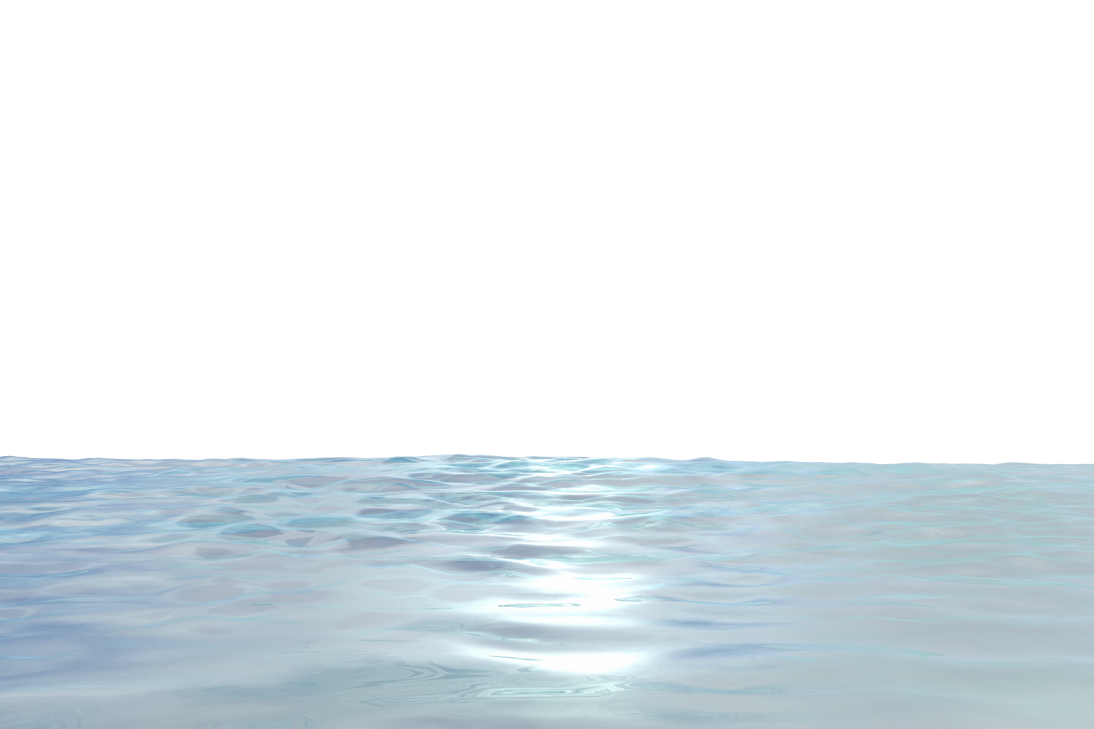
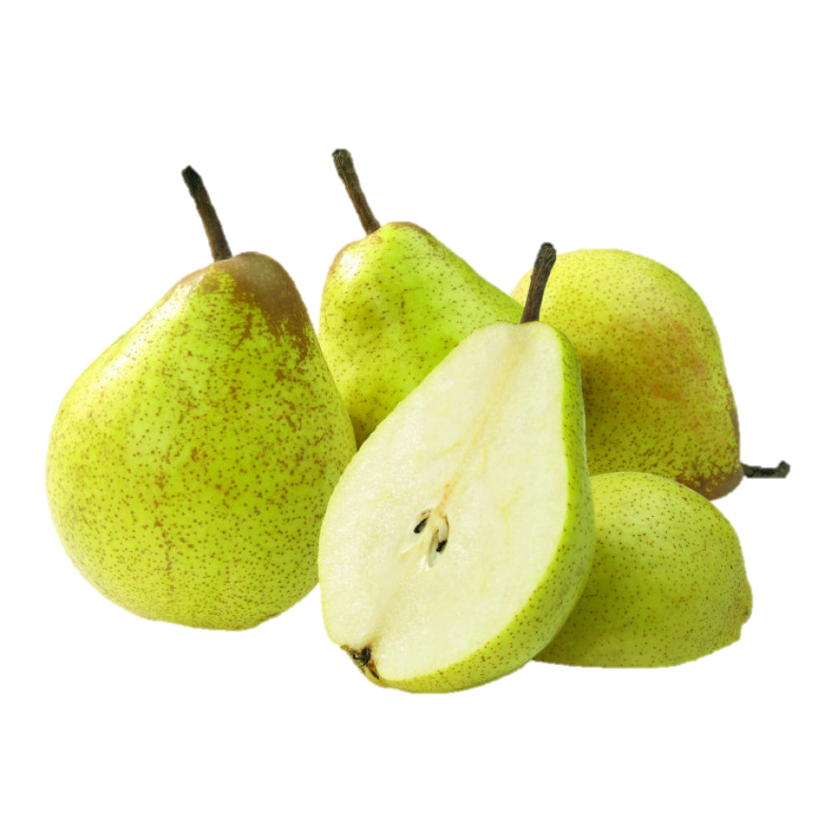
Introduction
Problematic
Agronomic Biofortification
Calcium
Improve food quality
Increase of mineral elements in edible parts of plants
In deficit can promote bone deformations or condition mobility
Rocha pear
Portuguese variety
Water
Can affect the soils and fruits quality
Crucial for nutrient absorption, evapotranspiration and other processes
Dependent on irrigation practices (drip irrigation)
Soil and spray fertilizers
Land and hydric shortage
Minimize mineral deficit in human diets
Importance to the country`s market
Ca²⁺
The study aimed to:
- Evaluate quality differences between irrigation waters of 2 different orchards (Rocha pear)
- Identify possible conditionings to Ca increases in fruits

Slide 3
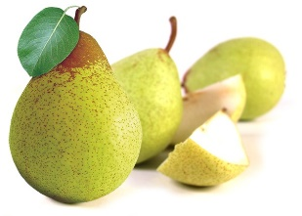
Materials and Methods
Irrigation Water Analysis
Electrical conductivity (EC)
pH
pHs
Cations (Na⁺, K⁺, Ca²⁺, Mg²⁺)
Anions (HCO₃⁻, Cl⁻, SO₄²⁻)
SAR index
LSI
Orchards: 2
Location: Portugal
District: Leiria (in Caldas da Rainha and Alcobaça)
Pyrus communis L.

Slide 4
Results
Proper irrigation practices play a key role in fruit trees and poor management can compromise fruit size and quality
Physical and chemical composition of irrigation waters provide information about effects on:
Crops (toxicity)
Soils (impermeability and/or alkalinization)
Maintenance of irrigation equipment (risk of scaling and corrosion)
Orchard 1 presents higher values of Na⁺, K⁺, SO₄²⁻ and HCO₃⁻ and inferior values of Ca²⁺, Mg²⁺ and Cl⁻ than orchard 2
Orchard 1: Sodium bicarbonate
Orchard 2: Sodium chloride bicarbonate
Figure 1. Classification of the hydrochemical facies of irrigation water (from two Rocha pear orchards) in a Piper's triangular diagram.

Slide 5
Results
Table 1. Values of electrical conductivity (EC), pH, Sodium Adsorption Ratio (SAR) index, pHs and Langelier Saturation Index (LSI) of irrigation waters from two Rocha pear orchards.
Parameter | Orchard 1 | Orchard 2
EC (at 20 °C) | 1211 µS/cm | 1198 µS/cm
pH | 7.4 | 7.5
SAR index | 7.4 | 3.5
pHs | 8.1 | 7.7
LSI | -0.69 | -0.21
Higher values:
- Orchard 1: EC, SAR index, pHs
- Orchard 2: pH, LSI
Figure 2. Water classification for agricultural use in Wilcox diagram of irrigation waters from two Rocha pear orchards.
Uptake of water by roots can be hindered by high salinity values
Salinity hazard: C3
Rocha pear is salt-tolerant
Agricultural use: Similar values of EC but SAR index is superior in orchard 1:
Orchard 1: C3S2
Orchard 2: C3S1
Parameter | Reference
EC | < 3000 µS.cm⁻¹
pH | 6 - 7.5
[Cl⁻] | < 355 mg.L⁻¹
Negative LSI | Waters with non-fouling tendency/ slight propensity for dissolution

Slide 6
Results
Alkalinization hazard: Orchard 2 offers less danger of alkalinization (S1) in comparison to orchard 1 (S2)
Water of orchard 2 has a lower concentration of Na⁺ in comparison to Ca²⁺ and Mg²⁺
Orchard 1 presents higher danger of soil alkalinization, but it may have been minimized by higher Ca levels in the soil compared to orchard 2
Mg and Ca counteract Na, since waters with high values of SAR, can alter the soil → Adsorption of Na to soil particles promotes its hardening/compaction, namely affecting soils with finer textures
Overall, water from both orchards cannot induce toxicity to the crop nor damage the soil in which they are located, and thus perhaps not compromise biofortification routes

Slide 7
Conclusions
Irrigation waters presented a slight difference, namely regarding the alkalinization hazard to the soils
Fluctuation in the ratio of cations (Na, Ca and Mg) in water and ionic balance (soil and the water) should be considered since it could impact the outcome of biofortification trials
Waters of both orchards did not induce toxicity to Rocha pear trees

Slide 8
Acknowledgments
The authors thanks to José Henriques (HBio Lda.) and António Peralta dos Santos for technical assistance on the orchard. We also give thanks to the research centers (GeoBioTec) UIDB/04035/2020, (CEF) UIDB/00239/2020 and Associate Laboratory TERRA (LA/P/0092/2020) for support facilities.
This research was funded by PDR2020, grant number 101-030734. Funding from Fundação para a Ciência e Tecnologia (FCT) UI/BD/150718/2020 is also greatly acknowledged.

