Slide 1

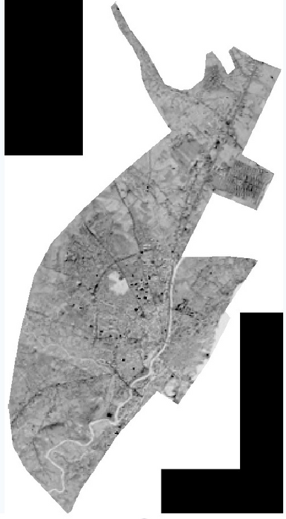
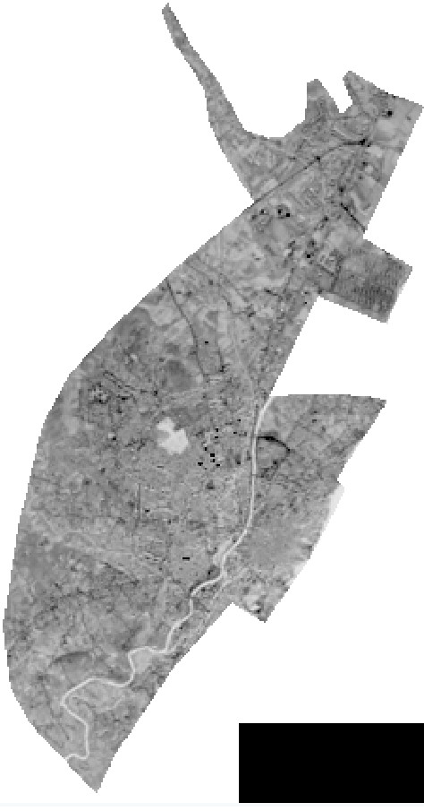
ECRS 2023
THE 5TH INTERNATIONAL ELECTRONIC CONFERENCE ON REMOTE SENSING
7-21 NOVEMBER 2023
“EVALUATION OF EARTHQUAKE DAMAGE IN HATAY/ANTAKYA CITY CENTER BY INVESTIGATION OF SPATIAL CHANGE BETWEEN 2000-2002"
ÖZGECAN MALLI‘1, ALPER ÇABUK‘2
‘1 INSTITUTE OF EARTH AND SPACE SCIENCES, ESKISEHIR TECHNICAL UNIVERSITY, IKI EYLUL CAMPUS, ESKISEHIR, TURKEY; OZGECANMALLI@OGR.ESKISEHIR.EDU.TR
‘2 INSTITUTE OF EARTH AND SPACE SCIENCES, ESKISEHIR TECHNICAL UNIVERSITY, IKI EYLUL CAMPUS, ESKISEHIR, TURKEY; ACABUK@ESKISEHIR.EDU.TR
† PRESENTED AT THE CHAIR OF THE 5TH INTERNATIONAL ELECTRONIC CONFERENCE ON REMOTE SENSING, GERMAN RESEARCH CENTRE FOR GEOSCIENCES, POTSDAM, GERMANY, 7-21 NOVEMBER 2023.

Slide 2
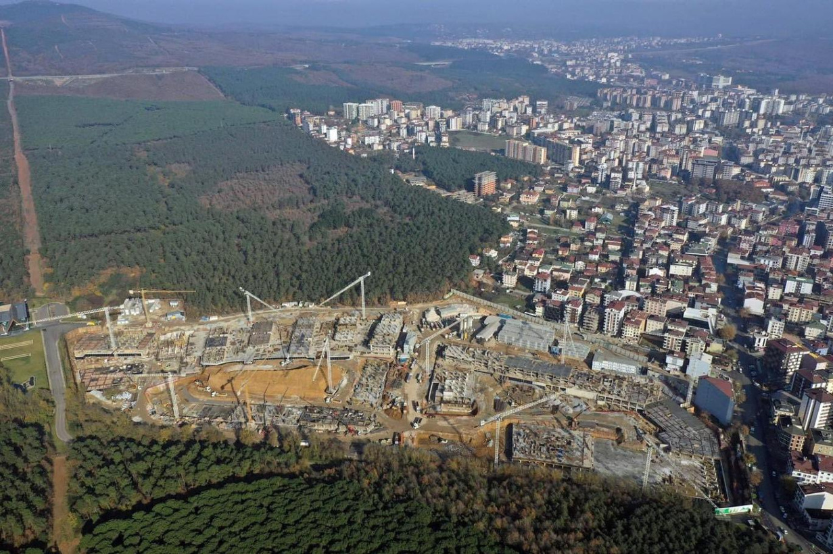
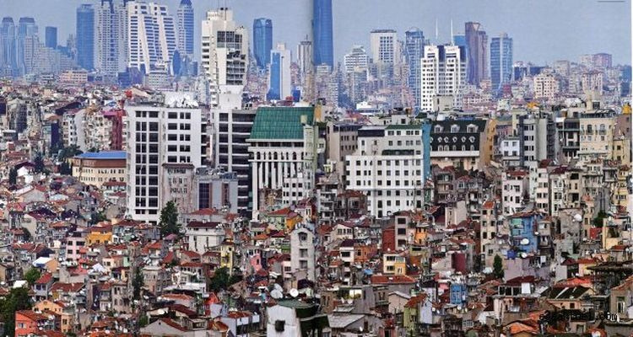
Article:
“Evaluatıon of Earthquake Damage In Hatay/Antakya Cıty Center By Investıgatıon of Spatıal Change Between 2000-2002"
INTRODUCTION
Uncontrolled population growth is viewed as the primary issue driving the rapid urbanisation of Turkey. This has caused the expansion of building projects, particularly in residential zones. As construction demands, technology, and regulations evolve, urban areas are becoming increasingly intricate with varying densities. Numerous buildings are raised in these regions, adhering to diverse regulations, which could render cities more susceptible to calamities. The aim of this study is to find the structures erected from 2000-2002 following the 1997 regulation and assess their state of harm subsequent to the 2023 quake.
2

Slide 3

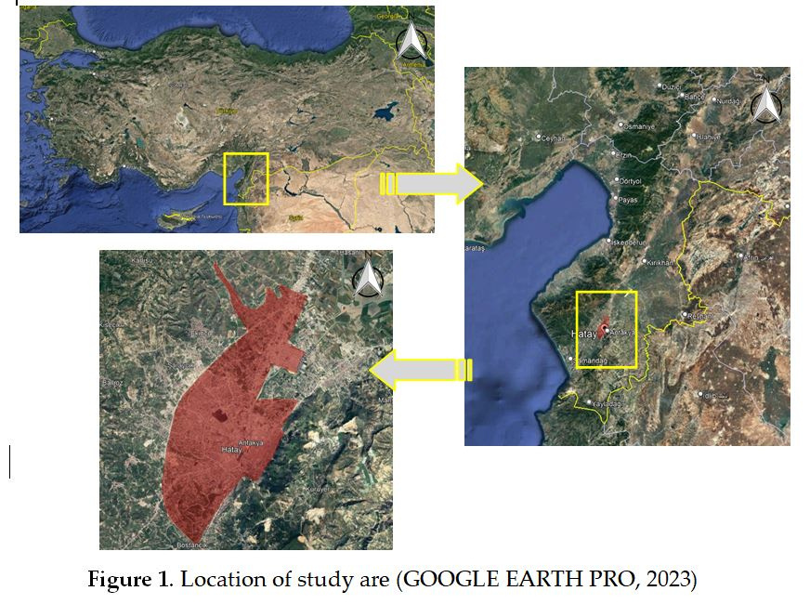
Article:
“Evaluatıon of Earthquake Damage In Hatay/Antakya Cıty Center By Investıgatıon of Spatıal Change Between 2000-2002"
STUDY AREA
The Hatay/Antakya district, located in southern Anatolia, has been chosen as the study area. It lies between the east longitudes of 36° 05' 22.503-36°10'39.342" and the north latitudes of 36° 15' 42.553'' - 36° 10' 29.71'' (UTM Zone 37K - WGS84), as depicted in Figure 1. Antakya is the central district of the Hatay province, covering an area of 21.4 km2. The city's altitude is 85 m from sea level. (Özşahi̇n & Kaymaz, 2015)
3

Slide 4
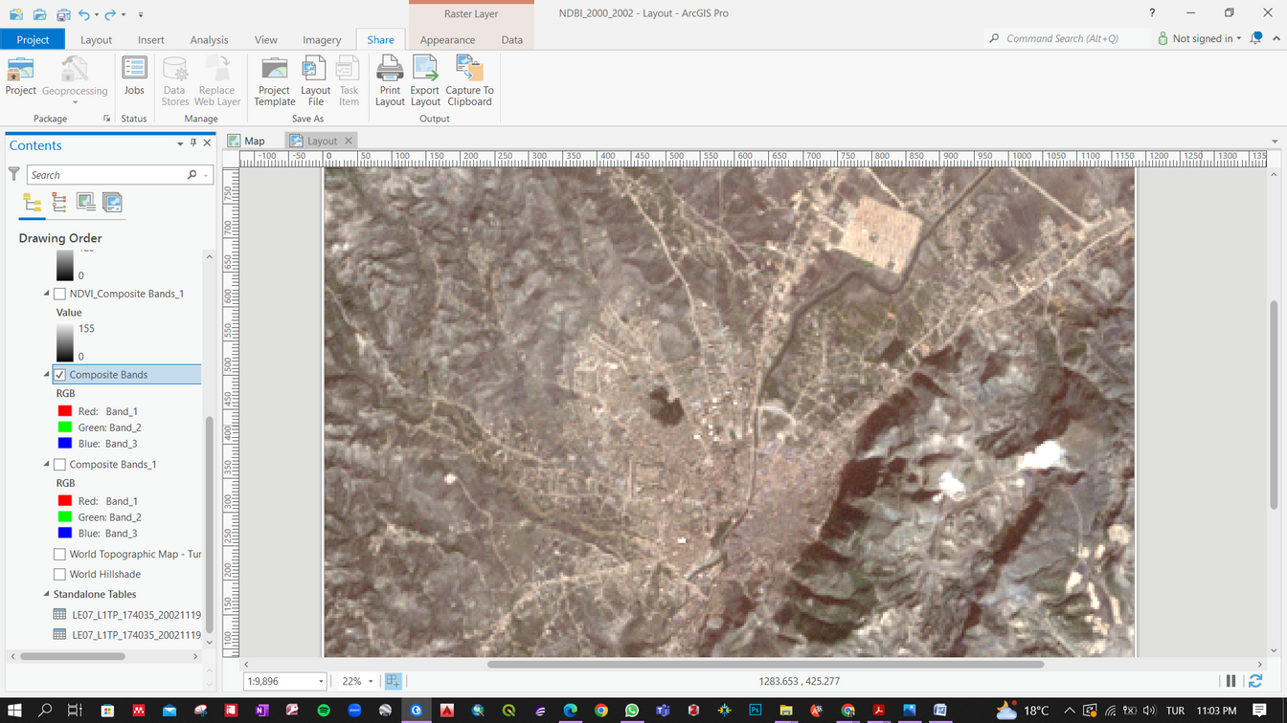
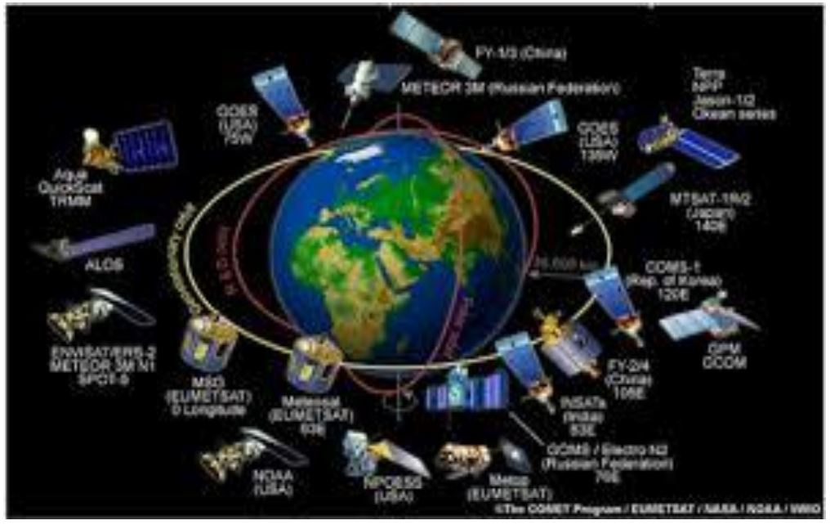
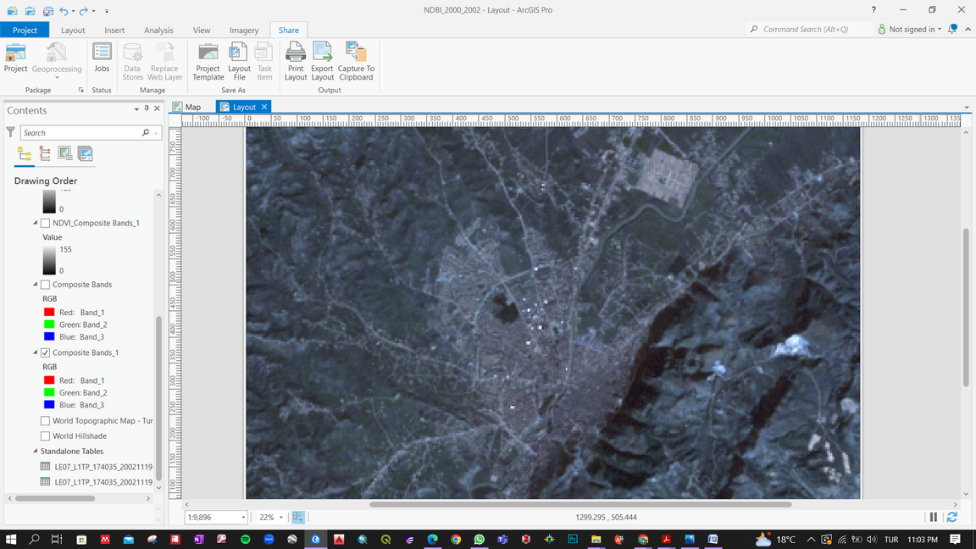
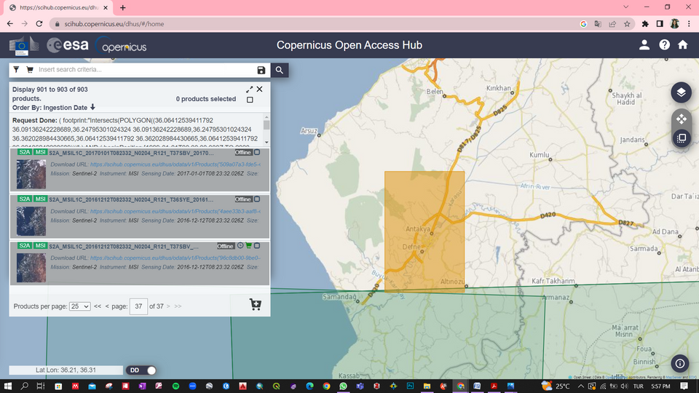
Article:
“Evaluatıon of Earthquake Damage In Hatay/Antakya Cıty Center By Investıgatıon of Spatıal Change Between 2000-2002"
SATELITTE DATA
  LANDSAT 7 :
Landsat 7 imagery acquired on January 14, 2000, and November 19, 2002. The image preprocessing consists of a band composite. (United States Geological Survey (USGS))
  SENTINEL 2 :
SENTINEL 2 imagery from July 19, 2023, was used. (Sentinel Copernicus website)
3

Slide 5
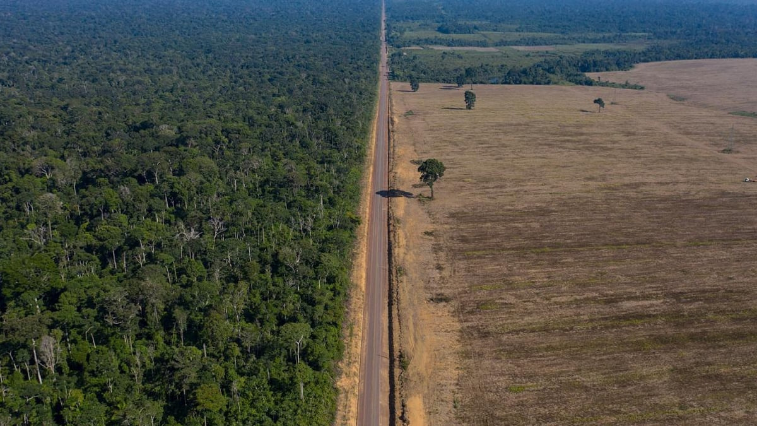
Article:
“Evaluatıon of Earthquake Damage In Hatay/Antakya Cıty Center By Investıgatıon of Spatıal Change Between 2000-2002"
“
METHOD
”
4

Slide 6

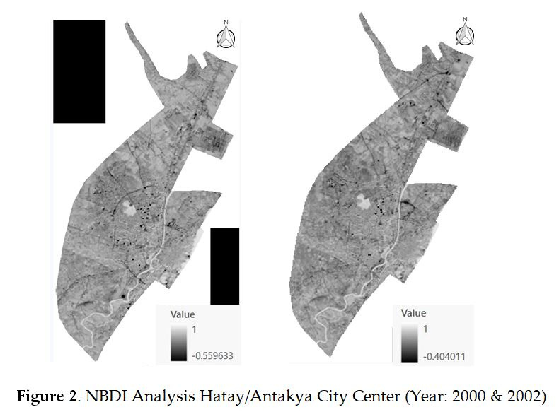
Article:
“Evaluatıon of Earthquake Damage In Hatay/Antakya Cıty Center By Investıgatıon of Spatıal Change Between 2000-2002"
NBDI; (Normalized Difference Built-up Index)
FORMUL;
NBDI = (SWIR – NIR) / (SWIR + NIR)
LANDSAT 7;
NBDI = (Band 5 – Band 4) /
(Band 5 + Band 4)
5

Slide 7
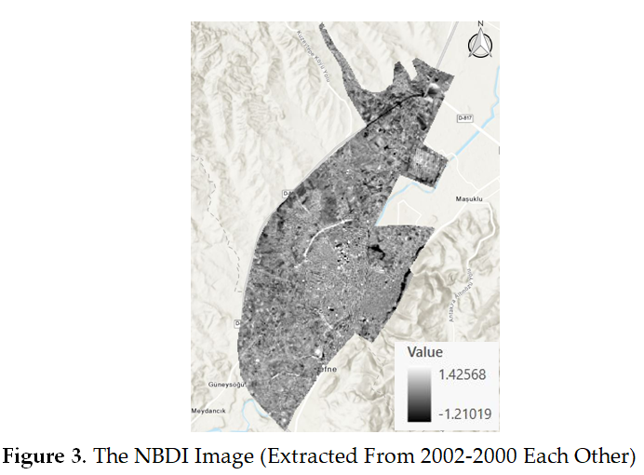
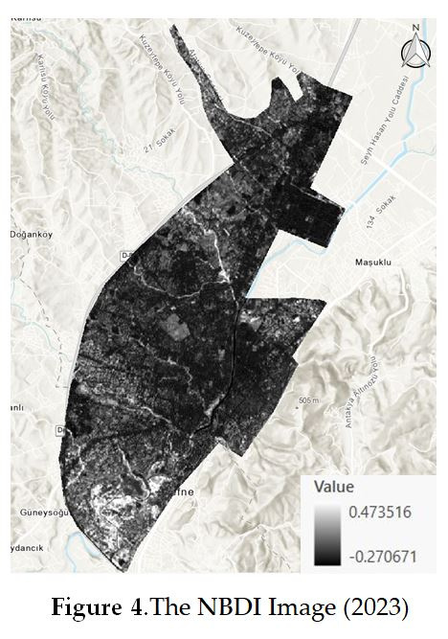
Article:
“Evaluatıon of Earthquake Damage In Hatay/Antakya Cıty Center By Investıgatıon of Spatıal Change Between 2000-2002"
NBDI; (Normalized Difference Built-up Index)
IN FIGURE 3, THE IMAGE RESULTING FROM THE DIFFERENCE BETWEEN THE NBDI IMAGES OF 2002-2000 IS SHOWN.
FIGURE 4 SHOWS THE NBDI CALCULATION PROCESS FOR THE YEAR 2023.
5

Slide 8

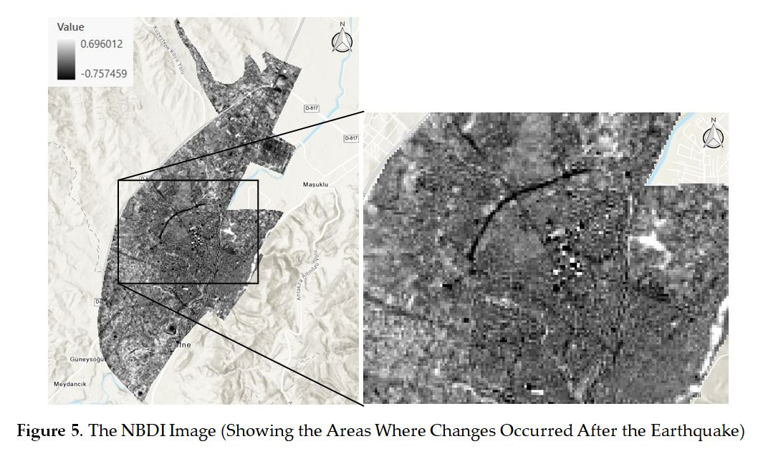
Article:
“Evaluatıon of Earthquake Damage In Hatay/Antakya Cıty Center By Investıgatıon of Spatıal Change Between 2000-2002"
RESULTS & DISCUSSION
6

Slide 9
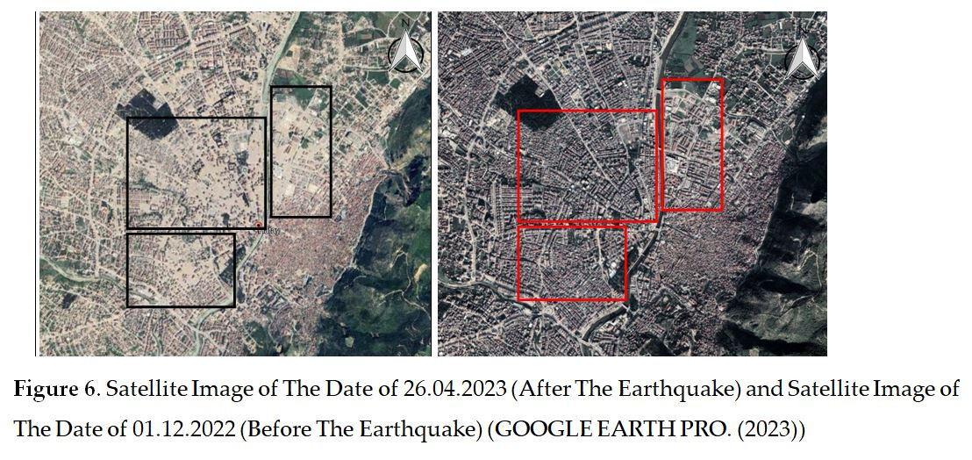
Article:
“Evaluatıon of Earthquake Damage In Hatay/Antakya Cıty Center By Investıgatıon of Spatıal Change Between 2000-2002"
RESULTS & DISCUSSION
6

Slide 10
REFERENCES
1.Kshetri, T. B. (n.d.). NDVI, NDBI AND NDWI CALCULATION USING LANDSAT 7 AND 8.
2.Özşahi̇N, E., & Kaymaz, Ç. K. (2015). Cbs Ve Ahs Kullanilarak Doğal Çevre Bileşenleri Açisindan Kentsel Mekânin Yerleşime Uygunluk Analizine Bir Örnek: Antakya (Hatay). Doğu Coğrafya Dergisi, 20(33), 111. Https://Doi.Org/10.17295/Dcd.52077
3.GOOGLE EARTH PRO. (2023). Retrieved on July 20, 2023
4.GOOGLE EARTH PRO. (2023). Retrieved on September 24, 2023
5.Romaniello, V., Piscini, A., Bignami, C., Anniballe, R., & Stramondo, S. (2017). Earthquake Damage Mapping By Using Remotely Sensed Data: The Haiti Case Study. Journal Of Applied Remote Sensing, 11(1), 016042. Https://Doi.Org/10.1117/1.Jrs.11.016042
22

Slide 11

THANK YOU!
23

