Slide 1



The 5th International Electronic Conference on Remote Sensing
University Abdelmalek Essaâdi
Session 3 : Remote sensing applications
Impact of Varied Conv-LSTM Model Parameters on Prediction Accuracy for NDSI-Based Salinity Index Analysis
Authors :
Naciri Hafssa¹, Nizar Ben Achhab¹, Raissouni Naoufal², Ezzaher Fatima Ezahrae¹.
¹ Mathematics and Intelligent Systems, Abdelmalek Essaâdi University, Tangier, Morocco
Presented by : Hafssa Naciri
7–21 Nov 2023
Notes:
Hello everyone. My name is Hafssa Naciri a PhD student from University Abdelmalek Essaâdi in Morocco. In my presentation, I will discuss the Impact of Varied Conv-LSTM Model Parameters on Prediction Accuracy for NDSI-Based Salinity Index Analysis

Slide 2







Table of
Contents
Introduction
01
Context | Study objectives
Materials
02
Study area | Satellite data | Image processing
03
Methodology
04
Results and discussion
05
Conclusion
ECRS 2023 7-21 November 2023 2/21
Notes:
In this presentation, I’ll be addressing the following points:
I am going to start by an introduction, where I’ll be presenting the context and the main objectives of my study. And then I’ll move to materials including study area, satellite data and image processing and then the Methodology this will lead to the Results and discussion and finally, a conclusion.

Slide 3


Context
Study Objectives
Application domains
Spatio-temporal remotely sensed data
DNN
RNN
CNN
LSTM
Hybrid models
Vegetation forecasting
Biophysical indices: NDVI, EVI, NDWI…
Land Cover Classification
Precipitation
Wildfires prediction
Climate data
Landslide detection
Drought forecasting
Land Surface Temperature (LST)
Crop yield prediction
Soil data
ECRS 2023 7-21 November 2023 3/21
Notes:
Since the advent of data science with the appearance of deep learning, time series analysis has been employed to forecast and identify future patterns and trends along with monitoring and detecting land cover changes. A wide range of models is utilized regarding time series forecasting, which includes machine learning methodologies such as Deep Neural Network (DNN), Convolutional Neural Network (CNN), Recurrent Neural Network (RNN), and Long Short-Term Memory Network (LSTM)

Slide 4
Context
Study Objectives
Vegetation forecasting
Hybrid model
Convolutional Long Short Term Memory (Conv-LSTM)
Normalized Differential Salinity Index (NDSI)
The aims of the study:
Examines the impact of Convolutional Long Short-Term Memory (Conv-LSTM) model parameters on the accuracy of predictions using the Normalized Differential Salinity Index (NDSI) time series.
ECRS 2023 7-21 November 2023 4/21
Notes:
The aim of this research is to examines the impact of Convolutional Long Short-Term Memory (Conv-LSTM) model parameters on prediction accuracy using Normalized Differential Salinity Index (NDSI) time series.

Slide 5



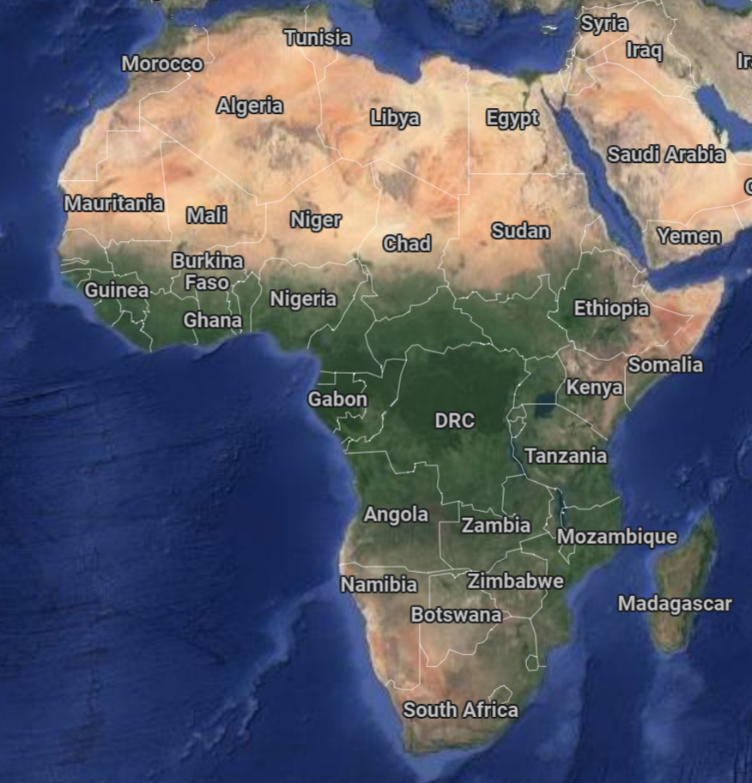
Study area
Satellite Data
Image processing
Tangier-Morocco
African continent (courtesy of google maps)
ECRS 2023 7-21 November 2023 5/21
Notes:
This research centers on region of Tangier, located in northern Morocco

Slide 6
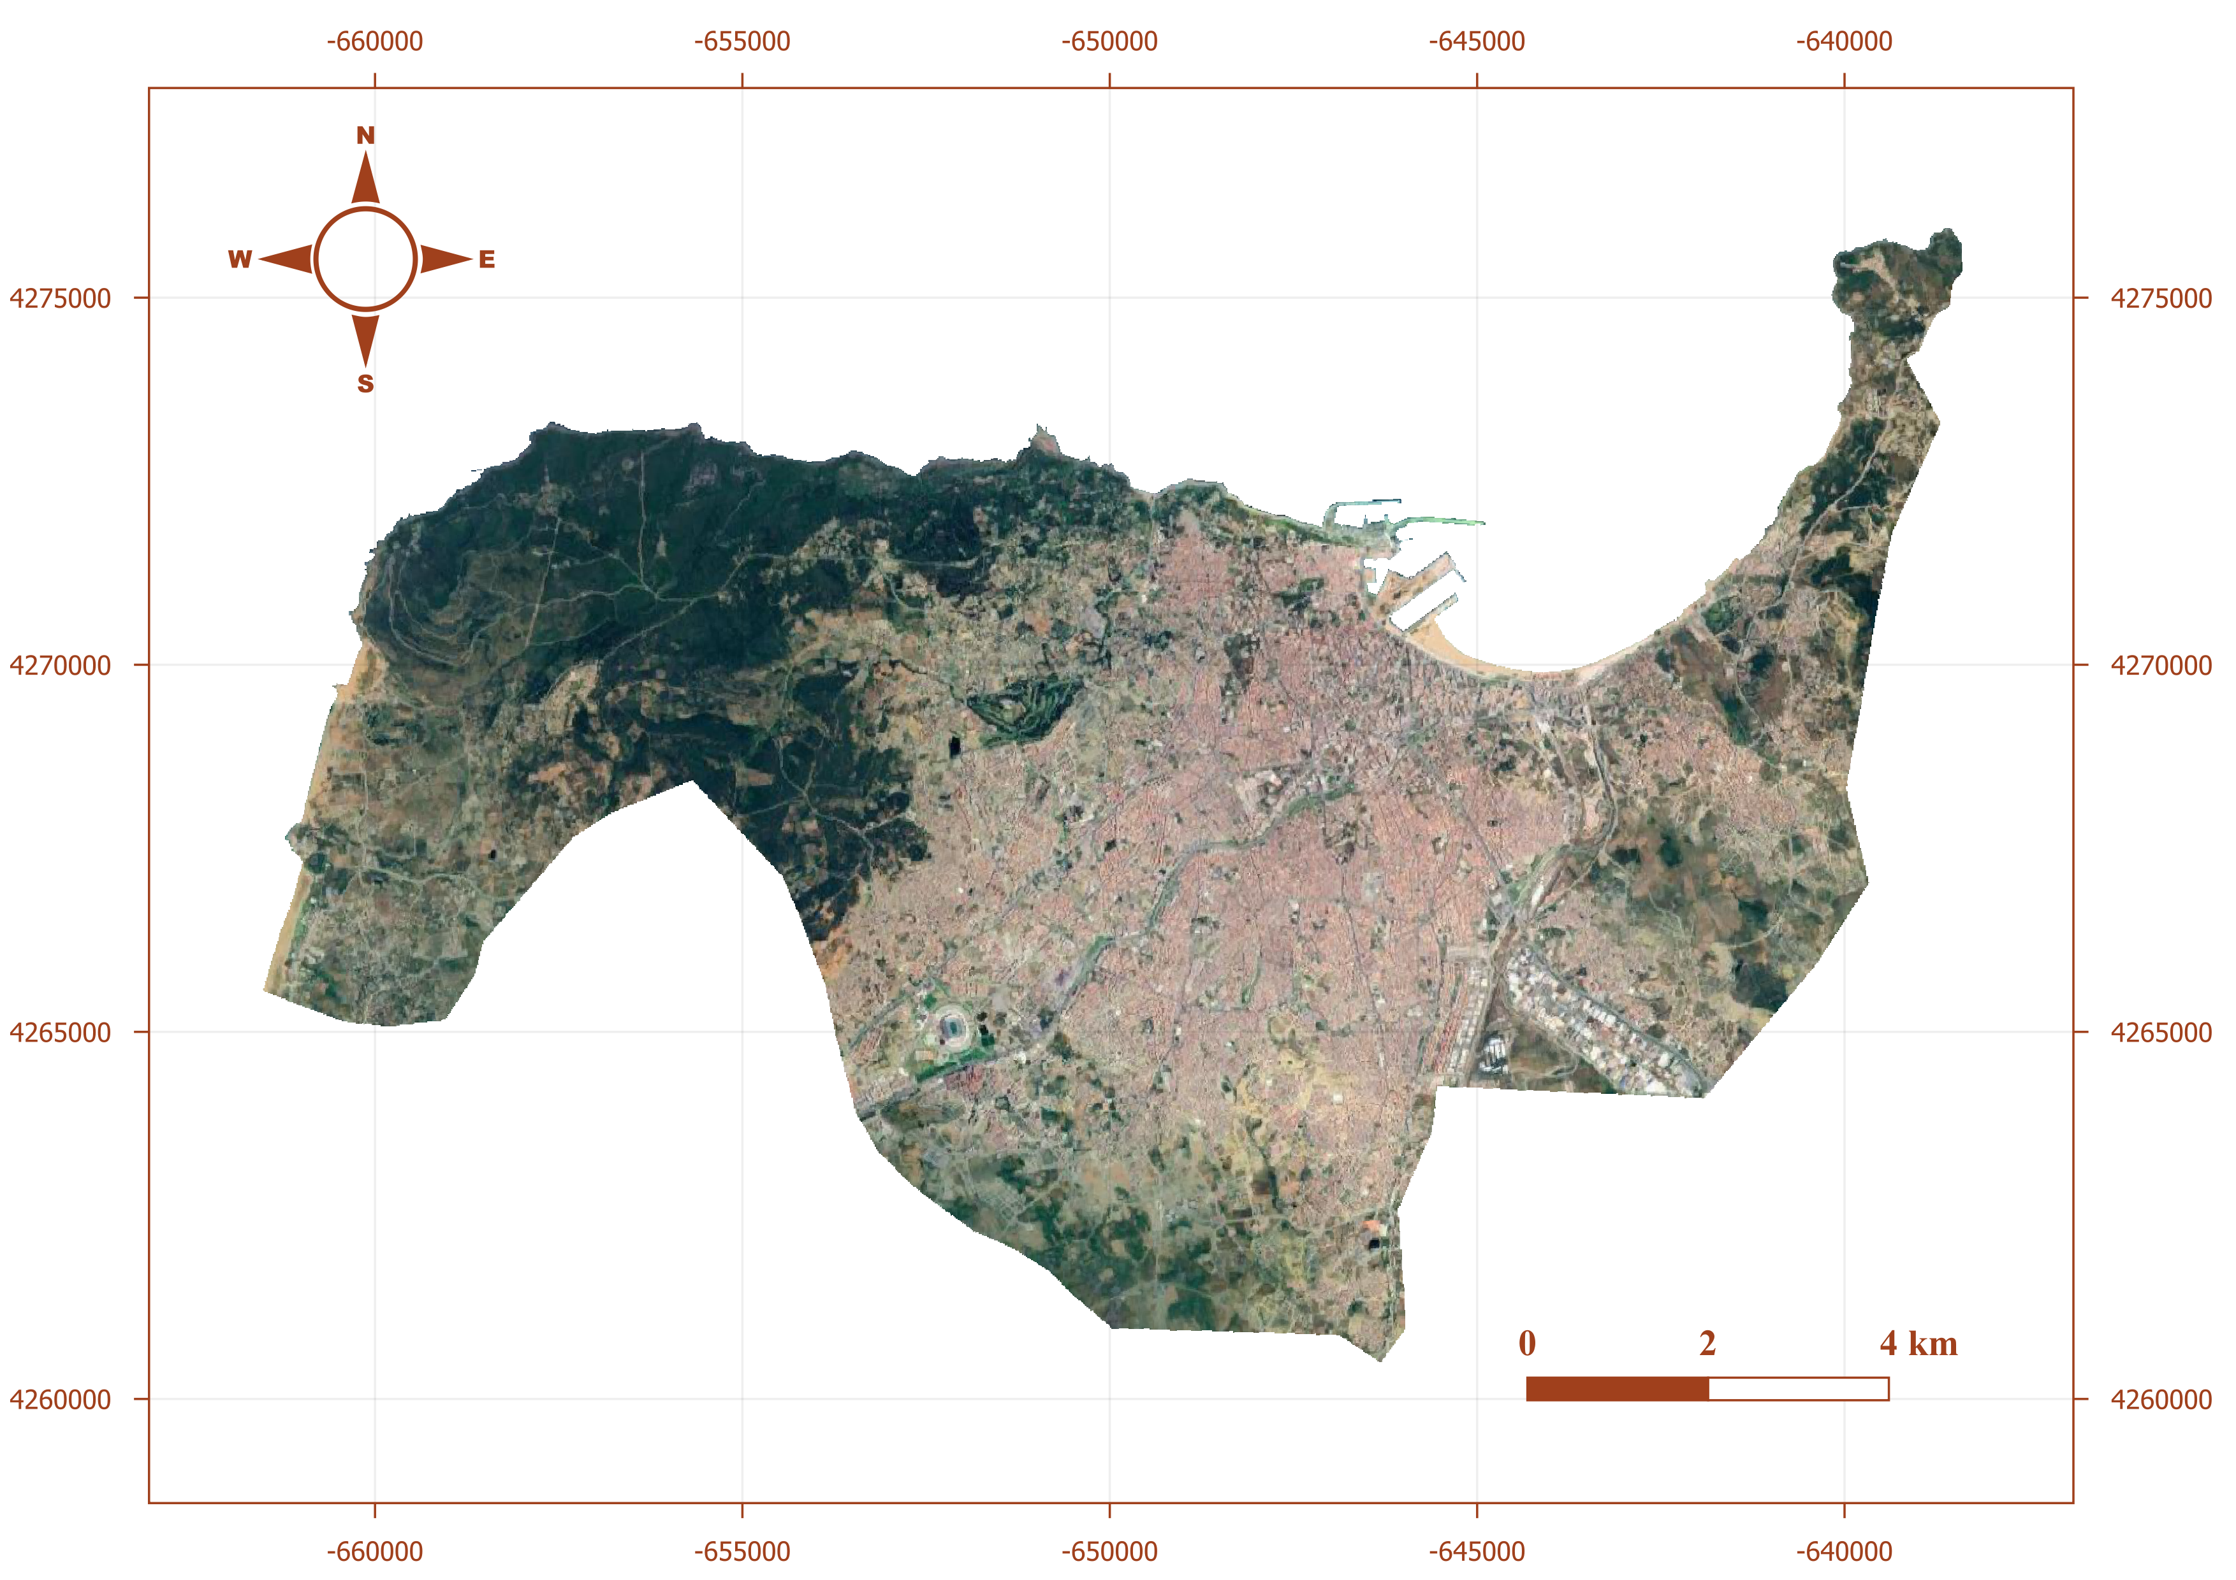
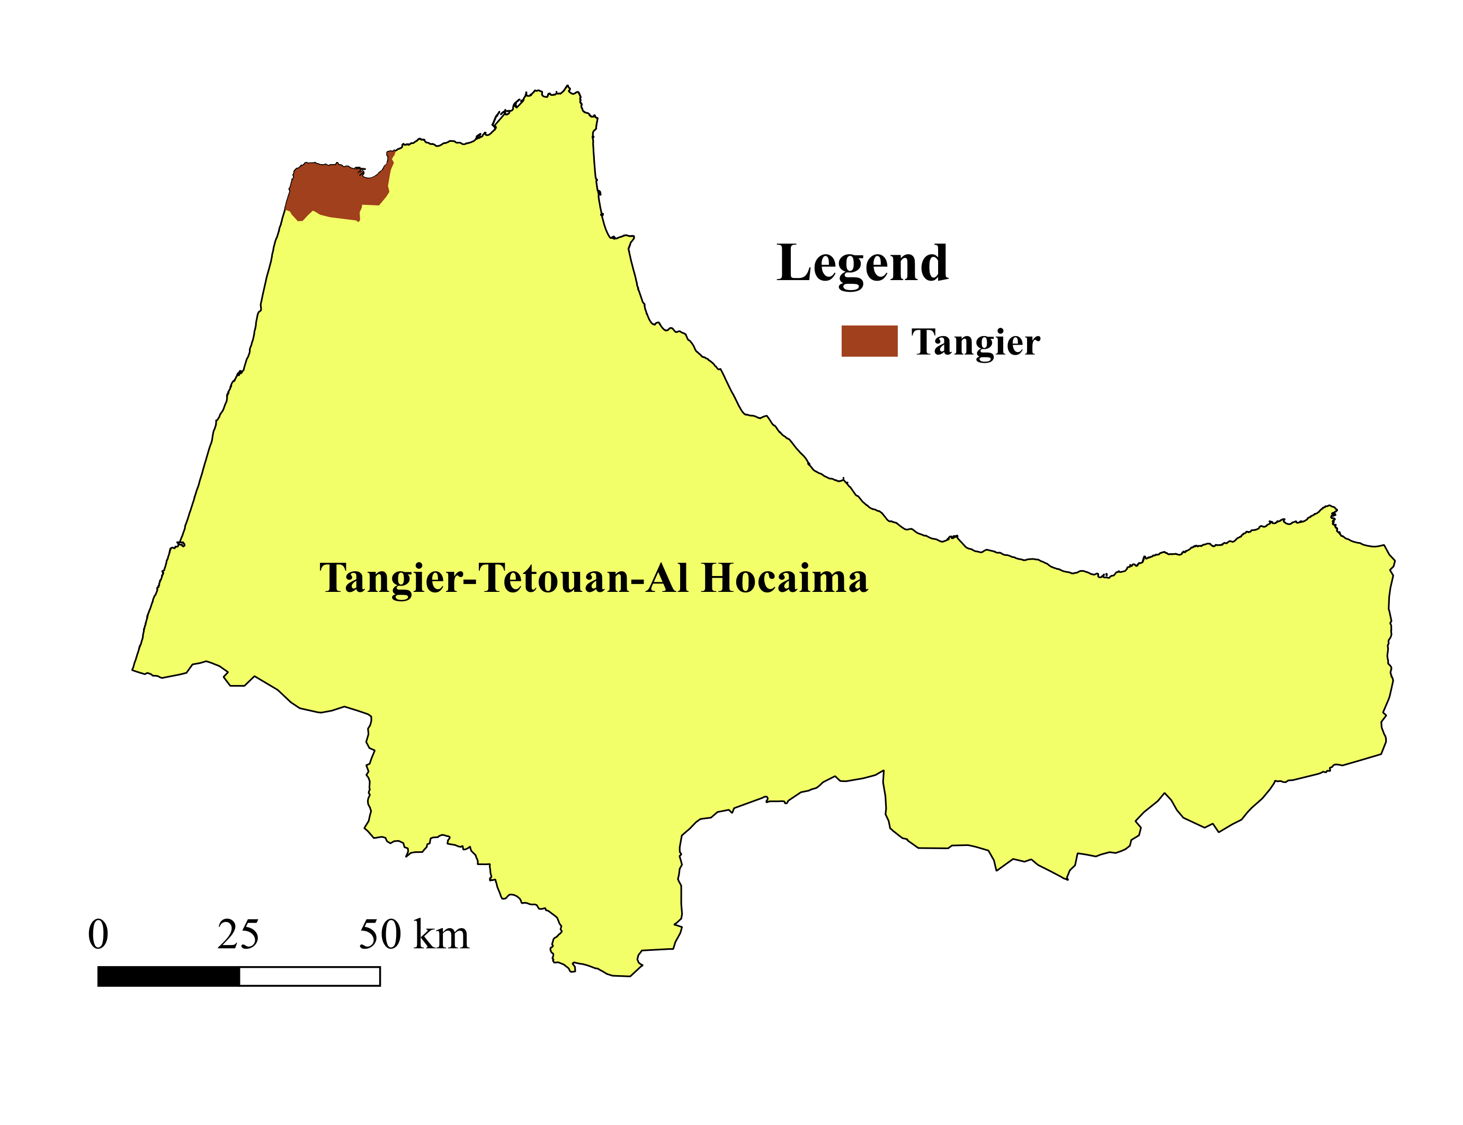
Study area
Satellite Data
Image processing
Tangier-Morocco
Latitude longitude coordinates :
35°46′N and 05°48′W
Total area :
352.5 Km²
ECRS 2023 7-21 November 2023 6/21
Notes:
The city is located in the region of Tangier-Tetouan-Al Hoceima with a total area of 352.5 square kilometers

Slide 7
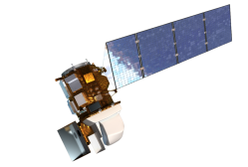

Study area
Satellite Data
Image processing
Landsat-8 characteristics
National Aeronautics and Space Administration
Table: Landsat-8 spectral band characteristics
Band | Resolution | Wavelength (µm) | Description
Band 1 | 30 m | 0.43-0.45 | Coastal aerosol
Band 2 | 30 m | 0.45-0.51 | Blue
Band 3 | 30 m | 0.53-0.59 | Green
Band 4 | 30 m | 0.64-0.67 | Red
Band 5 | 30 m | 0.85-0.88 | Near Infrared (NIR)
Band 6 | 30 m | 1.57-1.65 | SWIR 1
Band 7 | 30 m | 2.11-2.29 | SWIR 2
Band 8 | 15 m | 0.50-0.68 | Panchromatic
Band 9 | 30 m | 1.36-1.38 | Cirrus
Launch Date: February 11, 2013
30m resolution
9 spectral bands
16-day revisit time
RED (Band 4) and NIR (Band 5) reflectance
Landsat 8-9 OLI/TIRS Collection 2 Level-2 Science Products (L2SP)
ECRS 2023 7-21 November 2023 7/21
Notes:
The used data was collected from Landsat-8 satellite, launched by NASA in order to extends the legacy of Earth observation missions initiated by previous Landsat satellites.
The Landsat-8 Multispectral Imager provides 9 spectral Bands with a spatial resolution equal to 30 meters.
In this study we used the RED and Near infrared bands.

Slide 8
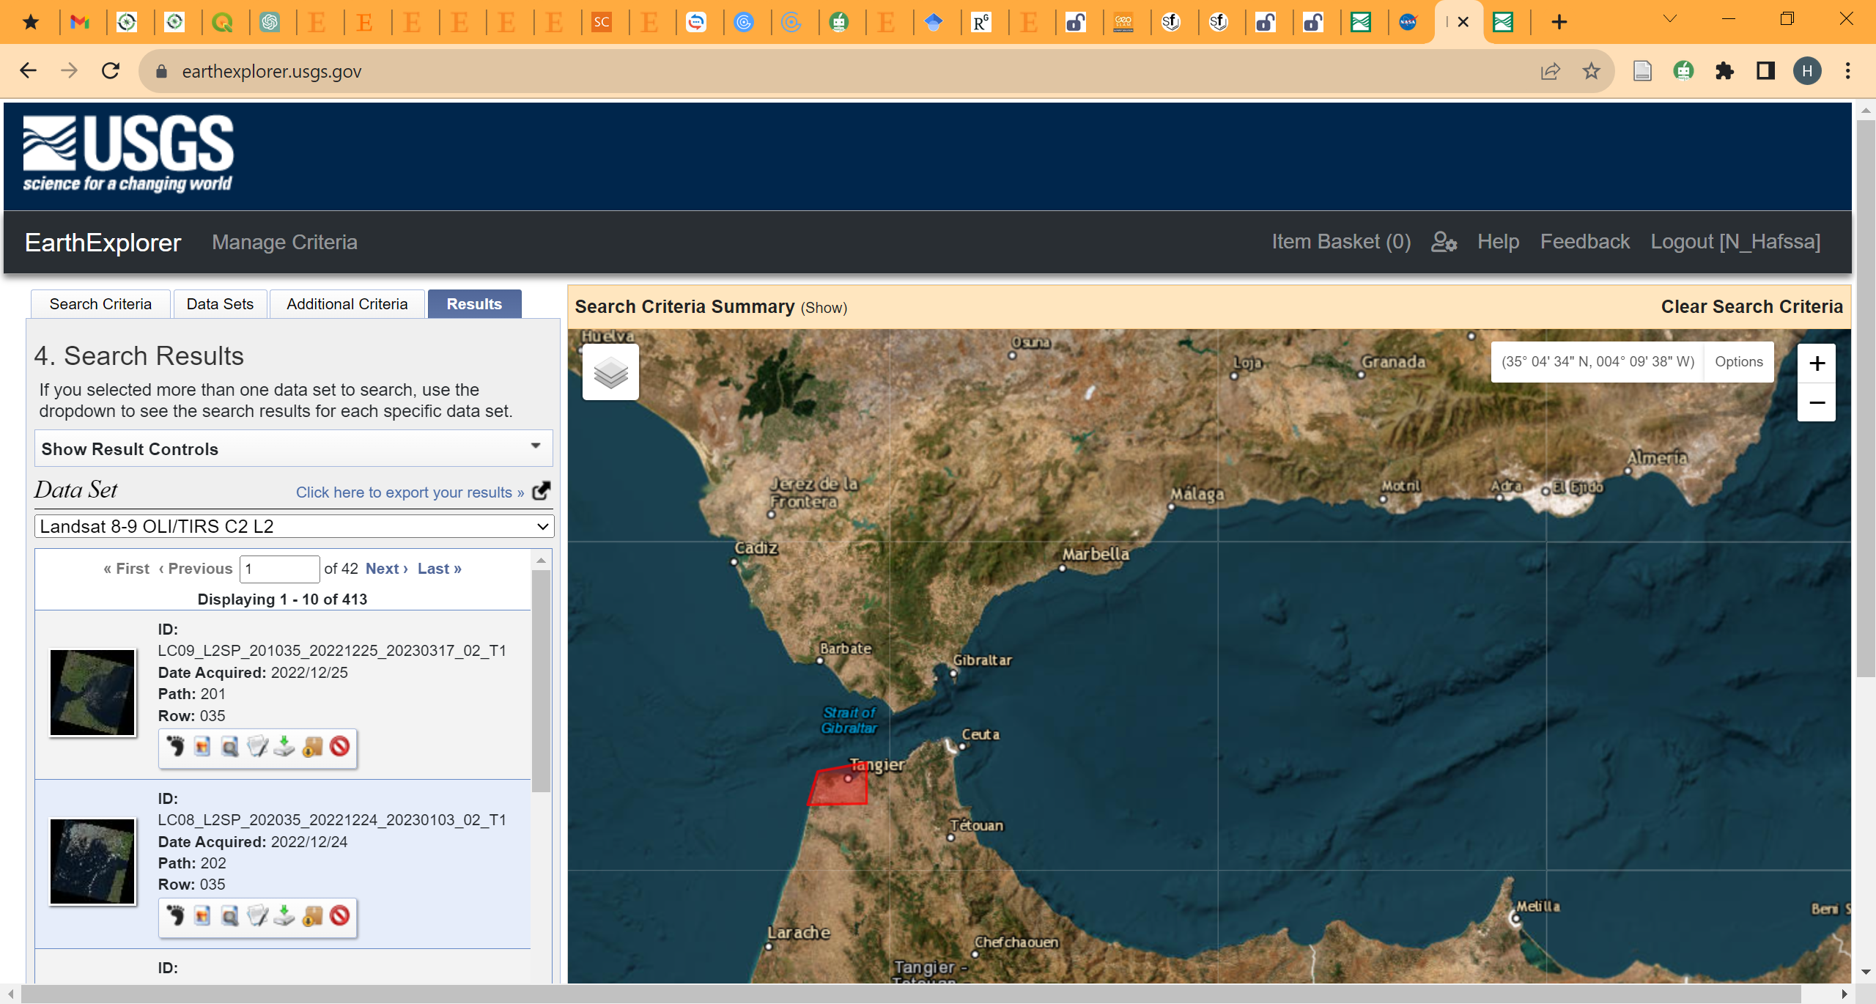
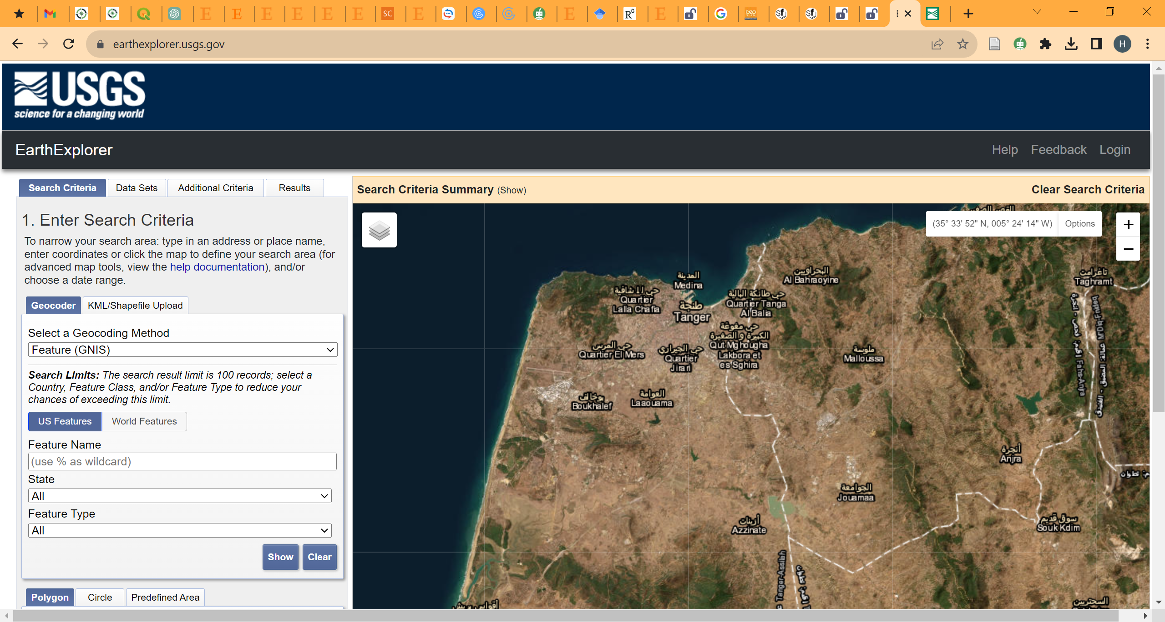
Study area
Satellite Data
Image processing
Image acquisition
https://earthexplorer.usgs.gov/
USGS EarthExplorer
Total Number of images from 2015 to 2022 : 413
ECRS 2023 7-21 November 2023 8/21
Notes:
the images were downloaded from the archives of USGS Earthdata platform

Slide 9
Study area
Satellite Data
Image processing
Image acquisition
Seasons
 | Winter | Spring | Summer | Autumn
2015 | 03/01/2015 | 02/04/2015 | 07/07/2015 | 09/09/2015
2016 | 31/01/2016 | 27/04/2016 | 09/07/2016 | 27/09/2016
2017 | 17/01/2017 | 07/04/2017 | 19/07/2017 | 30/09/2017
2018 | 11/01/2018 | 17/04/2018 | 06/07/2018 | 24/09/2018
2019 | 07/01/2019 | 13/04/2019 | 18/07/2019 | 27/09/2019
2020 | 01/01/2020 | 01/05/2020 | 04/07/2020 | 22/09/2020
2021 | 12/01/2021 | 18/04/2021 | 07/07/2021 | 02/10/2021
2022 | 06/01/2022 | 06/05/2022 | 10/07/2022 | 27/09/2022
Years
Number of used images : 32
ECRS 2023 7-21 November 2023 9/21
Notes:
In this study, four images for each year were selected, each representing one of the four seasons (Winter, Spring, Summer, and Autumn)
32 images where used in this study

Slide 10
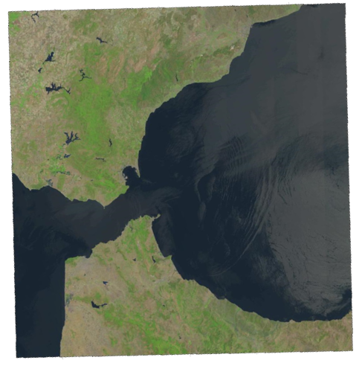
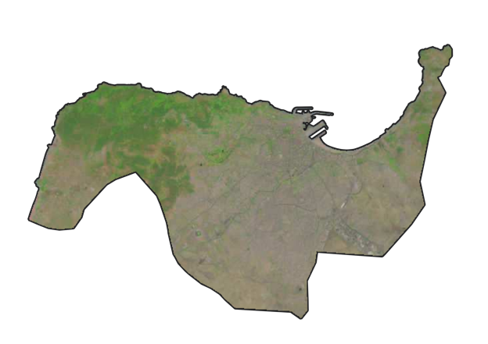


Study area
Satellite Data
Image processing
Landsat 8-9 RGB images from 2015 to 2022
Tangier region RGB images from 2015 to 2022
Atmospheric correction
Cloud removal
Masking
NDSI computing
…
…
ECRS 2023 7-21 November 2023 10/21
Notes:
After obtaining our images, we moved to the processing phase.
Firslty, the used landsat product was atmospheric correction and then we corrected the cloudy images. After that we masked the region of our study and then we computed NDSI index.
Image processing was conducted in the QGIS open-source platform for geographic information system (GIS) applications

Slide 11
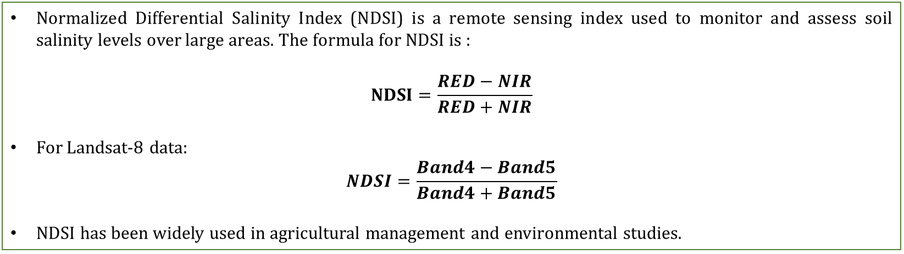
Study area
Satellite Data
Image processing
Normalized Differential Salinity Index (NDSI)
Normalized Differential Salinity Index (NDSI) is a remote sensing index used to monitor and assess soil salinity levels over large areas. The formula for NDSI is :
$$NDSI=\frac{RED−NIR}{RED+NIR}$$
For Landsat-8 data:
$$NDSI=\frac{Band4−Band5}{Band4+Band5}$$
NDSI has been widely used in agricultural management and environmental studies.
ECRS 2023 7-21 November 2023 11/21
Notes:
So, the Normalized Differential Salinity Index (NDSI) is a remote sensing index used to monitor and assess soil salinity levels over large areas.
NDSI is calculated using the RED and near-infrared (NIR) bands which is band 4 and band 5 for landsat data.
This index is widely used in agricultural management and environmental studies.

Slide 12
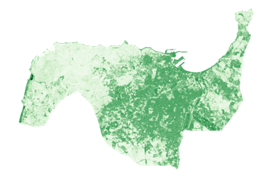
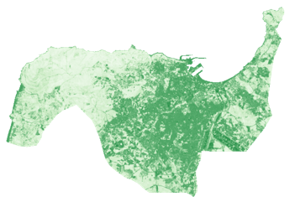

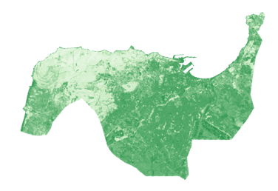
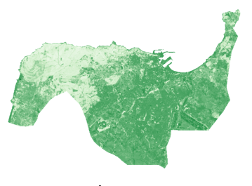
Study area
Satellite Data
Image processing
Example: Images of NDSI variation in Tangier region across the seasons of 2022
Winter season
Spring season
Summer season
Autumn season
ECRS 2023 7-21 November 2023 12/21
Notes:
This is an example of computed NDSI Images in Tangier region across the seasons of 2022.

Slide 13
Study area
Satellite Data
Image processing
NDSI Time Series
ECRS 2023 7-21 November 2023 13/21
Notes:
And this graph represent the used Time series for forecasting

Slide 14








Model Configuration
Model parametrization
1.Define Data Source
2.Preprocessing Data
3.Split Data
Numpy
Pandas libraries
Scikit-learn library
Training
Testing Sets
4.Conv-LSTM Model building
5.Visualize Results
Keras library with
Tensorflow
Matplotlib library
ECRS 2023 7-21 November 2023 14/21
Notes:
The model was developed using essential Python libraries, including NumPy [9], Pandas [10], and Keras [11]. To begin, the time series data for forecasting was imported using the Pandas library. Then, data preprocessing was conducted, involving data cleaning and normalization. Following this preprocessing step, the data was divided into training and testing sets. Typically, the training set is utilized to train the Conv-LSTM model, while the testing set is employed to assess the model's performance. The Conv-LSTM model was constructed using the Keras library, consisting of two layers. And the results where visualized using matplotlib library.

Slide 15
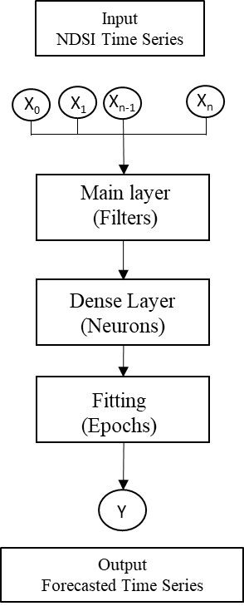
Model Configuration
Model parametrization
Con-LSTM model parameters:
Number of Filter : ranging from 10 to 100 with increments of 10, and from 100 to 1000 with increments of 100.
Number of Neurons : range of 10 to 100 neurons.
Number of Epochs : 10, 50, and 100
ECRS 2023 7-21 November 2023 15/21
Notes:
To analyze the impact of critical parameters on the performance of the Conv-LSTM model and its predictive accuracy, we configured the model using three key parameters. First, the number of filters in the main layer was manipulated to assess its influence on the model ability to capture temporal patterns and spatial features. The filter count was systematically varied, ranging from 10 to 100 with increments of 10, and from 100 to 1000 with increments of 100. Next, the number of neurons in the fully connected (dense) layer was held constant at a range of 10 to 100 neurons. Finally, we investigated the role of the number of training epochs, which dictates the number of iterations the model undergoes while learning from the dataset. This parameter was varied across three values: 10, 50, and 100, representing low, medium, and high numbers of epochs, respectively.

Slide 16


Forecasting accuracy variations
Calculated accuracy R² using Epochs=50
Filters | Neurons
 | 10 | 20 | 30 | 40 | 50 | 60 | 70 | 80 | 90 | 100
10 | 0.04 | 0.29 | 0.25 | 0.41 | 0.32 | 0.44 | 0.42 | 0.54 | 0.59 | 0.44
20 | 0.11 | 0.4 | 0.25 | 0.48 | 0.41 | 0.56 | 0.6 | 0.61 | 0.68 | 0.58
30 | 0.11 | 0.41 | 0.29 | 0.43 | 0.56 | 0.48 | 0.56 | 0.59 | 0.79 | 0.72
40 | 0.32 | 0.46 | 0.5 | 0.4 | 0.56 | 0.57 | 0.67 | 0.61 | 0.82 | 0.79
50 | 0.33 | 0.42 | 0.53 | 0.59 | 0.53 | 0.68 | 0.65 | 0.64 | 0.76 | 0.85
60 | 0.47 | 0.6 | 0.64 | 0.67 | 0.57 | 0.73 | 0.65 | 0.83 | 0.82 | 0.82
70 | 0.29 | 0.63 | 0.64 | 0.77 | 0.78 | 0.85 | 0.61 | 0.89 | 0.82 | 0.88
80 | 0.47 | 0.52 | 0.66 | 0.81 | 0.73 | 0.81 | 0.73 | 0.81 | 0.83 | 0.85
90 | 0.59 | 0.59 | 0.79 | 0.76 | 0.76 | 0.8 | 0.74 | 0.9 | 0.88 | 0.89
100 | 0.4 | 0.71 | 0.73 | 0.79 | 0.83 | 0.86 | 0.86 | 0.95 | 0.86 | 0.96
200 | 0.67 | 0.94 | 0.94 | 0.92 | 0.94 | 0.97 | 0.96 | 0.96 | 0.97 | 0.96
300 | 0.82 | 0.95 | 0.93 | 0.95 | 0.96 | 0.96 | 0.97 | 0.97 | 0.95 | 0.96
400 | 0.81 | 0.95 | 0.95 | 0.96 | 0.95 | 0.96 | 0.96 | 0.96 | 0.96 | 0.96
500 | 0.92 | 0.95 | 0.96 | 0.96 | 0.95 | 0.96 | 0.96 | 0.96 | 0.96 | 0.96
600 | 0.89 | 0.94 | 0.95 | 0.96 | 0.96 | 0.96 | 0.96 | 0.96 | 0.96 | 0.96
700 | 0.95 | 0.95 | 0.96 | 0.95 | 0.96 | 0.96 | 0.95 | 0.95 | 0.95 | 0.95
800 | 0.95 | 0.95 | 0.95 | 0.96 | 0.96 | 0.96 | 0.95 | 0.96 | 0.95 | 0.95
900 | 0.95 | 0.96 | 0.96 | 0.95 | 0.95 | 0.95 | 0.95 | 0.95 | 0.95 | 0.95
1000 | 0.95 | 0.95 | 0.95 | 0.96 | 0.95 | 0.95 | 0.95 | 0.95 | 0.95 | 0.95
ECRS 2023 7-21 November 2023 16/21
Notes:
These variations allowed us to explore the model performance under different training scenarios and ascertain how each parameter influenced the accuracy of predictions.
The accuracy was calculated using the coefficient of determination metric.
This table represent the values of coefficient of determination with 50 epochs

Slide 17
Forecasting accuracy variations
Scenario 1:
ECRS 2023 7-21 November 2023 17/21
Notes:
The results provide valuable insights into the interaction between Conv-LSTM model parameters and the accuracy of NDSI analysis.
In the first scenario, low epoch count (i.e., epochs=10) was employed, the initial accuracy was in the negative range. Nevertheless, this challenge was effectively addressed by introducing a substantial number of filters in the main layer, counting up to 10,000. This infusion of a high filter count yielded positive accuracy outcomes exceeding 60%. These findings underscore the compensatory effect of a substantial filter count in qualifying the limitations posed by a limited number of training epochs.

Slide 18
Forecasting accuracy variations
Scenario 2:
ECRS 2023 7-21 November 2023 18/21
Notes:
In the scenario of medium number of epochs, the observed fluctuations in accuracy were more pronounced. Notably, the accuracy was influenced by the number of filters in the main layer. Specifically, when the filter count ranged between 10 and 100, accuracy levels remained below 60%. However, with an escalation in the filter count, accuracy demonstrated a notable upward trajectory, ultimately reaching a plateau at 96%.

Slide 19
Forecasting accuracy variations
Scenario 3:
ECRS 2023 7-21 November 2023 19/21
Notes:
And finally, in high epochs number, prediction accuracy exhibited remarkable stability, consistently hovering around 97% regardless of variations in filter counts and neuron numbers. This stability suggests that, beyond a certain point, increasing the number of epochs yields diminishing returns in terms of accuracy enhancement.

Slide 20


Study Focus: Conv-LSTM model for NDSI analysis
Data Source: Landsat-8 remote sensing data
Examined Parameters:
  Number of filters in the main layer
  Number of neurons in the dense layer
  Number of training epochs
Key Findings:
  Relationship between parameters and prediction accuracy
  Varied model accuracy dynamics
  Rapid saturation at 97% with 100 epochs and 80-100 neurons
  Higher filter count (10,000) for saturation with 10 epochs
ECRS 2023 7-21 November 2023 20/21
Notes:
So, to conclude. In this study, Convolutional Long Short-Term Memory (Conv-LSTM) model performance was explored in the context of Normalized Differential Salinity Index (NDSI) analysis. Employing remote sensing data from Landsat-8, impact of three pivotal model parameters was studied: number of filters in the main layer, number of neurons in the fully connected (dense) layer, and number of training epochs.
The findings of this research shed light on the relationship between these parameters and prediction accuracy. Under varying conditions, interesting dynamics in model accuracy were observed. As a result, forecasting accuracy showed an upward trend, although with different speed. The model rapidly reached saturation in 97% with a high number of epochs and neurons. On the other hand, achieving saturation in scenarios with a low number of epochs necessitated a substantially higher filter count in main layer.

Slide 21
Thank you
ECRS 2023 7-21 November 2023 21/21
Notes:
And thank you for your attention.

