Slide 1
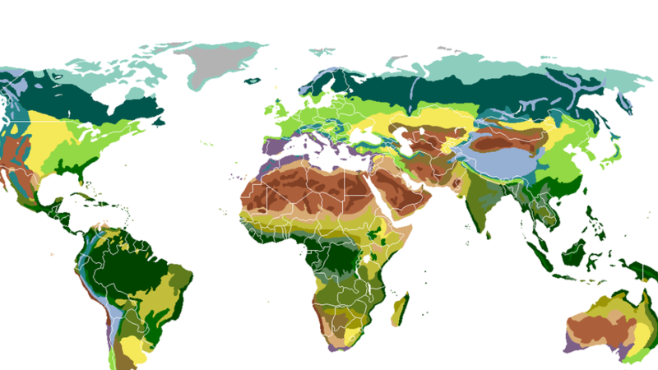


Landsat-8 satellite Imagery to Assess Mediterranean Forests Fire Impact on Land Surface Temperature and Vegetation
The 5th International Electronic Conference on Remote Sensing
UNIVERSITY ABDELMALEK ESSAÂDI
07 – 21 NOV 2023
S3 – Remote sensing applications
Authors :
Fatima Ezahrae Ezzaher ¹, Nizar Ben Achhab ¹, Naoufal Raissouni ² , Hafssa Naciri ¹, Abdelilah Aziyat ¹
¹ Mathematics and Intelligent Systems (MASI), University Abdelmalek Essaâdi, Morocco.
² Remote Sensing, Systems and Telecommunications (TST), Abdelmalek Essaadi University, Morocco

Slide 2








INTRODUCTION

Slide 3


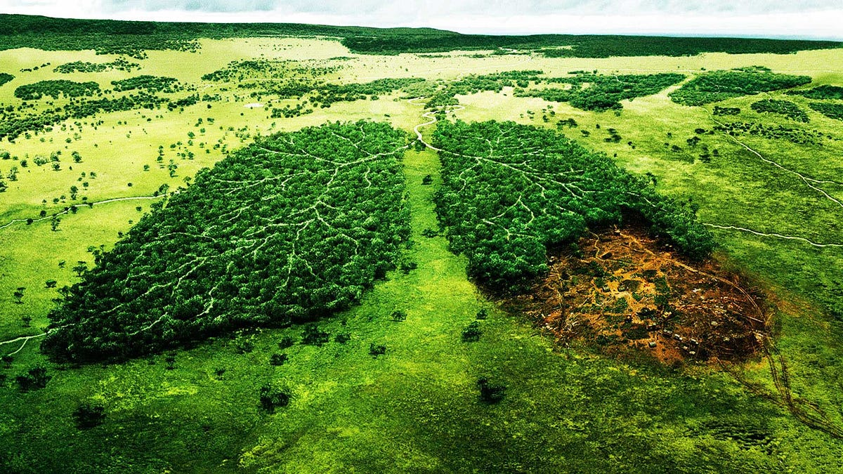



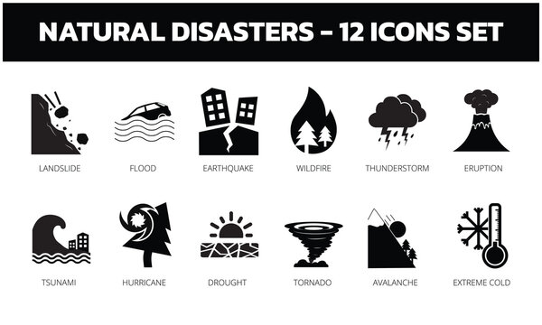
Aim
Context
Essential component of Earth’s ecosystems
It serves both environment and humans
forests serve as natural air purifiers
Protect us from natural disasters
Improve our overall quality of life

Slide 4
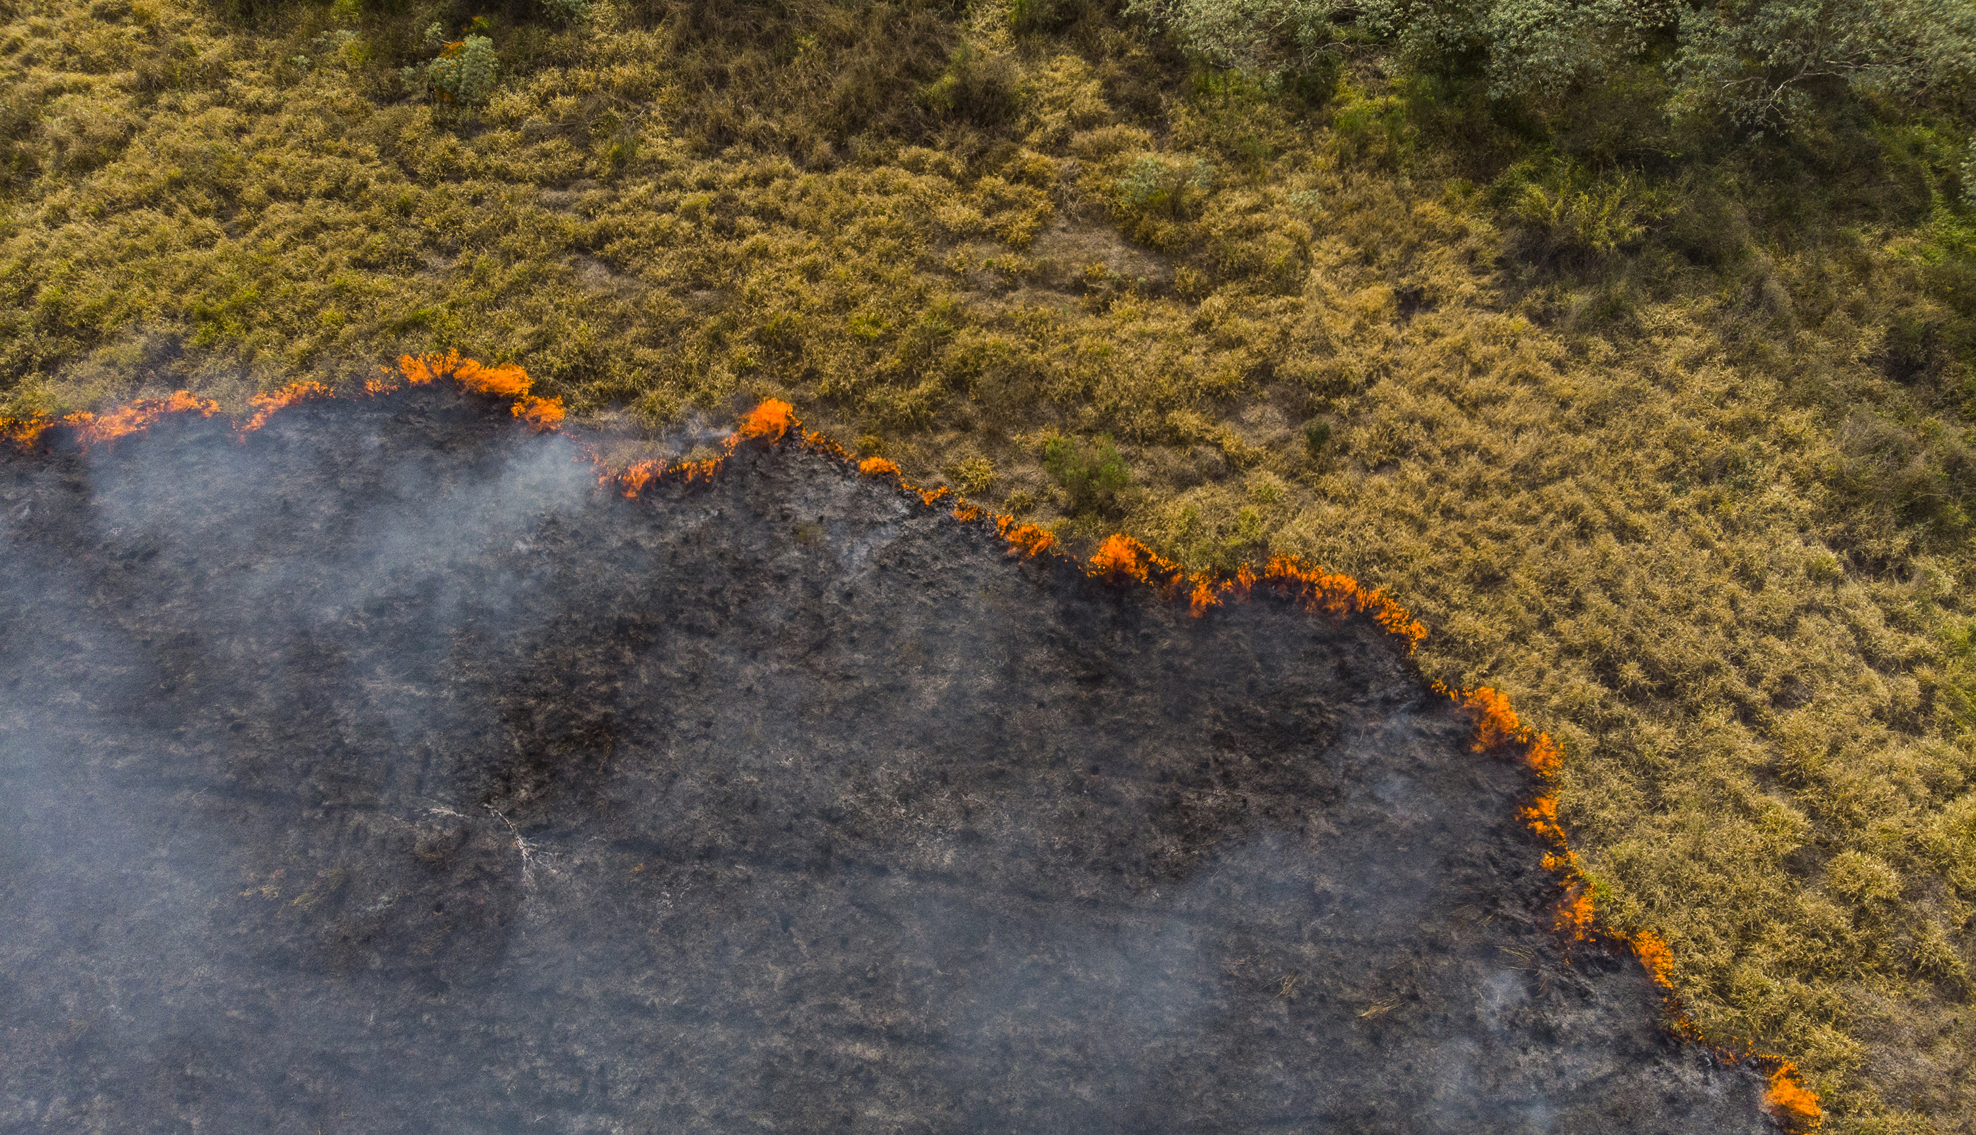
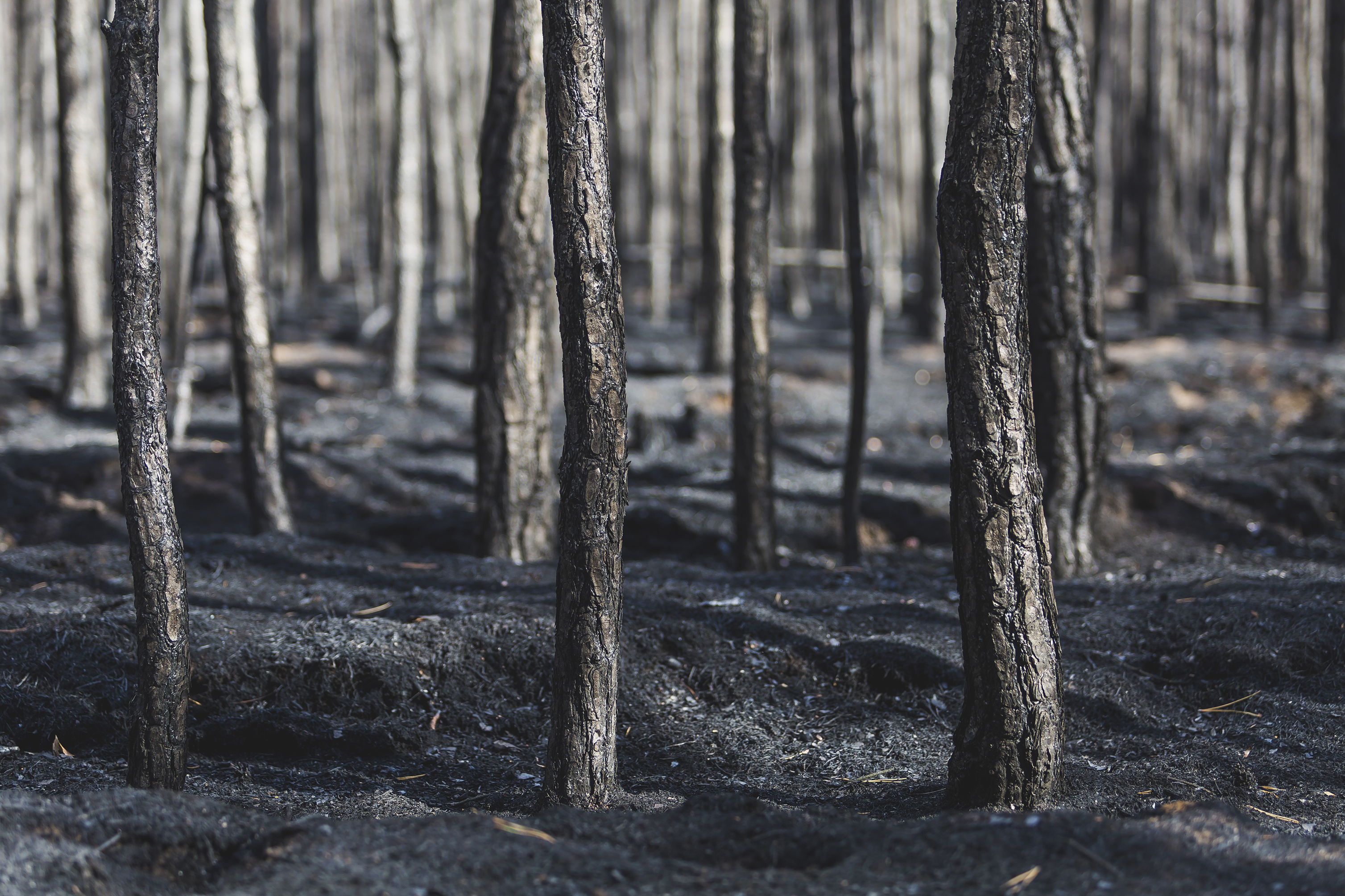
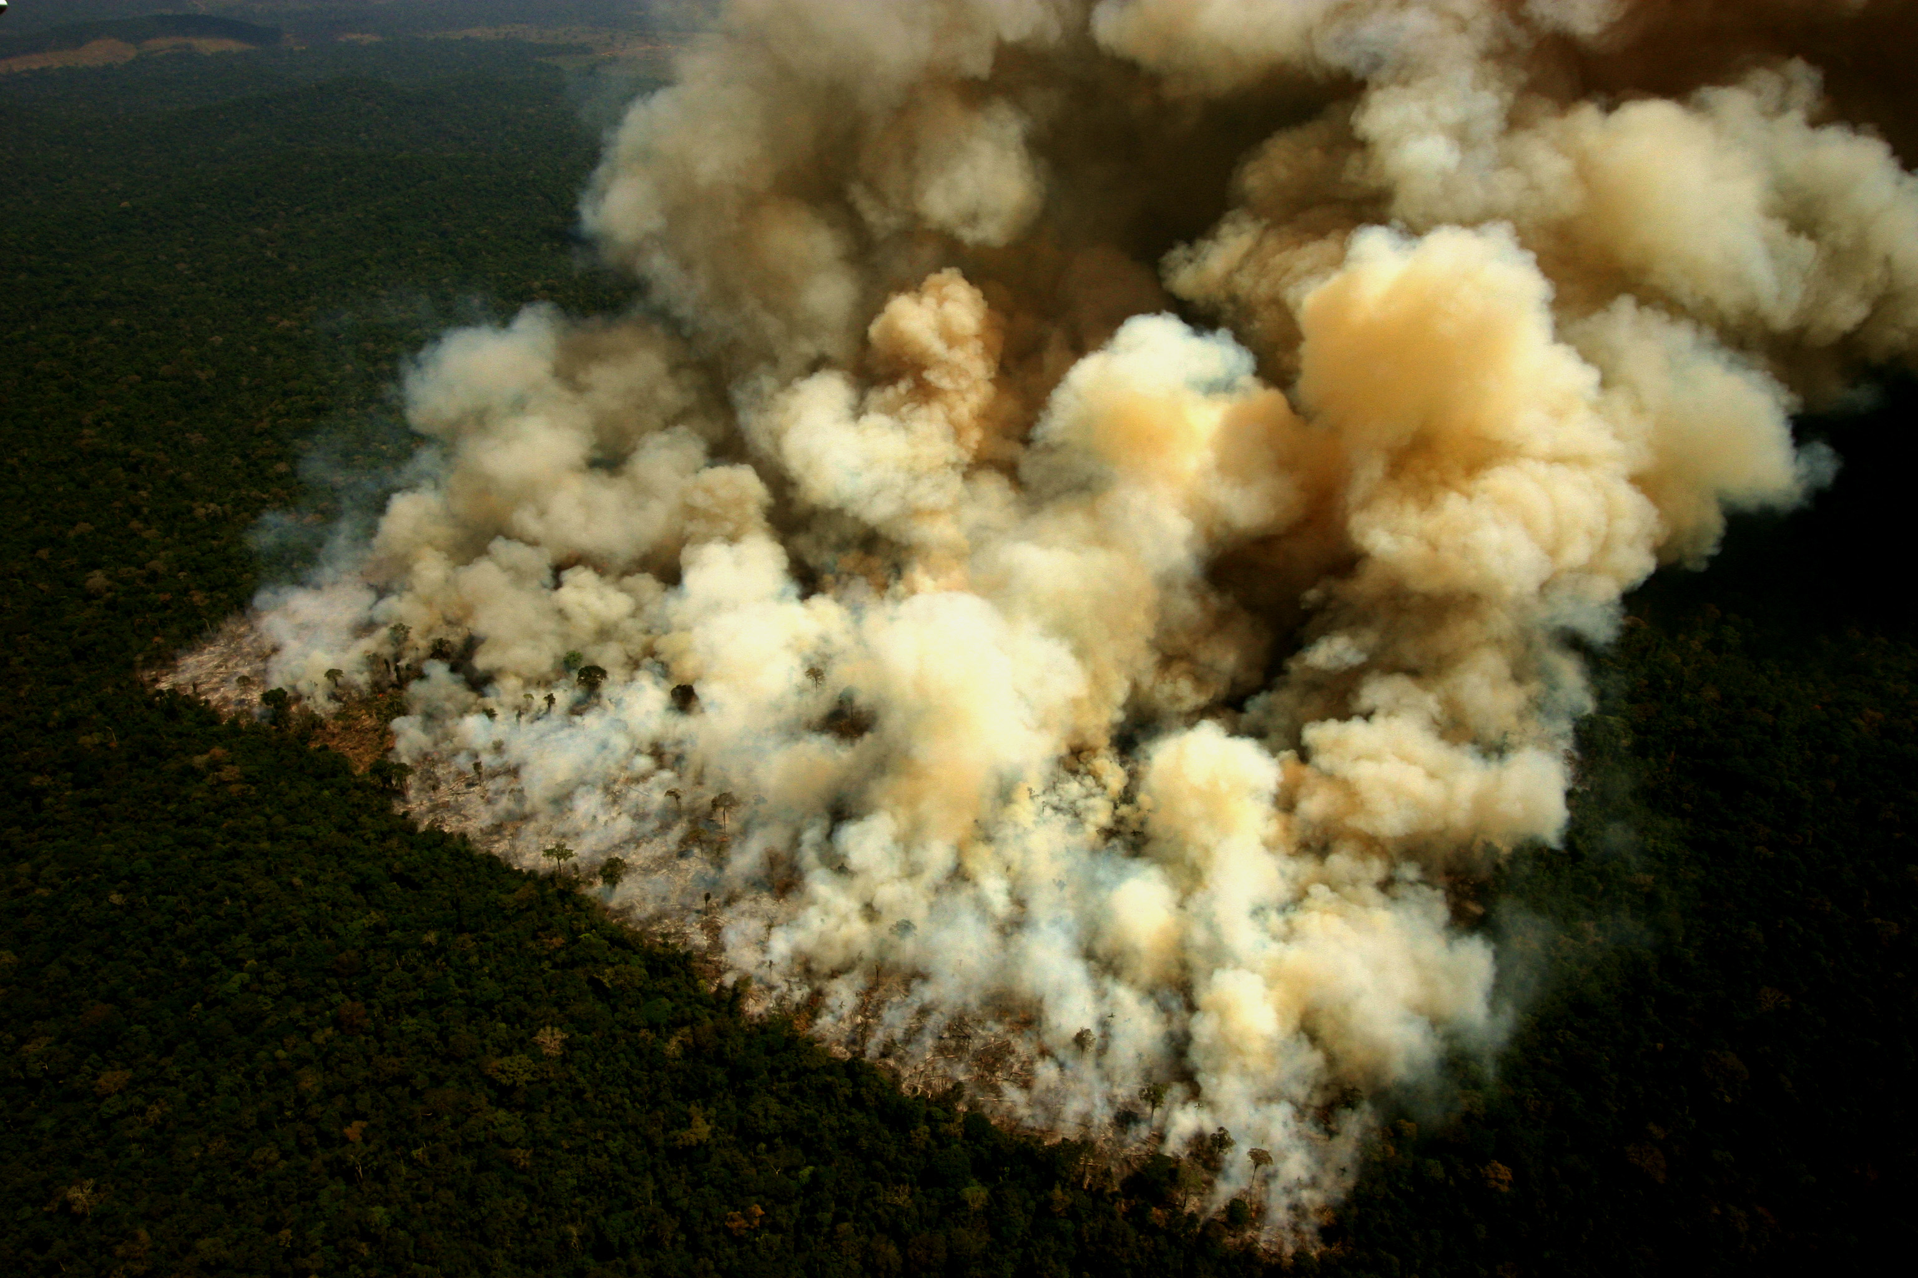
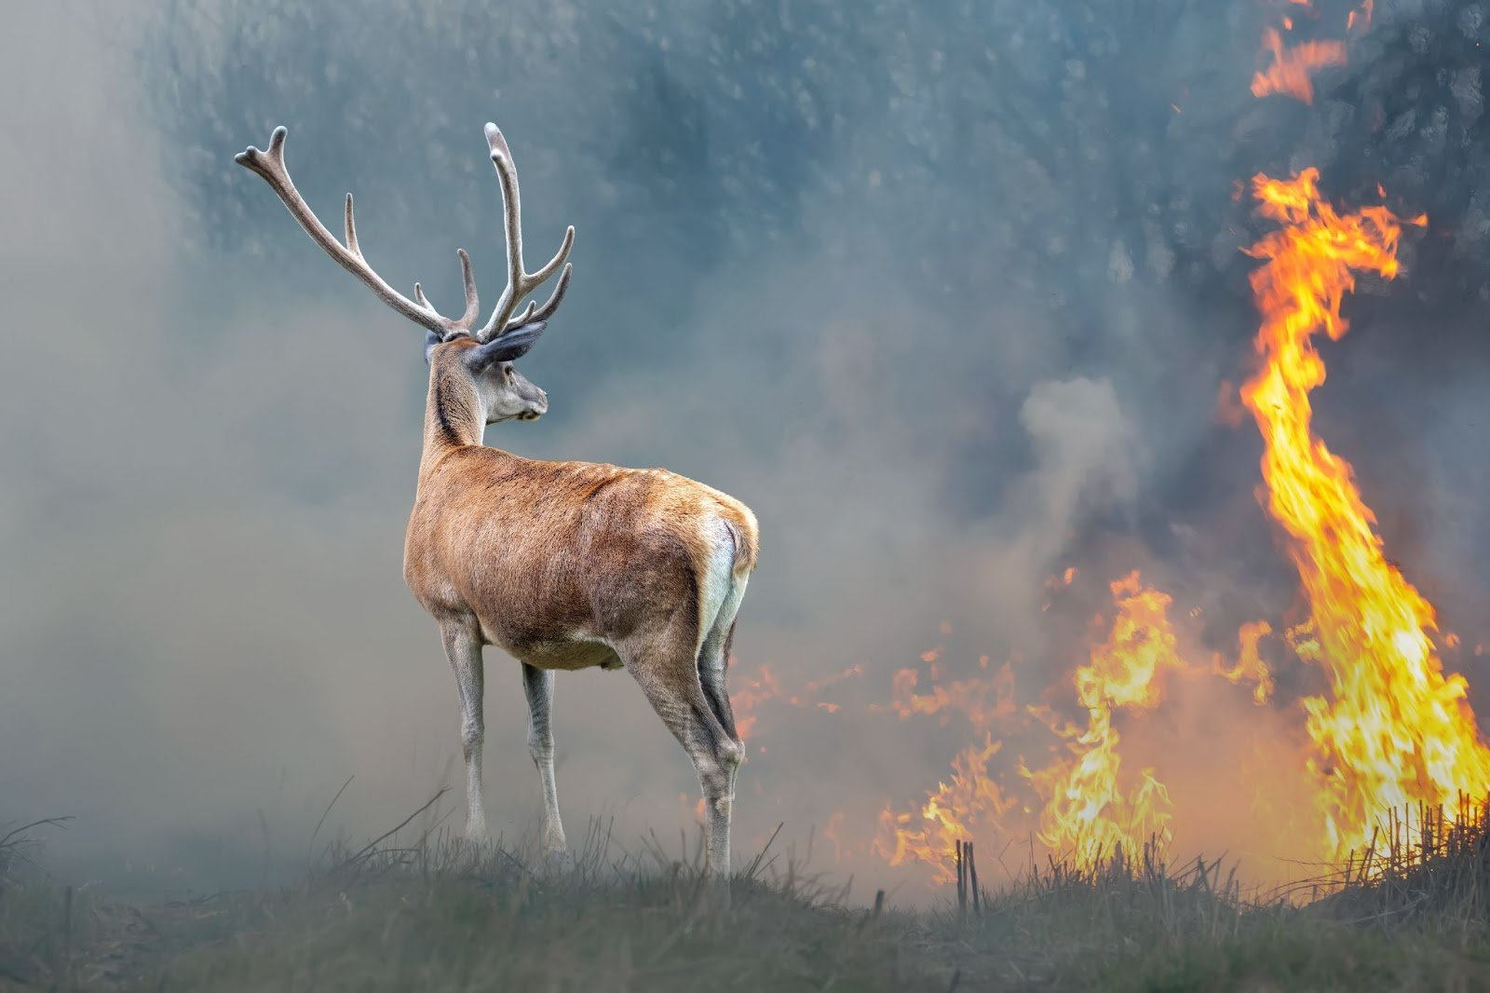
Aim
Context

Slide 5
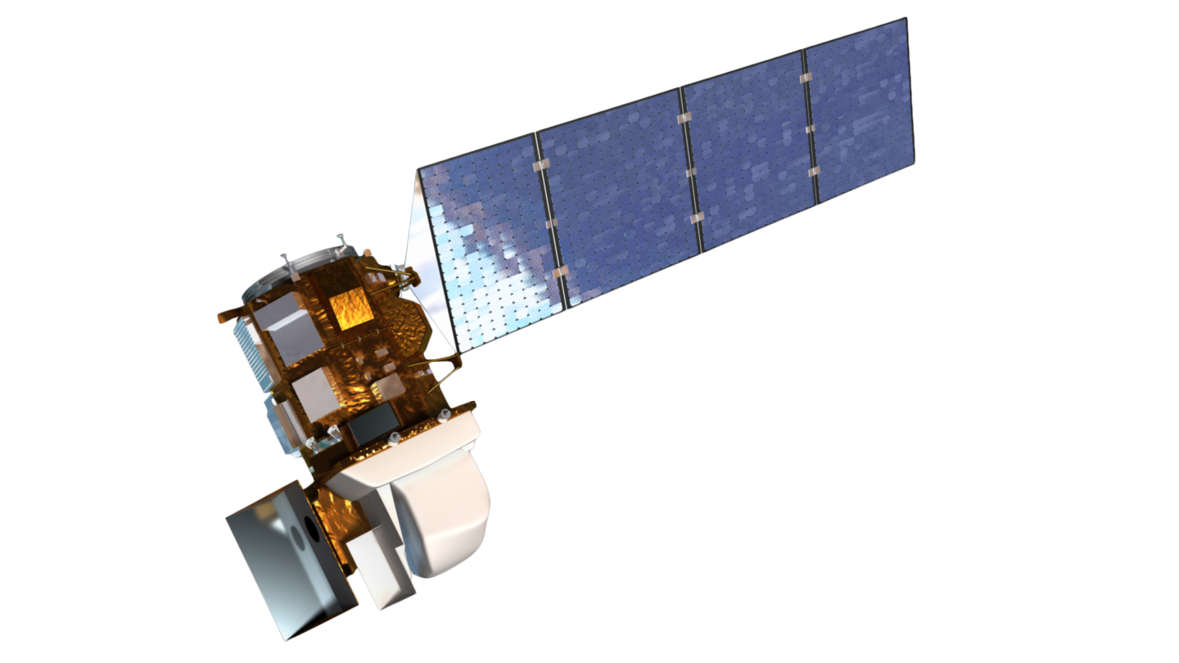
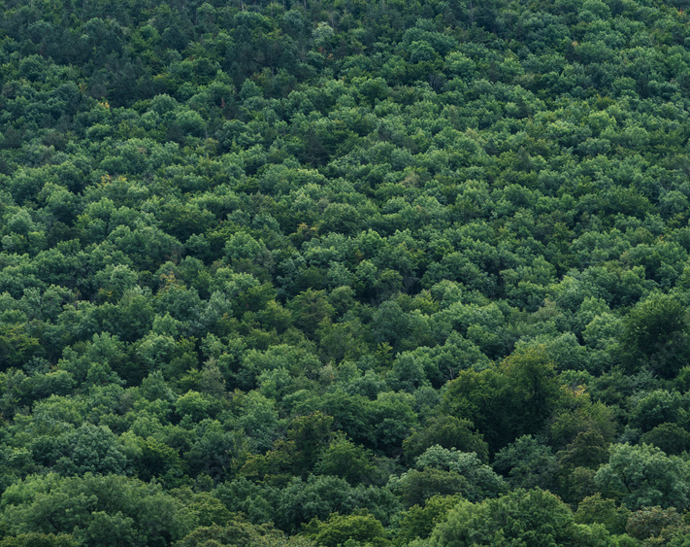

Aim
Context
Vegetation
Land surface temperature
Normalized Difference Vegetation Index
NDVI
Land Surface Temperature
LST

Slide 6
MATERIALS AND METHODS

Slide 7

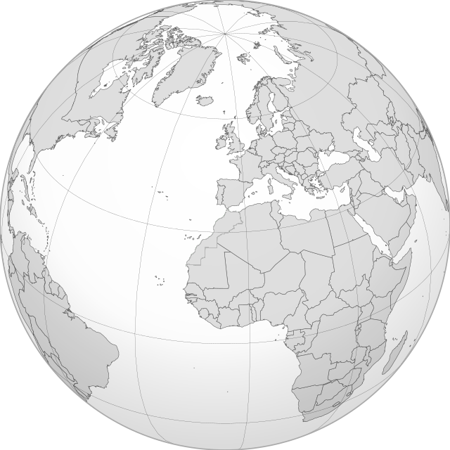

Satellite data
Study area
Algorithms

Slide 8
Satellite data
Study area
Algorithms
(a)
35.1167° N, 5.7754° W
600 Km²
(a)
(b)
292 Km²
308 Km²
(b)

Slide 9
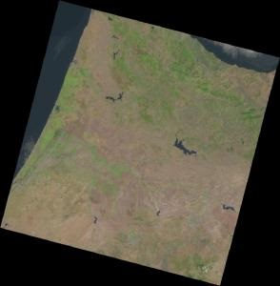
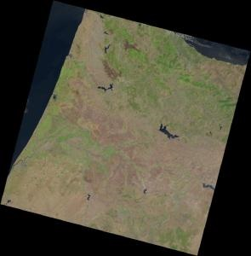
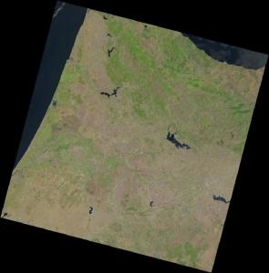
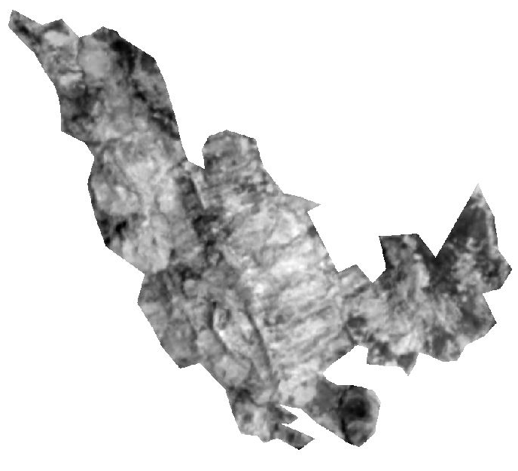
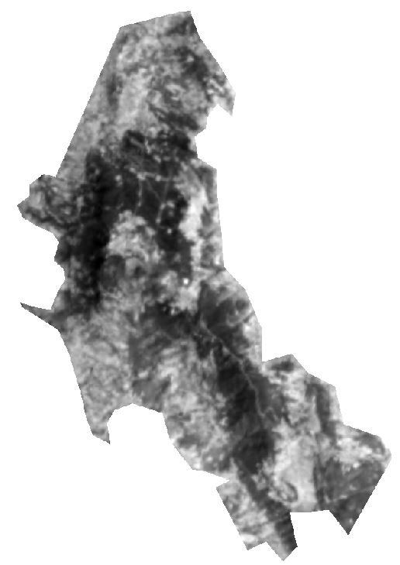
Algorithms
Satellite data
Landsat-8
Study area
Band description | Band number | Wavelength (µm) | Resolution (m)
Red | Band 4 | 0.64 - 0.67 | 30
Near-Infrared (NIR) | Band 5 | 0.85 - 0.88 | 30
TIRS 1 | Band 10 | 10.6 - 11.19 | 100
Red band (B4)
NIR band (B5)
TIRS1 band (B10)
14/08/2023
Scaling
19/08/2022
08/08/2021
Resampling
Clipping by mask layers

Slide 10

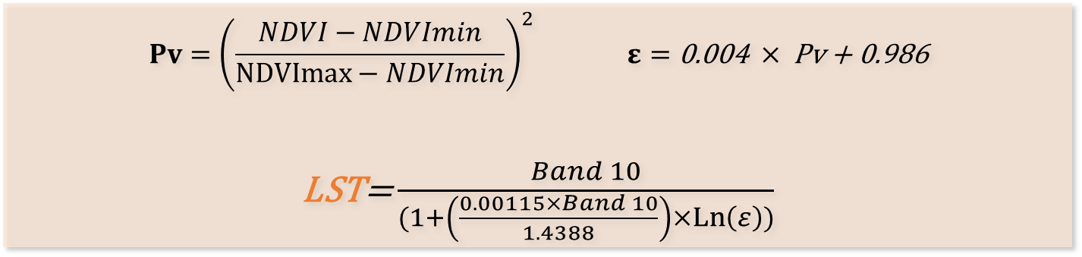

Study area
Algorithms
Satellite data
Normalized Difference Vegetation Index:
$$NDVI=\frac{Band 5−Band 4}{Band 5+Band 4}$$
Land Surface Temperature:
$$Pv={\left(\frac{NDVI−NDVImin}{NDVImax−NDVImin}\right)}^{2} ε=\text{0.004 }× \text{Pv}\text{ + 0.986}$$
LST= $\frac{Band 10}{(1+\left(\frac{0.00115×Band 10}{1.4388}\right)×\operatorname{Ln}\left(ε\right))}$
Band description | Band number | Wavelength (µm) | Resolution (m)
Red | Band 4 | 0.64 - 0.67 | 30
NIR | Band 5 | 0.85 - 0.88 | 30
TIRS 1 | Band 10 | 10.6 - 11.19 | 100

Slide 11
RESULTS & ANALYSIS

Slide 12

Results and Analysis

Slide 13
CONCLUSIONS

Slide 14
CONCLUSION
1
Wildfires have profound effects on land surface temperature and vegetation cover in forests, but also reveal their remarkable resilience.
2
Mediterranean forests in Morocco show recovery and restoration after devastating wildfires, according to our research.
Proactive wildfire prevention and control methods are critical in the era of changing climate patterns and increasing wildfire frequencies.
3

