Slide 1


Synthesis of new derivate of
5-mercapto-3-phenyl-1,3,4-thiadiazol-2-thione,
сrystal structure, Hirshfeld surface analysis
and estimation of its biological activity on PASS.
Gulnara Shakirzyanova¹, Omon Xolbekov¹, Lidiya Izotova¹ ,
Babaev Bakhrom², Baxtiyor Ibragimov¹
1. Institute of Bioorganic Chemistry, UzAS, M.Ulugbek Str., 83, 100125,Tashkent, Uzbekistan,
2. National University of Uzbekistan named after Mirzo Ulugbek, University Str., 174, Tashkent, Uzbekistan
Email: gulnara-sh@rambler.ru

Slide 2
The most important direction in the obtaining of new pharmaceuticals is synthesis of highly effective and low-toxic drugs. Researching new drugs with different biological activity implies the identification of new compounds with high efficacy and improved tolerability. It is very actually to create new pharmacological active compounds with high selectivity pharmaceuticals and minimized their negative effects.
Heterocyclic compounds of 1,3,4-thiadiazole are the important class of substances with a wide spectrum of biological activity. The sulfur atom of thiadiazole gives these compounds lipophilic properties, which allow to better penetrate through biological membranes. According to the mechanisms of biochemical reactions involving the thiadiazole fragments, potentially should connected with G-receptors, through enzyme binding, at the active final cysteine.
Thiadiazole derivatives are versatile and promising compounds with wide spectrum of biological activity. The thiadiazole moiety acts as a hydrogen-binding dominant on the one hand and an electron donor on the other.
Derivatives of 1,3,4-thiadiazoles are characterized of variety pharmacological properties, such as fungicidal, insecticidal, bactericidal, herbicidal, antitumor, anti-inflammatory, CNS stimulating properties.

Slide 3
Synthesis of
5-mercapto-3-phenyl-1,3,4-thiadiazol-2-thione derivative.
For the synthesis of new heterocyclic derivativeswith a wide spectrum of biological activity, we study the formation of various derivatives based on 5-mercapto-3-phenyl-1,3,4-thiadiazol-2-thione. The experiment was carried out according to the general procedure.
Reaction scheme:
We supposed that, excess of methylene chloride as a solvent for the reaction, and the other hand - promotes the binding of the potassium cation to the chloride ion. And the presence of a mixture of all of reagents, were promoted the formation of a methylene bridge in the structure of the resulting compound.

Slide 4
.
Investigation with PASS software
We studied the biological activity spectrum of obtained substance by PASS software. That screening let to describe biological activity properties of substance in a depending of its structure.
Such predictable analyses help to provide maximum information of biological activity of new structure substances whose molecular mechanism action is still unknown.
The structure of 5,5'-(methylenebis(sulfanediyl))bis(3-phenyl-1,3,4-thiadiazole-2(3H)-thione) was input in PASS software and predicted their biological activities.
Results of biological activities along with Pa and Pi predicted by PASS and described
in the table:
.

Slide 5
Pa | Pi | Activity
0,697 | 0,004 | Amyloid beta precursor protein antagonist
0,699 | 0,023 | 5-O-(4-coumaroyl)-D-quinate 3'-monooxygenase inhibitor
0,588 | 0,068 | Glycosylphosphatidylinositol phospholipase D inhibitor
0,509 | 0,003 | Cyclin-dependent kinase 5 inhibitor
0,509 | 0,011 | Taurine-2-oxoglutarate transaminase inhibitor
0,513 | 0,020 | FMO1 substrate
0,518 | 0,030 | CYP2A8 substrate
0,526 | 0,044 | Chloride peroxidase inhibitor
0,488 | 0,008 | Mcl-1 antagonist
0,536 | 0,057 | Complement factor D inhibitor
0,453 | 0,004 | Dual specificity phosphatase inhibitor
0,499 | 0,058 | Thioredoxin inhibitor
0,437 | 0,003 | Dual specificity phosphatase 1 inhibitor
0,548 | 0,117 | Aspulvinone dimethylallyltransferase inhibitor
From PASS software (Prediction of Activity Spectra for Substances) we chose results with Pa > 0.5 activity, and predicted, that 5,5'-(methylenebis(sulfanediyl))bis(3-phenyl-1,3,4-thiadiazole-2(3H)-thione) was very likely to exhibit the activity in experiment with Pa = 0,7.

Slide 6
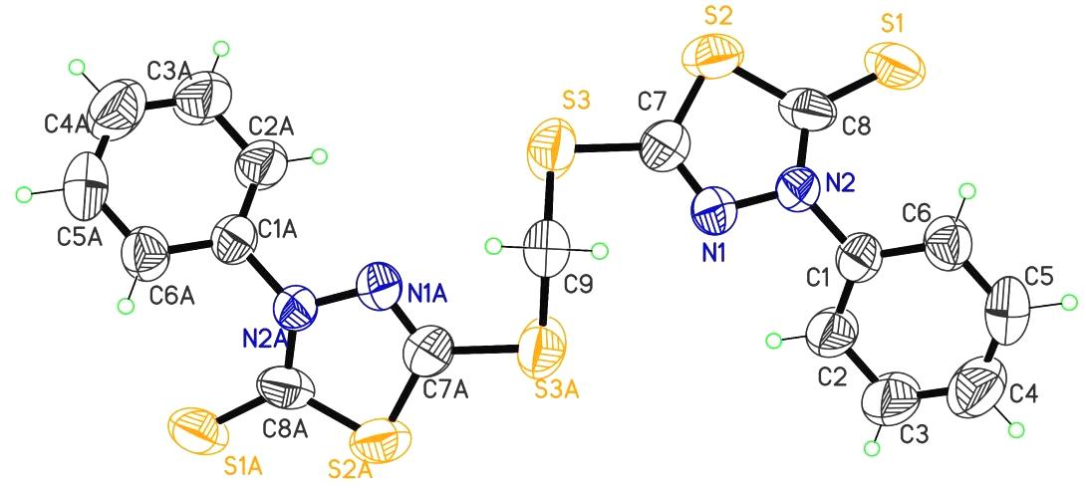
Molecular structure
5,5'-(methylenebis(sulfanediyl))
bis(3-phenyl-1,3,4-thiadiazole-2(3H)-thione) crystallized in the non-centrosymmetric orthorhombic space group Fdd2 with half-molecule in the asymmetric unit; a twofold rotation axis, which passes through the C9 atom, generates the other half of the molecule.
The 1,3,4-thiadiazole-2-thione unit is planar, with an r.m.s. deviation of 0.019 Å from the corresponding squares plane defined by the seven constituent atoms. Вenzene and thiadiazole rings are not coplanar (corresponding C2-C1-N2-N1 torsion angles are 32.4 (12)°).

Slide 7
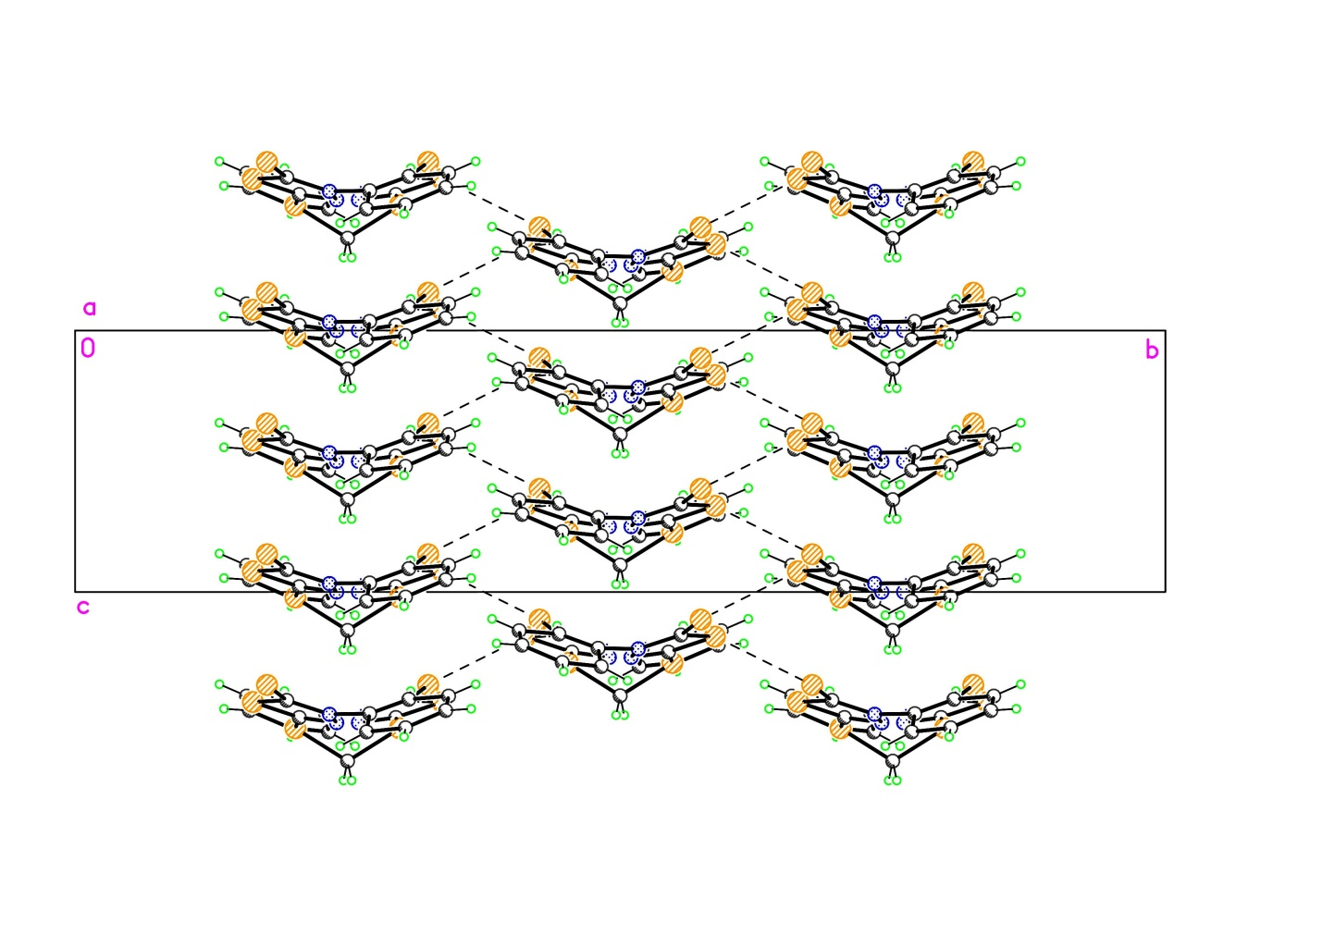
Crystal structure
The crystal packing is stabilized by intra- and intermolecular H-bonds, close intermolecular S…S contacts in the range of 3.416Å and by van-der-Waals interactions. Molecule are combined into tree-dimensional construction.

Slide 8
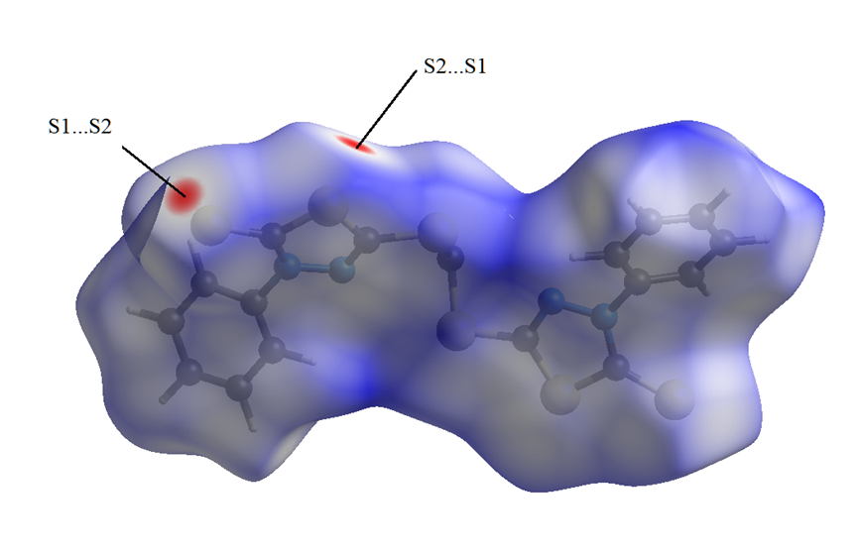
Hirshfeld surface analysis
The Hirshfeld surface analysis indicates that the most important contributions to the crystal packing are from H…H (26.3%) and S…H/H…S (23.3%) – weak H-bonds and van-der-Waals interactions. S…S (13.1%), S…C/C…S (11%), C…C (9.9%) and C…H/H…C (5.5%) interactions contribute less and S…N/N…S (1.9%) and N…N (0.4%) interactions contribute minor signiﬁcance to the overall HS.

Slide 9
Conclusion.
In the result of our experiment were obtained new 1,3,4-thiadiazole derivative - 5,5'-(methylenebis(sulfanediyl))bis(3-phenyl-1,3,4-thiadiazole-2(3H)-thione). The presence of a mixture of all of reagents, were promoted the formation of a methylene bridge in the structure of the resulting compound.
The crystal structure of (methylenebis(sulfanediyl))bis(3-phenyl-1,3,4-thiadiazole-2(3H)-thione) has been determined by X-ray diffraction and intermolecular interactions have been analyzed by HS.
The biological activity spectrum of 5,5'-(methylenebis(sulfanediyl))bis(3-phenyl-1,3,4-thiadiazole-2(3H)-thione) were studied by PASS online software, and obtained data let to describe biological activity properties in a depending of its structure.
On the base of structural features of the obtained compound, we suppose that on the molecular level, the 1,3,4-thiazole moieties of new derivative, will interact with protein’s cysteine ​​residues. Additionally, the presence of a disulfide bridge separated by a methylene fragment will facilitate easy penetration through the cell membrane, leading to subsequent exhibiting activity.
Confirmation of the potential properties of the new compound and researching the interconnection between the structure of 1,3,4-thiadiazole derivative and its biological activity, as well as explanations of its action mechanism on the molecular level, are in progress.

