Slide 1


NATIONAL UNIVERSITY OF OIL AND GAS «GUBKIN UNIVERSITY»
The 28th International Electronic Conference on Synthetic Organic Chemistry
Faculty of chemical and environmental engineering
AMINE OXIDE: SYNTHESIS AND ANALYSIS
Prepared by: M.A. Silin, L.A. Magadova, P.K. Krisanova,
M.M. Muhin, S.A. Borodin, A.A. Filatov, S.A. Mityurev
Presented by: Mityurev Savely Alekseevich
the scientific staff of the Department of Technology
of Chemicals for Oil and Gas Industry
Bachelor of the Department of Technology
of Chemicals for or Oil and Gas Industry

Slide 2

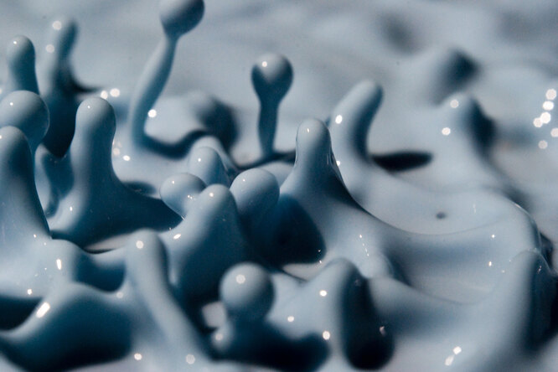


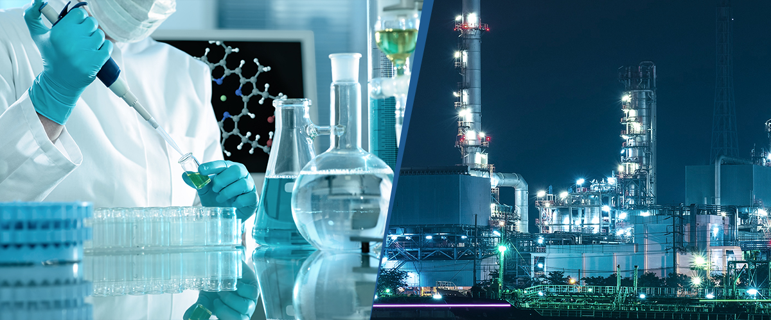


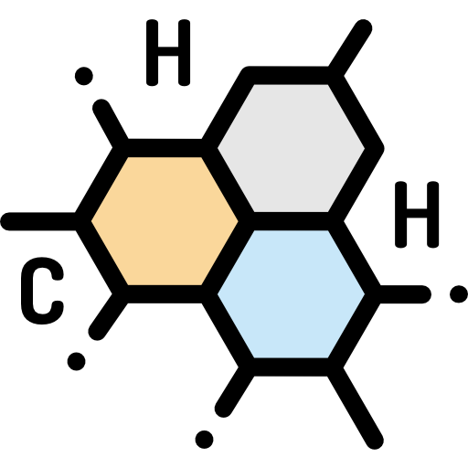
Performance plan
Scientific work relevance and problematics
Methods
Results and discussion
Conclusion
Introduction

Slide 3
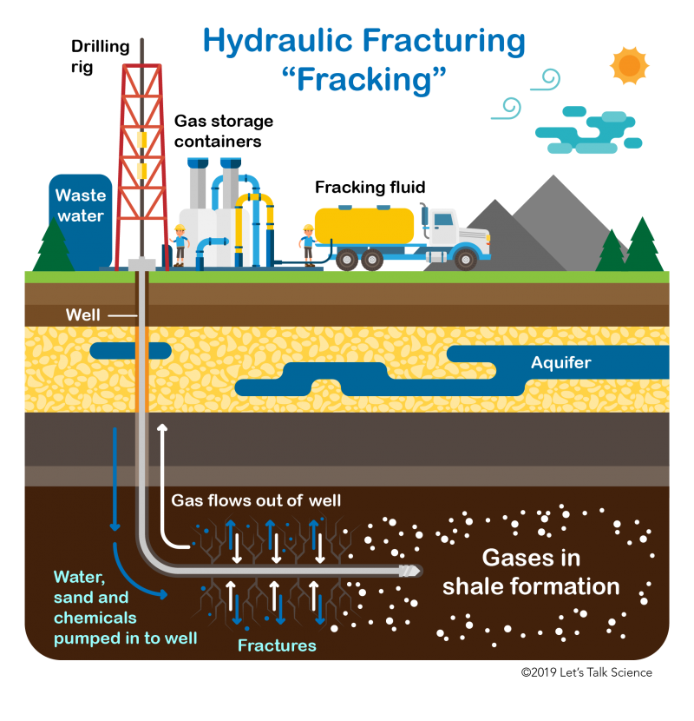
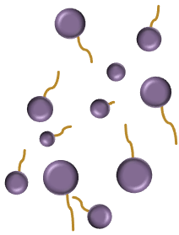
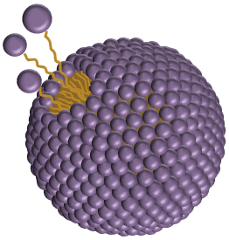
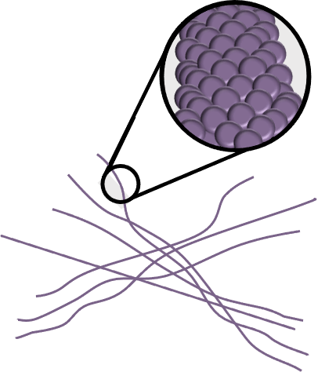
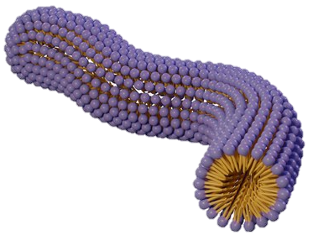
Surfactants and fracking
surfactant molecules
spherical micelle
Oil and Gas
cylindrical
micelle
Oil and Gas
rich layer
three-dimensional grid structure

Slide 4
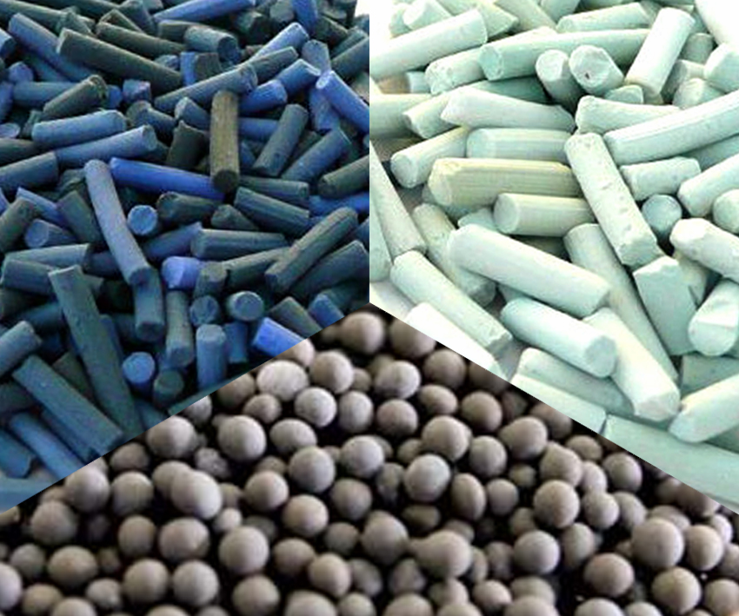
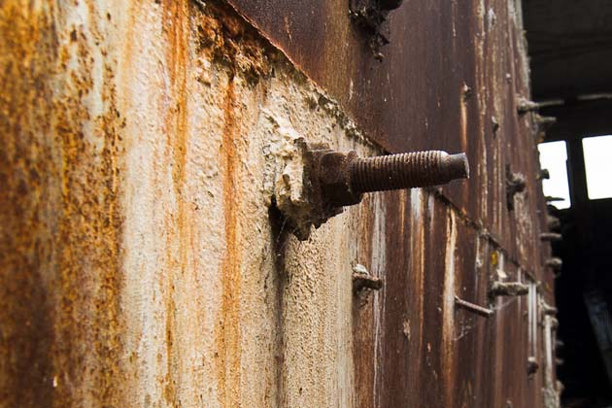

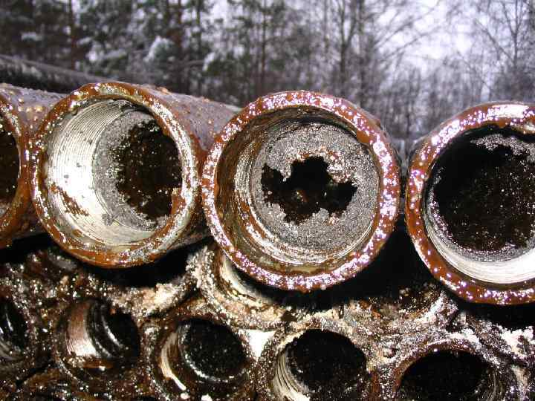

Light organochlorine compounds (LOC)
NO LOC
catalyst
deactivation
technological equipment corrosion
Non-polar hydrophobic (water-hating) tail
Polar hydrophilic (water-loving) head
deposits on processing units
+
–

Slide 5
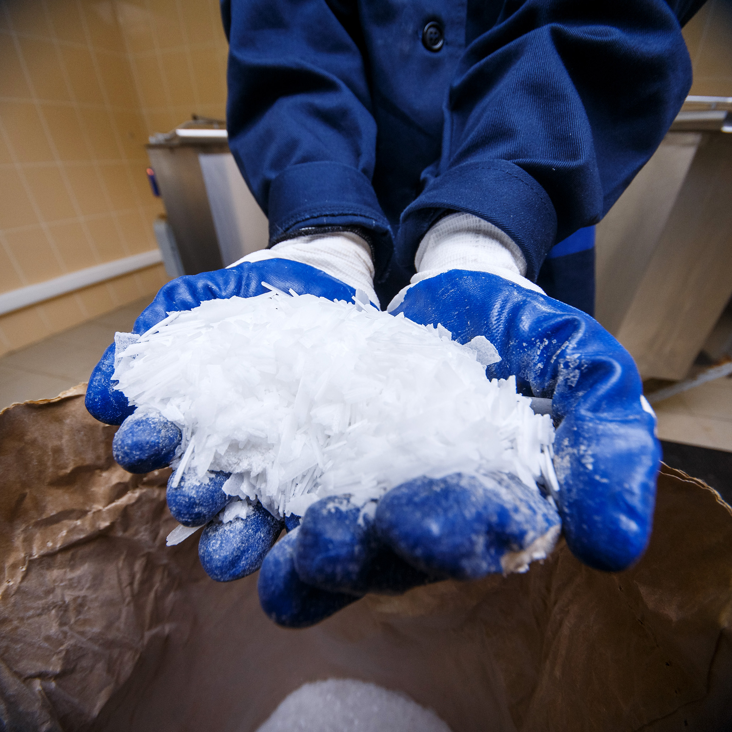
Research subject
“Amine Oxide”
(oleylamidopropyldimethylamine oxide – OADAO)
feasible industrial production in Russia
light organochlorine compounds absence in the synthesis
high stability
easy availability of raw materials
resistance to the impact of microorganisms
high degree of biodegradability

Slide 6
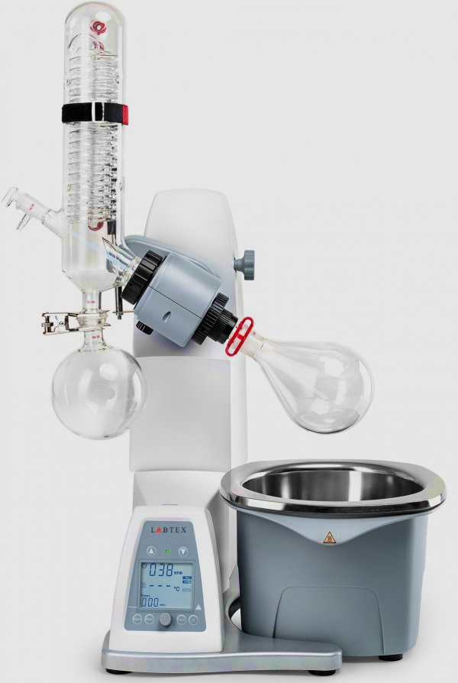
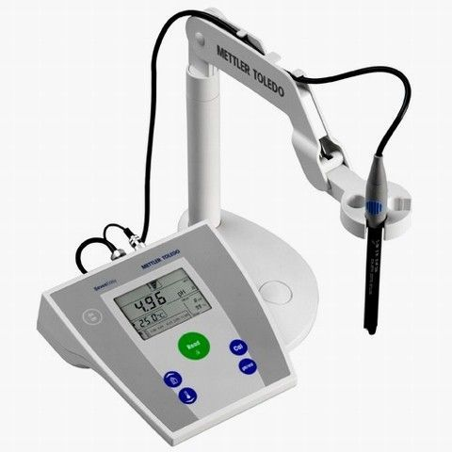
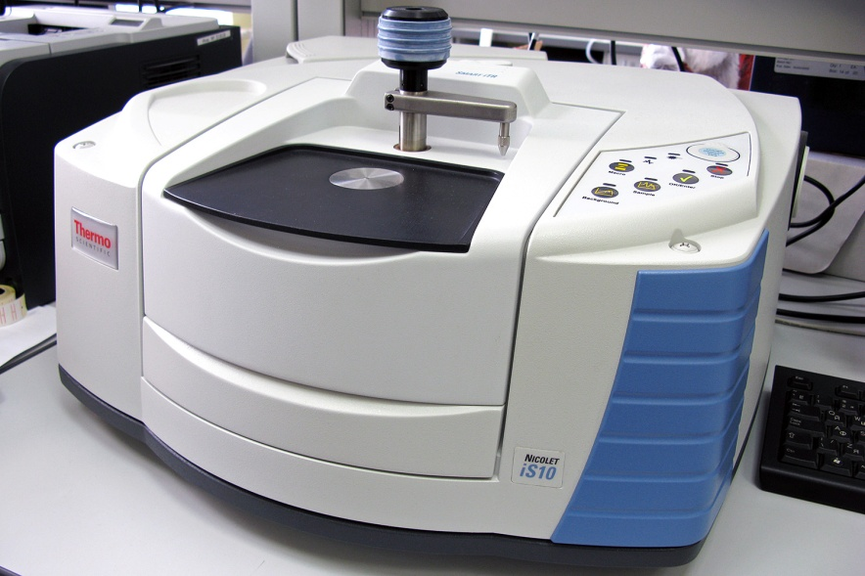
Synthesis results and Research methods
Reflux condenser
Motor
Sample feed tap
Evaporative flask
Warming bath
pH meter
(S20 SevenEasy Mettler Toledo)
Fourier transform infrared spectrometer
(Thermo Scientific Nicolet iS10)
Receiving flask
Synthesis conditions
Mass content of the amine oxide
Solvent | t, °C | τ, h | Characteristic features
– | 60 | 5-6 | abundant foam formation
PEG | 0,5000 |  | 43,33%
i-C₃H₈O |  |  | no foam at all
Potentiometric titration | Calculated value
36,93 % | 38,34 %
Control panel
Rotary evaporator (Labtex IR-1LT)

Slide 7
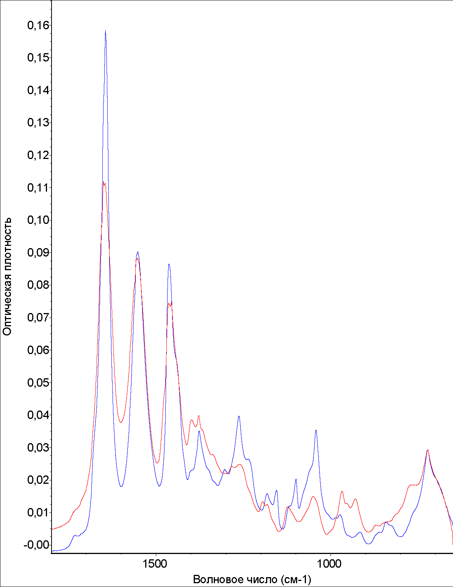
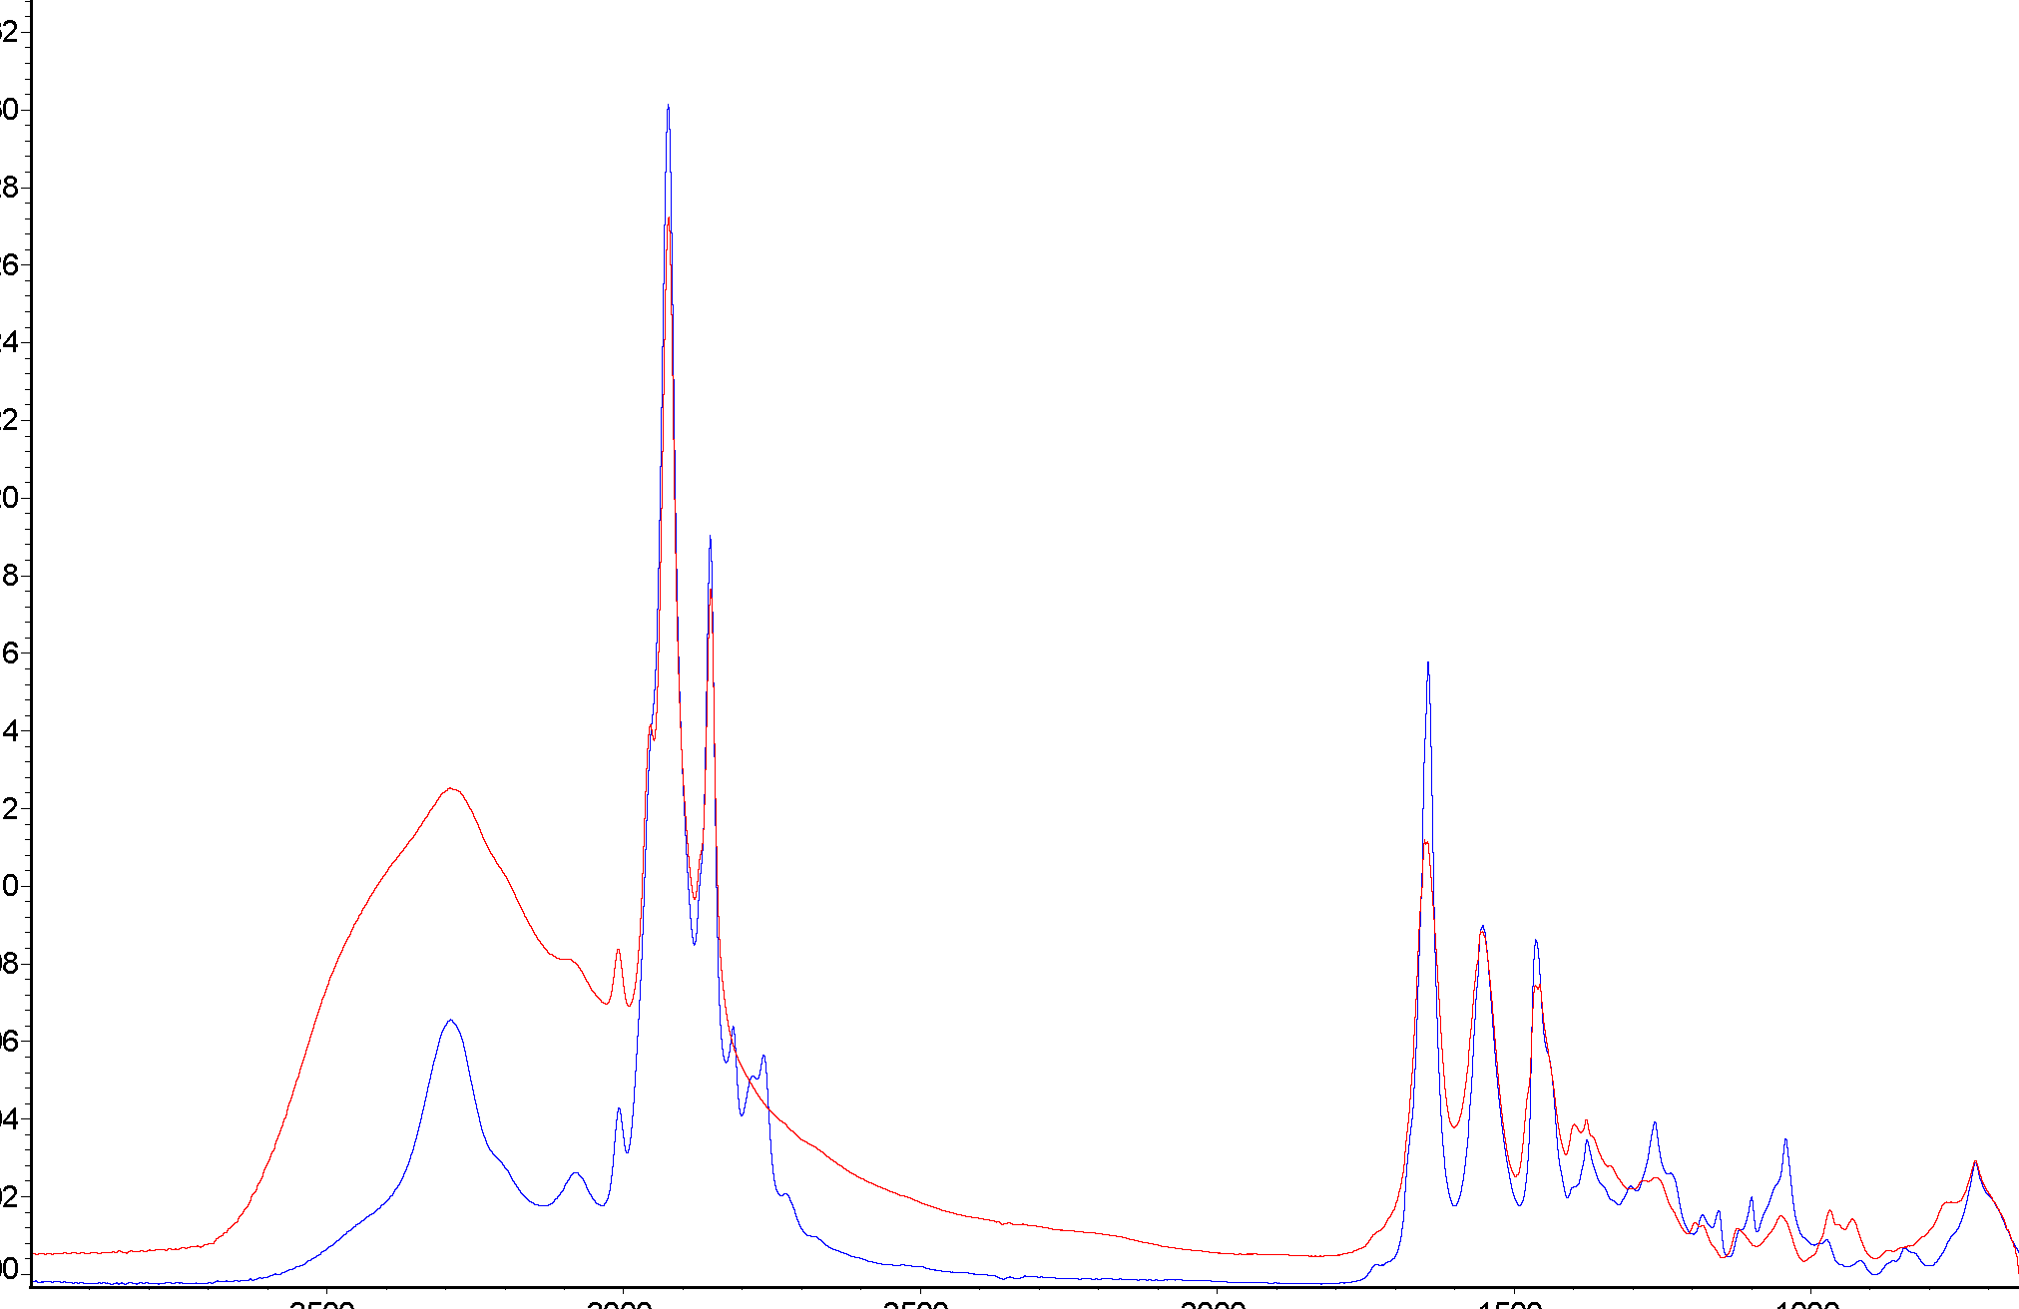
IR absorption spectra (FTIR)
0,16
0,32
0,30
End-product
0,15
Initial amine
0,14
0,28
1644-1650 cm⁻¹
0,26
0,13
0,12
0,24
3292 cm⁻¹
0,11
0,22
End-product
0,20
0,10
Initial amine
Absorbance
Wave number, cm-1 | Chemical bond
968 and 929 | N→O
3292 | O–H
1650–1644 | C=O
0,09
0,18
Absorbance
0,16
0,08
0,07
0,14
0,06
0,12
968 cm⁻¹
0,10
0,05
0,04
0,08
929 cm⁻¹
0,06
0,03
0,04
0,02
0,02
0,01
0,00
0,00
3500
3000
2500
2000
1500
1000
1500
1000
Wave number, cm⁻¹
Wave number, cm⁻¹

Slide 8
Conclusion:
Current research outcomes:
Way forward:
IR-Fourier spectroscopy and potentiometric titration confirm the successful synthesis;
variation temperature and duration of the synthesis
research the influence of synthesis conditions on the yield of end-product
The mass content of OADAO in the reaction mass at the end of synthesis is approximately 37 %. The calculated and experimental data are consistent;
develop the most appropriate synthesis technique
Amine oxide can simultaneously exist in the solution in two ionic forms, which is confirmed by the obtained IR spectra
investigation of amine oxide as a gelling agent of fracturing fluids on a water basis

