Slide 1
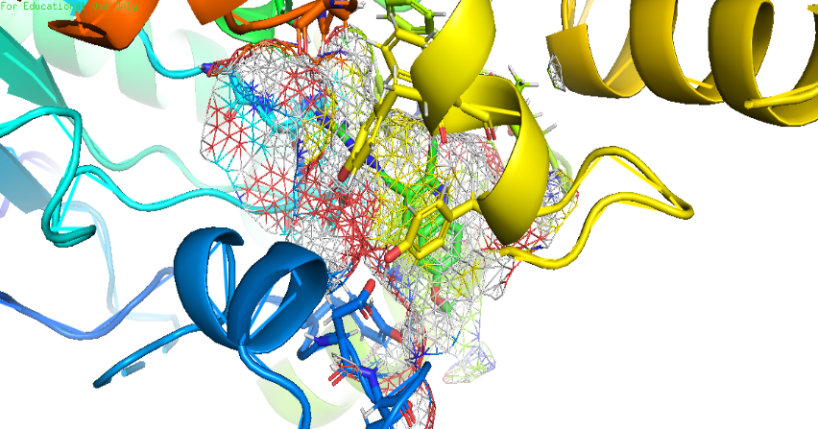
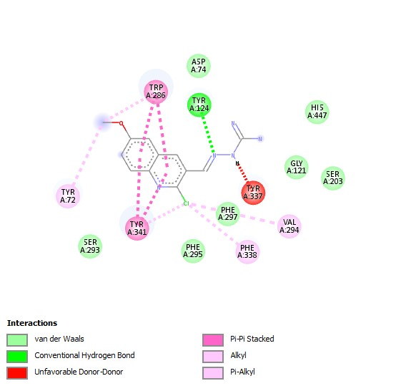
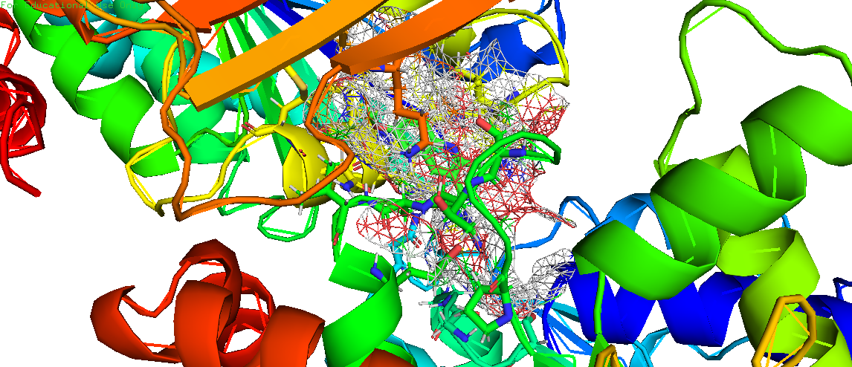
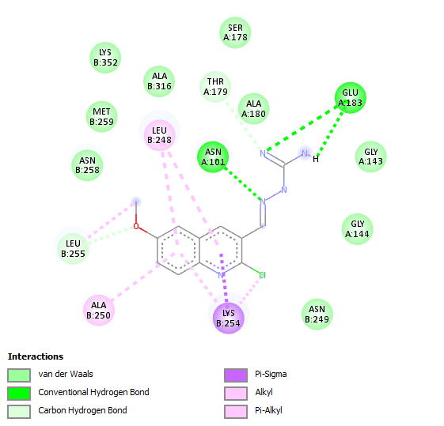
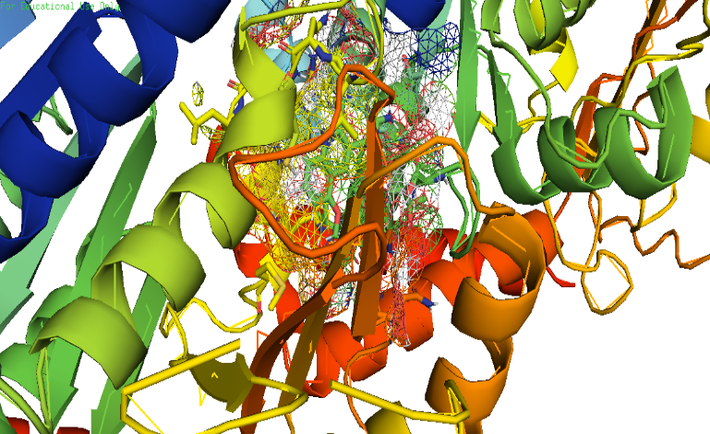
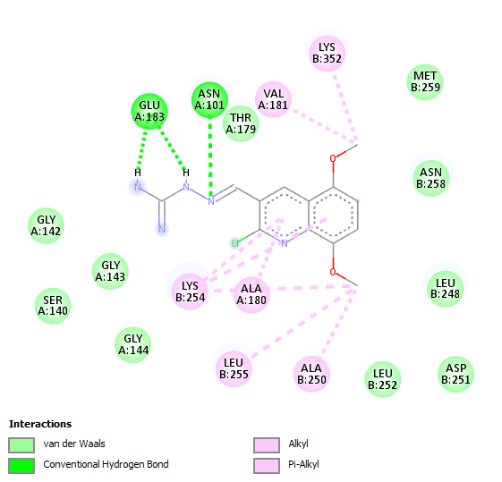
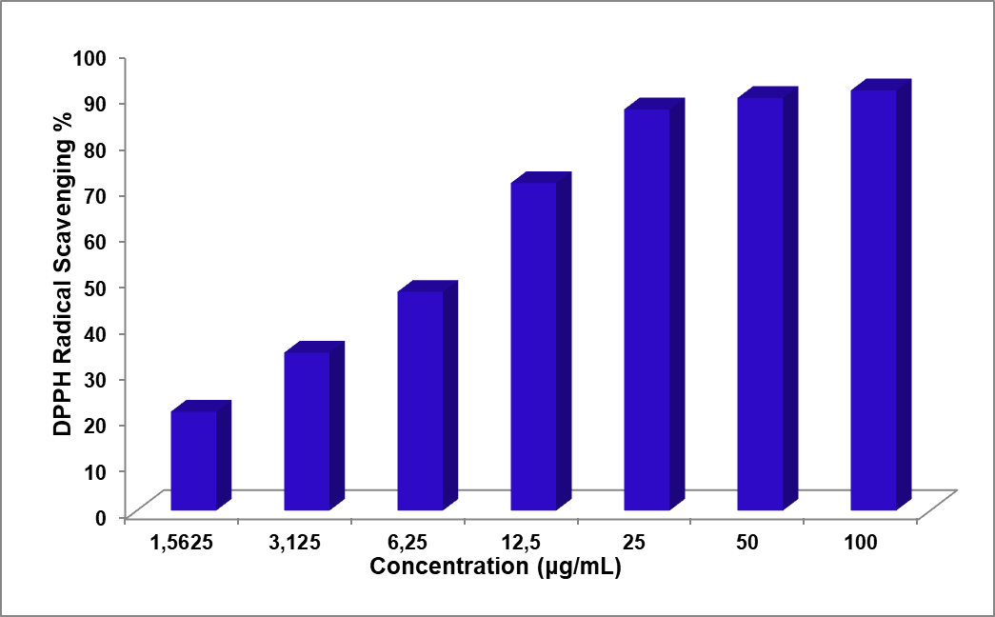
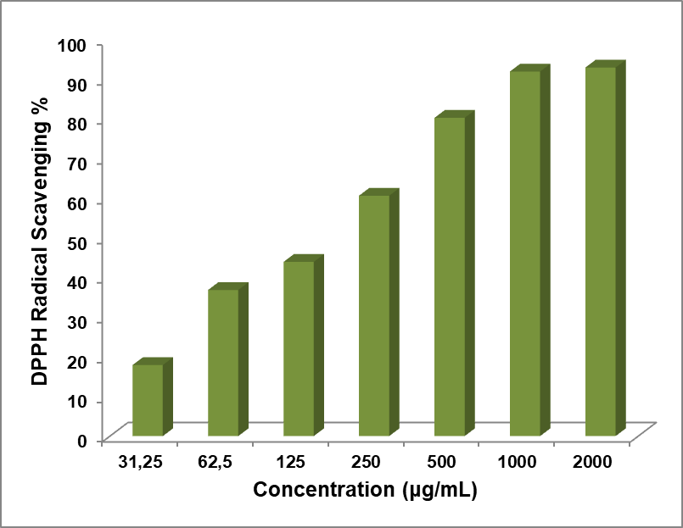
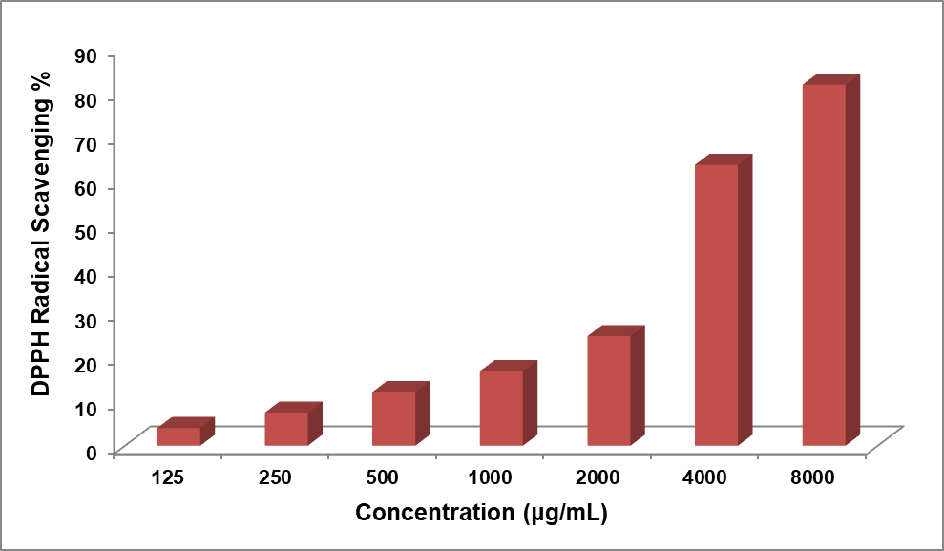
Application and Synthesis of a New Hybrid Heterocyclic De-rivative with Antioxidant Evaluation
Ait Belkacem Amira1, Djaafarou Roumaissa2 and RABHI Selma2
Affiliation1 Laboratory of Synthesis of Molecules With Biological Interest, Department of Exact Sciences; University of Frères Mentouri Constantine 1; Compus de Chaabet Ersas; Université des Frères Mentouri-Constantine; Constantine; 25000; Affiliation1Laboratory of analytic chemistry, Department of Exact Sciences; University of Frères Mentouri Con-stantine 1; Compus de Chaabet Ersas; Université des Frères Mentouri-Constantine; Constantine; 25000; Algeria;
INTRODUCTION & AIM
RESULTS & DISCUSSION
Hydrazine compounds have wide applications and are very interesting, including a wide range of biological activities, antibacterial [1], antidiabetic [2] , antiviral [3] , antimi-crobial [4] , anticancer[5] , Anti-Alzheimer [6] and antioxidant [7] .Such properties make these compounds particularly promising for the development of treatments targeting oxi-dative stress-related diseases.
The presence of numerous nitrogen atoms in these compounds grants them strong chela-tion properties with free radicals, which in turn significantly enhances their ability to in-teract effectively with target molecules. Such properties make these compounds par-ticularly promising for the de-velopment of treatments targeting oxidative stress-related diseases.
New hydrazine derivatives were synthesized using a simple condensation reaction. These compounds have shown strong inhibitory effects on acetylcholinesterase and tubulin, as well as antioxidant properties. Furthermore, ADMET analysis confirms that these com-pounds adhere to Lipinski's Rule of Five and can cross the blood-brain barrier without ex-hibiting any ADMET-related toxicity.
Hydrazine carboximidamides are easily synthesized through a simple condensation reaction (Scheme1) between quinoline carbaldehyde and aminoguanidine, without the use of a catalyst. The products obtained are (E)-2-((2-chloro-5,8-dimethoxyquinolin-3-yl)methylene)hydrazinecarboximidamide and (E)-2-((2-chloro-6-methoxyquinolin-3-yl)methylene)hydrazinecarboximidamide, with yields ranging from 93% to 98%. These compounds are identified by 1H NMR , The characteristic CHN condensation peak appears at 8.75 ppm
Docking study
the simulations of these compounds were evaluated for their inhibitory ability using Chimera, where the active site of the target atoms is fixed and the chromophore is flexible. As is well known, this program use a genetic algorithm (GA) to dock flexible ligands into protein binding site.
A1 with AChE
A2 with AChE
METHOD
A1 with Tubuline
Methods:
2Statistical Analysis
The reported results represent the average of three measurements, expressed as mean ± standard deviation (SD). The IC50 value, indicating the concentration required for 50% inhibition, was determined for each sample by plotting the percentage of inhibition against concentration and analyzing the resulting curve using linear regression. To iden-tify statistically significant differences (p &lt; 0.05) between the samples, a one-way analy-sis of variance (ANOVA) was performed using SPSS software.
2.3. Methods
2.3.1. Ligand preparation:
Preparation of derivative compounds for docking studies involved to designing small molecules, optimize their geometry, and minimize their energy. The resulting structures were then saved in the .pdb format.
2.3.2. Targets Preparation
The acetylcholinesterase (AChE) protein (PDB ID: 4m0e) [8], and tubulin protein (PDB ID: 1sa0) [9], were obtained in .pdb format from the Protein Data Bank. The targets were prepared by removing water molecules, trimming unnecessary chains, and adding polar hydrogens. Energy minimization was then performed, and the results were visual-ized and analyzed.
2.3.3. Synthesis of Compounds
An equimolar mixture of quinoline derivatives and aminoguanidine was stirred at reflex in methanol (MeOH) without a catalyst. The precipitate was then filtered, washed with MeOH, and recrystallizedfrom MeOH
A2 with Tubuline
Table of ADMET study results.
Entries | Lipinski’s rules | Veber’s rules | BBB | AMES toxic | carcinogenic | P-glycoprotein Inhibitor
A 1 | + | + | + | - | - | -
A 2 | + | + | + | - | - | +
Concentration (µg/mL) | 1,5625 | 3,125 | 6,25 | 12,5 | 25 | 50 | 100 | IC₅₀ (µg/mL)
BHA ª | 21,47±0,27 | 34,28±0,27 | 47,49±0,27 | 71,09±0,20 | 87,08±0,18 | 89,56±0,18 | 91,21±0,10 | 7,18±0,17
Concentration (µg/mL) | 31,25 | 62,5 | 125 | 250 | 500 | 1000 | 2000 | /
A1 ^{b} | 17,94±0,27 | 36,87±0,57 | 43,95±0,45 | 60,65±0.27 | 80,29±0,27 | 91,98±0,57 | 92,98±0,10 | 168,06±2,92
Concentration (µg/mL) | 125 | 250 | 500 | 1000 | 2000 | 4000 | 8000 | /
A2^{c} | 4,01±0,91 | 7,49±0,84 | 12,15±0,67 | 16,87±0,45 | 24,78±0,47 | 63,54±1,42 | 81,65±0,62 | 3902,15±40,35
(a)
(b)
(c)
(a) DPPH radical scavenging activities of various concentrations of BHA standard; (b) DPPH radical scavenging activities of various concentrations of A1; (c) DPPH radical scavenging activities of various concentrations of A2
CONCLUSION
New Hydrazine carboximidamides were successfully synthesized with excellent yields using a simple condensation reaction. These compounds demonstrated effective inhibi-tion of tubulin and AChE in molecular docking studies. Additionally, the ADMET analy-sis indicates that these compounds can cross the blood-brain barrier (BBB), suggesting their potential as anti-Alzheimer's agents. Furthermore, they have proven to be antioxi-dant compounds, especially A1, with an IC50 of 168.06 ± 2.92 µg/mL.
FUTURE WORK / REFERENCES
Tian, J.; Ji, R.; Wang, H.; Li, S.; Zhang, G. Discovery of Novel α-Aminophosphonates with Hydrazone as Potential Antiviral Agents Combined With Active Fragment and Molecular Docking. Front Chem 2022, 10, 911453.
Katariya, K.D.; Shah, S.R.; Reddy, D. Anticancer, antimicrobial activities of quinoline based hydrazone analogues: Synthesis, characterization and molecular docking. Bio-org Chem 2020.
https://sciforum.net/event/ecsoc-28

