Slide 1
Isolation and structural elucidation of flavonol and a flavonol glycoside from the butanol fraction of globimetula oreophila a mistletoe on azadirachta indica a. Juss (melliacea)
Dauda Garba¹*, Bila Hassan Ali², Bashar Bawa³, Abdulrazaq Sanusi⁴, Yahaya Muhammed Sani², Muhammad Garba Magaji⁵, Musa Isma’il Abdullahi¹, Aliyu Muhammad Musa², and Hassan Halimatu Sadiya² .
¹Department of Pharmaceutical and Medicinal Chemistry, University of Abuja, 900105, Nigeria;
²Department of Pharmaceutical and Medicinal Chemistry, Ahmadu Bello University, Zaria 810107, Nigeria;
³National Agency for Food and Drug Administration and Control, Gusau, Zamfara, Nigeria;
⁴Department of Pharmaceutical and Medicinal Chemistry, University of Ilorin, Kwara 240003, Nigeria;
⁵Department of Pharmacology and Therapeutics, Ahmadu Bello University, Zaria, Zaria 810107, Nigeria;
*Correspondence: dauda.garba@ymail.com; dauda.garba@uniabuja.edu.ng; Tel.: (D.G.); +2347069064878

Slide 2
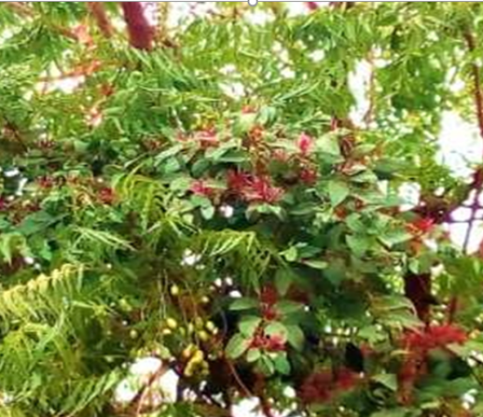
The plant
Cont’d….Introduction
Plate 1: Photograph of G. oreophila a hemiparasitic shrub on Azadirachta indica

Slide 3
INTRODUCTION
Globimetula oreophila is a hemiparasitic plant with medicinal properties, widely distributed across tropical Africa. It has a longstanding position in traditional medicine, offering remedies for common ailments in the regions it inhabits (Arzu et al., 2012).
Phytochemical investigations on the Globimetula genus have unveiled a diverse array of secondary metabolites including carbohydrates, triterpenes, tannins, glycosides, alkaloids, flavonoids, and saponins, as evidenced by prior studies (Dauda et al., 2016).
Our research endeavors have yielded significant findings, notably the isolation of prenylated quercetin from the ethyl acetate fraction (Dauda et al., 2017), elemental analysis of the crude ethanol extract, and a comprehensive qualitative and quantitative phytochemical analysis of this botanical specimen (Dauda et al., 2023a, 2023b).

Slide 4
AIM
This research study aims to isolate and characterize some of the bioactive compounds present in the butanol fraction of G. oreophila.
OBJECTIVES
isolate compounds from the n-butanol fraction using chromatographic techniques,
elucidate the structure of isolated compounds using spectroscopic techniques
MATERIAL AND METHOD
Chemicals: Analytical grade chemicals and reagents
Equipment: Gallenkhamp electrothermal melting point apparatus and ABB-MB3000 Bruker AVANCE III NMR spectrometer (400MHz)

Slide 5
METHODOLOGY

Slide 6
PHYTOCHEMICAL STUDIES
RESULTS AND DISCUSSION
TLC Profiles of Crude Extract and Fractions obtained from G. oreophila leaves

Slide 7
Isolation and Characterization of DG1

Slide 8
TLC profile of DG1 under UV spectrum

Slide 9
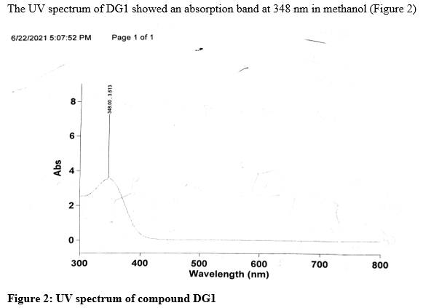

Slide 10
Figure 3: IR Spectrum Compound DG1

Slide 11
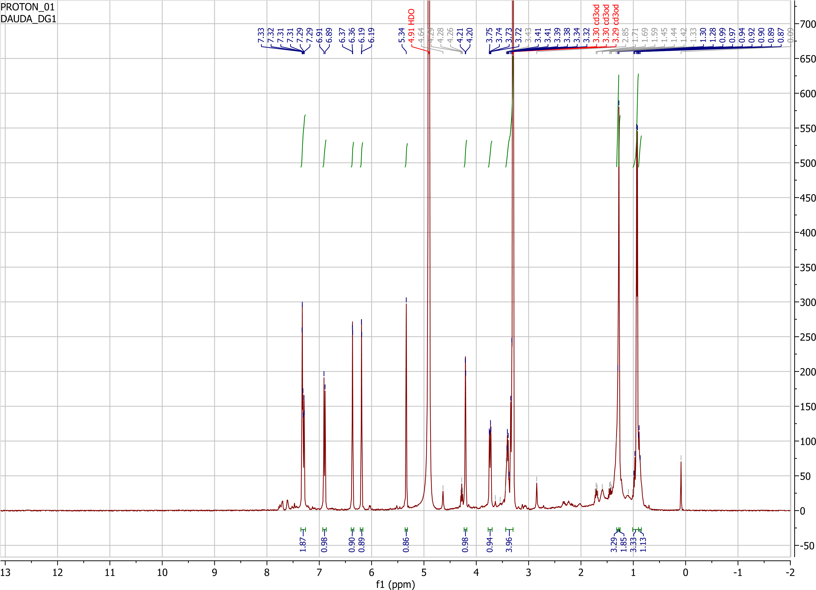
Figure 4: ¹H-NMR spectrum of DG1 in MeOD

Slide 12
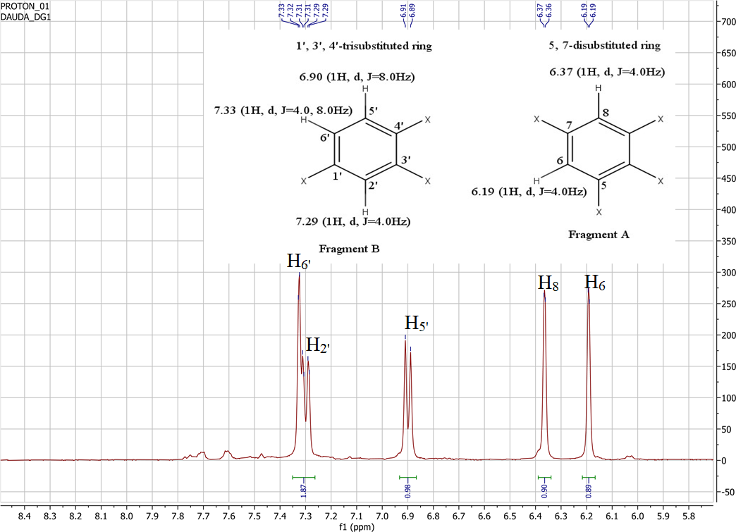
SPECTRAL ANALYSIS OF DG1
Figure 5: Expanded ¹H-NMR spectrum DG1 in MeOD (Aromatic region)

Slide 13
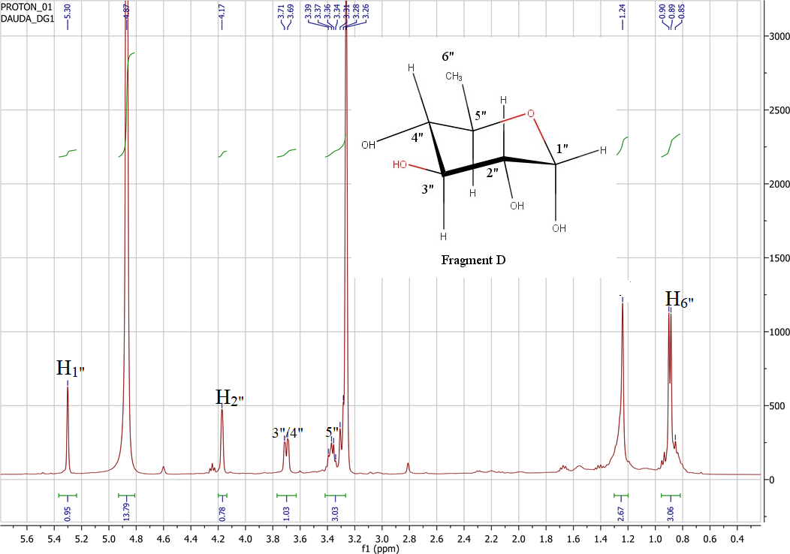
Figure 6: Expanded ¹H-NMR spectrum DG1 in MeOD (Sugar region)

Slide 14
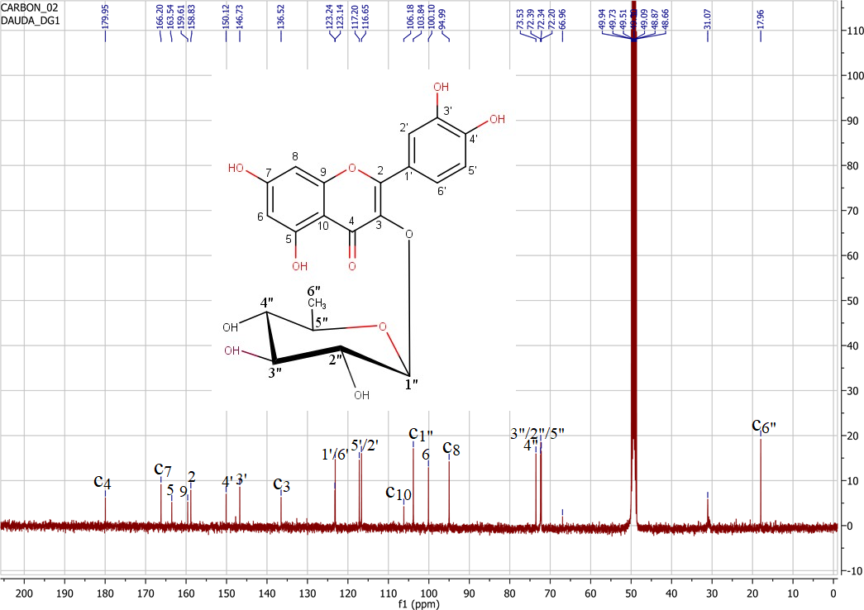
Figure 7: Proton decoupled ¹³C-NMR spectrum of DG1 in MeOD

Slide 15
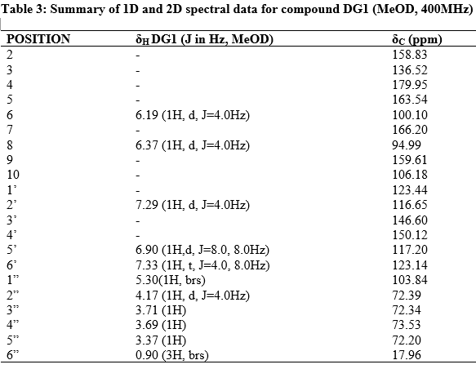
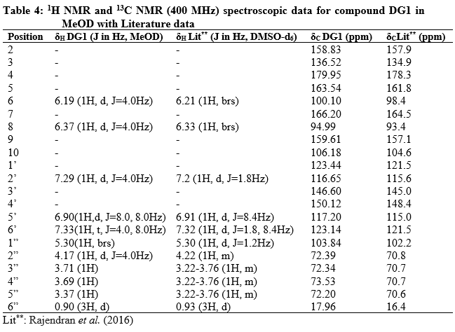

Slide 16
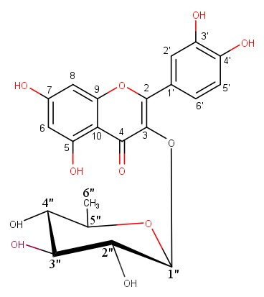
Isolation and Characterization of DG2
Figure 8: Quercetin 3-O-α-rhamnoside (Quercetrin)

Slide 17
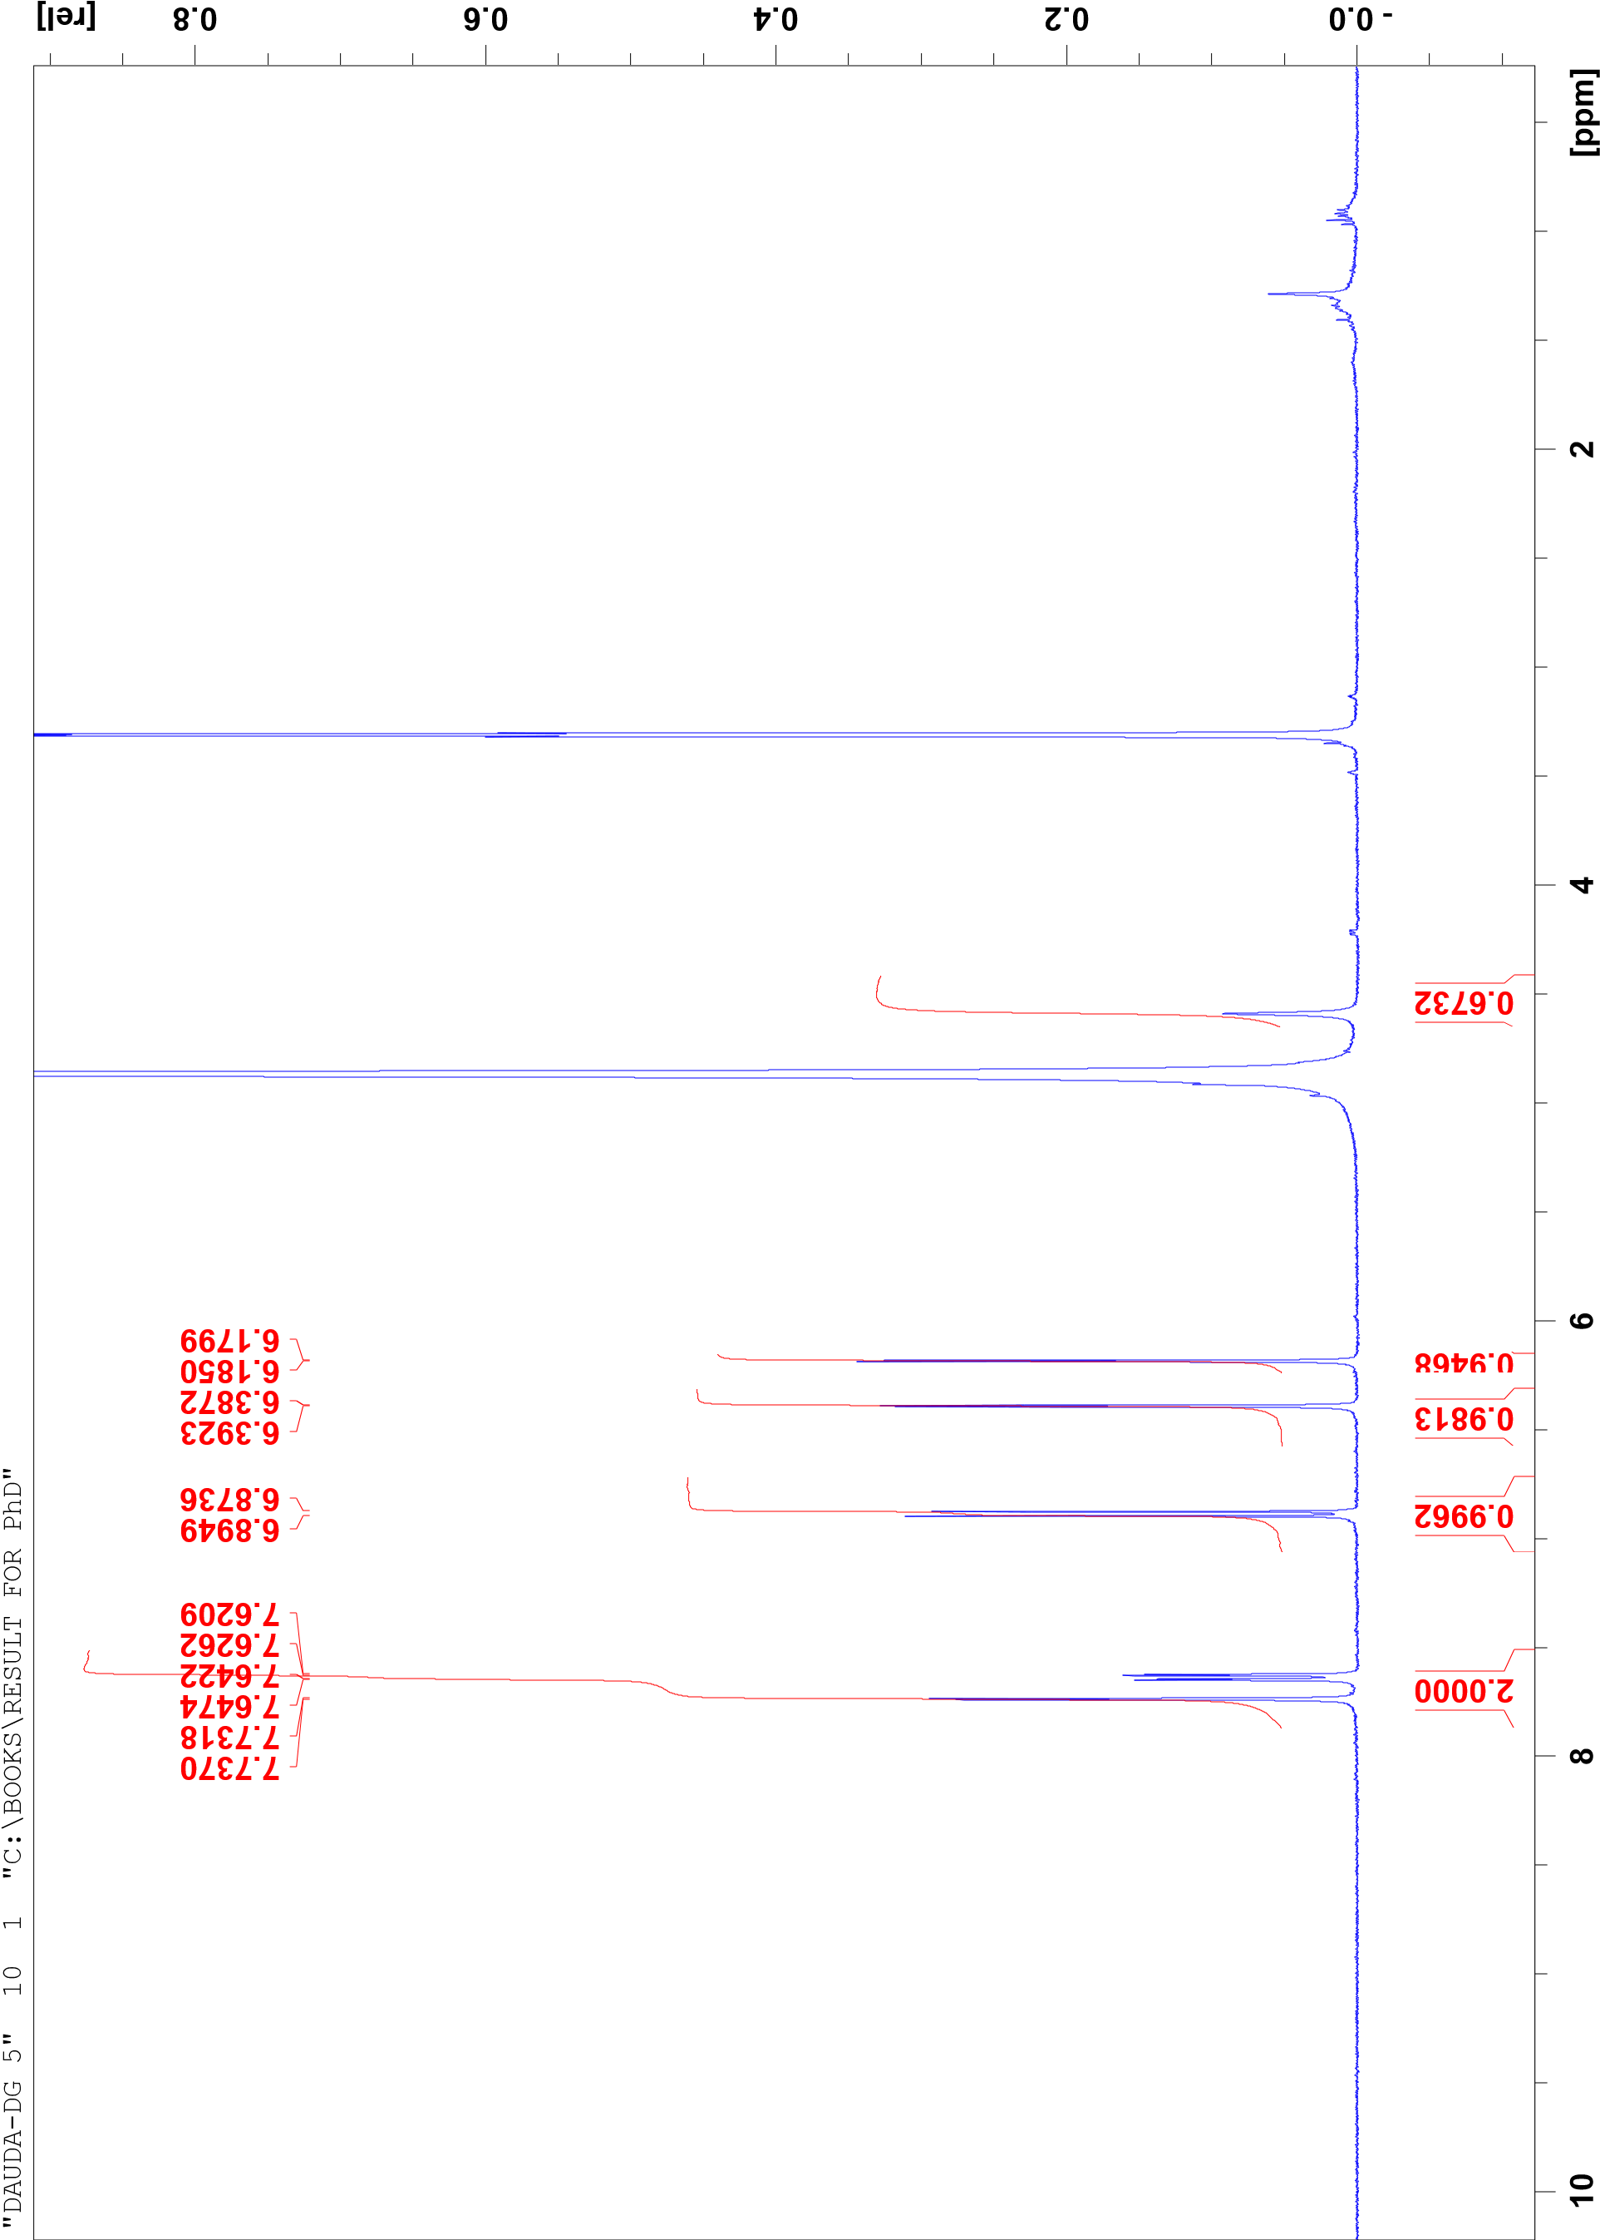
SPECTRAL ANALYSIS OF DG5
Figure 9: ¹H-NMR spectrum of DG5 in MeOD

Slide 18
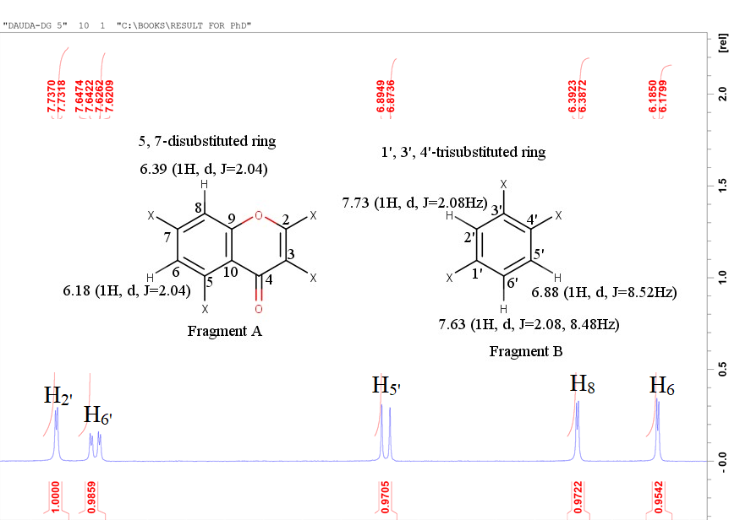
Figure 10: Expanded ¹H-NMR spectrum DG5 in MeOD (Aromatic region)

Slide 19
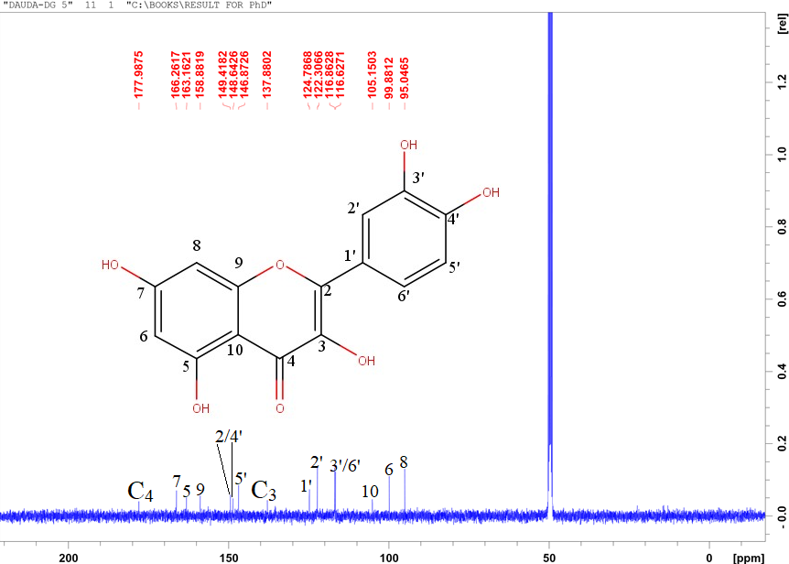
Figure 11: Proton decoupled ¹³C-NMR spectrum of DG5 in MeOD

Slide 20
Figure 12: DEPT experiment of DG5 in MeOD

Slide 21
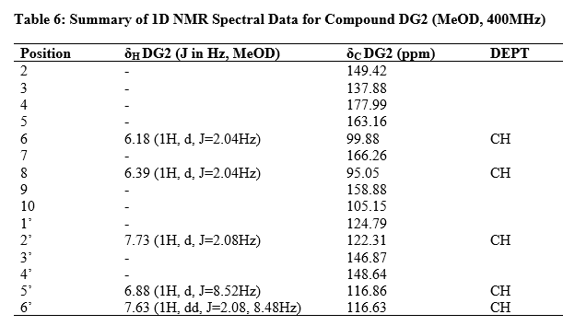
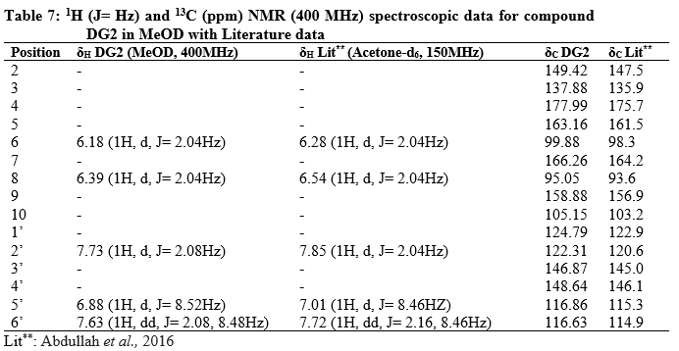

Slide 22
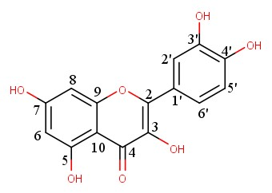
STRUCTURE OF DG5
Figure 13: 3, 5, 7, 3’, 4’-pentahydroxy flavone (Quercetin )
SUMMARY OF FINDINGS
Column chromatographic separation of n-butanol fraction led to the isolation of two compounds.
The class of compound isolated belongs to the flavonoid of the flavonol class.
CONCLUSION Compounds 1 and 2 were isolated for the first time from the plant and contributed to the chemical taxonomy of the plant.

Slide 23
References
Dauda G, Haruna AK, Hassan B, Sani YM, Haruna A, Abdullahi MI, Musa AM (2017) Prenylated Quercetin from the Leaves Extract of Globimetula oreophila (Hook. F) Danser. Niger. J. Sci. Res. 16, 725–729.
Dauda G, Ali BH, Muhammad SY, Muhammed MG, Muhammad MA, Hassan HS. (2023) Levels of trace metals content of crude ethanol leaf extract of Globimetula oreophila (Hook. f) danser growing on Azadirachta indica using atomic absorption spectroscopy. J. Curr. Biomed. Res. 3, 1397-1406.
Dauda G, Ali BH, Muhammed SY, Muhammad MG, Ismail AM, Muhammad MA, Hassan HS (2023) Qualitative and quantitative phytochemical profiling of ethnomedicinal folklore plant-Globimetula oreophila. J. Curr. Biomed. Res. 3, 1407-1426.
Arzu UT, Arzu BY, Fatima PK (2012) Antitumor and antibacterial activities of Viscum album L. grown on different host trees. Spatula DD. 2, 229–236
Polhill R, Wiens D (1998) Mistletoe of Africa; Royal Botanical Gardens, Kew: Richmond, UK; p. 370
Dauda G, Haruna AK, Musa AM, Hassan B, Mohammed IM, Magaji MG (2016). In-vivo antimalarial activity of ethanol leaf extract of Globimetula oreophila (Hook. F) Danser Azadiracchta Indica. Biol. Environ. Sci. J. Trop. 13, 55–59.

