Slide 1
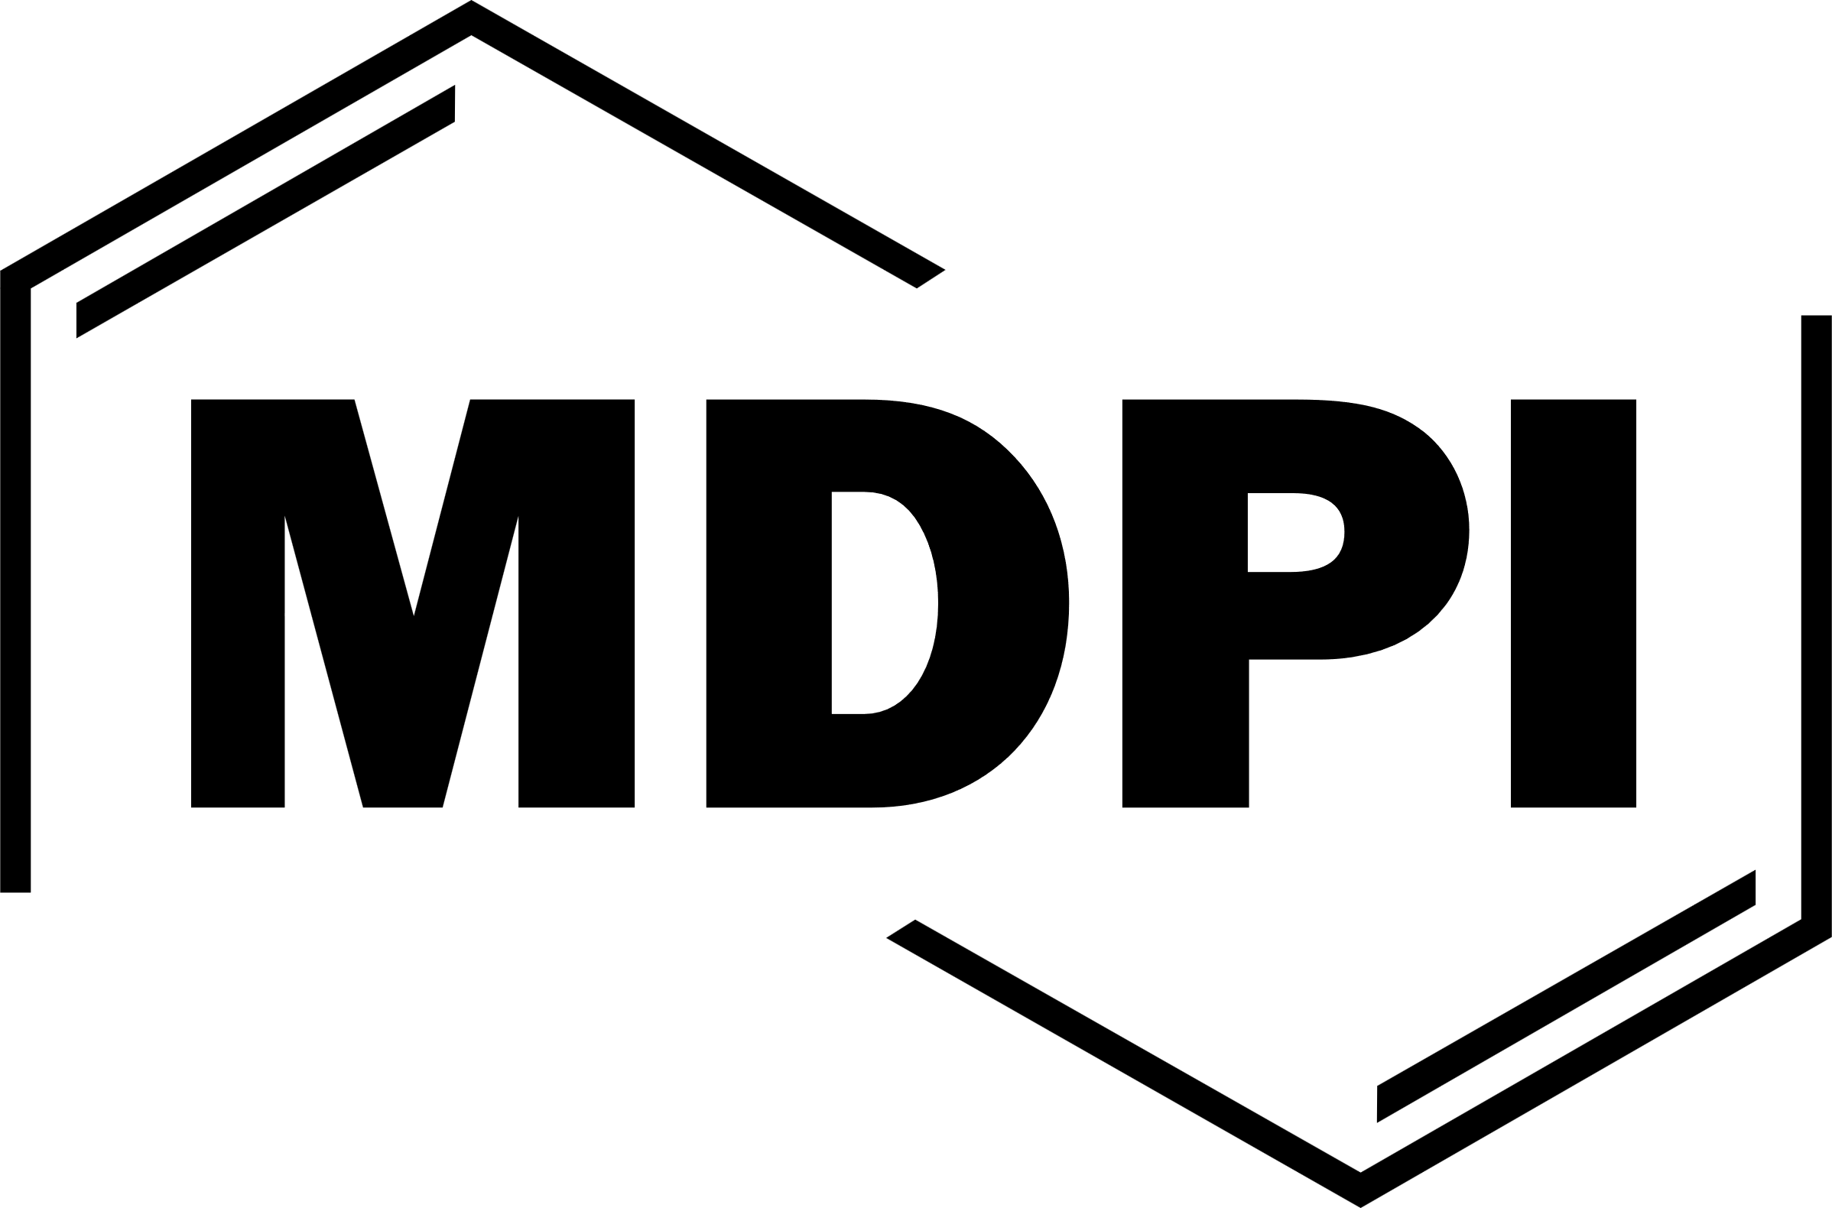
Studies on Anti-Cancer Agents from Natural Resources with Special Reference to Cannabis sativa & Datura metel L
Shrimanti Chakraborty¹, Piyush Kumar² and Manik Ghosh^{2*}
The 28th International Electronic Conference on Synthetic Organic Chemistry

Slide 2
CONTENTS
Why have we taken up this project?
What are our expectations?
What are we going to do?
How the experiment was performed?
What are our findings?

Slide 3
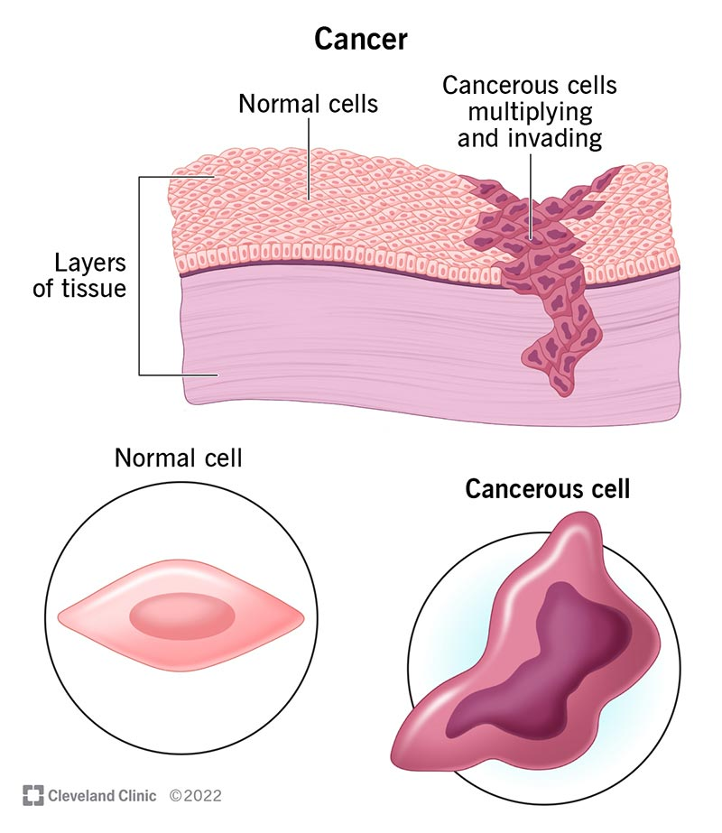
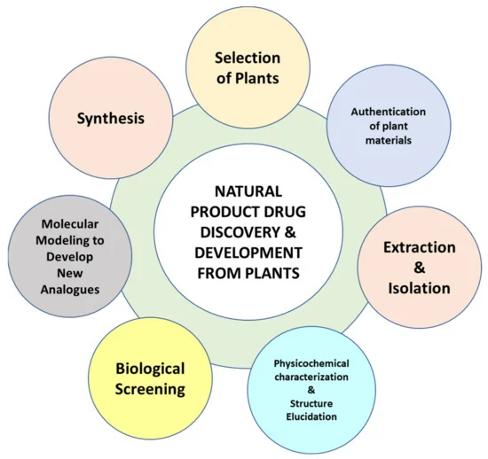
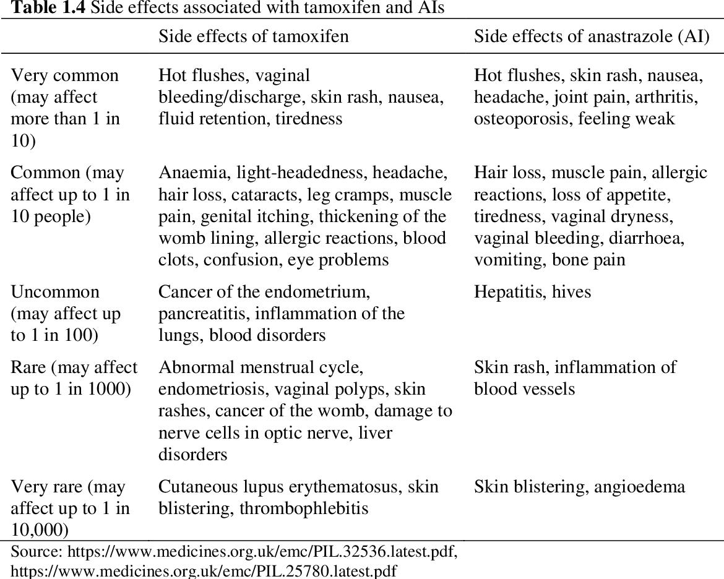
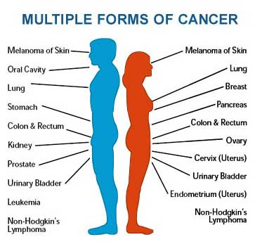
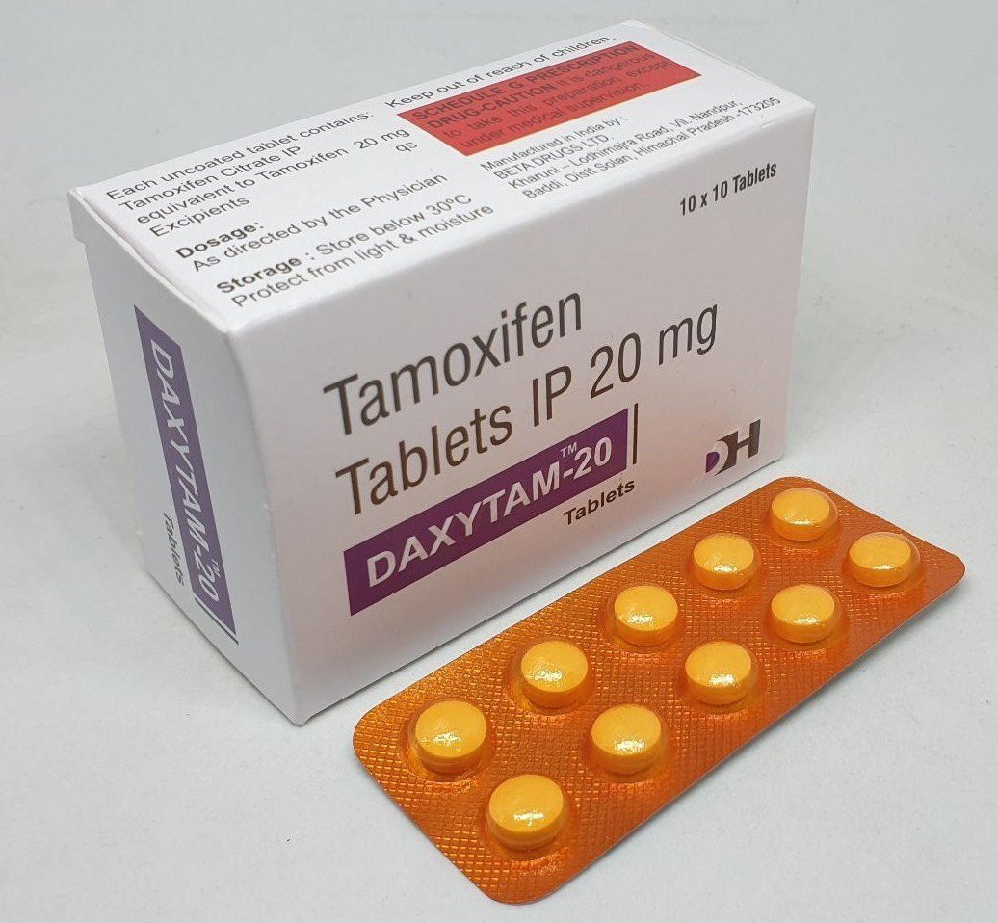
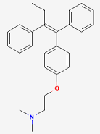
WHY HAVE WE TAKEN UP THIS PROJECT?
Notes:
https://my.clevelandclinic.org/health/diseases/12194-cancer
https://onlinesciencenotes.com/cancer-its-types-and-causes/
https://www.indiamart.com/proddetail/20-mg-tamoxifen-tablets-21160460230.html
https://pubchem.ncbi.nlm.nih.gov/compound/Tamoxifen
https://www.semanticscholar.org/paper/Investigating-barriers-to-tamoxifen-adherence-in-Moon/8211cc37e9dbf905df1183e1fdc703a0d7559d7d
https://www.mdpi.com/1420-3049/27/2/349#

Slide 4
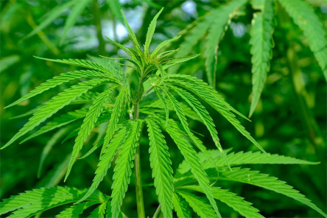
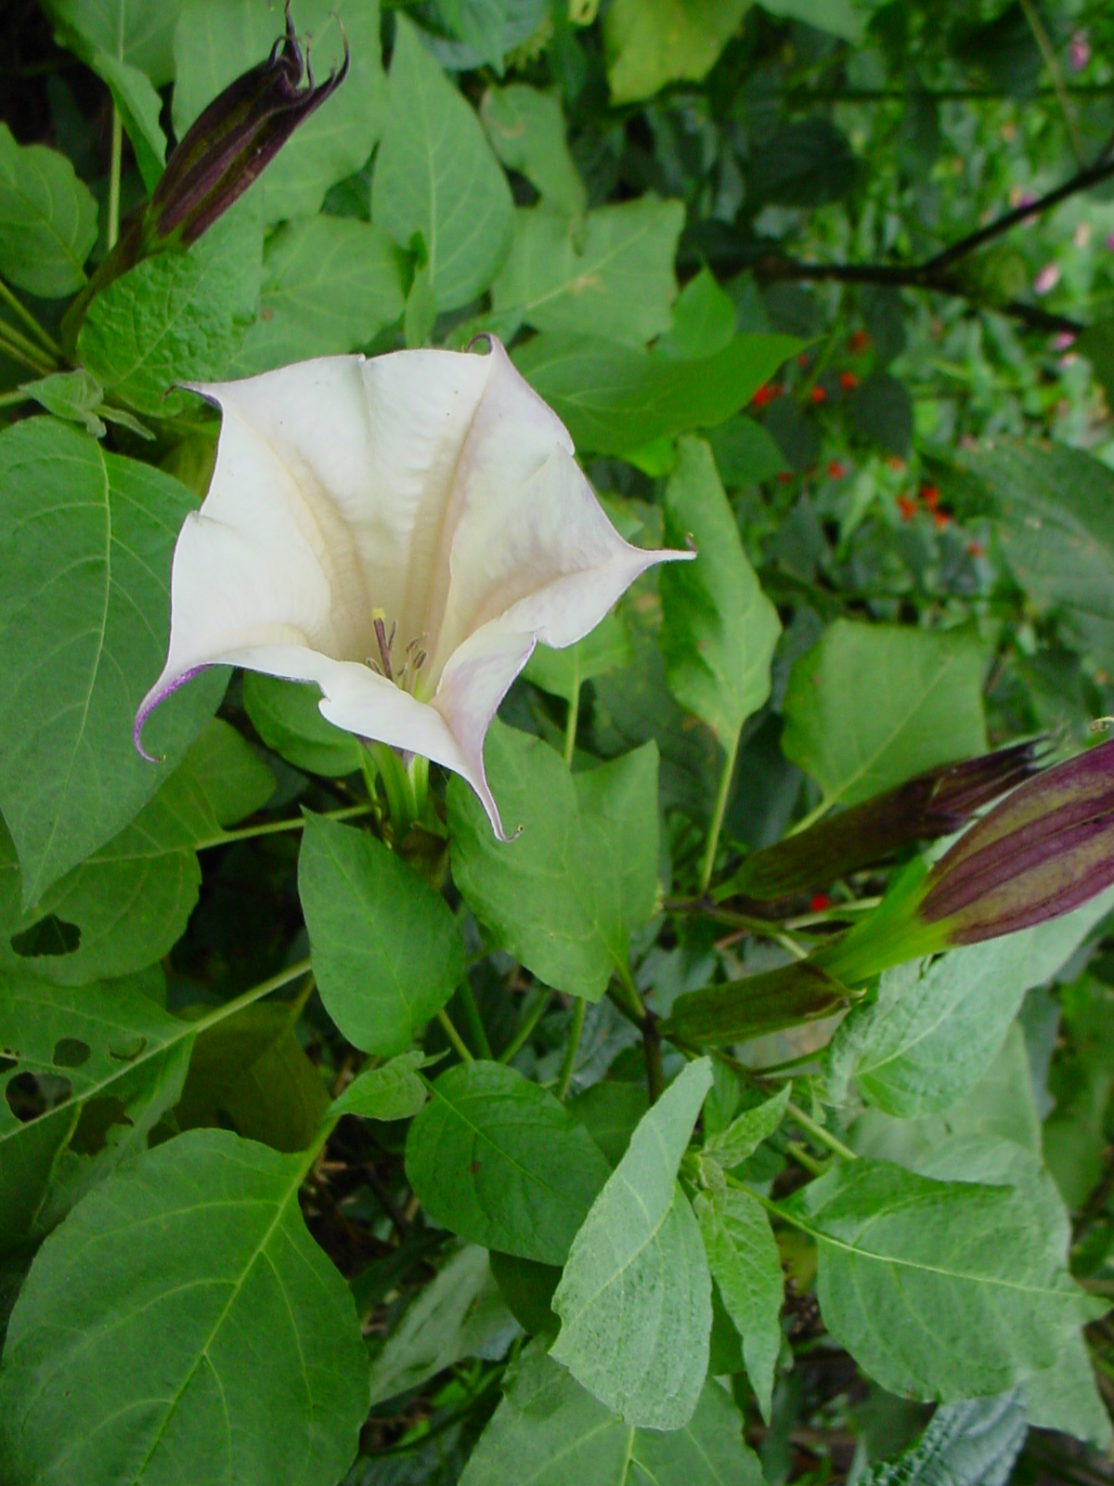
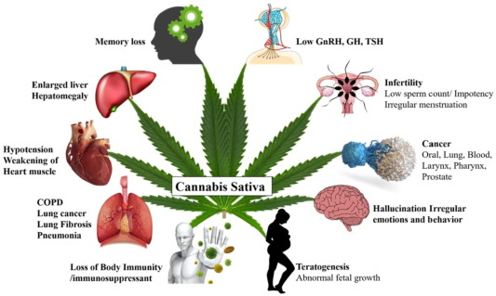
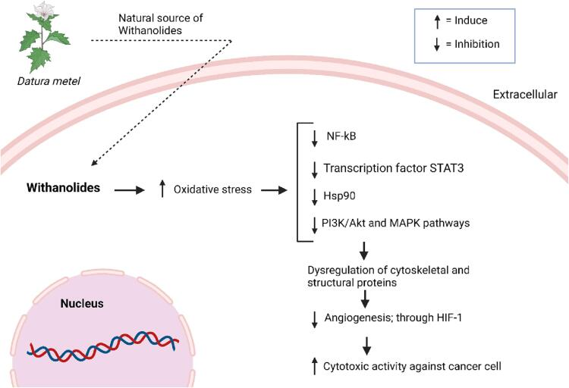
WHAT ARE OUR EXPECTATIONS?
Cannabis sativa
Datura metel L
Notes:
1C. https://www.sciencedirect.com/topics/neuroscience/cannabis-sativa
2C. https://www.sciencedirect.com/science/article/pii/S1319562X2100721X
3D. https://indiabiodiversity.org/species/show/32582
4D. https://europepmc.org/article/pmc/pmc10203738

Slide 5
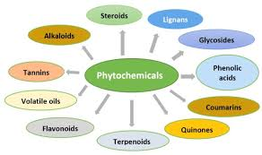
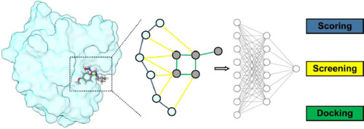
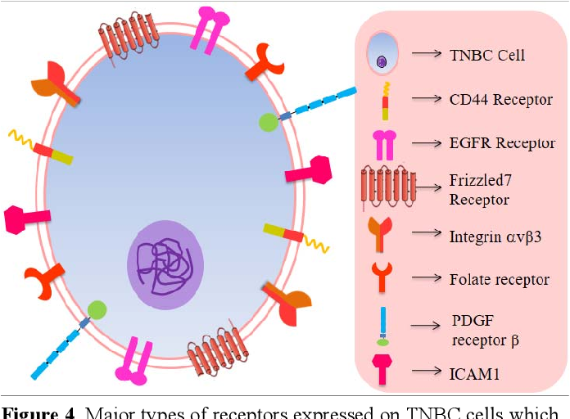
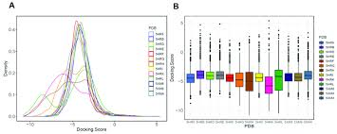
WHAT ARE WE GOING TO DO?
Selecting Phytoconstituents
Docking
Selecting Proteins
Comparing the Docking Scores of the Selected Receptors in contrast to that of the Phytoconstituents
Notes:
1. https://www.semanticscholar.org/paper/Current-advances-in-drug-delivery-systems-for-of-Mittal-Singh/9b4c4f824fd1ea11d20c1d16ad4064760c2e5c98
2. https://www.researchgate.net/figure/Some-major-classes-of-chemical-constituents-present-in-herbs-and-spices-Polyphenols-are_fig1_352372027
3. https://www.sciencedirect.com/science/article/pii/S2667318523000065
4. https://www.researchgate.net/figure/Comparison-of-docking-results-obtained-from-selected-binding-sites-on-each-AsfvPolX_fig3_357036542

Slide 6
HOW THE EXPERIMENT WAS PERFORMED?
Apigenine
Docking
Cannabigerol
Cannabichromene
Β-Caryophyllene Oxide
Breast cancer receptors
Rosmarinic acid
Luteolin
CDK4/6 (PDB ID:6GS7)
Epicatechin
Ferulic Acid
Atropine
EGFR (PDB ID:1M17)
Dinoxin B
Naringenin
Gallic Acid
Myrcene
Estrogen (PDB ID:3ERT)
Scopolamine
Cannabis sativa
Vitexin
Caryophyllene
Withametelin
Datura metel L
Combretastatin
Cannabidiol
PARP (PDB ID:5DS3)
Hyoscyamine
Β-myrcene
α-Humulene
PI3K (PDB ID:6B1O)
Withanolides
Cannabidiol acid
Strychnine
Naringin
α-pinene
THCA
Catechin
Linalool
Docking
p-OH–benzoic acid

Slide 7
WHAT ARE OUR FINDINGS?
Breast cancer receptors
Dinoxin B (-10.39)
Strychnine (-8.93)
CDK4/6 (PDB ID:6GS7)
Withametelin (-9.31)
Withanolides (-8.67)
THCA (-8.56)
Naringin (-8.54)
EGFR (PDB ID:1M17)
Withametelin (-8.78)
Strychnine (-8.95)
Dinoxin B (-10.72)
Datura metel L
Naringin (-9.19)
Estrogen (PDB ID:3ERT)
Withametelin (-10.69)
Cannabis sativa
Strychnine (-9.99)
Withanolides (-9.29)
THCA (-8.84)
Dinoxin B (-8.55)
Vitexin (-9.58)
PARP (PDB ID:5DS3)
Withametelin (-10.06)
Strychnine (-9.73)
Withanolides (-9.72)
Strychnine (-8.73)
PI3K (PDB ID:6B1O)

Slide 8
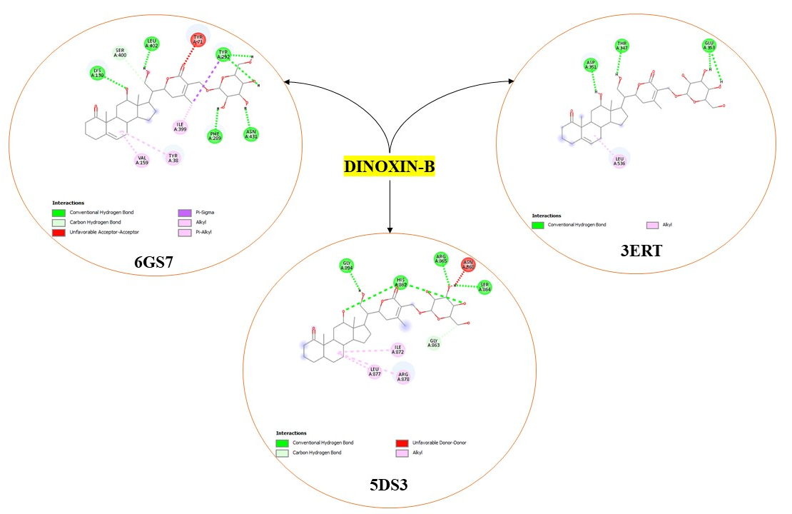
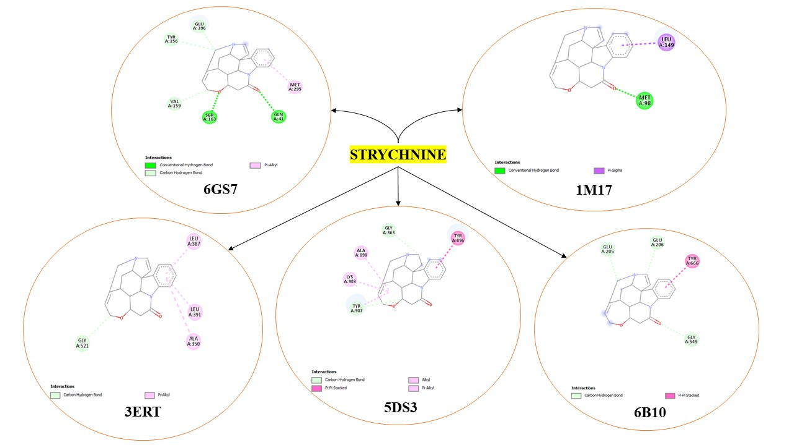
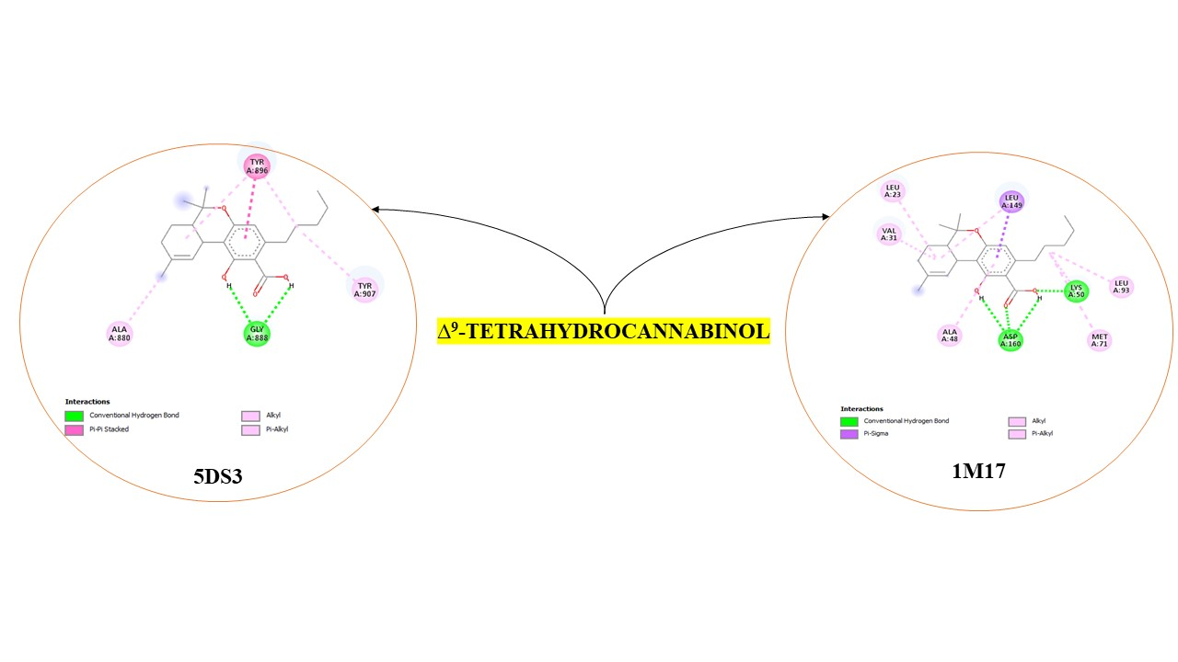

Slide 9
THANK YOU

