Slide 1
Phytochemical Constituents from Globimetula oreophila as Plasmepsin I and II Inhibitors in Antimalarial Drug Discovery: An In-silico Approach
Dauda Garba^{1, 2}*, Bila Hassan Ali², Bashar Bawa³, Abdulrazaq Sanusi⁴, Yahaya Muhammed Sani², Muhammad Garba Magaji⁵, Musa Ismail Abdullahi¹, Aliyu Muhammad Musa², and Hassan Halimatu Sadiya² .
¹Department of Pharmaceutical and Medicinal Chemistry, University of Abuja, 900105, Nigeria;
²Department of Pharmaceutical and Medicinal Chemistry, Ahmadu Bello University, Zaria 810107, Nigeria;
³National Agency for Food and Drug Administration and Control, Gusau, Zamfara, Nigeria;
⁴Department of Pharmaceutical Chemistry, Bauchi State University, Gadau, Nigeria.
⁵Department of Pharmacology and Therapeutics, Ahmadu Bello University, Zaria, Zaria 810107, Nigeria;
*Correspondence: dauda.garba@ymail.com; dauda.garba@uniabuja.edu.ng; Tel.: (D.G.); +2347069064878

Slide 2
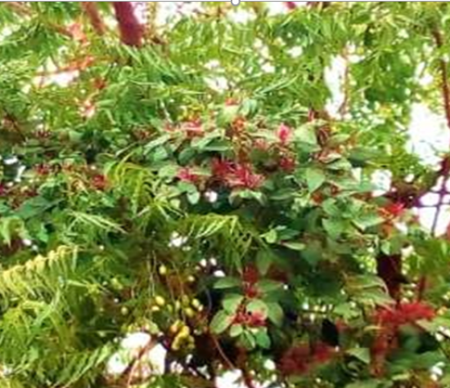
The plant
Cont’d….Introduction
Plate 1: Photograph of G. oreophila a hemiparasitic shrub on Azadirachta indica

Slide 3
INTRODUCTION
Globimetula oreophila, or mistletoe, a hemiparasitic plant, grows on dicotyledonous trees in tropical Africa, including Nigeria, Cameroon, Gabon, Congo, and the Central African Republic. It holds traditional medicinal value, with uses for diarrhea, stomachaches, headaches, and fevers, prepared by boiling its leaves and stems for oral consumption.
Ethnobotanical information indicates that G. oreophila has been used to cure various ailments, including diarrhea, stomachache, headache, and fever. As a treatment for these ailments, the leaves and stem are boiled and the resulting decoction is drunk (Arzu et al., 2012).

Slide 4
Introduction cont….
Previous phytochemical reports showed that the genus Globimetula contains several secondary metabolites such as carbohydrates, triterpenes, tannins, glycosides, alkaloids, flavonoids, and saponins (Dauda et al., 2016).
In previous studies, we reported the isolation of a prenylated quercetin from the ethyl acetate fraction of this plant (Dauda et al., 2016); elemental analysis of the crude ethanol extract (Dauda et al., 2023); and qualitative and quantitative phytochemical profiling of this plant (Dauda et al., 2023)
AIM
This study aims to evaluate the inhibitory activity of phytochemical constituents from G. oreophila leaf extract as a malaria-associated protein using an in silico docking study.
OBJECTIVES
Investigate the antimalarial mode of action and absorption, distribution, metabolism, and excretion (ADME) characteristics of the identified compounds via in silico analysis using the crystal structure of P. falciparum proteases

Slide 5
Software, Hardware and databases
AutoDock Vina (Trott and Olson, 2011), Molegro Molecular Viewer (MMV) (www.nlcbio.com), MGL tools (Sanner, Olson, and Spehner, 1996), UCSF Chimera (Pettersen et al., 2004), ChemDraw ultra.12, Discovery Studio, Spartan 04, SwissAdme (online server), Protox-II (online server), Mac OSX, Windows (Intel processor, Corei7).
Protein crystal structures
High-resolution, non-mutant crystal structure files of the following enzymes from P. falciparum were obtained from RCSB Protein Data Bank (http://www.rcsb.org/pdb) Plasmepsin-I [Plm-I; PDB ID: 3QS1] (Bhaumik et al., 2011), Plasmepsin-II [Plm-II; PDB ID: 1LF3] (Asojo et al., 2003).

Slide 6
In-silico antimalarial studies
A total of five (5) compounds were isolated from the G. oreophila plant; Stigmasterol, quercetin, quercetin-3-rhamnoside, 2’, 4-dihydroxy, 4’-methoxy chalcone, and prenylated dihydrostilbene. Their theoretical oral bioavailability and interaction with a validated crystal structure of some P. falciparum drug targets were studied in-silico.
Evaluation of theoretical oral bioavailability
The oral bioavailability of the characterized compounds (DG1, DG2, DG3, DG4, and DG5) was predicted theoretically based on Lipinski’s rule of five, on the SWISSADME server (http://www.swissadme.ch/index.php).
Protein structure preparation
As already mentioned, the crystal structures were obtained from the protein data bank (PDB). Before docking, residues located within 5.0Å around the native ligands. Chimera UCSF was used to remove all crystallographic water molecules, ions, and bound ligands from the 3D structures retrieved from PDB (Pettersen et al., 2004). The isolated receptors were prepared and saved as rec.pdb. AutoDock Tools (Sanner et al., 1996) were used to edit the rec.pdb files by adding polar hydrogen and Gastegier charges and saved them as pdbqt files.

Slide 7
Ligand structure preparation
The 2D structures of the characterized compounds (D1, DG2, DG3, DG4, and DG5) were generated using ChemDraw ultra.12, and Spartan 04 was used to convert the 2D structures to 3D. Using the AMI semi-empirical method, geometrical optimization was carried out on all the compounds using the Spartan software, and the optimized structures were stored as mol2 files. AutoDock Tools was used to add hydrogen and Gastegier charges and saved as mol2 files to pdbqt format.
Molecular docking analysis
The docking procedure for each protease enzyme was validated before docking the test compounds by separating the co-crystallized ligand from the enzyme crystal structure and re-docking it using the set-up parameters. The procedure that gives conformation superimposable with a geometrical conformation of the co-crystallized ligand in the active site was chosen (De Oliveira et al., 2013).
Before molecular docking, the active sites were defined according to the coordinates of the crystallographic structures of both enzymes by defining the grid box, and the best pose was obtained which was used for further studies. The UCSF Chimera was further used for post-docking visualization and pre-MD preparations of all systems (ligands and receptors).

Slide 8
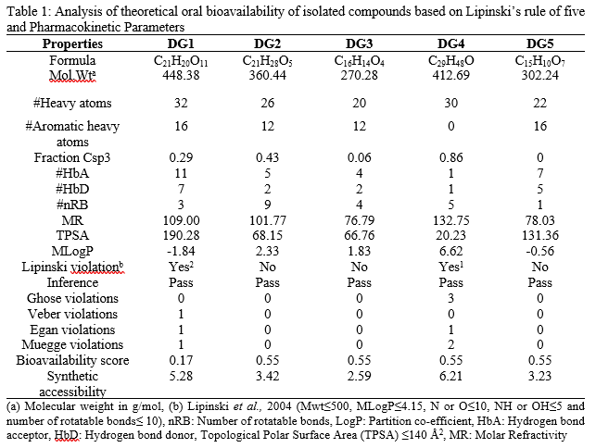
RESULTS

Slide 9
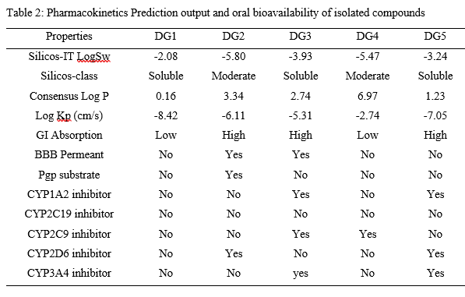

Slide 10
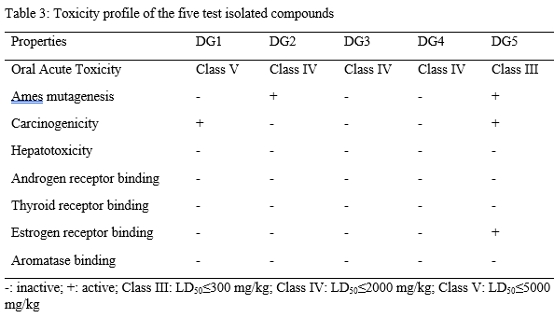

Slide 11
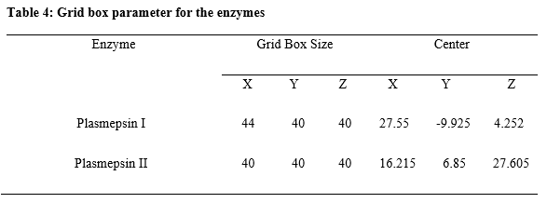
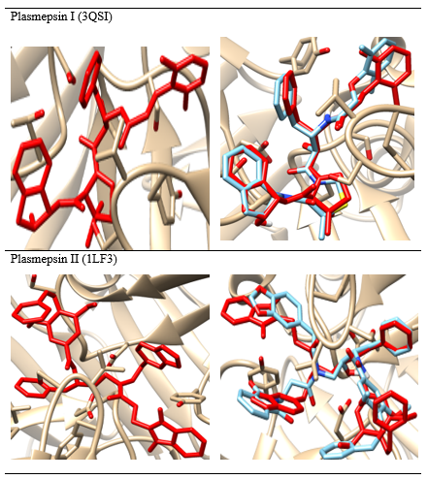
Molecular docking studies Grid box
Validation of docking procedure
Table 5: The crystal structures of enzyme complexes and re-docked ligands super-imposed on the crystal structures for validation

Slide 12
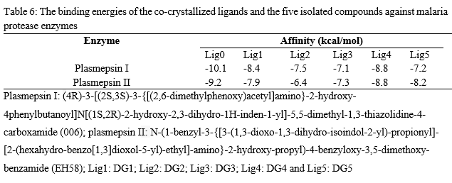
Binding Affinity of Ligands to the protease enzymes

Slide 13
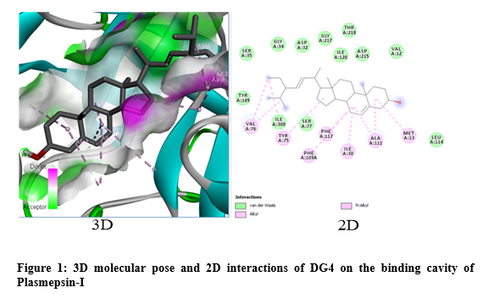
The binding pose and binding interaction analysis of Plasmepsin-I

Slide 14
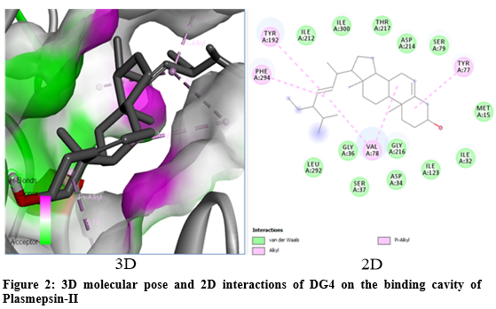

Slide 15
SUMMARY OF FINDINGS
Overall, the molecular docking analysis of the isolated compounds against Plasmepsin I and Plasmepsin II showed better binding energy with the receptor at the various active sites; suggesting they could inhibit protease enzymes in both the pre-erythrocytic and erythrocytic stage of malarial parasite’s life cycle.
Conclusion
The isolated compounds inhibited the protease enzymes at the active site with good binding energy. Thus, the secondary metabolites from G. oreophila leaves could lead to further development of potent plasmepsin inhibitors for the prevention and treatment of malaria.
CONTRIBUTIONS TO KNOWLEDGE
In-silico studies on the isolated compounds reveals their interactions with Plasmodium falciparum enzymes.

Slide 16
Few cited reference
Dauda G., Haruna, A. K., Musa, A.M., Hassan, B., Mohammed, I. M. and Magaji, M. G. (2016). Biological and Environmental Sciences Journal for the Tropics 13(2). ISSN 0794 – 9057
Dauda, G., Haruna, A. K., Hassan, B., Sani, Y. M., Haruna, A., Abdullahi, M. I. And Musa, A. M. (2017). Prenylated Quercetin from the Leaves Extract of Globimetula Oreophila (Hook. K) Danser. Nigerian Journal of Scientific Research, 16 (6)
Dauda G, Ali BH, Muhammad SY, Muhammed MG, Muhammad MA, Hassan HS. (2023) Levels of trace metals content of crude ethanol leaf extract of Globimetula oreophila (Hook. f) danser growing on Azadirachta indica using atomic absorption spectroscopy. J. Curr. Biomed. Res. 3, 1397-1406.
Dauda G, Ali BH, Muhammed SY, Muhammad MG, Ismail AM, Muhammad MA, Hassan HS (2023) Qualitative and quantitative phytochemical profiling of ethnomedicinal folklore plant-Globimetula oreophila. J. Curr. Biomed. Res. 3, 1407-1426.
Arzu, U. T., Arzu, B. Y. & Fatima, P. K. (2012). Antitumor and antibacterial activities of Viscum album L. grown on different host trees. Spatula DD, 2(4), 229-236

