Slide 1
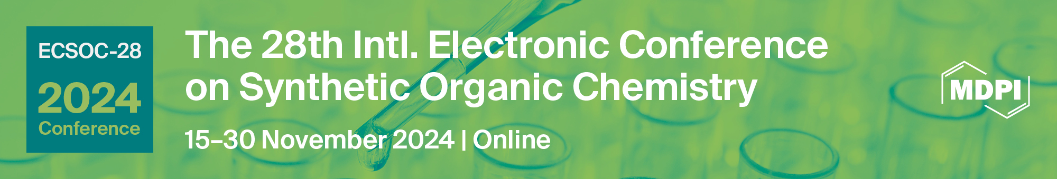
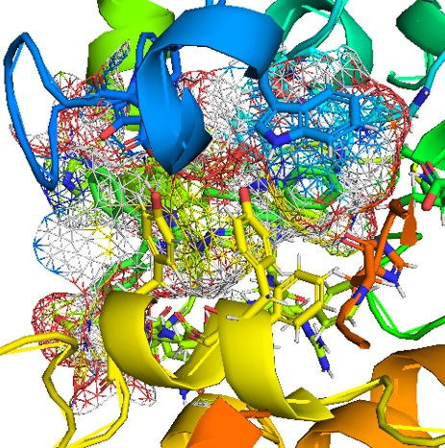
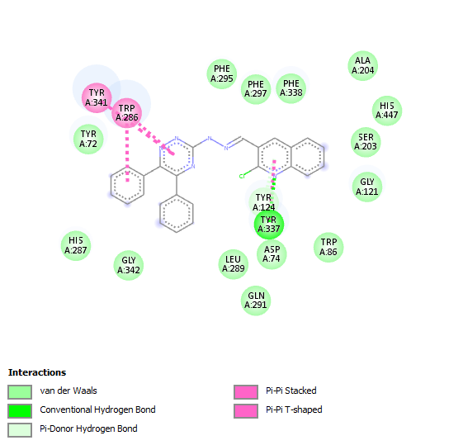
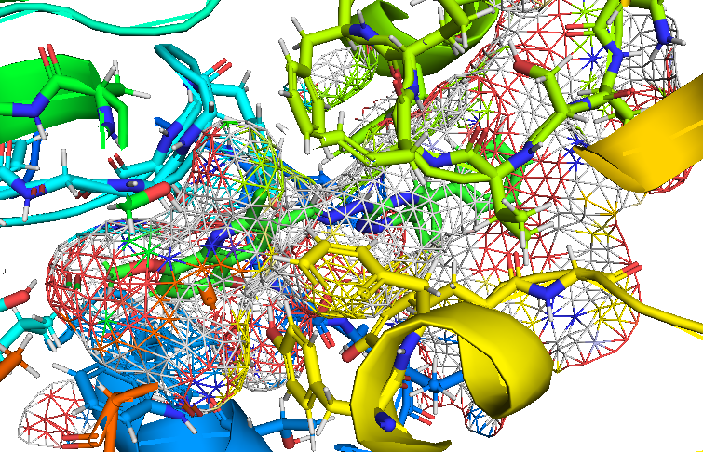
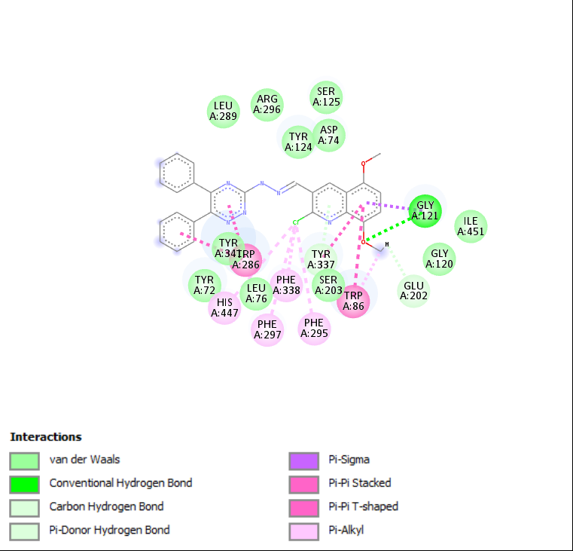
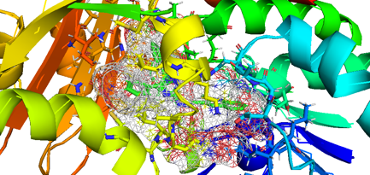
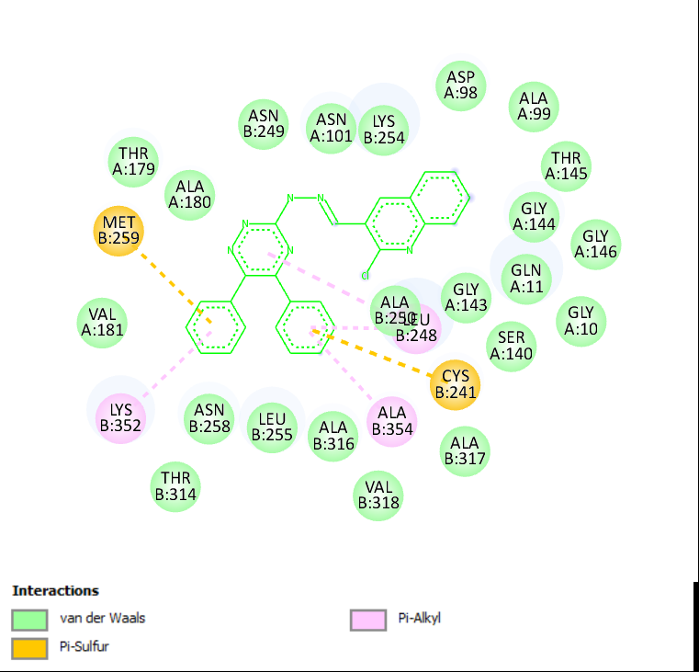
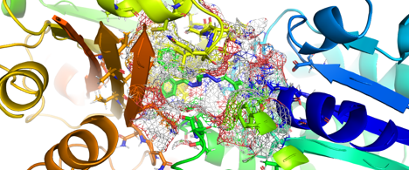
Simple Synthesis of New Bioactive Nitrogenous Compounds with In Silico Study
Ait Belkacem Amira1
Affiliation1 Laboratory of Synthesis of Molecules With Biological Interest, Department of Exact Sciences; University of Frères Mentouri Constantine 1; Compus de Chaabet Ersas; Université des Frères Mentouri-Constantine; Constantine; 25000; Algeria; aitbelkacem1amira@gmail.com
INTRODUCTION & AIM
RESULTS & DISCUSSION
Nitrogenous compounds have significant biological activity and play a crucial role in the treatment of numerous diseases such as diabetes [1], Alzheimer’s [2,3], and cancer [4]. Their ability to interact with various biological targets makes them valuable in drug development and therapeutic applications. develop medicament treats more than one disease it’s verry important, and interesting to reduce number of medicinal medicaments in the future.
This study focuses on anti-Alzheimer's and anti-cancer chromophores to inhibit both diseases with the same remedy.
Inhibition of acetylcholinesterase aims to alleviate the symptoms of the disease, as this enzyme is responsible for the degradation of acetylcholine in the brain [5]. And Inhi-bition of tubulin can stop cell division in cancerous cells and may help overcome re-sistance to medication in the treatment of various cancers [6]. However, a limitation of some drugs is their non-selective binding to tubulin.
For this study, we use 3-hydrazinyl-1,2,4-triazine with quinoline to synthesize new nitrogenous compound derivatives, which will then be evaluated as potential an-ti-Alzheimer's and anti-cancer agents through advanced docking studies. This approach will involve assessing the compounds' interactions with specific biological targets impli-cated in Alzheimer's, such as acetylcholinesterase, and in cancer, such as tubulin.
Furthermore, a comprehensive ADMET analysis will be conducted to evaluate the pharmacokinetic profiles of these compounds, to study their effectiveness in both AChE and tubulin.
The general procedure for synthesizing these compounds (Scheme1) was successfully completed, resulting in the formation of (E)-2-chloro-3-((2-(5,6-diphenyl-1,2,4-triazin-3-yl)hydrazono)methyl)quinoline and (E)-2-chloro-3-((2-(5,6-diphenyl-1,2,4- triazin-3-yl)hydrazono)methyl)-5,8-dimethoxyquinoline (Figure 1), with excellent yields. The synthesis involved a simple condensation reaction between quinoline derivatives and 3-hydrazinyl-1,2,4-triazine at room temperature without the use of a catalyst. The structures of the compounds were confirmed by NMR spectroscopy (Scheme 1).
Docking study
the simulations of these compounds were evaluated for their inhibitory ability using Chimera, where the active site of the target atoms is fixed and the chromophore is flexible. As is well known, this program use a genetic algorithm (GA) to dock flexible ligands into protein binding site.
A1 with AChE
METHOD
A2 with AChE
Methods:
Ligand preparation:
Preparation of derivative compounds for docking studies involved to designing small molecules, optimize their geometry, and minimize their energy. The resulting structures were then saved in the .pdb format.
Targets Preparation:
The acetylcholinesterase (AChE) protein (PDB ID: 4m0e) [7], and tubulin protein (PDB ID: 1sa0) [8], were obtained in .pdb format from the Protein Data Bank. The targets were prepared by removing water molecules, trimming unnecessary chains, and adding polar hydrogens. Energy minimization was then performed, and the results were visualized and analyzed.
Synthesis of Compounds:
An equimolar mixture of quinoline derivatives and 3-hydrazinyl-5,6-diphenyl-1,2,4-triazine was stirred at room temperature in ethanol (EtOH) without a catalyst. The precipitate was then filtered, washed with EtOH, and recrystallized from EtOH.
A1 with Tubuline
A2 with Tubuline
Table of ADMET study results.
Entries | Lipinski’s rules | Veber’s rules | BBB | AMES toxic | carcinogenic | P-glycoprotein Inhibitor
A 1 | + | + | + | - | - | -
A 2 | + | + | + | - | - | +
CONCLUSION
Nitrogenous compounds were successfully synthesized with excellent yields using a simple condensation reaction between quinoline derivatives and 3-hydrazinyl-1,2,4-triazine, without the need for a catalyst. These compounds have demonstrated effective inhibition of AChE and tubulin in docking studies, exhibiting high affinity and good scoring, particularly compound A2, which shows strong interactions within the active site. Additionally, the ADMET study indicates that these compounds can cross the
FUTURE WORK / REFERENCES
Kumar, H.; Dhameja, M.; Kurella, S.; Uma, A.; Gupta, P. Synthesis, in-vitro α-glucosidase inhibition and molecular docking studies of 1,3,4-thiadiazole-5,6-diphenyl-1,2,4-triazine hybrids: Potential leads in the search of new antidiabetic drugs. Mole Stru 2023, 1273, 134339.
Ge, X.; Xu, Z. 1,2,4‐Triazole hybrids with potential antibacterial activity against methicillin‐resistant Staphylococcus aureus. ARCH PHARM 2020, 354, 2000223.
https://sciforum.net/event/ecsoc-28

