Slide 1
SYNTHESIS, CHARACTERIZATION, AND IN-SILICO ADMET STUDIES OF SOME NEW PHENYLHYDRAZONE DERIVATIVES AS POTENT FOR ANTIMICROBIAL ACTIVITIES
CONFERENCE SEMINAR
PRESENTED
BY
RABIU BAKO
NOVEMBER, 2024

Slide 2
PRESENTATION OUTLINE
Introduction
Statement of Research Problem
Justification of the Study
Aim and objectives of the Study
Research Hypothesis
Materials and Methods
Results and Discussion
Summary of finding
Conclusion
References

Slide 3
INTRODUCTION
Infectious diseases caused by pathogenic agents have been a major problem to humans and account for the death of millions of people annually worldwide (Reygaert, 2018)
Some of these diseases threaten the health of millions people especially where no cure or vaccine exists (Alberta et al., 2020)
Recently infectious disease caused by corona virus (covid-19) became one of the top caused of death across the globe (WHO, 2020).

Slide 4
INTRODUCTION cont.
Antimicrobial resistance (AMR) posses urgent public health problem and economic challenge across the world (WHO, 2023).
AMR occurs when pathogens change over time and no longer respond to antimicrobial drugs making the infection hard to treat (WHO, 2023)
Misuse and overdose of antimicrobial drugs in humans result to antimicrobial drug resistance (Alberta et al., 2020).

Slide 5
INTRODUCTION cont.
Hydrazone: Hydrazone are class of organic compounds formed by replacement of oxygen of carbonyl compound to carbon nitrogen double (R-CH=N-) (Ii et al., 2021).
Hydrazone and their derivatives posses wide spectrum of biological activities (Nester et al., 2020).

Slide 6
STATEMENT OF RESEARCH PROBLEM
An estimated 700,000 deaths occur globally every year as a result of infections caused by antimicrobial resistant pathogens (AMR) (WHO., 2022).
AMR remains one of the top global public health threats facing humanity and
nearly 5million people died from AMR-related illness across the globe in 2019 (Murray et al., 2022).
Over a million people are dying yearly due to infections diseases such as lower respiratory, bloodstream, and intra-abdominal infections, because bacteria are resistant to treatment (WHO, 2022).

Slide 7
JUSTIFICATION OF THE STUDY
Phenylhydrazone is a new promising synthetic compounds which have been reported to have exhibited antimicrobial activity ( Painuli et al., 2023).
In order to control this global challenges of antimicrobial drug resistance there is need to search for new lead compounds with high efficacy and non-toxic effects (Ragab et al., 2022).

Slide 8
AIM OF THE STUDY
The aim of this research is to design, synthesize, characterize, and evaluate the antimicrobial activity of the phenylhydrazone derivatives through in-vitro and computational studies.

Slide 9
OBJECTIVES OF THE STUDY
The specific objectives of the research are:
Design some substituted Phenylhydrazones derivatives based on previous studies and evaluate their in-silico ADMET
Synthesize new Phenylhydrazones (condensation reaction)
Characterize the compounds by spectroscopic techniques
Screen the synthesized compounds for antimicrobial activities using in- vitro model.
Predict the molecular interaction of the compounds against DNA gyrase using computational model.

Slide 10
RESEARCH HYPOTHESIS
Null Hypothesis (H₀)
The newly synthesized Phenylhydrazone and pyrazoline derivatives do not possess antimicrobial activity.
Alternative Hypothesis (Ha)
The newly synthesized Phenylhydrazone and pyrazoline derivatives possesses antimicrobial activity.

Slide 11
MATERIALS AND REAGENTS
EQUIPMENT / APPARATUS | REAGENTS | SOFTWARE
Analytical grade Weighing balance | 4-bromoacetophenone | Auto Dock Vina version, 2011
Magnetic stirrer | 4-nitrophenylhydrazine | UCSF Chimera
Gallenkamp melting point | 2,4-dinitrophenylhydrazine | MGL tools
FTIR spectrometer | Phenyl-hydrazine & n-hexane | Marvin JS Chem. Sketch)
NMR spectrometer | 3-nitroacetophenone | Accelerys Discovery Studio,
Oven & incubation Refrigerator | chloroform &acetic acid Absolute ethanol & Ethyl acetate | Swiss ADME, Spartan 14

Slide 12
METHODs

Slide 13
METHODs
Extensive literature review was conducted for Phenylhydrazone and Pyrazoline derivatives
Designed library of 33 Phenylhydrazone and Pyrazoline derivatives
(using chem.-draw)
Literature data search designed library
(using scifinder)
10-compounds were found novels
The 10 novels Hydrazone and Pyrazoline derivatives were virtually screened for their in-silico ADMET

Slide 14
METHOD
Cpd R₁ R₂ R₃ R₄
HS1 H Br NO₂ NO₂
HS2 H Br H NO₂
HS3 NO₂ H H NO₂
HS4 NO₂ H NO₂ NO₂
HS5 NO₂ H H H
Scheme for Phenylhydrazone synthesis 1–5

Slide 15
METHOD
Fig; 3. Reaction mechanism of Phenylhydrazone

Slide 16
OBJECTIVE-1 RESULT AND DISCUSSION LIBRARY OF PHENYLHYDRAZONES AND THEIR IN-SILICO ADMET PARAMETERS

Slide 17
Phenylhydrazones Derivatives

Slide 18
PHENYLHYDRAZONE DERIVATIVES

Slide 19
RESULTS AND DISCUSSION FIVE NEW PHENYLHYDRAZONES FILTERED FROM THE LIBRARY

Slide 20
RESULT AND DISCUSSION
Table:2. . Pharmacokinetics Properties of Phenylhydrazone derivatives
 | Lipinski’s rule of five
Code | Mol.Wt (g/mol) | HbA | HbD | nRB | LogP | Lipinski | GIA | BA Score
HS1 | 379.17 | 5 | 1 | 5 | 5.22 | Yes | High | 0.55
HS2 | 334.17 | 3 | 1 | 4 | 4.79 | Yes | High | 0.55
HS3 | 300.27 | 5 | 1 | 5 | 4.46 | Yes | High | 0.55
HS4 | 345.27 | 7 | 1 | 6 | 4.89 | Yes | Low | 0.55
HS5 | 255.27 | 3 | 1 | 4 | 4.03 | Yes | High | 0.55
Cipro. | 331.34 | 5 | 2 | 3 | 1.98 | Yes | High | 0.55
Terbinafine | 291.43 | 1 | 0 | 4 | 4.88 | Yes | High | 0.55
Mol.wt; Molecular weight , GIA; gastrointestinal absorption, BA; bioavailability

Slide 21
RESULT AND DISCUSSION
Table:6. In-silico toxicity studies of Phenylhydrazone derivatives
 | PREDICTED COMPOUND OF ORGAN TOXICITY
CODE | LD50 mg/kg | Toxicity Class | Cyto | Carcino | Hepato | Immuno
HS1 | 1900 | 4 | Inactive (0.67) | Inactive (0.54) | Inactive (0.54) | Active (0.68)
HS2 | 1800 | 4 | Inactive (0.65) | Active (0.59) | Active (0.55) | Inactive (0.83)
HS3 | 250 | 3 | Inactive (0.72) | Active (0.57) | Active (0.53) | Inactive (0.95)
HS4 | 1000 | 4 | Inactive (0.74) | Active (0.63) | Active (0.55) | Inactive (0.79)
HS5 | 300 | 3 | Inactive (0.69) | Inactive (0.68) | Active (0.57) | Inactive (0.97)
LD; Lethal Dosage Cytotoxicity, carcinotoxicity, immunotoxicity & Hepatoxicity

Slide 22
OBJECTIVE-2 RESULTS AND DISCUSSION
PHYSICO-CHEMICAL PROPERTIES OF THE SYNTHESIZED PHENYLHYDRAZONE DERIVATIVES

Slide 23
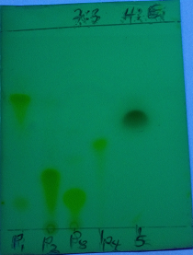
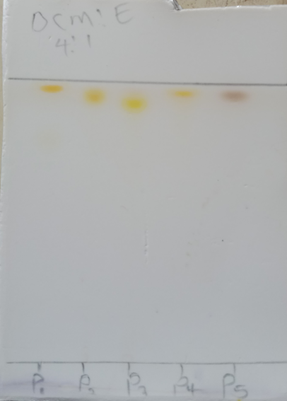
RESULT AND DISCUSSION
H:E (7:3) DCM:E (4:1)
Monitor TLC profile of 5 Phenylhydrazone derivatives

Slide 24
RESULTS AND DISCUSSION
Table:8 Yield and Physico chemical data of the five Phenylhydrazone derivatives.
Code | Mol. Formula | Mol. Wt. g/mol) | Color | M.P. (⁰C) | R_{f} Value | Yield (%)
HS1 | C₁₄H₁₁BrN₄O₄ | 379.17 | Pink | 213-215 | 0.91 | 40.00
HS2 | C₁₄H₁₂BrN₃O₂ | 334.17 | Brown | 220-222 | 0.85 | 67.00
HS3 | C₁₄H₁₂N₄O₄ | 300.27 | Sandy-brown | 213-215 | 0.83 | 67.00
HS4 | C₁₄H₁₁N₅O₆ | 345.27 | Yellow | 210-212 | 0.87 | 89.00
HS5 | C₁₄H₁₃N₃O₂ | 255.27 | Reddish Brown | 110-112 | 0.89 | 81.00

Slide 25
RESULTS AND DISCUSSION
SPECTRAL ANALYSIS; FTIR, ¹H-NMR, AND DEPTQ CONFIRMED THE STRUCTURE OF PHENYLHYDRAZONE DERIVATIVES

Slide 26
FIGURE 5: IR SPECTRUM FOR HS1

Slide 27
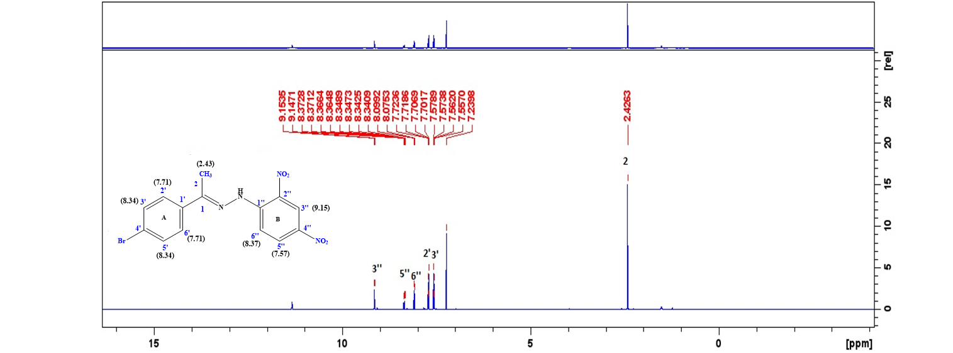
Fig.6 ¹HNMR Spectrum of HS1

Slide 28
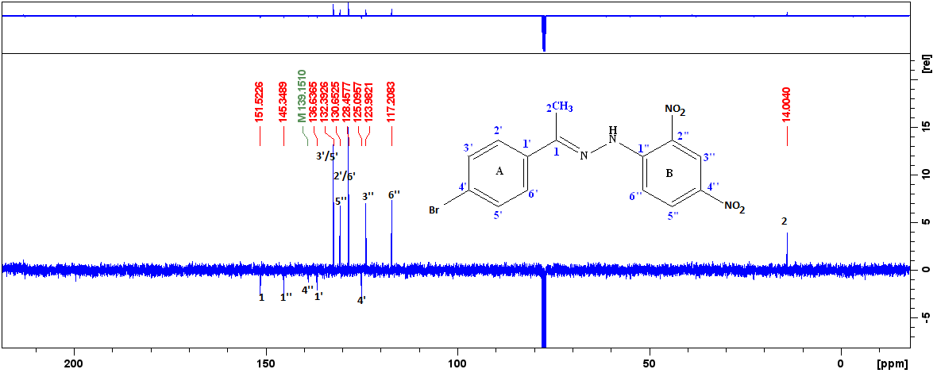
Figure 7: DEPTQ Spectrum of HS1 in CDCl3

Slide 29
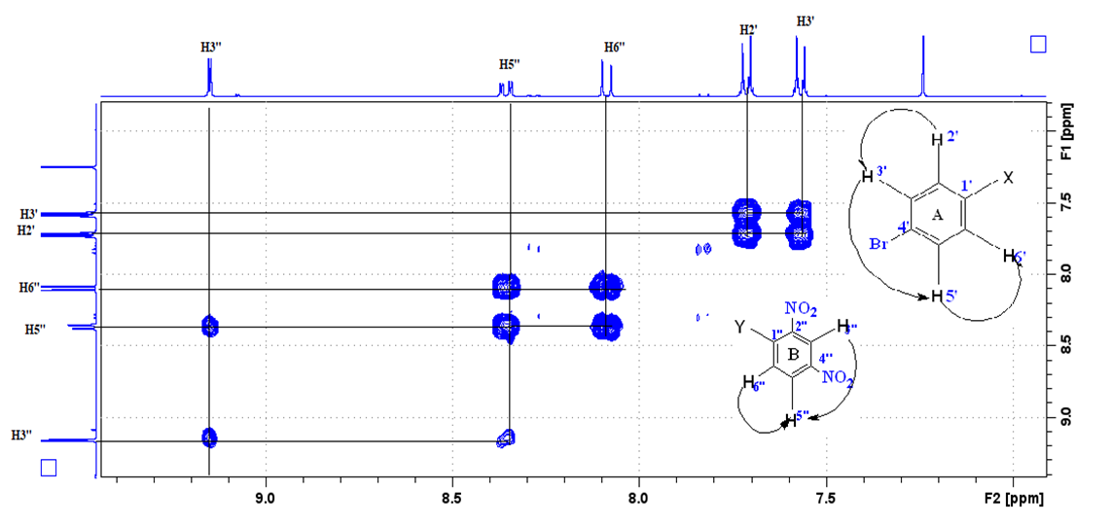
Figure 8: Cosy Spectrum for HS1

Slide 30
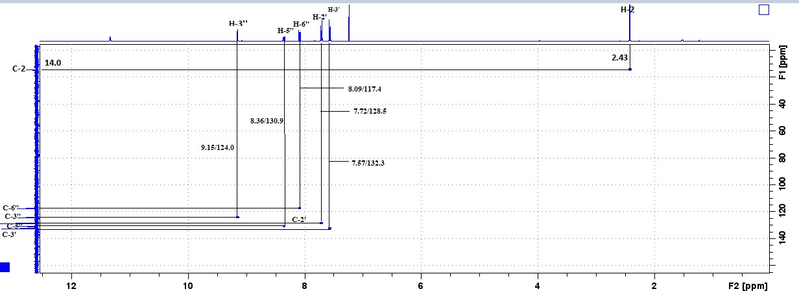
Figure 9: HSQC Spectrum for HS1

Slide 31
FIGURE 10: IR SPECTRUM OF HS2

Slide 32
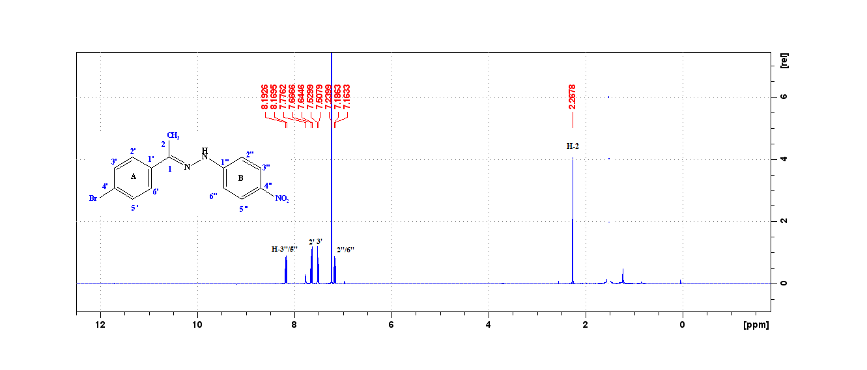
FIGURE 11: Proton Spectrum for HS2

Slide 33
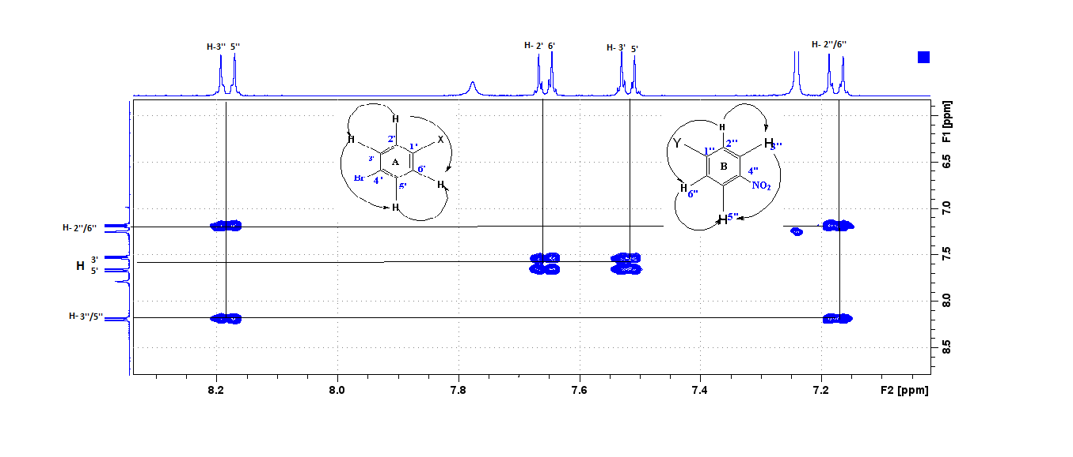
FIGURE 12: COSY SPECTRUM FOR HS2

Slide 34
FIGURE 13: FTIR SPECTRUM OF HS3

Slide 35
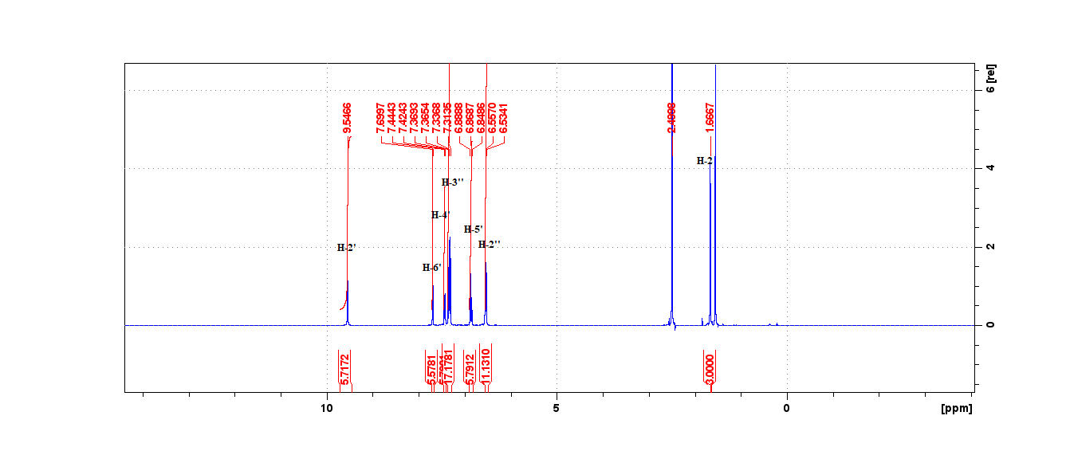
FIGURE 14: Proton Spectrum for HS3

Slide 36
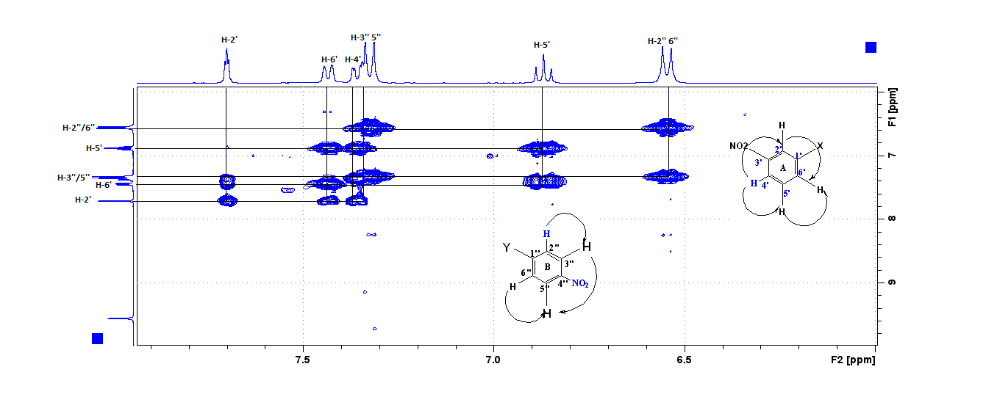
FIGURE 15: COSY SPECTRUM FOR HS3

Slide 37
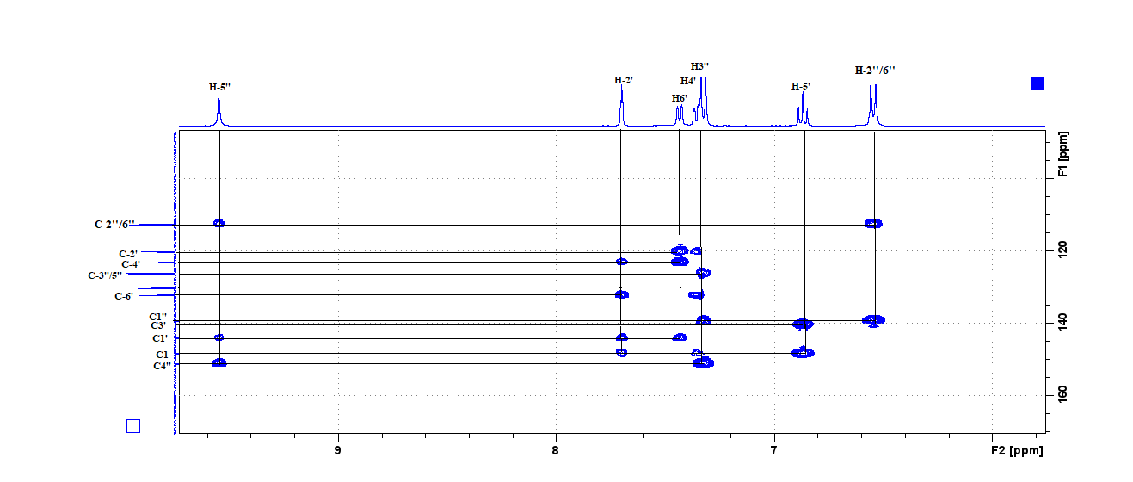
FIGURE 16: HMBC SPECTRUM OF HS3

Slide 38
SUMMARY OF THE RESEARCH WORK
33 compounds were designed from literature review of previous research
Only five (5) out of 33 compounds were found to be novels using scifinder
The selected compound were evaluated for their ADMET using Insilico techniques
The in-silico ADMET parameters prediction revealed favorable for the drug candidates

Slide 39
SUMMARY OF THE RESEARCH WORK
A series of five (5) new Phenylhydrazone derivatives were obtained by 1-step condensation reaction
An excellent quantity of synthesized yield (40–89%) of P-hydrazone derivatives were obtained
All the 5 synthesized compounds were structurally characterized and confirmed by spectral analysis.

Slide 40
CONCLUSION
Five (5) new compounds of (E)-Substituted-N-(phenylhydrazones) derivatives were synthesized and obtained by cyclization reaction with an excellent yield of (40–89%) and all compounds were structurally characterized and confirmed by spectral analysis.

Slide 41
REFERENCES
Ade, A., Amengor, C. D. K., Brobbey, A., Ayensu, I., Harley, B. K., & Boakye, Y. D. (2020). Synthesis and Antimicrobial Resistant Modulatory Activity of 2 , 4-Dinitrophenylhydrazone Derivatives as Agents against Some ESKAPE Human Pathogens. 2020.
Agrawal, P., & Jeyabalan, G. (2017). Indian Journal of Pharmaceutical and Biological Research ( IJPBR ) Synthesis and antimicrobial activity of some newer semicarbazone analogues. 5(2), 12–17.
Al-otibi, F., Alkhudhair, S. K., Alharbi, R. I., Al-askar, A. A., Aljowaie, R. M., & Al-shehri, S. (2021). The Antimicrobial Activities of Silver Nanoparticles from and Fungi. Molecules, 26(6081).
Arshad, M., Shoeb, M., Shahab, K., Asghar, A., & Dabeer, N. (2019). Benzeneamine: synthesis , characterization , antibacterial , and MTT assessment. SN Applied Sciences, 1(6), 1–8. https://doi.org/10.1007/s42452-019-0571-8

Slide 42
REFERENCES
Article, R. (2017). CHEMISTRY Hydrazide – hydrazones as potential antimicrobial agents : overview of the literature since 2010. 287–301. https://doi.org/10.1007/s00044-016-1756-y
Brvar, Matjaz, Perdih, A., Renko, M., Anderluh, G., & Solmajer, T. (2012). Structure-Based Discovery of Substituted 4 , 5 ′ -Bithiazoles as Novel DNA Gyrase Inhibitors. Figure 1.
Brvar, Matjaž, Perdih, A., Renko, M., Anderluh, G., Turk, D., & Solmajer, T. (2012). Structure-Based discovery of substituted 4,5′-bithiazoles as novel DNA gyrase inhibitors. Journal of Medicinal Chemistry, 55(14), 6413–6426. https://doi.org/10.1021/JM300395D
Daina, A., Michielin, O., & Zoete, V. (2019). SwissTargetPrediction: updated data and new features for efficient prediction of protein targets of small molecules. Nucleic Acids Research, 47(W1), W357–W3664. https://doi.org/10.1093/nar/gkz382

Slide 43
THANK YOU FOR LISTENING

