Slide 1
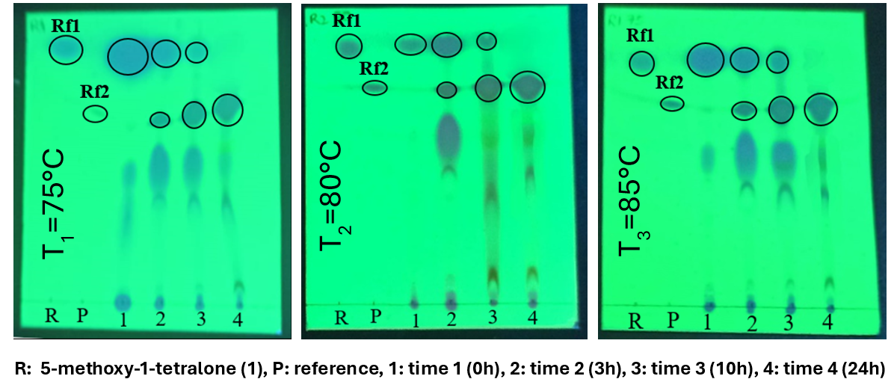
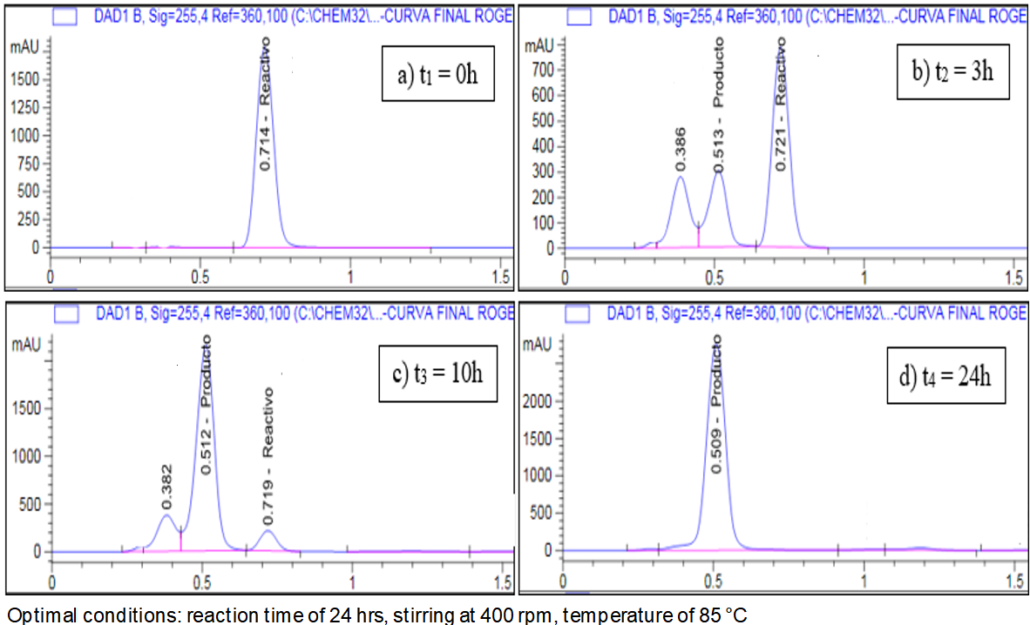
Figure 3. Monitors the reaction using thin-layer chromatography (TLC).
Kinetic study of acid-catalyzed Knoevenagel condensation be-tween 5-methoxy-1-tetralone and glyoxylic acid
Michelle E. Herrera ^{1*}, Elvia V. Cabrera¹, Roger S. Guanoluisa² and Ullrich Stahl¹
¹ Universidad Central del Ecuador, Faculty of Chemical Engineering, Research Group on Food, Organic Com-pounds, Materials, Applied Microbiology and Energy (ACMME), Ciudadela Universitaria, Quito, Ecuador; meherrerab@uce.edu.ec (M.E.H-B); evcabreram@uce.edu.ec (E.V-C) and ustahl@uce.edu.ec (U-S)
² Universidad Central del Ecuador, Faculty of Chemical Engineering, Ciudadela Universitaria, Quito, Ecuador. rsguanoluisa@uce.edu.ec (R.G.G-U)
INTRODUCTION
RESULTS & DISCUSSION
1-Tetralones (3,4-dihydro-1H-naphthalene-1-ones), have been the subject of much interest in organic synthesis and natural products, as they possess a structure with the appropriate functional groups for building the skeletons of a wide range of products, making them a key starting material, particularly due to their potential as lead compounds in the pharmaceutical industry. Chemists worldwide have been interested in the isolation, synthesis and structural modification of 1-tetralone and its derivatives due to their importance in the synthesis of bioactive compounds such as steroids, prostaglandin analogues, dyes, heterocycles and pharmaceuticals and new drug candidates [1-7], as well as their use as fluorescent dyes or sensors [8].
In this study, we synthesized, characterized (E)-2-(5-methoxy-1-oxo-3,4-dihydronaphthalen-2(1H)-ylidene)acetic acid by a modi-fication in acid medium of the Knoevenagel condensation reaction
TLC
HPLC
METHOD
Synthesis and characterization
Figure 1. Scheme of the reaction scheme Synthesis of (3).
Kinetic parameters
Parameters | 1 | 2 | 3
Temperature, [°C] | 75 | 80 | 85
Time, [h] | 24 | 24 | 24
Yield, [%] | 90.30 | 93.75 | 94.16
Reaction Order (α) | 1.26 | 1.21 | 1.13
K, [(mL/mmol∗min)^{α−1}] | 0.0129 | 0.0161 | 0.0196
Ea, [kJ/mol] | 43.1014
A [(mL/mmol∗min)^{α−1}] | 8.4608E+03
The compound (1) (400 mg, 2.27 mmol mmol) was added to diglyme (8 mL) and water (0.22 mL) and left in agitation, the glyoxylic acid (0.4 mL, 9,94 mmol) and a catalytic amount of sulfuric acid (0.03 mL) were added. The reaction mixture was heated to temperatures of 75°C, 80°C and 85°C, with constant stirring at 400 rpm, for 24 hrs. For reaction monitoring, TLC and HPLC were performed at times ranging from the beginning at 0 hrs to the end at 24 hrs.
The final product obtained (2) was recrystallized in ethanol yellow crystals, yield: 94 %, Rf (dichloromethane, methanol and glacial acetic acid; 4.5: 0.45: 0.05) = 0.62. UV-vis (Ethanol) [λmax (nm)]: 260.1. IR (KBr) υmax (cm⁻¹): 3460. 61 (O-H), 1696,8 (C=O), 1673.6 (C=O α,β-insaturado). MS (EI) m/z: 214 [M-H2O]+, 186 [M-CO]+, 171 [M-CH2]+. 1H-NMR (400 MHz, CDCl3, δ/ppm): 7.51 (d, 1Haromatic, J = 7.85 Hz), 7.32 (t, 1Haromatic, J = 7.95 Hz), 7.06 (d, 1Haromatic, J = 8,01 Hz ), 6.86 (s,1H, =CH-), 3.87 (s, 3H, O-CH3 ), 3.39 (t, 2H, -CH2), 2.99 (t, 2H, -CH2) and 13C-NMR (400 MHz, CDCl3, δ/ppm): 21.59, 26.82, 55.79, 115.01, 119.96, 122.15, 127.57, 133.34, 144.61, 152.10, 156.50, 171.61, 187.09.
Pop
CONCLUSION
Pop
In this work, the kinetic study of the Knoevenagel condensation reaction between 5-methoxy-1-tetralone and glyoxylic acid, catalyzed by sulfuric acid to produce (3) was carried out. The ideal reaction parameters were 24 hr time, 400 rpm and 85 °C for 94.16% yield, which were followed by TLC and HPLC. A pseudo first order reaction, kinetic constant (k=0.0196 mL/(mmol*min)), pre-exponential factor (A=8.4608E+03 (mL/(mmol min)) and activation energy (Ea=43.1014 kJ/mol) were determined for the rate law by nonlin-ear regression method, which provided the best model fit and statistical parameters. By FTIR, GC-MS and 1H and 13C NMR the product obtained was clearly identified and the purity.
FUTURE WORK / REFERENCES
[1] Chumpradit, S.; Kung, M. P.; Vessotskie, J.; Foulon, C.; Mu, M.; Kung, H.F. Iodinated 2-Aminotetralins and 3-Amino-1-benzopyrans: Ligands for Dopamine D2 and D3 Receptors, J. Med. Chem. 1994, 37, 4245-4250.
[2] Foulon, C.; Kung, M.P.; Kung, H.F. Synthesis of (R,S)-2’-trans-7-hydroxy-2- [N-n-propyl-N-(3’-iodo-2’-propenyl)-amino]tetralin(trans-7-OH-PIPAT): a new D3 dopamine receptor ligand, J. Med. Chem. 1993, 36, 1499-1500.
[3] Meyer, J.H.; Bartlett, P.A. Macrocyclic Inhibitors of Penicillopepsin Design, Synthesis, and Evaluation of an Inhibitor Bridged between P1 and P3, J. Am. Chem. Soc. 1998, 120, 4600-4609.
[4] Matsumoto, T.; Ohsaki, M.; Suzuki, M.; Kimura, Y.; Terashima, S. Synthesis of 4-demethoxyanthracyclines carrying a lipophilic alkanoyl group at the C9-position, Chem. Pharm. Bull. (Tokyo). 1986, 34, 4605-4612.
[5] Stout, D.M.; Gorczynski, R.J. N-Aralkyl substitution of 2-amino-5,6- and -6,7-dihydroxy-1,2,3,4-tetrahydronaphthalenes. 2. Derivatives of a hypotensive-positive inotropic agent, J. Med. Chem. 1982, 25 326-328.
[6] Tagmatarchis, N.; Thermos, K.; Katerinopoulos, H.E. N-(Iodopropenyl)-octahydrobenzo[f]-and -[g]quinolines: synthesis and adrenergic and dopaminergic activity studies, J. Med. Chem. 1998, 41, 4165-4170.
[7] Sanchez, C.; Reines, E.H.; Montgomery, S.A. A comparative review of escitalopram, paroxetine, and sertraline: Are they all alike? Int Clin Psychopharm. 2014, 29, 185-196.
[8] Sheng, K.; Song, Y.; Lei, F.; Zhao, W.; Fan, L.; Wu, L.; Liu, Y., Wu, S.; Zhang, Y. Research progress in pharmacological activities and structure-activity relationships of tetralone scaffolds as pharmacophore and fluorescent skeleton. Eur. J. Med. Chem. 2022, 227, 113964.
https://sciforum.net/event/ecsoc-28

