Slide 1
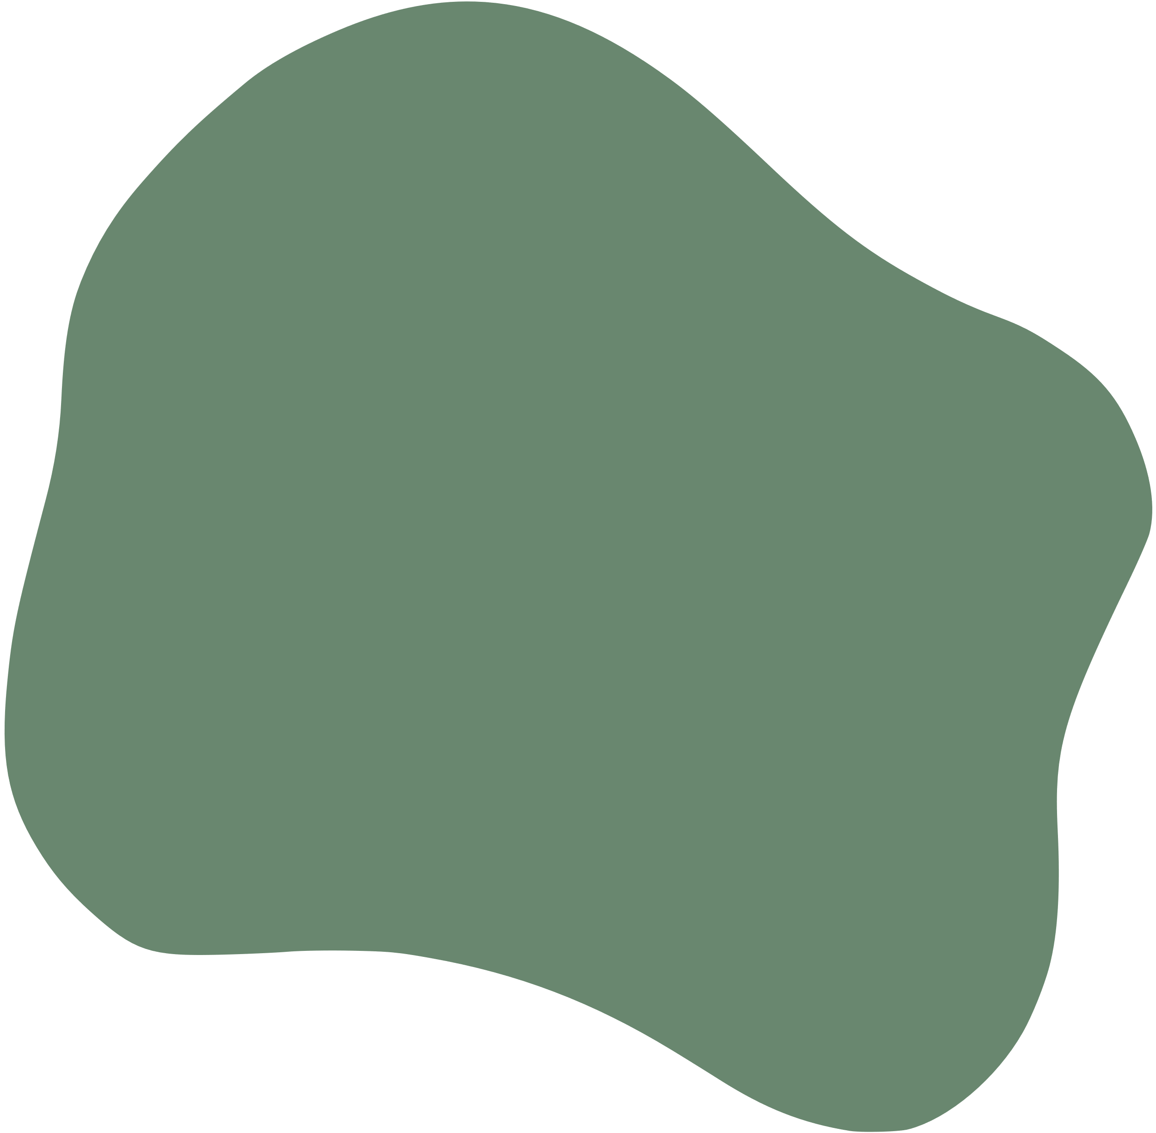

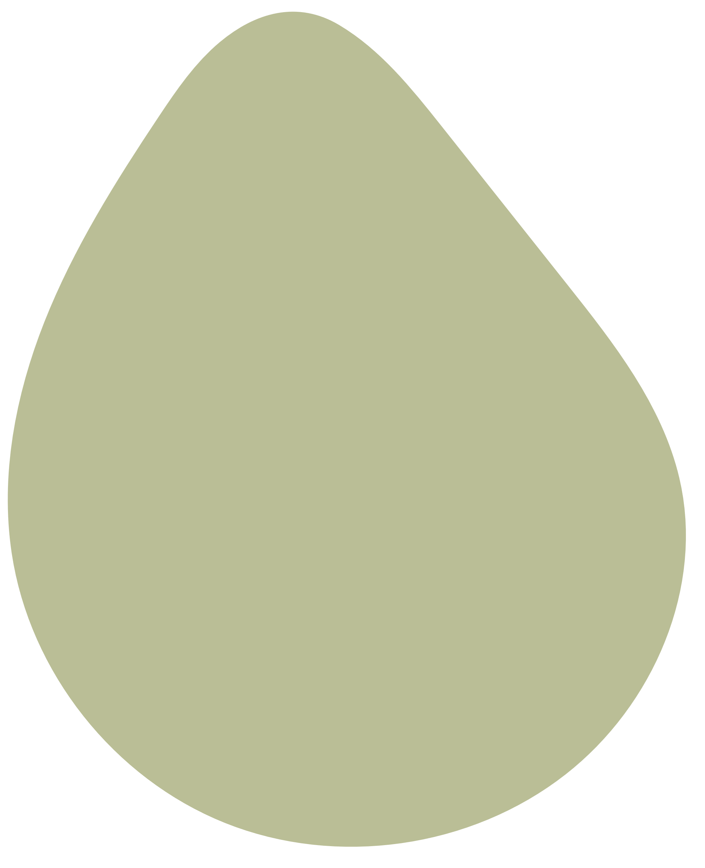




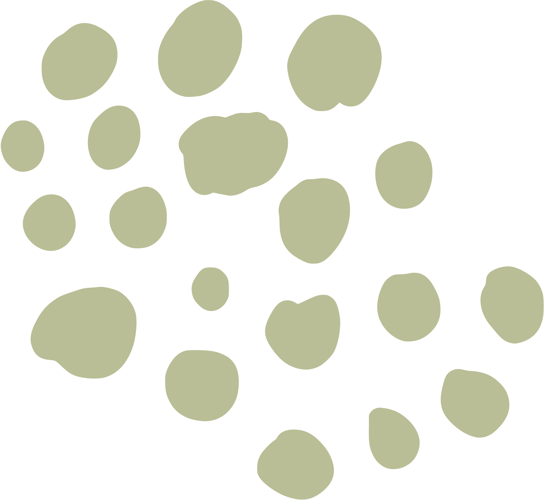




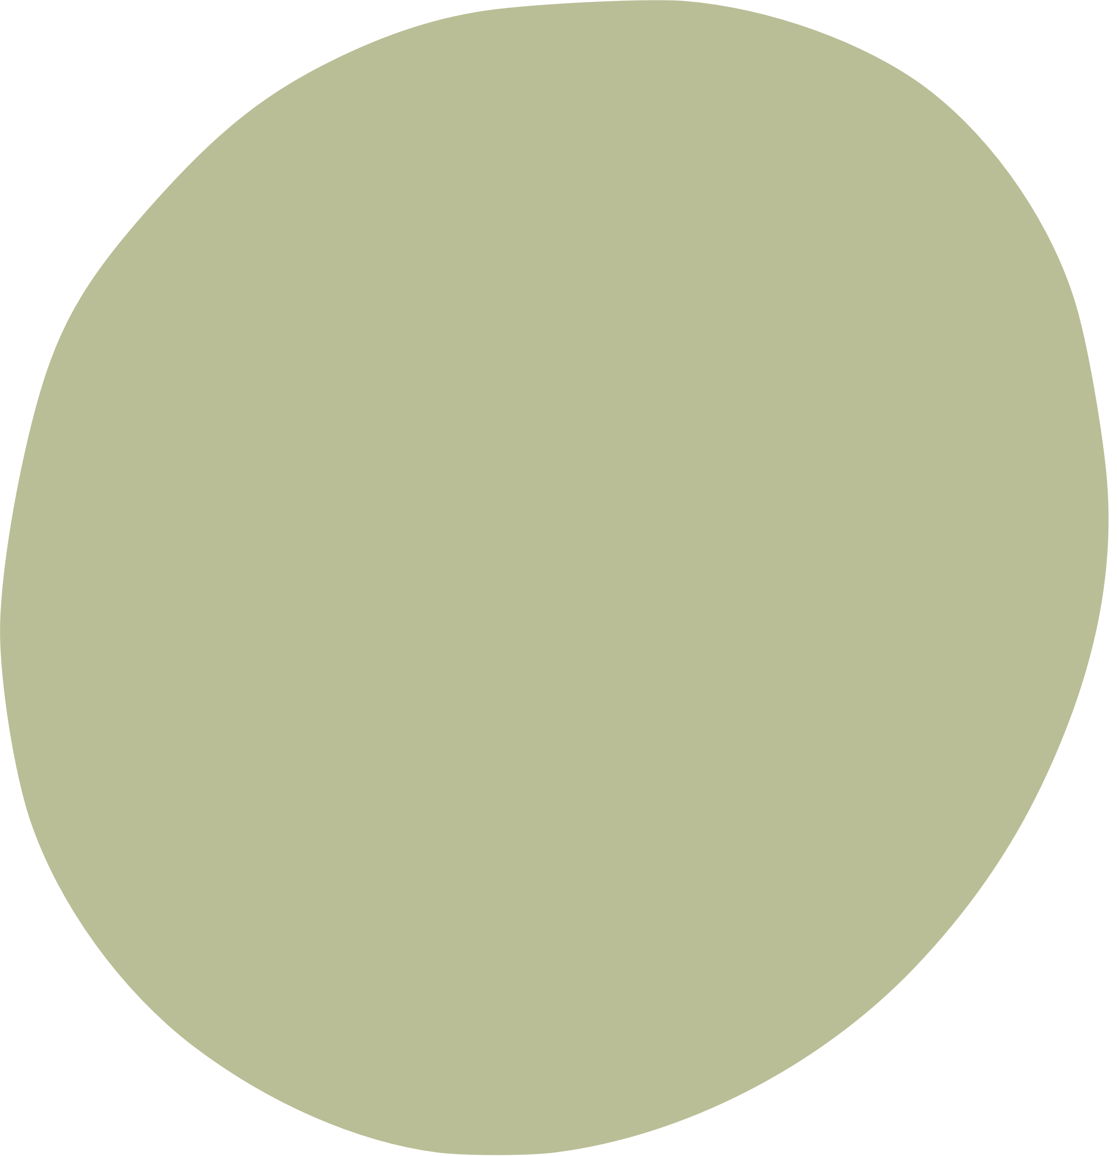
PEOPLE'S DEMOCRATIC REPUBLIC OF ALGERIA
MINISTRY OF HIGHER EDUCATION AND SCIENTIFIC RESEARCH
ENVIRONMENTAL RESEARCH CENTRE
THE 29TH INTERNATIONAL ELECTRONIC CONFERENCE ON SYNTHETIC ORGANIC CHEMISTRY
EVALUATION OF CHEMICAL COMPOSITION AND BIOLOGICAL ACTIVITY
OF ESSENTIAL OIL OF ORIGANUM VULGARE L. SSP. GLANDULOSUM
Author’s:
Amina Dridi¹*, Nabila Bouhaddouda², Youssouf Driouche¹, Meriem Ferfar¹
¹ Environmental Research Center (CRE), Annaba, Algeria
² University 20 August 1955, Skikda, Algeria

Slide 2
INTRODUCTION
Origanum vulgare L. ssp. glandulosum, an aromatic Mediterranean plant, produces essential oil rich in p-cymene, thymol, and carvacrol. These compounds confer strong antimicrobial activity, with large inhibition zones and low MIC values through mechanisms such as enzyme inhibition and membrane disruption. The oil and hydromethanolic extracts also exhibit notable antioxidant activity, demonstrated by DPPH assays. The combined antimicrobial and antioxidant properties underline its value for pharmaceutical, food, and cosmetic applications

Slide 3
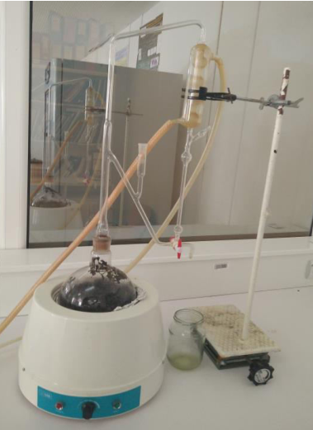
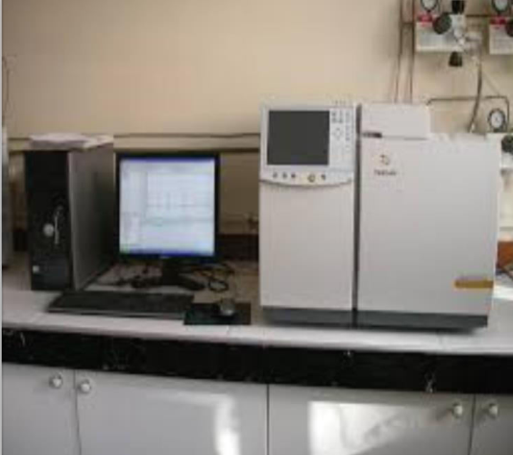
MATERIALS AND METHODS
Essential oil extraction by hydrodistillation (Clevenger)
Analysis by GC/MS

Slide 4
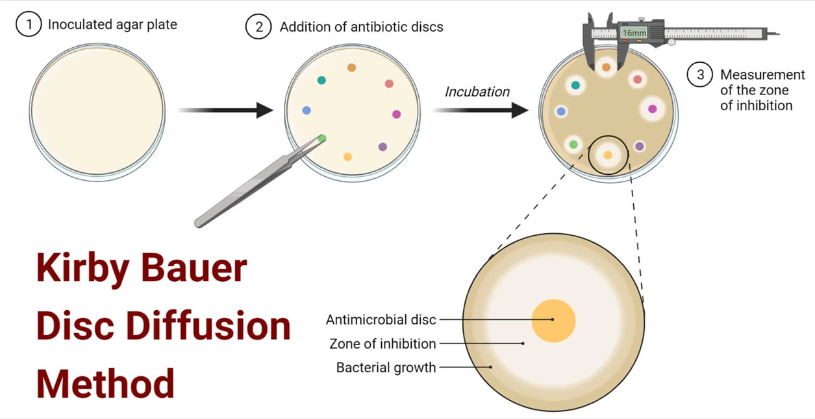
Antibacterial activity:
Disc diffusion

Slide 5
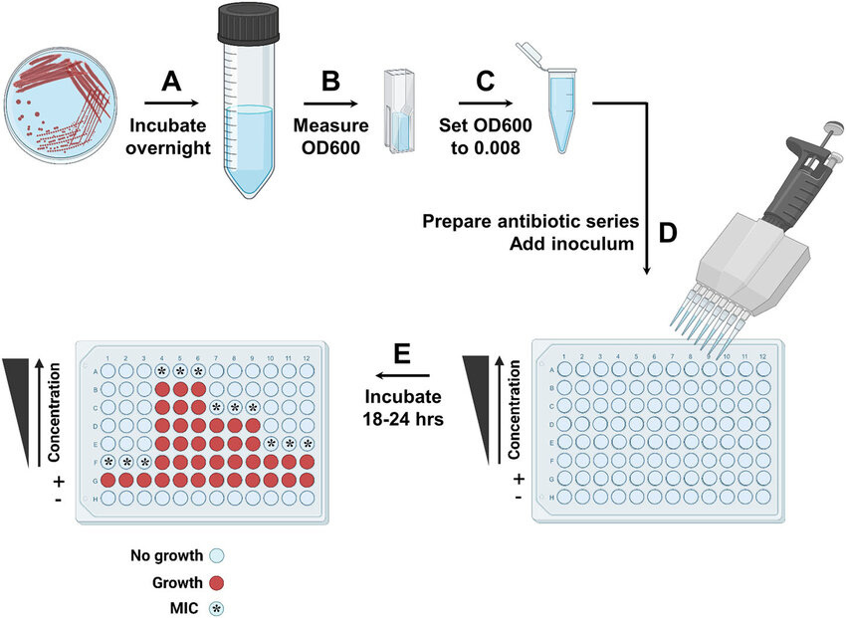
DETERMINATION OF CMI

Slide 6
RESULT ET DISCUSSION
CHEMICAL COMPOSITION
•43 compounds identified representing 98.55% of the oil.
•• Major constituents:
•- p-cymene (25.6%)
•- thymol (23.1%)
•- carvacrol (20.3%)
•- γ-terpinene (16.6%)
Thymol/carvacrol chemotype conferring strong bioactivity.

Slide 7
ANTIBACTERIAL ACTIVITY
•BROAD-SPECTRUM INHIBITION AGAINST:
• - ESCHERICHIA COLI (MIC = 0.78 MG/ML)
• - STAPHYLOCOCCUS AUREUS (MIC = 1.56 MG/ML)
• - ENTEROCOCCUS FAECALIS (MIC = 0.78 MG/ML)
•• INHIBITION ZONES: 49–52 MM.
•• ACTIVITY ATTRIBUTED TO PHENOLS (THYMOL, CARVACROL).

Slide 8
ANTIOXYDANT ACTIVITY
IC₅₀ ESSENTIAL OIL = 461.62 ΜG/ML.
IC₅₀ VITAMIN C = 25.59 ΜG/ML.
• MODERATE ANTIOXIDANT ACTIVITY.

Slide 9
CONCLUSION
• Essential oil rich in thymol and carvacrol.
Strong Antibacterial activity.
• Moderate antioxidant activity.
• Potential as a natural alternative to synthetic molecules.

Slide 10
Thank you for your attention.

