Slide 1


2025
MODELING OF THE REACTION SCHEME OF PHOTO-REDUCTION OF A NITRO COMPOUND IN THE PRESENCE OF A HYDROGEN DONOR
Sorokina T., Ovsyannikov D.
National Research Center
Nizhny Novgorod Lobachevsky State University, Nizhny Novgorod

Slide 2

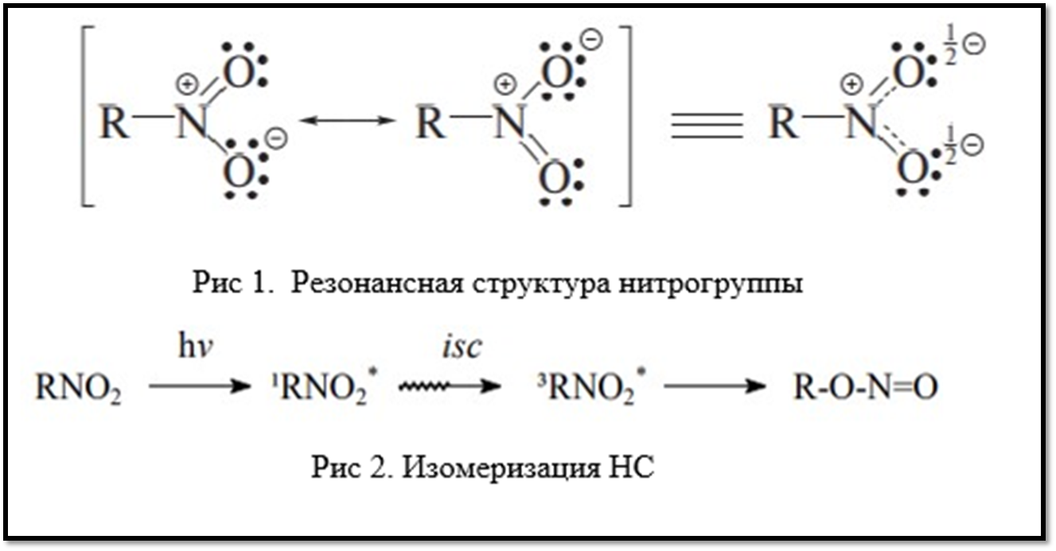
The preface
Nitroalkanes
colorless or yellowish liquids with high boiling points.
The C—N—O angles are 120°
The length of the N—O simple bond is 0.136 nm, and the length of the N=O double bond is 0.115 nm.
The lifetime of HC in excited singletons is 10-12 s
the reaction is easier to carry out photochemically.
09.2025
2

Slide 3

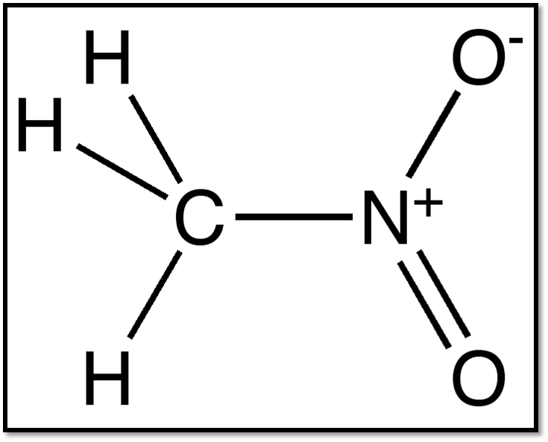
Discussion of the problem
Of interest is the photo-reduction of aliphatic HC to an amine.
An interesting fact has been established: the transfer of a hydrogen atom from a methyl group is less preferable than the transfer from an amino group.
It is impossible to find a general reaction mechanism in the literature.
This work is devoted to the study of the mechanism of interaction of triplet nitromethane with dimethylamine as the simplest representatives of their classes of compounds.
09.2025
3

Slide 4
Done earlier:
In previous work, we assumed that the mechanism of photochemical reduction of nitromethane in the presence of dimethylamine would undergo the following transitions:
The following proposed reactions are considered:
1. ³CH₃NO₂ + HN(CH₃)₂ → CH₃NO₂H∙ + HNCH₂CH₂.
2. ³CH₃NO₂ + HN(CH₃)₂ → CH₃NO₂H∙ + HNCH₃CH₂∙
3. CH₃NO₂H∙ + HN(CH₃)₂ → CH₃NO₂H₂ + ∙N(CH₃)₂
4. CH₃NO₂H∙ + HN(CH₃)₂ → CH₃NO₂H₂ + HNCH₃CH₂∙
5. ∙N(CH₃)₂ + HN(CH₃)₂ → HN(CH₃)₂ + HNCH₃CH₂∙
6. CH₃NO₂H₂ → CH₃NO + H₂O
7. 2 ∙N(CH₃)₂ → (CH₃)₂N-N(CH₃)₂
8. 2 HNCH₃CH₂∙ → CH₃NHCH₂CH₂NHCH₃
9. CH₃NO₂H∙ → CH₃NO + OH∙
10. CH₃NO + H₂ → CH₃NOH₂∙
11. CH₃NOH₂∙ → CH₃NH∙ + OH∙
12. ³CH₃NO₂ + CH₃NO₂H ∙ → CH₃NO₂H₂ + ∙ CH₂NO₂
Reaction | Δ_{r}H°(298.15), kJ·mol-1 | Δ_{r}G°(298.15), kJ·mol-1
1 | -50.66 | -54.37
2 | -56.32 | -59.03
3 | +97.96 | +95.95
4 | +92.31 | +91.28
5 | -5.65 | -4.66
6 | -41.64 | -89.50
7 | -192.85 | -126.54
8 | -285.95 | -226.67
9 | +158.14 | +114.20
10 | -127.93 | -90.96
11 | +257.43 | +210.75
12 | -119.90 | -116.10
09.2025
Table 1. Changes in the standard enthalpies and Gibbs energies of the studied reactions
4

Slide 5


Setting the task
Создание и описание
TASK:
Find the transition states to predict the mechanism of a chemical reaction
09.2025
5

Slide 6
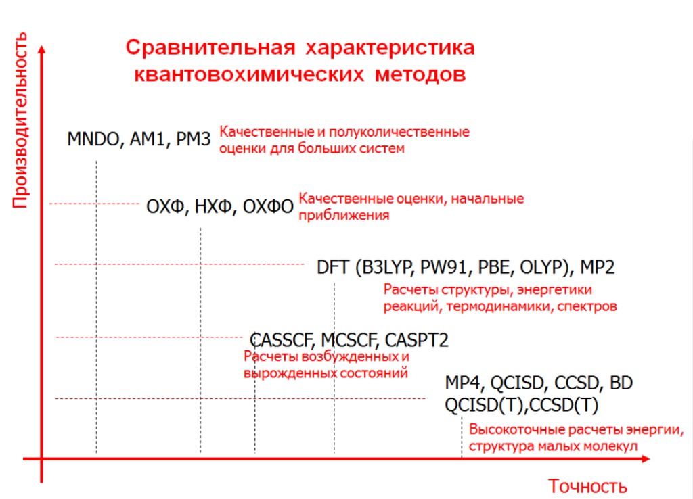
Choosing a method
The calculations were performed in the Orca version 5.0.3 program using the revPBE/def2-SVP method
09.2025
6

Slide 7
Progress of work
Previously assumed key reactions:
³CH₃NO₂ + HN(CH₃)₂ → CH₃NO₂H∙ + HNCH₃CH₂.
³CH₃NO₂ + CH₃NO₂H ∙ → CH₃NO₂H₂ + ∙ CH₂NO₂
³CH₃NO₂ + CH₃NO₂H ∙ → CH₃NO₂H₂ + ∙ CH₂NO₂
09.2025
7

Slide 8
Progress of work
New key reactions :
³CH₃NO₂ + HN(CH₃)₂ → CH₃NO₂H∙ + HNCH₃CH₂.
³CH₃NO₂ + CH₃NO₂H ∙ → CH₃NO₂H₂ + ∙ CH₂NO₂
CH₃NO₂H₂ + ³CH₃NO₂→ ∙CH₂NO₂H₂ + CH₃NO₂H∙
∙CH₂NO₂H₂ → OHCH₂NOH
OHCH₂NOH → CH₃NO + ∙OH
09.2025
8

Slide 9
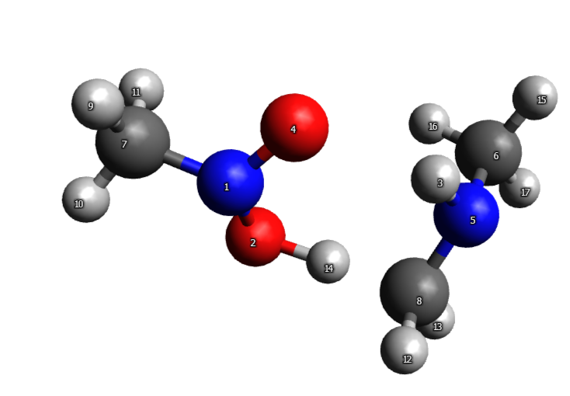
Discussion of the results
Transition state for 1 reaction:
kcal/mol
Ea = 6,5ккал/моль
09.2025
³CH₃NO₂ + HN(CH₃)₂ → CH₃NO₂H∙ + HNCH2CH2.
9

Slide 10
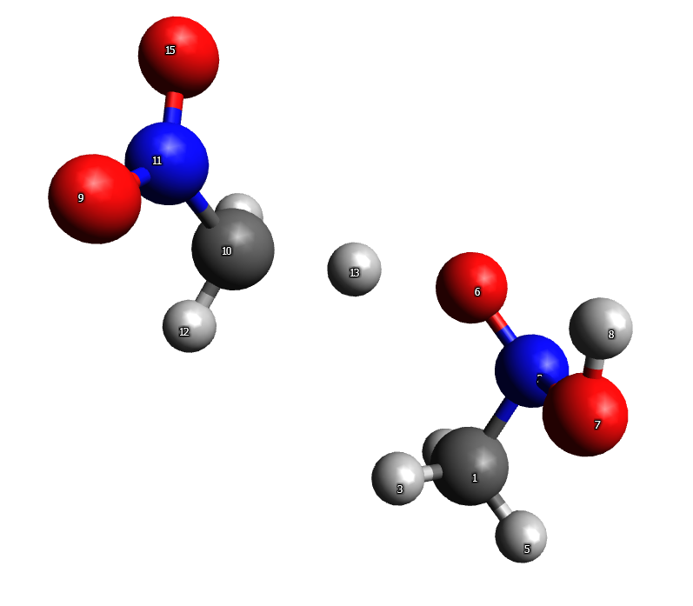
Discussion of the results
Transition state for 2 reaction:
кkcal/mol
Ea = 22,9 ккал/моль
09.2025
³CH₃NO₂ + CH₃NO₂H ∙ → CH₃NO₂H₂ + ∙ CH₂NO₂
10

Slide 11
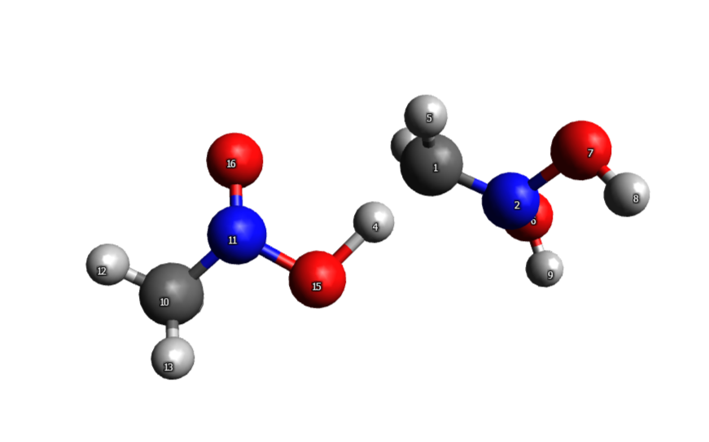
Discussion of the results
Transition state for 3 reaction:
kcal/mol
Еа = 11,94 ккал/моль
09.2025
CH₃NO₂H₂ + ³CH₃NO₂→ ∙CH₂NO₂H₂ + CH₃NO₂H∙
11

Slide 12
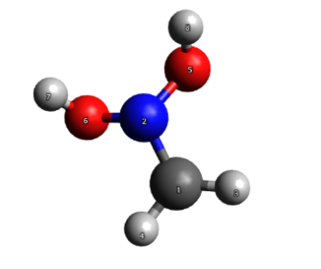
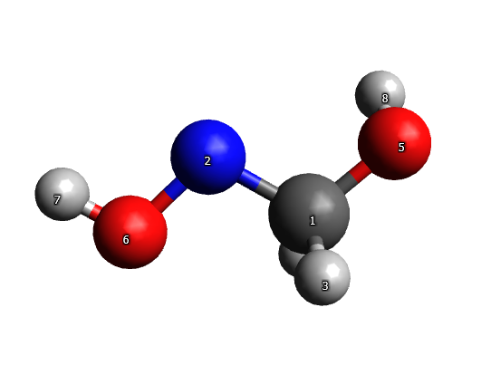
Discussion of the results
Profile 4 reactions:
kcal/mol
Ea = 0 ккал/моль
09.2025
∙CH₂NO₂H₂ → OHCH₂NOH
12

Slide 13
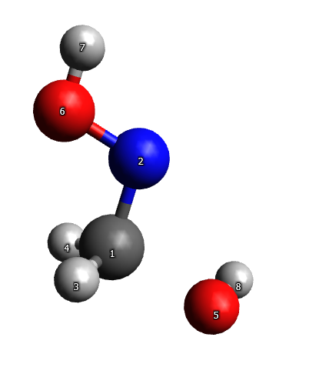
Discussion of the results
Profile 5 reactions:
kcal/mol
Ea = 0 ккал/моль
09.2025
OHCH₂NOH → CH₃NO + ∙OH
13

Slide 14
Создание и описание
Conclusion:
Work has been done to prove a new mechanism for photochemical reduction of nitromethane in the presence of a hydrogen donor (dimethylamine), which will flow through α-hydrogen
09.2025
14

Slide 15
Thanks for the attention!

