Slide 1
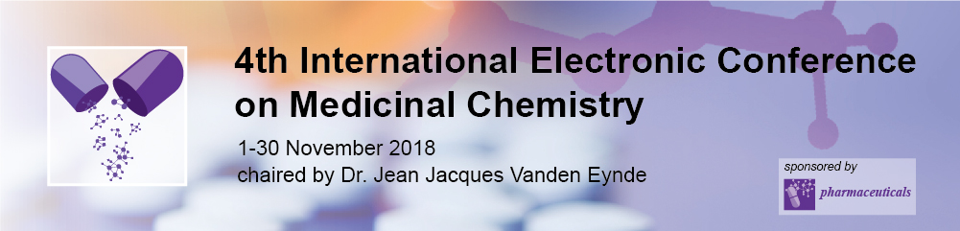

Impact of Different Geometrical Structures of Copper(II) Complexes on Interactions with Bio-Relevant Nucleophiles under Physiological Conditions
Enisa Selimović¹, Andrei V. Komolkin², Andrei V. Egorov², and Tanja Soldatović¹ *
¹Department of Chemical-Technological Science, State University of Novi Pazar, Vuka Karadžiča bb, 36300 Novi Pazar, Serbia
²St.Petersburg State University, 7/9 Universitetskaya nab., 199034, St.Petersburg, Russia
* Correspondence: tsoldatovic@np.ac.rs

Slide 2
Impact of Different Geometrical Structures of Copper(II) Complexes on Interactions with Bio-Relevant Nucleophiles under Physiological Conditions

Slide 3
Abstract: Substitution reactions of square-planar [CuCl₂(en)] and square-pyramidal [CuCl₂(terpy)] complexes (where en= 1,2-diaminoethane and terpy= 2,2’:6’,2’’- terpyridine) with bio-relevant nucleophiles have been investigated at pH 7.4 in the presence of 0.010 M NaCl. Mechanism of substitution was probed via mole-ratio, kinetic, mass spectroscopy and EPR studies. In the presence of an excess of chloride, the octahedral complex anion [CuCl₄(en)]²⁻ forms rapidly while equilibrium reaction was observed for [CuCl₂(terpy)]. Different order of reactivity of selected bio-molecules toward Cu(II) complexes was observed. The nature of the buffer just affects the Cu(II) complexes conformational dynamics. According to EPR data L-Methionine forms a most stable complex with [CuCl₂(en)] among the bio-ligands considered while [CuCl₂(terpy)] complex is very stable and there are no significant changes in its square-pyramidal geometry in the presence of buffer or bio-ligands. The obtained results represent progress in investigation of the mechanism of substitution reactions between Cu(II) complexes and biological relevant nuclepohiles. Also, they provide very useful information for the future design of potential copper-based anticancer drugs (Selimović, E., et al. J. Coord. Chem. 2018, 71(7), 1003-1019).
Keywords: Copper(II); bio-molecules; structure – reactivity correlation; kinetics; EPR studies

Slide 4
Introduction
Over the past decades, transition metal complexes have attracted considerable attention in medicinal inorganic chemistry, especially as synthetic metallonucleases and metal-based anticancer drugs that are able to bind to DNA under physiological conditions [1].
Copper(II) complexes offer various potential advantages as antimicrobial, antiviral, anti-inflammatory, antitumor agents, enzyme inhibitors, chemical nucleases, and they are also beneficial against several diseases like copper rheumatoid and gastric ulcers [2]
Clear understanding of complex formation reactions of copper(II)-complexes with bio-relevant nucleophiles is still largely missing. Substitution behavior of Cu-complexes at physiological conditions (dilute aqueous solutions at or near room temperature, presence of physiological buffers) is complex due to the rather high molecular mobility and distortions of complex local symmetry. Because of many difficulties in interpretations of experimental studies, the available data are often incomplete or even contradictive.
[1] J.C. Pessoa, I. Santos, A. Paulo. J. Inorg. Biochem., 2011, 105, 637-644.
[2] S.P. Fricker, Dalton Trans., 2007, 43, 4903-4917.

Slide 5
Results and discussion
Structures of the investigated complexes and nucleophiles
The main goals of these studies were: (i) to investigate the ligand-substitution reactions between the copper(II) complexes and biologically important nucleophiles under physiological conditions; (ii) to investigate the changes in the coordinative geometry around Cu(II).

Slide 6
Results and discussion
In the presence of an excess of chloride, the octahedral complex anion [CuCl₄(en)]²⁻ forms rapidly
Absorbance changes for the reactions between [CuCl₂(en)] complex (0.0001 M) and chloride for different molar ratios at pH 7.4 (0.025 M Hepes buffer) and 295 K (left panel); Stoichiometry of chloride-[CuCl₂(en)] complex by mole-ratio method (right panel).
E. Selimović, A. V. Komolkin, A. V. Egorov, T. Soldatović, J. Coord. Chem. 2018, 71(7), 1003-1019.

Slide 7
Results and discussion
Second-order rate constants for the reactions of the [CuCl₂(en)] and [CuCl₂(terpy)] complexes with bio-molecules: 5’-IMP, 5’-GMP, L-Met and DL-Asp at pH 7.4 (0.025 M Hepes buffer) in 0.010 M NaCl at 295 K.
[CuCl₂(en)] L-Met DL-Asp 5’-IMP 5’-GMP GSH
k₁²⁹⁵/M⁻¹s⁻¹ 10² k-₁²⁹⁵[Cl⁻]/M⁻¹s⁻¹ k₂²⁹⁵ /M⁻¹s⁻¹ 10² k-₂²⁹⁵[Cl⁻]/M⁻¹s⁻¹ | 5.1 ± 0.3 0.84 ± 0.09 3.0 ± 0.1 0.46 ± 0.05 | 12.9 ± 0.8 9.2 ± 0.3 1.8 ± 0.2 0.96 ± 0.05 | 16.7 ± 0.8 97.2 ± 5.8 2.6 ± 0.3 3.5 ± 0.1 1.1 ± 0.1 10.5 ± 0.9 0.56 ± 0.04 3.6 ± 0.3 | 199.4 ± 2.7 19.7 ± 0.9 25.0 ± 0.8 5.5 ± 0.3
[CuCl₂(terpy)] | 5 ’-IMP | 5’-GMP | L-Met GSH | DL-Asp
k₁²⁹⁵/M⁻¹s⁻¹ k₂²⁹⁵ /M⁻¹s⁻¹ | 4.7 ± 0.1 0.60 ± 0.03 | 13.5 ± 0.6 2.5 ± 0.1 | 40.9 ± 1.2 42.4 ± 2.2 4.97± 0.25 2.6 ± 0.1 | 98.7 ± 6.1 1.61 ± 0.08
The different order of reactivity of bio-molecules toward [CuCl₂(en)] and [CuCl₂(terpy)] complexes could be explained by different geometrical structures of complexes (octahedral in the case of the excess of chloride and square-pyramidal) and their different preferences toward donor atoms of bio-molecule, as well as, by presence of steric hindrances.
E. Selimović, A. V. Komolkin, A. V. Egorov, T. Soldatović, J. Coord. Chem. 2018, 71(7), 1003-1019.

Slide 8
Mass spectrum has shown two new signals at m/z = 477.150 and m/z = 521.00, assigned to [CuCl(terpy)]⁺−Hepes fragments of coordinated Hepes buffer
Results and discussion
Mass spectra for the [CuCl₂(terpy)] complex in 0.025 M Hepes buffer in the presence of 0.010 M NaCl.
E. Selimović, A. V. Komolkin, A. V. Egorov, T. Soldatović, J. Coord. Chem. 2018, 71(7), 1003-1019.

Slide 9
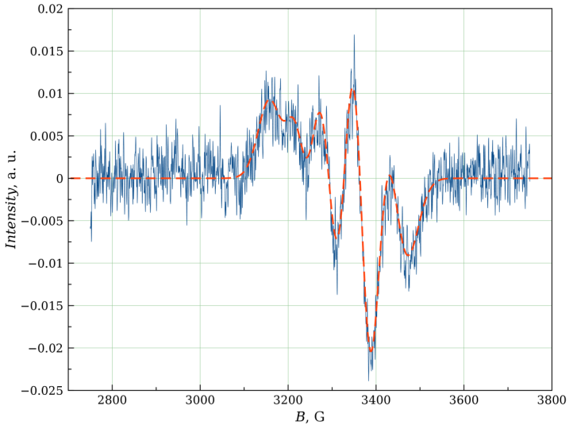
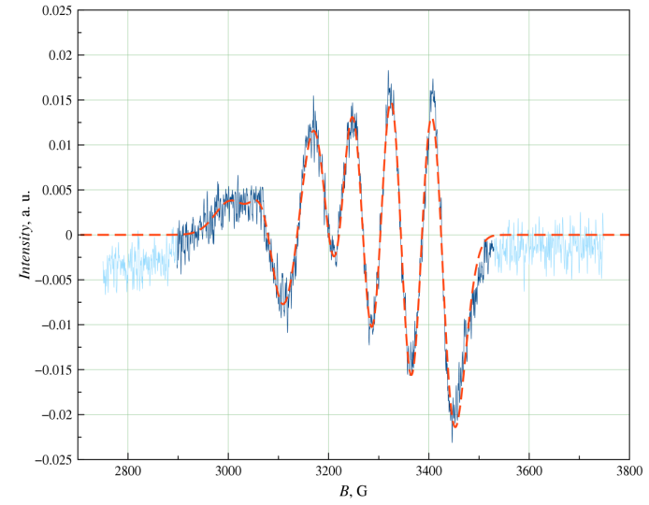
L-Met forms the most stable complex with [CuCl₂(en)] among the ligands considered, while [CuCl₂(terpy)] complex did not show significant changes in its square-pyramidal geometry in the presence of the buffer or bio-ligands.
Results and discussion
Left panel: EPR spectrum of 0.0001 M [CuCl₂(en)] complex solution in 0.010 M NaCl 0.025 M Hepes buffer, pH 7.4, at 300 K. Right panel: EPR spectrum of 0.0001 M equimolar [CuCl₂(en)]−L-Met solution in 0.0010 M NaCl 0.025 M Hepes buffer, pH 7.4, at 300 K.
E. Selimović, A. V. Komolkin, A. V. Egorov, T. Soldatović, J. Coord. Chem. 2018, 71(7), 1003-1019.

Slide 10
Conclusions
In the presence of an excess of chloride, the octahedral complex anion [CuCl₄(en)]²⁻ forms rapidly and all substitution processes of this complex species should be considered.
Different order of reactivity of bio-molecules toward [CuCl₂(en)] and [CuCl₂(terpy)] complexes could be explained by different geometrical structures of complexes (octahedral and square-pyramidal, respectively) in the presence of chloride and their different preferences toward donor atoms of bio-molecules.
Mass spectra of [CuCl₂(terpy)] complex in Hepes buffer have shown the presence of two new signals at m/z = 477.150 and m/z = 521.00 which represent the positive ions assigned to [CuCl(terpy)]⁺-Hepes fragments, the m/z = 477.150 signal also appears in mass spectra of ligand-substitution reaction between [CuCl₂(terpy)] and bio-molecules in molar ratio 1:1, and 1:2 at pH 7.4 (0.025 M Hepes buffer).
According to EPR data L-Met forms a most stable complex with [CuCl₂(en)] among the ligands considered while [CuCl₂(terpy)] complex is very stable and there are no significant changes in its square-pyramidal geometry in the presence of buffer or ligands molecules.

Slide 11
Acknowledgments
EPR and mass spectrometry measurements were conducted in Magnetic Resonance Research and Chemical Analysis and Materials Research Centers in the Research Park of Saint-Petersburg State University with the kind help from E. A. Bessonova, D. V. Dzema, and S. M. Sukharzhevskii. The authors also thank Dr. K. Kämpf (Laboratory of Biomolecular NMR, St.Petersburg State University) and Prof. M. G. Shelyapina (Faculty of Physics, St.Petersburg State University) for their valuable help. E. Selimović and T. Soldatović gratefully acknowledge financial support from State University of Novi Pazar, Novi Pazar, Republic of Serbia.

