Slide 1
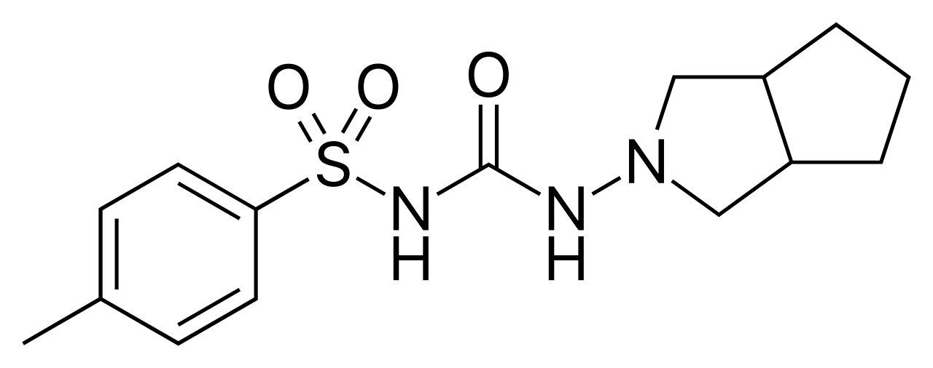
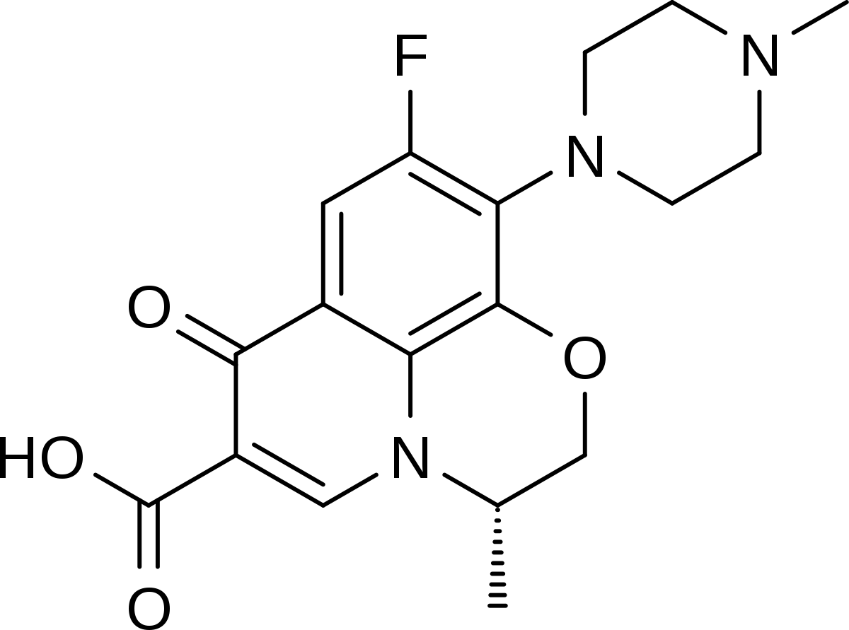
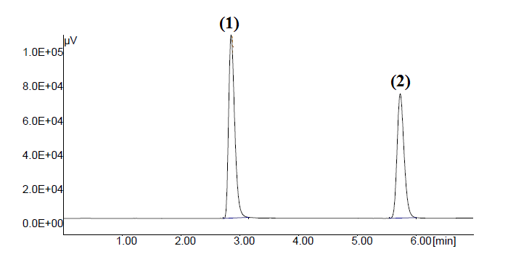
In vitro Drug-Drug Interaction Studies of Gliclazide With Levofloxacin By Using HPLC: Guidelines for Co-prescription Drugs Santosh S. Chhajed*, Harshala Chaudhari, Yatish Rajderkar, Akshada Pingle, Sandeep Sonawane, Sanjay Kshirsagar Department of Pharmaceutical Chemistry MET, Institute of Pharmacy, Nashik-422003
Abstract:
A simple, accurate reversed-phase high-performance liquid chromatography method was developed and validated for simultaneous determination of gliclazide (GLZ) and fluoroquinolone antibacterial levofloxacin (LVO). The method was developed by using a stainless steel analytical column , C18 (250,4.6 mm,5µm). The system was operated using a mobile phase consisting of methanol and phosphate buffer (pH 3.0) at a flow rate of 0.8mL minˉ¹ with ultraviolet detection monitored at wavelength 228 nm. The above method was validated using ICH analytical method validation guidelines. Utilizing HPLC techniques, an assay was intended to determine in vitro effects of levofloxacin on sulphonyl urea an anti-diabetic gliclazide. Obtained results were further verified with UV spectrophotometric method. Availability of gliclazide was reduced in the presence of levofloxacin. This in vitro analyses confirms the co-administartion of gliclazide and levofloxacin and may serve the foundation for designing further in vivo studies.
Introduction
Diabetes mellitus (DM), a major lifestyle disease is undoubtedly the most challenging public health problem of 21st century. Diabetes is a chronic metabolic disease that occurs when the human body is not able to produce enough of the hormone insulin.
Gliclazide (GLZ) is a well-known antidiabetic agent prescribed frequently for treatment of DM. GLZ known to act by its selective binding with sulfonylurea receptors (SUR-1) on the surface of the pancreatic beta-cells which in turn leads to exocytosis of insulin vesicles leading to insulin release.
Levofloxacin (LVO), is an fluoroquinolone class of antimicrobial agent use for the treatment of different infections. LVO is active against both Gram-positive and Gram-negative bacteria. It acts by inhibiting the two type enzymes, namely DNA gyrase and topoisomerase IV¹
Structures
a. Gliclazide
b. Levofloxacin
Earlier work: Literature
Drug interaction occurs in between Levofloxacin and sulfonylurea class of anti-diabetic agents which leads to rare fatal side effects.
Hence it is necessary to study absorption interactions occurring between these drugs.
To the best of our knowledge, there is no analytical HPLC method reported for simultaneous estimation of these two co-prescription drugs.
Experimentals
In the present investigation, an attempt has been made to develop a sensitive, simple, accurate, rapid and reproducible reverse-phase HPLC method for simultaneous determination of LVO and GLZ, an representative sulphonylurea class of drug followed by its validation, in accordance with the ICH guidelines.
Optimized Chromatographic Conditions
Isocratic elution with mobile phase methanol: phosphate buffer pH 3.0 (70:30) (v/v) was carried out on phenomenex kinetex C18 column (250×4.6mm,5μm) at flow rate of 0.8mLmin⁻¹ the wavelength was fixed at 228 nm.
Gliclazide |  |  |  |  | Levofloxacin
Injection | Intraday |  | Interday |  | Intraday |  |  | Interday
 | Area | RSD (%) | Area | RSD (%) | Injection | Area | RSD (%) | Area | RSD (%)
1 | 75040 |  | 75964 |  | 1 | 357142.75 |  | 352537
2 | 76511 |  | 76390.5 |  | 2 | 351285 |  | 358729
3 | 76337 | 0.75 | 75626 | 0.40 | 3 | 355478 | 1.32 | 359271 | 1.34
4 | 76578.3 |  | 76321 |  | 4 | 362371 |  | 359271
5 | 76329.8 |  | 76392 |  | 5 | 364444.5 |  | 358796
6 | 76231 |  | 76193 |  | 6 | 359141 |  | 367542
Fig: 3 Representative chromatogram of levofloxacin (1) and gliclazide (2)
Results And Discussion
Simple and reliable HPLC method for simultaneous estimation of drugs GLZ and LVO in the active have been developed for co-prescription drugs.
It has been observed that absorption gliclazide was decreased significantly that is 0.28 percent when taken along with levofloxacine.
The outcome of the developed HPLC method demonstrates that simultaneous determination of gliclazide and levofloxacin is very useful for pharmaceutical manufacturers, physicians and clinicians.
Table 2: Precision parameters of Drugs
Time (mins) | Gliclazide (µgmL⁻¹) | Levofloxacin (µgmL⁻¹)
0 | - | -
15 | 8.49 | 0.51
30 | 12.42 | 3.09
45 | 19.86 | 11.48
60 | 26.47 | 25.11
75 | 34.44 | 42.50
90 | 45.63 | 54.67
105 | 52.55 | 65.97
120 | 62.94 | 83.55
Validation studies
Time (mins) | Gliclazide (µgmL⁻¹) | Levofloxacin (µgmL⁻¹)
0 | - | -
15 | 4.75 | 0.48
30 | 13.47 | 3.49
45 | 15.84 | 10.63
60 | 25.33 | 23.64
75 | 31.6 | 43.10
90 | 36.77 | 54.23
105 | 45.47 | 66.14
120 | 51.50 | 83.49
Sample | Linear range (µgmL⁻¹) | Correlation coefficient | LOD (µgmL⁻¹) | LOQ (µgmL⁻¹)
LVO | 5-25 | 0.999 | 0.050407 | 0.319787
GLZ | 1-5 | 0.999 | 0.10553 | 0.152748
Conclusion
From the present study it is concluded that developed method was used to understand interaction of gliclazide on fluoroquinolone antibacterial levofloxacin with significant precision and robustness.
Table1: Results obtained from linearity, LOD, and LOQ
Key References
Geerlings SE, Hoepelman AI. Immune dysfunction in patients with diabetes mellitus (DM) FEMS Immunol Med Microbiol. 1999;26:256–65.
Muller LM, Gorter KJ, Hak E, Goudzwaard WL, Schellevis FG, Hoepelman AI, et al. Increased risk of common infections in patients with type 1 and type 2 diabetes mellitus. Clin Infect Dis. 2005;41:281–8.
Peleg AY, Weerarathna T, McCarthy JS, Davis TM. Common infections in diabetes: Pathogenesis, management and relationship to glycaemic control. Diabetes Metab Res Rev. 2007;23:3–13.)
Table 3: Percent availability of gliclazide after interaction with levofloxacin
Table 4: Percent availability of Gliclazide and Levofloxacin in individual dosage form
Fig. 1: Linearity Curve Of Levofloxacin
Fig.: 2 Linearity Of Gliclazide

