Slide 1
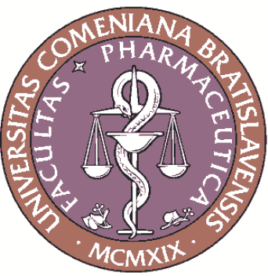
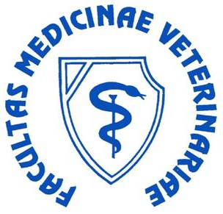
Antibacterial and Antifungal Activity of Selected Styrylquinoline Derivatives
Hana Michnova^{1,2,}*, Sarka Pospisilova^{1,2}, Ewelina Spaczynska³, Wioleta Cieslik³,
Alois Cizek², Robert Musiol³ and Josef Jampilek¹
¹ Department of Pharmaceutical Chemistry, Faculty of Pharmacy, Comenius University, Odbojarov 10, 83232 Bratislava, Slovakia
² Department of Infectious Diseases and Microbiology, Faculty of Veterinary Medicine, University of Veterinary and Pharmaceutical Sciences, Palackeho 1, 61242 Brno, Czech Republic
³ Institute of Chemistry, University of Silesia, 75 Pulku Piechoty 1a, 41 500 Chorzow, Poland
* Corresponding author: michnova.hana@gmail.com

Slide 2
Antibacterial and Antifungal Activity of Selected Styrylquinoline Derivatives
Graphical Abstract

Slide 3
Abstract:
Although bacterial resistance is commonly known, this problem is not related only to the domain of bacteria. The occurrence of resistant mutants of fungi is also observed. Another problem with some known antifungal drugs is only topical application due to their toxicity or limited bioavailability. Thus, this situation refers to the urgency to design and discover not only antibacterial but also antifungal drugs.
Styrylquinoline derivatives structurally related to dichloroquinoline (e.g., chloroxine) are potential antimicrobial compounds. These derivatives were studied by Cieslik et al. recently. Some of these structures expressed antifungal activity comparable with or higher than that of the standard fluconazole. Antibacterial effect, especially against Staphylococcus strains, was observed as well. Based on these results, new structures were synthesized and evaluated with respect to their activity, which is presented in this work. New compounds were tested against Candida strains for their antifungal effect and against Staphylococcus and Enteroccocus strains for their antibacterial activity. Antibacterial effects were tested also against methicillin-resistant staphylococci and vancomycin-resistant enterococci.
Keywords: antibacterial activity; antifungal activity; styrylquinoline; Candida; Staphylococcus

Slide 4
Introduction
Antibacterial resistance is a serious problem which threaten the health of everyone in the world. Infections caused by resistant bacteria occurred formerly only in hospitals and are known as nosocomial infections. These infections are still really dangerous for immunocompromised patients (e.g. AIDS, transplantation, anticancer chemotherapy). Methicillin-resistant Staphylococcus aureus and vancomycin-resistant enterococci belong to the group of the most common causes of nosocomial infections. On the other hand, infections caused by resistant bacterial strains have become more frequent in community nowadays. Thus, the urgency of the problem is increasing¹.
Human fungal infections generally receive less attention than viral or bacterial diseases; however, mortality from invasive fungal infections is very high, often exceeding 50% ². Candida sp. is one of the most frequent causes of mycoses ². Fungi have adapted for commonly used antifungal drugs as well. The development of resistance, high toxicity and limited bioavailability cause a serious problem to find a suitable drug for treatment.
Jampilek, J. Design and Discovery of New Antibacterial Agents: Advances, Perspectives, Challenges. Curr. Med. Chem. 2018, 25, in press, doi: 10.2174/0929867324666170918122633.
Jampilek, J. How can we bolster the antifungal drug discovery pipeline? Future Med. Chem. 2016, 8, 1393-1397.

Slide 5
Styrylquinoline derivatives
Quinoline moiety seems to be really useful for the design and synthesis of novel antimicrobial agents^{3–5}. Researchers supposed that an aromatic quinoline moiety is important for antifungal activity, since its change for quinazoline or 2,4-dioxo-quinoline led to a decrease of activity or complete inactivation^{4–6}.
Some styrylquinoline derivatives were tested by Cieslik et al. This study found that the presence of the hydroxyl moiety in position C₍₈₎ of the quinoline ring B significantly increased the antibacterial activity. Subsequent substitution by chlorine in positions C₍₅₎ and C₍₇₎ was very beneficial as well⁷.
Jampilek, J.; Dolezal, M.; Kunes, J.; Buchta, V.; Silva, L.; Kralova, K. Quinaldine derivatives: Preparation and biological activity. Med. Chem. 2005, 1, 591-599.
Musiol, R.; Jampilek, J.; Nycz, J.E.; Peško, M.; Carroll, J.; Kralova, K.; Vejsova, M.; O‚Mahony, J.; Coffey, A.; Mrozek, A.; Polanski, J. Investigating the Activity Spectrum for Ring-Substituted 8-Hydroxyquinolines. Molecules 2010, 15, 288-304.
Jampilek, J.; Musiol, R.; Finster, J.; Pesko, M.; Carroll, J.; Kralova, K.; Vejsova, M.; O‚Mahony, J.; Coffey, A.; Dohnal, J.; Polanski, J. Investigating biological activity spectrum for novel styrylquinazoline analogues. Molecules 2009, 14, 4246-4265.
Musiol, R.; Jampilek, J.; Buchta, V.; Silva, L.; Niedbala, H.; Podeszwa, B.; Palka, A.; Majerz-Maniecka, K.; Oleksyn, B.; Polanski, J. Antifungal properties of new series of quinoline derivatives. Bioorg. Med. Chem. 2006, 14, 3592–3598.
Cieslik, W.; Musiol, R.; Nycz, J.; Jampilek, J.; Vejsova, M.; Wolff, M.; Machura, B.; Polanski, J. Contribution to investigation of antimicrobial activity of styrylquinolines. Bioorg. Med. Chem. 2012, 20, 6960-6968.

Slide 6
Styrylquinoline derivatives – Synthesis
Synthesis of the discussed styrylquinoline derivatives is illustrated in Scheme 1 and described by Musiol et al. ^{6,8,9}
Scheme 1. Synthesis of ring-substituted styrylquinolines.
6. Musiol, R.; Jampilek, J.; Buchta, V.; Silva, L.; Niedbala, H.; Podeszwa, B.; Palka, A.; Majerz Maniecka, K.; Oleksyn, B.; Polanski, J. Antifungal properties of new series of quinoline derivatives. Bioorg. Med. Chem. 2006, 14, 3592–3598.
Musiol, R.; Podeszwa, B.; Finster, J.; Niedbala, H.; Polanski, J. An efficient microwave-assisted synthesis of structurally diverse styrylquinolines. Chem. Mon. 2006, 137, 1211–1217.
Musiol, R.; Jampilek, J.; Kralova, K.; Richardson, D. R.; Kalinowski, D.; Podeszwa, B.; Finster, J.; Niedbala, H.; Palka, A.; Polanski, J. Investigating biological activity spectrum for novel quinoline analogues. Bioorg. Med. Chem. 2007, 15, 1280–1288.

Slide 7
Experimental – Method
The series of styrylquinoline derivatives were tested for antimicrobial activity against three MRSA isolates, three VRE isolates and against Staphylococcus aureus ATCC 29213 and Enterococcus faecalis ATCC 29212 as reference and quality control strains. The antifungal activity was evaluated against Candida albicans CCM 8261, C. krusei CCM 8271 and C. parapsilosis CCM 8260. Ciprofloxacin and amphotericin B were used as reference antibacterial agents. MICs were determined by the microdilution method. The tested compounds were diluted in microtiter plate to final concentrations from 256 µg/mL to 2 µg/mL for bacteria and from 128 µg/mL to 1 µg/mL for Candida. Plates were incubated at 37 °C for 24 and 48 hours. The MIC was defined as the lowest concentration of the compound, at which no visible bacterial growth was observed. At least 3 independent measurements were made within the test, and the results were averaged.

Slide 8
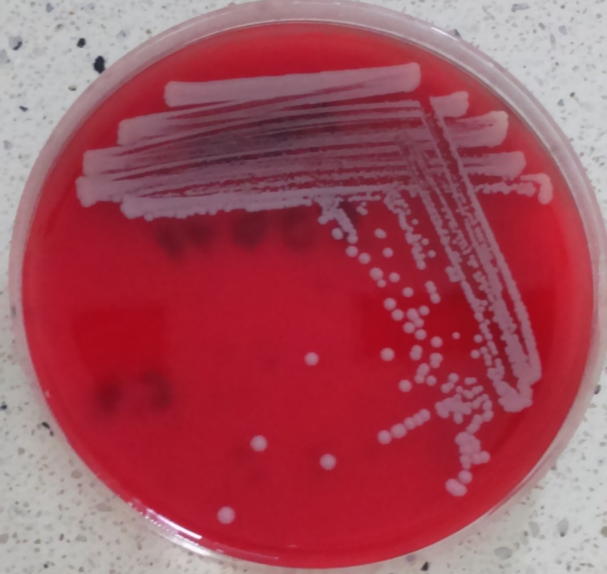
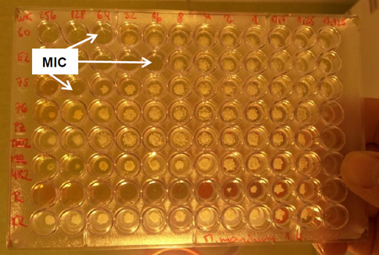
Experimental – Method
Figure 1: MRSA 63718
Figure 2: Microtiter plate with highlighted MIC values

Slide 9
Results – Antibacterial activity
Table 1. Structure of ring-substituted styrylquinolines and in vitro antibacterial activities (MIC [μM]) in comparison with standard ciprofloxacin (CPX).
Comp. | R¹ | R² | MIC [µM]
 |  |  | S.a. | MRSA₁ | MRSA₂ | MRSA₃ | E.f. | VRE₁ | VRE₂ | VRE₃
1 | 8-OAc | 2-NO₂ | >765 | 5.98 | >765 | >765 | >766 | >766 | >766 | >766
2 | 8-OH | 2-NO₂ | 438 | >875 | 876 | 876 | >876 | >876 | >876 | >876
3 | 8-OAc-5,7-Cl | 2-NO₂ | >634 | 5.54 | 354 | 177 | >635 | >635 | >635 | >635
4 | 8-OH-5,7-Cl | 2-NO₂ | 177 | 2.48 | 159 | 19.8 | 177 | 354 | >709 | >709
5 | 8-OAc-5,7-Cl | 3-NO₂ | 317 | 159 | 317 | 159 | >635 | >635 | >635 | >635
6 | 8-OH-5,7-Cl | 3-NO₂ | 88.6 | 88.6 | 177 | 177 | 354 | 354 | >709 | >709
7 | 8-OAc-5,7-Cl | 4-NO₂ | >634 | >634 | >634 | 635 | >635 | >635 | >635 | >635
8 | 8-OH-5,7-Cl | 4-NO₂ | 354 | 709 | 709 | 709 | 354 | 354 | 354 | >709
9 | 8-OAc | 2,4-NO₂ | >674 | >674 | >674 | >674 | 675 | 675 | 675 | >675
10 | 8-OAc-5,7-Cl | 2,4-NO₂ | 286 | >571 | 571 | 571 | >571 | >571 | >571 | >571
11 | 8-OH-5,7-Cl | 2,4-NO₂ | 19.70 | 9.85 | 78.8 | 39.4 | 630 | 315 | >630 | 630
CPX | – | – | 0.75 | 24.1 | 386 | 48.3 | 3.02 | 3.02 | 3.02 | 193
S.a. – Staphylococcus aureus ATCC 29213; MRSA₁ – MRSA 63718; MRSA₂ – MRSA SA 630; MRSA₃ – MRSA SA 3202; E.f. – Enterococcus faecalis ATCC 29212; VRE₁ – VRE342B; VRE₂ – VRE368; VRE₃ – VRE725B.

Slide 10
Discussion – Antibacterial activity
In general, the results of the screening with respect to the antibacterial activities (see Table 1) of novel styrylquinoline derivatives confirmed findings about structure-activity relationships of these structures from former studies.
Antistaphyloccocal activity depends on the hydroxyl moiety in position C₍₈₎. The activity decreases in case of its acetylation.
The importance of the substitution by chlorine in C₍₅₎ and C₍₇₎ positions of the quinoline scaffold was confirmed.
Structures differently substituted by NO₂ were investigated. Higher activity was observed for the monosubstitution of styryl in positions C₍₂₎ˈ and C₍₃₎ˈ than in C₍₄₎ˈ. However, 5,7-dichloro-2-[(E)-2-(2,4-dinitrophenyl)ethenyl]quinolin-8-ol (11) showed high activity against all four staphylococci; thus, it seems that 2,4-NO₂ disubstitution of the styryl moiety significantly increases the activity.
The tested compounds showed only moderate activity or were completely inactive against enterococci. Nevertheless, a higher activity was observed for 5,7-dichloroquinoline-8-ol derivatives.

Slide 11
Results – Antifungal activity
Table 2. Structure of ring-substituted styrylquinolines and in vitro antifungal activities (MIC [μM]) in comparison with standard amphotericin B (AMB).
Comp. | R¹ | R² | MIC [µM]
 |  |  | C. albicans | C. krusei | C. parapsilosis
1 | 8-OAc | 2-NO₂ | 12.0 | 23.9 | 47.9
2 | 8-OH | 2-NO₂ | 438 | 219 | 219
3 | 8-OAc-5,7-Cl | 2-NO₂ | >317 | >317 | >317
4 | 8-OH-5,7-Cl | 2-NO₂ | 44.3 | 44.3 | 88.6
5 | 8-OAc-5,7-Cl | 3-NO₂ | 79.4 | 159 | 317
6 | 8-OH-5,7-Cl | 3-NO₂ | 44.3 | 88.6 | 177
7 | 8-OAc-5,7-Cl | 4-NO₂ | >317 | >317 | >317
8 | 8-OH-5,7-Cl | 4-NO₂ | 177 | 88.6 | 88.6
9 | 8-OAc | 2,4-NO₂ | >337 | >337 | >337
10 | 8-OAc-5,7-Cl | 2,4-NO₂ | >286 | >286 | >286
11 | 8-OH-5,7-Cl | 2,4-NO₂ | 158 | 158 | >315
AMB | – | – | 4.33 | 8.66 | 4.33
C. albicans – Candida albicans CCM 8261; C. krusei – Candida krusei CCM 8271; C. parapsilosis – Candida parapsilosis CCM 8260.

Slide 12
Discussion – Antifungal activity
Chlorinated compounds showed only moderate antifungal activity against tested strains of Candida.
Similarly as in case of antibacterial effect, the acetylation of 5,7-dichloroquinoline-8-ol derivatives decreased antifungal activity.
2-[(E)-2-(2-nitrophenyl)ethenyl]quinolin-8-yl acetate (1) was the most potent against fungi, which is in contrast with observations and relationships for antibacterial activity.

Slide 13
Conclusions
New synthesized styrylquinoline derivatives were evaluated for their antibacterial and antifungal activity. Eleven of them were selected, and their results were presented in this contribution.
The highest activity was observed against the tested strains of Staphyloccocus aureus including its methicilin-resistant isolates. 5,7-Dichloro-2-[(E)-2-(2,4-dinitrophenyl)ethenyl]quinolin-8-ol (11) expressed higher activity against MRSA than ciprofloxacin. 5,7-Dichloroquinoline-8-ol derivatives are assumed to be promising antistaphyloccocal agents.
The tested compounds showed only moderate activity or were completely inactive against enterococci.
Only moderate activity was observed against Candida sp. Contrary to antibacterial structure-activity relationships, 2-[(E)-2-(2-nitrophenyl)ethenyl]quinolin-8-yl acetate (1) showed the highest activity against all 3 tested Candida species.

Slide 14
Acknowledgments
This contribution was supported by grant FaF UK/9/2018 of the Faculty of Pharmacy of the Comenius University, grant No. UK/229/2018 of the Comenius University, NCN grant Opus:DEC-2013/09/B/NZ7/00423 of the Polish National Centre for Science and partially by SANOFI-AVENTIS Pharma Slovakia, s.r.o.
THANK YOU FOR YOUR ATTENTION

