Slide 1
Effect of Senecio serratuloides and its bioactive compound on hypertension
Charlotte Mungho Tata¹, Derek Ndinteh², Benedicta Ngwenchi Nkeh-Chungag³, Opeopluwa Oyehan Oyedeji⁴ and Constance Rufaro Sewani-Rusike¹
¹Department of Human Biology, Faculty of Health Sciences, Walter Sisulu University, Mthatha 5117, South Africa.
²Department of Applied Chemistry, Faculty of Science, University of Johannesburg, South Africa.
³Department of Biological Sciences, Faculty of Natural Sciences, Walter Sisulu University,
Mthatha 5117, South Africa
⁴Department of Chemistry, Faculty of Science and Agriculture, University of Fort Hare, PBX1314 Alice, 5700 Eastern Cape Province, South Africa.
* Corresponding author: crusike@wsu.ac.za

Slide 2
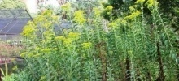
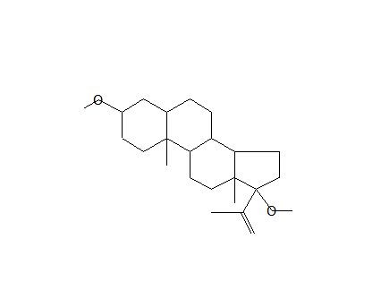
Effect of Senecio serratuloides and its bioactive compound on hypertension
Graphical Abstract
Senecio serratuloides
Folk medicine-Hypertension
Phytochemical Antioxidant Antihypertensive
Hexane
HE
Dichloromethane
DE
Ethyl acetate
EE
Methanol
ME
Antihypertensive
HE, DE, EE, ME –hexane, dichloromethane, ethyl acetate and methanol extracts respectively

Slide 3
Abstract:
Ethnopharmacological knowledge provides useful information for experimental pharmacological studies. Based on this knowledge, this study was aimed at isolating the bioactive compound in Senecio serratuloides which is used in treating hypertension in Eastern Cape Province of South Africa. Senecio serratuloides was serially extracted using hexane, dichloromethane, ethyl acetate and methanol. The fractions were tested for their phytochemical constituents, antioxidant capacity and antihypertensive properties. Methanol fraction was subjected to thin layer and column chromatography for isolation of bioactive compound whose acute antihypertensive effects was determined. Ethyl acetate and methanol fractions had more phytochemicals, better antioxidant capacity and significantly (p<0.001) prevented increase in systolic and diastolic blood pressure. The bioactive compound (Estran-3-one, 17-(acetyloxy)-2-methyl-, (2à,5à,17á)-) isolated from the methanol fraction significantly prevented increase in blood pressure from the first to the fourth hour after treatment. Senecio serratuloides is a potential source of lead compounds for treating hypertension.
Keywords: Senecio serratuloides; Hypertension; Bioactive compound

Slide 4
Introduction
Hypertension (HTN) is the central pathophysiologic contributor to cardiovascular morbidity and mortality [1].
Despite the availability of numerous medication classes that lower blood pressure, the global prevalence of HTN is on the increase due to several factors one of which is imperfect (or non-) adherence to prescribed medication; as a result of many factors one being medication related such as high dosing frequency, polypharmacy and adverse drug reactions [2].
Therefore there is need for novel agents with better efficacy and little or no side effects.
Ethnopharmacology is very important in the search for these novel agents for example, about 74 % of the drugs from plants were discovered by chemists who were attempting to identify the chemical substances in plants that were responsible for their medical uses by humans [3].
An example of a plant which is used in folk medicine for treating HTN in Eastern Cape, South Africa and thus maybe a source antihypertensive agents is Senecio serratuloides (Personal communication, traditional healer). This study was aimed at serially fractionating S. serratuloides using solvents of varying polarities in order isolate of bioactive compound from one of the fractions.

Slide 5
Results and discussion
Table 1. Phytochemical constituents
Table 2. Total antioxidant capacity and radical Scavenging (IC₅₀)
Phytochemical | HE | DE | EE | ME
Alkaloids | _ | + | + | +
Phenols | _ | _ | + | +
Steroids | + | + | + | +
Tannins | _ | _ | + | +
Saponins | + | + | + | +
Flavonoids | _ | _ | + | +
Terpenes | + | _ | + | +
Glycosides | + | _ | + | +
 | HE | DE | EE | ME
ABTS (IC50 mg/ml) | 11.79 | 2.38 | 1.09 | 0.41
DPPH (IC50 mg/ml) | # | # | 0.61 | 0.18
FRAP (µgAAE/mg extract) | 37.8±2 | 52.4±0.4 | 61.1±1 | 157.6±1
AAE - ascorbic acid equivalent, # - very weak scavenging properties as percentage inhibition at the concentrations examined were far lower than the 50.
+ Phytochemical present - Phytochemical absent
Table 3. Effect of extracts on % increase in BP
Ethyl acetate and methanol extracts had more phytochemicals, better antioxidant capacity and significantly (p<0.001) prevented increase in systolic and diastolic blood pressure.
BP | NT | LN | CPT | HE | DE | EE | ME
SBP | 1±2 | 23±3 | 13±1** | 22±1 | 19±2 | 11±1*** | 13±0.1**
DBP | 3±2 | 30±3 | 10±1** | 29±1 | 6±2b | 5±1*** | -7±4***
**p<0.01, *** p ˂ 0.001 different from L-NAME group
HE, DE, EE, ME –hexane, dichloromethane, ethyl acetate and methanol extracts respectively

Slide 6
Table 4. Effect of bioactive compound on systolic and diastolic blood pressure
 | Time/hrs | NT | LN | CPT | BC
SBP | 0 | 146±3 | 146±1 | 147±1 | 147±2
 | 1 | 149±4 | 180±3 | 168±4* | 153±1***
 | 2 | 147±3 | 175±5 | 170±3 | 153±2***
 | 4 | 140±1 | 171±2 | 160±3 | 157±2**
DBP | 0 | 113±5 | 110±2 | 117±3 | 113±4
 | 1 | 112±2 | 152±4 | 141±5 | 108±3***
 | 2 | 117±2 | 142±6 | 140±4 | 115±3***
 | 4 | 112±1 | 129±2 | 128±5 | 115±6
Figure 1. Bioactive compound (Estran-3-one, 17-(acetyloxy)-2-methyl-, (2à,5à,17á)-) from methanol extract (ME)
The bioactive compound (Estran-3-one, 17-(acetyloxy)-2-methyl-, (2à,5à,17á)-) isolated from the methanol extract significantly prevented increase in SBP from the first to the fourth hour and DBP from the first to the second hour after treatment.
Values are expressed as mean±SEM. n- 6; NT-normotensive control; LN-L-NAME group; CPT-captopril; BC-bioactive compound; SBP-systolic blood pressure; DBP diastolic blood pressure. * p< 0.05, ** p ˂ 0.01, *** p˂ 0.001 compared to L-NAME group.
HE, DE, EE, ME –hexane, dichloromethane, ethyl acetate and methanol extracts respectively

Slide 7
Conclusions
Senecio serratuloides is a potential source of lead compounds for treating hypertension.
References
Dharmashankar, K. and Widlansky, M. E. (2010) ‘Vascular endothelial function and hypertension: insights and directions.’, Current hypertension reports. United States, 12(6), pp. 448–455. doi: 10.1007/s11906-010-0150-2.
Antoniou, S. et al. (2016) ‘Management of Hypertensive Patients With Multiple Drug Intolerances: A Single-Center Experience of a Novel Treatment Algorithm’, Journal of Clinical Hypertension, 18(2), pp. 129–138. doi: 10.1111/jch.12637.
Farnsworth N.R. (2008). The role of ethnopharmacology in drug development. In: Chadwick D.J. and Marsh J. Bioactive compounds from plants. Norvatis foundation symposia: John Wiley and sons. 2-19. Available at: https://books.google.co.za/books?id=ikQIqadZlI0C.

Slide 8
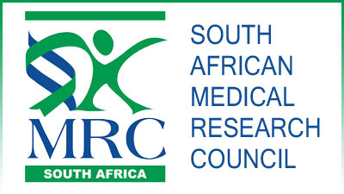
Acknowledgments

