Slide 1
New 1,6-diphenyl-1H-pyrazolo[3,4-b]pyridines Derivatives with Potent Antichagasic Activity
Júlio César Soares ^{1,}*, Joana Ribeiro ¹, Camilo Henrique Lima ¹, Gisele Portapilla², Sérgio de Albuquerque² and Luiza Dias¹
¹Laboratório de Química Medicinal, Faculdade de Farmácia, Universidade Federal Fluminense, Niterói, RJ, Brazil;
²Departamento de Análises Clínicas, Toxicológicas e Bromatológicas, Universidade de São Paulo/USP, Faculdade de Ciências Farmacêuticas de Ribeirão Preto, Ribeirão Preto, SP, Brazil * Corresponding author: juliovanelis@id.uff.br

Slide 2
New 1,6-diphenyl-1H-pyrazolo[3,4-b]pyridines Derivatives with Potent Antichagasic Activity
Graphical Abstract
Notes:
Normatizar: OAc ou -C=OCH3

Slide 3
Abstract: Chagas’ disease is an infection caused by the protozoan Trypanosoma cruzi that represents a major public health threat in Latin America. Previously we developed 4-carbohydrazide derivatives of 1H-pyrazolo[3,4-b]pyridine as antichagasic agents, which the hit compound was the N’-4-hydroxybenzylidene-carbohydrazide derivative. In order to verify the influence of the substituent position and the carbohydrazide moiety replacement for the 1,3,4-oxadiazoline moiety, herein we described the synthesis and in vitro evaluation of trypanocidal activity and cytotoxicity of eleven new 1,6-diphenyl-4-(substituted)-1H-pyrazolo[3,4-b]pyridine derivatives. All the new 1,6-diphenyl-3-methyl-4-(substituted)-1H-pyrazolo[3,4-b]pyridine derivatives were obtained with yields ranging from 70 to 95% and had their structures elucidated by spectroscopic methods. These compounds were evaluated in vitro against intracellular amastigote form of T. cruzi, using the benznidazole drug as the positive control and had their cytotoxicity profiles determined on LLCMK₂ mammalian cells. Among the new compounds, the N’-2-hydroxybenzylidene-carbohydrazide and 2-(N’-acetyl-1,3,4-oxadiazolin-2-yl)-phenyl acetate derivatives showed the most significant antichagasic activities and low cytotoxicity profile in comparison to benznidazole drug. The results suggest that the 2-substituted position of the phenyl group connected to the carbohydrazide or oxadiazoline moieties play an important role for the antichagasic activity of 1,6-diphenyl-4-(substituted)-1H-pyrazolo[3,4-b]pyridines compounds. Furthermore, our results indicate a bioisosteric replacement of carbohydrazide moiety by the 1,3,4-oxadiazoline ring.
Keywords: Chagas disease; Trypanosoma cruzi; 1H-pyrazolo[3,4-b]pyridine.

Slide 4
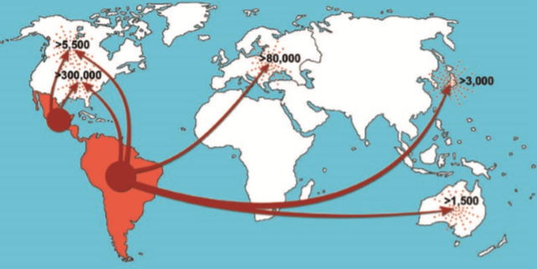
Introduction
Chagas disease, also known as american trypanosomiasis, is an infection caused by the protozoan Trypanosoma cruzi responsible for a burden of 6 million infections and 7 thousand death globally each year¹.
Although it is endemic in 21 counstries across Latin America, on last decades Chagas disease has been spread to non-endemic areas due to migration².
Immigration Routes from Latin America and an estimate of the number of infected people. ³
¹ WHO. Chagas disease (American trypanosomiasis). Available in: <http://www.who.int/mediacentre/factsheets/fs340/en/>. Acess in: 22 out. 2018. ² CHATELAIN, E. Comput. Struct. Biotechnol. J., 15, 98–103, 2017. ³ COURA, J. R.; VIÑAS, P. A. Nature, 465, S6–S7, 2010.

Slide 5
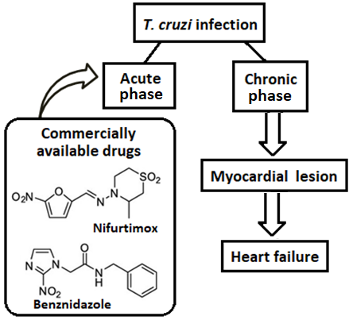
Introduction
Chagas disease is considered one of the main causes of heart failure in Brazil, that is highly associated with persistence of amastigote form of T. cruzi in cardiac muscle of chronically infected patients^{4,5}.
The development of new drugs against T. cruzi is still required since the only two drugs (nifurtimox and benznidazole) currently used cause severe side effects and are not effective in chronic infection⁵.
⁴ CHATELAIN, E. J Biomol Screen, 20 (1), 22–35, 2015. ⁵ BERMUDEZ, J. et al. Acta Trop., 156, 1–16, 2016.

Slide 6
Introduction
The hit compound from previous work was the N’-4-hydroxybenzylidene-carbohydrazide derivative⁶ (LQMed 41).
In order to verify the influence of the substituent position and the replacement of carbohydrazide moiety for 1,3,4-oxadiazoline moiety, herein we described the synthesis and in vitro evaluation of trypanocidal activity and cytotoxicity of 11 new 1,6-diphenyl-4-(substituted)-1H-pyrazolo[3,4-b] pyridine derivatives.
⁶ DIAS, L.R.S. et al. Bioorg. Med. Chem., 15(1), 211, 2007.

Slide 7
Results and discussion
All new compounds were purified by recrystallization and their structures were elucidated by spectroscopic methods (IR, 1D and 2D NMR (¹H and ¹³C) and HRMS).
The new compounds were synthesized using the 4-carbohydrazide-1,6-diphenyl-3-methyl-1H-pyrazolo[3,4-b]pyridine (1)⁶ as the key intermediate.
The reaction between 1 and hydroxybenzaldehydes (2) in a green solvent medium (glycerol)⁷ furnished the N’-benzylidene-carbohydrazide derivatives (LQMed 521-524 ).
⁶ DIAS, L.R.S. et al. Bioorg. Med. Chem., 15(1), 211, 2007. ⁷ RIBEIRO, J. L. S. Master’s Dissertation. Universidade Federal Fluminense, 2017.

Slide 8
Results and discussion
The 1,3,4-oxadiazoline derivatives (LQMed525-529) were synthesized from N’-benzylidene-carbohydrazides (LQMed41, 521-524) by treatment with refluxing acetic anhydride. ⁸⁻¹⁰
The LQMed525-529 compounds have the hydroxyl group replaced by the acetyl group.
⁸ KOÇYIĞIT-KAYMAKÇIOĞLU, B. et al. Med. Chem. Res., 21(11), 3499, 2012. ⁹MALLIKARJUNA, B.P. et al. Eur. J. Med. Chem., 44(11), 4739, 2009. ¹⁰ MOREIRA OSÓRIO, T. et al. Bioorg. Med. Chem. Lett., 22(1), 225, 2012.

Slide 9
Results and discussion
Additional hydrolysis step was carried out in order to obtain two new hydroxylated 1,3,4-oxadiazoline derivatives (LQMed530 and 531) from the corresponding acetylated compounds (LQMed525 and 526). In this step, ultrasound was used for improving reaction time and yields¹¹.
¹¹ PACCOLA, C. E. T et al. J. Phys. Chem. C, 119 (33), 19162–19170, 2015.

Slide 10
Results and discussion
Trypanocidal activity evaluation against the amastigote form of T. cruzi.
BZD = Benznidazole drug
The low solubility of LQMed529 (R= 3-OAc-4-OCH₃) in water and DMSO has prevented its evaluation.

Slide 11
Results and discussion
Cytotoxicity on LLCMK₂ mammalian cells and Selectivity Index.
BZD = Benznidazole drug

Slide 12
Conclusions:
The new 1,6-diphenyl-3-methyl-4-(substituted)-1H-pyrazolo[3,4-b]pyridine derivatives (LQMed521-531) were synthesized in good yields and were evaluated in vitro for trypanocidal activity and cytotoxicity profile;
Among the new compounds, the N’-2-hydroxybenzylidene-carbohydrazide derivative (LQMed524) and the 2-(N’-acetyl-1,3,4-oxadiazolin-2-yl)-phenyl acetate derivative (LQMed527) have exhibited higher activities against T. cruzi and low cytotoxicity profile in comparison with benznidazole drug;
The results showed that the 2-substituted position of phenyl group connected to the carbohydrazide or oxadiazoline moiety plays an important role for the antichagasic activity of this class of compounds;
Furthermore, these results indicate a nonclassical bioisosteric replacement of the carbohydrazide moiety by the 1,3,4-oxadiazoline ring;
The findings showed that LQMed524 and 527 are promising drug candidates for the treatment of chronic phase of the Chagas disease.

Slide 13
Acknowledgments
This study was financed in part by the Coordenação de Aperfeiçoamento de Pessoal de Nível Superior - Brasil (CAPES)

