Slide 1


Z-Stereoselective Catalytic Synthesis of Natural Acids, Lembehynes, and Acetogenins - Modern Preparations for Medicine
Vladimir A. D'yakonov ^{1,}*, Lilya U. Dzhemileva ¹, Alexey A. Makarov ¹,
Regina A. Tuktarova ¹, Svetlana R. Ishmukhametova ¹, Evgenii N. Andreev ¹, and Usein M. Dzhemilev ¹
¹ Institute of Petrochemistry and Catalysis, Russian Academy of Sciences, 141 Prospekt Oktyabrya, Ufa 450075, Russian Federation
* Corresponding author: DyakonovVA@gmail.com

Slide 2
Z-Stereoselective Catalytic Synthesis of Natural Acids, Lembehynes, and Acetogenins - Modern Preparations for Medicine
Graphical Abstract

Slide 3
Abstract:
The report discusses the latest achievements of the authors in developing original methods for stereoselective synthesis of natural acetogenins, higher bis-methylene-separated di- and trienoic acids, lembehynes that are of exceptional interest as low-toxic target antitumor drugs, as well as compounds with neritogenic activity for treating neurodegenerative diseases.
The synthetic approaches to the above listed natural compounds are based on the use at the key stage of the synthesis, of new organometallic reactions, such as Ti-catalyzed homo- and cross-cyclomagnesiation of 1,2-dienes, involving available Grignard reagents.
The studies of the synthesized compounds for their antitumor and antibacterial activities in vitro were performed with the use of unique equipment in “Centre for Molecular Design and Biological Screening of Candidate Substances for the Pharmaceutical Industry” at the Institute of Petrochemistry and Catalysis of RAS using modern methods such as flow cytofluorometry, fluorescence microscopy and Western blotting.
For compounds that showed the greatest activity, in vivo tests were performed for linear mice with grafted malignant Lewis carcinoma.
Key words: Natural acetogenins; Higher bis-methylene-separated(interrupted) di- and trienoic acids; Lembehynes; Antitumor drugs; Neritogenic activity.

Slide 4
1,2-DIENES IN STEREOSELECTIVE SYNTHESIS OF ALKENES
Hydrometalation of 1,2-dienes
S. Nagahara et el. Bull. Chem. Soc. Jpn., 1993, 66, 3783.
Cycloalumination of 1,2-dienes
U.M. Dzhemilev et al. Russ. Chem. Bull. 2002, 51, 2255.
Cyclomagnesiation of 1,2-dienes
U.M. Dzhemilev et al. Tetrahedron., 2004, 60, 1287.

Slide 5
INTERMOLECULAR CYCLOMAGNESIATION OF ALKYL(ARYL)
ALLENES AND N,O-CONTAINING 1,2-DIENES
70-85%
80-85%
N-containing 1,2-diene:cyclo-1,2-diene:EtMgBr:Mg:[Ti]= 10:12:26:20:1; Et₂O, 6 h, r. t.
80-95%
85-90%
O-containing 1,2-diene:cyclo-1,2-diene:EtMgBr:Mg:[Ti]= 10:11:24:20:0.5; Et₂O, 6 h, r. t.
V.A. D’yakonov, A.A. Makarov, E.Kh. Makarova, U.M. Dzhemilev, Tetrahedron.– 2013, V. 69, P. 8516-8526

Slide 6
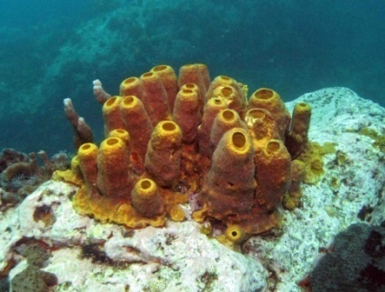
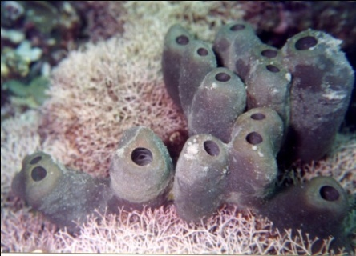
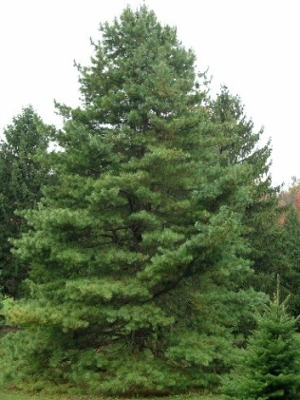
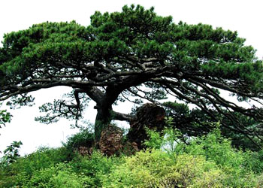
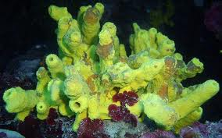
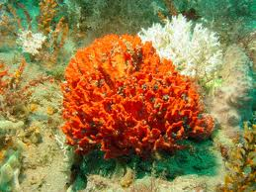
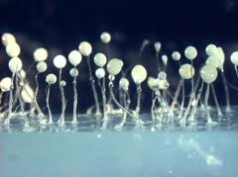
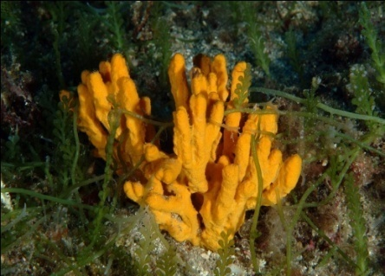
NATURAL SOURCES OF 5Z,9Z-DIENOIC ACIDS
Natural
5Z,9Z-dienoic acids
Aplysina fistularis
Erylus formosus
R
Pinus koraiensis
Isolated from the marine sponges (Aplysina fistularis, Axinella verrucosa) and seeds (Pinus tabulaeformis)
Pinus tabulaeformis
Chondrilla nucula
Carballeira N.M., et al. J. Nat. Prod., 2002, 64, 1715
Dictyostelium
discoideum
Axinella verrucosa
Microciona prolifer
Efficient inhibitors of topoisomerases I and II; simultaneously exhibit antitumor, antiviral, antiparasitic and antibacterial activities

Slide 7
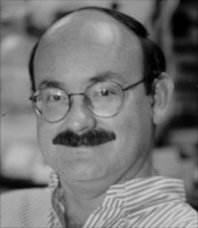
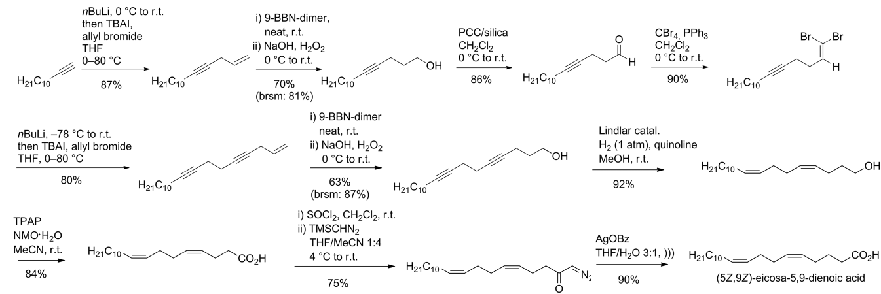

KNOWN METHODS FOR THE SYNTHESIS OF 5Z,9Z-DIENOIC ACIDS
4 стадии, выход 12%
2 изомера
N.M. Carballeira, A. Emiliano, A. Guzman. Chem. Phys. Lipids, 100, (1999), 33-40
Prof. Nestor Carballeira
University of Puerto Rico
N.M. Carballeira, J.E. Betancourt, E.A. Orellano, F.A. Gonzalez. J. Nat. Prod, 65, (2002), 1715-1718
13 стадий, выход 12%
J. Adrian , C. B. W. Stark, Eur. J. Org. Chem, 27, (2016), 4607-4610
Prof. Christian B. W. Stark
Universität Hamburg

Slide 8
EFFICIENT SYNTHESIS OF 5Z,9Z-DIENOIC ACIDS
The cyclomagnesiation reaction of allenes to give 2,5-dialkylidenemagnesacyclopentanes
Known
Natural
5Z,9Z-dienoic acids
Dzhemilev U.M., et al. Tetrahedron, 2004, 60, 1287
D’yakonov V.A., et al. Tetrahedron, 2008, 64, 10188
NEW METHOD :
Stereoselective synthesis of practically important 5Z,9Z-dienoic acids is based on the new reaction.
Isolated from the marine sponges (Aplysina fistularis, Axinella verrucosa) and seeds (Pinus tabulaeformis)
Carballeira N.M., et al. J. Nat. Prod., 2002, 64, 1715
Russ.Chem.Bull., 2012, 61(1),158; Russ.J. Org.Chem., 2012, 48(3), 349;
Tetrahedron, 2013, 69, 8516; Chem.Commun., 2013, 49, 8401.

Slide 9
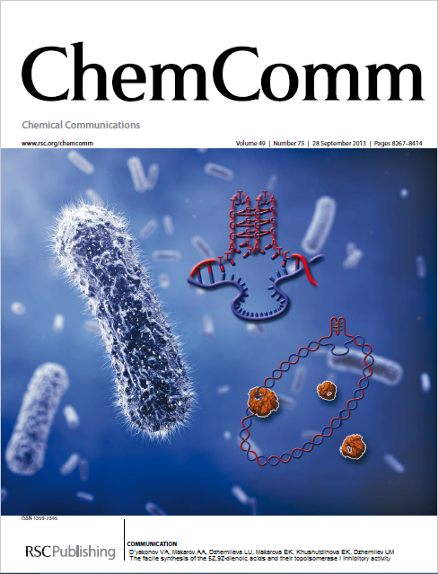
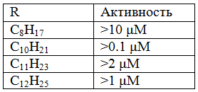
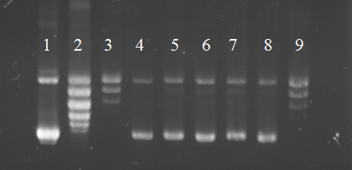
IN VITRO STUDY ON TOPOISOMERASE I INHIBITORY ACTIVITY OF THE SYNTHESIZED 5Z,9Z-DIENOIC ACIDS
Fig. Electrophoregram of the products of relaxation of supercoiled plasmid DNA in vitro induced by topoisomerase I (Topogen, USA) in the presence of (5Z,9Z)-5,9-eicosadienoic acid. 1. Supercoiled plasmid DNA (pHOT1). 2. Relaxed DNA form (visualization of the set of topoisomers). 3. Negative control with DMSO (concentration 3%). 4. Relaxation reaction of plasmid DNA in the presence of camptothecin (10 μM). 5–9. Effect of different concentrations of (5Z,9Z)-5,9-eicosadienoic acid on the relaxation of plasmid DNA (5 – 0.75, 6 – 0.5, 7 – 0.25, 8 – 0.1, 9 – 0.01 μM).
V. A. D’yakonov, A. A. Makarov, L. U. Dzhemileva,
E. H. Makarova, U. M. Dzhemilev, Chem. Commun.,
2013, 49, 8401

Slide 10
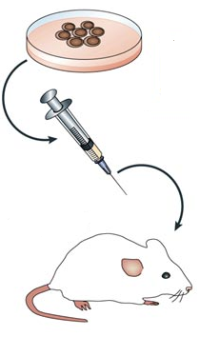
EICOSA-5Z,9Z-DIENOIC ACID
As a tumor model, malignant Lewis lung carcinoma (LLC) was taken, growing as a solid node, metastasizing hematogenically into the lungs, Which is not subjected to spontaneous regression. In the experiments, 53 female C57Bl / 6j mice with an average body weight of 20 g, were used.
1) Analysis of survival rates revealed a significant increase in the lifespan of mice under the influence of agent B-1 at a dose of 30 mg / kg relative to the control group and mice in the administration of paclitaxel.
2) With intraperitoneal administration during the period of progressive growth of LLC, the agent B-1 effectively retards the growth of the primary node by inhibiting tumor cell division.
Conclusion: The conducted studies reveal, that agent B-1 possesses antitumor properties. They are manifested, when introduced into mice intraperitoneally during tumor progression. The tolerability of the agent B-1 in animals upon course administration of up to 100 mg / kg is good.

Slide 11
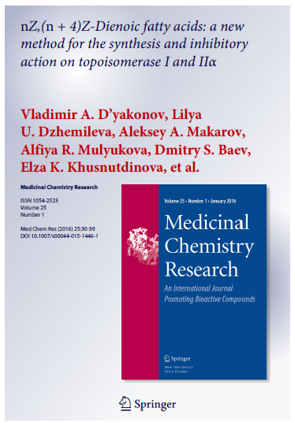
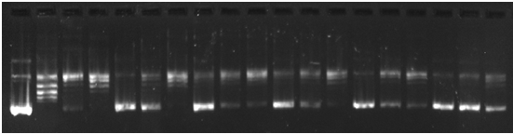
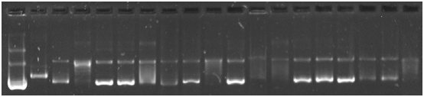
EFFECT OF THE POSITION OF THE 1Z,5Z-DIENE GROUP ON THE INHIBITORY ACTIVITY OF hTOPI AND hTOPII
3Z,7Z
5Z,9Z
6Z,10Z
7Z,11Z
11Z,15Z
3Z,7Z
5Z,9Z
6Z,10Z
7Z,11Z
11Z,15Z
V.A. D’yakonov, et al. Med. Chem. Res., 2016, 25(1), 30-39
V.A. D’yakonov, et al. Bioorg. and Med. Chem. Lett., 2015, 25(11), 2405–2408

Slide 12
SYNTHESIS OF STEROID 5Z,9Z-DIENOIC ACIDS
(a): EtMgBr, Mg, Cp₂TiCl₂ (10 mol%), diethyl ether; (b): H₃O⁺; (c): H₂CrO₄/H₂SO₄, acetone, CH₂Cl₂.
V.A. D´yakonov, L.U. Dzhemileva, A.A. Makarov, A.R. Mulyukova, R.A. Tuktarova, I.I. Islamov, U.M. Dzhemilev. Russ. Chem. Bull., 2015, 64(9), 2135-2140.

Slide 13
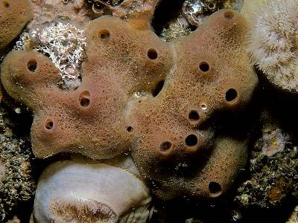
FIRST SYNTHESIS OF
5Z,9Z,13Z-EICOSATRIENOIC ACID
Haliclona cinerea
n = 4, m =1, q = 2 (59%)
(a): EtMgBr, Mg, Cp₂TiCl₂ (5 mol%), diethyl ether; (b): H₃O⁺; (c): Br(Ph₃P(CH₂)CO₂H)-NaHMS, THF
V. А. D'yakonov, A. A. Makarov, A. R. Salimova, E. N. Andreev, U. М. Dzhemilev, Mendeleev Communications, 2017, 27, 234-236

Slide 14
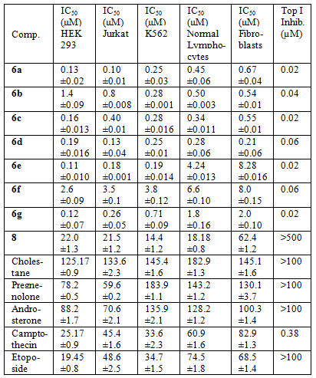
SYNTHESIS AND IN VITRO STUDY OF CYTOTOXIC ACTIVITY OF STEROID 5Z,9Z-DIENOIC ACIDS
1a
1b
1c
1d
1e
1f
1g
2
V.A. D'yakonov, L.U. Dzhemileva, R.A. Tuktarova, A.A. Makarov, I.I. Islamov, A.R. Mulyukova, U.M. Dzhemilev. Steroids, 2015, 102, 110-117 ; V.A. D'yakonov, R. A. Tuktarova, L.U. Dzhemileva, M.M. Yunusbaeva, I.R. Ramazanov, U.M. Dzhemilev. Anti-Cancer Agents in Medicinal Chemistry, 2017, 17, 1126-1135.

Slide 15
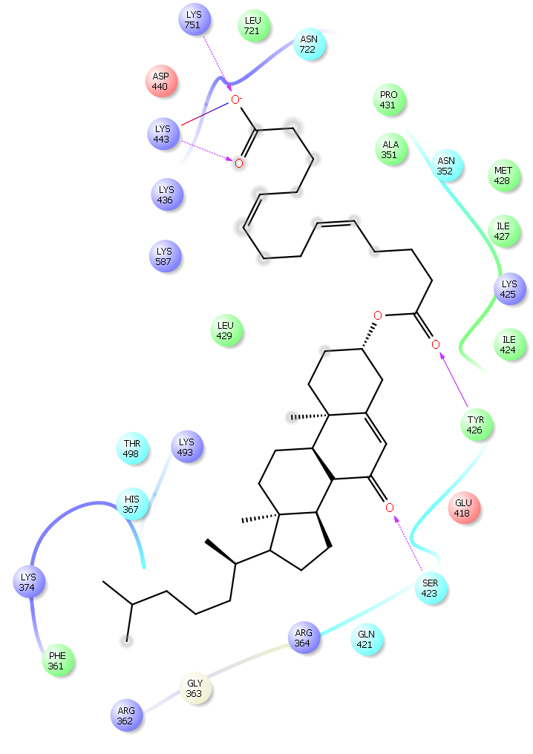
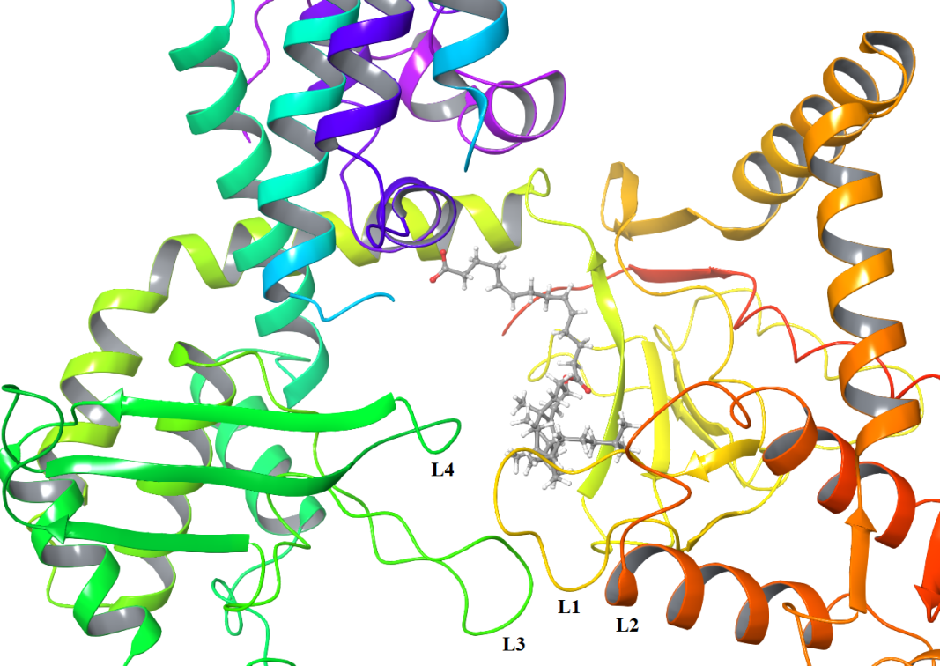
MECHANISM OF TOPOISOMERASE I INHIBITION IN THE PRESENCE OF STEROID 5Z,9Z-DIENOIC ACIDS
V.A. D'yakonov, R.A. Tuktarova, L.U. Dzhemileva, M.M. Yunusbaeva, I.R. Ramazanov, U.M. Dzhemilev. Novel Hybrid Molecules on the Basis of Steroids and (5Z,9Z)-Tetradeca-5,9-dienoic Acid: Synthesis, Anti-Cancer Studies and Human Topoisomerase I Inhibitory Activity. Anti-Cancer Agents in Medicinal Chemistry, 2017, 17, 1126-1135.

Slide 16
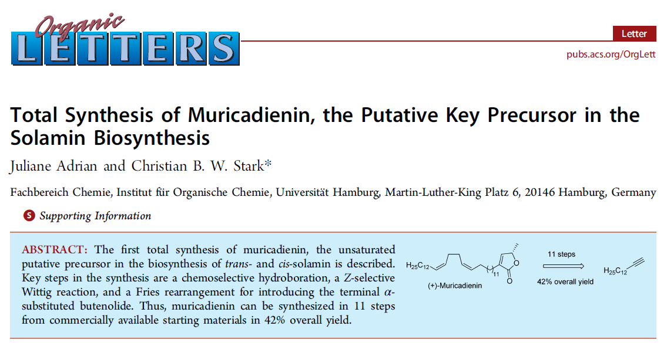
Prof. Christian B. W. Stark
Org. Lett., 2014, 16 (22), pp 5886–5889

Slide 17
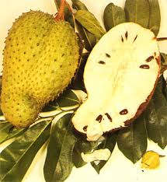
ORIGINAL METHOD FOR THE SYNTHSIS OF MURICADIENIN AND ITS ANALOGS – THE FOUNDATION FOR THE DEVELOPMENT MODERN ANTIBACTERIAL, ANTIVIRAL AND ANTITUMOR DRUGS
+
100%
89%
75%
Muricadienin
Isolated from the roots of the plant Annona muricata
>98%
Can be synthesized in 11 stages in 42% yield
Org. Lett., 2014, 16 (22), pp 5886–5889
5 stages,
Total yield 65%
~87%
Muricadienin
Usein M. Dzhemilev; Vladimir A. D’yakonov; Regina A. Tuktarova; Lilya U. Dzhemileva; Svetlana R. Ishmukhametova; Milyausha M. Yunusbaeva; Armin de Meijere; J. Nat. Prod. August 17, 2016 (Article) pp 2039–2044

Slide 18
BRAIN DISEASES - THE EPIDEMIC OF THE XXI CENTURY
Prevalence of socially significant diseases:
Neurological / Mental
Cardiovascular
Oncological
PROGNOSES
Disease 2009 2040 million people Parkinson's Disease 16 32
Alzheimer's Disease 25 75
In the world: 2013 - 44.5 million, 2030 - 75.5 million; 2050 - 135.5 million people
DEMENTIA
Russia: 1.4 - 1.8 million people
Extract from G8 Science Ministers and Presidents of Science Academies protocol
(London UK, 12 June 2013)
«…Cooperation in the field of neurodegenerative diseases is considered as an example of global challenges involving the creation of a global research infrastructure, which is confirmed by increased funding for this in the US and Canada, as well as by organizing relevant research centers in Paris and Bonn.»

Slide 19
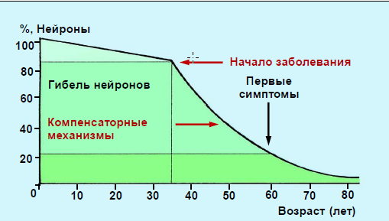
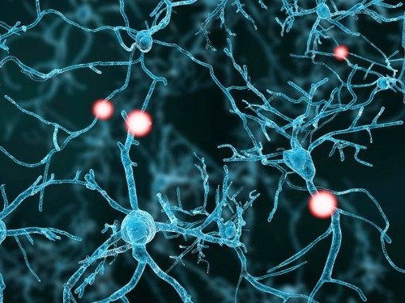

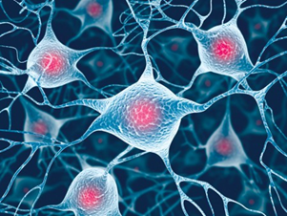
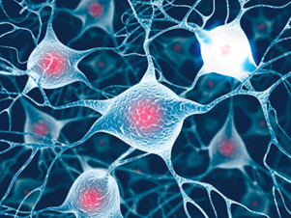

CURRENT CONCEPTS OF PATHOGENESIS, DIAGNOSIS,
AND TREATMENT OF NEURODEGENERATIVE DISEASES
Nonspecific neuronal cell death mechanisms
Increased secretion of
growth factors
Activation of antioxidant
systems
Enhancement of interneural connections at the site of neuron death
Neuronal death

Slide 20
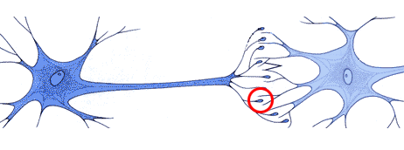
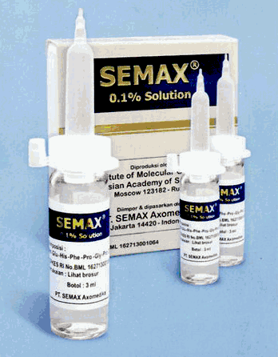
BASIC CONCEPT IN THE TREATMENT OF NEURODEGENERATIVE DISEASES (NDD)
Most NDD causes changes in the chemical communication system in the neural tissue
Oxidative stress
because of the mitochondria destruction
Apoptosis of neurons
and microglia
Neurotrophic factors as neuroprotectors upon neurodegenerative diseases
Problem with addressable delivery!
EXPENSIVE! And not always effective! Quickly destroyed!

Slide 21

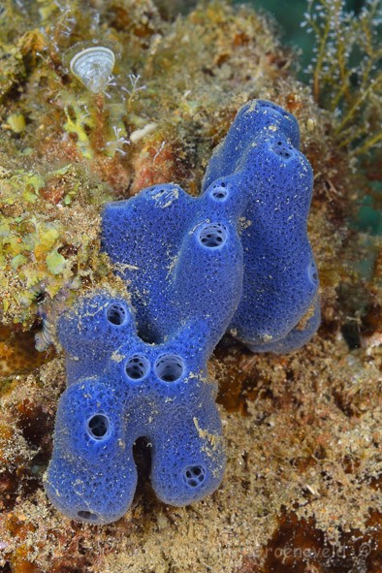
LEMBEHYNES - EFFICIENT NEURITOGENIC COMPOUNDS
Prof. Motomasa Kobayashi
Osaka University
Haliclona sp.

Slide 22
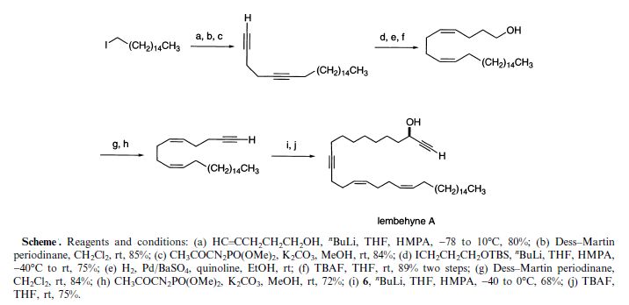
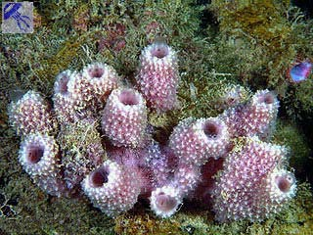
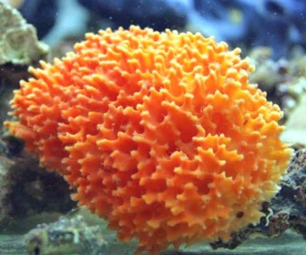
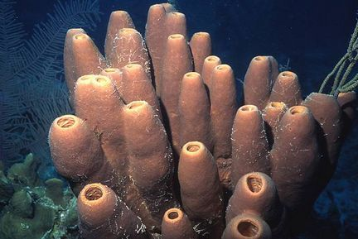
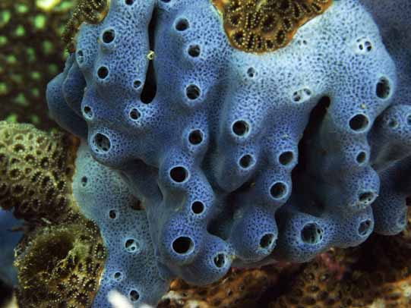
TOTAL SYNTHESIS OF LEMBEHYNE A

Slide 23
PREPARATION OF THE KEY MONOMER IN THE SYNTHESIS OF LEMBEHYNE А
V.A. D’yakonov, L.U. Dzhemileva, A.A. Makarov, E.N. Andreev, U.M. Dzhemilev, Russ. J. Org. Chem., 2016, V. 52(12), 1844–1846;
V.А. D'yakonov, A.A. Makarov, L.U. Dzhemileva, E.N. Andreev, U.М. Dzhemilev. Total Synthesis of Neuritogenic Alkynes: Lembehyne B and Key Intermediate of Lembehyne A. ChemistrySelect, 2017, 2, 1211.

Slide 24
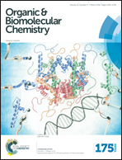
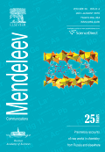
CROSS-CYCLOMAGNESIATION FOR THE SYNTHESIS OF NEIRITOGENIC ALKYNE – LEMBEHYNE B
V. А. D'yakonov, A. A. Makarov, L. U. Dzhemileva, E. N. Andreev, U. М. Dzhemilev, Mendeleev Communications, 2017, 27, 122-124; L.U. Dzhemileva, V.A. D’yakonov, A.A. Makarov, E.N. Andreev, M.M. Yunusbaeva, U.M. Dzhemilev, Org. Biomol. Chem. 2017, 15, 470.

Slide 25
PREPARATION OF NATURAL LEMBEHYNE В AND ITS SYNTHETIC ANALOGS INVOLVING THE WEINREB AMID

Slide 26
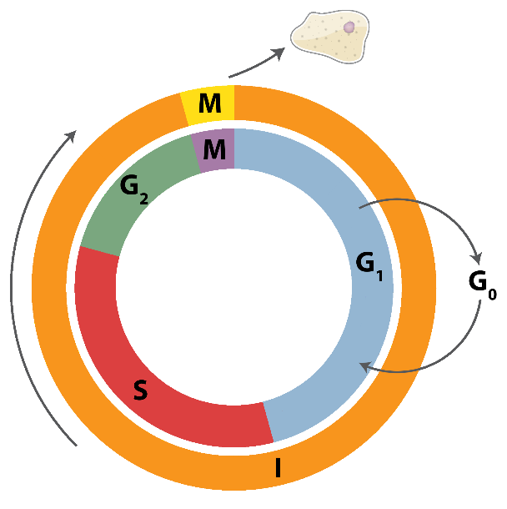
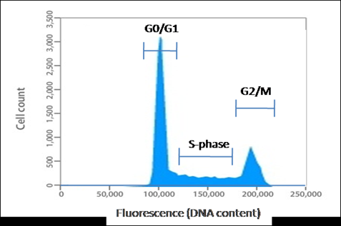
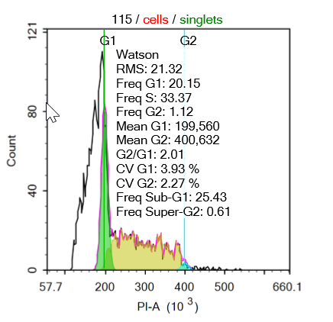
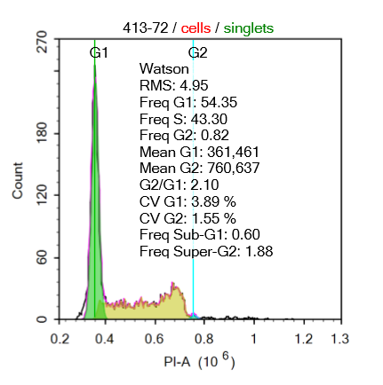
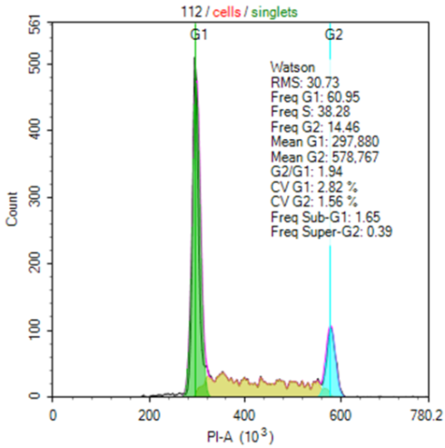
IN VITRO ANALYSIS OF CELL CYCLE OF LEMBEHYNE B
ON THE LEUKEMIA CELL LINES AND NEUROBLASTOMA CELLS
Cell cycle progression in Jurkat cells
The cell cycle in Jurkat cells
without treatment with Lembehyne B
Cell cycle progression in Neuro2A cells

Slide 27
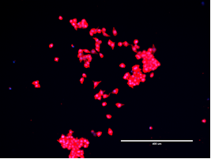
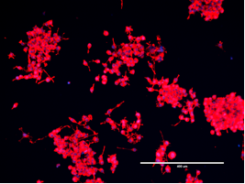
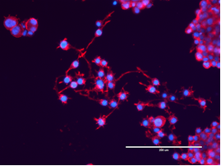
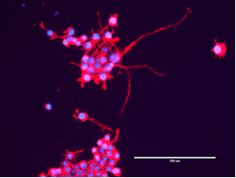
STUDY OF NEURITOGENIC ACTIVITY OF LEMBEHYNE
ON NEURO2A CELLS
Control – after incubation for 72 h
Incubation for 24 h
For 48 h
For 72 h

Slide 28
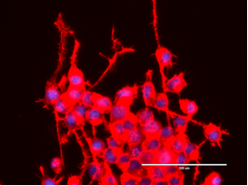
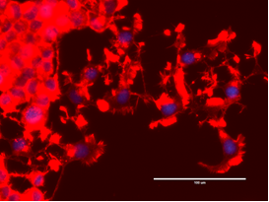
STUDY OF NEURITOGENIC ACTIVITY OF LEMBEHYNE B
ON NEURO2A CELLS
IN COMPARISON WITH NERVE GROWTH FACTOR
Lembehynes
NGF
Differentiation of Neuro2A cells during incubation for 48-72 hours with the addition to the cultivation medium only of lembehyne B (left) and only of NGF (nerve growth factor) (right). Staining with DAPI and ActinRedTM 555 ReadyProbesTM Reagent (InvitrogenTM).

Slide 29
Conclusions
Reactions of catalytic homo- and cross-cyclomagnesiation of aliphatic and functionally substituted allenes using available Grignard reagents are efficient tools for the design and stereoselective synthesis of natural functionally substituted bis-methylene-separated Z-dienes, fatty acids, acetogenins and lembehynes, exhibiting a broad spectrum of biological activities.

Slide 30



Acknowledgments
This work was financially supported by the Russian Science Fundation(Grants 14-13-00263, 16-13-10172, 18-73-10030), Russian Foundation for Basic Research (Grants16-03-00543, 17-43-020502, 18-29-09068) and Grant of the RF President for the support of leading scientific schools(NS-5240.2018.3).

