Slide 1
Hepatoprotective and antioxidant effects of oligoribonucleotides-D-mannitol complexes against thioacetamide-induced liver fibrosis
Tetiana Marchyshak¹, Larisa Semernikova¹, Tetiana Yakovenko¹ and Zenoviy Tkachuk^{1,}*
¹ Institute of Molecular Biology and Genetics, National Academy of Sciences of Ukraine 150, Zabolotnogo Str., Kyiv, Ukraine, 03680.
* Corresponding author: ztkachuk47@gmail.com

Slide 2
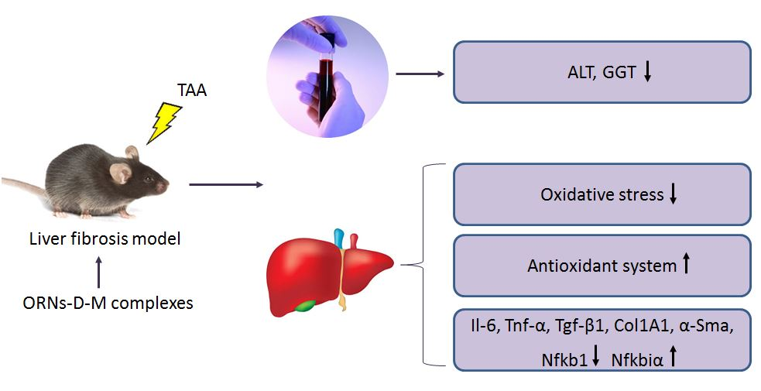
Hepatoprotective and antioxidant effects of oligoribonucleotides-D-mannitol complexes against thioacetamide-induced liver fibrosis

Slide 3
Abstract: Hepatic fibrosis is a reversible wound-healing response of the liver to a variety of etiological factors. The cascade of reactions that leads to liver fibrosis includes inflammation, oxidative stress, and activation of hepatic stellate cell. Activated stellate cells overexpress the components of the extracellular matrix, including fibril-forming type I and III collagens, elastin, and glycoproteins. This overexpression leads to the deposition of collagen contributing to the development of liver fibrosis. Oligoribonucleotides-D-mannitol complexes (ORNs-D-M) display a vast spectrum of biological effects, ORNs-D-M has been previously reported to exhibit anti-inflammatory, membrane-stabilizing and antioxidant activities under acute hepatotoxicity. However, there is no previous study investigated the efficacy of ORNs-D-M on hepatic fibrosis. Therefore, the aim of this study was to investigate the protective effect of the ORNs-D-mannitol on liver fibrosis.
The results of the research showed that treatment with the ORNs-D-mannitol attenuated TAA-induced liver fibrosis that is expressed in reduction of TBA-reactive substances (TBARS), carbonyl derivatives, myeloperoxidase (MPO) activity and in recovery of protein thiol groups, reduced glutathione, glutathione-S-transferase (GST) and glutathione peroxidase (GPx) activities. During TAA-induced liver fibrosis was investigated that the ORNs-D-mannitol reduced the expression mRNA level of pro-inflammatory genes. Furthermore, the ORNs-D-mannitol suppress the HSCs/myofibroblasts activation by reduced expression of α-SMA, COL-1, and TGF-β1 markers in the liver.
Keywords: Oligoribonucleotides-D-mannitol complexes; liver fibrosis; thioacetamide.

Slide 4
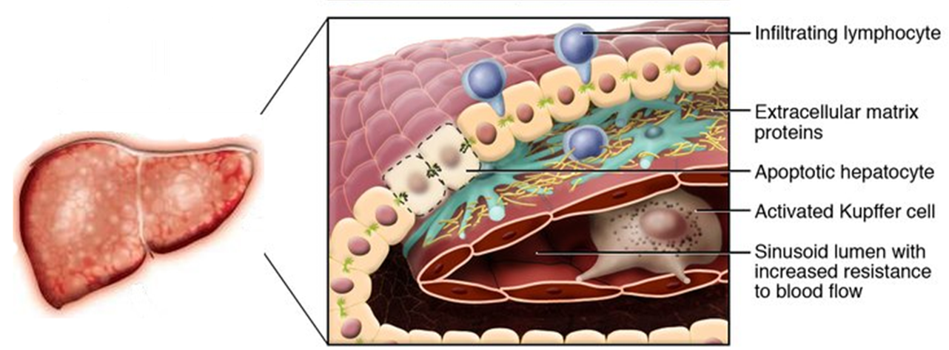
Introduction
Liver fibrosis results from chronic damage to the liver in which damaged regions are encapsulated by proteins of the extracellular matrix. The main pathogenic mechanisms, which are responsible for the development of liver fibrosis, are inflammation, oxidative stress, massive necrosis of hepatocytes, infiltration of parenchyma by lymphocytes and activation of hepatic stellate cells. Activated stellate cells are characterized by high level of proliferation, migration and contractility. These cells migrate and accumulate at the regions of tissue repair, secrete large amounts of the components of the extracellular matrix.
* Adapted to – R. Bataller / Journal of Clinical Investigation (2005)

Slide 5
Introduction (Cont.)
Natural oligoribonucleotides (ORNs) and the oligoribonucleotides-D-mannitol complexes (ORNs-D-M) display a vast spectrum of biological effects, including:
cellular metabolism stimulation with activation of endogenous synthesis of nucleic acids, regulatory proteins and enzymes;
increase in cellular mitotic activity;
stimulation of reparation processes;
stimulation of ATP synthesis;
membrane stabilizing effect;
anti-inflammatory effect.

Slide 6
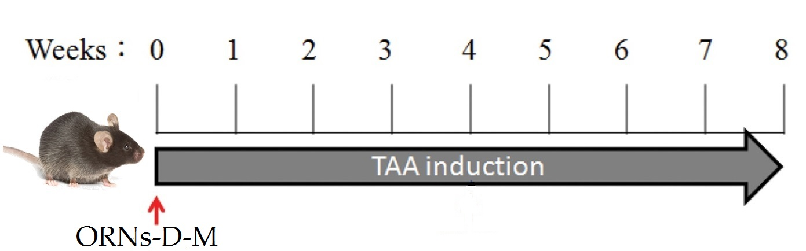
Introduction (Cont.)
Indicators of inflammation and liver damage
Indicators of oxidative stress
Glutathione-related antioxidant defense system
Expression of Il-6, Tnf-α, Tgf-β1, Col1A1,
α-Sma, Nfkb1, Nfkbiα

Slide 7
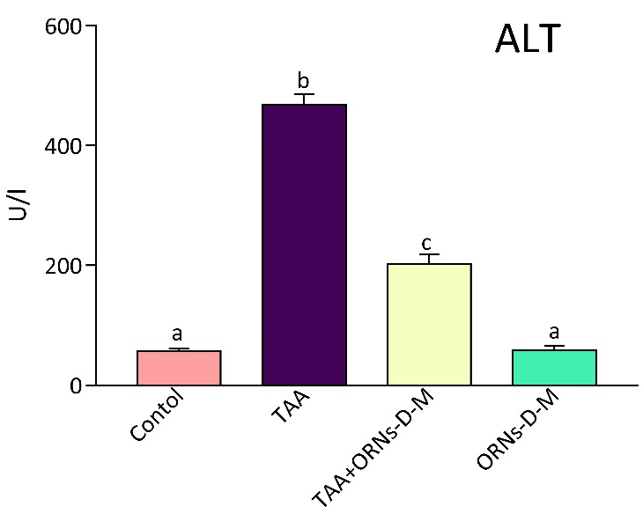
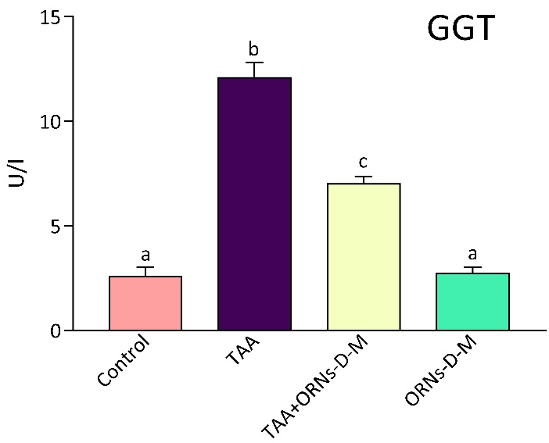
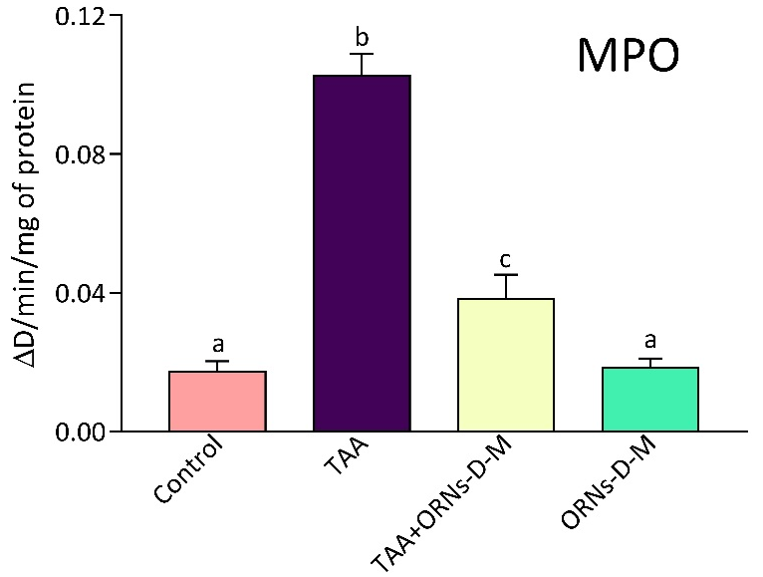
Results and discussion
The chronic toxic liver injury was characterized by an increase in the level of aminotransferase (ALT) and γ-glutamyl transpeptidase (GGT) by 5.1 and 5 times, respectively, compared with the control group. Administration of ORNs-D-M exerted a cytoprotective effect on hepatocytes and decreased the ALT and GGT levels. Previously, it was shown that ORNs-D-M have membrane-stabilizing properties. Therefore, we assume that ORNs-D-M can stabilize the structural integrity of the membrane of hepatocytes at the chronic toxic liver injury.
MPO is an enzyme stored in azurophilic granules of neutrophils and macrophages and released into extracellular space in the inflammation foci. It has been found that treatment with ORNs-D-M significantly reduced MPO activity, compared to the group of mice receiving TAA. The results showed that the ORNs-D-M application mitigated inflammatory infiltration of parenchyma by neutrophils and lymphocytes.

Slide 8
Results and discussion
 | Liver TBARS (nmol/mg of protein) | Protein carbonyl derivatives in liver (nmol/mg of protein) | Protein thiol groups in liver (nmol/mg of protein) | Reduced glutathione in liver (μmol/mg of protein) | GST activity in liver, μmol/min/mg of protein | GPx activity in liver, nmol/min/mg of protein
Control | 495.2±61.9 | 393.7±57.2 | 9282.6±302.7 | 109.82±7.9 | 1.37±0.15 | 305.11±22.3
TAA | 2755.2±92.1 | 1400.1±34.5 | 2192.0±161.2 | 19.85±1.2 | 0.52±0,10 | 97.12±8.6
TAA+ORNs-D-M | 1083.8±51.1 | 911.1±68.8 | 5445.5±469.8 | 56.81±6.9 | 1.05±0.12 | 225.36±13.0
ORNs-D-M | 434.3±75.4 | 410.9±60.3 | 9517.5±411.0 | 106.11±5.5 | 1.45±0.18 | 299.83±25.7
It was demonstrated that the TAA intoxication exerted considerable oxidative stress in the liver. The chronic toxic liver injury was characterized by an increase in the level of TBARS and protein carbonyl derivatives and decrease in the level of protein thiol groups, reduced glutathione, GST and GPx. The ORNs-D-M application attenuates thioacetamide-induced free radical damage of hepatic biopolymers and increases the activity of glutathione-dependent enzymes. But how ORNs-D-M ameliorate oxidative stress remained unclear. We assume, that the ORNs-D-M probably acted by increasing the level of reduced glutathione and thereby increase the GPx and GST activities, that neutralize ROS.

Slide 9
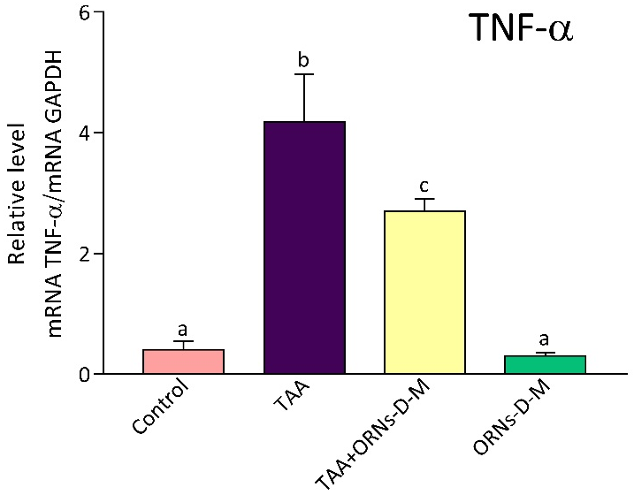
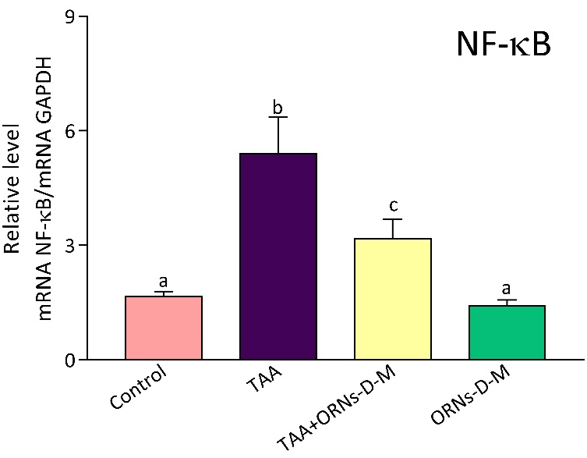
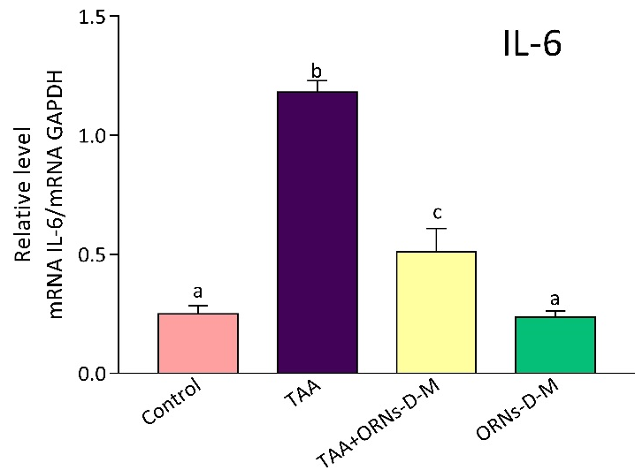
Results and discussion
Cytokines IL-6 and TNF-α are produced by inflammatory cells, and their levels are regulated by proinflammatory and anti-inflammatory responses. In this case, NF-κB plays a crucial role in the regulation of inflammatory responses. NF-κB is important transcription factor that is able to modulate the expression of proinflammatory cytokines, such as IL-6 and TNF-α, and the profibrogenic factors including TGF-β1, which can enhance the survival and proliferation of activated stellate cells. In this study, treatment with ORNs-D-M, reduced the increased expression of the IL-6, TNF-α and NF-κB mRNA in comparison with the TAA-treated group. We assume that complexes may suppress NF-κB activation, which leads to reducing TNF-α and IL-6 mRNA expression.

Slide 10
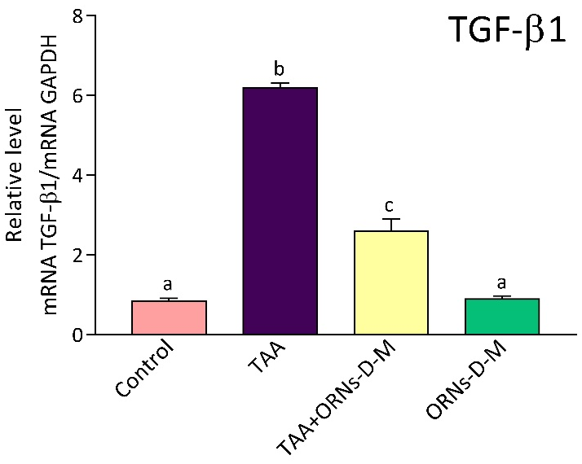
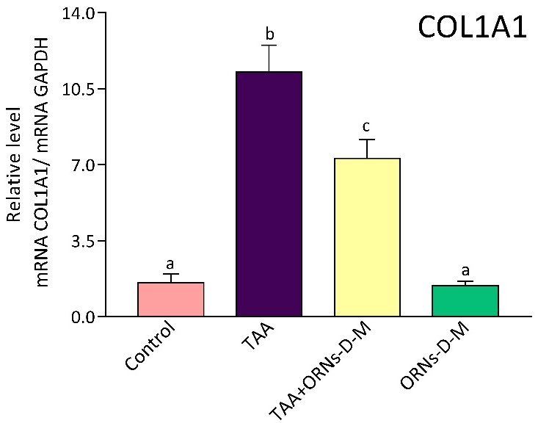
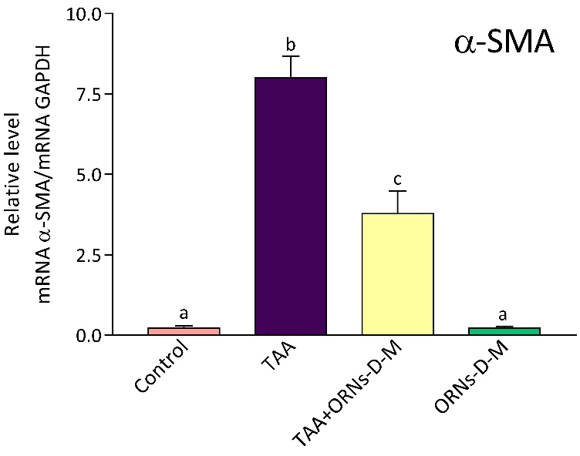
Results and discussion
HSC activation is a central event in the development of hepatic fibrosis. Activated stellate cells are characterized by a high level of proliferation, migration and contractility. Activated hepatic stellate cells (α-SMA positive) are capable for ECM overproduction, including collagen I and III. ORNs-D-M therapy remarkably diminished TAA-induced fibrogenesis, which is associated with decrease in TGF-β1 and COL1A1 mRNAs that play a crucial role in the development of fibrosis. In addition, the level of α-SMA (a representative molecule of activated stellate liver cells) was substantially decreased in the group of mice treated with ORNs-D-M.

Slide 11
Conclusions
The ORNs-D-M treatment has a protective effect in the model of TAA-induced chronic toxic liver damage.
The ORNs-D-mannitol attenuated thioacetamide-induced free radical damage of hepatic biopolymers that is expressed in reduction of TBARS, carbonyl derivatives and in recovery of protein thiol groups, reduced glutathione.
ORNs-D-M complexes modulate the expression of proinflammatory and profibrotic genes that are involved in the development of liver fibrosis.
We assume that the mechanisms by which the complexes protect the liver from chronic toxic damage are associated with their anti-inflammatory properties and the ability to modulate some signaling pathways (including NF-κB signaling).

