Slide 1
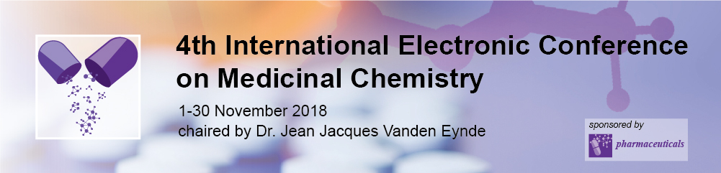



Enantiopure Oxazoloisoindolinones: Promising Small Molecules for p53-based Therapy with Potential Anticancer Properties
Valentina Barcherini ^{1,}*, Margarida Espadinha ¹, Joana Soares ², Sara Gomes ², Alexandra Antunes ³, Lucília Saraiva ², Maria M. M. Santos ¹
¹Research Institute for Medicines (iMed.ULisboa), Faculty of Pharmacy, University of Lisbon, Av. Prof. Gama Pinto, 1649-003, Lisbon, Portugal;
²UCIBIO/REQUIMTE, Faculty of Pharmacy, University of Porto, R. Jorge de Viterbo Ferreira 228, 4050-313, Porto, Portugal;
³Centro de Química Estrutural, Instituto Superior Técnico, University of Lisbon, Av. Rovisco Pais, 1049-001, Lisbon, Portugal.
* Corresponding author: vbarcherini@ff.ulisboa.pt

Slide 2
Enantiopure Oxazoloisoindolinones: Promising Small Molecules for p53-based Therapy with Potential Anticancer Properties
OXAZOLOISOINDOLINONES
p53
selectivity
potent antitumor activity
no toxic effects

Slide 3
Abstract: The tumor protein p53 is a widely-studied therapeutic target in cancer treatment, as this transcription factor is inactivated in all types of human cancers. In 50% of malignancies, p53 is expressed in its wild-type form and generally inhibited by two major negative regulators, MDM2 and MDMX. In the remaining 50% of cases, p53 is inactivated by mutations principally on its DNA-binding site, thus not exercising its regulatory function. In the last years, our research group has been involved in the synthesis of potential p53 reactivators. Starting from the enantiopure aminoalcohol tryptophanol, we have recently developed several small molecules that reactivate p53. Here we present our most updated results on the development of a chemical library of tryptophanol-derived oxazoloisoindolinones. This class of compounds is accessed by cyclocondensation reaction of enantiopure forms of tryptophanol and several achiral oxoacids. In this synthetic approach, the chiral inductor is responsible for the stereo-outcome of the final product and it is part of the main skeleton of the bioactive molecules. From this work bicyclic lactams SLMP53-1 and DIMP53-1 were identified as the most promising hits. Further hit-to-lead optimization is ongoing, and assessment of the antiproliferative activity of the optimized oxazoloisoindolinones against four different cancer cells lines highlights that this chemical family displays potent antitumor activity towards p53 with no apparent toxic effects.
Keywords: Cancer, p53, Tryptophanol, Enantiopure Drugs, Antitumor activity

Slide 4
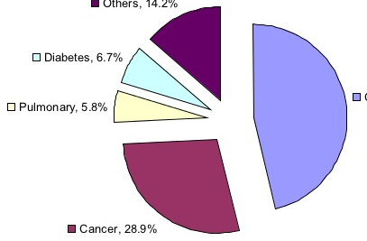
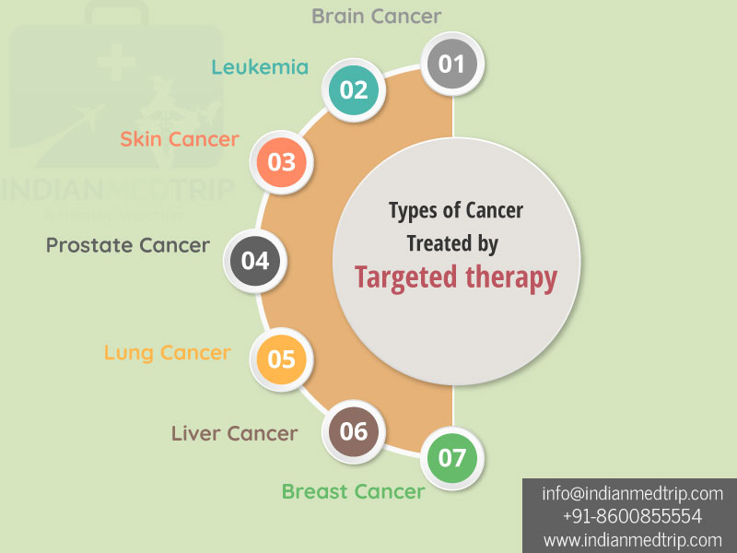






Introduction - Cancer in facts
Cancer is a group of diseases that can affect any part of the body via an uncontrolled and anomalous cellular proliferation
Others 14.2%
Every year 14 million people world-wide hear the words:
“You have cancer”
National Vital Statistics
(WHO Data)
Diabetes 6.7%
Pulmonary 5.8%
Cardiovascular 47.8%
Cancer 28.9%
Deaths in 2015
2nd leading cause of death globally after cardiovascular diseases
Types of Cancer Treated by
Targeted therapies
8.8
million
1-in-6 deaths is due to cancer

Slide 5
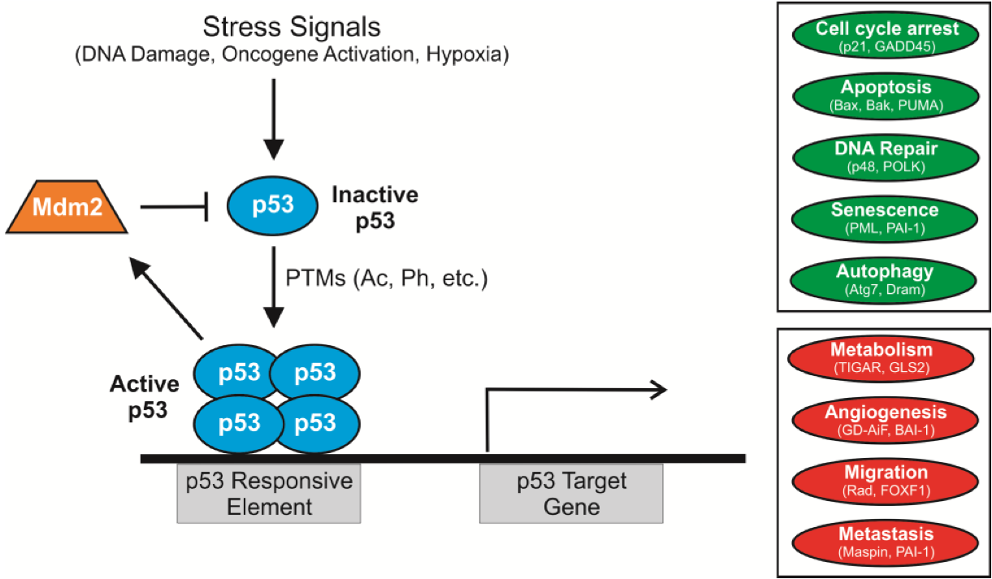
Introduction - Role of p53 in Cancer
The p53 signaling pathway is activated under cellular stress, ultimately leading to tumor suppression.
p53 is responsible for the integrity of the cells, controlling the cell cycle, DNA repair and synthesis, cell differentiation, genomic plasticity, senescence, angiogenesis and programmed cell death.
Stress Signals
(DNA Damage, Oncogene Activation, Hypoxia)
Transcriptional Activation
Inactive wild type p53
p53
MDM2
Ubiquitination
Post Translational Modifications
(Ac, Ph, etc)
Ubiquitination
MDMX
p53
p53
Active
wild type
p53
p53

Slide 6
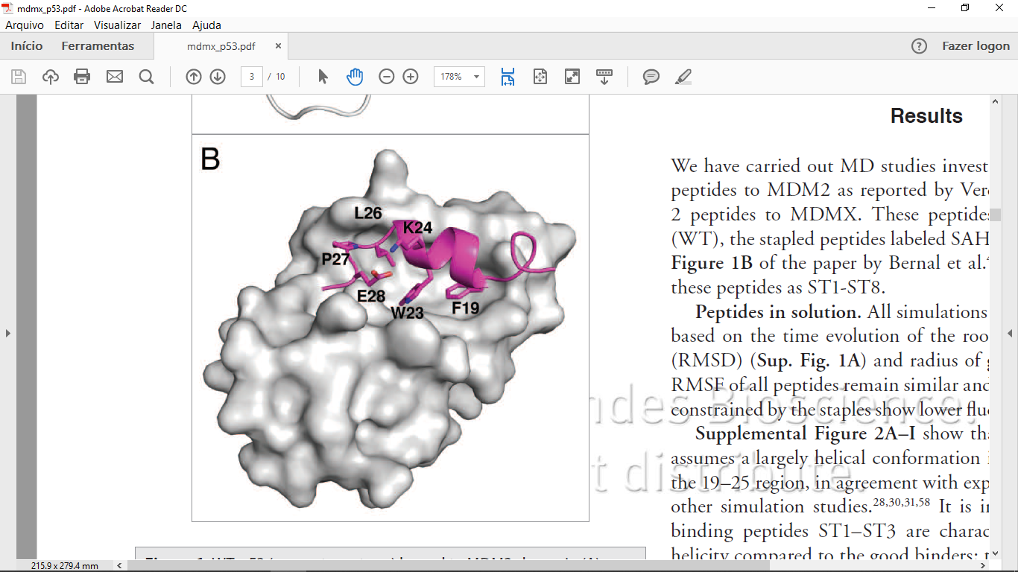
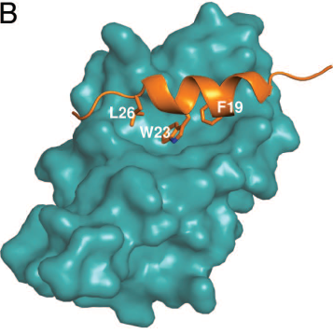
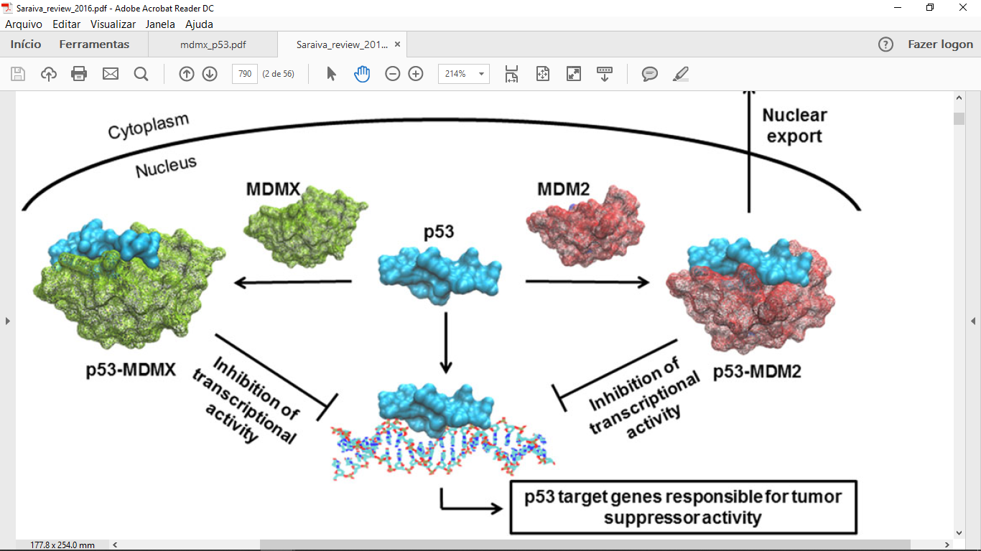
Introduction - wild type p53, MDM2 and MDMX
p53-MDM2
p53-MDMX
wt p53
wt p53 binds to a specific nucleotide sequence termed p53-responsive elements, stimulating a p53-dependent expression
Inhibition of the transcriptional activity
Inhibition of the transcriptional activity
wt p53 function is inactivated due to the overexpression of endogenous negative regulators, MDM2 and MDMX which interact with p53.
The interface between these two proteins consists of steric complementarity between the MDMs clefts and the hydrophobic face of the α-helix of p53.
p53 targets genes responsible for the tumor suppressor activity

Slide 7
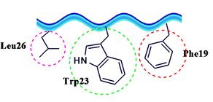
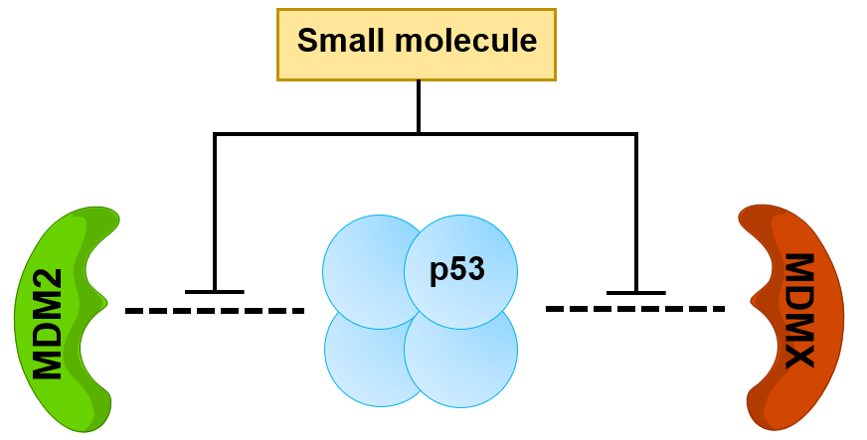
Introduction - Reactivation of wild type p53
There are 3 key hydrophobic residues in p53 responsible for the interaction of p53-MDM2: Phe19, Trp23 and Leu26
The p53 activity can be restored using different strategies, depending on the p53 status: in case of wt p53, reactivation is carried out by inhibition of its main negative regulators
p53-MDM2 inhibitors
Only 8 candidates in clinical trials (2 discontinued)
NO Dual p53-MDM2/X inhibitors in clinical trials

Slide 8
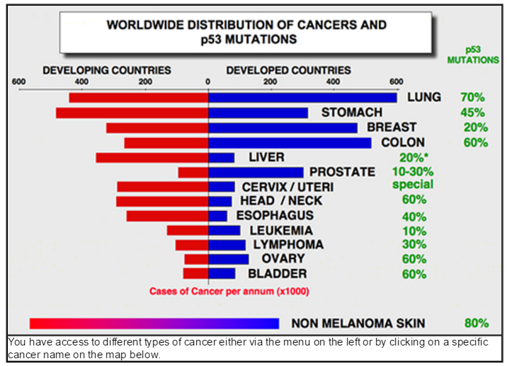

Introduction - mutant p53 in cancer
p53 is a highly mutated protein in different types of tumors
Up to 50% of mutations in different types of cancers
75% mutations in invasive cancers
Mutations of p53 and upregulation of MDM2 and MDMX are independent events and, usually, do not occur in the same tumor

Slide 9
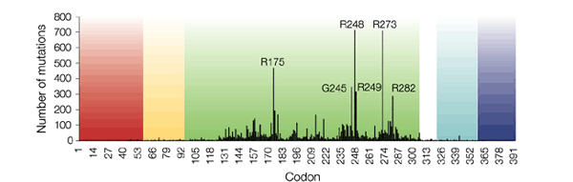
Introduction
p53 function perturbations are observed in cancers as result of point mutations on the TP53 gene
loss of p53 protein expression
missense mutations
TD
325-393
About one-third of these mutations simply destabilize this only marginally stable domain, lowering its melting temperature so that it rapidly unfolds at body temperature.
TAD1
1-42
TAD2
43-63
DBD
102-292
NLS
305-322
AA
p53
DNA-binding domain
9

Slide 10


Introduction - Reactivation of mut p53
p53 reactivators
Small molecules
+
mutant p53
The p53 activity can be restored by targeted reactivation of the mutant p53, restoring the wt conformation and transcriptional activity, inducing depletion, inhibiting downstream pathways, and inducing synthetic lethality.
Restoration of p53 conformation
Mutant p53
mut p53 reactivators
act as
MOLECULAR CHAPERONES
Mutant p53
Mutant p53
Mutant p53
Mutant p53
p53 targets genes responsible for the tumor suppressor activity
10

Slide 11
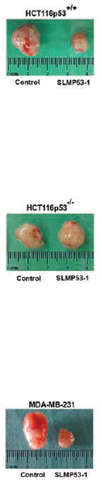
Introduction - Hit compounds developed by Santos’s team
The first oxazoloisoindolinone developed was compound 3a, a bicyclic lactam derived from the aminoalcohol phenylalaninol
3a
SLMP53-1
DIMP53-1
p53-MDM2 inhibitor
wt and mut p53 reactivator
p53-MDM2/X dual inhibitor
Soares J. et al., Eur. J. Pharm. Sci., 2015, 66, 138
Soares J. et al., Oncotarget, 2016, 7, 4326
Soares J. et al., Mol. Oncol., 2017, 11(6), 612
HCT116p53^{+/+}
HCT116p53^{-/-}
SLMP53-1 potently suppresses the growth of wt/mut p53-expressing tumors, but not of p53-null tumors, in xenograft mice models
Control
SLMP53-1
Control
SLMP53-1
Patent
Saraiva L., Santos M.M.M., et al., WO2014207688, 2014
11

Slide 12
Results and discussion - Ongoing Hit-to-Lead Optimization
Hit Identification
Lead Optimization
SLMP53-1
DIMP53-1

Slide 13
Results and discussion - Synthesis of oxazoloisoindolinones
Oxazoloisoindolinones are accessed by cyclocondensation reaction of enantiopure forms of tryptophanol and several achiral oxoacids. In this synthetic approach, the chiral inductor is responsible for the stereo-outcome of the final product and it is part of the main skeleton of the bioactive molecules.
35 compounds synthesized

Slide 14
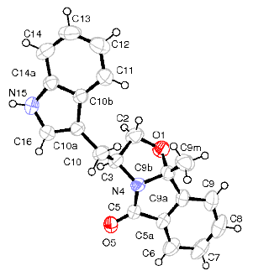
Results and discussion - NMR characterization
The aminoalcohol (tryptophanol) is responsible to the stereo-outcome of the final products.
A new stereocenter is formed in position 9b.
Absolute configuration established by
X-ray crystallographic analysis of SLMP53-1
¹³C-NMR analysis
¹H-NMR spectra of SLMP53-1 and compound 1 between 4.5 and 1.5 ppm
compound | C-9b | C-2 | C-3 | CH₂-indole
SLMP53-1 | 98.9 | 74.6 | 56.0 | 30.8
1 | 99.2 | 74.7 | 56.2 | 30.6
Chemical shifts expressed in ppm.

Slide 15
Results and discussion - Biological evaluation towards wt p53
Structure-activity relationship studies
Assessment of the antiproliferative activity of the optimized oxazoloisoindolinones against:
Human colon carcinoma, HCT116
Human lung carcinoma, NCI-H460 cell line
Human malignant melanoma, A375
Human breast adenocarcinoma, MCF-7
highlights that most of the bicyclic lactams composing this chemical family displays potent antitumor activity once the derivatives are assayed in A375 cell line.
(S)-tryptophanol-derived bicyclic lactams are more active than the corresponding enantiomers.
Introduction of aromatic groups in position 9b and the presence of bulky and electron-withdrawing groups on the indole nitrogen improve the activity.

Slide 16
Results and discussion - Biological Evaluation towards mut p53
The bioactivity of compounds was evaluated using a yeast-based screening strategy.
Restoration of the wt-like activity of mut p53R280K was studied.
compound | % mutant reactivation | SEM | p
SLMP53-1 | 61 | 1.8 | -
1 | 8.7 | 5.4 | 0.772
2 | 87 | 11 | 0.0001
3 | 13 | 2.1 | -
4 | 9.5 | 8.1 | 0.847
5 | 13 | 7.9 | 0.845
Most promising tryptophanol-derived oxazoloisoindolinones
Structure-activity relationship studies
*data expressed as mean ± SEM (standard error of meaning); p = precision.
Small groups in position 9b and the presence of moderate electron-withdrawing groups on the indole nitrogen improve the activity

Slide 17
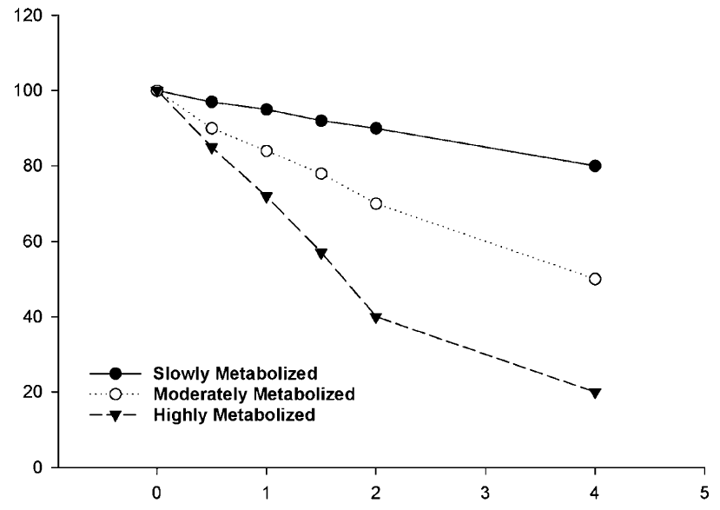


Results and discussion - in vitro Stability studies
MICROSOMAL STABILITY
SLMP53-1 and DIMP53-1 were selected to assess the in vitro stability of the chemical family in human microsomes.
SLMP53-1 | DIMP53-1
t_{1/2} = 128 min | t_{1/2} = 102 min
DIMP53-1
After 2 hours
69% went under metabolic Phase I chemical
modifications
$$\frac{compound}{internal standard}$$
%
SLMP53-1
After 2 hours
58% went under metabolic Phase I chemical
modifications
Slowly Metabolized
Moderately Metabolized
Highly Metabolized
$$hours$$
Yan Z., Caldwell G.W., Methods in Pharmacology and Toxicology - Optimization in Drug Discovery: in vitro methods., 2014, 10: 151-162.

Slide 18
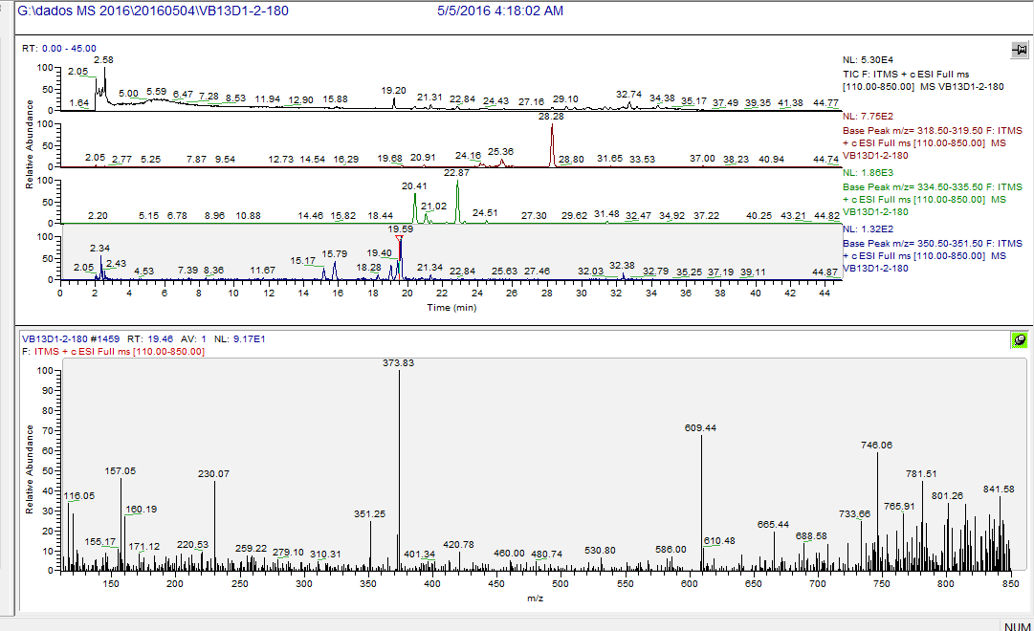
Results and discussion - in vitro Stability studies
SCREENING OF PHASE I METABOLITES – SLMP53-1
Total ion chromatogram obtained by LC-ESI(+)-MS of SLMP53-1 under microsomes incubations
Extracted ion chromatogram of ion 319 m/z
Extracted ion chromatogram of ion 335 m/z
Extracted ion chromatogram of ion 350 m/z
2 major and 1 minor monohydroxylated metabolites found.
1 major and 4 minor dihydroxylated metabolites found.

Slide 19
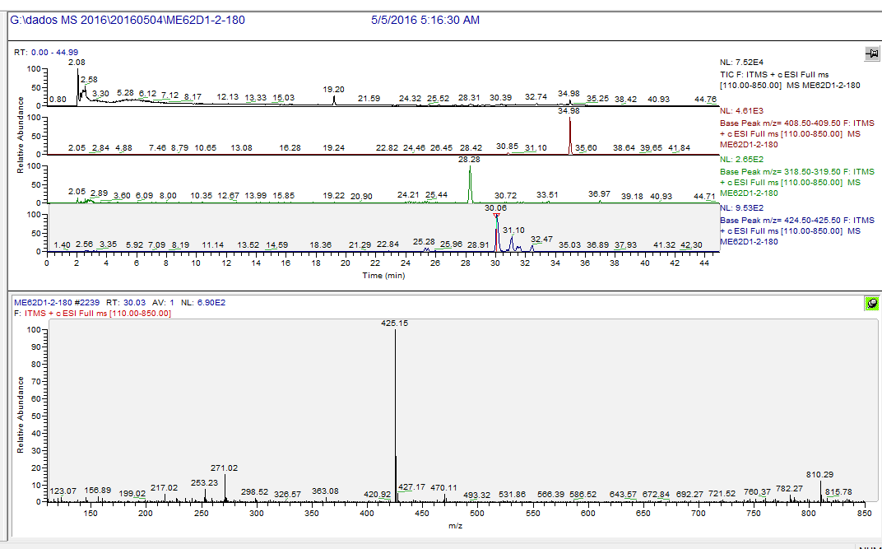
Results and discussion - in vitro Stability studies
SCREENING OF PHASE I METABOLITES – DIMP53-1
Total ion chromatogram obtained by LC-ESI(+)-MS of SLMP53-1 under microsomes incubations
Extracted ion chromatogram of ion 409 m/z
Extracted ion chromatogram of ion 319 m/z
Extracted ion chromatogram of ion 425 m/z
No di-hydroxylated metabolites observed for DIMP53-1
DIMP53-1 is metabolized into SLMP53-1
1 major and 2 minor monohydroxylated metabolites found.

Slide 20

Results and discussion - in vitro Stability studies
PLASMA STABILITY
After
3 hours 85% of compound resulted
unmodified
After
3 hours 100% of compound resulted
unmodified
CHEMICAL STABILITY
The kinetics of SLMP53-1 and DIMP53-1 degradation in PBS buffer at 37 °C and pH 7.4 shows that nearly 30% of test compounds degrades within 1 h, with 50% of degradation occurring after 2-3 h.

Slide 21
Conclusions
Hit-to-lead optimization of SLMP53-1
Evaluation of the antitumoral bioactivity of the lead generation
Evaluation of the stability studies of SLMP53-1 and DIMP53-1
Library of 35 bicyclic lactams obtained with good to excellent yields between 71 and 96%
most of the bicyclic lactams composing this chemical family displays potent antitumor activity once the derivatives are assayed in A375 cell line.
1 oxazoloisoindolinone restores the wild-type growth inhibitory effect to mut p53R280K in about 86%. (the hit-compound SLMP53-1 of 61%);
In human microsomes: moderate stability
In human plasma: high stability;
In PBS buffer at pH 7.4: moderate stability:

Slide 22







Acknowledgments
FUNDINGS
PTDC/DTP-FTO/1981/2014
PTDC/QUI-QOR/29664/2017
UID/DTP/04138/2013 PD/BI/135334/2017
IF/00732/2013.
Dr. Maria SANTOS
(Faculty of Pharmacy,
University of Lisbon)
Prof. Dr. Lucilia SARAIVA (UCIBIO/REQUIMTE
Faculty of Pharmacy, University of Porto)
Dr. Alexandra ANTUNES
(Centro de Química Estrutural, Instituto Superior Técnico)

