Slide 1
Systematic study of lipase-catalyzed resolution of propranolol precursors
Isabel Borreguero-Requejo¹, and Andrés R. Alcántara^{2,}*
¹ Actual address: GSK, Production GMS, Alcalá de Henares Factory. Ctra. de Ajalvir, km. 2,500, E28006- Alcalá de Henares, Madrid.
² Department of Chemistry in Pharmaceutical Sciences. Pharmacy Faculty, Complutense University of Madrid (UCM). Ciudad Universitaria, Plaza de Ramon y Cajal, s/n. E28040-Madrid, Spain. Phone no. (+34)-913941820 .Fax no. (+34)-913941822.
* Corresponding author: andalcan@ucm.es

Slide 2
Systematic study of lipase-catalyzed resolution of propranolol precursors
Graphical Abstract

Slide 3
Abstract: Propranolol ((R,S)-1-isopropylamino-3-(1-naphthoxy)-2-propanol), is a well-known beta-adrenergic blocking agent used for treatment of arterial hypertension and other cardiovascular disorders, is commercially available as a racemic mixture. However, it is also well proven that mainly the (S)-enantiomer has the desired therapeutic effect; therefore, many stereoselective synthetic protocols for the preparation of the (S)-eutomer can be found in literature, mediated by an enzymatic resolution of the chemically-prepared racemate. Generally speaking, the resolution should preferentially be carried on a precursor of the desired target drug such as the racemic aryloxyhalohydrines, easily prepared by opening epychlorhydrine with an aromatic alcohol.
In this communication we present the kinetic resolution of aryloxyhalohydrines (precursors of propranolol and other beta-adrenergic blockers) by lipase-catalyzed stereoselective transesterification with enol esters. A factorial design of experiments was undertaken to assess best reaction conditions (temperature, solvent, acyl donor, …) for the efficient separation of enantiomers, both of them useful for therapeutic purposes; hence, besides the previously antihypertensive activity of (S)-propranolol, the correspondent (R)-antipode displays a stronger antiarrhythmic and membrane-stabilizing effect, and it is also useful as a vaginal contraceptive. Through this stereoselective enzymatic acylation, the correspondent halohydrine ester and remnant alcohol can be easily separated and efficiently transformed into both enantiomers of propranolol.
Keywords: propranolol; lipase; kinetic resolution, transterification; enantiomers

Slide 4
Introduction (1/4)
Hypertension, or elevated blood pressure, is one of the most common risk factor for coronary artery disease, heart failure, stroke, and renal failure. Approximately 50 million Americans have a systolic or diastolic blood pressure above 140/90 mm Hg (the onset of hypertension) and most commonly appears during the fourth, fifth, and sixth decades of life [1].
Hypertension is the main avoidable cause of premature death worldwide [2], and its treatment has become an important public health challenge in both economically developing and developed countries. According to a recent study [3], the global occurrence of hypertension is foreseen to hover around 40% in all adults, leading to a 5.2% increase in the overall prevalence between 2000 and 2010. This figure results of computing together a 2.6% decrease in high-income countries and a 7.7% increase in low/middle–income countries.
[1] Mancia, G.; Fagard, R., et al. 2013 ESH/ESC Guidelines for the management of arterial hypertension. Eur. Heart J. 2013, 34 (28), 2159-2219.
[2] Whelton, P. K.; Carey, R. M.; et al. 2017 ACC/AHA/AAPA/ABC/ACPM/AGS/APhA/ASH/ASPC/NMA/PCNA Guideline for the prevention, detection, evaluation, and management of high blood pressure in adults: executive summary a report of the American College of Cardiology/American Heart Association task force on clinical practice guidelines. Hypertension 2018, 71 (6), 1269-1324.
[3] Mathews, J. Global Antihypertensive Drugs Market US$ 23.1 Billion by 2023. https://www.linkedin.com/pulse/global-antihypertensive-drugs-market-us-231-billion-2023-mathews/

Slide 5
Introduction (2/4)
Today, a large number of drugs are currently available to treat hypertension [4], based on different mechanisms of action :
diuretics,
sympatholytic drugs (centrally acting drugs, ganglionic blocker drugs, adrenergic neuron blocking drugs, β-adrenergic blocking drugs, α-adrenergic blocking drugs and mixed α/β-adrenergic blocking drugs),
vasodilators (arterial or arterial and venous),
calcium channel blockers,
angiotensin-converting enzyme inhibitors
angiotensin receptor antagonists
One of the most archetypical compounds for treating hypertension are those β-blockers possessing the aryloxypropanolamine structure.
It is well-known that the (S)-enantiomer of β-blockers are more potent antagonists than the corresponding (R)-antipodes [5].
[4] Lemke, T. L.; Williams, D. A., Foye's Principles of Medicinal Chemistry. Wolters Kluwer Health, 2012. ISBN: 978-1609133450
[5] Agustian, J.; Kamaruddin, A. H.; Bhatia, S., Single enantiomeric beta-blockers The existing technologies. Process Biochem. 2010, 45 (10), 1587-1604.

Slide 6
Introduction (3/4)
Different chemoenzymatic procedures for preparing enantiopure version of these drugs, starting from racemic halohydrines (prepared by opening epychlorhydrine with an aromatic alcohol), rather through enzymatic acylation or hydrolysis [6]
A) Stereoselective enzyme-mediated acylation
B) Stereoselective enzyme-mediated hydrolysis
[6] Hoyos, P.; Pace, V.; Alcántara, A. R., Chiral Building Blocks for Drugs Synthesis via Biotransformations. In Asymmetric Synthesis of Drugs and Natural Products, Nag, A., Ed. CRC Press: Boca Raton, Florida, 2018; pp 346-448.

Slide 7
Introduction (4/4)
Some comments on the resolution:
Only moderate resolutions have been described using propranolol as substrate [7]
Enzymatic acylation is preferred because the stereoselective discrimination is carried out in an earlier step.
While hydrolysis worked faster than transesterification, the ease of workup and isolated yields are in favour of the latter [6]
FOCUS ON ACYLATION: Reaction to optimize
[7] Barbosa, O.; Ariza, C.; Ortiz, C.; Torres, R., Kinetic resolution of (R/S)-propranolol (1-isopropylamino-3-(1-naphtoxy)-2-propanolol) catalyzed by immobilized preparations of Candida antarctica lipase B (CAL-B). New. Biotech. 2010, 27 (6), 844-850..

Slide 8
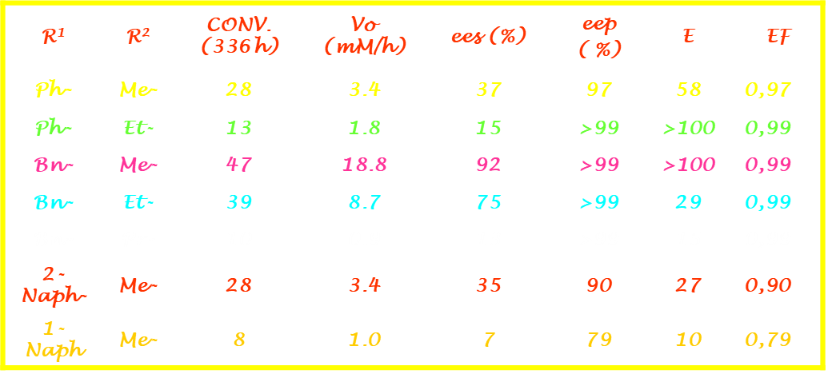
Results and discussion (1/8)
TEST REACTION: Secondary alcohols resolution
EXPERIMENTAL DESIGN [8]: To check influential variables
FACTOR
VARIABLE
MAXIMUM (+)
CENTRAL POINT
(C. P.)
MINIMUM (-)
X_{A}
Solvent Log P
4,5
2,03
-0,4
X_{B}
Molar ratio
Acyl donor/alcohol
5/1
3/1
1/1
X_{C}
Temperature (ºC)
46
25
4
X_{D}
Catalyst amount (mg)
250
150
100
[8] De Fuentes, I. E. Ph. D. Thesis, Complutense University of Madrid, unpublished data

Slide 9
Test reaction: use of vinyl acetate and isooctane (according to the previous optimization)
Results and discussion (2/8)
Conversion (%)
Lipases tested:
Immobilized lipase from Rhizomucor miehei (Lipozyme IM20)
Crude lipase from Humicola lanuginosa (HLL, recently renamed Thermomyces laguginosus)
Crude lipase from Pig Pancreas (PPL)
ª Protein amount (Biuret).
^{b} Enantiomeric ratio (product), E = [ln [1-c(1+ee_{p})]]/[ln [1-c(1-ee_{p})]]
^{c} Enantiomeric factor EF = (ees) / [c/ (1-c)]
Time (h)
Best biocatalyst: Lipozyme IM20
Conversion and enantiomeric excess followed by HPLC (chiral column Chiralcel-OD)

Slide 10
Reaction optimization: TEMPERATURE
Results and discussion (3/8)
REACTION TIME 24 h. | T (ºC) | c (%) | e.e of R-1a (%) | E | EF
 | 4 | 17 | 18 | 18 | 0.88
 | 25 | 42 | 59 | 18 | 0.81
 | 37 | 48 | 74 | 20 | 0.80
 | 50 | 34 | 43 | 17 | 0.83
 | 60 | 39 | 56 | 27 | 0.88
Best temperature:
37º C

Slide 11
Results and discussion (4/8)
Reaction optimization: SOLVENT
Best solvent:
isooctane
REACTION TIME 24 h. | solvent | logP | c (%) | e.e of R-1a (%) | E | EF
 | 1,1,1-trichloroetane | 2.5 | 34 | 42 | 15 | 0.81
 | Cyclohexane | 3.2 | 43 | 60 | 16 | 0.80
 | Methylcyclohexane | 3.7 | 48 | 73 | 19 | 0.79
 | isooctane | 4.5 | 49 | 71 | 14 | 0.74
 | Nonane | 5.1 | 45 | 64 | 16 | 0.78
 | dodecane | 6.6 | 43 | 59 | 15 | 0.78

Slide 12
Results and discussion (5/8)
Reaction optimization: Acyl donor
Vinyl acetate
Vinyl butyrate
Vinyl propionate
Vinyl laurate
Acetic anhydride
Vinyl chloroacetate
Isopropenyl acetate
Best acyl donor:
Vinyl propionate
Acyl donor | T(h) | CONV. (%) | ees (%) | E | EF
Acetic anhydride | 24 | 14 | 9 | 12 | 0.74
Isopropenyl acetate | 144 | ----- | ---- | ---- | ----
Vinyl chloroacetate | 48 | 49 | 69 | 12 | 0.72
Vinyl acetate | 24 | 59 | 71 | 14 | 0.74
Vinyl propionate | 4 | 59 | >99 | >100 | ----
Vinyl butyrate | 6 | 62 | >99 | >100 | ----
Vinyl laurate | 6 | 8 | >99 | >100 | ----
Best solvent:
isooctane

Slide 13
Results and discussion (6/8)
Column
separation

Slide 14
Results and discussion (7/8)
Other substrates, best exp. conditions

Slide 15
Results and discussion (8/8)
Other substrates, best exp. conditions
Substrate | t (h) | Biocat, (mg) | Conversion (%) | ee subst.R(-) | E
1b | 5 | 450 | 56 | > 99 | 41
1c | 22 | 450 | 39 | 44 | 29
1c | 4 | 600 | 37 | 89 | 15
1d | 3 | 450 | 63 | >99 | 18

Slide 16
Conclusions
Optimization of the kinetic resolution of aryloxyhalohydrines (precursors of propranolol and other beta-adrenergic blockers) by lipase-catalyzed stereoselective transesterification with enol esters.
A previous factorial design of experiments was undertaken to assess best reaction conditions (temperature, solvent, acyl donor, …)
Best conditions for acylation of racemic 1-chloro-3-(naphthalen-1-yloxy)propan-2-ol (propranolol precursor)
Catalysts: Lipozyme IM20
T=37ºC
Acyl donor: vinyl propionate
Solvent: isooctane
CONVERSION: 55% ee_{s} > 99%
Easy column separation and straightforward synthesis of both enantiomers of beta-blockers, useful for therapeutic purposes.
Similar results were obtained in the stereoselective enzymatic acylation of other halohydrines, showing the applicability of the resolution procedure

Slide 17
Acknowledgments
Comunidad Autónoma de Madrid, Ph. D. Thesis grant
Complutense University of Madrid, Funding for
Research Groups

