Slide 1


PDR combined with magnetic fingerprint algorithm for indoor positioning
Beijing University of Civil Engineering and Architecture,
School of Surveying and Mapping and Urban Spatial Information
Reporter：Kaiyue Qiu
Reporter Time：2018.07.14

Slide 2
I. Introduction
II. Methods
content
III. Experiments
IV. Conclusion
Notes:
The paper is organized as follows。

Slide 3
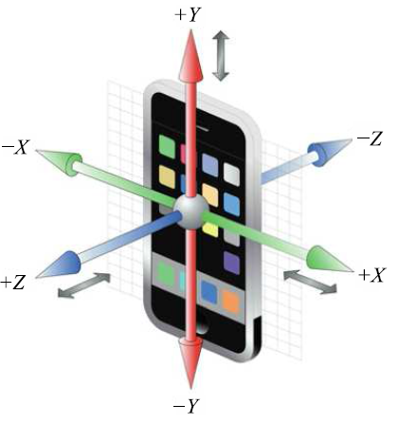








I. Introduction
Background
Collect
Fingerprinting
Signal Pinpointing
Advantages | Disadvantages
Adapt to most indoor scenes | Difficulties in positioning between different floors
More potential for positioning accuracy improvement | Accuracy improvement needs to determine the matching threshold
Low system construction cost
Range type: time of arrival (TOA), time difference of arrival (TDOA), angle of arrival (AOA), etc.
Non-ranging: Received Signal Strength Indication (RSSI) and fingerprint.

Slide 4
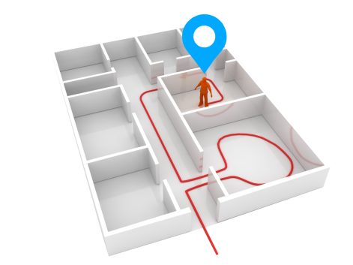
I. Introduction
Indoor positioning system
Off-line
modeling
Matching area
Geomagnetic reference map
Fingerprint
database
On-line matching
The direction of the target movement
Real-time measurement sequence
Fingerprint matching algorithm

Slide 5



I. Introduction
Separate geomagnetic positioning
When only using the geomagnetic intensity as a match element, there is a phenomenon that geomagnetic intensity is similar between different locations, like these dots in the above figure.
Represents best positioning result
Represents the positioning result with acceptable error
Represents the positioning result with unacceptable error
How to solve it

Slide 6
II. Methods
Technical route
Smart phone
Indoor map
Sensor
Pretreatment
.5
Offline data collection
Particle Filter Algorithm
Geomagnetic Data
Acceleration
Step Count
Geomagnetic
Data Acquisition
Behavior Tracking
Create Geomagnetic Fingerprint
Weight Estimation
Gyro
Direction
Re-sampling
Pedestrian
Dead
Reckoning
Behavioral Data
Magnetometer
Key Geomagnetic Fingerprints
Failure
Detection

Slide 7

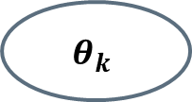
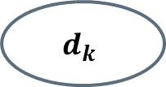
II. Methods
Pedestrian Dead Reckoning
$$d_{k}$$
Accelerometer
X
Weinberg approach model
x(k), y(k)
$$θ_{k}$$
θ
Direction sensor
d_{step}
Obtained by the three values of azimuth, tilt angle and rotation angle provided by the Android API
x(k+1), y(k+1)
Y

Slide 8
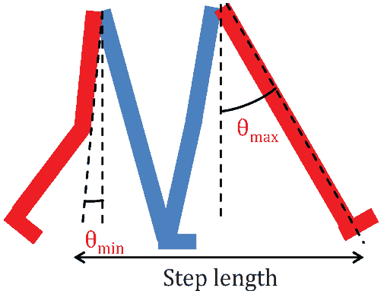
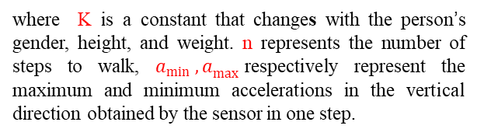
II. Methods
Pedestrian Dead Reckoning
  Step size estimation
where K is a constant that changes with the person’s gender, height, and weight. n represents the number of steps to walk, $a_{min}{ ,a}_{max}$respectively represent the maximum and minimum accelerations in the vertical direction obtained by the sensor in one step.

Slide 9
Thank
You
Email：1181295376@qq.com

