Slide 1
An Analysis of the Use of Multiple Transmission Power Levels on Wireless Sensor Networks
Felipe Antonio Moura Miranda – Federal Institute of Education, Science and Technology of Sao Paulo
miranda@ifsp.edu.br
Paulo Cardieri – State University of Campinas
cardieri@decom.fee.unicamp.br

Slide 2
Motivation
The energy consumption in wireless sensor networks is the critical concern of different studies, especially because of the great effort, or even the impossibility, to replace the battery of their motes.

Slide 3
motivation
Consequently, it is fundamental to investigate and evaluate the energy spent by every individual task executed by the motes in order to provide an efficient use of their batteries.

Slide 4
motivation
The contribution of this works is a detailed investigation of the impact caused by the use of different transmission power levels employing different metrics, offering a wide perspective on the subject.

Slide 5
Introduction
The electronic industry is regularly lowering the power consumption of their products, achieving even figures of nanowatts.

Slide 6
Introduction
The problem is that even a small, but continuous, consumption can deplete a battery, which usually is the primary power supply of a mote, in the long-term.

Slide 7
Methodology
Sensor
Simulations
Model based on direct measurements
Considers the different operational states
Common architecture:
Battery: 150 mAh / 540 C
Sensor: Texas Instruments LM75
Transceiver: Digi Xbee PRO
Microcontroller: Atmel Atmega8L
Battery
Transceiver
Microcontroller

Slide 8
Methodology
Transmission power levels
Plane Earth Propagation Model : path loss exponent set to 3.5
Reaching longer hops
transmission power for reaching one hop
transmission power for reaching two hops
transmission power for reaching three hops
transmission power for reaching four hops
transmission power for reaching five hops
transmission power for reaching, directly, the base station
Promiscuous reception was considered in all scenarios
Unnecessarily received messages

Slide 9
Transmission Power levels
Transmitter: 10
10
9
8
7
6
5
4
3
2
1
Base Station

Slide 10
Transmission Power levels
Transmitter: 10
Reach: 1 hop
Receivers: {9}
Addressee: 9
10
9
8
7
6
5
4
3
2
1
Base Station

Slide 11
Transmission Power levels
Transmitter: 10
Reach: 3 hops
Receivers: {9,8,7}
Addressee: 7
10
9
8
7
6
5
4
3
2
1
Base Station

Slide 12
Transmission Power levels
Transmitter: 10
Reach: 5 hops
Receivers: {9,8,7,6,5}
Addressee: 5
10
9
8
7
6
5
4
3
2
1
Base Station

Slide 13
Transmission Power levels
Transmitter: 10
Reach: 10 hops
Receivers: {9,8,7,6,5,4,3,2,1}
Addressee: Base Station
10
9
8
7
6
5
4
3
2
1
Base Station

Slide 14
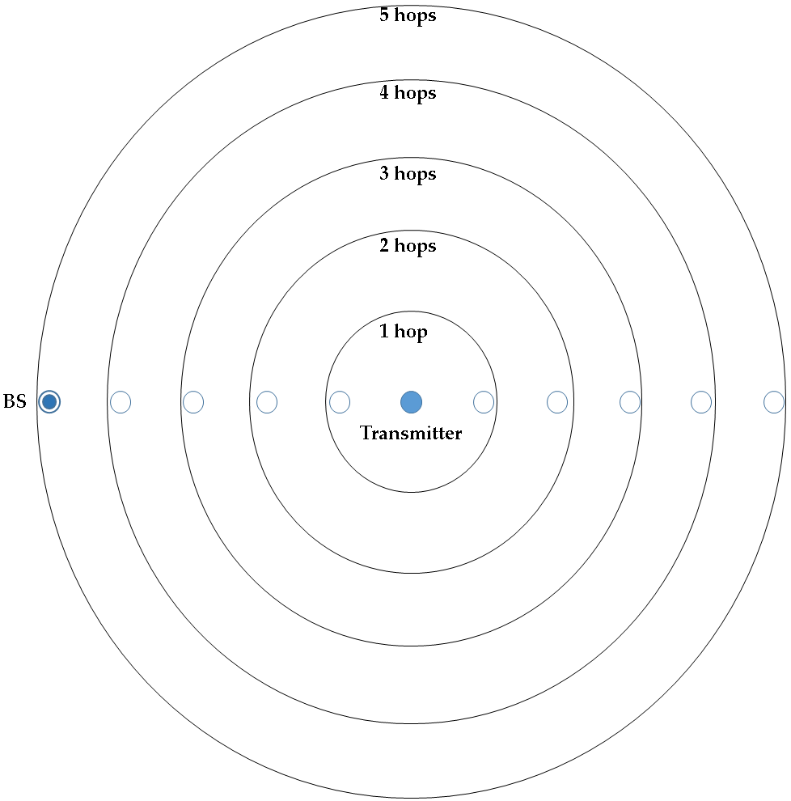
Transmission Power levels
Worse depending on the transmitter location

Slide 15
Methodology
Network lifetime
from the moment the network operation begins until the first mote runs out of battery
Network cost
10 motes = U$445,10

Slide 16
Methodology
Message log
Listened Messages: All messages received by a mote, regardless their addressee.
Rerouted Messages: All messages that a mote had to reroute in order to reach the base station.
Overheard Messages: Only the messages that a mote received but were not addressed to it.
Generated Messages: All messages created and transmitted by a mote.

Slide 17
simulation
10
Simulated Network
6 different traffic loads
9
8
7
6
5
4
3
2
1
Base Station

Slide 18
Results
Primary Consumption
Active states
Transmission/reception
Sensing, processing
Secondary Consumption
Active states
Transmission/reception
Sensing, processing

Slide 19
Results
Energy consumption of each part/functionality
Transmission Power / Reach | Radio-Tx | Radio-Rx | Microcontroller | Sensor
1 hop | 32.03% | 24.70% | 41.18% | 2.08%
2 hops | 77.47% | 11.18% | 10.38% | 0.96%
3 hops | 91.11% | 4.96% | 3.48% | 0.44%
4 hops | 95.57% | 2.61% | 1.56% | 0.24%
5 hops | 97.52% | 1.52% | 0.80% | 0.15%
Base station | 99.47% | 0.34% | 0.14% | 0.04%
Increase

Slide 20
Results
Energy consumption profile of secondary states in all scenarios
Radio | Microcontroller | Sensor
47.61% | 23.81% | 28.58%

Slide 21
Results
The difference between the lifetime of the simulated networks decreased when the traffic load got lower

Slide 22
Results
The difference between the lifetime of the simulated networks decreased when the traffic load got lower

Slide 23
Results
Lifetime of the simulated networks with different transmission powers.
Traffic Load (msg/s) | Lifetime (in hours) – 1 hop | Lifetime (in hours) – 2 hops | Lifetime (in hours) – 3 hops | Lifetime (in hours) – 4 hops | Lifetime (in hours) – 5 hops | Lifetime (in hours) – Max Power
1.16E-05 | 7111.35 | 7067.55 | 6981.56 | 6863.59 | 6568.67 | 4797.62
2.78E-04 | 6457.86 | 5690.14 | 4595.49 | 3614.01 | 2307.02 | 561.01
0.00166 | 4364.89 | 2821.47 | 1651.28 | 1041.33 | 526.16 | 100.01
0.166 | 969.93 | 437.78 | 208.51 | 119.86 | 56.35 | 10.13
0.1 | 182.28 | 76.89 | 35.62 | 20.26 | 9.45 | 1.69
1 | 18.65 | 7.76 | 3.57 | 2.10 | 0.94 | 0.17

Slide 24
Results
All network costs per working got lower when the traffic generation was reduced

Slide 25
results
Network cost per hour of the simulated networks with different transmission powers
Traffic Load (msg/s) | Network Cost per hour – 1 hop | Network Cost per hour – 2 hops | Network Cost per hour – 3 hops | Network Cost per hour – 4 hops | Network Cost per hour – 5 hops | Network Cost per hour – Max Power
1.16E-05 | US$0.06 | US$0.06 | US$0.06 | US$0.06 | US$0.07 | US$0.09
2.78E-04 | US$0.06 | US$0.07 | US$0.10 | US$0.12 | US$0.19 | US$0.79
0.00166 | US$0.10 | US$0.16 | US$0.27 | US$0.42 | US$0.84 | US$4.45
0.166 | US$0.46 | US$1.01 | US$2.13 | US$3.71 | US$7.90 | US$43.94
0.1 | US$2.44 | US$5.79 | US$12.49 | US$21.97 | US$47.10 | US$263.37
1 | US$23.86 | US$57.36 | US$124.68 | US$211.95 | US$473.51 | US$2,618.23

Slide 26
Results
More power, less listened messages

Slide 27
Results
More power, less rerouted messages

Slide 28
Results
Overheard Messages: messages that a mote received but were not addressed to it.
Increased, then decreased

Slide 29
Concluding remarks
The use of multiple transmission power levels achieved both positive and negative results, depending on the employed metric.
The results about the traffic of messages were very positive, but, it cannot be analyzed alone, without energy issues, due to the focus of this work on wireless sensor networks.
As the messages were sent further when using higher transmissions power levels, the quantity of rerouted messages also decreased. One result that can be inferred, but is not analyzed in this work, is that the less hops a message has to perform, the lower is the chance of it be corrupted or lost.

Slide 30
Concluding remarks
The results indicate that the use of multiple transmission power levels would suit better in low message traffic networks or when dealing with reliability/message loss constraints.

