Slide 1
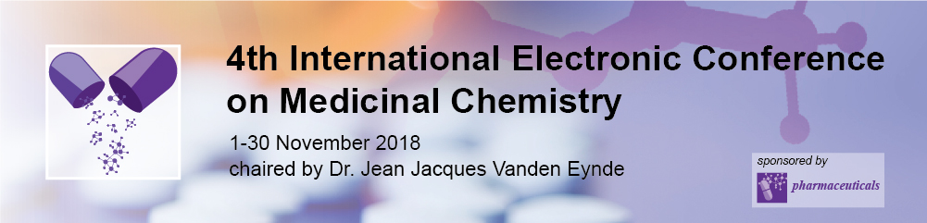
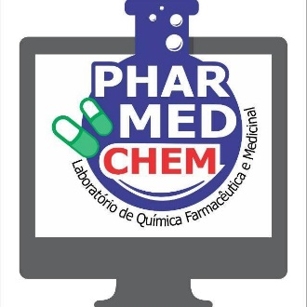

Molecular docking and pharmacokinetic and toxicological predictions of natural compounds with anticholinesterasic activity
Daniel Castro da Costa¹, Heldem Ronam Cristo Teixeira¹, Lorane Izabel da Silva Hage-Melim¹*
¹Laboratory of Pharmaceutical and Medicinal Chemistry (PharMedChem), Federal University of Amapá, Macapá, Amapá 68902-280, Brasil.
* Corresponding author: loranehage@gmail.com

Slide 2
Abstract
Alzheimer's disease (AD) is considered the leading and most common age-related dementia, accounting for 50-60% of cases. The most commonly used pharmacotherapeutic approach for the symptomatic control of AD is anticholinesterase drugs, that is, they have an inhibitory activity on the enzyme acetylcholinesterase (AChE), thus increasing the cerebral levels of the neurotransmitter acetylcholine (Ach). For many years, Traditional Chinese Medicine has been cataloging numerous medicinal plants, which present various pharmacological activities, such as anti-Alzheimer's activity. This variety of plants, present compounds that interact with multiple proteins that are involved in several pathways associated with AD. The main objective of this study is an in silico study of 14 natural compounds, where the molecular docking and pharmacokinetic and toxicological predictions was carried out. As a first step the following molecules were selected in the literature: 1,8-cineole, bornil acetate, α-pinene, β-pinene, camphor, cariophilene epoxide, physostigmine, galantamine, γ-terpinene, honokiol, huperzine A, licoramine , magnolol and resveratrol, and later designed with the Chemsketch program and the chemical structures optimized with the Hartree-Fock method and the base function 6-31G ** previously validated in the Laboratory of Pharmaceutical and Medicinal Chemistry (PharMedChem) and implemented in the Gaussian program 03. The second step was the molecular docking study carried out with the software GOLD 4.1 where it was possible to study the intermolecular interactions among the selected natural products with the amino acids present in the active site of the AChEenzyme, the connections were largely hydrophobic interactions and hydrogen bonds and all 14 molecules showed interactions with the amino acid residues TRP286, PHE295, TYR341, TYR72 present in the catalytic site of the target enzyme, but only 13 presented three or more interactions, predominantly. In order to predict the pharmacokinetic properties of the selected molecules, the QikProp module of the Schrödinger software was used, which computed some important properties such as: molecular weight, polar surface area (PSA), logP, logBB, percentage of human oral absorption, activity predicted in the central nervous system, apparent permeability in cells and MDCK. As a result, all 14 molecules were found to have satisfactory PSA, LogBB, permeability to Caco-2 and MDCK cells, but only 7 molecules were able to cross the blood-brain barrier. The toxicity profile of the 14 molecules selected was performed by the DEREK program, where a total of 19 structural alerts were verified. The molecules that presented these alerts were: camphor, caryophyllene epoxide, physostigmine, honokiol, magnolol and resveratrol. Based on the results presented by the study, the following compounds were found: α-pinene, β-pinene, galantamine, γ-terpinene and lycoramine presented potential for use in the planning and development of new anti-Alzheimer drug candidates.
Keywords: Alzheimer's disease; molecular docking; natural compounds; pharmacokinetic predictions; toxicological predicions.

Slide 3
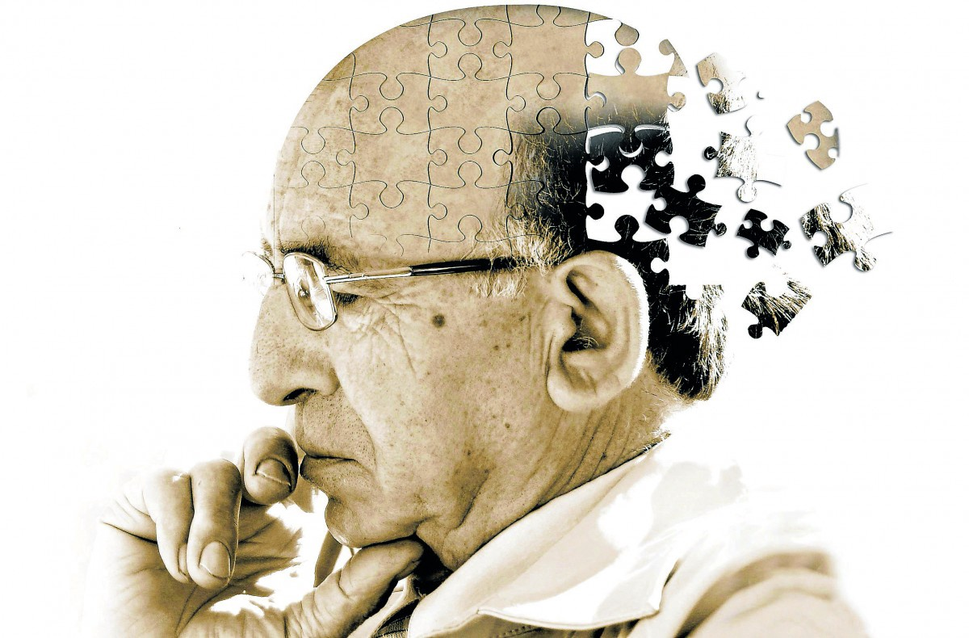
INTRODUCTION
Alzheimer Disease is a progressive neurodegeneration, with marked loss of cognitive functions: memory, concentration and learning.
Currently, it is considered as the most common senile dementia, and may present in 1% of the population with 65 years old.
Increasing to 35% in the population with 85 years old.
It is estimated that 26 milion people sulfer from this type of dementia worldwide.
(BAGATIN et al., 2013; FERREIRA; MASSANO, 2013)
Source: https://www.dm.com.br/opiniao/2018/03/alzheimer-e-suas-complicacoes.html

Slide 4
MAIN SYMPTOMS
IN THE EARLY STAGES
OF THE DISEASE
IN THE ADVANCED STAGES
RECENT MEMORY DEFICIT
BEHAVIORAL DISORDERS:
Irritability;
Aggressiveness;
Hallucinations;
Depression.
DIFFICULTY OF ATTENTION
DECREASED VISUOSPATIAL ABILITY

Slide 5
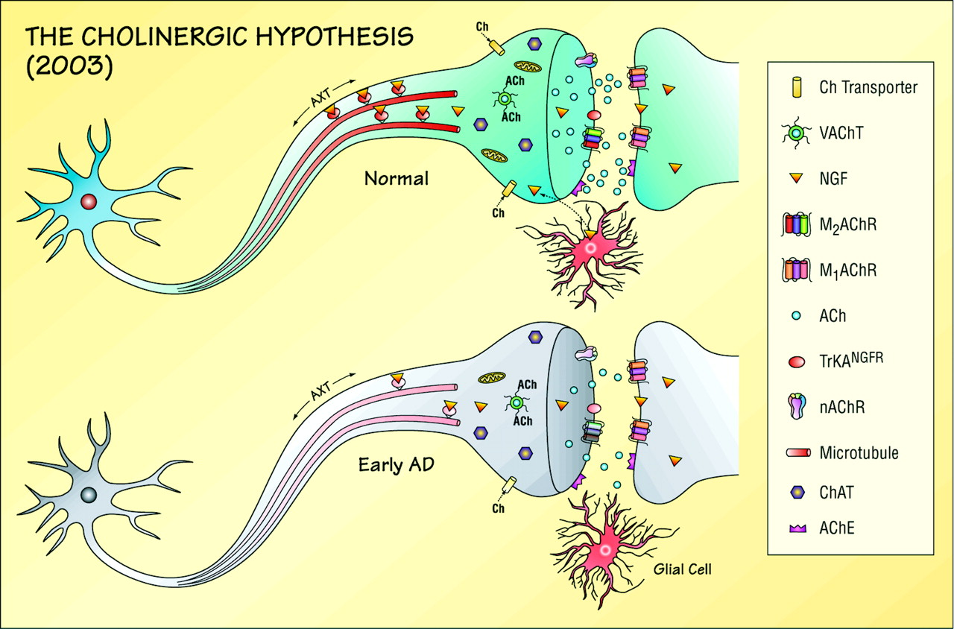
CHOLINERGIC HYPOTHESIS
Relates amnesic dysfunction to the variable loss of cholinergic neurons in the basal Meynert nucleus, as well as the decrease in the expression of the enzyme choline acetyltransferase (ChAT) responsible for the production of acetylcholine (DE FALCO et al., 2016).
Source: TERRY; BUCCAFUSCO, 2003

Slide 6
ACETYLCHOLINESTERASE INHIBITORS
(IAChE)
The use of IAChE in the treatment of patients with AD has as main function, to increase the cerebral levels of the neurotransmitter acetylcholine (Ach), in this way, optimizes the cholinergic neurotransmission, benefiting the cognitive function of the patient (TALESA, 2001).
Several IAChE with different chemical structures and mechanisms of inhibition have been used with this purpose being the main responsible for the relative gain of cognitive abilities, on the part of the patient, being clinically demonstrated a real improvement in the attention deficit (TALESA, 2001).

Slide 7
ACETYLCHOLINESTERASE INHIBITORS
(IAChE)
1
2
3
Tacrine.
Rivastigmine;
Galantamine;
Donepezil
4

Slide 8
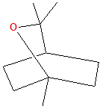
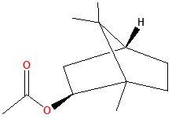
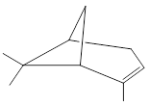
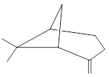
RESULTS AND DISCUSSION
NAME | STRUCTURE
1,8 - cineole
Acetate bornyl
α-Pinene
β-Pinene
MOLECULES
STUDIED

Slide 9
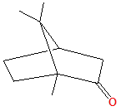
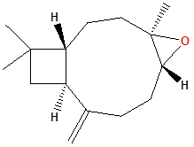
RESULTS AND DISCUSSION
NAME | STRUCTURE
CAMPHOR
CARYOPHYLLENE EPOXIDE
PHYSOSTIGMINE
MOLECULES
STUDIED

Slide 10
RESULTS AND DISCUSSION
NAME | STRUCTURE
GALANTAMINE
γ-TERPINENE
HONOKIOL
MOLECULES
STUDIED

Slide 11
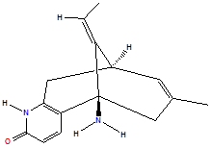
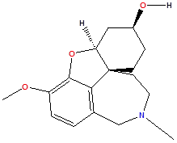
RESULTS AND DISCUSSION
NAME | STRUCTURE
HUPERZINE A
LYCORAMINE
MAGNOLOL
MOLECULES
STUDIED

Slide 12
RESULTS AND DISCUSSION
NAME | STRUCTURE
RESVERATROL
MOLECULES
STUDIED

Slide 13
RESULTS AND DISCUSSION
MOLECULAR DOCKING
Molecular docking is an intensive and prominent computational method in the process of drug discovery. The benefit of docking is to identify the mode of binding of the linkers at the binding site of the enzyme or receptor through specific key interactions and to predict the binding affinity between the protein-binding complexes.

Slide 14
MOLECULE | AMINO ACID | INTERACTION | DISTANCE | SCORE
1,8 - cineole | TYR341 TRP286 | Hidrofobic π –Alkyl Hidrofobic π –Alkyl | 4.72 4.78 4.73 5.17 | 50.16
Acetate bornyl | PHE295 TRP286 TYR341 | Hidrofobic π –Alkyl Hidrofobic π –Alkyl Conventional hydrogen bridge type Hidrofobic π –Alkyl π –Sigma | 4.58 5.19 5.37 3.12 4.43 2.23 | 50.72
α-Pinene | TYR341 TRP286 | Hidrofobic π –Alkyl Hidrofobic π -Alkyl | 3.58 4.65 5.20 5.34 5.03 | 43.47

Slide 15
MOLECULE | AMINO ACID | INTERACTION | DISTANCE | SCORE
β-Pinene | TYR341 TYR286 | Hidrofobic π –Alkyl Hidrofobic π –Alkyl | 3.20 4.92 5.00 4.82 5.33 | 43.74
Camphor | TRP286 PHE295 TYR341 | Hidrofobic π –Alkyl Hidrofobic π –Alkyl Hidrofobic π –Alkyl π –Sigma | 5.03 5.33 4.48 4.33 3.65 2.16 | 43.11

Slide 16
MOLECULE | AMINO ACID | INTERACTION | DISTANCE | SCORE
Caryophyllene Epoxide | TRP286 TYR72 TYR341 PHE295 | Hidrofobic π –Alkyl π –Sigma Hidrofobic π –Alkyl Hidrofobic π –Alkyl Conventional hydrogen bridge type | 3.57 4.62 5.02 5.06 5.25 5.31 2.86 4.11 4.27 4.44 4.87 4.90 3.03 | 53.87
Physostigmine | TYR341 TYR441 | Hidrofobic π –π Hidrofobic π –Alkyl | 3.46 4.28 | 71.68

Slide 17
MOLECULE | AMINO ACID | INTERACTION | DISTANCE | SCORE
Galantamine | TRP286 TYR72 TRP286 TYR72 | Hidrofobic π –Alkyl Hidrofobic π –Alkyl Hidrofobic π –π Hidrofobic π –π | 4.43 4.90 5.07 9.92 4.24 3.40 3.66 | 59.14
γ-Terpineno | TRP286 TYR72 | Hidrofobic π –Alkyl Hidrofobic π –Alkyl | 3.44 3.59 4.38 4.50 4.54 4.94 3.53 3.92 4.85 | 49.62

Slide 18
MOLECULE | AMINO ACID | INTERACTION | DISTANCE | SCORE
Honokiol | TRP286 TYR72 TYR341 TYR341 TYR72 TRP286 TRP295 | Hidrofobic π –π Hidrofobic π –π Hidrofobic π –π Hidrofobic π –Alkyl Conventional hydrogen bridge type | 4.59 5.60 5.41 5.14 3.96 5.21 2.08 3.00 2.77 | 67.58
Huperzine A | TYR341 TRP286 TYR72 | Hidrofobic π –π Hidrofobic π –Alkyl Hidrofobic π –Alkyl | 4.29 3.38 3.86 4.07 4.57 3.94 4.57 | 61.72

Slide 19
MOLECULE | AMINO ACID | INTERACTION | DISTANCE | SCORE
Lycoramine | TYR341 TYR72 TYR341 | Hidrofobic π –Alkyl Hidrofobic π –π Carbonic hydrogen interactions Carbonic hydrogen interactions | 3.85 5.29 3.78 2.18 2.57 2.82 | 59.73
Magnolol | TRP286 TYR72 TYR341 TYR341 TYR72 TRP286 | Hidrofobic π –π Hidrofobic π –π Hidrofobic π –π Hidrofobic π –Alkyl Hidrofobic π –Alkyl Hidrofobic π –Alkyl | 3.62 4.45 3.86 3.92 4.32 3.92 4.94 | 74.51
Resveratrol | TRP286 TYR72 TRP295 | Hidrofobic π –π Carbonic hydrogen interactions Conventional hydrogen bridge type | 4.37 4.46 5.38 2.81 3.07 | 73.14

Slide 20
In a study conducted by Fang et al. (2014), the interaction of the two compounds analyzed with the amino acid residues of the catalytic site of the enzyme was verified, showing that the two inhibitors presented strong and moderate interactions with residues TYR124, TRP286, GLU292 and TRY341.
Czarnecka et al. (2017) verified that the synthesized compound presented π-π stacking and cation-π type interactions with residues TRP84 and PHE330 demonstrating inhibitory activity for AChE

Slide 21
PREDICTION OF PHARMACOKINETIC PROPERTIES (ADME) AND TOXICOLOGICAL PROPERTIES (TOX)
The pharmacokinetic properties and toxicity of the compounds are one of the main reasons for terminating the development of drug candidates (GUPTA; MOHAN, 2014).
The QikProp module of the Schrödinger software was used to predict the pharmacokinetic properties of the studied molecules.

Slide 22
PHARMACOKINETIC PROPERTIES OF THE STUDIED MOLECULES
 | Molecule | Caco-2 (nm/sec) | MDCK (nm/sec) | AIH (%) | LogBB | PSA (Å)
1 | 1,8 - cineole | 9906.04 | 5899.29 | 100 | 0.609 | 7.489
2 | Acetate bornyl | 3674.25 | 2019.43 | 100 | 0.194 | 35.426
3 | α-Pinene | 9906.04 | 5899.29 | 100 | 0.869 | 0
4 | β-Pinene | 9906.04 | 5899.29 | 100 | 0.855 | 0
5 | Camphor | 4256.65 | 2367.55 | 100 | 0.28 | 24.409
6 | Caryophyllene Epoxide | 9906.04 | 5899.29 | 100 | 0.104 | 12.535
7 | Physostigmine | 125.702 | 64.358 | 72.014 | 0.631 | 57.857
8 | Galantamine | 864.354 | 467.521 | 91.329 | 0.441 | 42.446
9 | γ-Terpineno | 9906.04 | 5899.29 | 100 | 0.863 | 0
10 | Honokiol | 1660.18 | 855.683 | 100 | -0.617 | 40.258
11 | Huperzine A | 208.402 | 100.472 | 77.232 | -0.051 | 61.667
12 | Lycoramine | 791.199 | 424.902 | 93.187 | 0.362 | 42.377
13 | Magnolol | 1883.22 | 980.584 | 100 | -0.569 | 40.438
14 | Resveratrol | 275.15 | 122.628 | 82.038 | -1.29 | 67.309
Source: QikProp, 2018

Slide 23
All 14 compounds showed high permeability for caco-2 cells with values ​​above 100 nm / sec.
10 compounds showed high permeability for MDCK cells and 4 presented intermediate scores.
As for human intestinal absorption, the compounds: 1, 2, 3, 4, 5, 6, 9, 10 and 13 demonstrated optimal absorption with 100% scores. The compounds: 7, 8, 11, 12 and 14 presented intermediate scores.
The ability to cross the blood-brain barrier is crucial for compounds with activity in the central nervous system. Seven compounds presented excellent results: 1, 3, 4, 7, 8, 9 and 12. The other seven compounds did not present the ability to cross the BBB.
All the molecules studied presented PSA results below 90 Å2, demonstrating an optimal ability to permeate cells.

Slide 24
TOXICITY PROFILE
The toxicity profile of the selected molecules was performed by the program called DEREK, which performs these predictions by verifying the relationship between certain structures present in the molecules (toxicophore) with their probable toxic activity.
A total of 19 structural alerts were verified. The molecules that presented these alerts were: camphor, caryophyllene epoxide, physostigmine, honokiol, magnolol and resveratrol.
None of the 14 molecules studied had potential for carcinogenicity and mutagenicity.

Slide 25
TOXICOLOGICAL PROPERTIES OF THE STUDIED MOLECULES
 | Molecule | Carcigenocity | Mutagenicity
1 | 1,8 - cineole | Inactive | Inactive
2 | Acetate bornyl | Inactive | Inactive
3 | α-Pinene | Inactive | Inactive
4 | β-Pinene | Inactive | Inactive
5 | Camphor | Inactive | Inactive
6 | Caryophyllene Epoxide | Inactive | Inactive
7 | Physostigmine | Inactive | Inactive
8 | Galantamine | Inactive | Inactive
9 | γ-Terpineno | Inactive | Inactive
10 | Honokiol | Inactive | Inactive
11 | Huperzine A | Inactive | Inactive
12 | Lycoramine | Inactive | Inactive
13 | Magnolol | Inactive | Inactive
14 | Resveratrol | Inactive | Inactive
Source: DEREK, 2018

Slide 26
CONCLUSIONS
Based on the results presented by the study, the following compounds were found: α-pinene, β-pinene, galantamine, γ-terpinene and lycoramine presented potential for use in the planning and development of new anti-Alzheimer drug candidates.

Slide 27

ACKNOWLEDGMENTS

