Slide 1
Pleiotropic focused anticancer approach of dihydropyridines, dihydropyrimidines and heteroaromatic compounds
G. Duburs,* B. Vigante, E. Bisenieks, A. Krauze, A. Plotniece,A. Sobolev
I. Domracheva, R. Smits, K. Pajuste
Latvian Institute of Organic Synthesis
Riga, Latvia
*Corresponding author: gduburs@osi.lv

Slide 2
Pleiotropic focused anticancer approach of dihydropyridines, dihydropyrimidines and
heteroaromatic compounds
BIOPROTECTORS, BIOPROCESS REGULATORS
on basis of partially hydrogenated or heteroaromatic nitrogen heterocycles
MEMBRANE ACTIVE COMPOUNDS AND DIKETONES
Membrane forming lipid type compounds (amphiphilic, comprising heterocycles or conjugated systems as linkers, self-assembling, capable to form nanoparticles)
GPCRs – incorporated into membrane matrix; synthesis of GPCR regulators
Partially hydrogenated nitrogen heterocycles, condensed and heteroaromatic derivatives: dihydropyridines, dihydropyridones, dihydropyrimidines, hexahydroquinolines, polynuclear heterocycles, 5- and 7-member analogues;
Redoxproceses; antioxidants, radioprotectors. Chemoenzymatic enantioselective transformations.
Synthesis of anticancer and antiviral agents
Regulators of transmembrane transport functions:
selective inhibitors or activators of Ca²⁺ transport;
regulators of drug efflux (inhibition of multiresistance)
Nanoparticles for transport of nucleic acids, drugs, proteins
Modificators of capsid protein self-assembling

Slide 3
Abstract
Complex, focused anticancer therapy approach has been developed in Latvian Institute of Organic Synthesis by making use of privileged partially hydrogenated nitrogen-containing heterocycles, namely dihydropyridines, dihydropyrimidines, their oxidized heteroaromatic derivatives. Topics of results include:
Conventional approach by chemotherapy and synergism and potentiation of anticancer drugs;
Inhibition of multidrug resistance by inhibition of drug efflux pumps;
Improvement of efficacy of cancer radiotherapy by use of radioprotectors to prevent damage of normal tissues. So, radioprotector diethone(dietone) for skin protection was discovered, elaborated, and developed as ointment. Toxicity of dietone and novel radioprotectors is very low;
Amphiphilic compounds have been synthesized, nanoparticles for anticancer drug and gene delivery have been created, pleiotropic properties have been checked, inclusion of magnetic particles for targeted transport performed.
Mitigation of cancer risk factors – e.g., hepatitis B virus chemotherapy by capsid assembly deregulation for prevention of chronic liver diseases, because chronic hepatitis, in up to 40% of cases, progresses to cyrrhosis and further to hepatocellular carcinoma;
Keywords – anticancer, dihydropyridine, dihydropyrimidine, membrane

Slide 4
1.Potentiation of cytotoxic effect
Anticancer chemotherapy agent 5-fluorouracil (5-FU) is widely used in chemotherapeutic praxis as an antimetabolic anticancer agent for the treatment and palliative management of various forms of cancer including colorectal, pancreatic, breast and stomach cancer. 5-FU is associated with side effects such as mucositis, dermatitis, cardial toxicity, etc.. As an alternative strategy, 5-FU can be combined with synergists, which may enhance the efficacy of chemotherapy with reduced toxicity to normal cells [1].Synergists could be used also regarding other chemotherapy agents[2].
[1]Mirunalini S., et al. 3,3’-Diindolylmethane and 5-fluorouracil act synergistically to promote apoptosis and modify oxidant-antioxidant status on human cervical cancer (HeLa) status.Eur.J.Pharmaceut.Med.Res., 2017,4,612-619.
[2]Lewandowska U. et al. Synergistic interactions between anticancer chematherapeutics and phenolic compounds and anticancer synergy between polyphenols. Postepy High Med Dosw2014, 68, 528-540.
4-Alkyl-2,6-dimethyl-1,4-dihydropyridine-3,5-bis-carbonyloxyacetic acid disodium salts increase antitumor activity of 5-fluorouracil (in vitro) – the most active compounds are 4-methyl- and 4-ethyl-derivatives. Their 4-dezalkyl analogue(carbatone) possesses antimetastatic activity, and also some potentiating effect on the activity of various antitumor agents, it was used to decrease the cyclophosphane toxicity in mice; it also potentiates the cytostatic activity of cyclophosphane, 5-fluorouracil and arabinosyl cytosine against leukemia P 388, murine sarcoma 37 and Walker’s carcinosarcoma. Carbatone exhibited no antitumor activity. 4-Alkylcarbatone analogues possess superior potentiation activity.

Slide 5
Potentiation of anticancer drugs
Combination of compounds |  | IC₅₀
Compound 1 | Compound 2 | Compound 1 [µM] | Compound 2 [µM]
5-FU | - | 30 | -
- | Carbatone | - | 1315
- | Disodium salt of 4-ethyl-2,6-dimethyl-1,4-dihydropyridine-3,5-bis-carbonyloxyacetic acid | - | >2104
- | Disodium salt of 2,4,6—trimethyl-1,4-dihydropyridine-3,5-bis-carbonyloxyacetic acid | - | >2694
5-FU | Carbatone | 6.7 | 0.67
5-FU | Disodium salt of 4-ethyl-2,6-dimethyl-1,4-dihydropyridine-3,5-bis-carbonyloxyacetic acid | 3.7 | 0.37
5-FU | Disodium salt of 2,4,6—trimethyl-1,4-dihydropyridine-3,5-bis-carbonyloxyacetic acid | 1.4 | 0.14
4-Methyl- and 4-ethyl-carbatones increase antitumor activity of 5-fluorouracil on MDA cells
Duburs G., Bisenieks E., Shestakova I., Kalvinsh I., Vigante B., Uldrikis J., Domraceva I., Poikans J., Bruvere I., Stonans I. Pharmaceutical combination of 5-fluorouracil and derivative of 1,4-dihydropyridine and its use in the treatment of cancer. US 8,492,413 B2 (2013).

Slide 6
2.Inhibition of multidrug resistance by inhibition of drug efflux pumps
Modulation of multidrug resistance in tumor cells may be used to improve cancer chemotherapy. Synthesis of multidrug resistance nodulators (P-glycoprotein, MDR associated protein BCRP1, breast cancer resistance protein MRP1) on the basis of partially hydrogenated pyridines and related polycyclic heterocycles has been designed and performed.
The calcium channel blocker verapamil is the most investigated and often used as a reference compound but, unfortunately, cardiotoxicity is observed in combination with actual anticancer drugs
Pharmacophore approach with modified linker
Rational approach to drug design – structural analogy with known active agents – has been used in our research
A pharmacophore model has been created assuming the central part of verapamil as the linker and methoxyphenyl groups as essential features for the pharmacophore
A.Krauze, L.Krasnova, S.Grinberga, E.Sokolova, I.Domracheva, I.Shestakova and G.Duburs. Synthesis of alkylsulfanyl-1,4-dihydropyridines as potential multidrug resistance modulators. Het. Comm.,2016, 22, 3, 157–160.
Outer (periferal) parts of verapamil were (partially) preserved, but inner part - linker – was exchanged to “privileged” system – dihydropyridine.
6
6
Notes:
Pielietota zāļu dizaina racionālā pieeja:
MDR modulatora Verapamila līdzinieku konstruēšana.
Ar savienotājposmu saistīto farmakoforu modelis

Slide 7
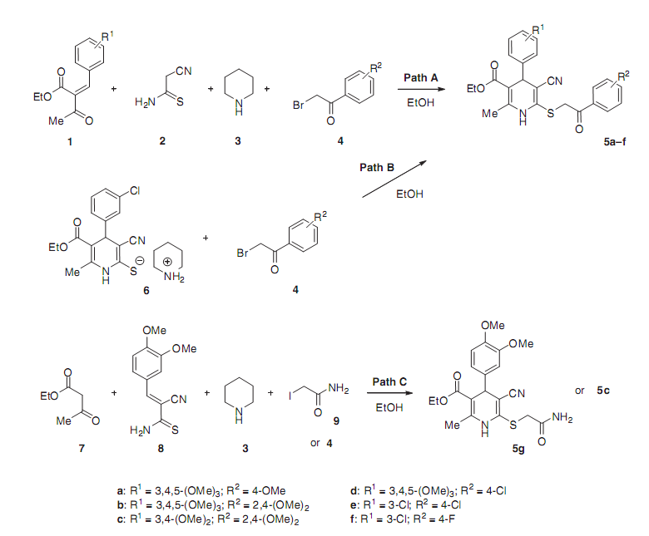
DHPs 5a–d were prepared by one-pot reaction of ethyl 2-arylmethylidenacetoacetate 1 with 2-cyanothio-acetamide (2) in the presence of equimolar amount of piperidine (3) as base in ethanol followed by subsequent
alkylation of the resultant thiolate with substituted 2-bromoacetophenone 4
( pathway A). In turn, DHPs 5e,f were prepared in 73–89% yields by treatment of the thiolate 6 with substituted 2-bromoacetophenone 4 (pathway B).
MDR modulating activity of tested 1,4-dihydropyridine derivatives 5a–g.
DHP 5a at 20 μm concentration displays high P-gp inhibition activity, the activity of DHPs 5c is comparable, DHPs 5b,d are slightly less active than verapamil. Compounds 5a-d have low Ca^{2+.}antagonist activity.

Slide 8
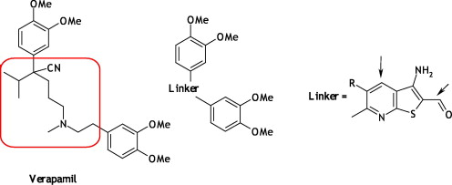
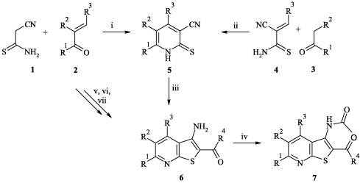
Thieno[2,3-b]pyridines—A new class of multidrug resistance (MDR) modulators
Rational approach of drug design —structural analogy with known medicines—was used also to develop more efficacious MDR modulators on the basis of thieno[2,3-b]pyridines. As part of our research interest towards bioactive N,S-containing heterocyclic compounds, we postulated that thieno[2,3-b]pyridine scaffold might be suitable for the linked pharmacophore approach. Model was created assuming one part of Verapamil as linker and methoxyphenyl groups as essential for pharmacophore
Pharmacophore approach with modified linker
As a result - new class of multidrug resistance (MDR) modulators, possessing a 3-amino-thieno[2,3-b]pyridine scaffold has been discovered. Pharmacophore model was created assuming thieno[2,3-b]pyridine scaffold as linker and methoxyphenyl groups as essential for potential MDR-reversal drug.
Structure of thienopyridines
Comp | R¹ | R² | R³
6j | Me | COOEt | 3,4,5-(OMe)₃C₆H₂
6k | Me | COOEt | 3,4,5-(OMe)₃C₆H₂
6l | Me | COOEt | 3,4,5-(OMe)₃C₆H₂
6m | Me | COOEt | 4-OEtC₆H₄
6n | Me | COOEt | 4-OBu(n)C₆H₄
6o | Me | COOBu | 3,4,5-(OMe)₃C₆H₂
6p | Me | COOC₂H₄OMe | 4-OMeC₆H₄
6q | Me | COOC₂H₄OMe | 3,4,5-(OMe)₃C₆H₂
6r | Me | COOC₂H₄OMe | 3,4,5-(OMe)₃C₆H₂
A.Krauze , S. Grinberga, L. Krasnova, I. Adlere, E. Sokolova, I. Domracheva, I. Shestakova, Z. Andzans, G. Duburs. Bioorg Med Chem 2014,22,5860-5870.

Slide 9
Table 3. MDR modulating activity and calculated log P values of tested compounds
MDR modulating activity and calculated logP values of tested compounds.
Compound | log P | MDR, EC₅₀ (μM) |  |  | Ca²⁺, A7R5, IC₅₀ (μM) | LD₅₀ (mg/kg)
 |  | P-gp | MRP1 | BCRP1
Verapamil |  | 7.1 ± 2.0 | 27.8 ± 0.8 | 37.3 ± 7 | 0.3 ± 0.1 | 962
MK-571 |  | n.e. | 12.4 ± 2.2 | — | n.e. | 752
Reversan |  | 18.4 | 9.8 ± 0.5 | — | >100 | 885
6a | 4.10 | 3.8 ± 0.1 | 6.6 ± 1.0 | 2.6 ± 0.6 | 14.0 ± 0.9 | >2000
6b | 4.80 | 4.5 ± 0.2 | n.e. | 0.7 ± 0.1 | 15.4 ± 2.0 | >2000
6c | 4.70 | 5.6 ± 0.2 | 11.9 ± 1.3 | 3.6 ± 0.6 | 6.0 ± 0.8 | 2808
6d | 4.58 | 10.3 ± 1.5 | 41.4 | 4.1 ± 0.9 | 5.6 ± 1.4 | 1045
6j | 5.04 | 9.0 ± 0.5 | 5.2 ± 0.8 | 1.5 ± 0.0 | 14.0 ± 1.1 | >2000
6k | 4.92 | 0.3 ± 0.1 | 5.2 ± 0.6 | 0.7 ± 0.3 | 19.0 ± 3.0 | >2000
6l | 4.79 | 6.4 ± 0.6 | 12.4 ± 0.4 | 2.6 ± 0.3 | 46.0 ± 1.4 | >2000
6m | 5.51 | 4.2 ± 0.7 | n.e. | 1.3 ± 0.2 | >100.0 | >2000
6n | 6.41 | n.e. | n.e. | n.e. | — | —
6o | 5.82 | 1.5 ± 0.1 | n.e. | 0.4 ± 0.08 | 5.0 ± 0.7 | >2000
6p | 4.67 | 1.0 ± 0.1 | n.e. | 0.8 ± 0.1 | 21.0 ± 4.0 | >2000
6q | 4.55 | 1.4 ± 0.1 | 3.9 ± 0.6 | 1.3 ± 0.2 | 2.2 ± 0.3 | >2000
6r | 4.42 | 0.3 ± 0.2 | 1.1 ± 0.1 | 0.2 ± 0.05 | 3.1 ± 0.4 | 2097
6s | 4.30 | 2.0 ± 0.0 | 7.0 ± 1.0 | 2.5 ± 0.5 | 9.0 ± 1 | 2983
Especially compound 6r

Slide 10
Recent 90 page review article by Stefan and Wiese contains large quantity of small molecule inhibitors of multidrug resistance-associated protein-1: derivatives of different heterocycles. This article pays special attention to just discussed compounds – derivatives of thienopyridine and especially to compound 6r – the best known pleiotropical active on all three important proteins of the ABC cassette.
“In 2014, Krauze et al. synthesized and evaluated thieno[3,2-b]pyridines as modulators of ABC transport proteins.485 Although the authors did not find a selective MRP1 inhibitor, it is noteworthy that a triple inhibitor of MRP1, P-gp, and BCRP was found in low and submicromolar concentration range (compound 6r; IC50 = 1.1 𝜇M (H69AR, calcein AM); 0.3 𝜇M (MES-SA/Dx5, rhodamine 123); 0.2 𝜇M (MES-SA/MX2, Hoechst 33342; Figure 58)). This is up to now the most potent triple inhibitor of MRP1, P-gp, and BCRP.
Thienopyridine 6r as a rare example of a nanomolar triple MRP1, P-gp and BCRP1 inhibitor”,
Stefan S.M. , Wiese M. Small-molecule inhibitors of multidrug resistance-associated protein 1 and related processes: A historic approach and recent advances.Med Res Rev 2018, 1-89.

Slide 11
3.Improvement of efficacy of cancer radiotherapy – by radioprotectors to prevent damage of normal tissues.
Acute skin and mucosal toxicities and pharmaceutical interventions
Ionizing radiation is used in diagnostics, cancer-related therapy, has industrial applications. Exposure to ionizing radiation includes induction of cellular death, genetic mutations, carcinogenesis [1], acute skin and mucosal tissues damage
Nowadays stereotactic approach is used in cancer clinics quite often (that is, focusing of radiation energy from several radiation sources); nevertheless, radiation damage of normal tissues is still noticed, radiation dermatitis;
radiation induced oral mucositis, radiation-induced xerostomia take place [2]).
Chemical radioprotectors are promising strategy. Late effects of radiation such as radiation induced cancer could compromise the quality of life of cancer patients. Unfortunately usually radioprotectors are highly toxic.
Amifostine is recommended for the prevention of mucositis at radiotherapy associated with head and neck malignancies or esophagitis associated with non-small-cell lung cancer [3,4].
Amifostine has to be administered intravenously (slow infusions!) or subcutaneosly. It causes hypotension.
Paliformin – (a recombinant form of keratinocyte growth factor) is administered intravenously. So more convenient, low toxic and effective radioprotectors are advisable.
Ionizing radiation is not only a problem for cancer patients, but also a public health concern due to the potential for a nuclear and/or radiological event, e.g. bioterrorism and nuclear attack [5].
[1] Smith T.A. et al. Radioprotective agents to prevent cellular damage due to ionizing radiation. Transl.Med.2017,15,232.
[2]Radvansky L.J. et al. Prevention and management of radiation-induced dermatitis, mucositis, and xerostomia. Am.J.Health-Syst.Pharm.2013,70,1025-1031.
[3] Kamran M.Z. et al. Radioprotective agents: Strategies and translational advances. Medicinal Res.Rev.2016,36,461-493. [4] Akita S. Advances in Wound Care.2014, Vol.3, N.1, 1-11.
[5] Ryan J. Ionizing Radiation: the good, the bad and the ugly. J.Invest.Dermatol.2012,132, 985-993.

Slide 12
Resultate der vergleichenden Bewertung der radioprotektiven Wirkung von Dieton und anderen Radioprotektiva bei lokaler Röntgenbestrahlung der Haut mit 30 Gy
Präparat | Redurtion langdauernder Stadien der Strahlenreaktion % |  | Gewichtete Summations bevertung
 | Erythem | Feuchte Desquamation
Kontrolle | - | - | -
Diethon 2,5% auf hydrophiler | 38,8 | 62,8 | 51,3
Grundlage
Diethon 5% auf Kolloidgrundlage | 25,9 | 58,9 | 46,4
Diethon 5% mit Kastoröl | 42,0 | 60,0 | 53,0
Diethon 5% mit Lanolin | 42,0 | 52,0 | 42,4
Ionol | 28,0 | 43,0 | 37,85
Cystamin | -58,0* | 52,0 | 39,0
Eugenol | - | 36,0 | 27,5
Kastoröl | 38,0 | - | 7,6
Grundlage 1 | - | - | -
Grundlage 2 | - | - | -
Anmerkung: In der Tabelle sind nur Werte angefürt, die sich von der Kontrolle ststistisch signifikant unterscheiden * Verstärkung der Reaktion
Diethone was studied comparing with radioprotective substances, as cystamine, eugenol, methyluracil.
Diethone had the best results.
At x-ray irradiation (dose 20 Gy) duration of erythema is shortened twice in case of use of dietone (22h versus 50h). At dose 30 Gy radiodermatitis passed to less-heavy form.
Ivanov E.V. et al. Radiobiol.Radiother.1990,31,H.1,69-78.

Slide 13
Untersuchungsergebnisse zur heilenden Wirkung von Diethon bei lokaler Röntgenbestrahlung mit einer Dosis von 30 gy
Präparat | Zahl der Lokusse | Gesamtdauer Der Reaktion[d] (X±m) | Desquamation [d] |  | Verkürzung der Dauer der feuchten Desquamation [%]
 |  |  | trockene | feuchte
Kontrolle | 14 | 10,8±0.2 | 3,0±0,3 | 3,4±0,2 | -
Diethon (5%ige Salbe) | 14 | 9,7±0,2** | 4,0±0,2* | 1,1±0,2* | 67,7
Methylurazil-Salbe (10%) | 14 | 11,0±0,3 | 3,1±0,2 | 2,4±0,4 | 29,4
Anmerkung: Unterschiede sind statistisch signifikant: * von Kontrolle; * von der Reihe mit Methylurazil-Salbe;
Therapeutic activity of dietone ointment: it is better than methyluracil ointment. Time of recovery is shorter, regeneration is more intense. Dietone (diethone) has very low toxicity, its LD₅₀ > 20,000 mg/kg (mice). It does not possess embriotoxic activity, but it has antimutagenic properties. It belongs to new class of antioxidants – 1,4-dihydropyridines; it inhibits auto-oxidation of polyunsaturated systems, e.g.,β-carotene, vitamin A, polyunsaturated lipids, it has synergy with vitamin E.
.

Slide 14
4. Amphiphilic self-assembling lipid type compounds
Natural lipid vs synthetic lipids
RNA transfection activity on BHK-21 cell line compare with Lipofectamine
RNA could be transfected by novel self-assembling nanoparticles, and transfection activity may be superior comparing to commercial standard lipofectamine.
Shape of amphiphilic self-assembling molecule is important in case of formation of nanoparticle.

Slide 15
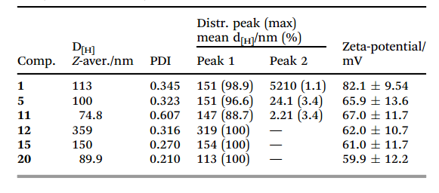
 | Het | CMC, μM
1 | Py | 30
5 | 4-Me₂N-Py | 35
11 | 3-Me-Py | 20
12 | 3-Ph-Py
15 | 3-MeCO-Py | 15
20 | Morf
Pajuste K., Hyvönen Z., Petrichenko O., Kaldre D., Rucins M., Cekavicus B., Ose V., Skrivele B., Gosteva M., Morin-Picardat E., Plotniece M., Sobolev A., Duburs G., Ruponen M., Plotniece A. Gene delivery agents possessing antiradical activity: self-assembling cationic amphiphilic 1,4-dihydropyridine derivatives. New J. Chem., 2013 37(10), 3062.

Slide 16
Cytotoxicity of cationic dihydropyridine amphiphiles
R; R’ | HT-1080 IC₅₀, μg/ml |  | MG-22A IC₅₀, μg/ml |  | 3T3 LD₅₀, mg/kg
 | CV | MTT | CV | MTT
H | * | * | * | * | >2000
CF₃ | * | * | * | * | >2000
H | 3 | 3 | 6 | 3 | 1482
CH₃ | 10 | 5 | 40 | 29 | 1431
NMe2 | 10 | 3 | 6 | 10 | 1706
HT-1080 – Human lung fibrosarcoma cell line; MG-22A – mice hepatoma cell line; NIH 3T3 – mice fibroblast cell line
* - no cytotoxicity observed
Cationic dihydropyridines possessing ethoxycarbonyl groups in positions 3 and 5 of the DHP cycle reveal no cytotoxicity even at 2000 mg/kg.
Analogue amphiphiles comprising dodecyloxycarbonyl groups in positions 3 and 5 have significant cytotoxicity to tested cancer cell lines, but low cytotoxicity to normal (non cancerous) cell line

Slide 17
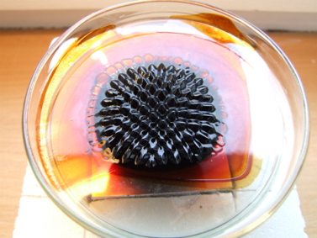
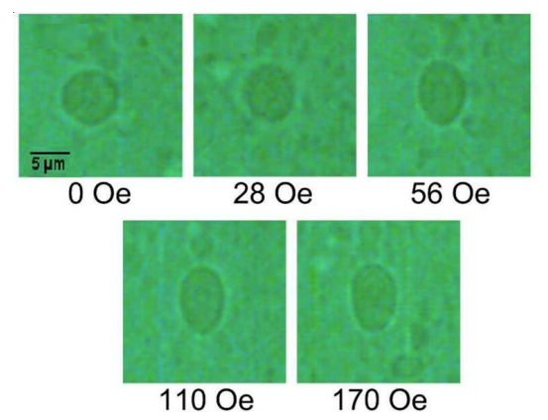
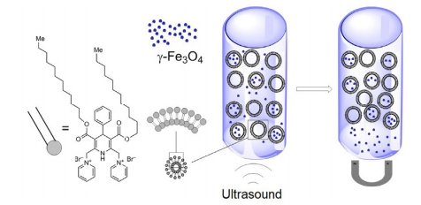
Studies of magnetoliposomes
Giant synthetic magnetic liposome deformation in magnetic field
Studies of magnetoliposomes were performed: – formation by making use of self-assembling dihydropyridine amphiphiles and maghemite nanoparticles.
Due to magnetic field giant magnetic liposomes undergo deformation.
It supports proposed bilayer structure.
Petričenko O., Ērglis K., Cēbers A., Plotniece A., Pajuste K., Béalle G., Ménager Ch., Dubois E., Perzynski R. Bilayer properties of giant magnetic liposomes formed by cationic pyridine amphiphile and probed by active deformation under magnetic forces. Eur. Phys. J. E, 2013, 36(9), DOI 10.1140/epje/i2013-13009-0
Petrichenko O., Plotniece A., Pajuste K., Ose V., Cēbers A. Formation of magnetoliposomes using self-assembling 1,4-dihyd-ropyridine derivative and maghemite γ-Fe₂O₃ nanoparticles. Chem. Heterocycl. Comp. (Engl. Ed.) 2015, 51(7), 672.

Slide 18
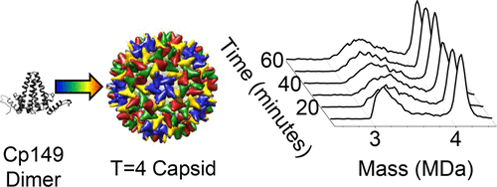
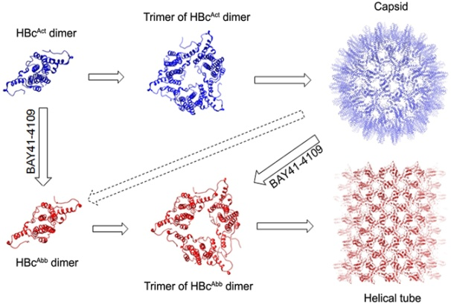
5. Hepatitis B virus capsid self-assembly deregulators.
Studies have been performed in the area of novel approach in antiviral chemotherapy: capsid protein assembly misdirection to stop replication of the virus[1,2]. Despite the fact that safe and effective hepatitis B vaccine, as well as a series of chemicals against hepatitis B virus has been developed, there are more than 350 million chronic carriers of hepatitis B virus in the world . Chronic hepatitis B in up to 40% of cases progresses to liver cirrhosis, hepatic decompensation, and hepatocellular carcinoma. Previous treatment methods keep the transcription of the covalently closed circular DNA in the cell inactive, but cannot provide long-term disease control.
Thorough studies of capsid assembly process revealed different pathways [2].
[1].Liu Ch.et al. Allosteric conformational changes of human HBV core protein transform its assembly.
Sci Rep.2017,7,1404.
[2].Lutomski C.A. et al. Multiple pathways in capsid assembly. JACS 2018, 140, 5784-5790.

Slide 19
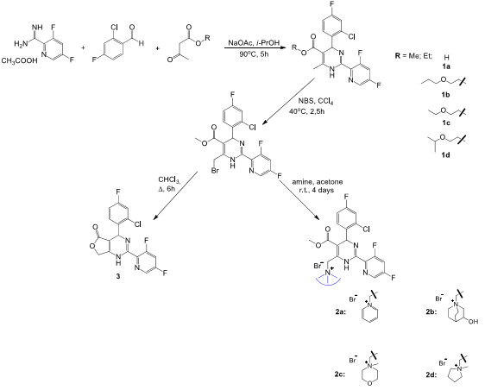
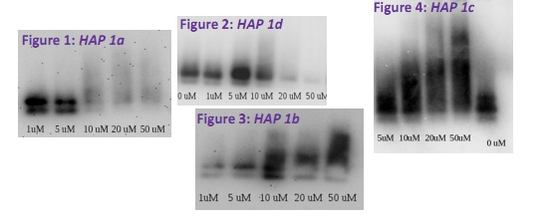
Several compounds of the class of heteroaryl dihydropyrimidine (or HAP), such as BAY 41-4109, are capable of suppressing hepatitis B virus replication by blocking the proper self-assembly of capsids: capsid proteins associate in wrong manner by different kinetics.
In collaboration with the Latvian Biomedical Research and Study Centre we synthesized and studied novel heteroaryldihydropyrimidine (HAP ) derivatives, which revealed different type of activities on hepatitis B capsid protein assembling comparing to BAY 41-4109. Compounds 1b and 1c showed a dose dependent effects on hepatitis B core aggregation, inducing formation of increased size aggregates. Standard compound BAY 41-4109 is quite different: it induces dose dependent decrement of the relative quantity of assembled capsids (similar to compounds 1a and 1d).
Native agarose gel electrophoresis and subsequent HBc specific immunoblotting pictures show dose
dependent effect of tested compounds on HBV
nucleocapsid assembly
These studies are related to the protein-protein interaction field, which is new, fast developing approach.
Bakail M., Ochsenbein F. Targeting protein-protein interactions, a wide open field for drug design. C.R.Chimie ,2016,19, 19-27.
A similar approach can be used for other viruses, e.g. HIV capsids
S.Thenin-Houssier, S,T,Valente. HIV capsid inhibitors antiretroviral agents. Curr.HIV.Res.,2016,14(3), 270-282.
Scheme of synthesis of HAP derivatives
J.D.Baines. Herpes simplex virus capsid assembly and DNA packaging: a present and future antiviral drug target.Trends Microbiol..2011,19(12),606-613.

Slide 20
Conclusions
4-Methyl- and 4-Ethylcarbatone significantly potentiate antitumor activity of 5-fluorouracil.
Novel class of multidrug resistance modulators (thieno[2,3-b]pyridines) has been discovered. Pleiotropic activity to different ATP binding cassette transporters was revealed.
Dihydropyridine Dietone has radioprotective activity for prevention and treatment of radiogenic skin injuries.
1,4-DHP moiety can be used as active linker and scaffold for construction of novel type of gene transfection agents. It is another argument to D. Triggle’s statement for 1,4-DHP structure as privileged.
(Triggle D. Cell Mol.Neurobiol., 2003, 3,293-303).
5. Novel compounds revealed different type of activities on hepatitis B capsid protein assembly comparing to standard compound. These studies are related to the protein-protein interaction field.
.

Slide 21
Acknowledgements
Studies are partially funded by Latvian State Research Program “Biomedicine”.

