Slide 1
3rd International Electronic Conference on Water Sciences (ECWS-3)
STOCHASTIC ASSESSMENT OF THE INFLUENCE OF RESERVOIR OPERATION IN HYDROLOGICAL DAM SAFETY THROUGH RISK INDEXES
Ivan Gabriel-Martin, Alvaro Sordo-Ward, Luis Garrote & Isabel Granados
Departamento de Ingeniería Civil: Hidráulica, Energía y Medio Ambiente
NOVEMBER-2018

Slide 2
Introduction Materials and Methods Results and Discussion Conclusions
Introduction
Failure of Large Dams is a concern in many countries.
Dam risk assesment has evolved lately. Importance of initial reservoir level.
Evolution of stochastic methodologies.
PROPOSAL
STOCHASTIC METHODS
INITIAL RESERVOIR LEVEL
ECONOMIC ASSESMENT
DAM AND DOWNSTREAM SAFETY

Slide 3
Introduction Materials and Methods Results and Discussion Conclusions
Materials and Methods
Generation of synthetic inflow hydrographs.
Stochastic initial reservoir level assignation.
Reservoir-Dam system routing.
Risk-Index analysis.
Applied to a concrete gravity multipurpose dam
Reservoir Levels (m.a.s.l) |  | Maximum Outflow Capacity at Maximum Normal Level (MNL) (m³/s)
Maximum Normal Level (MNL) | 386 | Gated-spillway | 2200
Design flood level (DFL) | 387
Crest of dam (COD) | 388 | Bottom outlet | 57

Slide 4
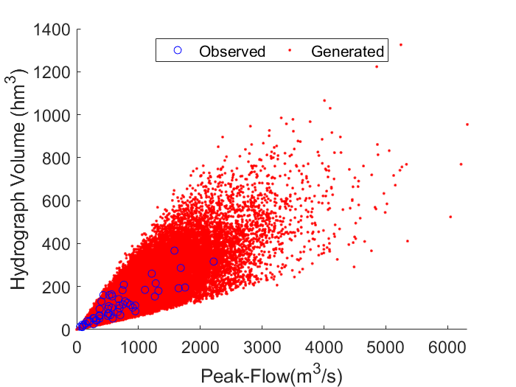
Introduction Materials and Methods Results and Discussion Conclusions
Results and Discussion
Hydrograph generation
Damage Curves
Initial Reservoir Level
Risk Index
Scenario 1 I_{R} (10³ euros)
1445.6
Scenario 2 I_{R} (10³ euros)
980.5
Scenario 3 I_{R} (10³ euros)
93.0

Slide 5
Introduction Materials and Methods Results and Discussion Conclusions
Conclusions
For the case study, considering the fluctuation of initial reservoir level provided a more realistic assessment of hydrological dam and downstream safety.
The global risk index reduced its value up to 93 % if variable initial reservoir level is accounted, from 1445.6 x10³ to a value of 93.0 x10³ euros in the case study.
Acknowledgements
The authors would like to thank the funds from Fundación José Entrecanales Ibarra in the framework of the Program “Support program for research purposes”. The authors acknowledge the computer resources and technical assistance provided by the Centro de Supercomputación y Visualización de Madrid (CeSViMa) and the funds from Universidad Politécnica de Madrid in the framework of their Program “Ayudas para contratos predoctorales para la realización del doctorado en sus escuelas, facultad, centro e institutos de I+D+i” and in the framework of their Program “Ayudas a dirigidas a jóvenes investigadores doctores para fortalecer sus planes de investigación”.
Main References
Gabriel-Martin, I.; Sordo-Ward, A.; Garrote, L.; G. Castillo, L. Influence of initial reservoir level and gate failure in dam safety analysis. Stochastic approach. J. Hydrol. 2017, 550, 669-684, https://doi.org/10.1016/j.jhydrol.2017.05.032
Sordo-Ward, A.; Gabriel-Martin, I.; Bianucci, P.; Garrote, L. A Parametric Flood Control Method for Dams with Gate-Controlled Spillways. Water 2017, 9, 237. https://doi.org/10.3390/w9040237

