Slide 1



Multi-Index Drought Assessment in Europe
Panagiotis D. Oikonomou, Christos A. Karavitis, and Elpida Kolokytha

Slide 2
Introduction
Drought is a normal climatic phenomenon, and its recurrence is inevitable.
Drought is a combination of natural events that many times is boosted by anthropogenic pressures.
Drought indicators are conveying objective information about a system’s status that may aid decision makers to identify:
  Onset
  Magnitude
  Duration

Slide 3
Introduction
SPI and SPEI offer a very well tested and dependable combination of indicators.
In southern Europe winter droughts are crucial, whereas in northern Europe the summer ones are most impactful.
Drought events have regularly occurred all over Europe and particularly in the last fifty years.
Last fifty years, drought has cost more than 100 billion € at EU level.

Slide 4
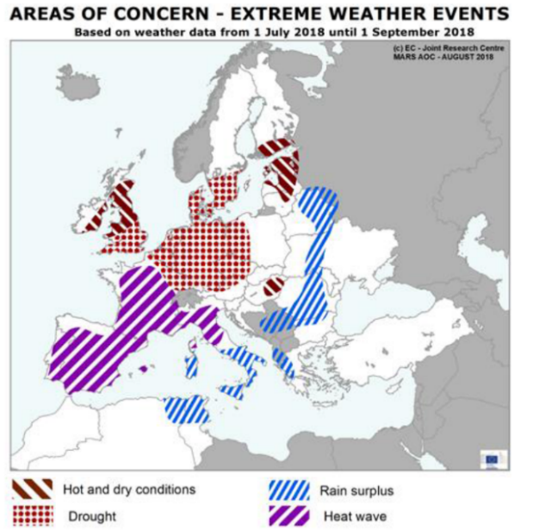
Weather Situation in Europe during July & August 2018
Source: DG AGRI, 2018

Slide 5
Materials & Methods
E-OBS gridded dataset (ensemble version)
Resolution: 0.25 deg. regular grid
Period: 1969-2018
Parameters
  daily min. temperature
  daily max. temperature
  daily precipitation sum

Slide 6
Materials & Methods

Slide 7
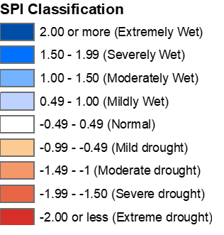
Drought Event of 1990

Slide 8
Drought Event of 2007

Slide 9
Drought Event of 2018

Slide 10
Conclusions
The application of SPI and SPEI clearly depicts drought events all over Europe with two distinct zones, the Mediterranean and the Northern one beyond the Alps.
SPEI captures the main impact of increased temperatures on vegetation water demand, which most of the times is more pronounced than SPI.
The comparison indicated that 1990 drought event was the greatest on record.
Both indices offer an initial assessment on drought critical areas and comparability, towards contingency planning implementation for timely and effective mitigation efforts.

