Slide 1
Evaluation of extreme dry and wet conditions using climate and hydrological indices in the upper part of the Gallikos River Basin
Christos Mattas¹*, Christina Αnagnostopoulou², Panagiota Venetsanou¹, Georgios Bilas³, and Georgia Lazoglou²
1 Faculty of Science, School of Geology, Laboratory of Engineering Geology and Hydrogeology, AUTH; cmattas@geo.auth.gr, pvenetsn@geo.auth.gr
2 Faculty of Science, School of Geology, Department of Meteorology and Climatology, AUTH; chanag@geo.auth.gr, glazglou@geo.auth.gr
3 Faculty of Agriculture, Forestry and Natural Environment, School of Agriculture, Laboratory of Applied Soil Science, AUTH; bilas@agro.auth.gr
* Correspondence: cmattas@geo.auth.gr, Tel.: +30 2310998519

Slide 2
Introduction
The Intergovernmental Panel on Climate Change (IPCC) since 2008 has highlighted the vulnerability of freshwater resources against the observed climate change and pointed out the consequences on humans and ecosystems.
Mediterranean basin is considered to be one of the most prone areas to the impacts of climate change as it is mentioned by many researchers in their publications starting from the previous decade.
In the year 2009, the Interdisciplinary Climate Change Impacts Study Committee (CCISC) was set up by the Bank of Greece studying the economic, social and environmental impacts of climate change in Greece. It indicated the awareness of the Greek scientific society about climate change.

Slide 3
Introduction
According to the Hellenic National Meteorological Service (HNMS) the main climate types that occur in Greece are Bsk, Bsh, Cfa, Csa.
The first two aforementioned climate types correspond to semi arid types and therefore the areas belonging to these zones are suffering from long dry periods during the summer period and are subjected to severe stress due to the agricultural and touristic activities.
The spatial distribution of the climate in relation to water resources and crops has been investigated over the last decades by the use of climate indices and relative maps that depict the climate zonation for the Greek extent have been designed.

Slide 4
Introduction
The Gallikos river basin is an agricultural area and the majority of the residents are employed in this sector.
Extreme flooding events have been recorded over the last decades inundating large areas resulting in human losses and infrastructure and agriculture damages.
The most recent events were recorded during the years 2004, 2014 and 2015. According to HNMS the climate of the studied area is characterized as cold semi arid (Bsk).
Therefore the Gallikos study area was selected as an indicative and representative case study for the investigation of the climate characteristics and the hydrological behavior.

Slide 5
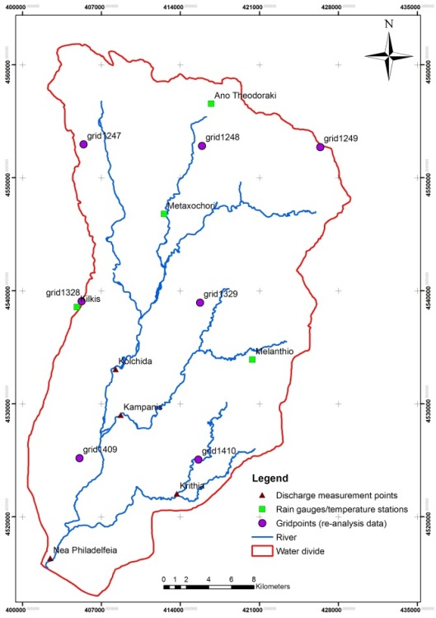
Materials and Methods
Regional settings
The upper part of Gallikos river basin is located in northern Greece and has an a extent of 868km². The river length within the boundaries of the study area is 45km.
A very dense hydrographic network is developed in the area.
The water flow has a seasonal character.
The main geological formations that outcrop in the basin are Quaternary and Tertiary sediments, limestone and dolomites and crystalline bedrock formations (gneiss, quartzites, schists).

Slide 6
Materials and Methods
Data collection and analysis
Precipitation and temperature data were derived from re-analysis data base ERA-Interim (spatial resolution 12.5km×12.5km) for the time period 1980-2006.
Data from rain gauges and temperature measurement stations that were operating in the area for the same time period under the supervision of the competent authorities were also evaluated.
During the years 2004 to 2006 the river water flow rate was measured at different branches of the hydrographic network at specific time intervals and after rainfall events.
Descriptive statistics were applied on data. The Standarized Precipitation Index (SPI) and de Martonne Index was applied to investigate water availability and aridity of the studied region over the years.

Slide 7
Materials and Methods
SPI is a widely used index to characterize meteorological drought by quantifying precipitation deficit. Depending on the SPI timescale range, drought impacts reflect the water availability on different water resources (e.g. soil moisture for short timescales, groundwater and reservoir storage for long timescales). In the present paper a 12month timescale SPI was calculated for reanalysis and raw data.
The de Martonne aridity index is utilized as a measure of the aridity of an area at a local level. Both annual and monthly values were calculated in the present study for re-analysis and raw data.
Annual cumulative curves are used in order to investigate the homogeneity of the measurements between the different rain gauges comparing each station with the others. The coincidence of the points on a straight lines, could mean that there is dependence between the rain gauges.

Slide 8
Results
The mean precipitation and temperature for the entire basin was estimated for the period 1980-2006. The results that are depicted in the Table showed that the re-analysis data overestimate the precipitation values, while the temperature values are quite similar. The homogeneity tests that were conducted between the data showed that all the measurements are quite reliable since the cumulative curves form straight lines with very high dependence.

Slide 9
Results
In this figure the discharge fluctuation is depicted for the years 2004 to 2006 at four different locations.
The distribution of the values seems to follow a typical hydrological pattern for Greece. During summer months the lowest values are recorded.
An increasing trend appears at the end of autumn along with precipitation increase and in winter (after January) that soil is saturated the discharge has a continuous increase till the early summer months that starts to reduce as it is expected.

Slide 10
Results
The curves that illustrate discharge are parallel. Peaks and low values occur at the same time.
The different branches of the river are recharged mainly from rain and drain distinct parts of the basin apart from Nea Philadelphia that is the receiver of the entire network discharge.
The similarity of the fluctuation indicates, as a general rule, that the meteorological events (e.g. rainfall incidents or drought periods) affect the hydrographic network of the entire basin the same way.

Slide 11
Results
De Martonne aridity index for raw data showed a variation of the climate categories from semi dry to humid climates.
More specific for the 27 years, the climate percentages were: Semi dry 40.8%, Mediterranean 25.9%, Semi humid 14.8% and Humid 18.5%.
It is noticeable that five consecutive years (1990-1994) were recorded as semi dry period while the most humid period was between 2002-2006.
The corresponding percentages for the re-analysis data were: Semi dry 7.4%, Mediterranean 22.2%, Semi humid 25.9%, Humid 33.3% and Very Humid 11.2%.
These results suggest that the re-analysis data present much more wetter years compared to the raw data.
According to the monthly de Martonne index of raw data for the time period 1980-2006, the land needs to be irrigated during the months June, July, August and September.

Slide 12
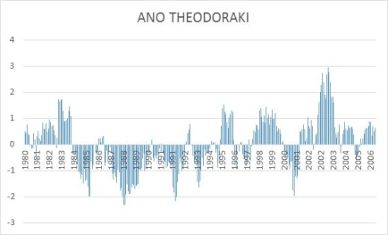
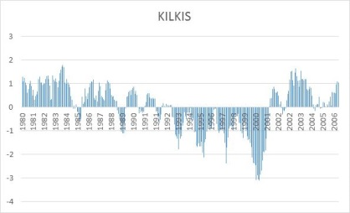
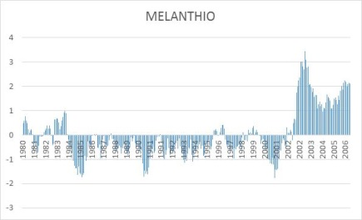
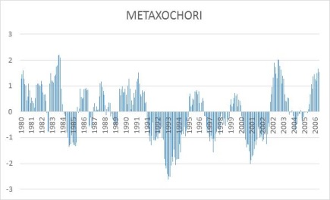
SPI -12 results for raw data

Slide 13
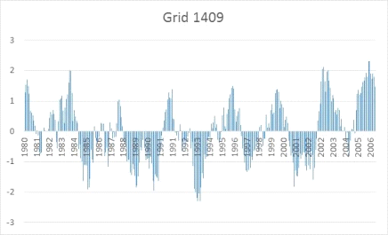
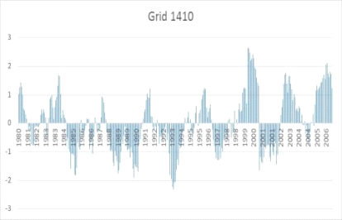
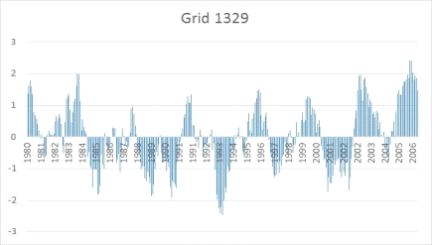
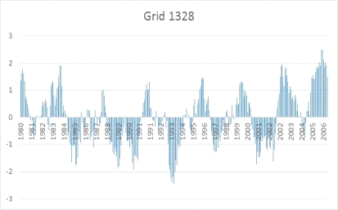
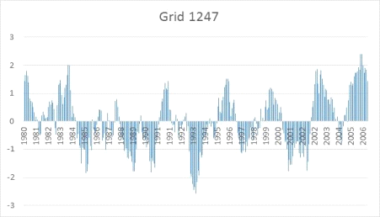
SPI -12 results for re-analysis data

Slide 14
Results
The results of SPI index for 12month timescale for raw and re-analysis data are depicted in previous figures, respectively.
As shown in the first figure, there is a continuous change between wet and dry periods.
The Melanthio rain gauge appeared to have the longest drought period, from 1984 to 2002, while for the Ano Theodoraki station the dry period was from 1984 to 1995.
The drought period for the Kilkis and Metaxochori stations was shifted to 1991 and 2001 showing a delay of approximately 10 years.
The SPI values based on the re-analysis precipitation data are closer to the two northern stations (Ano Theodoraki and Metaxochori).
All grid points showed that the period 1991 to 1995 was the driest one which is in accord with the De Martonne results.

Slide 15
Discussion and Conclusions
Water resources of Gallikos basin are under severe stress as it is revealed by the application of SPI and de Martonne indices due to the long drought periods that last even for decades.
The agricultural sector is depended on water resources and therefore the economy of the area.
The water resources managers that are involved in the area should act as soon as possible in order to prevent and reverse the existing and upcoming impacts from climate change.
Indicative set of measures could include change of cultivation types, construction of infrastructures for the exploitation of surface water (such as dams or implementation of artificial recharge), change of irrigation methods and sufficient presence of the state control mechanisms.

Slide 16
References
IPCC. Climate change and water. IPCC Technical Paper VI, 2008.
European Commission. EU action against climate change. Leading global action to 2020 and beyond, Environment, 2008.
Lionello, P., et al., . The Mediterranean climate: an overview of the main characteristics and issues. Mediterranean Climate Variability,. Lionello, P., Malanotte-Rizzoli, P., Boscolo, R. (Eds.), Elsevier, 2006, Amsterdam, pp. 1–26.
Lionello, P. & Scarascia, L.. The relation between climate change in the Mediterranean region and global warming. Reg Environ Change, 2018, 18: 1481..
Georgopoulou E., Mirasgedis S., Sarafidis Y., Vitaliotou M., Lalas D.P., Theloudis I., Giannoulaki K-D., Dimopoulos D., Zavras V. . Climate change impacts and adaptation options for the Greek agriculture in 2021–2050: A monetary assessment. Climate Risk Management, 2017, 16, 164–182.
Bank of Greece. The environmental, economic and social impacts of Climate Change in Greece. June 2011, Athens, ISBN: 978-960-7032-49-2 (in Greek).
Giannakopoulos, C., Kostopoulou, E., Varotsos, K.V., Tziotziou, K., Plitharas, A., . An integrated assessment of climate change impacts for Greece in the near future. Reg. Environ. Change, 2011, 11 (4), 829–843.
Eleftheriou D., Kiachidis K., Kalmintzis G., Kalea A., Bantasis C., Koumadoraki P., Spathara M.E., Tsolaki A., Tzampazidou M.I, Gemitzi A. Determination of annual and seasonal daytime and nightime trends of MODIS LST over Greece - climate change implications.. Science of the Total Environment, 2018, 616–617:937–947.
Koutroulis A.G., Tsanis I.K., Daliakopoulos I.N., Jacob D. . Impact of climate change on water resources status: A case study for Crete Island, Greece. Journal of Hydrology, 2013, 479, 146–158.
Mimikou, M. and Baltas, E. Assessment of Climate Change Impacts in Greece: A General Overview. American Journal of Climate Change, 2013, 2, 46-56.
Arampatzis G., Panagopoulos A., Pisinaras V., Tziritis E., Wendland F. . Identifying potential effects of climate change on the development of water resources in Pinios River Basin, Central Greece. Applied Water Science, 2018, 8:51.
Peel, M.C.; Finlayson, B.L.; McMahon, T.A. Updated world map of the Köppen-Geiger climate classification. Hydrol. Earth Syst. Sci. 2007, 11, 1633–1644.
Kottek, M., Grieser, J., Beck, C., Rudolf, B., Rubel, F. . World map of the Köppen-Geiger climate classification updated, 2006 Meteorologische Zeitschrift, 15(3), 259–263.
Anagnostopoulou C. . Drought episodes over Greece as simulated by dynamical and statistical downscaling approaches. Theor Appl Climatol., 2017, doi 10.1007/s00704-016-1799-5
Baltas E.A. . Climatic Conditions and Availability of Water Resources in Greece. International Journal of Water Resources Development, 2008, 24:4, 635-649, DOI:10.1080/07900620802230129.
Tsitroulis, I., Voudouris, K., Vasileiou, A., Mattas, C., Sapountzis, Μ., & Maris, F. . Flood hazard assessment and delimitation of the likely flood hazard zones of the upper part in Gallikos river basin. Bulletin of the Geological Society of Greece, 2016, 50(2), 995-1005. F
RA report. Implementation of the European directive 2007/60/EC. Preliminary assessment of the flood hazard. Athens, December 2012, 80.
Mattas, C.; Voudouris, K.S.; Panagopoulos. A. Integrated Groundwater Resources Management Using the DPSIR Approach in a GIS Environment Context: A Case Study from the Gallikos River Basin, North Greece. Water, 2014, 6, 1043-1068.
Mattas C.. Hydrogeological research of the Gallikos river basin. PhD thesis, 2009, School of Geology, AUTH.
World Meteorological Organization: Standardized Precipitation Index User Guide (M. Svoboda, M. Hayes and D. Wood). WMO-No. 1090, 2012, Geneva.

