Slide 1
Analyses of monthly discharges in Slovakia using hydrological exploratory methods
Mária Ďurigová ¹, Dominika Ballová ² and Kamila Hlavčová ^{3,}*
¹ Department of Land and Water Resources Management, Slovak University of Technology, Radlinského 11, 810 05 Bratislava, Slovakia; maria.durigova@stuba.sk
² Department of Mathematics and Descriptive Geometry, Slovak University of Technology, Radlinského 11, 810 05 Bratislava, Slovakia; ballova@math.sk
³ Department of Land and Water Resources Management, Slovak University of Technology, Radlinského 11, 810 05 Bratislava, Slovakia; kamila.hlavcova@stuba.sk
* Correspondence: maria.durigova@stuba.sk

Slide 2
Content
Introduction
Materials and Methods
The analysis of the residuals
Pettitt´s test
The analysis of the runoff regime changes by the deviations
Results
Discussion

Slide 3
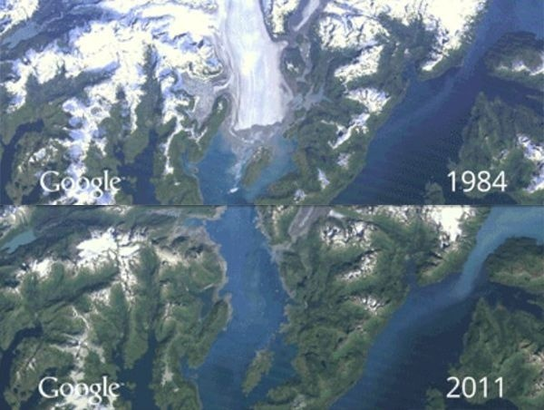
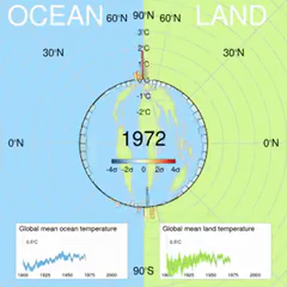
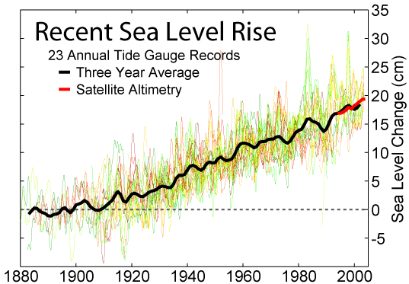
Introduction
The changes around us due to climate change:
global warming,
melting of the glaciers, increasing sea levels,
more occurrences of extremes in hydrology and meteorology.
Recorded by US satellite Landsat
http://www.teraz.sk/slovensko/predpoved-pocasia-pre-slovensko-na-uto/263575-clanok.html
CC BY-SA 3.0, https://commons.wikimedia.org/w/index.php?curid=478900

Slide 4
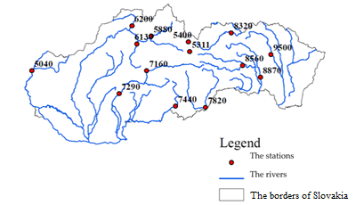
Materials and Methods
Slovakia belongs to the north temperate climate zone.
The data series used are the mean monthly discharges of 14 stage-discharge gauging stations in Slovakia, all of them were measured from 1931 to 2016.
The data was provided by the Slovak Hydrometeorological Institute.
Stage-discharge gauging stations | The rivers | Number of station | Catchment area (km²)
Moravský sv. Ján | Morava | 5040 | 24,129.30
Čierny Váh | Čierny Váh | 5311 | 243.06
Podbánské | Belá | 5400 | 93.49
Dierová | Orava | 5880 | 1,966.75
Martin | Turiec | 6130 | 827.00
Kysucké Nové Mesto | Kysuca | 6200 | 955.09
Bánska Bystrica | Hron | 7160 | 1,766.48
Brehy | Hron | 7290 | 3,821.38
Holiša | Ipeľ | 7440 | 685.27
Lenártovce | Slaná | 7820 | 1,829.65
Jaklovce | Hnilec | 8560 | 606.32
Košické Olšany | Torysa | 8870 | 1,298.30
Hanušovce | Topľa | 9500 | 1,050.03
Chmelnica | Poprad | 8320 | 1,262.41
The localization of the 14 stage-discharge gauging stations used in Slovakia.
List of the stage-discharge gauging stations with the numbering and the catchment areas

Slide 5
Materials and Methods
The analysis of the residuals
Pettitt´s test
The analysis of the runoff regime changes by the deviations
The detection of change-points
The change-point tests seek to find abrupt changes in the mean of series based on the ranking of the observations. These tests are a widely used tool in hydrological processes.
http://rsta.royalsocietypublishing.org/content/370/1962/1228

Slide 6
1. The analysis of residuals
Graph 1: The sample of the station with the mean monthy discharges.
The residuals are calculated as the differences between the mean monthly discharges (Graph 1) and the long-term mean monthly discharge.
These residuals are cumulatively added and are then are plotted on a graph (Graph 2). The maximal value of the cumulative curve of the residuals represents the change-point (point with the arrow in the Graph 2).
Graph 2: The cumulative curve of the residuals with the maximal value (the point with the arrow).
Graph 3: The sample of the station with the mean monthly discharges divided by the change-point

Slide 7
2. Pettitt´s test
It is a widely used tool for detecting change-points in hydrological processes.
The null hypothesis of this test is that there is no change in the mean of the time series. The alternative hypothesis says that there is a statistically significant change in the series.
The test statistic is defined:
$$\hat{U}=max\left|U_{k}\right|$$
where U_{k} is given
$$U_{k}=2\sum_{i=1}^{k}{r_{i}}−k\left(n+1\right)$$
where k=1,2,…,n and r_{i} are the ranks of the observations X_{i}. The most probable change-point is located where $\hat{U}$ reaches its maximum value.

Slide 8
3. The analysis of the runoff regime changes by the deviations
This method deals with the dependence of the runoff regime of each month on the runoff regime of that year.
The mean annual discharge deviations considering the long-term mean annual discharge (Formula 3) and the mean monthly discharge deviations considering the long-term mean monthly discharge (Formula 4) were calculated.
$∆_{1}=\frac{Q_{i}−Q̅}{Q̅}∗100$ ${(3) ∆}_{2}=\frac{Q_{j}−Q_{j}}{{Q̅}_{j}}∗100 (4)$
where:
Δ₁ – the deviations of the mean annual discharges from the long-term mean annual discharge,
Q_{i} – the mean annual discharge for each i-year,
Q̅ - the long-term mean annual discharge,
Δ₂ – the deviations of the mean monthly discharges from the long-term mean monthly discharge,
Q_{j} – the mean monthly discharge of the j-month in that i-year,
Q̅_{j} – the long-term mean monthly discharge of the j-month.
The method compares data time series divided into two periods.

Slide 9
3. The analysis of the runoff regime changes by the deviations
Four approaches were used to divide the time data series into two periods:
A division of the time data series into two 30-year periods. The first period was from 1931 to 1960, and the second period was from 1986 to 2016.
A division of the time data series into two halves; the first period was from 1931 to 1973, and the second period was from 1974 to 2016.
A division of the time data series by an analysis of the residuals. The change-point of the summer and winter periods determines the division of the time data series (Table 1 in Results, the columns Qsum and Qwin). The summer period was defined as May to October and the winter period from November to April.
A division of the time data series also by an analysis of the residuals. The change-point of the mean monthly discharge period determines the division of the time data series (Table 1 in Results, the last column Qm).

Slide 10
3. The analysis of the runoff regime changes by the deviations
The trend lines of the deviations created an angle α.
α=α₁-α₂
The angle α ranges from (10⁰, -10⁰) to (20⁰, -20⁰) and indicates a certain change.
The angle greater than (20⁰, -20⁰) indicates a significant change in the runoff regime.
$$∆_{1}=\frac{Q_{i}−\overline{Q}}{\overline{Q}}∗100$$
α₁
the first period
the second period
$$∆_{2}=\frac{Q_{j}−\overline{Q}j}{{\overline{Q}}_{j}}∗100$$

Slide 11
Results - 1. The analysis of the residuals
Many change-points were indentified in 1941 for September and in 1952 for November,
a considerable number of change-points were identified in the 1970s and 1980s.
Table 1
Stat. | Jan. | Feb. | Mar. | Apr. | May | Jun | Jul | Aug | Sep | Oct | Nov | Dec | Q_{sum} | Q_{win} | Q_{m}
5040 | 1974 | 1988 | 1948 | 1970 | 1987 | 1987 | 1952 | 1987 | 1941 | 1941 | 1952 | 1988 | 1942 | 1948 | 1948
5311 | 1953 | 1977 | 1983 | 1972 | 1979 | 1989 | 1975 | 1972 | 1984 | 1980 | 1952 | 1966 | 1979 | 1980 | 1980
5400 | 1947 | 1944 | 1953 | 1953 | 1974 | 2002 | 1985 | 1981 | 1975 | 1962 | 1952 | 1952 | 1964 | 1953 | 1981
5880 | 1954 | 1954 | 1951 | 1956 | 1986 | 1954 | 1993 | 1978 | 1941 | 1981 | 1952 | 1962 | 1945 | 1983 | 1949
6130 | 1974 | 1965 | 1951 | 1970 | 1972 | 1968 | 1966 | 1966 | 1941 | 1980 | 1952 | 1976 | 1966 | 1977 | 1967
6200 | 1973 | 1965 | 1976 | 1970 | 1938 | 1954 | 1975 | 1986 | 1941 | 1981 | 1952 | 1989 | 1987 | 1965 | 2002
7160 | 1953 | 1977 | 1981 | 1972 | 1996 | 1989 | 1966 | 1966 | 1941 | 1984 | 1952 | 1966 | 1985 | 1970 | 1981
7290 | 1953 | 1977 | 1983 | 1970 | 1987 | 1989 | 1966 | 1966 | 1941 | 1984 | 1952 | 1980 | 1985 | 1981 | 1981
7440 | 1982 | 1979 | 1970 | 1980 | 1942 | 1994 | 1952 | 1970 | 2009 | 1973 | 1952 | 1976 | 2009 | 1980 | 1981
7820 | 2008 | 1979 | 1941 | 1961 | 1969 | 1964 | 1952 | 1970 | 1944 | 1963 | 1952 | 1976 | 1953 | 1980 | 1980
8560 | 1953 | 1977 | 1945 | 1980 | 1945 | 1975 | 1960 | 1960 | 1941 | 1984 | 1952 | 1952 | 1955 | 1953 | 1955
8870 | 1953 | 1965 | 1945 | 1980 | 1974 | 2004 | 1996 | 1985 | 1941 | 1973 | 1952 | 1985 | 1969 | 1981 | 1945
9500 | 1953 | 1977 | 1986 | 1980 | 1973 | 1964 | 1996 | 1985 | 1941 | 1980 | 1980 | 1987 | 1969 | 1981 | 1981
8320 | 1975 | 1969 | 1946 | 1970 | 1982 | 1967 | 1996 | 1960 | 1941 | 1973 | 1952 | 1950 | 1949 | 1970 | 1949
The range of colors from green to red represents the period from the earliest change-point year to the latest change-point year.

Slide 12
Results – 2. Pettitt´s test
More than a quarter of the change-points are statistically significant (58 change-points out of 210).
November has 6 significant change-points in 1952. Overall, there were 8 change-points in 1952.
The entire measured period of the mean monthly discharges (Qm in the Table 2) has 4 significant change-points out of a total of 9 change-points in 1980.
Table 2
Stat. | Jan | Feb | Mar | Apr | May | Jun | Jul | Aug | Sep | Oct | Nov | Dec | Q_{sum} | Q_{win} | Q_{m}
5040 | 1973 | 1988 | 1948 | 1988 | 1997 | 1987 | 1987 | 1987 | 1954 | 1954 | 1981 | 1998 | 1987 | 1948 | 1988
5311 | 1953 | 1971 | 1983 | 1979 | 1996 | 1989 | 1975 | 1972 | 1980 | 1981 | 1952 | 1966 | 1980 | 1979 | 1980
5880 | 1954 | 1954 | 1951 | 1952 | 1986 | 1954 | 1993 | 1978 | 1941 | 1981 | 1950 | 1962 | 1945 | 1983 | 1949
5400 | 1947 | 1944 | 1944 | 1997 | 1974 | 2002 | 1985 | 1981 | 1941 | 1962 | 1952 | 1952 | 2002 | 1953 | 1981
6130 | 1992 | 2006 | 1998 | 1972 | 1987 | 1968 | 1972 | 1986 | 1942 | 1966 | 1966 | 1976 | 1966 | 1977 | 1967
7160 | 1983 | 1977 | 1983 | 1972 | 1996 | 1989 | 1975 | 1980 | 1981 | 1941 | 1952 | 1966 | 1980 | 1970 | 1980
6200 | 1973 | 1965 | 2009 | 1970 | 1938 | 1957 | 1982 | 1986 | 1941 | 1941 | 1952 | 1989 | 1987 | 1936 | 2002
7290 | 2000 | 1981 | 1983 | 1988 | 1987 | 1989 | 1972 | 1978 | 1981 | 1941 | 1952 | 1967 | 1985 | 1983 | 1985
7440 | 1982 | 1981 | 1970 | 1988 | 1991 | 1991 | 1952 | 1952 | 1950 | 1962 | 1980 | 1970 | 1950 | 1980 | 1980
7820 | 1983 | 1980 | 1941 | 1961 | 1964 | 1989 | 1975 | 1996 | 1980 | 1944 | 1945 | 1966 | 1950 | 1980 | 1980
8560 | 1983 | 1973 | 1955 | 1980 | 1991 | 1976 | 1960 | 1960 | 1955 | 1945 | 1952 | 1968 | 1980 | 1970 | 1980
8870 | 1953 | 2006 | 1986 | 2001 | 1969 | 1937 | 1996 | 1995 | 1941 | 1973 | 1945 | 1945 | 1969 | 1983 | 1945
9500 | 2004 | 2006 | 1986 | 2000 | 1969 | 1964 | 1952 | 1981 | 1996 | 1945 | 1981 | 1982 | 1969 | 1983 | 1981
8320 | 1961 | 1969 | 1971 | 1970 | 1936 | 1936 | 1996 | 1945 | 1941 | 1945 | 1952 | 1960 | 1949 | 1970 | 1949
The underlined years in Table are change-points with a p-value ≤ 0.15.
The range of colors from green to red represents the period from the earliest change-point year to the latest change-point year.

Slide 13
Results – 3. The analysis of the runoff regime changes
A significant number of the changes in the runoff regime were identified at the Šaštín-Stráže station (5040). Where from May to November, but excluding September, changes in the runoff regime were identified.
The method found the most changes in the runoff regime were in October, where changes in five stations were identified.
The graph shows an analysis of the deviations for the stage-discharge gauging station 5040 (Šaštín-Stráže) in August.
The division of the measured period is based on the seasonal mean monthly discharges (Table 1, Qsum vs. Qwin).
Specifically for this graph, the first period was from 1931 to 1942 and the second period from 1943 to 2016.
The change-point was in 1942 (Table 1, row 5040, column Qsum). The angle between the trend lines is 21.1°. This means a significant change in the runoff regime in August.
1931-1942
1943-2016
α=21.1°

Slide 14
Discussion
The analysis of the residuals identified the most changes in September (year 1941) and in November (year 1952). A lot of the change-points were identified in the 1970s and 1980s. This simple method is applicable to hydrological data series. A disadvantage is the absence of statistical significance, but Pettitt's test, which showed statistical significance, was used in the study.
The change-points identified by Pettitt´s test show several significant change-points in November of 1952. More than a quarter of the change-points were statistically significant.
A considerable number of changes in the runoff regime were identified at the Šaštín-Stráže (5040) station and at other stations in October.
The results of the analyses show certain changes in the mean monthly discharges, but in order to confirm their correctness, it will be necessary to examine other hydrological and meteorological elements and use other methods for identifying the changes.

Slide 15
Thank you for your attention

