Slide 1
Flood risk management methodology for Lakes and adjacent areas: The Lake Pamvotida Paradigm
3rd International Electronic Conference on Water Sciences (ECWS-3)
G. Papaioannou¹, A. Loukas², L. Vasiliades³
Institute of Marine Biological Resources and Inland Waters, Hellenic Centre for Marine Research, 19013 Anavissos - Attiki, Greece; E-mail: gpapaioan@hcmr.gr
School of Rural and Surveying Engineering, Aristotle University of Thessaloniki, 54124 Thessaloniki, Greece. E-mail: agloukas@topo.auth.gr
Department of Civil Engineering, School of Engineering, University of Thessaly, 38334 Volos, Greece. E-mail: lvassil@civ.uth.gr

Slide 2
Objectives
Floods are one of the most devasting natural hazards with high mortality percentage, destruction of infrastructure and large financial losses. According to the EU Flood Directive (Directive 2007/60/EC), several scenarios should be investigated such as scenarios with low, medium and high probability of flooding (eg: T = 50, 100, 1000 years).
This study presents a methodological approach for flood risk management at lakes and adjacent areas that is based on the implementation of the EU Floods Directive (2007/60/EC) in Greece. Contemporary engineering approaches have been used for the estimation of the inflow hydrographs.
  The hydraulic-hydrodynamic simulations implemented in the following order:
    hydrologic modelling of lake tributaries and estimation flood flow inflow to the lake,
    flood inundation modelling of lake tributaries,
    simulation of the lake as a closed system,
    simulation of the lake outflows to the adjacent areas,
    simulation of flood inundation of rural and urban areas adjacent to the lake.

Slide 3
Flood inundation modelling for lakes and adjacent areas
The main goal is to highlight the possible disastrous effect of fluvial floods on human health, economic activities, cultural heritage, and the environment for three typical design return periods (T = 50, 100, 1000 years), according to the European Union Flood Directive 2007/60/EC and the respective Greek legislation.
Flood risk management methodological framework for lakes and adjacent areas :
  The single event-based deterministic approach is adopted, based on three modelling components:
    a synthetic storm generator/estimator;
    a hydrological simulation model; and
    a hydraulic simulation model.
Basic assumptions: The flood hazard is connected to the determination of the input rainfall return period.
Results: Flood hazard maps (for T = 50, 100, 1000 years) corresponding to the “average” hydrological scenario as well as two “extreme” scenarios, which allow providing lower and upper uncertainty bounds of the estimated flood quantities for each return period of interest. The proposed framework is described in the next paragraphs.

Slide 4
Synthetic Design Storm Estimator
Basic assumption : Flood risk is determined in terms of return period, T, of the design rainfall (hyetograph).
Several rainfall scenarios investigated, setting D = 24 h (which is about five times larger than the time of concentration of the basin) and Δt = 15 min.
Semi-distributed approach - Spatially-varying rainfall inputs across sub-basins, thus accounting for the heterogeneity of the storm regime over the study basin, which is due to climatic reasons as well as relief and orography effects.
  The computational procedure for extracting design hyetographs across sub-basins comprised three steps:
    estimation of partial rainfall depths for all temporal scales and return periods of interest, on the basis of spatially-averaged Intensity Duration Frequency (IDF) curves relationships;
    derivation of a synthetic hyetograph, by placing the partial depths at specific time intervals across the given duration (i.e., 24 h); and
    application of an empirical reduction formula, to transform point to areal estimations.
The IDF relationships could be described by the following equation, proposed by (Koutsoyiannis et al., 1998):
i(d, T) = λ΄ (Τ^{κ} – ψ΄) / (1 + d/θ)^{η}
  where λ΄, ψ΄, κ, θ and η are parameters that were estimated using a stepwise approach (Monte Carlo approach, Tyralis et al., 2013).

Slide 5
Hydrological Modelling
For each return period of interest (T = 50, 100, 1000 years), three scenarios (herein referred to as low, average and high) have been formulated, in order to account for joint rainfall and hydrological uncertainties. Specifically, the design rainfall estimation provided by the IDF relationship is assumed to correspond to the average scenario (or median 50%), while its 80% confidence limits, which are measure of rainfall uncertainty, correspond to the two extreme scenarios (e.g. low-20% and high-80%) (Efstratiadis et al., 2014). The design hyetorgraphs have been produces by IDF curves using the Alternating Block Method (ABM) for return periods of T=50 and 100 years, and the method of Worst Case Design Storm (WCDS) for the return period of T=1000 years.
Hydrological uncertainty has been expressed in terms of three typical antecedent soil moisture conditions (dry, moderate, wet). SCS-CN approach (SCS, 1972) used for the estimation of excess rainfall.
  Antecedent soil moisture conditions:
    the dry (or low) represented by CNI,
    the moderate (or average) represented by CNII,
    and the wet (or high) represented by CNIII. and transformation of the hyetograph to flood runoff.
The transformation of the excess rainfall over the basin to flood hydrograph at the outlet junction is made by using the dimensionless curvilinear unit hydrograph approach of SCS of the HEC-HMS modelling system.

Slide 6
Hydraulic-Hydrodynamic Modelling
Under complex and composite flow conditions and wide flood plains, a 2D-modelling approach is generally suggested due to the provision of more accurate or realistic results (Papaioannou et al., 2016). Therefore, the two dimensional (2D) HEC-RAS model is used for the hydraulic/hydrodynamic flow simulation and flood routing within streams/rivers and lakes.
Digital Elevation Model (DEM) processing (pixel size = 5m) :
  Digital Surface Models (DSM) that derived from 1:5000 aerial photos was merged
  Total DSM has been processed to fill/sink the erroneous areas
  The final DSM has been re-corrected using typical elevation downgrading methods for the DEM generation
Roughness coefficient estimation - CORINE land cover data and standard roughness coefficient tables (e.g. Dimitriadis et al., 2016)
  Based on EU Flood Directive guides the “upper” and “lower” boundaries of Manning’s roughness coefficient were estimated, as −50% and +50% of the average Manning’s roughness coefficient values, respectively.
Hydraulic structures detection through: a) Aerial photographs, b) A GIS database of the technical works, c) Field observations and d) Information collected by several authorities.

Slide 7
Hydraulic-Hydrodynamic Modelling
Flood protection works and the geometry of all hydraulic structures incorporated to the final DEM
A basic concern in flood inundation modelling of urban and suburban areas is the building representation within the 2D hydraulic-hydrodynamic model
Urban and suburban areas flood inundation modelling component:
  The main methodologies followed for the representation of the built up areas are:
    (a) The cells of the mesh that are within a building block area are defined as solid object.
    (b) The cells of the mesh that are within a building block area are assigned with big elevation values in order to work as a blocked area.
    (c) The cells of the mesh that are within a building block area are assigned with big roughness coefficient values.
  Recent studies that investigated the building block representation methods showed that all techniques have disadvantages and advantages and none of them prevail among the others (Bellos and Tsakiris, 2015). Therefore, the second building block representation methodology is followed in this study for large urban areas (cities) and the third method for suburban areas and small settlements (villages) based on the modelling simulation time and the scale (large scale applications) of the proposed framework.

Slide 8
Hydraulic-Hydrodynamic Modelling
Three (3) hydrologic/hydraulic scenarios have been formulated and simulated for every basin/sub-basin, stream/river reach and lake and every return period, considering uncertainty.
  Low scenario represents the dry antecedent soil moisture conditions (CNI), the design synthetic storm is estimated for the 20% confidence level of IDF curves using the ABM for the storm time distribution, and low Manning’s roughness coefficient (e.g. n_{low}=n_{average}-0,5*n_{average}).
  Average scenario represents average antecedent soil moisture conditions (CNII), the design storm is estimated by the median IDF curves (50%) using the ABM for the storm time distribution, and the estimated Manning’s roughness coefficient (n_{average}) and
  High scenario represents high antecedent soil moisture conditions (CNIII), the design storm is estimated for the 80% confidence level of IDF curves using the WCDS for the storm time distribution and high Manning’s roughness coefficient (e.g. n_{high}=n_{average}+0,5*n_{average}).
  In total, nine (9) scenarios were simulated for the three (3) return periods (e.g. T=50, 100, 1000 years).

Slide 9
Average values of Manning’s roughness coefficient based on CORINE land cover data.

Slide 10
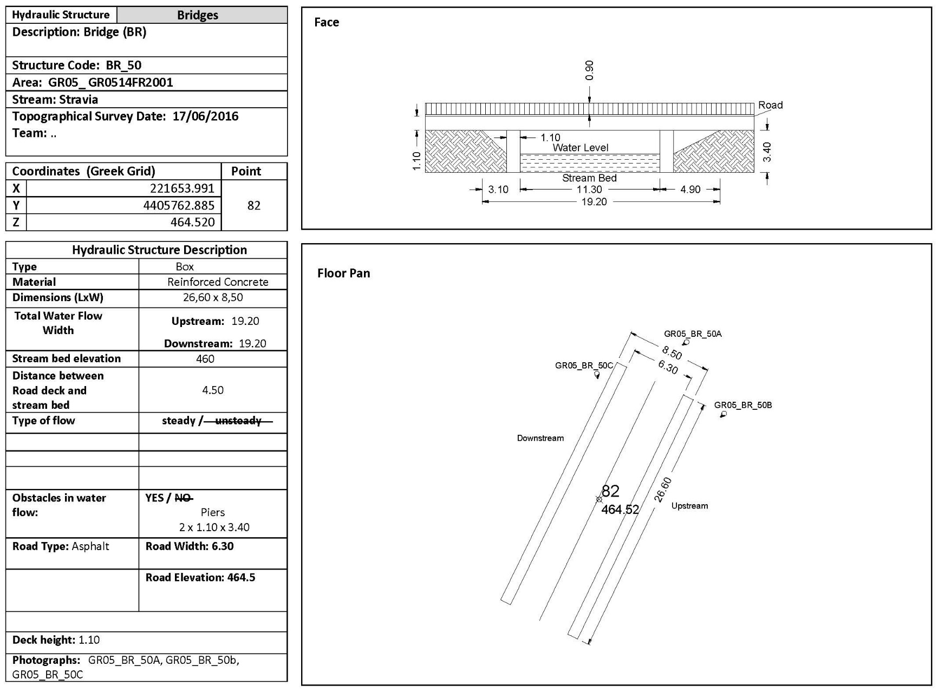
Ground Survey of hydraulic structure BR_50 at Stravia stream

Slide 11
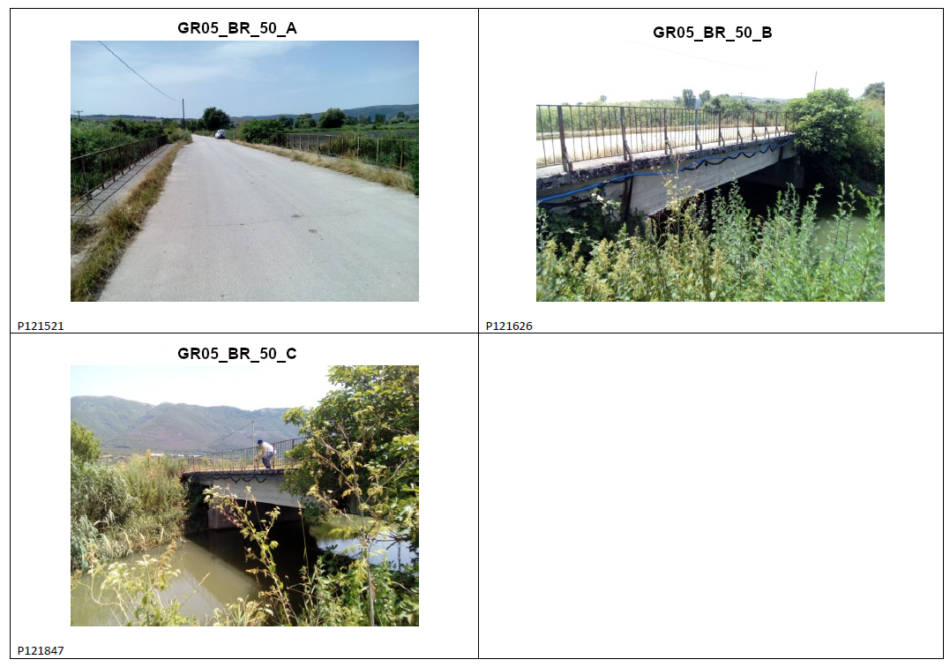
Photographs of hydraulic structure BR_50 at Stravia stream

Slide 12
Methodology application: The Lake Pamvotida Paradigm
The hydrological and hydraulic model of the basin consists of
  15 sub-basins,
  13 flow nodes, and
  11 stream reaches.
Basin is division :
  the upstream sub-system consists of 10 sub-basins, which drain into the Lake Pamvotida.
  The downstream sub-system is divided into four (4) sub-basins (to the Northwest; Fig. 1).
The lake has five inflow nodes (i.e. J5, J6, J7, J8, J11) and it is modelled as an independent sub-basin (GR0514FL2009) and its runoff is concentrated in the node J4.
When the stage of the lake increase above a certain threshold, a part of the stored volume overflows to the lower sub-system, which begins from node J4 and ends to node J1 and then it is diverted to the Kalama River basin through a canal.
In total, eight (8) stream reaches with total length of 46.7 km are located in the potential flood hazard zone and they have simulated for the routing of flood hydrographs and the estimation of flood hazard.

Slide 13
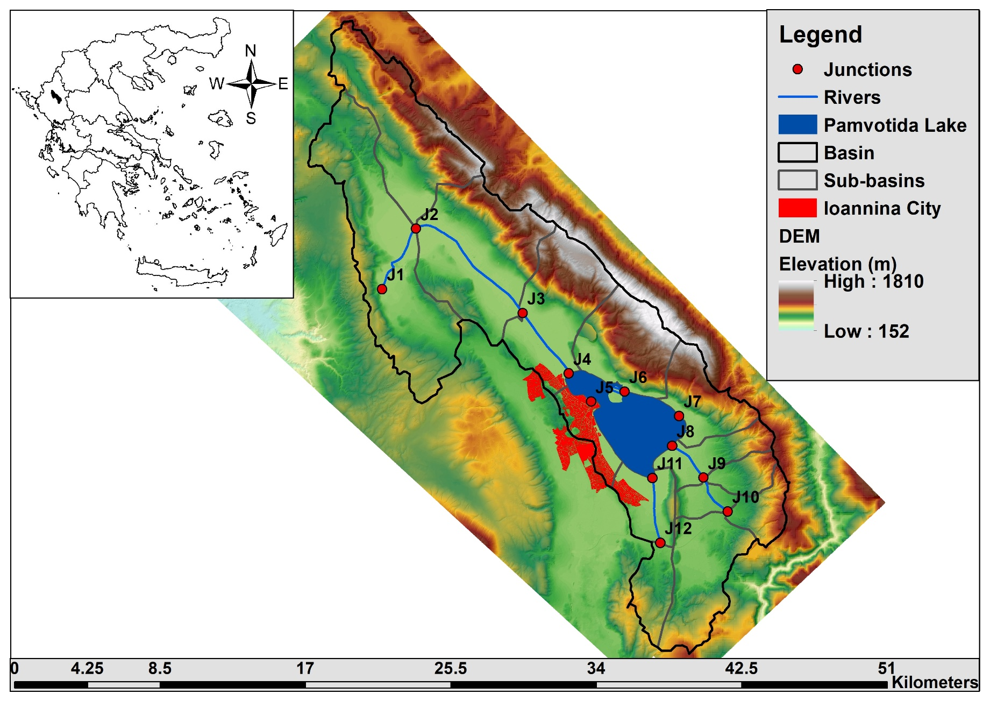
Study Area: The Lake Pamvotida Paradigm

Slide 14
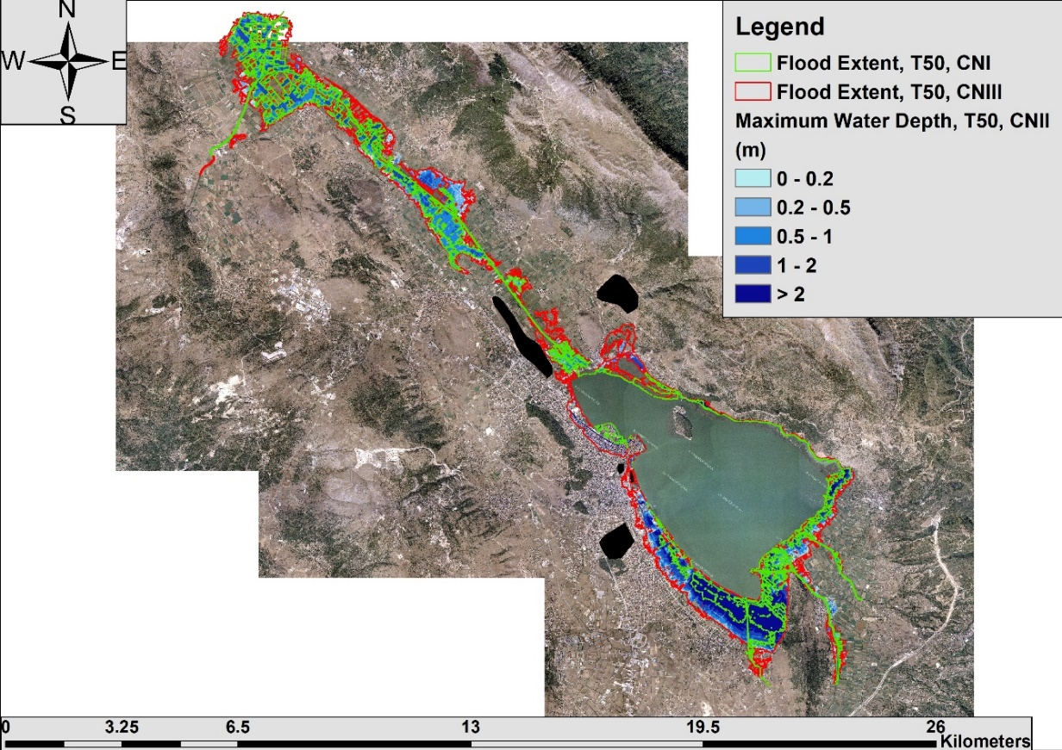
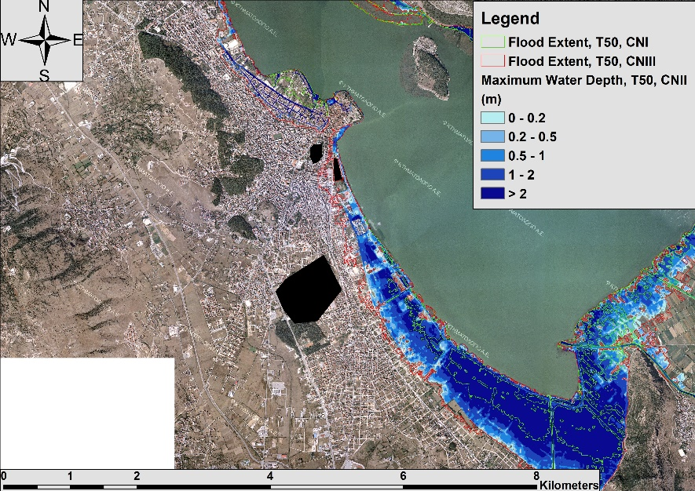
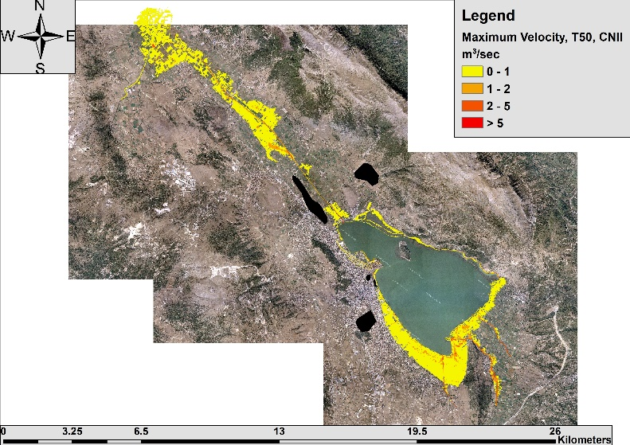
Pamvotida watershed: Hydraulic modelling results
Flood extent and water depths of return period T = 50 years for all configurations of input rainfall, soil moisture conditions and roughness coefficients (up) and simulated velocities (down) only for average moisture conditions (CNII)

Slide 15
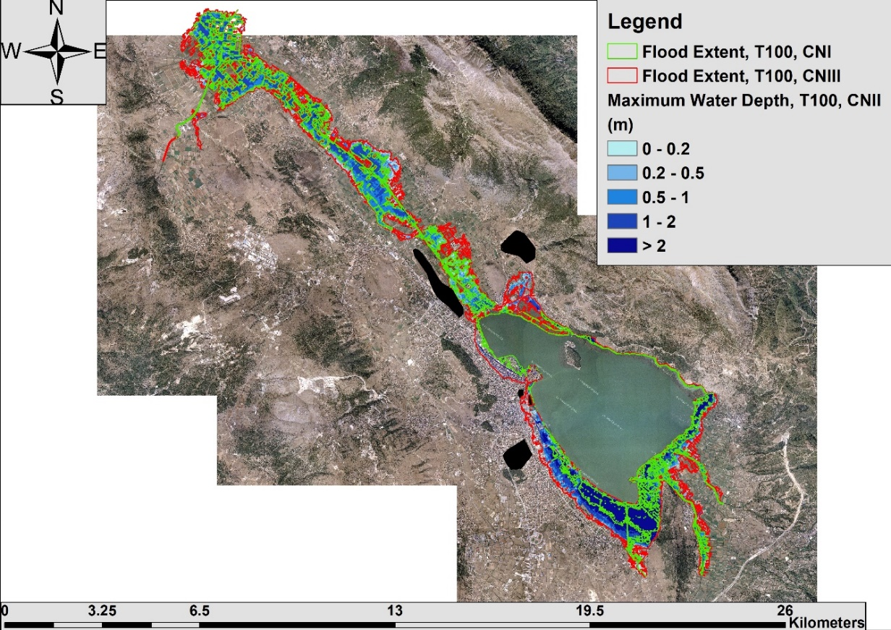
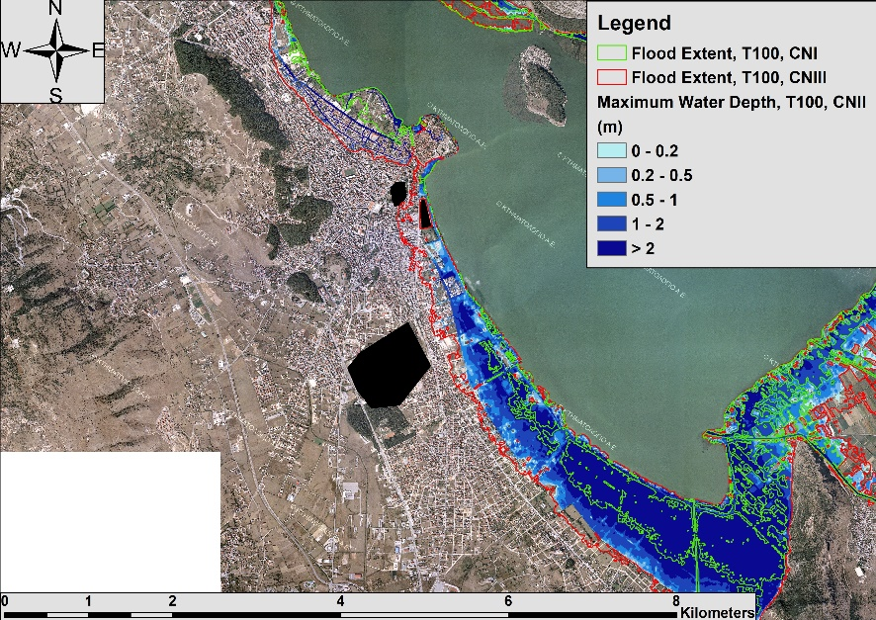
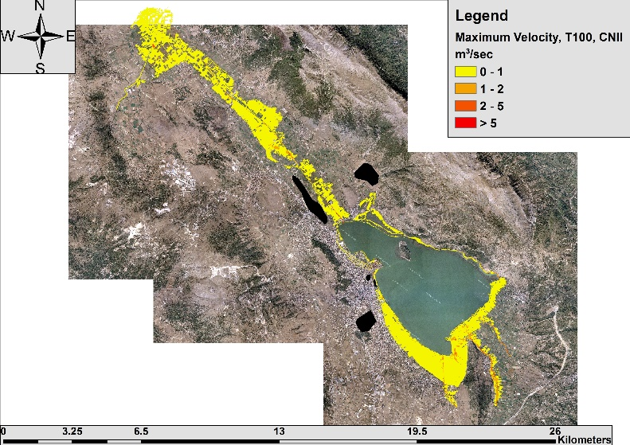
Pamvotida watershed: Hydraulic modelling results
Flood extent and water depths of return period T = 100 years for all configurations of input rainfall, soil moisture conditions and roughness coefficients (up) and simulated velocities (down) only for average moisture conditions (CNII)

Slide 16
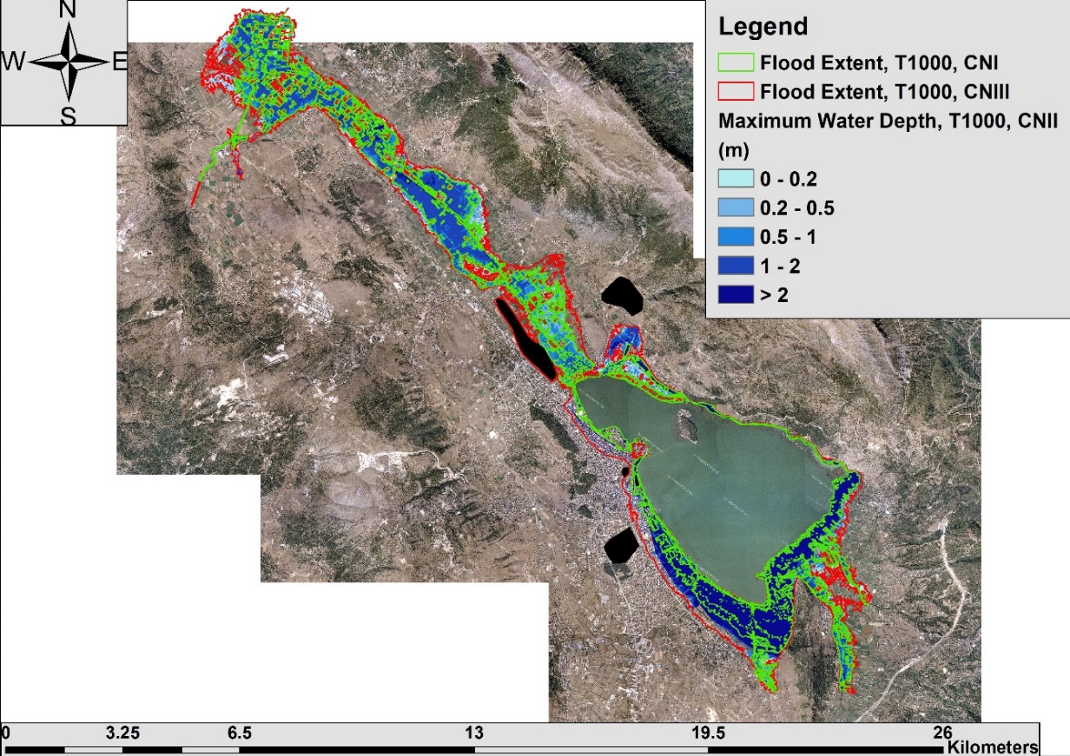
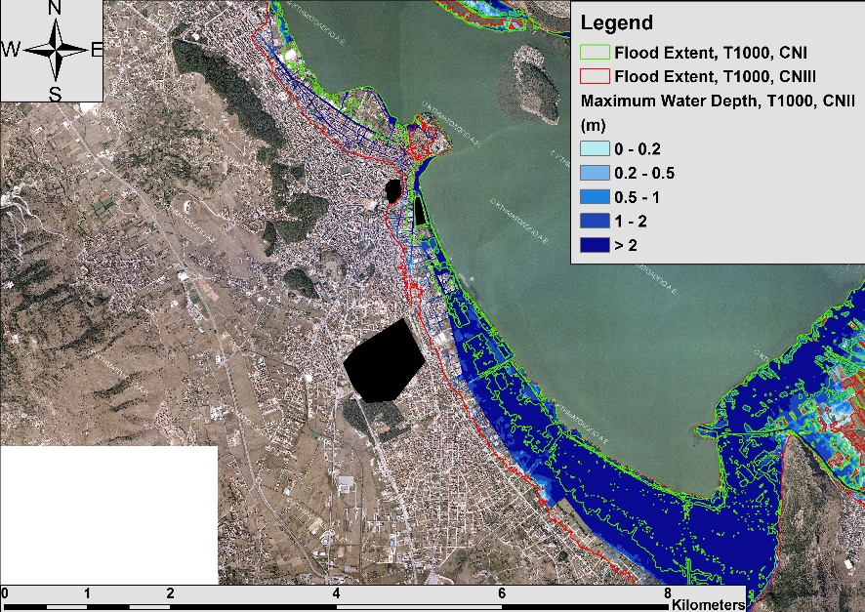
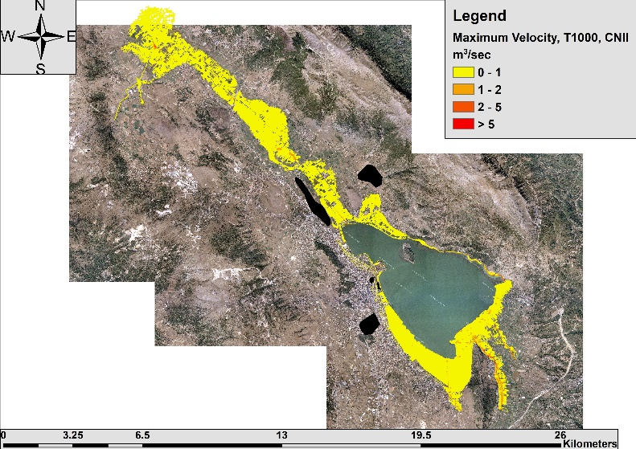
Pamvotida watershed: Hydraulic modelling results
Flood extent and water depths of return period T = 1000 years for all configurations of input rainfall, soil moisture conditions and roughness coefficients (up) and simulated velocities (down) only for average moisture conditions (CNII)

Slide 17
Pamvotida watershed: Hydraulic modelling results
Total inundated area (km²) of Lake Pamvotida basin for all examined hydrologic and hydraulic scenarios at the selected return periods.

Slide 18
Pamvotida watershed: Hydraulic modelling results
The two methodologies, outlined before, for rural and not significant settlements and for significant urban areas (e.g. Ioannina City) have been applied in the hydraulic simulations.
The results indicate that the inundated area increases with the return period of the event and the depth of water is more sensitive than the water velocity.
Results are quite diverse, since the uncertainty bounds of all key flood quantities (peak flows, flood volumes, inundated areas, etc.) strongly overlap the risk expressed in terms of return period of rainfall.
Special attention should be given to the developed methodology and its application only for specific return periods and hydrologic-hydraulic conditions due to the great variability in the peak discharge estimation.
An ensemble of methods and scenarios should always be applied for engineering purposes, in order to choose the most appropriate technique in relation to the flood prone areas and proposed flood protection measures.

Slide 19
Conclusions
In this study, a methodological approach for implementing the EU Floods Directive 2007/60/EC in Greece is developed, emphasized for flood risk management in rural, urban and suburban areas, which is demonstrated for the Lake Pamvotida basin.
The methodology is based on typical hydrological and flood inundation modelling and mapping techniques for ungauged catchments. Spatially-distributed design hyetographs are applied for hydrologic and hydraulic 2D modelling of floods taking into account parametric and structural uncertainty.
According to the flood extent values, it seems that the uncertainty induced in hydrological modeling, with respect to extreme rainfall estimation and antecedent soil moisture conditions, dominates against the return period.
It should be emphasized that these two components are not the sole sources of uncertainty within rainfall-runoff transformations. This makes it essential to move to more rigorous methodological approaches (e.g. stochastic), instead of quantifying the flood risk on the basis of the return period of rainfall.

Slide 20
Reference
Bellos, V.; Tsakiris, G. Comparing Various Methods of Building Representation for 2D Flood Modelling In Built-Up Areas. Water Resour. Manag. 2015, 29, 379–397.
Dimitriadis, P., A. Tegos, A. Oikonomou, V. Pagana, A. Koukouvinos, N. Mamassis, D. Koutsoyiannis, and A. Efstratiadis, Comparative evaluation of 1D and quasi-2D hydraulic models based on benchmark and real-world applications for uncertainty assessment in flood mapping, Journal of Hydrology, 534, 478–492, doi:10.1016/j.jhydrol.2016.01.020, 2016.
Efstratiadis, A., A. D. Koussis, D. Koutsoyiannis, and N. Mamassis, Flood design recipes vs. reality: can predictions for ungauged basins be trusted?, Natural Hazards and Earth System Sciences, 14, 1417–1428, doi:10.5194/nhess-14-1417-2014, 2014.
Koutsoyiannis, D.; Kozonis, D.; Manetas, A. A mathematical framework for studying rainfall intensity-duration-frequency relationships. J. Hydrol. 1998, 206, 118–135.
Papaioannou, G., A. Loukas, L. Vasiliades, and G. T. Aronica, Flood inundation mapping sensitivity to riverine spatial resolution and modelling approach, Natural Hazards, 83, S117–S132, 2016.
Soil Conservation Service (SCS). National Engineering Handbook, Section 4, Hydrology (NEH-4); U.S. Department of Agriculture: Washington, DC, USA, 1972.
Tyralis, H.; Koutsoyiannis, D.; Kozanis, S. An algorithm to construct Monte Carlo confidence intervals for an arbitrary function of probability distribution parameters. Comput. Stat. 2013, 28, 1501–1527.
THANK YOU FOR YOUR ATTENTION!

