Slide 1
Detection of metabolite corona on amino functionalised polystyrene nanoparticles
and its implications in freshwater organisms
Konstantinos Grintzalis^{1,2}*, Thomas N. Lawson², Iseult Lynch³, Mark R. Viant²
¹ School of Biotechnology, Dublin City University, Republic of Ireland
² School of Biosciences, University of Birmingham, United Kingdom
³ School of Geography, Earth and Environmental Sciences, University of Birmingham, United Kingdom
* Corresponding author: konstantinos.gkrintzalis@dcu.ie

Slide 2
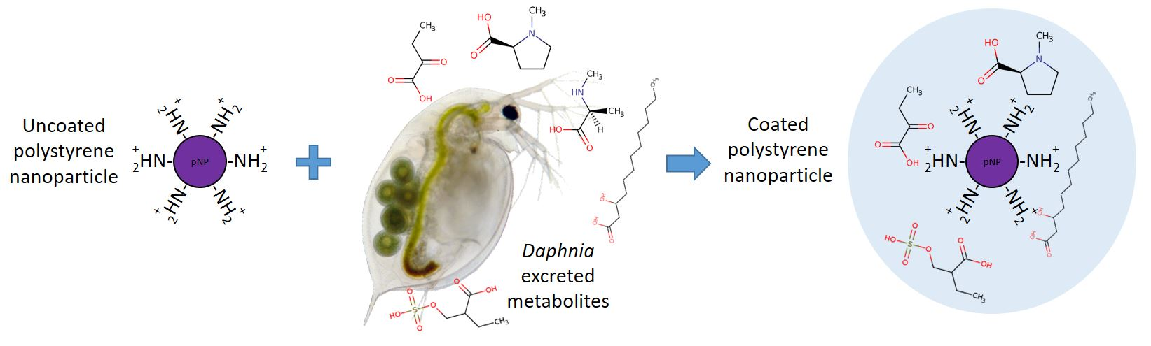
Detection of metabolite corona on amino functionalised polystyrene nanoparticles
and its implications in freshwater organisms
Notes:
In this study we present a method for detecting a small molecule, metabolite, corona on polystyrene nanoparticles. The method was developed and applied in a freshwater model system of Daphnia and algae. The impact of this corona was evaluated on freshwater organisms.

Slide 3
Abstract: Protein corona formation on nanoparticles (NPs), affect NP physicochemical properties, cellular uptake and toxicity, and has been reported extensively. To date, studies of the occurrence and potential importance of small molecule (metabolite) coronas are limited. We sought to determine such a corona using high-sensitivity metabolomics combined with a well-established model system for freshwater ecotoxicology (Daphnia magna feeding on Chlorella vulgaris) and amino functionalised polystyrene NPs (NH₂-pNPs). Initially, we optimised our method using a targeted LC-MS/MS approach for sodium dodecylsulphate (SDS) as an analogue to signalling molecules that are known to occur in our freshwater model system. Following, we performed an untargeted discovery metabolomics study – using high-sensitivity nanoelectrospray direct infusion mass spectrometry (DIMS) for the unbiased assessment of the metabolite corona of NH₂-pNPs in the freshwater model system. Untargeted DIMS metabolomics reproducibly detected 100s of small molecule peaks extracted from the NH₂-pNPs when exposed to conditioned media from the D. magna-C. vulgaris model system. Attempts to annotate these extracted metabolites, including through the application of van Krevelen and Kendrick Mass Defect plots, indicate a diverse range of metabolites that were not clustered into any particular class. Overall, we demonstrate the existence of an ecologically relevant metabolite corona on the surface of NPs through application of a high-sensitivity, untargeted mass spectrometry metabolomics workflow.
Keywords: metabolite corona, Daphnia magna, direct infusion mass spectrometry, untargeted metabolomics, polystyrene nanoparticles

Slide 4
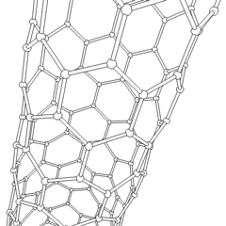
Introduction
Engineered nanomaterials are currently being used in a wide range of commercial products due to their physico-chemical properties. As a result, their levels within the environment are increasing and this has raised concerns over the exposure and possible health effects on humans and other organisms.

Slide 5
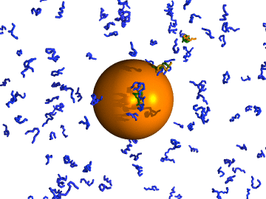
Introduction
Nanoparticles rapidly adsorb proteins on their surface in a competitive manner, generating a corona which affects their interactions with cells and organisms and in turn impacts their toxicity and uptake.
So far, studies on NP coronas have focused on the protein component and even though the scientific community and literature anticipate that smaller molecules could also bind to nanoparticles, this novel component of the corona has not yet been fully characterised.
The overall aim of the present study was to develop, optimise and apply a robust procedure for isolating the metabolites bound to positively charged amino functionalised polystyrene nanoparticles (NH₂-pNPs) and study its role in a freshwater system.

Slide 6
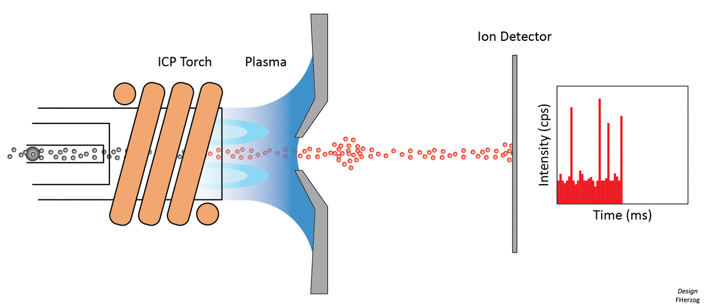
Introduction
Our first objective was to develop a protocol to isolate and measure this small molecule corona from NH₂-pNPs. We used sodium dodecyl sulphate (SDS) as a reference compound, due to its molecular similarity to sulphonated lipid chemical signalling molecules (kairomones) that are known to be excreted into the environment by Daphnia.
The second objective was to expand beyond this targeted detection to a high-sensitivity untargeted metabolomics semi-quantitative method (via nanoelectrospray direct infusion mass spectrometry, DIMS) to detect metabolites excreted from a well-established model system for freshwater ecotoxicology that form a small molecule corona on NPs.
Finally, using feeding performance we explored the impact of corona formation on Daphnia magna physiology.

Slide 7
Results and Discussion: SDS optimisation
OECD
Media
Filter
Filtered
OECD
Media
Filtered
OECD Media
+1 ppm SDS
(no pNP)
Filtered
OECD Media
+1 ppm SDS
+ 10 μg pNP/ml
Filtered
OECD Media
+ 10 μg pNP/ml
(no SDS)
Wash steps
Extraction
Re-suspension
LC-MS/MS detection of SDS
Notes:
We used OECD media as this is the culture media for our freshwater model system.
SDS was incubated in the presence or absence of nanoparticles and additional control of SDS in the absence of nanoparticles was also used.
Using LC-MS/MS to quantify SDS we optimised the washing, extraction and re-suspension steps of our protocol.

Slide 8
Results and Discussion: SDS optimisation I
2 extractions are sufficient to extract all signal of bound SDS.
3 washings are more than enough to remove unbound SDS.
Notes:
We optimised the washing and extraction of our protocol using SDS.
SDS was incubated at a concentration of 1 ppm in the presence or absence of NH₂-pNPs. As part of the extraction protocol we performed none and up to three sequential washes, and the level of SDS was measured in the incubation solution (i.e. no wash) and in each of the three wash solutions.
In addition, the level of SDS extracted from the corona of the NH₂-pNPs after one, two or three washes were also quantified.
We conclude that 3 washings are more than enough to remove unbound SDS and 2 extractions are sufficient to extract all signal of bound SDS.

Slide 9
Results and Discussion: SDS optimisation II
Extraction in methanol:water is more efficient than methanol:formic acid.
2 extractions are sufficient to extract all signal of bound SDS.
Notes:
Then, we compared methanol:water versus methanol:formic acid as extraction options, for a single extraction versus two or three repeated extractions.
SDS was incubated at 1 ppm in the presence or absence of NH₂-pNPs and after 3 washes the bound SDS was extracted with methanol:water or methanol:formic acid.
The amount of SDS from the corona is shown following the first, second and third extractions.
We conclude that extraction in methanol:water is more efficient than methanol:formic acid and 2 extractions are sufficient to extract all signal of bound SDS.

Slide 10
Results and Discussion: Corona detection
OECD Media
with Daphnia
and Chlorella
OECD Media
0 48h
Filter
Filter
Filtered Conditioned Media
Filtered
OECD
Media
Filtered Conditioned Media
+pNP
Filtered Conditioned Media
(no pNP)
Filtered
OECD
Media
+pNP
Wash steps
Extraction
Re-suspension
DIMS detection of metabolites
Notes:
Having optimised the multi-step NP metabolite corona extraction protocol, we applied this semi-quantitative method to detect a wider range of metabolites binding to NH₂-pNPs using our freshwater model system.
Specifically, NH₂-pNPs were exposed for 24 hours to conditioned or unconditioned media and the coronae were extracted and analysed using positive and negative ion DIMS metabolomics.
Appropriate negative controls were included, comprising of incubations using conditioned media without NPs and separately unconditioned media with NH₂-pNPs, therefore, enabling us to determine the unique metabolite features observed as corona features on NPs.
This entire exposure, extraction and DIMS metabolomics analysis was repeated twice, completely independently, to ensure consistency of the findings.
A unique list of 102 and 182 biological features in positive and negative ion mode, respectively, was determined, representing only the metabolite peaks that reproducibly recovered from NH₂-pNPs in the two independent experiments.

Slide 11
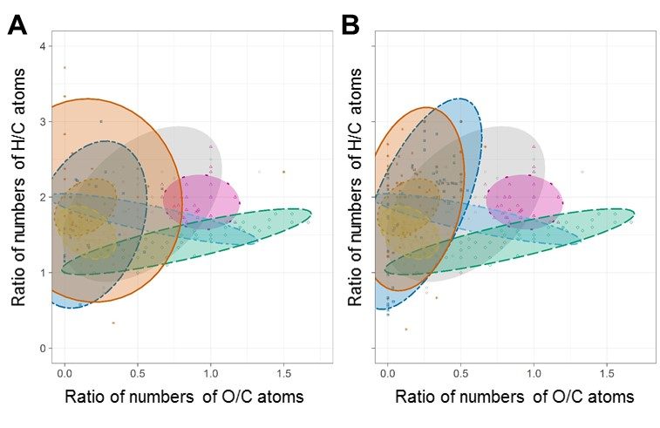
Results and Discussion: Corona detection
Negative
Positive
Negative Positive
Metabolite corona features show a diverse distribution
Notes:
We then used Van Krevelen diagrams to determine whether the molecular formulae of the metabolite corona cluster together into one or different chemically related groups.
Plotting the ratios of H:C and O:C provides evidence of the category of metabolites represented.
Additionally, in order to relate the molecular formulae that we detected to known biological molecules, we plotted a van Krevelen diagram for reference metabolites from the KEGG database.
A comparison of these plots indicates that the observed metabolite corona, in both ion modes, shows an overall chemical similarity with the biological molecules from KEGG and is not composed of any particular class of metabolites, meaning that the corona composed of a diverse range of chemical formulae.

Slide 12
Results and Discussion: Corona detection
CH₂ COO
Kendrick mass
Nominal Kendrick mass
Kendrick mass
Nominal Kendrick mass
Positive
Negative
Nominal Kendrick mass
Nominal Kendrick mass
Kendrick mass
Kendrick mass
Notes:
This finding is also in agreement with the Kendrick Mass Defect (KMD) plots for the features of the metabolite corona.
KMD plots are a user-friendly data visualisation method in particular for organic molecules with repeating groups. KMD plots represent a normalised way to depict mass spectrometry data based on a repeating group and calculating homologous series for this group by generating the Kendrick mass (y axis) and the nominal Kendrick mass (x axis) for each feature and plotting them against each other.
The Kendrick Mass Defect plots from the detected corona features do not show the characteristic straight lines exhibited by a homologous series, therefore, indicating a diverse pool of corona-derived metabolites from different classes.

Slide 13
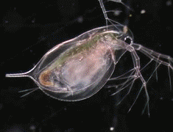
Results and Discussion: Corona impact on Daphnia
OECD Media
with Daphnia
and Chlorella
OECD Media
0 24h
Filter
Filter
Filtered
Conditioned
Media
Filtered
OECD
Media
Control Exposed
0 h
1 h
Filtered Conditioned Media
+pNP
Filtered Conditioned Media
(no pNP)
Filtered Conditioned Media
+pNP
Filtered Conditioned Media
(no pNP)
Expose daphniids for 24 hours, isolate daphniids and quantify feeding performance
Feeding = Δ[algae]/h
Notes:
To show if nanoparticles and corona formation have implication to freshwater organisms we assessed the feeding performance of daphniids.
Daphniids were cultured and allowed to condition media upon feeding with algae.
As a control, unconditioned clean OECD media (without daphniids or algae) was used.
Media were filtered and NPs were incubated for 24 hours to create a metabolite corona. As controls conditioned and unconditioned media in the absence of NPs were used.
Then, new animals (daphniids) were exposed to the conditioned/unconditioned media in absence or presence of NPs for 24 hours.
Finally, all animals were alive after exposure, collected and feeding performance was assessed using our previously published method.

Slide 14
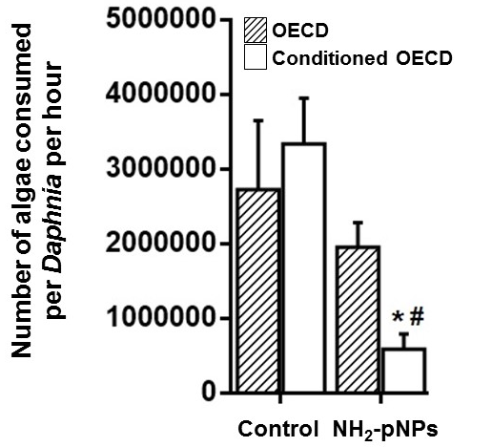
Results and Discussion: Corona impact on Daphnia
Results show that exposure to NH₂-pNPs decreased the feeding performance in conditioned and unconditioned media by 82% and 29% (not significant by unpaired t-test compared to unexposed animals), respectively.
It is evident that NH₂-pNPs incubated in conditioned media had a stronger impact on feeding performance and this could be attributed to the corona formed which makes NH₂-pNPs more accessible to daphniids as they filter their surrounding media during exposure.
Notes:
Results show that exposure to NH₂-pNPs caused a decrease in the feeding performance in conditioned media by 82% and in unconditioned media by 29%. It is evident that NH₂-pNPs when incubated in conditioned media a stronger impact on the feeding performance occurred and this could be attributed to the corona formation which makes NH₂-pNPs more accessible to daphniids as they filter their surrounding media during exposure.

Slide 15
Conclusions
We present the development and application of an optimised protocol for the semi-quantitative detection of a small molecule metabolite corona from amino functionalised polystyrene nanoparticles.
The new method reproducibly detected metabolites that were present within a freshwater model ecosystem (of Daphnia and algae) and that had subsequently bound to the NH₂-pNPs.
This is the first attempt to demonstrate the existence of such an ecologically relevant corona on the surface of NPs and also revealed its importance in freshwater organisms using phenotypic endpoints (feeding).
Notes:
We present the development and application of an optimised protocol for the semi-quantitative detection of a small molecule metabolite corona extracted from amino functionalised polystyrene nanoparticles.
This new method reproducibly detected metabolites that were present within a freshwater model ecosystem (of Daphnia and algae) and that had subsequently bound to the NH₂-pNPs. This represents the first attempt to demonstrate the existence of such an ecologically relevant corona on the surface of NPs, and was achieved through application of high-sensitivity, untargeted direct infusion mass spectrometry metabolomics.
The importance of such a corona formation was validated in freshwater organisms using feeding rate as phenotypic endpoint.

Slide 16
Acknowledgements
Notes:
We would like to thank you for your attention and acknowledge the financial support for this study to the EU FP7 project FutureNanoNeeds - Framework to respond to regulatory needs of future nanomaterials and markets (Grant Agreement No. 604602). The authors acknowledge use of the University of Birmingham’s Daphnia research facility.

