Slide 1

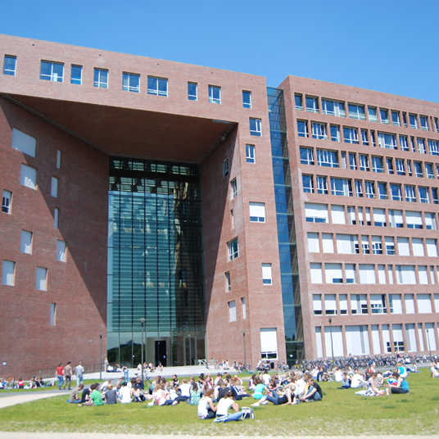


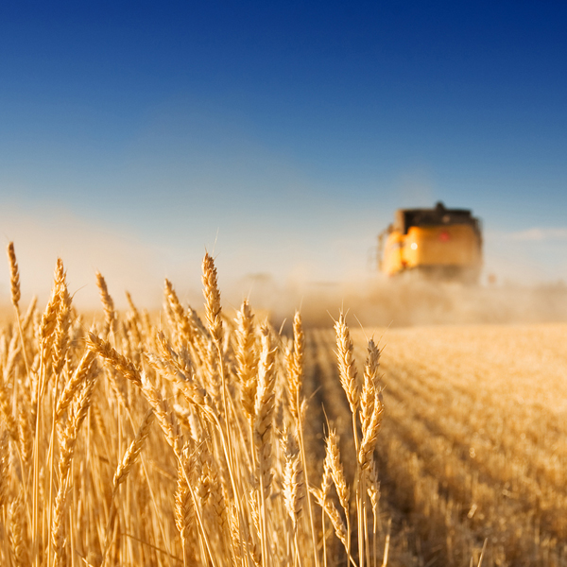
Integrated metabolome mining and annotation workflow accelerates specialised metabolite discovery
Justin J.J. van der Hooft et al.
Bioinformatics Group – Wageningen University, The Netherlands
3rd International Electronic Conference on Metabolomics 15-30 Nov. 2018

Slide 2
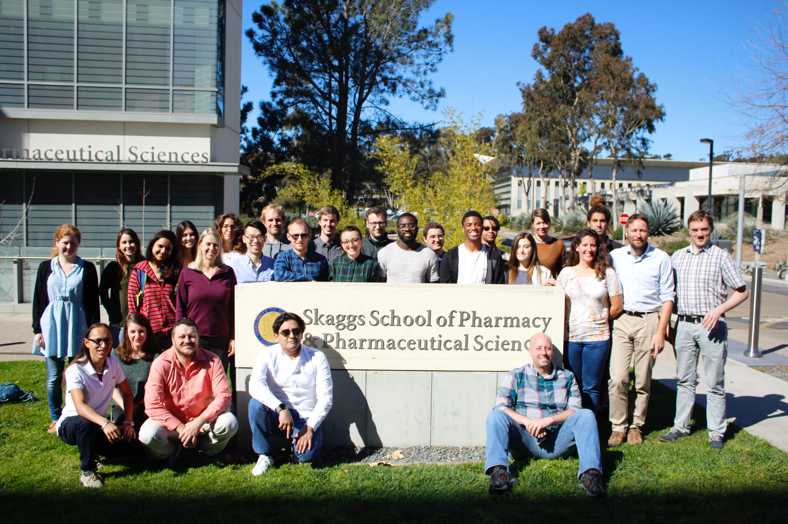
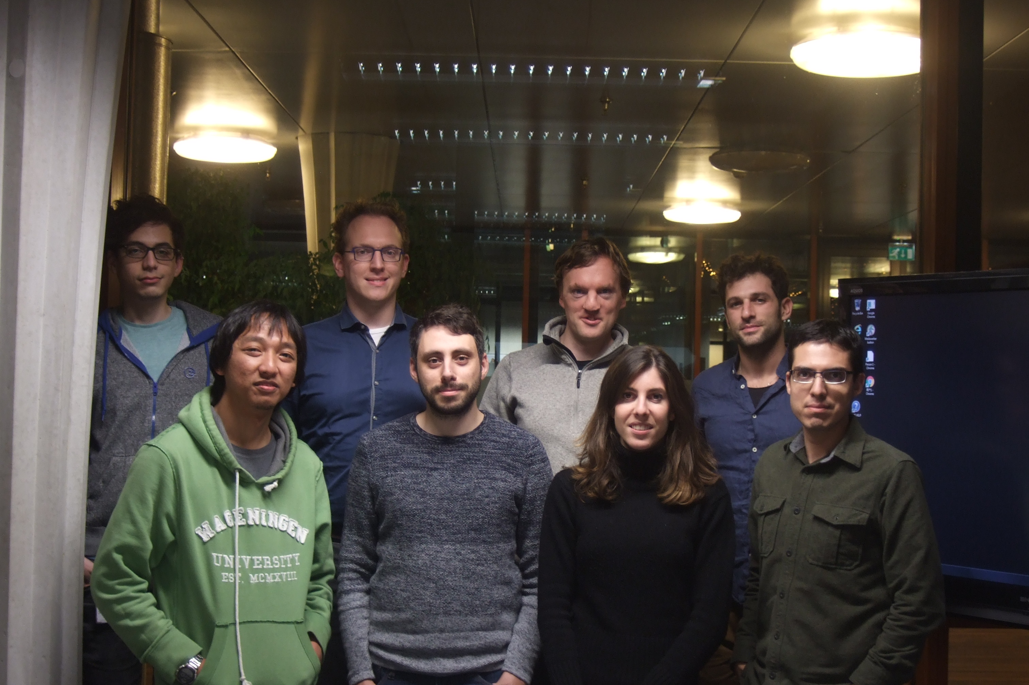
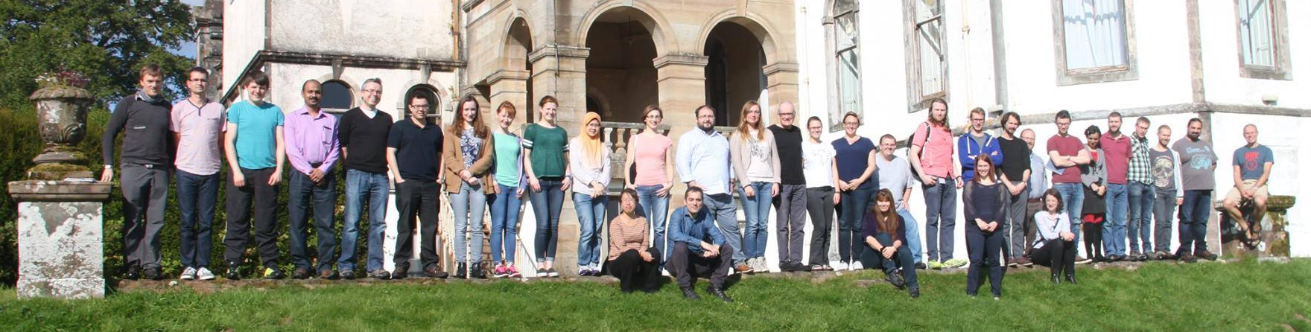









Team work! ☺
Medema lab - Wageningen University, NL
Dorrestein lab – San Diego, USA
Glasgow Polyomics – University of Glasgow, UK
Funding €€
€€

Slide 3
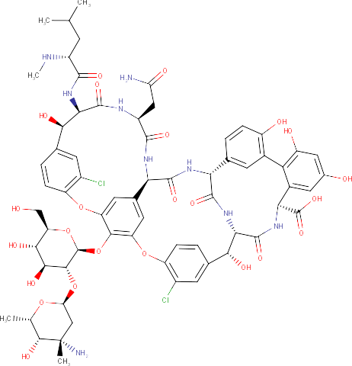
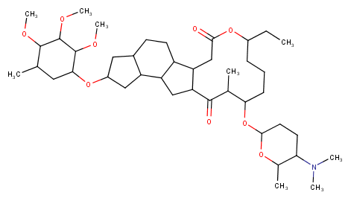
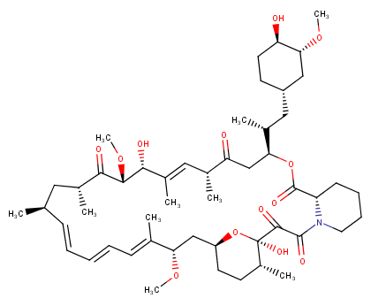
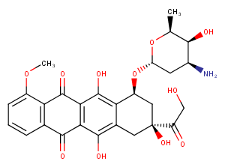
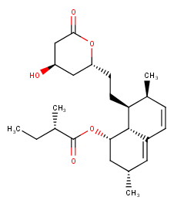
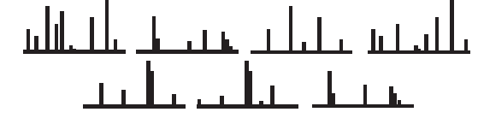
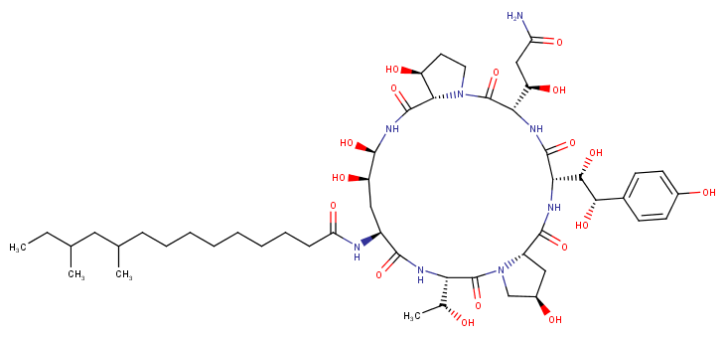
The challenge….
Bacteria, fungi, and plants produce a large & diverse arsenal of high-value molecules:
vancomycin
(antibiotic)
rapamycin
(immunosuppressant)
doxorubicin
(chemotherapeutic agent)
spinosad (insecticide)
Pneumocandin
(antifungal)
lovastatin
(cholesterol lowering agent)
Mass spectrometry fragmentation spectrum
….is large-scale coupling of spectral data to molecular structures
of known & especially novel natural products molecules

Slide 4
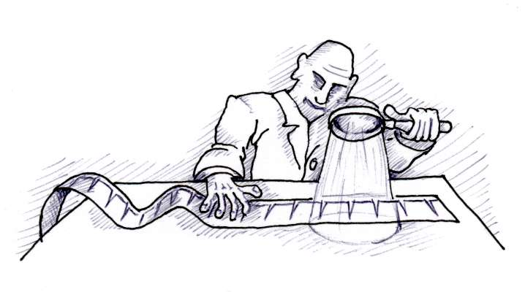


Motivation
MS/MS information is key to study large sample sets with diverse chemistries
Integrated workflow exploits complementary tools to enhance interpretation

Slide 5
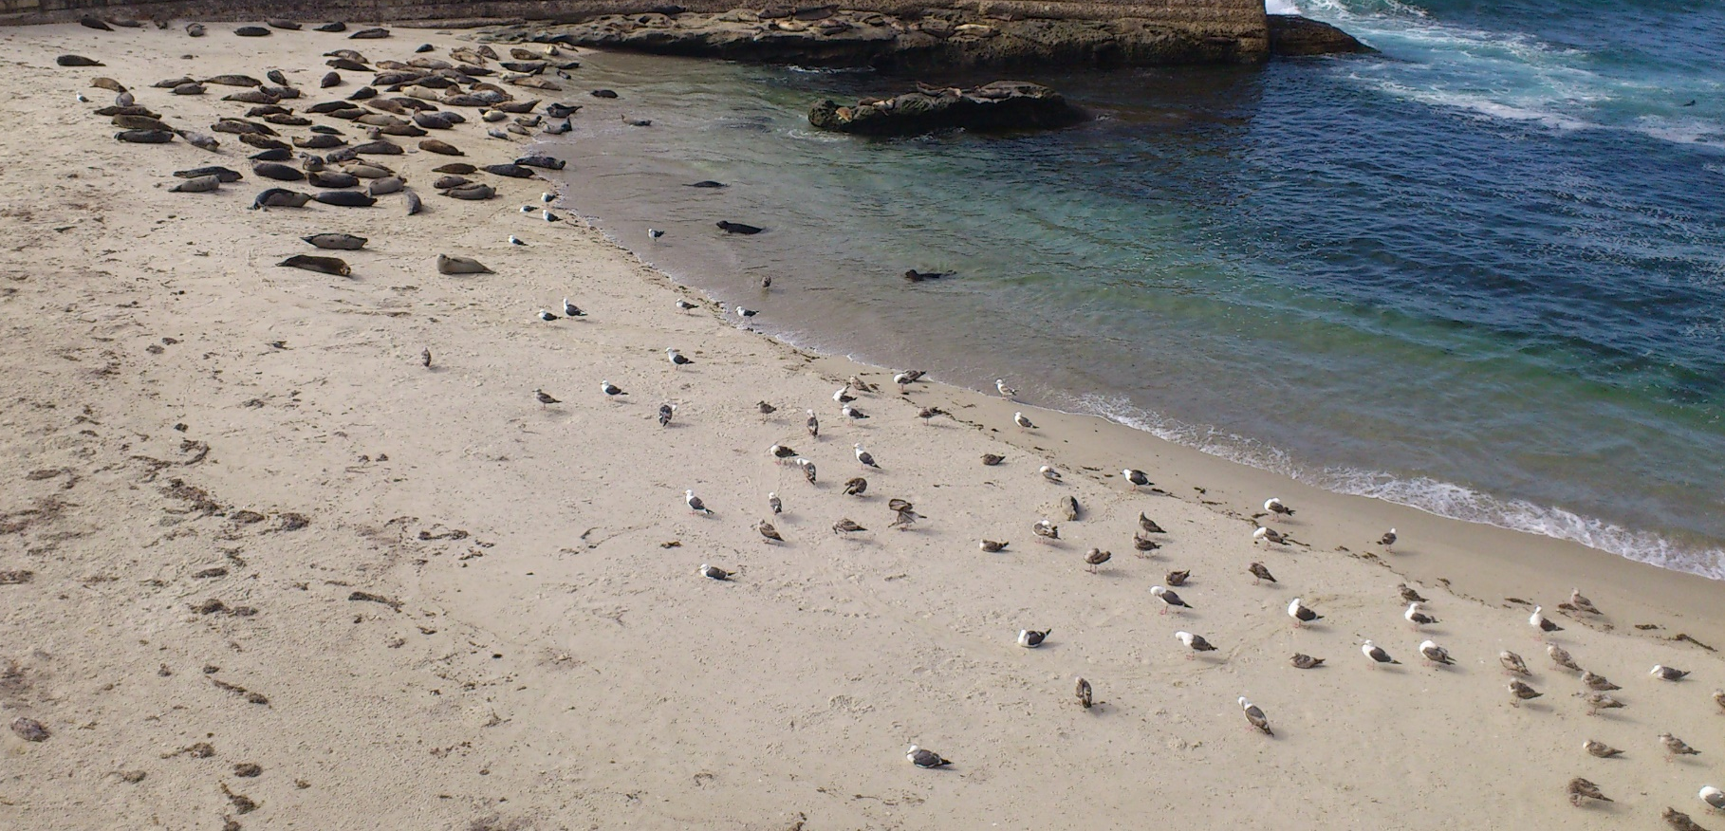
Motivation: Improved annotation power by pattern mining
Molecular Families based on spectral similarity (Molecular Networking in GNPS)
Substructures by extracting “building blocks of metabolomics” (MS2LDA)
Exploit grouping to:
Propagate library matches
Predict candidates
Predict chemistries

Slide 6
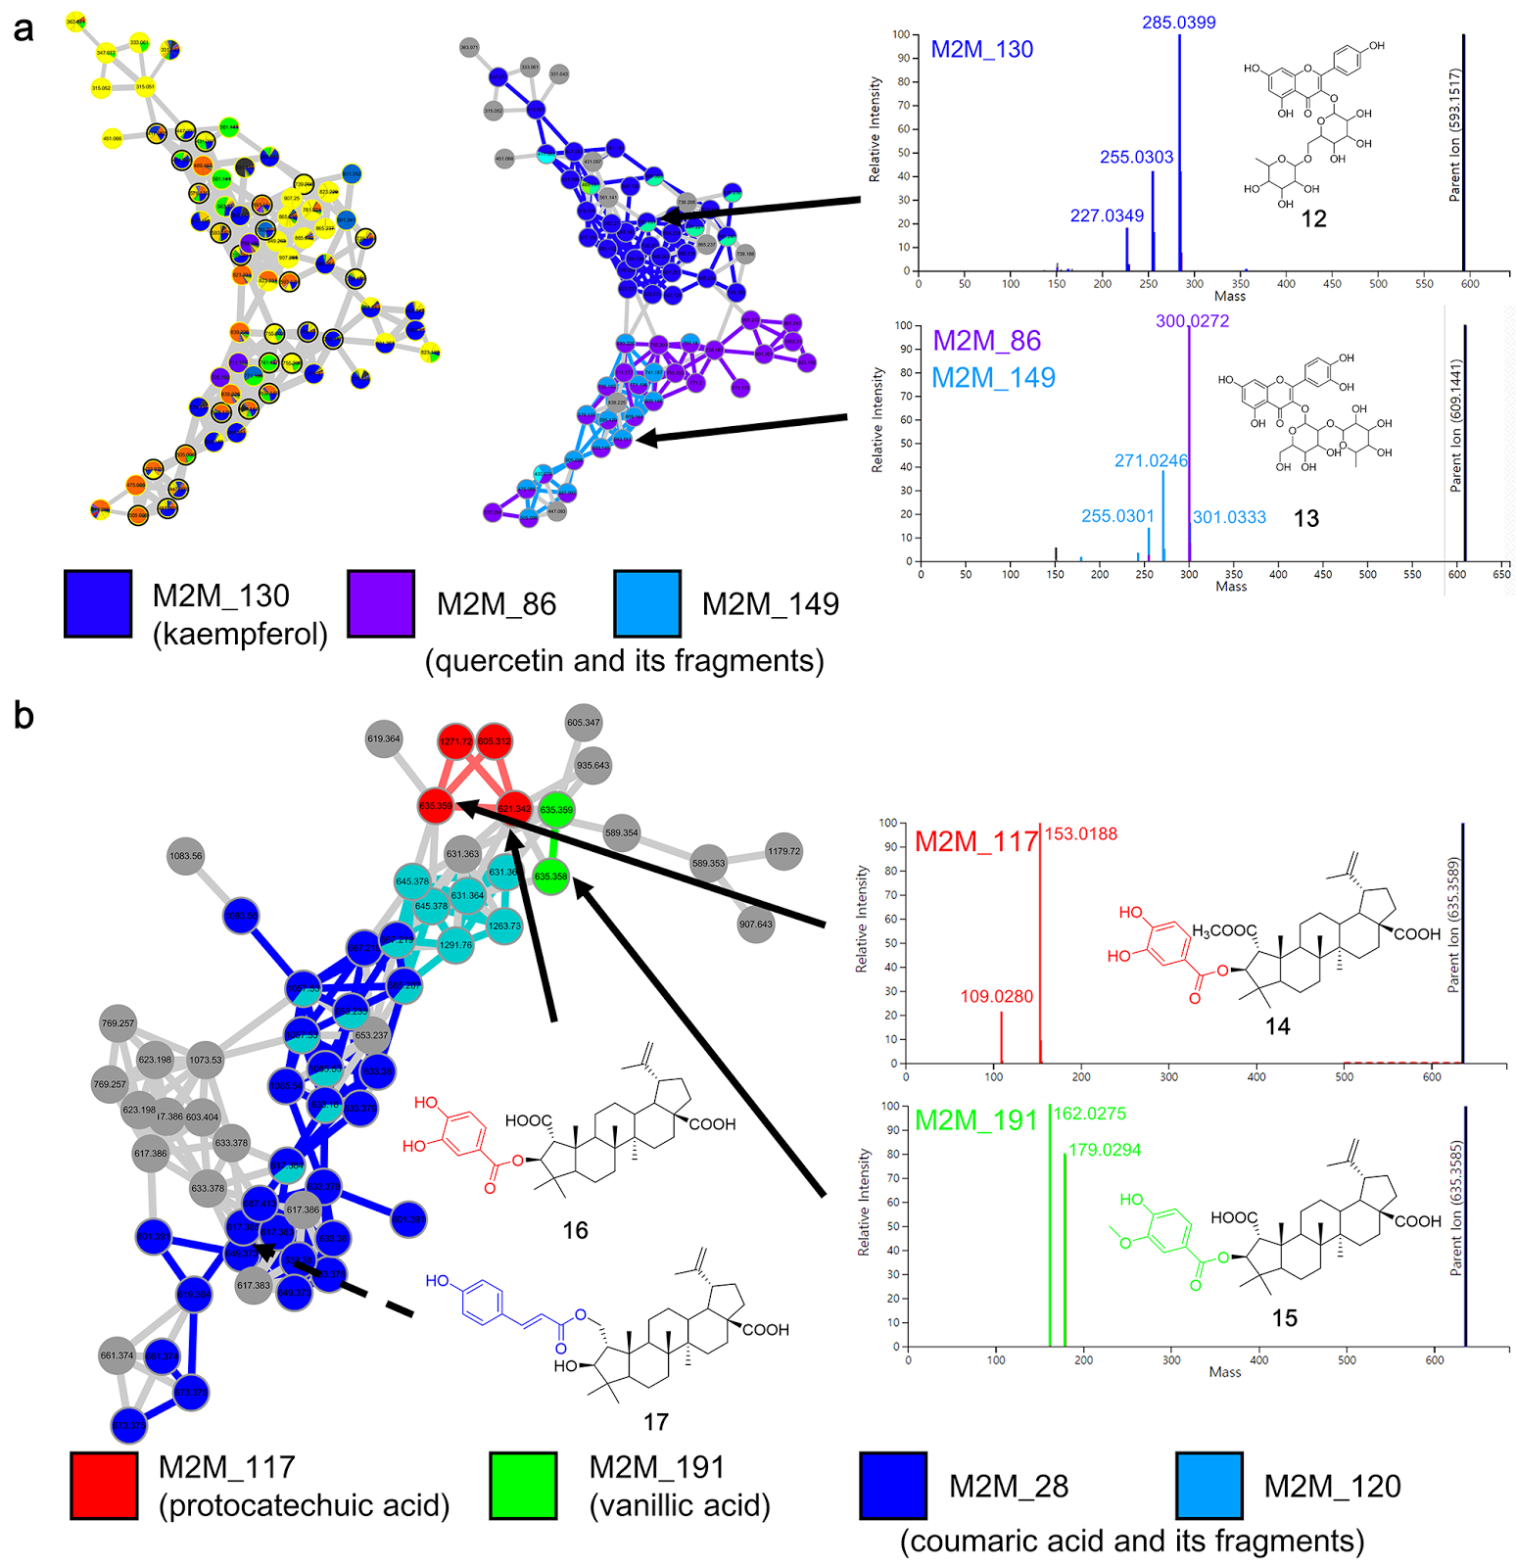
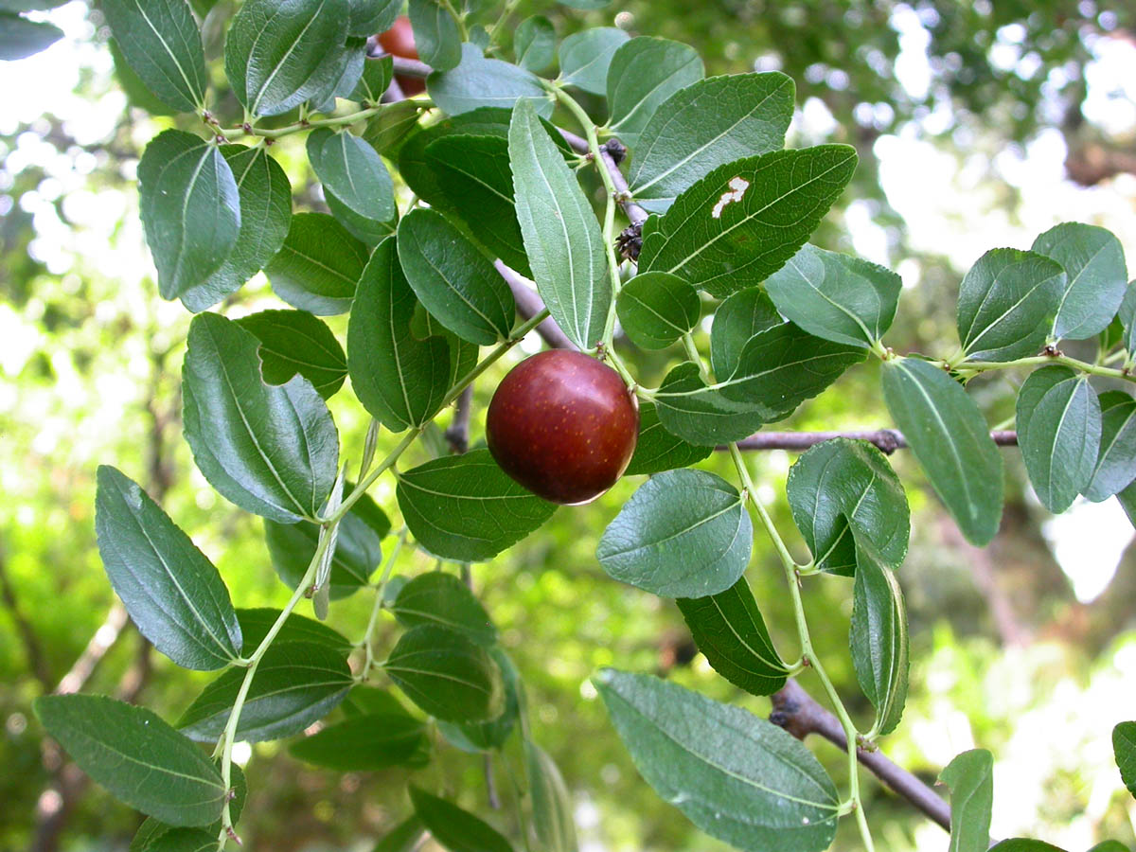

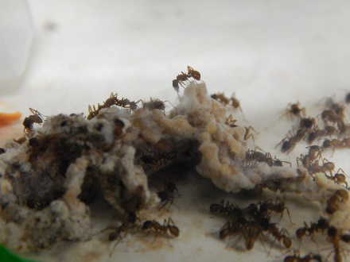
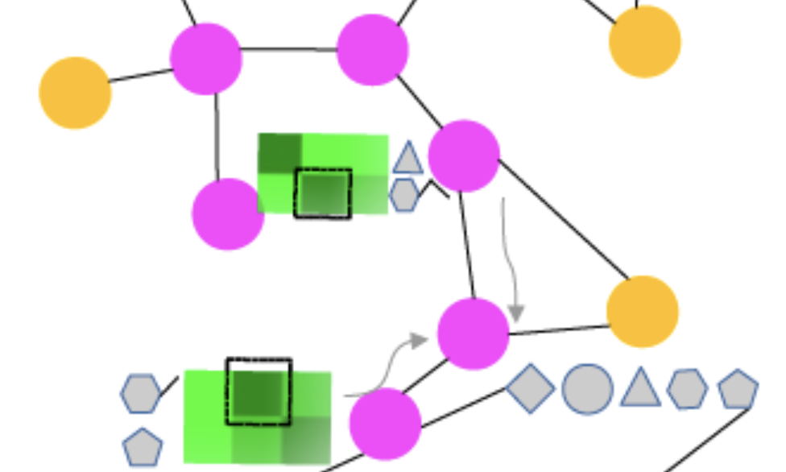
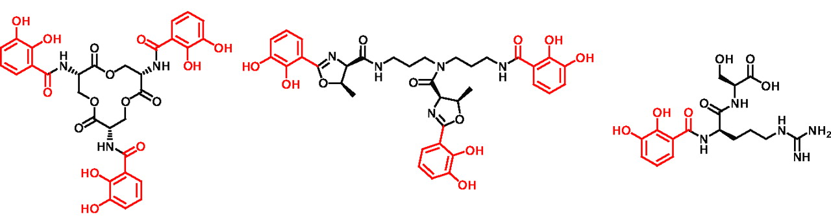
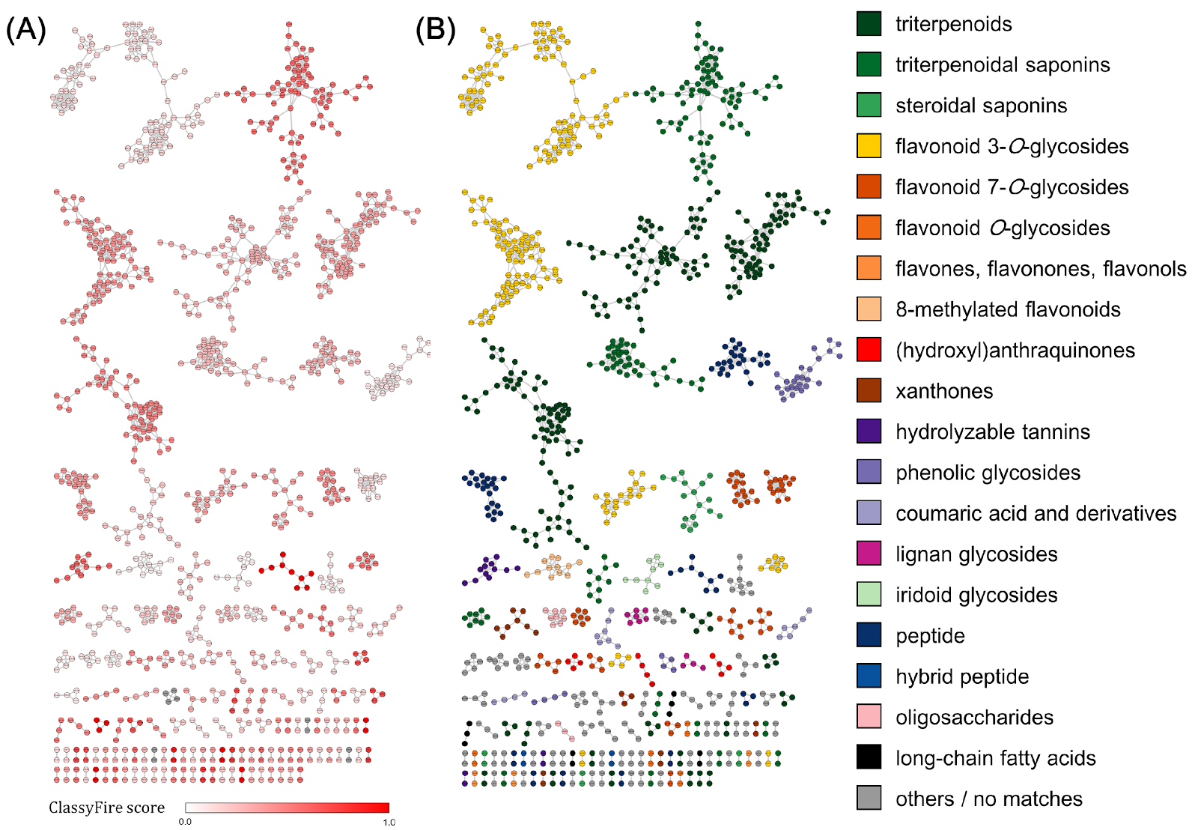

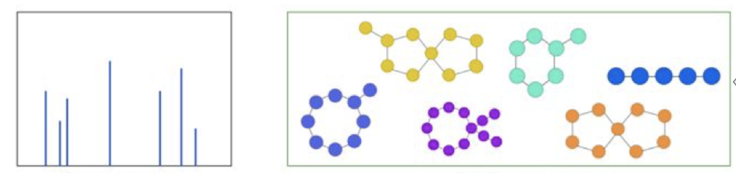
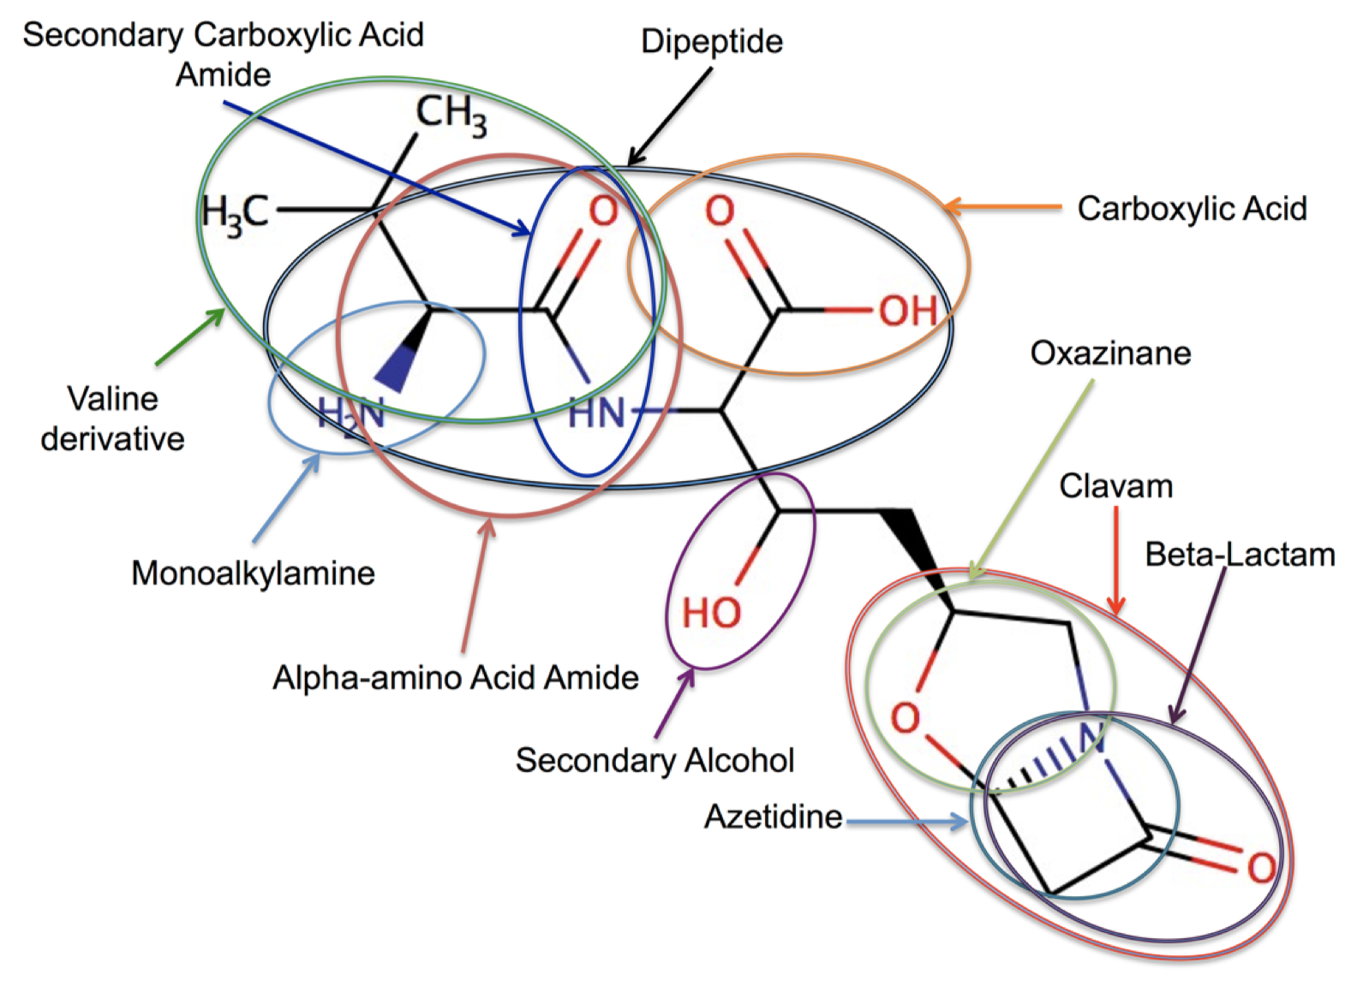
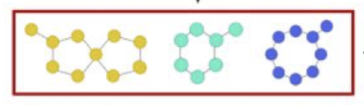
Integrated workflow
Spectrum
Peptide database
Dr Madeleine Ernst, UCSD

Slide 7
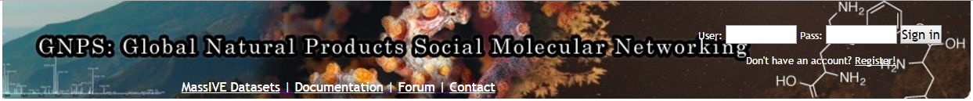
Molecular Networking
Very similar MS/MS spectra are grouped to:
- link spectra across different samples
- reduce redundancy in data set (”consensus spectrum”)
Wang, M., et al., “Sharing and community curation of mass spectrometry
data with Global Natural Products Social Molecular Networking”
Nat Biotech (2016)
Watrous, JD et al. “Mass spectral molecular networking of living
microbial colonies” PNAS (2012)
Dr Ricardo R. da Silva
Dr Madeleine Ernst
Dr Mingxun Wang
Dr Louis-Felix Nothias

Slide 8







0.7
0.3
0.2
0.8
0.5
0.8
0.7
0.9

Slide 9
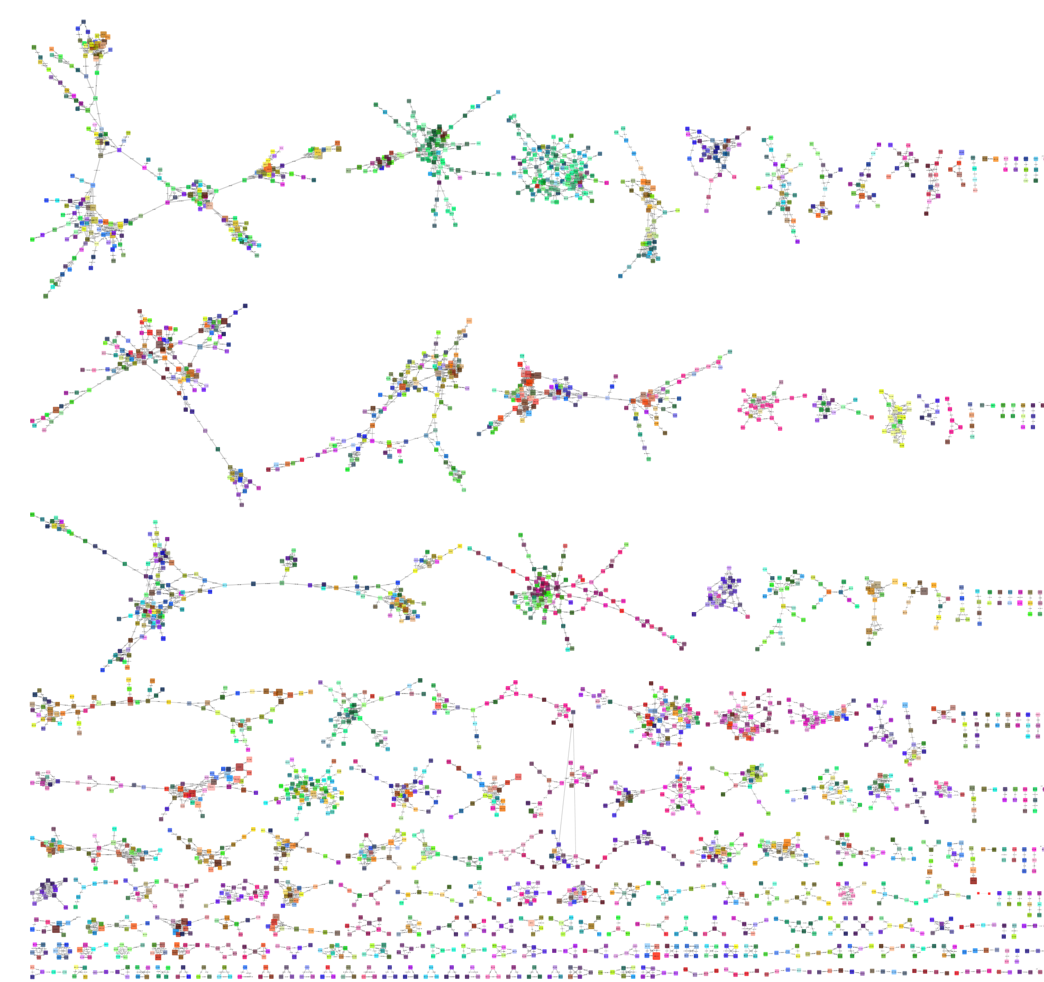
Spectral library matches from GNPS
Libraries from diverse sources
Seed node annotations for molecular families
Library MS/MS Spectra
Diterpenoids
Flavonoids
Pharmaceuticals
MS contaminants

Slide 10
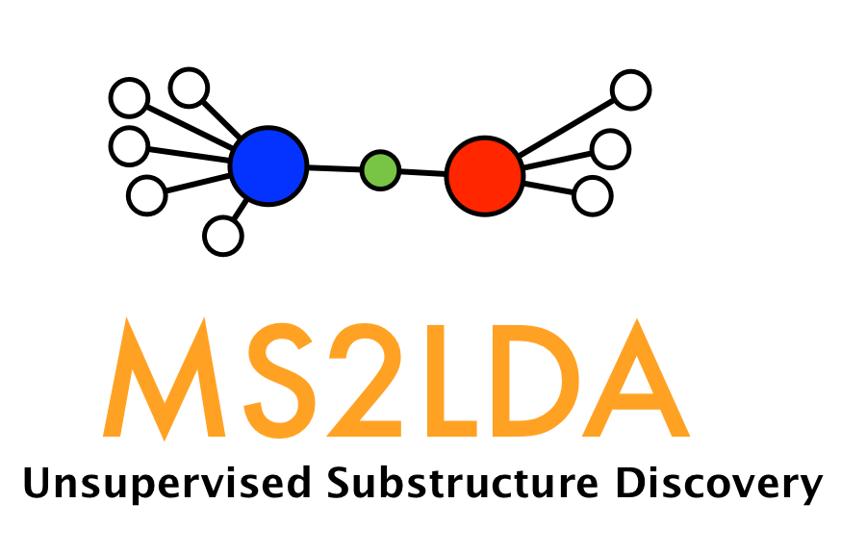
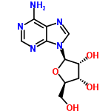
Topic modelling: from text to molecules
Documents <-> molecules
Words <-> fragments/neutral losses
Van der Hooft et al., PNAS, 2016

Slide 11
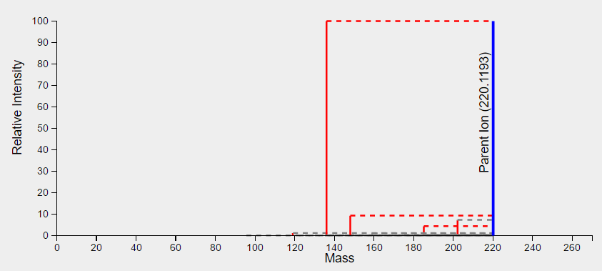
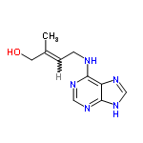
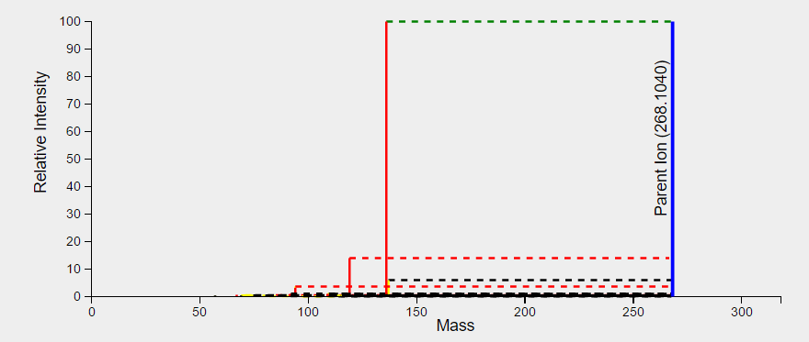
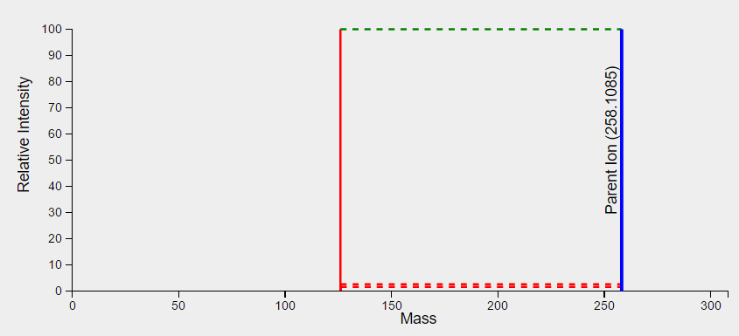
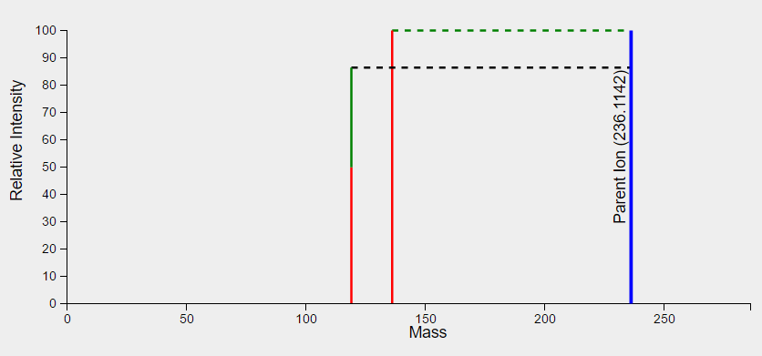
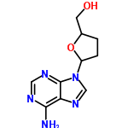
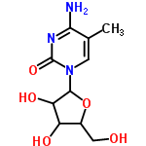
Validation: MS2LDA with standards

Slide 12
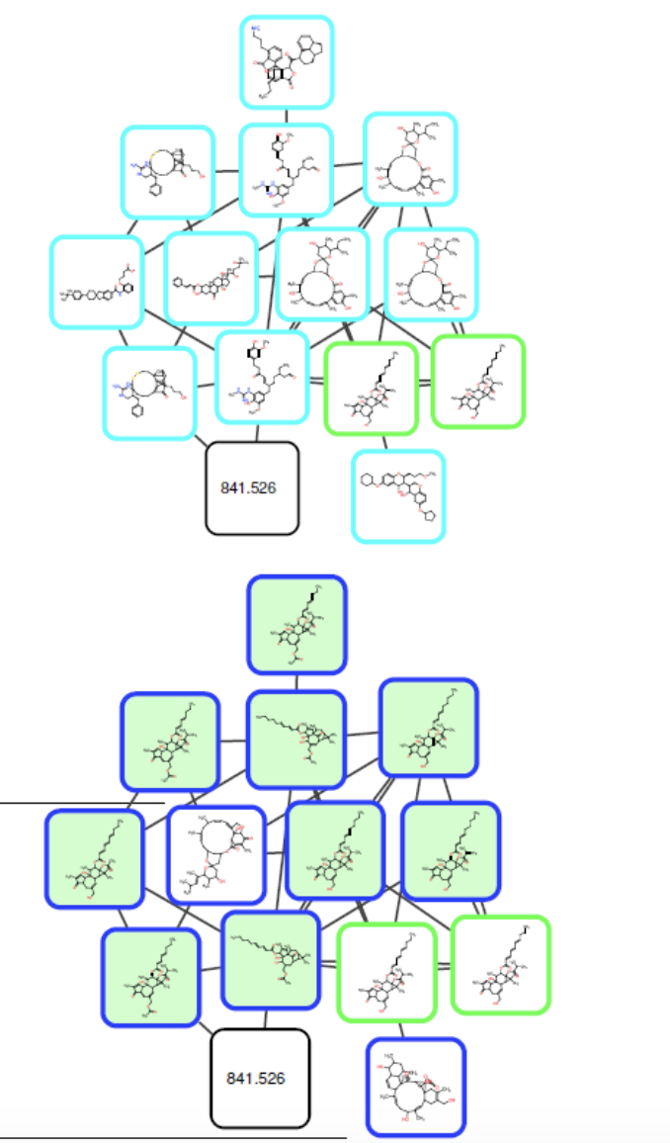
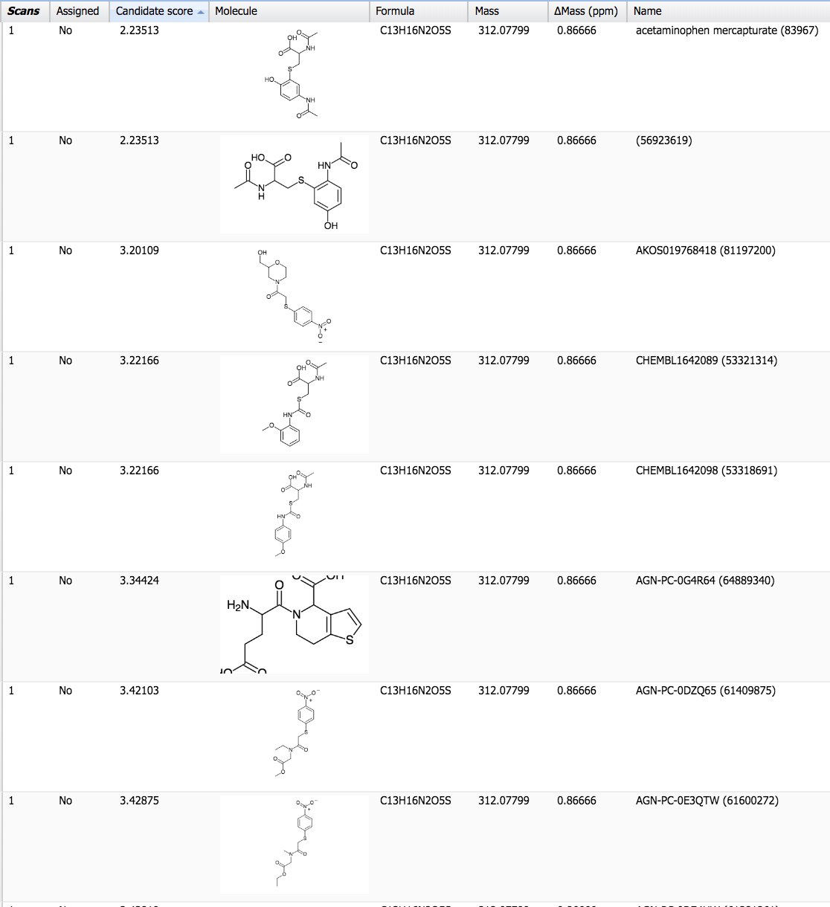
Network annotation propagation
More coherent candidate structures within family
Rerank list based on neighboring annotations
Exploiting the network topology
Without
Network
topology
Molecular Fingerprints
Exploiting
The network
Ranked lists of in silico annotators (MetFrag)
Reranked(!) lists of in silico annotators
Library Match
Da Silva et al., Plos Comp Biol., 2018

Slide 13
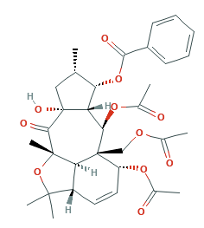
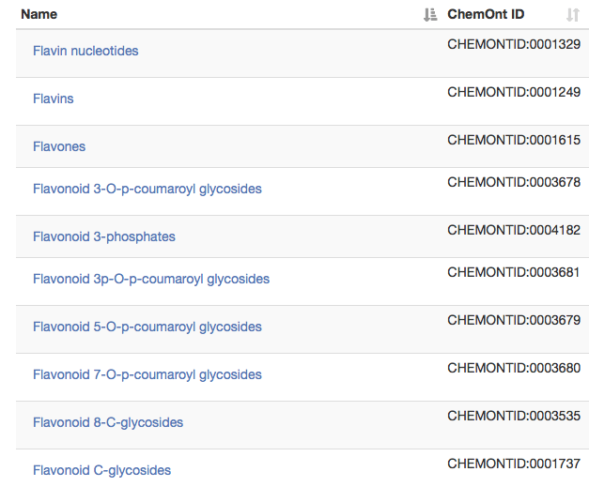
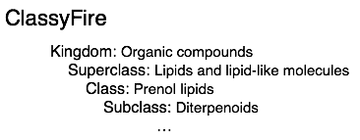
ClassyFire – SMILES and substituents
INPUT:
CC1CC2(C(C1OC(=O)C3=CC=CC=C3)C(C4(C(C=CC5C4C(C2=O)(OC5(C)C)C)OC(=O)C)COC(=O)C)OC(=O)C)O
OUTPUT:
Figure part of Fig. 1 from Djoumbou Feunang et al., J. Cheminform, 2016
Djoumbou Feunang et al., J. Cheminform, 2016

Slide 14
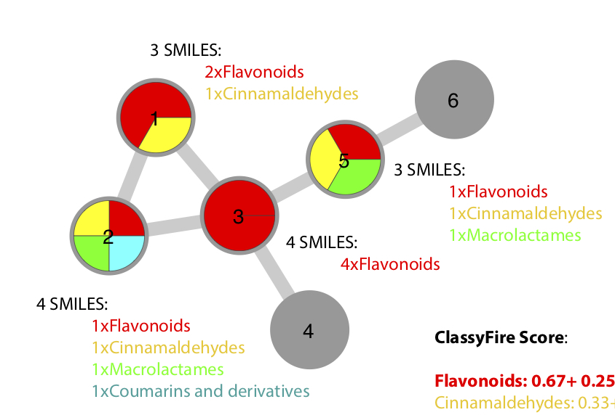
ClassyFire – Chemical predictions for MFs
ClassyFire Scoring:
Flavonoids:
2.25 nodes/
6 nodes =
0.375
Database hits:
4 nodes/
6 nodes =
0.67
Disclaimer: scores dependent on structural database contents!

Slide 15

Illuminating the Rhamnaceae chemistry
Molecular Networking
plant related classifications:
different flavonoids
phenolic glycosides
triterpenoids
Dr Kyo Bin Kang, UCSD

Slide 16
Annotating plant molecular families
Flavonoid-3-O-glycoside Molecular Family:
Differentiation of subfamilies
Kaempferol and Quercetin based
Triterpenoid Molecular Family:
Differentiation of modifications
Protocatechuic acid and Vanillic acid based

Slide 17
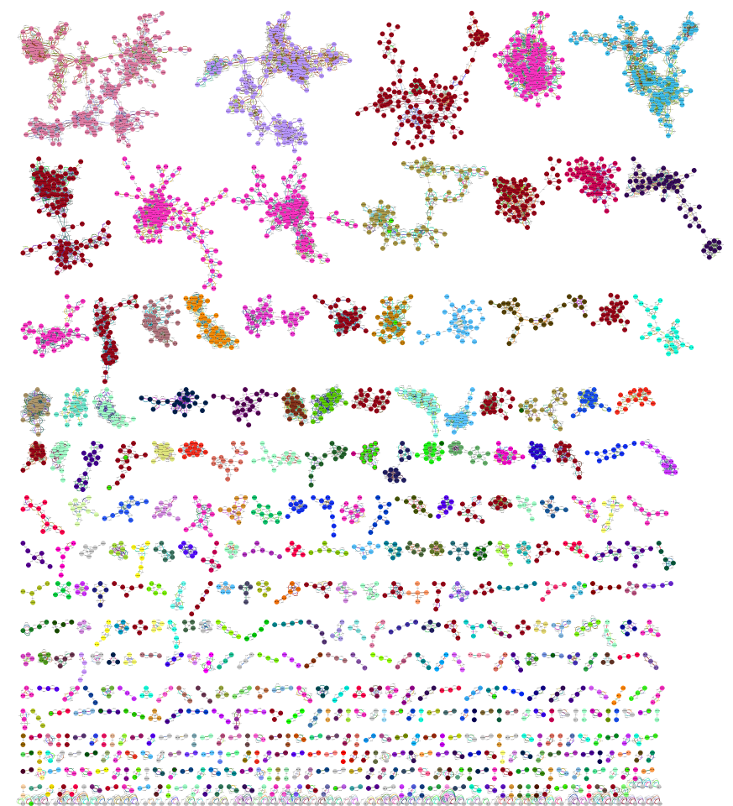
Illuminating bacterial chemistry
Molecular Network of
146 Streptomyces and Salinispora sp.
Triterpenoids
Lipids - PE
DIVERSE
Cyclic peptides
Alpha amino acid esters
and many more….
Crusemann et al., J. Nat. Prod., 2017

Slide 18
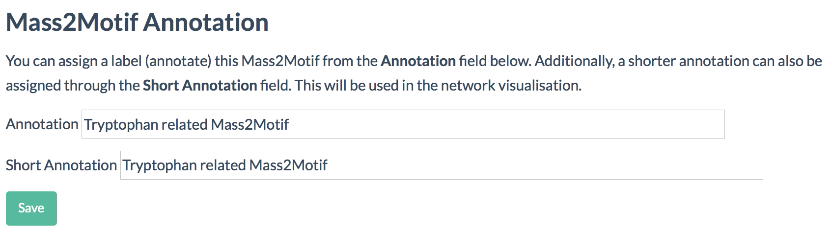
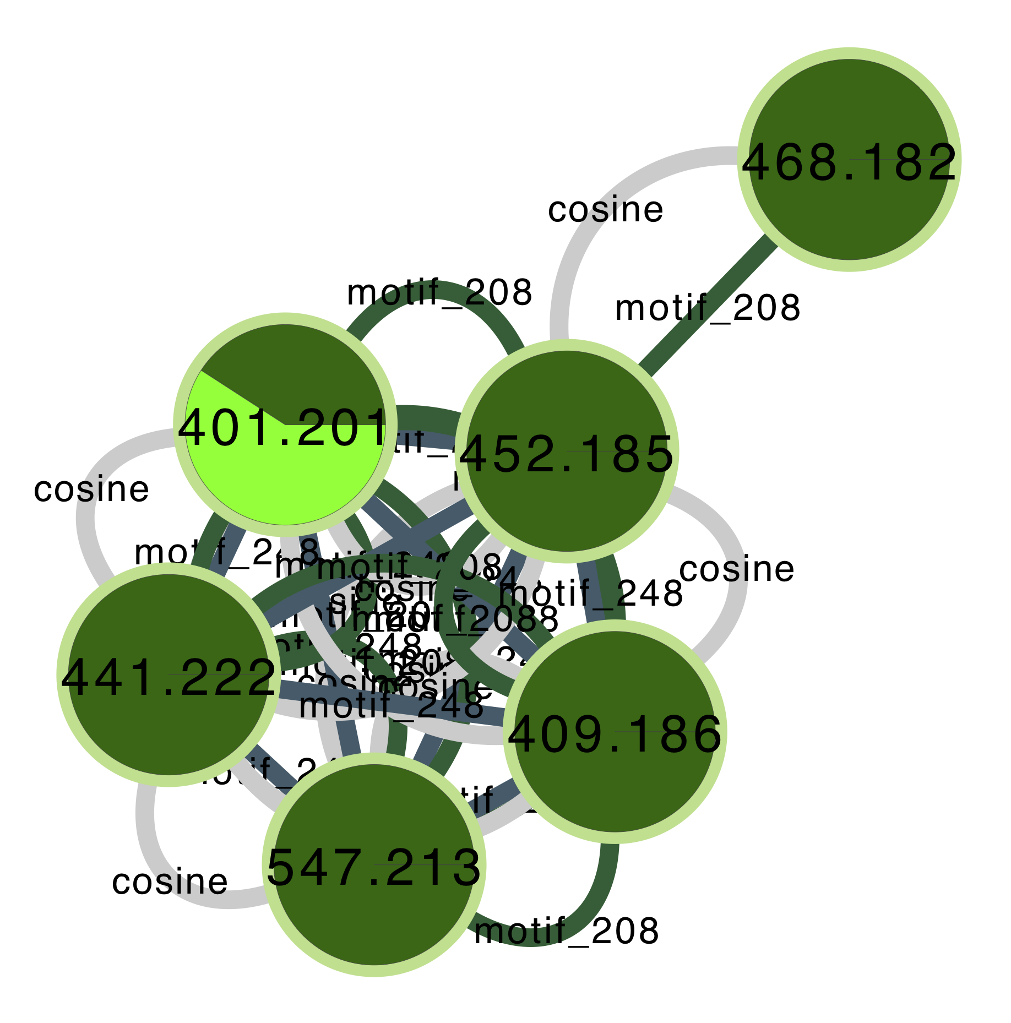
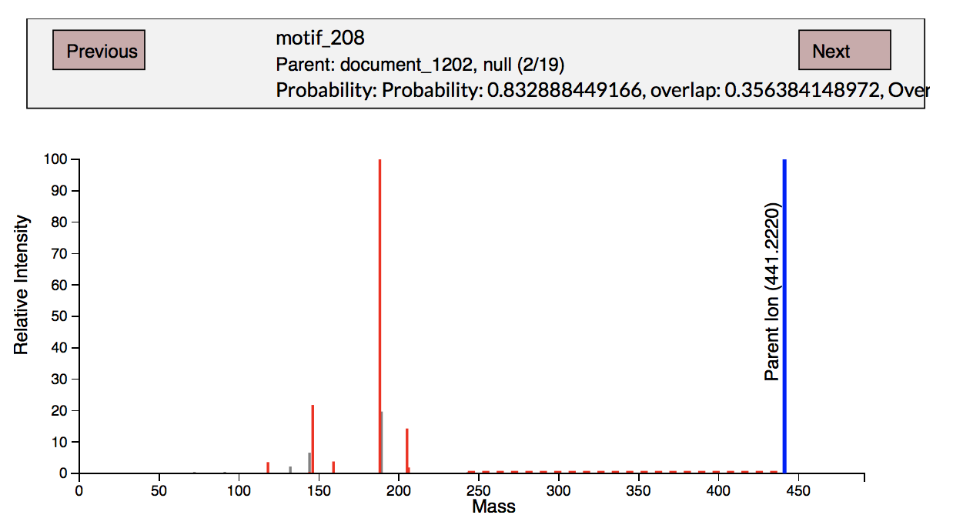
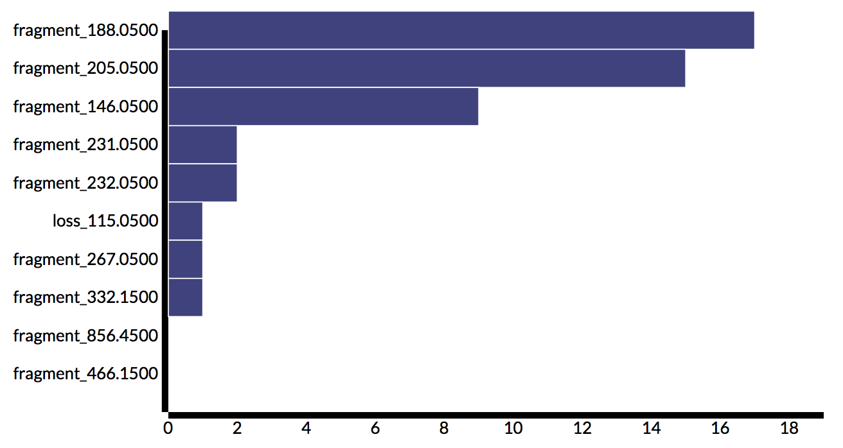
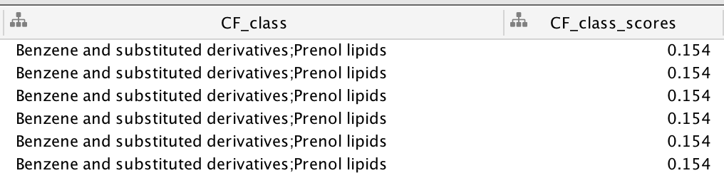
Annotation of bacterial family I
Motif 208

Slide 19
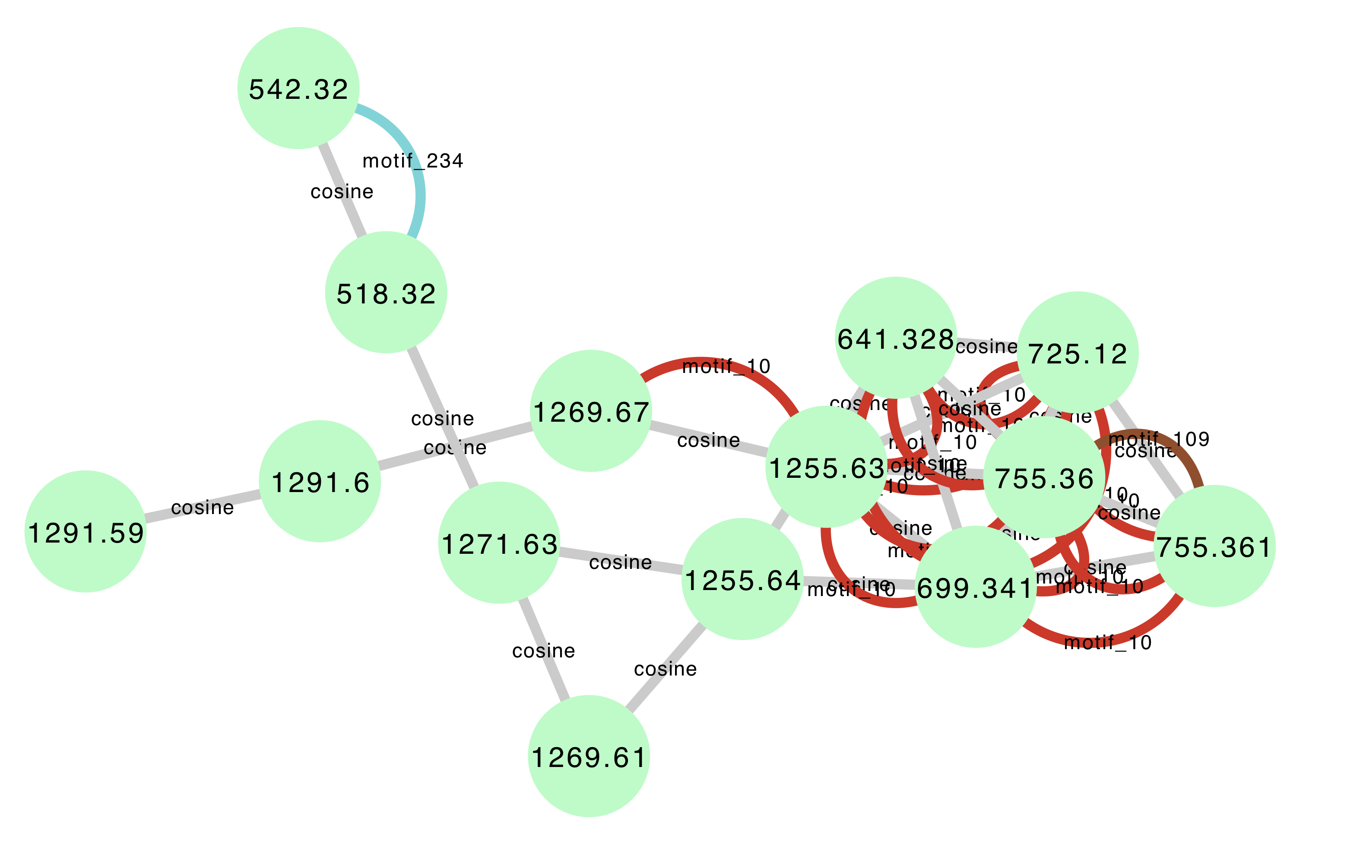
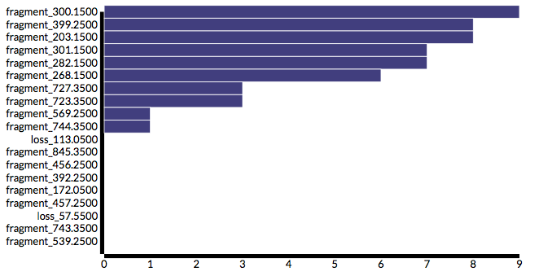
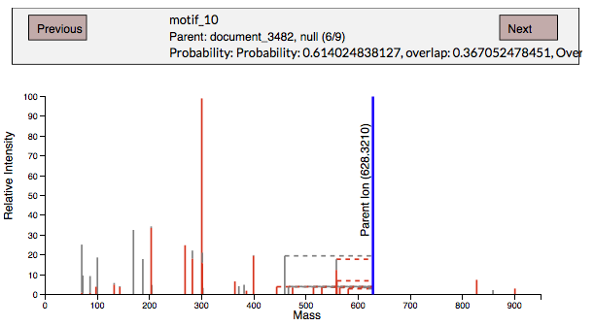
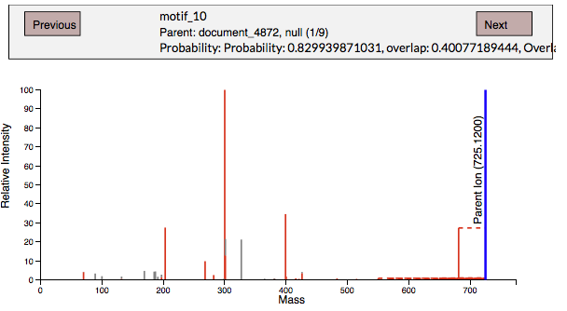

Annotation of bacterial molecular family II
Actinomycin D
Mohimani et al., Nat. Chem. Biol., 2017
Crnovcic et al., RCS Advances, 2014

Slide 20











Annotation of bacterial molecular family III
A Photorhabdus/Xenorhabdus molecular family
Ring
Tail
Xenoamicin A

Slide 21







Annotation of fungal garden molecular family
https://metlin.scripps.edu
N-acyl homoserine lactone

Slide 22



Linking substructures to genetic elements
iOMEGA: Integrated Omics for MEtabolomics and Genomics Annotation
Gene Cluster Families & Metabolite Families
<-->

Slide 23




Thank you!
Special Issue: Metabolomics Data Processing and Data Analysis—Current Best Practices
Deadline for manuscript submissions: 28 February 2019
Guest Editors
Dr. Kati Hanhineva
University of Eastern Finland
Twitter: @KatiHanhineva
Dr. Justin van der Hooft
Wageningen University
Netherlands
Twitter: @jjjvanderhooft
Keywords
Metabolomics data processing data interpretation annotation and visualization data analysis

