Slide 1
The Use of Mitochondrial Metabolomics via Combined GC/LC-MS Profiling to Reveal Metabolic Dysfunctions in sym1-deleted Yeast Cells
Daqiang Pan ^{1,2}, Caroline Lindau ³, Nils Wiedemann ³ and Bernd Kammerer ^{1,*}
¹ Center for Biological Systems Analysis ZBSA, Albert-Ludwigs-University Freiburg, 79104 Freiburg, Germany;
² Institute of Pharmaceutical Sciences, Albert-Ludwigs-University Freiburg, 79104 Freiburg, Germany;
³ Institute of Biochemistry and Molecular Biology, ZBMZ, Faculty of Medicine, University of Freiburg, 79104 Freiburg, Germany.
* Corresponding author: bernd.kammerer@zbsa.uni-Freiburg.de

Slide 2
Introduction
SYM1…
is an ortholog of human MPV17, whose mutation causes mitochondrial DNA depletion syndrome [1]
encodes a channel protein, which is located in the inner mitochondrial membrane [2,3]
[1] Trott et al., 2004. [2] Spinazzola et al., 2006. [3] Reinhold et al., 2012.
[4] Dallabona et al., 2010. [5] Dalla Rosa et al., 2016. [6] Antonenkov et al., 2015.

Slide 3
Introduction
SYM1…
is an ortholog of human MPV17, whose mutation causes mitochondrial DNA depletion syndrome [1]
encodes a channel protein, which is located in the inner mitochondrial membrane [2,3]
However, the function of sym1/mpv17 protein is still unknown. Their deletion or mutation results in…
impaired mitochondrial bioenergetics functions and morphological features [4]
insufficiency of deoxynucloetide and slow DNA replication in mitochondria [5]
[1] Trott et al., 2004. [2] Spinazzola et al., 2006. [3] Reinhold et al., 2012.
[4] Dallabona et al., 2010. [5] Dalla Rosa et al., 2016. [6] Antonenkov et al., 2015.

Slide 4
Introduction
SYM1…
is an ortholog of human MPV17, whose mutation causes mitochondrial DNA depletion syndrome [1]
encodes a channel protein, which is located in the inner mitochondrial membrane [2,3]
However, the function of sym1/mpv17 protein is still unknown. Their deletion or mutation results in…
impaired mitochondrial bioenergetics functions and morphological features [4]
insufficiency of deoxynucloetide and slow DNA replication in mitochondria [5]
Hypothesis about sym1/mpv17…
Sym1 channel transports metabolic intermediates into and out of mitochondria [4]
Mpv17 is a weakly cation-selective channel that modulates membrane potential[6]
[1] Trott et al., 2004. [2] Spinazzola et al., 2006. [3] Reinhold et al., 2012.
[4] Dallabona et al., 2010. [5] Dalla Rosa et al., 2016. [6] Antonenkov et al., 2015.

Slide 5
Introduction
Mitochondrial metabolomics
Isolation of mitochondria and the rest of cytoplasm before metabolomics analysis
Compartment-specific distribution and regulation of metabolites could be observed [7, 8]
[7] Chen et al., 2016. [8] Pan et al., 2018.

Slide 6
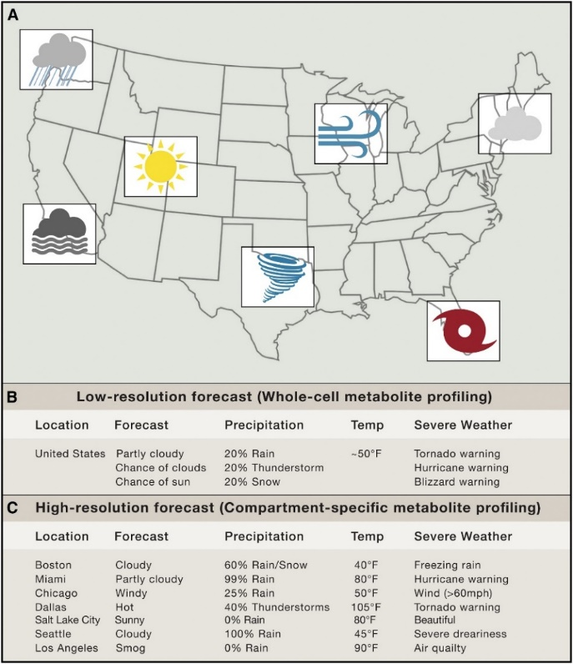
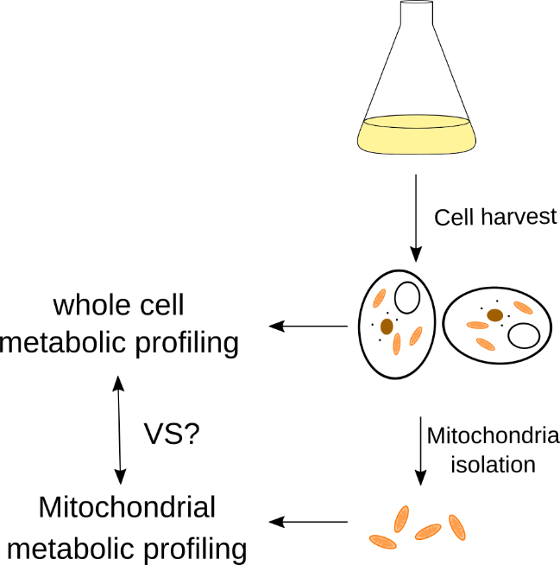
Introduction
Mitochondrial metabolomics
Isolation of mitochondria and the rest of cytoplasm before metabolomics analysis
Compartment-specific distribution and regulation of metabolites could be observed [7, 8]
Weather in different regions of a country
Metabolites in different parts of cells
[9] Van Vranken and Rutter, 2016
[7] Chen et al., 2016. [8] Pan et al., 2018.

Slide 7
Workflow
Mitochondria isolation

Slide 8
Workflow
Mitochondria isolation
Metabolic profiling using LC/GC-MS

Slide 9
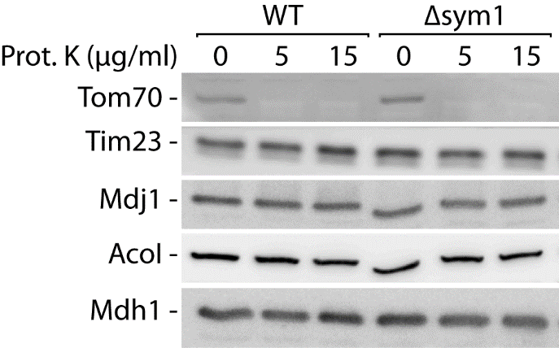
Results and Discussion
Mitochondrial inner membrane was intact after the isolation
After proteinase K incubation Tom70 were depleted, while Tim23 and other marker proteins were maintained, indicating an intact mitochondrial inner membrane.
Tom: protein translocase of mitochondrial outer membrane
Tim: protein translocase of mitochondrial inner membrane
Mdj: mitochondrial DnaJ (HSP40) family
Aco: aconitase
Mdh1: mitochondrial malate dehydrogenase

Slide 10
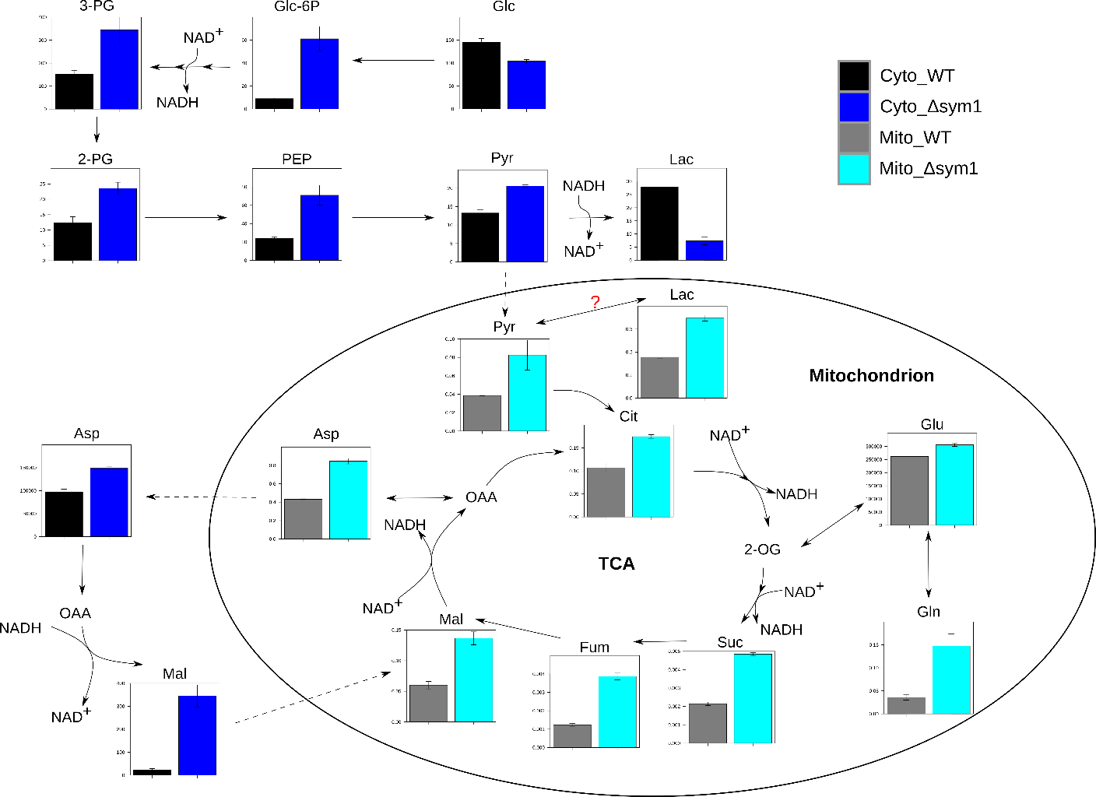
Results and Discussion
Impaired energy metabolism in Δsym1 cells
Upregulated/accumulated glycolysis and TCA cycle intermediates

Slide 11
Results and Discussion
Impaired energy metabolism in Δsym1 cells
Upregulated/accumulated glycolysis and TCA cycle intermediates
Lactate was reduced in cytosol but accumulated in mitochondria

Slide 12
Results and Discussion
Impaired energy metabolism in Δsym1 cells
Upregulated/accumulated glycolysis and TCA cycle intermediates
Lactate was reduced in cytosol but accumulated in mitochondria
Highly accumulated cytosolic malate

Slide 13
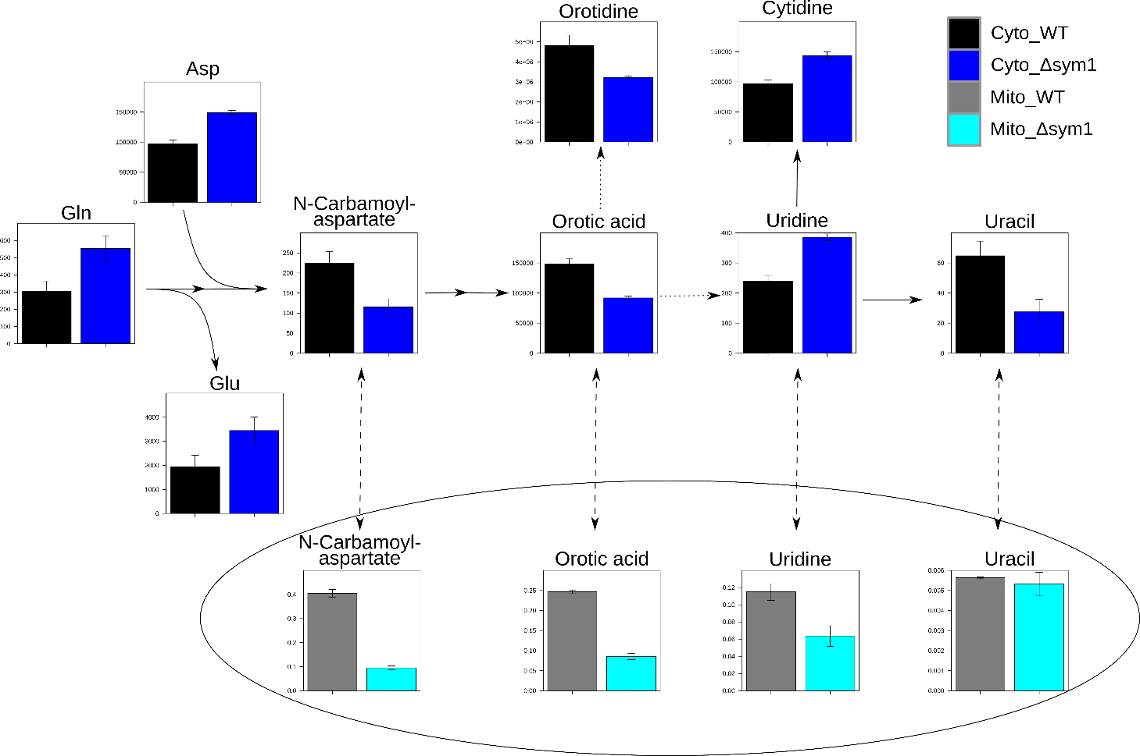
Results and Discussion
Impaired pyrimidine metabolism
Reduction of most of the pyrimidine biosynthesis intermediates
?
?
?
?

Slide 14
Results and Discussion
Impaired pyrimidine metabolism
Reduction of most of the pyrimidine biosynthesis intermediates
Accumulation of cytosolic uridine
May be related to the mDNA deletion syndrome
?
?
?
?

Slide 15
Results and Discussion
Impaired lysine biosynthesis/metabolism
Accumulation of 2-amminoadipic acid (2-AAA) and saccharopine (Sarop) and reduction of lysine indicate an interrupted lysine biosynthesis/metabolism.

Slide 16
Results and Discussion
Impaired lysine biosynthesis/metabolism
Accumulation of 2-amminoadipic acid (2-AAA) and saccharopine (Sarop) and reduction of lysine indicate an interrupted lysine biosynthesis/metabolism.
Given that cells can take up lysine from the medium, a drop test will be investigated to prove the hypothesis.

Slide 17
Results and Discussion
Δsym1 yeast cells have a defective lysine biosynthesis
SCgal
-Lys
BY4741
Δsym1
SCgal
BY4741
Δsym1
SCgal
-Arg
BY4741
Δsym1
Serial dilution of yeast cells
SCGal (mimimal medium with galactose as carbon source) plates were incubated at 30 °C, 40 hours
Other plates at 19 °C and 23 °C showed the same effect. (data not shown here)

Slide 18
Results and Discussion
Δsym1 yeast cells have a defective lysine biosynthesis
SCgal
-Lys
BY4741
Δsym1
Δsym1 yeast failed to grow on plate without lysine, supporting the hypothesis that the lysine biosynthesis is arrested.
SCgal
BY4741
Δsym1
SCgal
-Arg
BY4741
Δsym1
Serial dilution of yeast cells
SCGal (mimimal medium with galactose as carbon source) plates were incubated at 30 °C, 40 hours
Other plates at 19 °C and 23 °C showed the same effect. (data not shown here)

Slide 19
Results and Discussion
Δsym1 yeast cells have a defective lysine biosynthesis
SCgal
-Lys
BY4741
Δsym1
Δsym1 yeast failed to grow on plate without lysine, supporting the hypothesis that the lysine biosynthesis is arrested.
SCgal
BY4741
Δsym1
SCgal
-Arg
BY4741
Δsym1
Interestingly, sym1 protein is not correlated with lysine biosynthesis, so what can be the reason for this fatal effect?
Serial dilution of yeast cells
SCGal (mimimal medium with galactose as carbon source) plates were incubated at 30 °C, 40 hours
Other plates at 19 °C and 23 °C showed the same effect. (data not shown here)

Slide 20
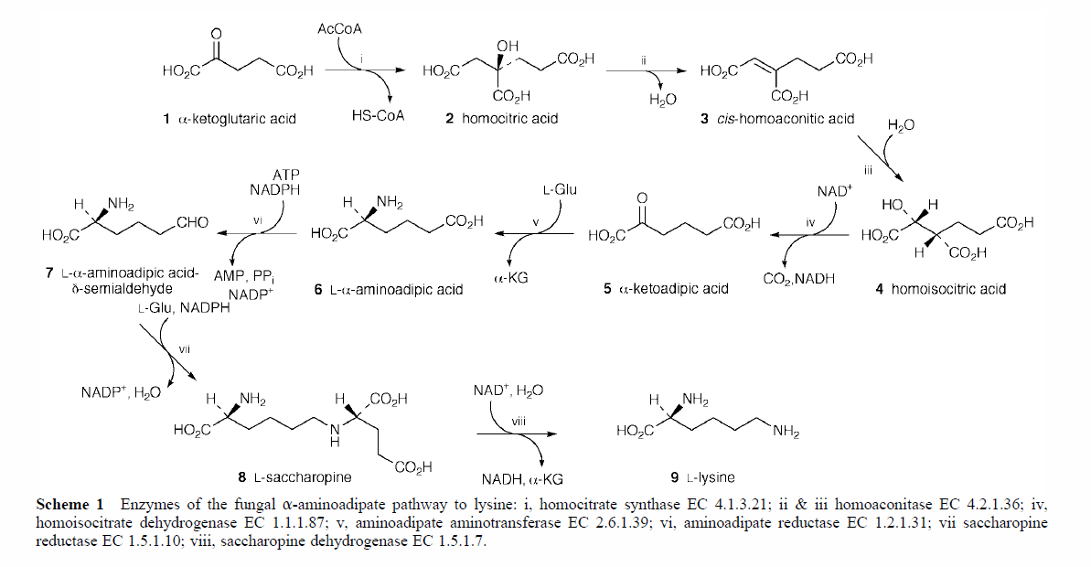
Results and Discussion
Yeast lysine biosynthesis
[10] Zabriskie and Jackson, 2000.

Slide 21
Results and Discussion
Potential reasons for the defective lysine biosynthesis in Δsym1 cells
Accumulated intermediates and reduced lysine indicates a defect in the last step
[10] Zabriskie and Jackson, 2000.

Slide 22
Results and Discussion
Potential reasons for the defective lysine biosynthesis in Δsym1 cells
Inhibited or down-regulated saccharopine dehydrogenase
[10] Zabriskie and Jackson, 2000.

Slide 23
Results and Discussion
Potential reasons for the defective lysine biosynthesis in Δsym1 cells
Changed redox state in cytosol results in reduced NAD⁺ and accumulated NADH
This is correlated with the accumulated glycolysis and reduced lactate
NAD⁺ is regenerated by reducing pyruvate to lactate, which is apparently inhibited in Δsym1 cells
[10] Zabriskie and Jackson, 2000.

Slide 24
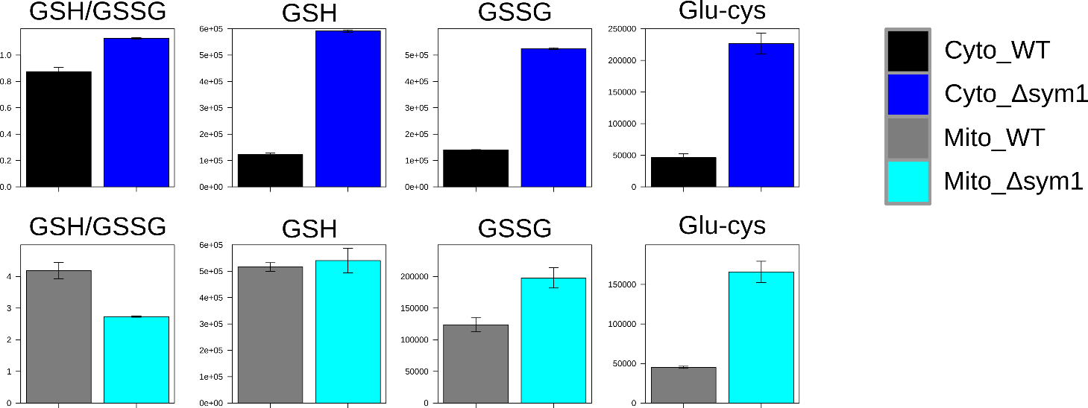
Results and Discussion
Altered glutahione metabolism indicates a imbalanced redox state
Increased cytosolic GSH/GSSG ratio
Reduced mitochondrial GSH/GSSG ratio
Overall upregulated/accumulated glutathione fluxes

Slide 25
Outlook
NAD(P)H assay to identify the Redox state in the mitochondria and cytosol
Application of proteomics to interesting candidates
Application of isotope-labeled metabolites to track the altered pathways
Screening of about 50 unknown mitochondrial membrane protein knockouts
Automatization the search of candidates by python script to find out significant altered metabolites from the screening

Slide 26
Acknowledgements
Prof. Dr Bernd Kammerer
Prof. Dr Nils Wiedemann
Prof. Dr Stefan Günther
Caroline Lindau
CF Metabolomics:
Simon Lagies
Michel Karther
Christoph Bauer
Mannuel Schlimpert
Johannes Plagge
Lukas Braun

