Slide 1
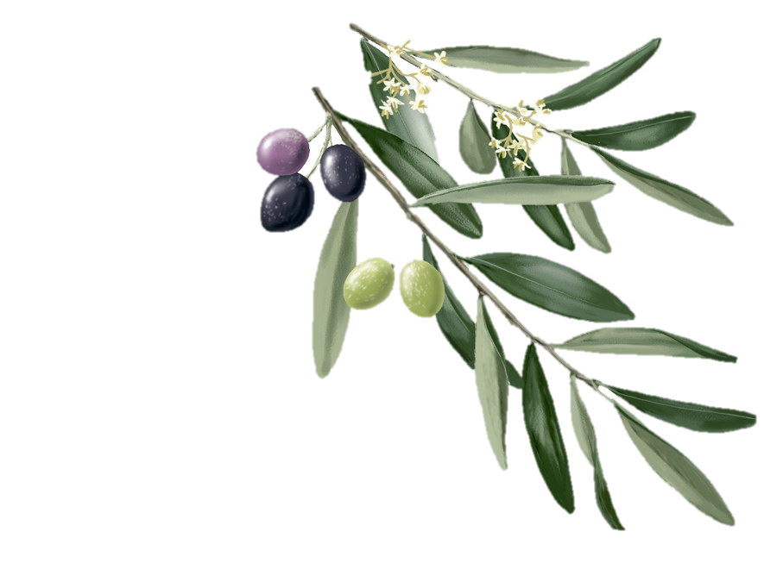
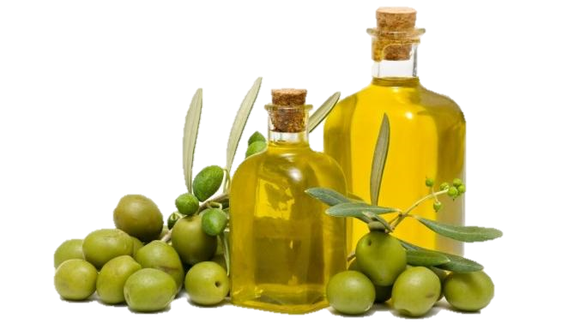
Can the increment of temperature associated to climate change alter the olive oil chemical composition and its nutritional and nutraceutical properties?
Rosa Sánchez-Lucas^{1,}*, Cristina López-Hidalgo¹, María Benlloch-González², and Jesús V. Jorrín-Novo¹
¹ Dpt. Biochemistry and Molecular Biology: AGR-164; University of Cordoba (Spain)
² Dpt. Agronomy: AGR-174; University of Cordoba (Spain).
* g82salur@uco.es

Slide 2
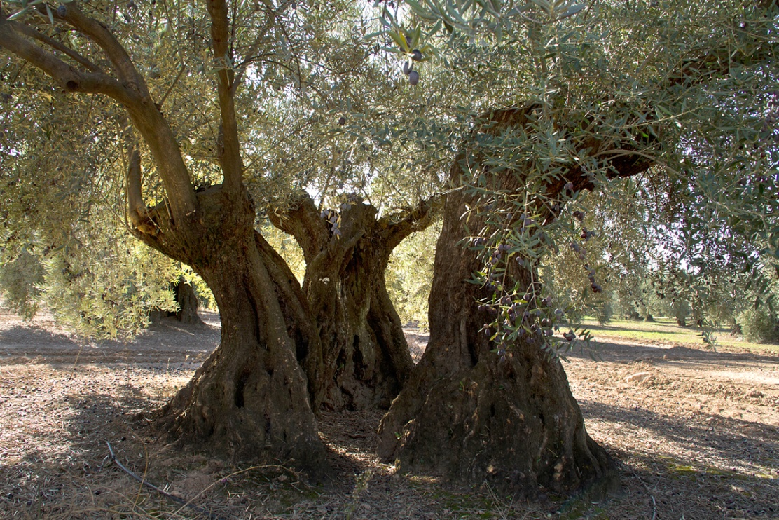
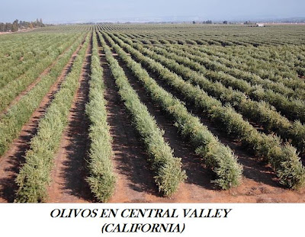
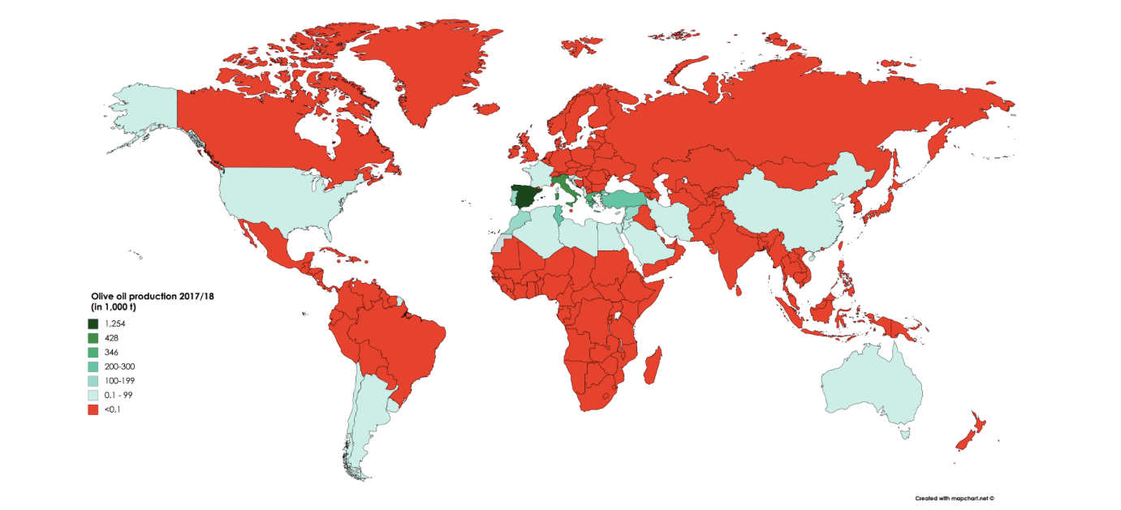
Introduction
Olive tree as experimental system
Strategic crop for Spain.
3 major varieties.
Arbequina
Hojiblanca
Picual
Olive oil production (1000 t)

Slide 3
Olive oil as nutraceutical food product
Olive oil = olive juice without chemical extraction or aditives.
High content FA (unsaturated) and low content FFA
High content of polyphenols (antioxidant power) .
Different vitamins, sterols, pigments…

Slide 4
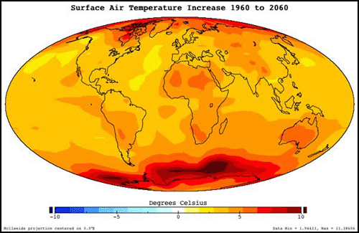
Thermal stress
Climate change scenarios
Thermal increase
Mediterranean area with several damages.

Slide 5
Objectives
To study how thermal increase (+4ºC) affected to the development, maturity and organoleptic properties of olive fruits through phenology, morphometry and biomolecular approaches.
Metabolite profiles of ripening stages: i) green fruits; ii) turning red; iii) and purple pigmentation, were analyzed by UHPLC/qTOF strategy.
To identify the principal metabolites affected by thermal increase and that play a role in the quality of the oil (organoleptic and nutraceutical characteristics).

Slide 6
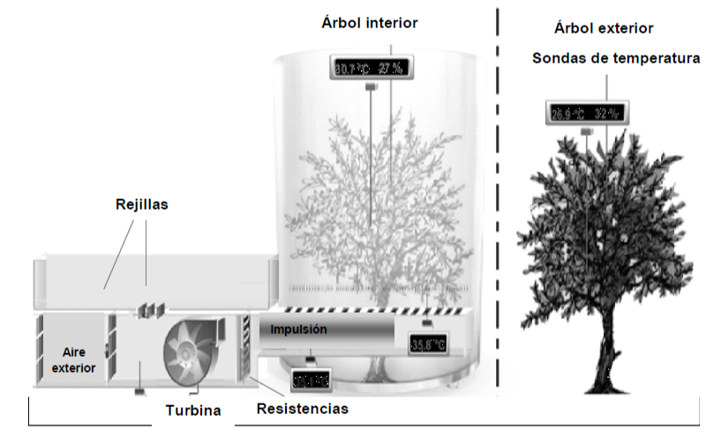
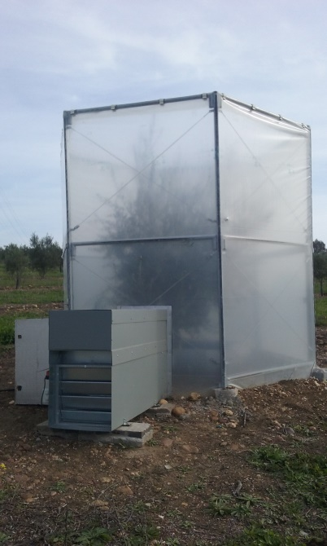
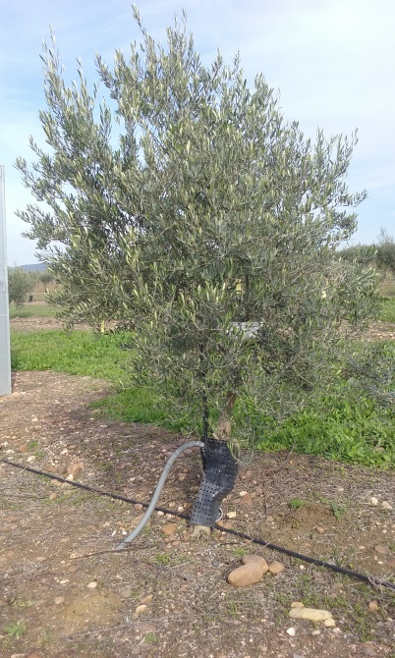
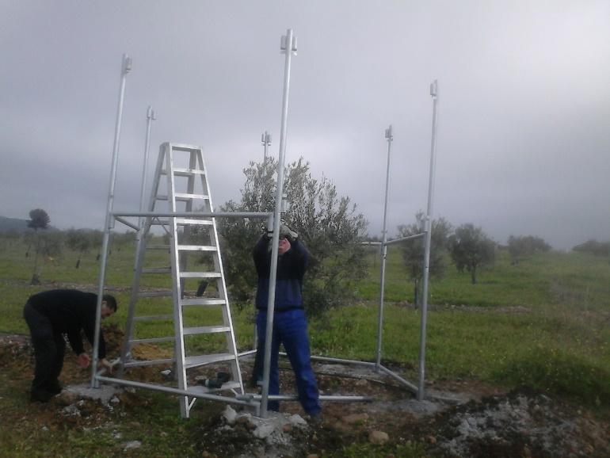
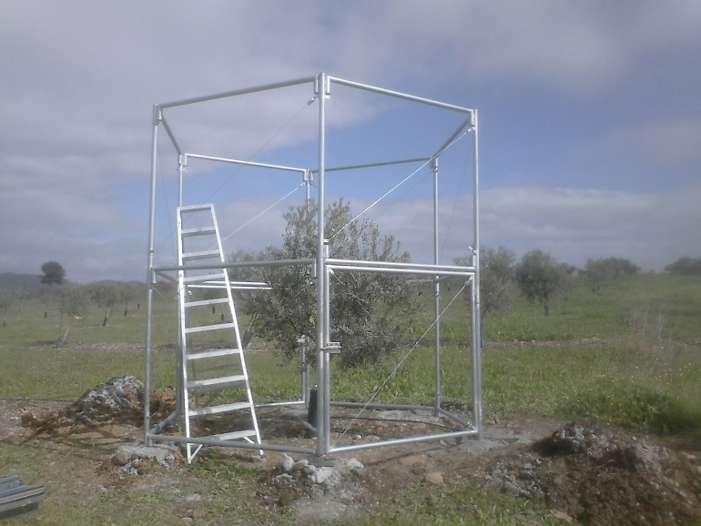
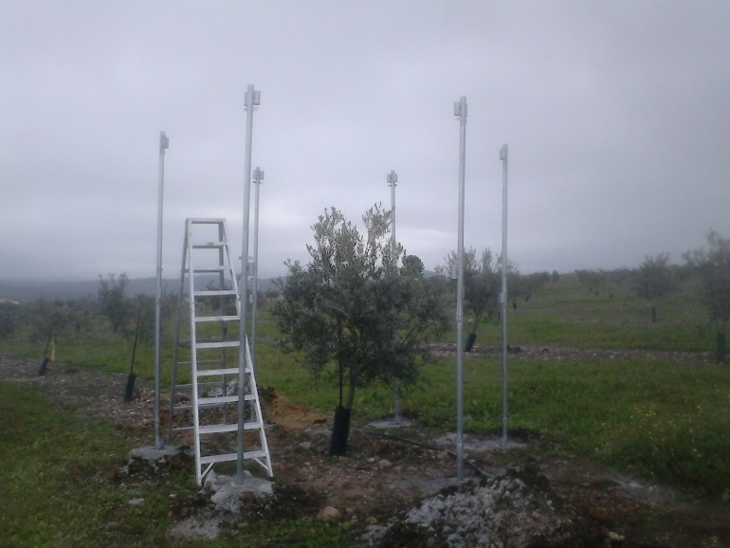
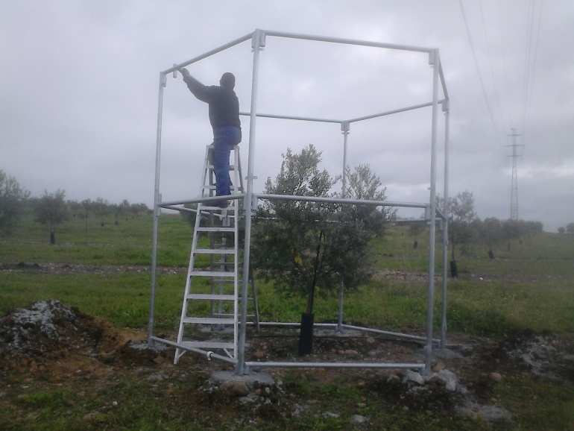
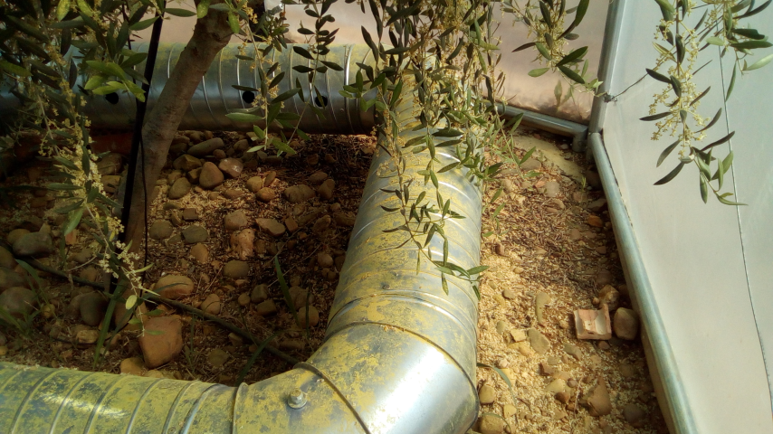
Materials and Methods
Experimental design
AT+4ºC:
8 OTC indoor trees
AT:
8 Control outdoor trees
Campaign 2015/2016
+4ºC Treatment
Ambient Temperature
Temperature Pobe and Datalogger
Open Top Chambers (OTC)
Ventilation Grill
Outdoor Air
Injection
Turbine
Resistances

Slide 7
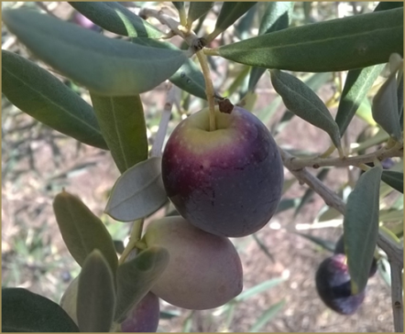
Phenology
Growth
Flowering processes [1]
Ripening processes
Morphology and chemical composition
Total production
Fruit size
Fat yield
Anthocyanins and polyphenols contents
Metabolomic approaches
5 ripening stages were collected
3 ripening stages were selected
[1] Benlloch-González et al. (2018). Scientia Horticulturae, 240:405-410.

Slide 8
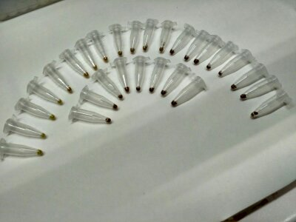
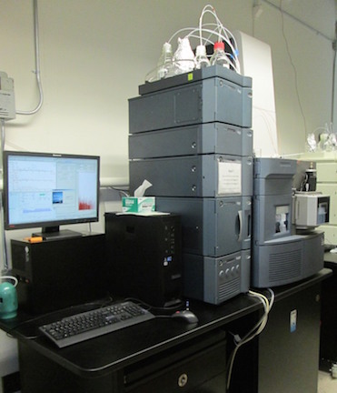
Metabolomic analysis by UPLC-MS/MS
Metabolite extraction: methanol: chloroform: water (5:2:2) protocol[2]
Tissue homogeneization
Extract SpeedVac desecation
Statistical analysis
Identification and Quantification
Metabolites methanol reconstitution
Spectra analyses
UHPLC/qTOF- MS analysis
(UPLC Acquity H-Class Xevo G-2)
[2] Valledor et al. (2014.). Plant J. 79, 173–180

Slide 9
Results
 | Perfect Flowers (% ) | Total Production/tree (Kg FW) | Fruit size (g FW/nº fruits) | Pulpe/pit (g FW/g FW) | Fat yield (% DW)
AT | 6.0 ± 1.4 a* | 5.8 ± 0.7 a** | 5.7 ± 0.1 a** | 9.0 ± 0.3 a** | 54 ± 1 a*
AT+4ºC | 0.5 ± 0.2 b* | 0.3 ± 0.0 b** | 3.2 ± 0.2 b** | 3.7 ± 0.3 b** | 36 ± 5 b*

Slide 10
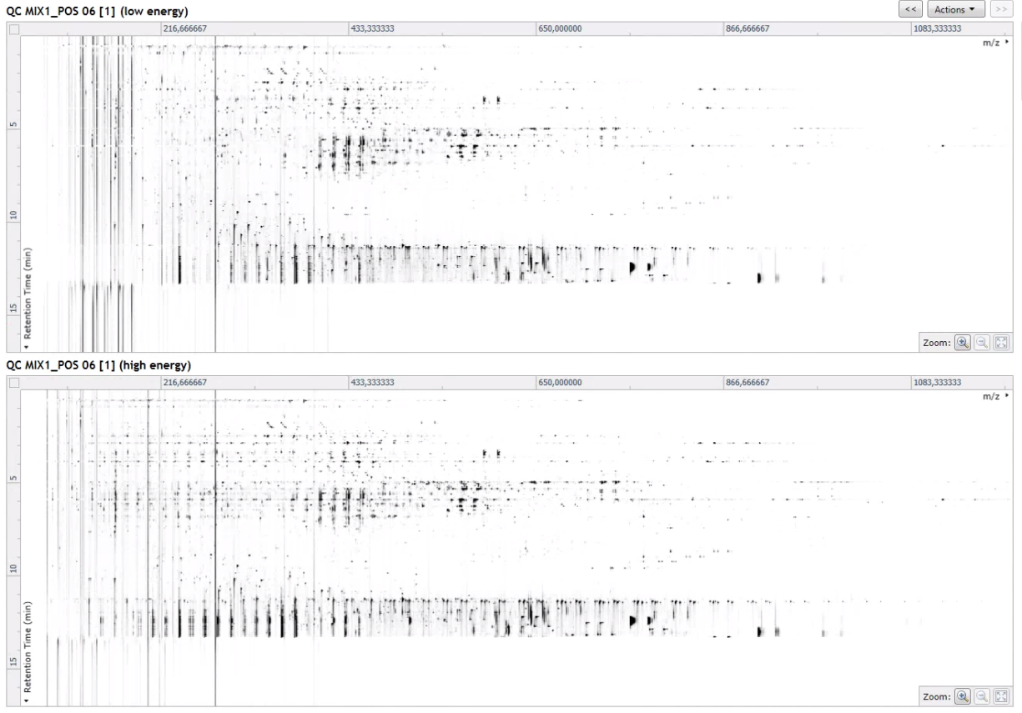
~ 97.000 signals
9877 annotated compounds
~700 metabolites identified

Slide 11
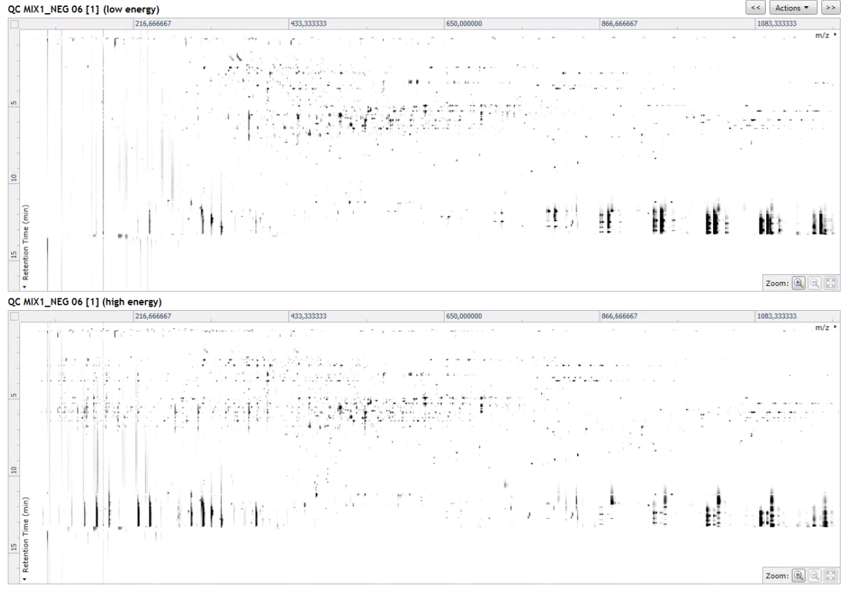
~ 49.000 signals
1162 annotated compounds
~290 metabolites identified

Slide 12
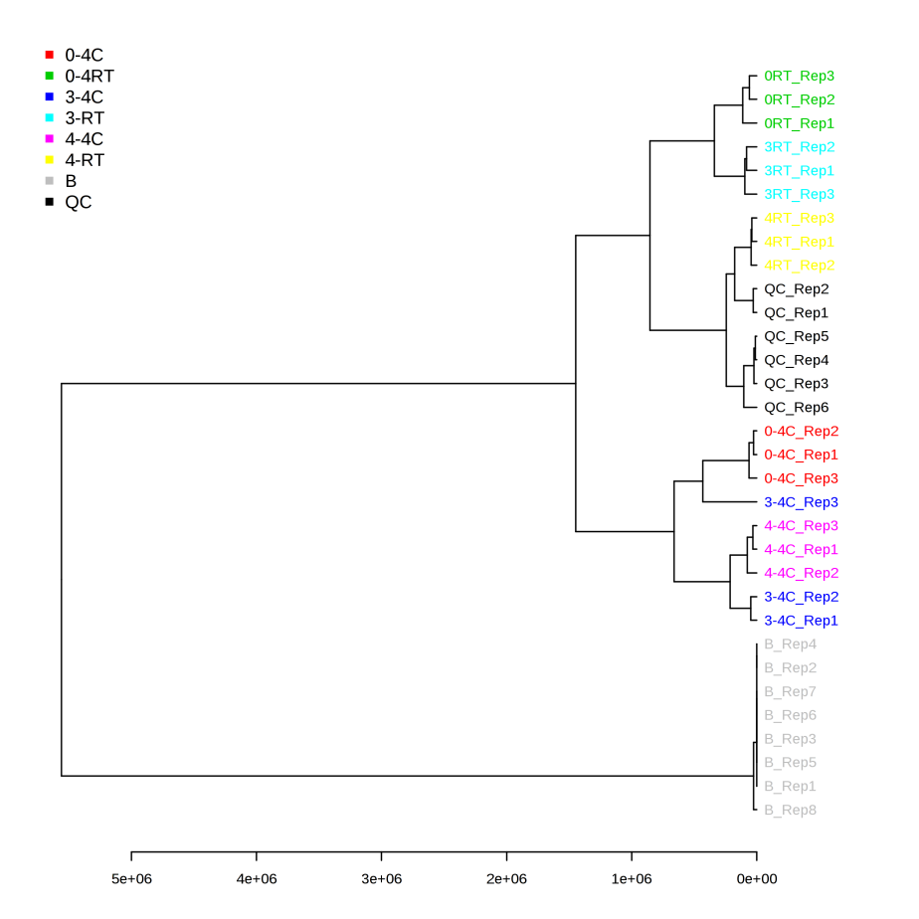

Slide 13
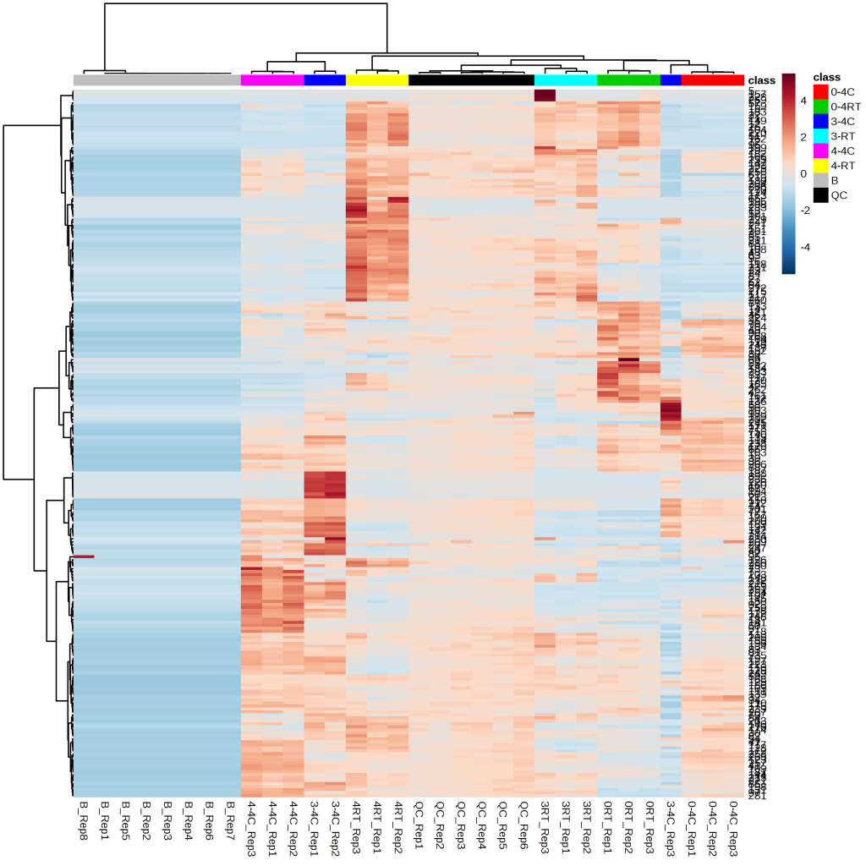
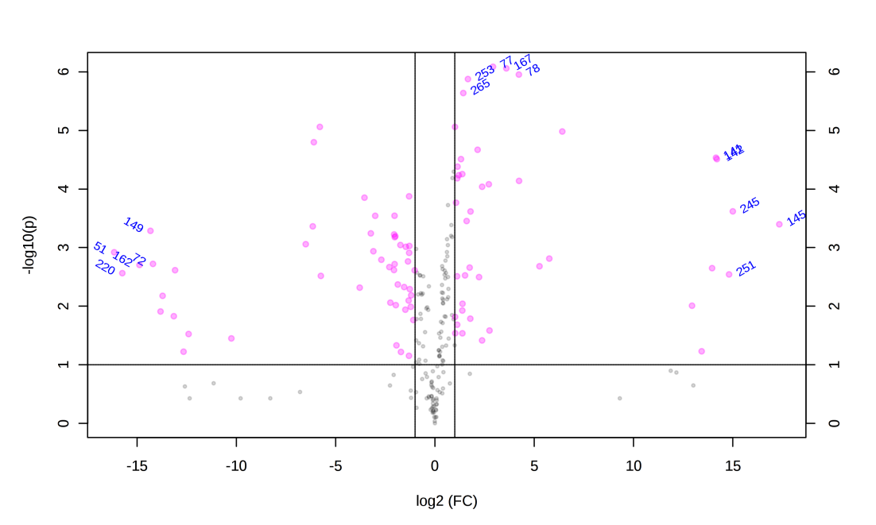
193 metabolites were differents at green ripening stage
Fold Change │2│

Slide 14
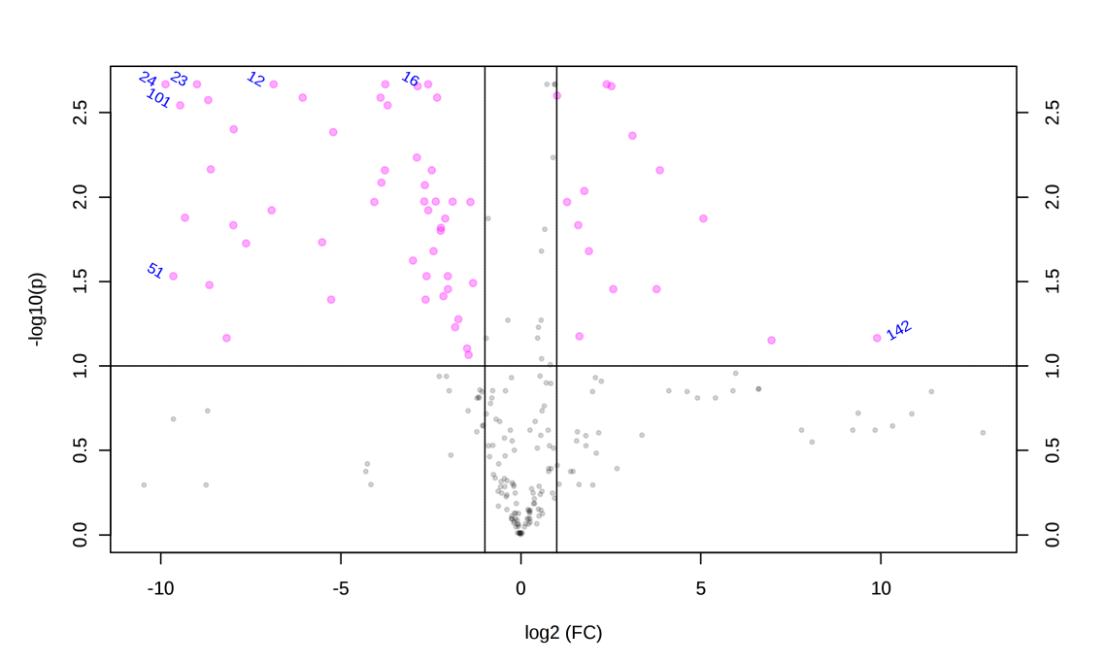
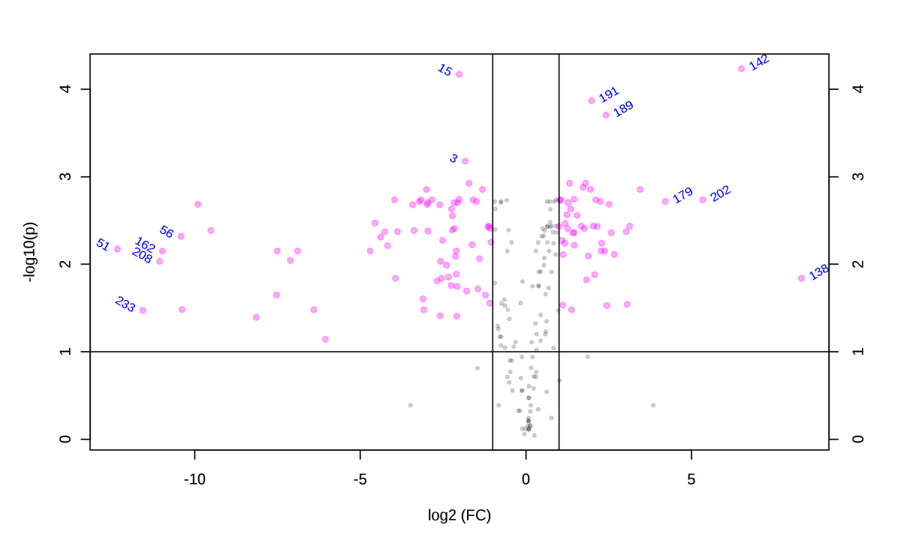
177 metabolites were differents at turning-red ripening stage
Fold Change │2│
241 metabolites were differents at purple ripening stage
Fold Change │2│
Functional categorization was carried out manually

Slide 15
Conclusions
Around 800 metabolites were identified by UHPLC/qTOF MS strategy using a restricted parameters.
Present in 2/3replicates and absent in blank
With description known and fragmentation spectra
Quality control reproducibility
Around 200 metabolites/ripening stage present differences (FDR<0,05) between AT and AT+4ºC treatments.
The major ripening processes affected by +4ºC were fatty acids synthesis, plant cell wall degradation, and terpene, phenylpropanoids and flavonoids biosynthesis.
The results suggest that global warming will be affect the ripening processes modifying the fruit characteristics and the final oil quantity and quality.

Slide 16
Perspectives
Analysis by RT-qPCR of 103 gene expressions
Lipid metabolism
ABA- ethylene-AIA response
Plant wall degradation
Anthocyanin biosynthesis
Olive secondary metabolites
Analysis of flowering and ripening processes by proteomics assays
Extension of the study with other varieties

Slide 17
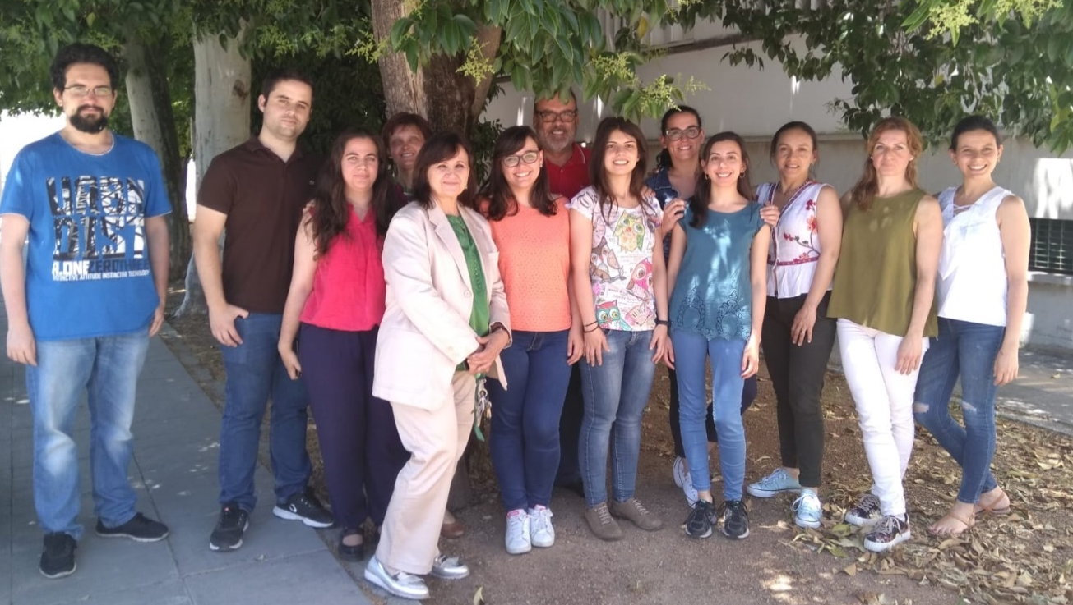
Dpt. Biochemistry and Molecular Biology; AGR-164
Jesús Jorrín Novo
Ana Maldonado Alconada
MªCarmen Molina Gómez
Mª Dolores Rey Santomé
MªÁngeles Castillejo Sánchez
Victor M. Guerrero Sánchez
Cristina López Hidalgo
Isabel Gómez Gálvez
Fabiola Santos Rodríguez
Dpt. Agronomy; AGR-174
Manuel Benlloch
María Benlloch González
Acknowledgements:
Consejería de Economía y Conocimiento de la Junta de Andalucía “Incentivos a Proyectos de Investigación de Excelencia” (Ref. AGR/7152).
FPU grant supported by the Ministry of Education of Spain (FPU14/00186).

Slide 18
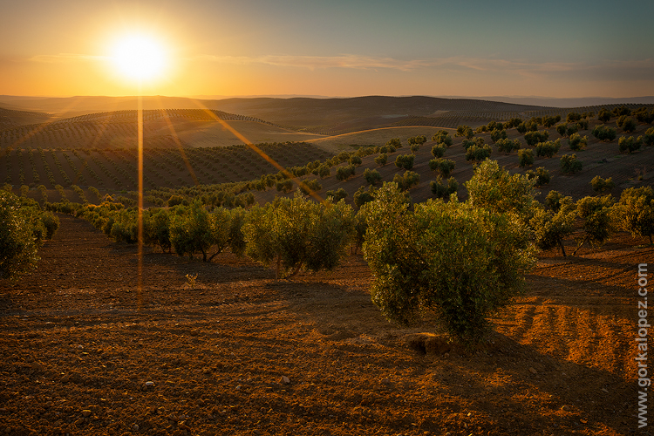
Thanks for your attention

