Slide 1
Illuminating the Dark Metabolome
Associate Professor Oliver A.H. Jones
RMIT University

Slide 2
What is the Dark Metabolome
“all the metabolites present in a system that are either not extracted and/or not seen using standard analytical methods, or are lost/transformed during extraction”.

Slide 3
Why do you think we don’t see metabolites?
Metabolite Numbers
The latest version of the Human Metabolome Database (version 4.0) lists 114,100 individual entries (~threefold increase from version 3.0.
Includes large quantities of predicted MS/MS and GC-MS reference spectral data as well as predicted (physiologically feasible) metabolite structures.
Actual number of human metabolites could be higher.
Not counting anthropogenic compounds (e.g. pollutants)
How many do you identify in your metabolomics studies?

Slide 4
How many Metabolites?
Just considering one class there are a huge number of permutations
40 common fatty acids
40 FA acyl CoA
64000 TAGs
120 1-, 2-, 3- MAG
Total = 69,000
Conc. Range 10⁹
NMR
GC-MS
LC-MS
Custom assays
Global
profiles
Polarity
Log ⁻⁶ to ¹⁴
Mass < 1500 amu

Slide 5
Why do you think we don’t see metabolites?
Metabolite Extraction
Do we extract all metabolites present?
Do we see and/or identify all the metabolites that we extract?
Some metabolites transformed in extraction
“What happens to metabolites bound to proteins or lipids, or those that are sensitive to light, heat or organic solvents?”

Slide 6
Why bother?
“Our results indicate that (insert experiment here) resulted in a change in amino acid levels and energy metabolism”.
This was a problem in 2005

Slide 7
So we need to extract and identify more metabolites and we need to do it without altering them.
How?

Slide 8
Reinvigorate old technology
NMR is a main stay of Metabolomics but has sensitivity issues
Dynamic Nuclear Polarization (DNP) is technique that can be used to enhance the sensitivity of NMR by combining electron paramagnetic resonance phenomena with NMR experiments

Slide 9
DNP

Slide 10
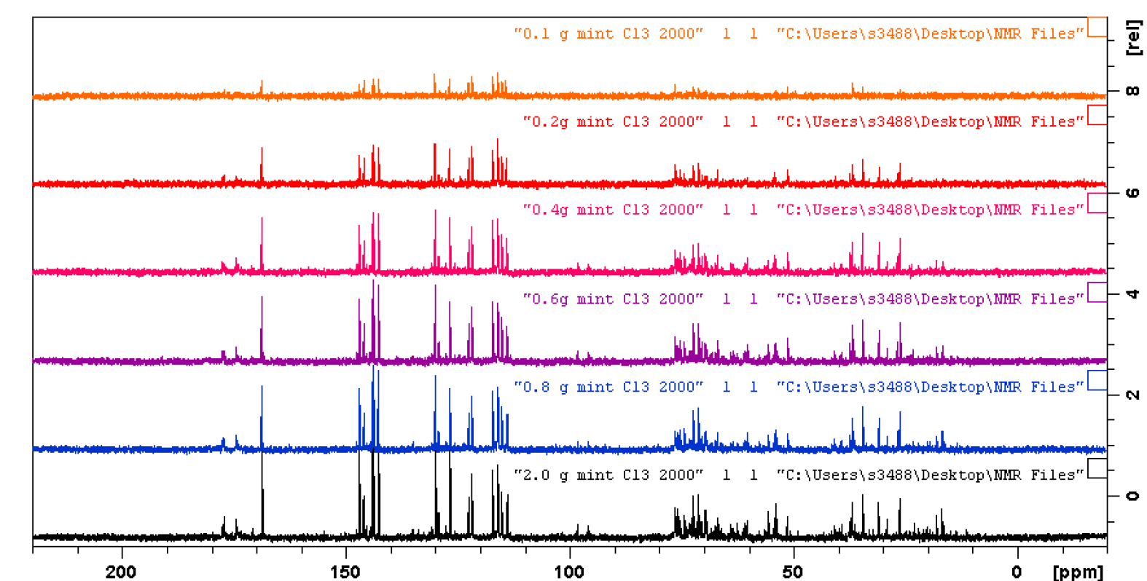
Other Advantages – alternative nuclei
Far less NMR sensitive than ¹H, ¹³C is widely distributed in biological molecules.

Slide 11
³¹P
Less NMR sensitive than the hydrogen and fluorine nuclei but more sensitive than ¹³C.
Phosphorus is well distributed in biological systems and plays a role in several important biological processes, including energy metabolism,
³¹P NMR yields sharp lines and has a wide chemical shift range and thus has featured in some metabolism studies, for example environmental toxicology.

Slide 12
Problems
DNP is carried out at very low temperatures (100 K or -173.15 ºC)
Relies on the use of polarising agents such as 1-(TEMPO-4-oxy)-3-(TEMPO-4-amino)propan-2-ol (TOTAPOL) as a source of unpaired electrons
But increasingly it is being carried out cheaply and at higher temperatures

Slide 13
Problems
Another option is to create new polarising agents.
New lipophilic biradicals based on a cholesterol scaffold could be used, for example, to obtain homogenous DNP enhancement throughout a lipid bilayer and any metabolites attached to it in situ.

Slide 14
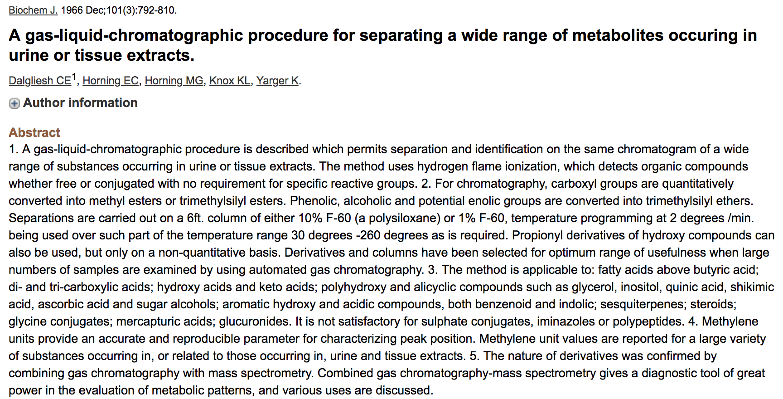
What about Chromatography?

Slide 15
What about HPLC
Liquid chromatography, with the detection of over 1000 compounds being reported in certain sample types.
The theoretical maximum peak capacity for conventional liquid chromatography is ~1500
The use of very long columns is also required for such detailed analysis, long run times of hours or even days are often required.

Slide 16
What else could be used?
2D HPLC involves coupling two columns, with uncorrelated retention mechanisms (orthogonal), in series
During the analysis fractions are collected from the first dimension and injected in the second dimension
The total peak capacity of the system is thus the product of the peak capacity of each dimension (almost)
Can heart-cut specific fractions of interest

Slide 17
2D HPLC
3rd Pump
2nd Pump
Pump
Autosampler
Detector
Switching Valve
Column
Column
Detector

Slide 18
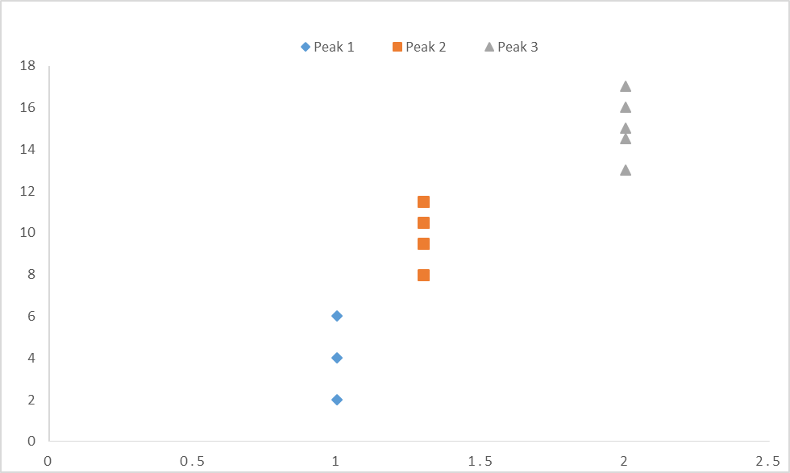
Pick your phase
Retention time of Column 1 (mins)
Retention time of Column 2 (mins)

Slide 19
Separation space
Retention time of Column 1 (mins)
Retention time of Column 2 (mins)

Slide 20
2D vs 1D
Intensity
Retention time on column (mins)

Slide 21
2D vs. 1D
Retention time of column 1 (mins)
Retention time of column 2 (mins)

Slide 22
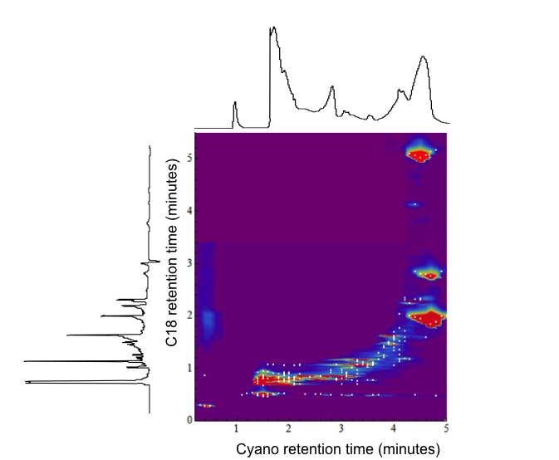
2D vs. 1D

Slide 23
Advantages of 2D HPLC
Increase separation space
Increase in total peak capacity
(1500*1500 = 225,000 - 114,100 = 110,900 ‘spare’ capacity)
Increase in efficiency and resolution resolution
Can we predict structure from retention time
Interesting chemistry to be explored
Notes:
Mineral from food packaging

Slide 24
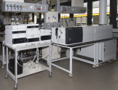
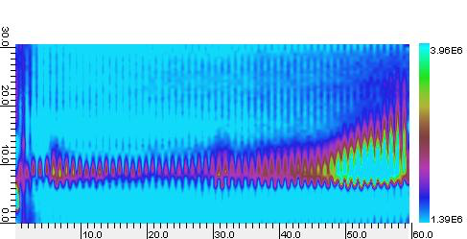
Things to be aware of
Sample dilution
Column selection
Solvent mismatch
Column re-equilibration

Slide 25
Other Options
Commercial libraries have been complemented by extensive open-access databases, such as mzCloud and the Human Metabolome Database, containing hundreds of thousands of spectra.
The creation of in house libraries of pure compounds may be of help but, of course, there can be no in- house libraries made of, as yet, unknown metabolites.
In-silico predictive tools
Mining existing data – e.g. MetaboLights

Slide 26
Acknowledgements
PhD Students
Lydon Alexandrou
Christine Close
Jake Collie
Asal Hajnajafi
Stuart Hombsch
Will McCance
Hugh McKeown
Tim Ong
Elvina Parlindungan
Lada Staskova
Postdocs
Dr YuFei Wang
Others
Dr Jess Pandohee
Dr Paul Stevenson

Slide 27
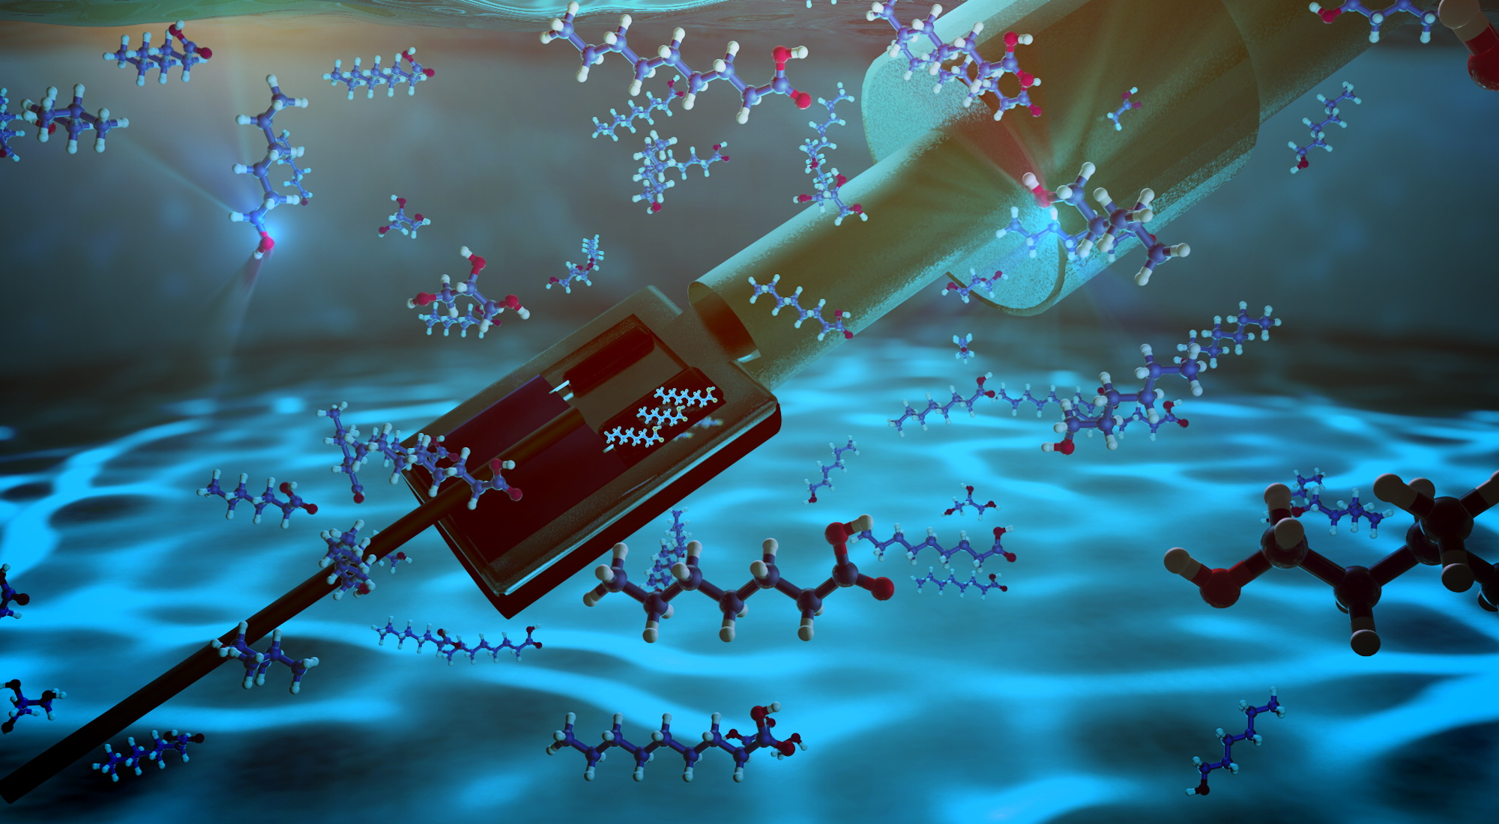
Thank you for listening
For further information oliver.jones@rmit.edu.au
@dr_oli_jones

