Slide 1
Cavitation erosion and wear mechanisms of AlTiN and TiAlN films deposited on stainless steel substrate
Mirosław Szala ^{1,*}, Mariusz Walczak ¹, Kamil Pasierbiewicz ^{1,2}, Mariusz Kamiński¹ ¹ Lublin University of Technology, Faculty of Mechanical Engineering, Poland ² University of Economics and Innovation, Poland * email: m.szala@pollub.pl
https://sciforum.net/conference/ciwc2019

Slide 2
Presentation plan
Aim of the work
Materials and methods
Results and discussion
Description of films properties in relation to stainless steel substrate
Cavitation erosion - mechanism of cavitation erosion damage
Cavitation erosion - effect of cavitation erosion on nanoindentation results
Sliding wear behavior - ball-on-disc test: quantitative and qualitative evaluation
Conclusions

Slide 3
Aim of the work
The aim of this work was to study the cavitation erosion and sliding wear mechanisms of magnetron sputtered AlTiN and TiAlN coatings deposited on stainless steel substrate.
The paper is an introduction to CER testing of films deposited on various metal alloy substrates, and a quantitative determination of its CER. Thus, the thin films, such as TiAlN or AlTiN, its application in fluid machinery, precise mechanics components and engines in cavitation wear prevention are proposed.

Slide 4
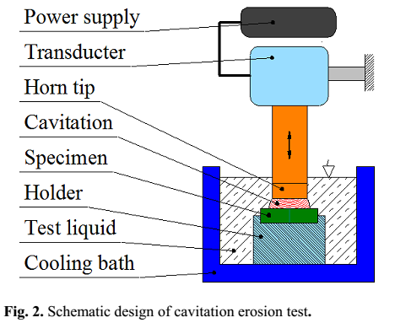
Materials and methods
Materials:
AlTiN and TiAlN films were deposited by DC magnetron sputtering process (approx. 3 µm thick)
stainless steel substrate grade AISI 304 (a reference sample, marked as SS304)
Methods:
Optical Profiler
Calotester
Metallographic/structural investigations (LOM and SEM-EDS)
Ultra Nanoindentation Tester
Scratch testing
Rockwell adhesion tests
Wear testing
Cavitation erosion - ASTM G32: a vibratory apparatus with stationary specimen procedure (see, figure 1)
Sliding tests, ball-on-disc method, a nano-tribotester (WC - counter sample 0.5 mm diameter; a load of 0.8 N, sliding distance of 90 m and sliding radius of 5 mm)
Figure 1 Design of vibratory apparatus for cavitation tests

Slide 5
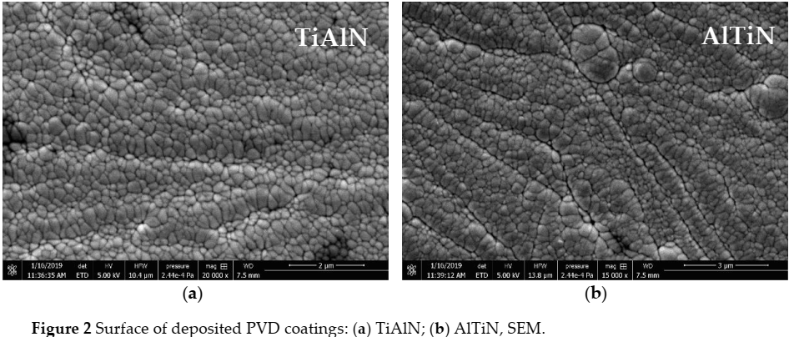
Results and discussion Description of films properties in relation to stainless steel substrate
Figure 2 Surface of deposited PVD coatings: (a) TiAlN; (b) AlTiN, SEM.
Table 1. Results of SEM-EDS surface chemical composition spot analysis
Table 2. Films critical loads estimated in scratch test: Lc1 – first symptoms of cohesive failure (angular or parallel cracking), Lc2 – beginning of adhesive failure (buckling, chipping, spalling, etc.), Lc3 – total failure of the coating or massive exposure of the substrate (mean ± SD)
Film | Spot | Chemical element, wt%
 |  | Ti | Al | N
TiAlN | 1 | 52.93 | 30.63 | 16.43
 | 2 | 52.27 | 30.07 | 17.67
 | 3 | 50.20 | 31.10 | 18.70
 | Average | 51.80 | 30.60 | 17.60
AlTiN | 1 | 41.93 | 35.63 | 22.43
 | 2 | 43.30 | 35.10 | 21.60
 | 3 | 44.97 | 35.47 | 19.57
 | Average | 43.40 | 35.40 | 21.20
Film | Lc1 [N] | Lc2 [N] | Lc3 [N]
TiAlN | 0.91 ± 0.54 | 7.23 ± 1.19 | 15.38 ± 3.43
AlTiN | 0.91 ± 0.61 | 8.87 ± 2.40 | 18.93 ± 4.76

Slide 6
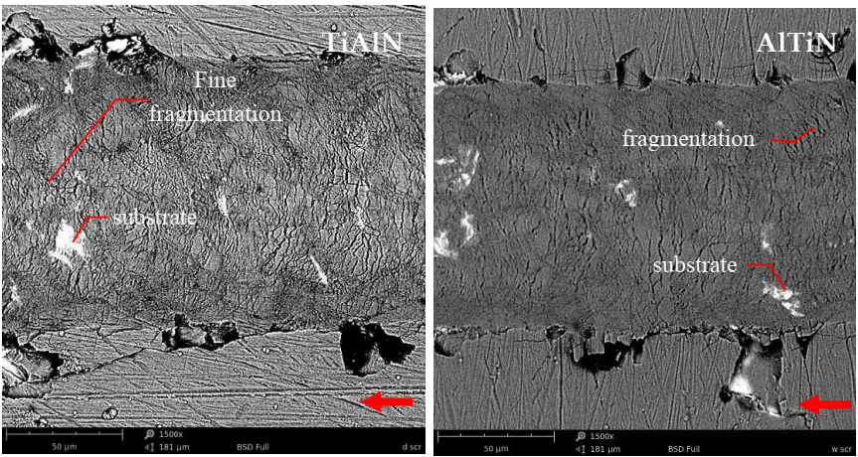
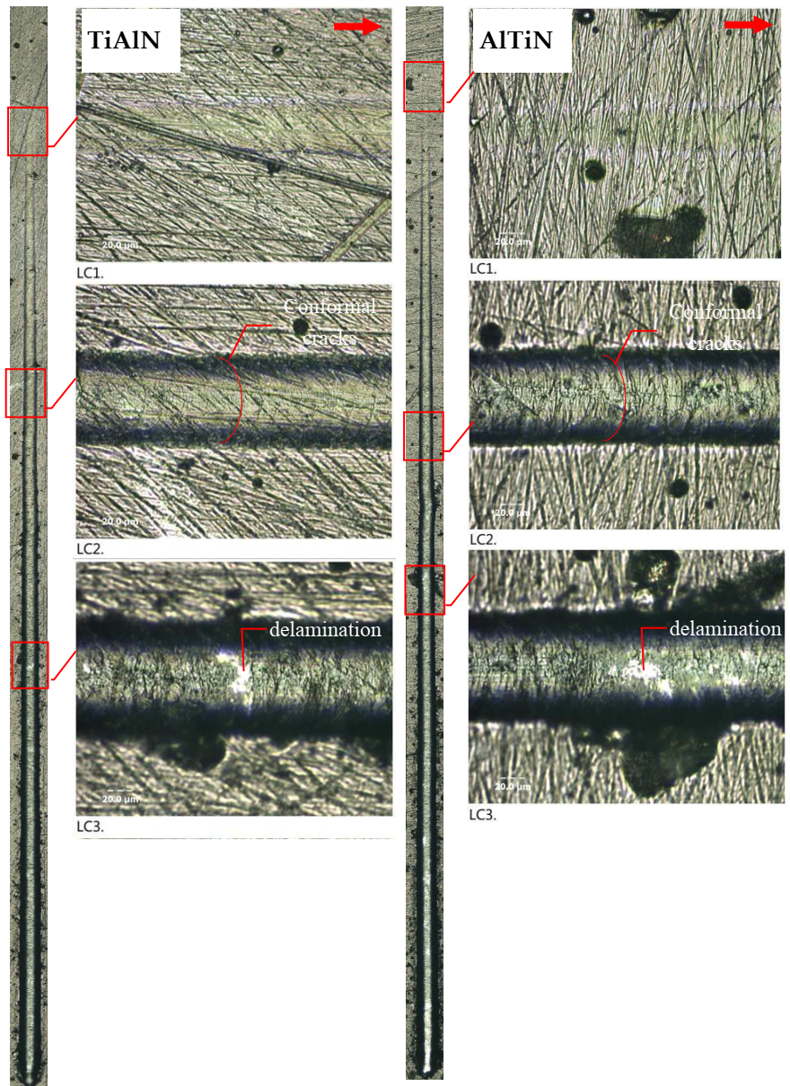
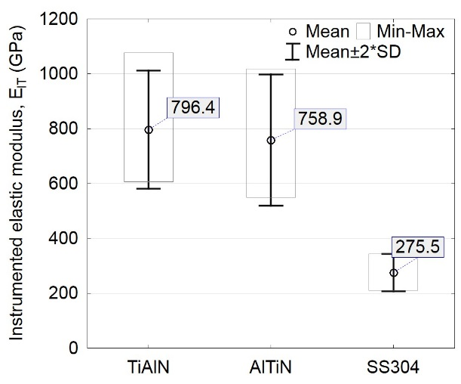
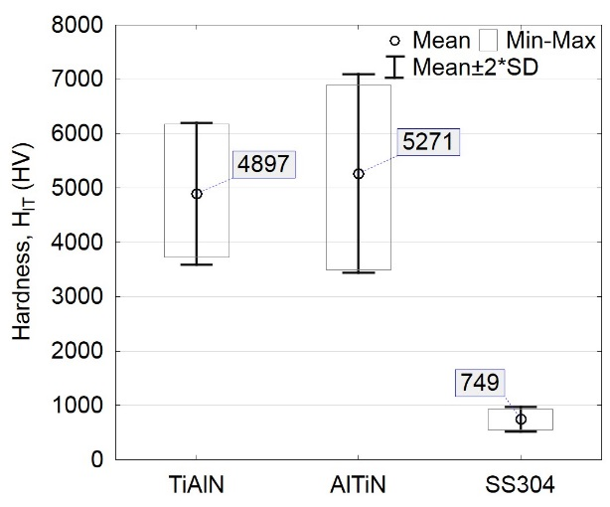
Results and discussion Description of films properties in relation to stainless steel substrate
Figure 4 Comparison of films at the end of the scratch trace, direction of the scratch marked by an arrow, magnify. 1500x, SEM
Figure 5 Elastic modulus and hardness of coated and bare SS304 samples
Fig ure 3 Scratch traces: a - TiAlN; b – AlTiN and enlarged characteristic areas of Lc1, Lc2 and Lc3. (total scratch trace 3 mm)

Slide 7
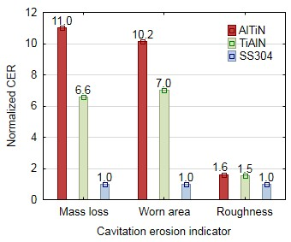
Results and discussion Cavitation erosion
Figure 6 Normalized cavitation erosion resistance (CER) calculated in reference to SS304 based on mass loss (mg), portion of worn area (%) and Sa roughness parameter (um), 4.5 h of cavitation test

Slide 8
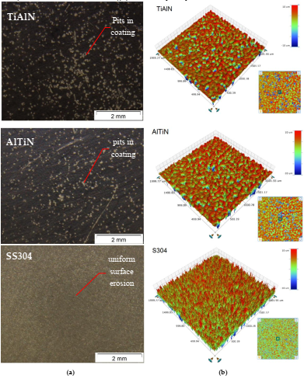
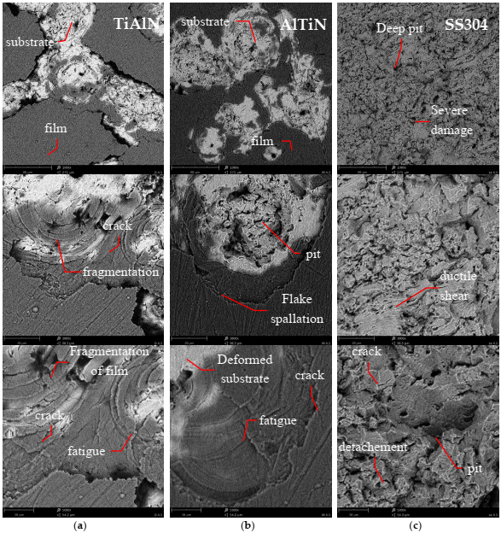
Results and discussion Cavitation erosion - Mechanism of cavitation erosion damage
Figure 7 Macroscopic view of cavitation erosion worn surface, stereoscopic microscope (a) and roughness profile of tested surfaces (b) after 4.5 hours of cavitation
Figure 8 Comparison of cavitation eroded thin films and stainless steel, after 4.5 hours of testing: column (a) TiAlN; (b) AlTiN; (c) SS304; SEM, 1000x 3000x and 5000x.

Slide 9
Results and discussion Cavitation erosion - Effect of cavitation erosion on nanoindentation results
Figure 9 Loading-unloading nanoindentation curves of samples surfaces estimated before and after (marked as “cav”) cavitation erosion test.
Table 3. Results of H - hardness, E – elastic modulus and W_{total} – total work done, W_{elastic} – elastic work done; measured by nanoindentation on as deposited and affected by cavitation (marked as “cav”) stainless steel and film samples
Sample | SS304 | SS304_cav | TiAlN | TiAlN_cav | AlTiN | AlTiN_cav
H_{IT} _{(O&P)} [GPa] | 8.3±1.3 | 8.7±0.4 | 54.4 ±8.7 | 49.3±11.7 | 59.6±12.0 | 41.1±8.9
E* _{(O&P}) [GPa] | 304.3±41.3 | 277.6±13.0 | 908.6±205.7 | 698.8±144.8 | 835.0 ±151.0 | 543.7±101.0
H/E | 0.027 | 0.031 | 0.060 | 0.071 | 0.071 | 0.077
H³/E² | 2.445 × 10⁻⁶ | 3.538 × 10⁻⁶ | 3.945 × 10⁻⁶ | 7.123 × 10⁻⁶ | 6.101 × 10⁻⁶ | 1.051 × 10⁻⁵
W_{total} [pJ] | 2892.5±250.6 | 2722.2±78.3 | 1174.8±124.6 | 1314.1±121.5 | 1203.3±113.9 | 1463.3±145.7
W_{elastic} [pJ] | 555.0±22.3 | 559.1±17.1 | 668.8±41.9 | 721.8±26.1 | 732.2±40.7 | 785.1±44.5

Slide 10
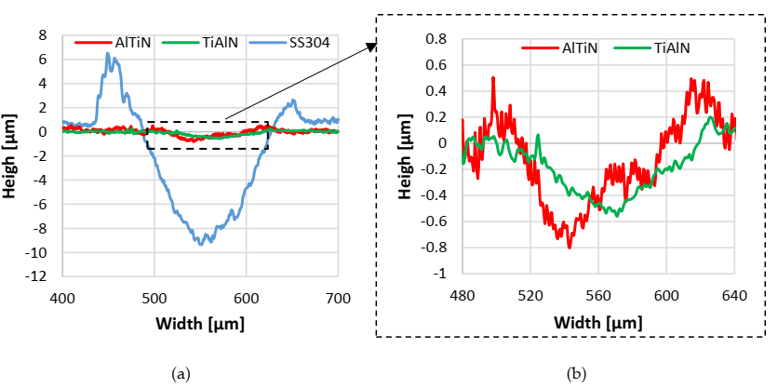
Results and discussion Sliding behavior (ball-on-disc test)
Table 4. Sliding wear results for films and reference SS304 sample (mean ± SD)
Sample | Wear factor, K (mm³N⁻¹m⁻¹) | Coefficient of friction, µ (-)
TiAlN | 1.35E-05 ± 4.36E-06 | 0.319 ± 0.037
AlTiN | 2.09E-05 ± 3.49E-06 | 0.340 ± 0.031
SS304 | 50.17E-05 ± 61.52E-06 | 0.628 ± 0.088
Figure 10 Sliding wear profiles: (a) films and stainless steel sample; (b) enlarged selected area of TiAlN and AlTiN wear traces from (a).

Slide 11
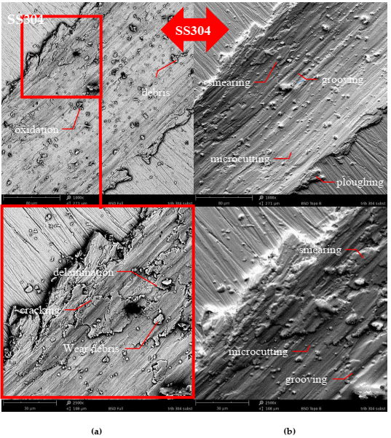
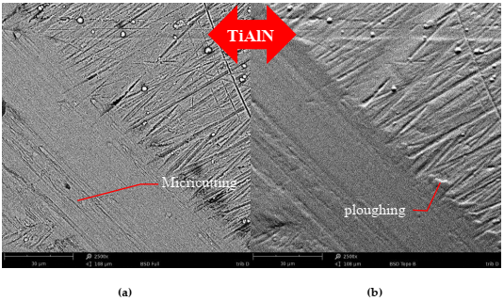
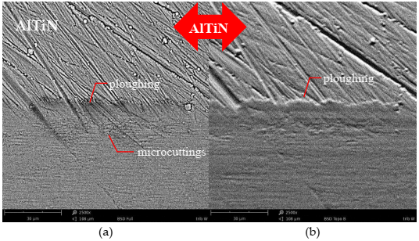
Results and discussion Sliding behaviour (ball-on-disc test)
Figure 11 Wear trace on the SS304 sample: (a) SEM-BSD and (b) SEM-topo, 1000x and 2500x..
Figure 12 Wear trace on the TiAlN and AlTiN film: (a) SEM-BSD and (b) SEM-topo, 1000x and 2500x.

Slide 12
Conclusions
The stainless steel is applicate for different components and considered as structural metal with moderate resistance for cavitation erosion. Thus, application of PVD coatings is proposed as an easy to implement in industry practice and a promising attempt for wear prevention of stainless steel parts. In the present work, the cavitation erosion and sliding wear mechanisms of magnetron sputtered AlTiN and TiAlN coatings deposited on SS304 stainless steel (SS) were investigated. The fallowing conclusions can be drawn:
The properties of films acknowledged that coatings present satisfying structure i.e. typical columnar morphology, Sa roughness parameter bellow value of 0.2 µm and varies in thickness ≈ 2.7 µm for TiAlN and ≈ 3.8 µm for AlTiN. Also, Rockwell and scratch tests of films indicate satisfactory adhesion to the steel substrate although, higher force of Lc2 parameters for AlTiN than TiAlN suggests that AlTiN adhered strongly to substrate. AlTiN film was tougher i.e. exhibited higher H/E parameter than TiAlN.
Cavitation erosion resistance for AlTiN was almost one third higher than TiAlN films and superior almost ten times than SS304 sample. The influence of films structural and mechanical properties i.e. hardness, adhesion and elastic modulus, on cavitation erosion resistance was acknowledged.
Cavitation erosion mechanism of both AlTiN and AlTiN coatings presents a brittle manner and relies on fatigue processes that result in coating rupture and spallation. However, comparison of cavitation worn TiAlN and AlTiN films allows to claim higher level of fragmentation for TiAlN film than AlTiN, which finally accelerates wear of TiAlN films. Additionally, films nanoindentation results measured before and after cavitation testing indicate changes in coatings structure, that acknowledged wear mechanism that starts with coating internal delamination in flake spallation mode.
Sliding wear of uncoated SS304 sample was much severe than after PVD coatings deposition. Resistance to sliding wear of AlTiN and TiAlN was more than 24 times higher than stainless steel sample. Additionally, deposition of PVD films onto stainless steel substrate decreases almost twice the friction coefficient. Sliding wear mechanism of both AlTiN and TiAlN films relies on grooving, micro-scratching and micro-ploughing.
It was confirmed that various fluid machinery components made from austenitic stainless steel that undergo cavitation erosion can be with prevented by depositing AlTiN and TiAlN films.
Notes:
z

Slide 13
Cavitation erosion and wear mechanisms of AlTiN and TiAlN films deposited on stainless steel substrate
Thank you for your attention
Mirosław Szala, PhD Eng. Lublin University of Technology Faculty of Mechanical Engineering Department of Materials Engineering email: m.szala@pollub.pl
https://sciforum.net/conference/ciwc2019

