Slide 1





Nanotechnology to improve the performances of hydrodynamic surfaces
Ali ALSHEHRI,
El Hadj DOGHECHE, Laurent KEIRSBULCK., Philippe Champagne

Slide 2
OUTLINES
Introduction (Maritime industry challenges)
Project Strategy
Super-Hydrophobic Surfaces (Potential solution, Conditions & Publications)
Market Studies
Proposed Solutions
Achievements
Conclusion

Slide 3
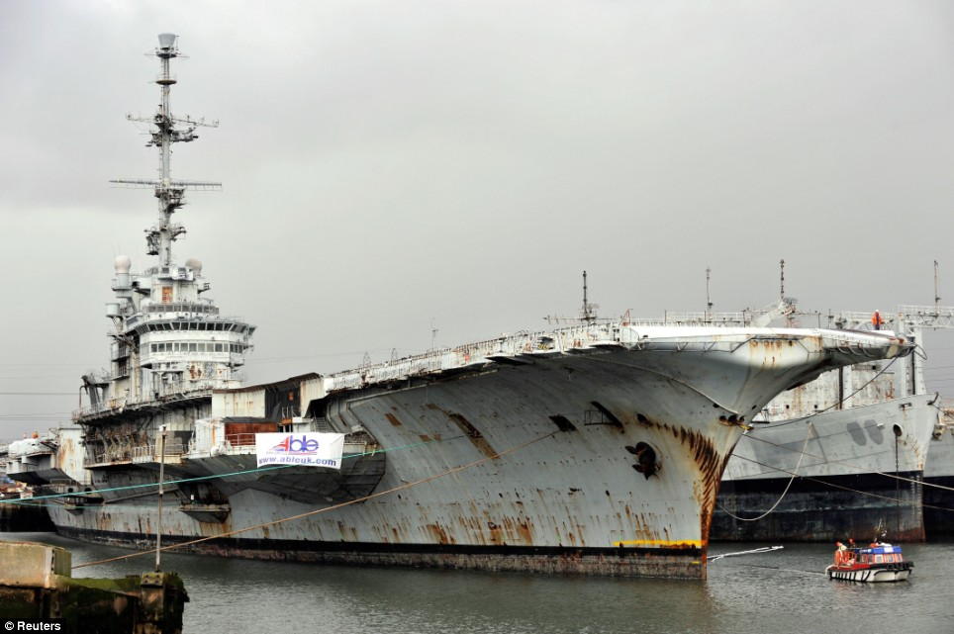
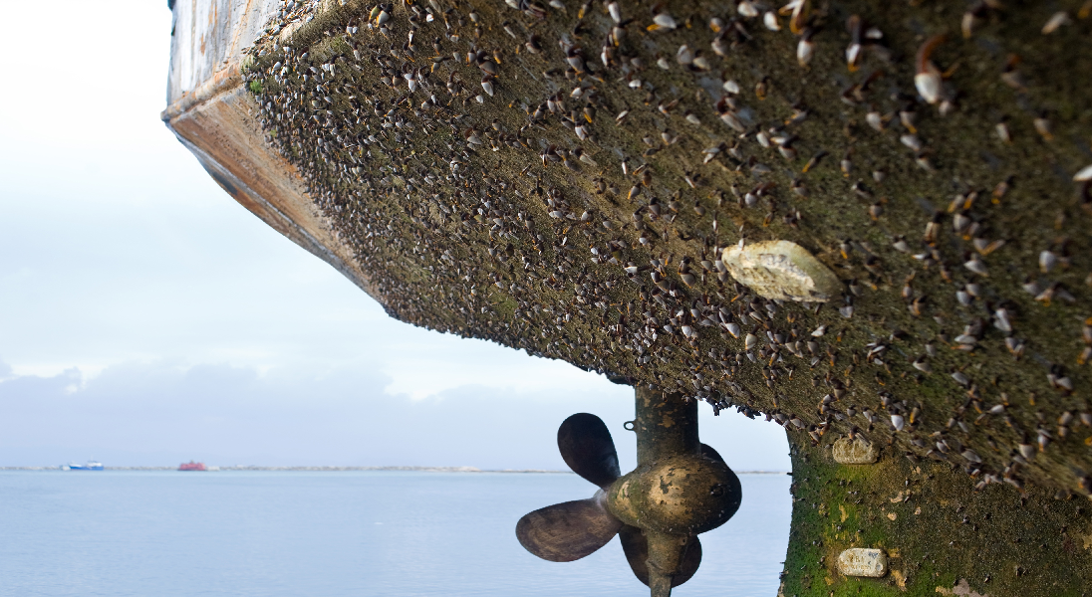
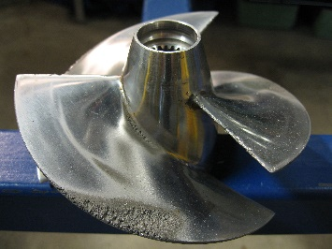
contexte
  Corrosion ($276 billion for usa/YAER = 3.1% of usa gdp) *
  Fouling ($150 billion / year 2020 globe ) **
  Energy
  Environment (2001, IMO Convention prohibit TBT) ***
  Hydrodynamic performances
* J. H. P. Gerhardus, “Corrosion Costs and Preventive Strategies in the United States,” NACE Int., pp. 3–11, 2002.
** C. Hellio and D. Yebra, Advances in marine antifouling coatings and technologies. Woodhead Publishing Limited, 2009.
*** TBT (Tributyltin)

Slide 4
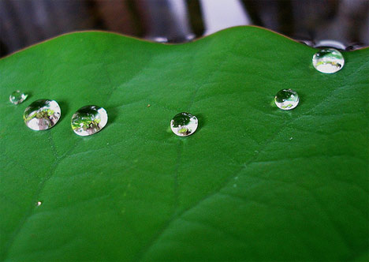
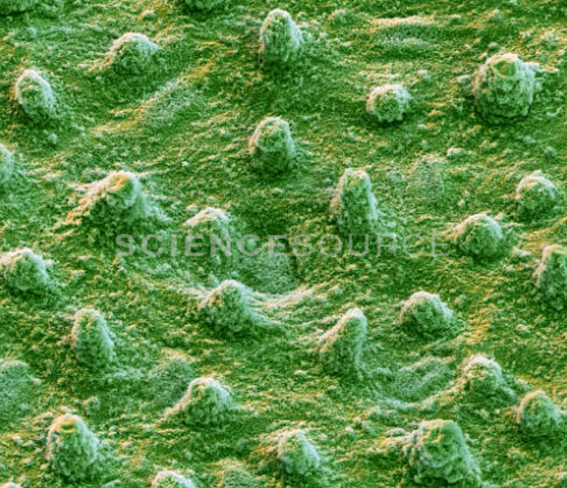
Objective
  enhance the maritime surfaces CHARACTERISTICS BY Super hydrophobic treatment
θ
Liquid
(WCA) (θ) ≥ 150°
Sliding Angle (SA) (α) ≤ 10°
Solid
θ: Water Contact Angle (WCA)
α
α: Sliding Angle (SA)

Slide 5
Super hydrophobic Coating (Publications)

Slide 6
strategy
Market study
Creation of Super Hydrophobic surfaces
Hydrophobic test
Hydrodynamic tests

Slide 7
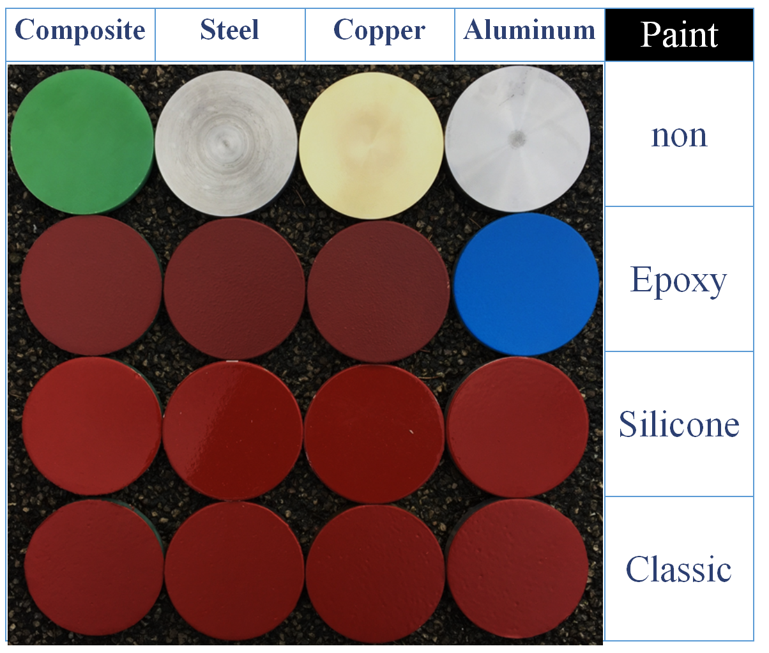

strategy
Market study
Creation of Super Hydrophobic surfaces
Hydrophobic test
Hydrodynamic tests

Slide 8
Market Studies
configuration of paint layers
Epoxy, 250µm
Primer (Pr), 40µm
Epoxy
paint system
Water Contact Angle (WCA)
Sliding Angle (SA)
Sliding speed (Vs)
Surface morphology
Energy-dispersive X-ray (EDX)
Surface tension (ST)
Surface roughness (RA)
Silicone Antifouling (AF),150µm
Tie Coat (TC), 100µm
Anti Corrosion (AC), 150µm
Ø = 100 mm
Primer (Pr), 40µm
Silicone A.F.
paint system
Classic Antifouling (AF),150µm
Tie Coat (TC), 100µm
Anti Corrosion (AC), 150µm
Primer (Pr), 40µm
Classic A.F.
paint system

Slide 9
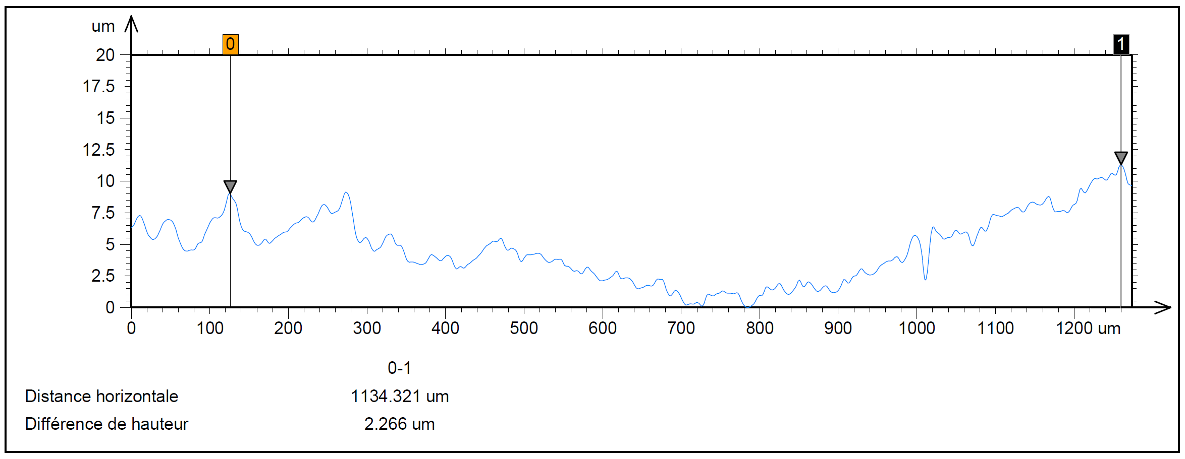
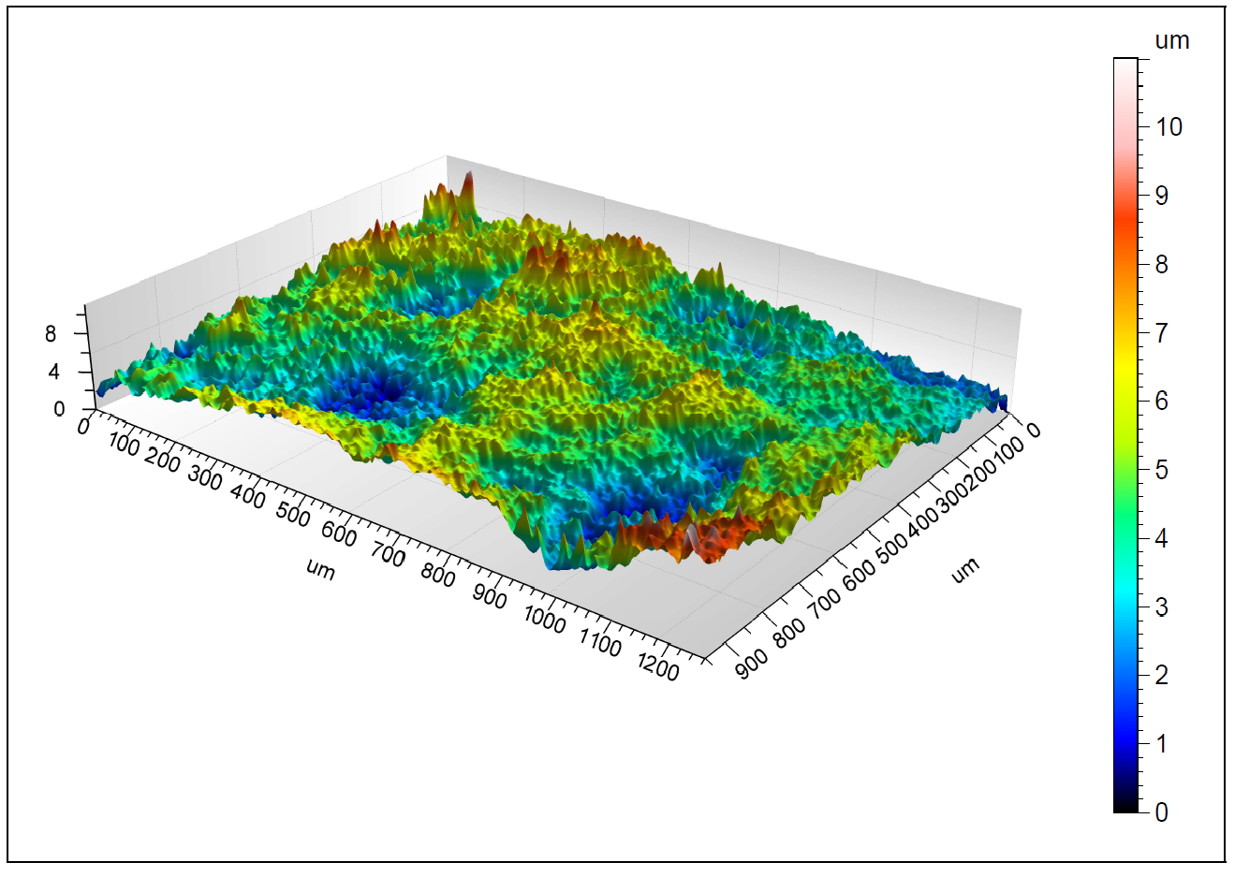
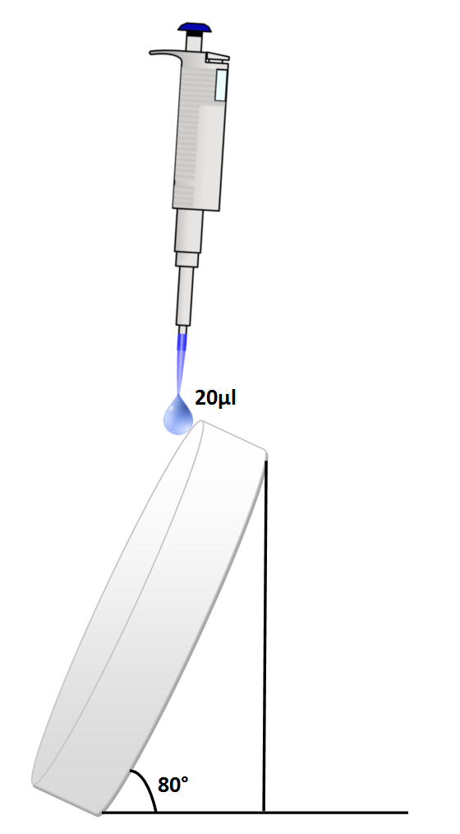
Epoxy
Paint
Surface morphology
Confocal microscopy
EDx
Element | Weight % | Atom %
Al | 0.28 | 0.42
S | 1.12 | 1.43
Mg | 2.03 | 3.42
Si | 3.40 | 4.95
Cl | 8.91 | 10.27
Fe | 10.68 | 7.81
O | 13.00 | 33.19
Zn | 24.21 | 15.13
Cu | 36.37 | 23.38
Total | 100.00 | 100.00
WCA = 85°
SA = 36°
ST= 43 (mJ.m-²)
Ra = 373 (nm)
Vs = 0.23 m/s

Slide 10
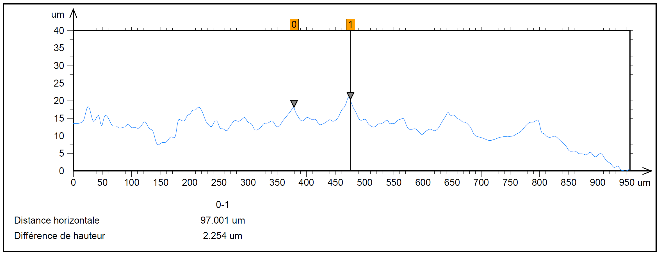
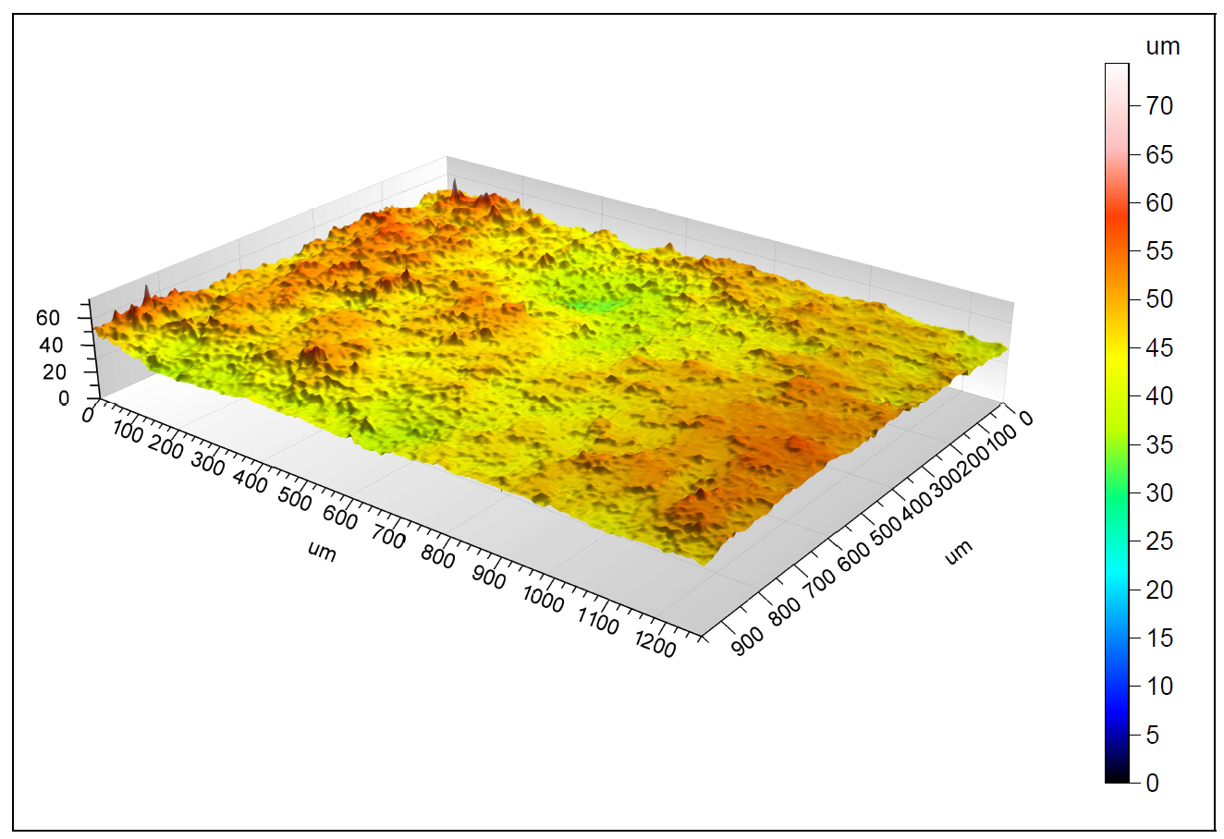
Classic A.F. Paint
Surface morphology
Confocal microscopy
EDx
Element | Weight % | Atom %
Ca | 0.70 | 0.47
Cl | 1.69 | 1.30
Fe | 6.55 | 3.20
S | 7.73 | 6.59
Mg | 10.15 | 11.41
Si | 19.86 | 19.31
Ba | 22.09 | 4.39
O | 31.23 | 53.32
Total | 100.00 | 100.00
WCA = 84°
SA = 37°
ST= 43 (mJ.m-²)
Ra = 923 (nm)
Vs = 0.16 m/s

Slide 11
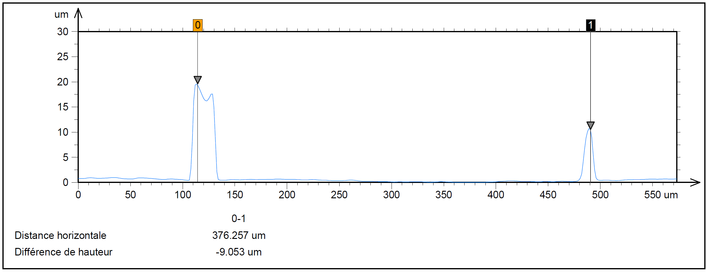
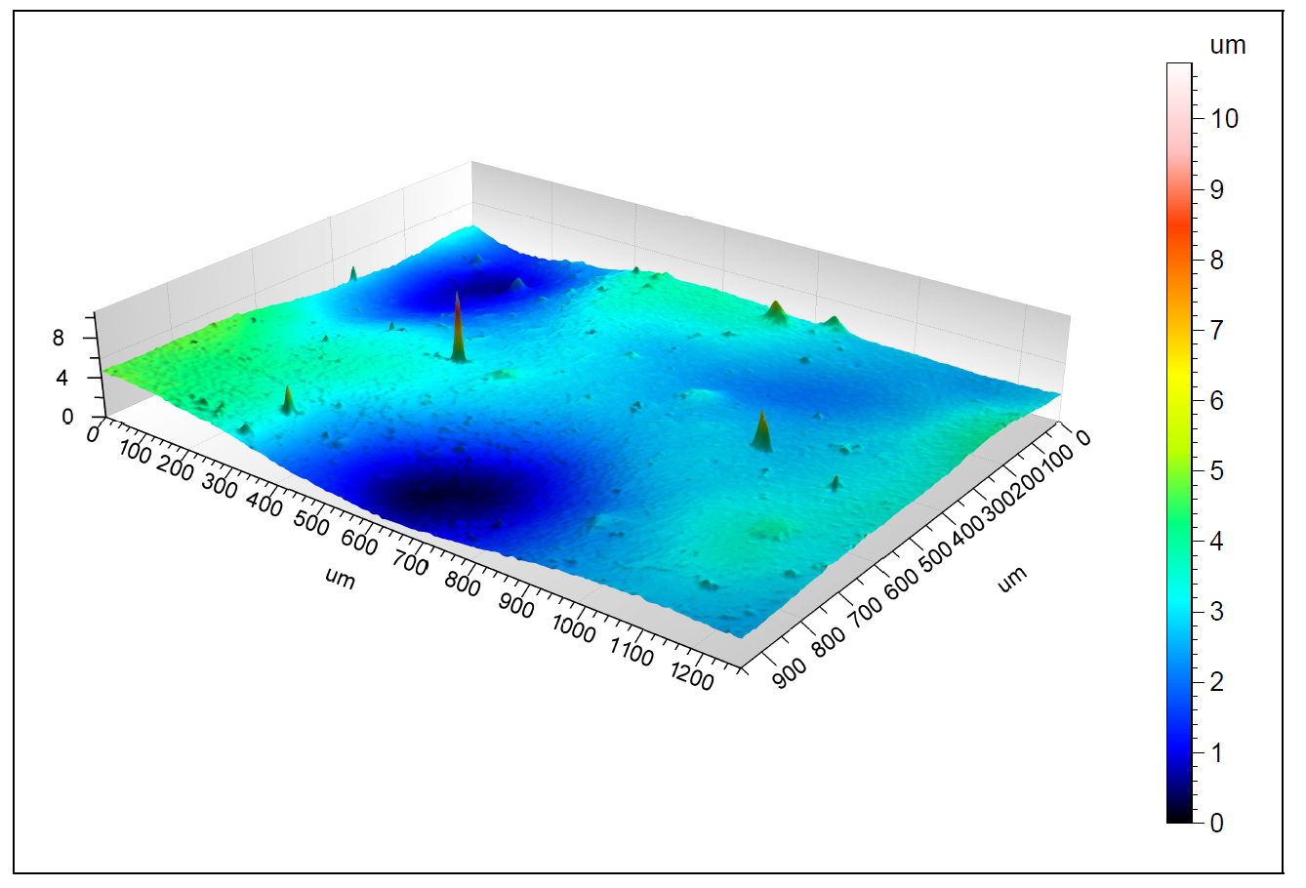
Silicone A.F. Paint
Surface morphology
Confocal microscopy
EDx
Element | Weight % | Atom %
Fe | 2.43 | 0.99
O | 33.22 | 47.07
Si | 64.35 | 51.95
Total | 100.00 | 100.00
WCA = 101°
SA = 16°
ST= 23 (mJ.m-²)
Ra = 121 (nm)
Vs = 0.3 m/s

Slide 12



Market Studies
WCA = 101°
SA = 16°
ST= 23 (mJ.m-²)
SS = 0.3 m/s
Silicone A.F.
paint system
75€/L
WCA = 84°
SA = 37°
ST= 34 (mJ.m-²)
SS = 0.16 m/s
WCA = 85°
SA = 36°
ST= 43 (mJ.m-²)
SS = 0.23 m/s
Classic A.F
paint system
40€/L
Epoxy
paint system
25€/L
Lotus Leaf : WCA=153.4°,SS = 0.32 m/s

Slide 13
strategy
Market study
Creation of Super Hydrophobic surfaces
Hydrophobic test
Hydrodynamic tests
ZnO + ODS
Epoxy
Aluminum

Slide 14
Proposed Solutions
Create Super-Hydrophobic Surfaces from Nanotechnology Process
ZnO NRS nanorods by Hydrothermal process (antibacterial, simple fabrication & green material: most popular solution studied (0.5 M Paper 2007-2017)
reduce surface energy ODS (OctaDecyltrimethoxySilane)

Slide 15
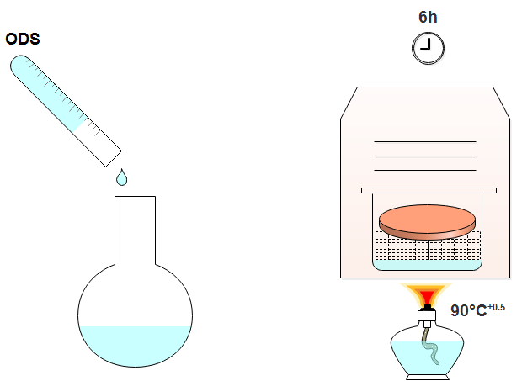
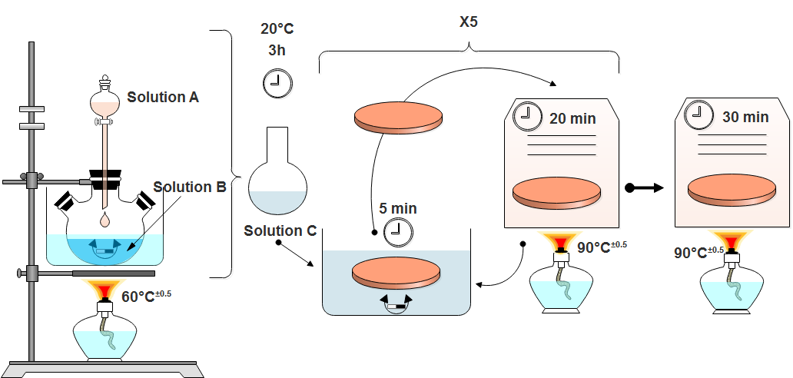
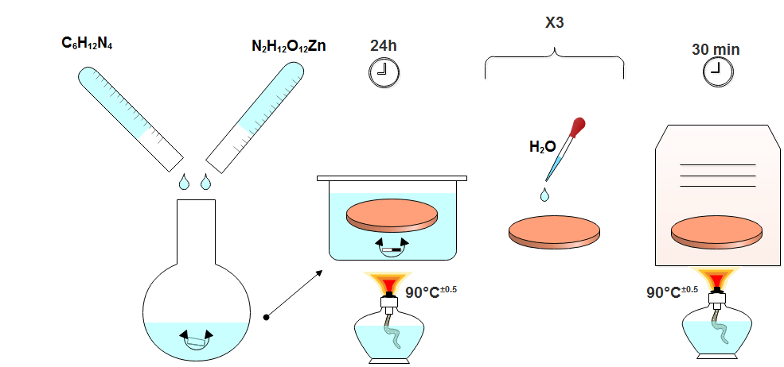
protocol
3. ODS
1. ZnO seeds
2. ZnO NRs

Slide 16
seeds

Slide 17
ZnO NRs

Slide 18
strategy
Market study
Creation of Super Hydrophobic surfaces
Hydrophobic test
Hydrodynamic tests

Slide 19
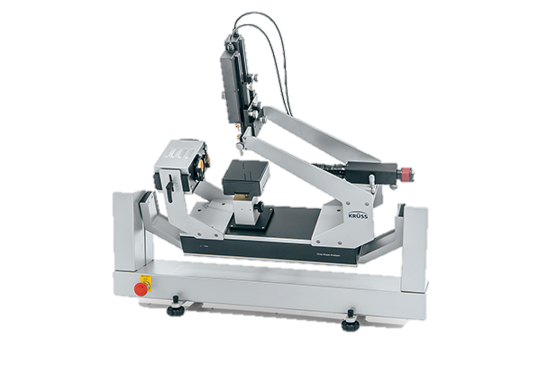
CHARACTERIZATION (wca & sa)
θ
Liquid
Solid
θ: Water Contact Angle (WCA)
α
α: Sliding Angle (SA)
DSA25S, Kruss

Slide 20
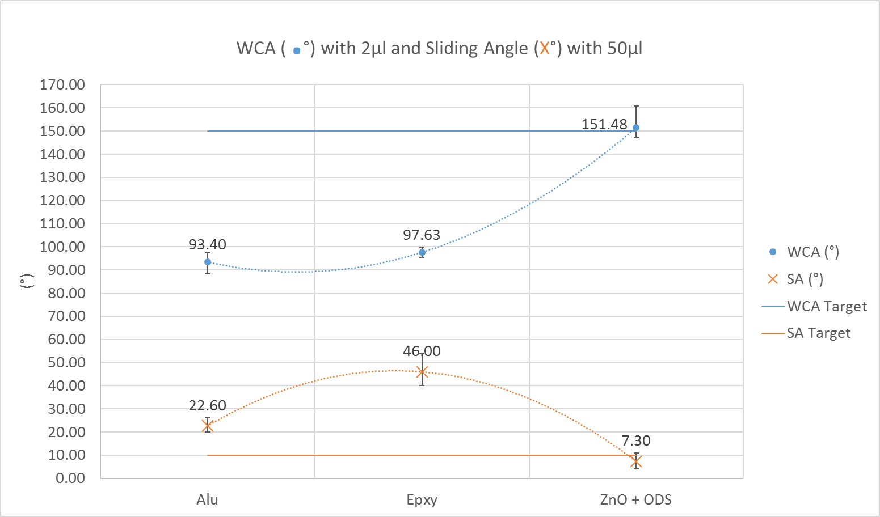
CHARACTERIZATION (aluminium + epoxy) (wca & sa)

Slide 21
strategy
Market study
Creation of Super Hydrophobic surfaces
Hydrophobic test
Hydrodynamic tests

Slide 22
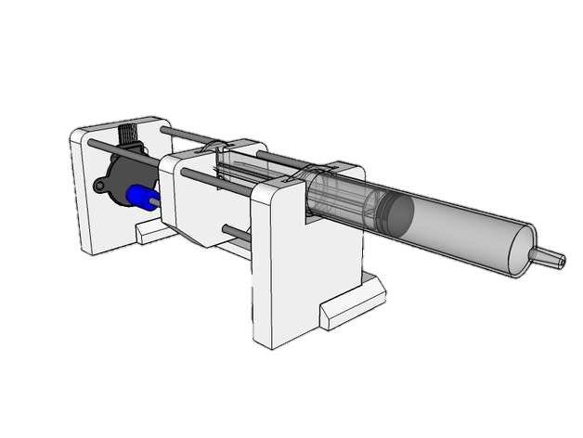
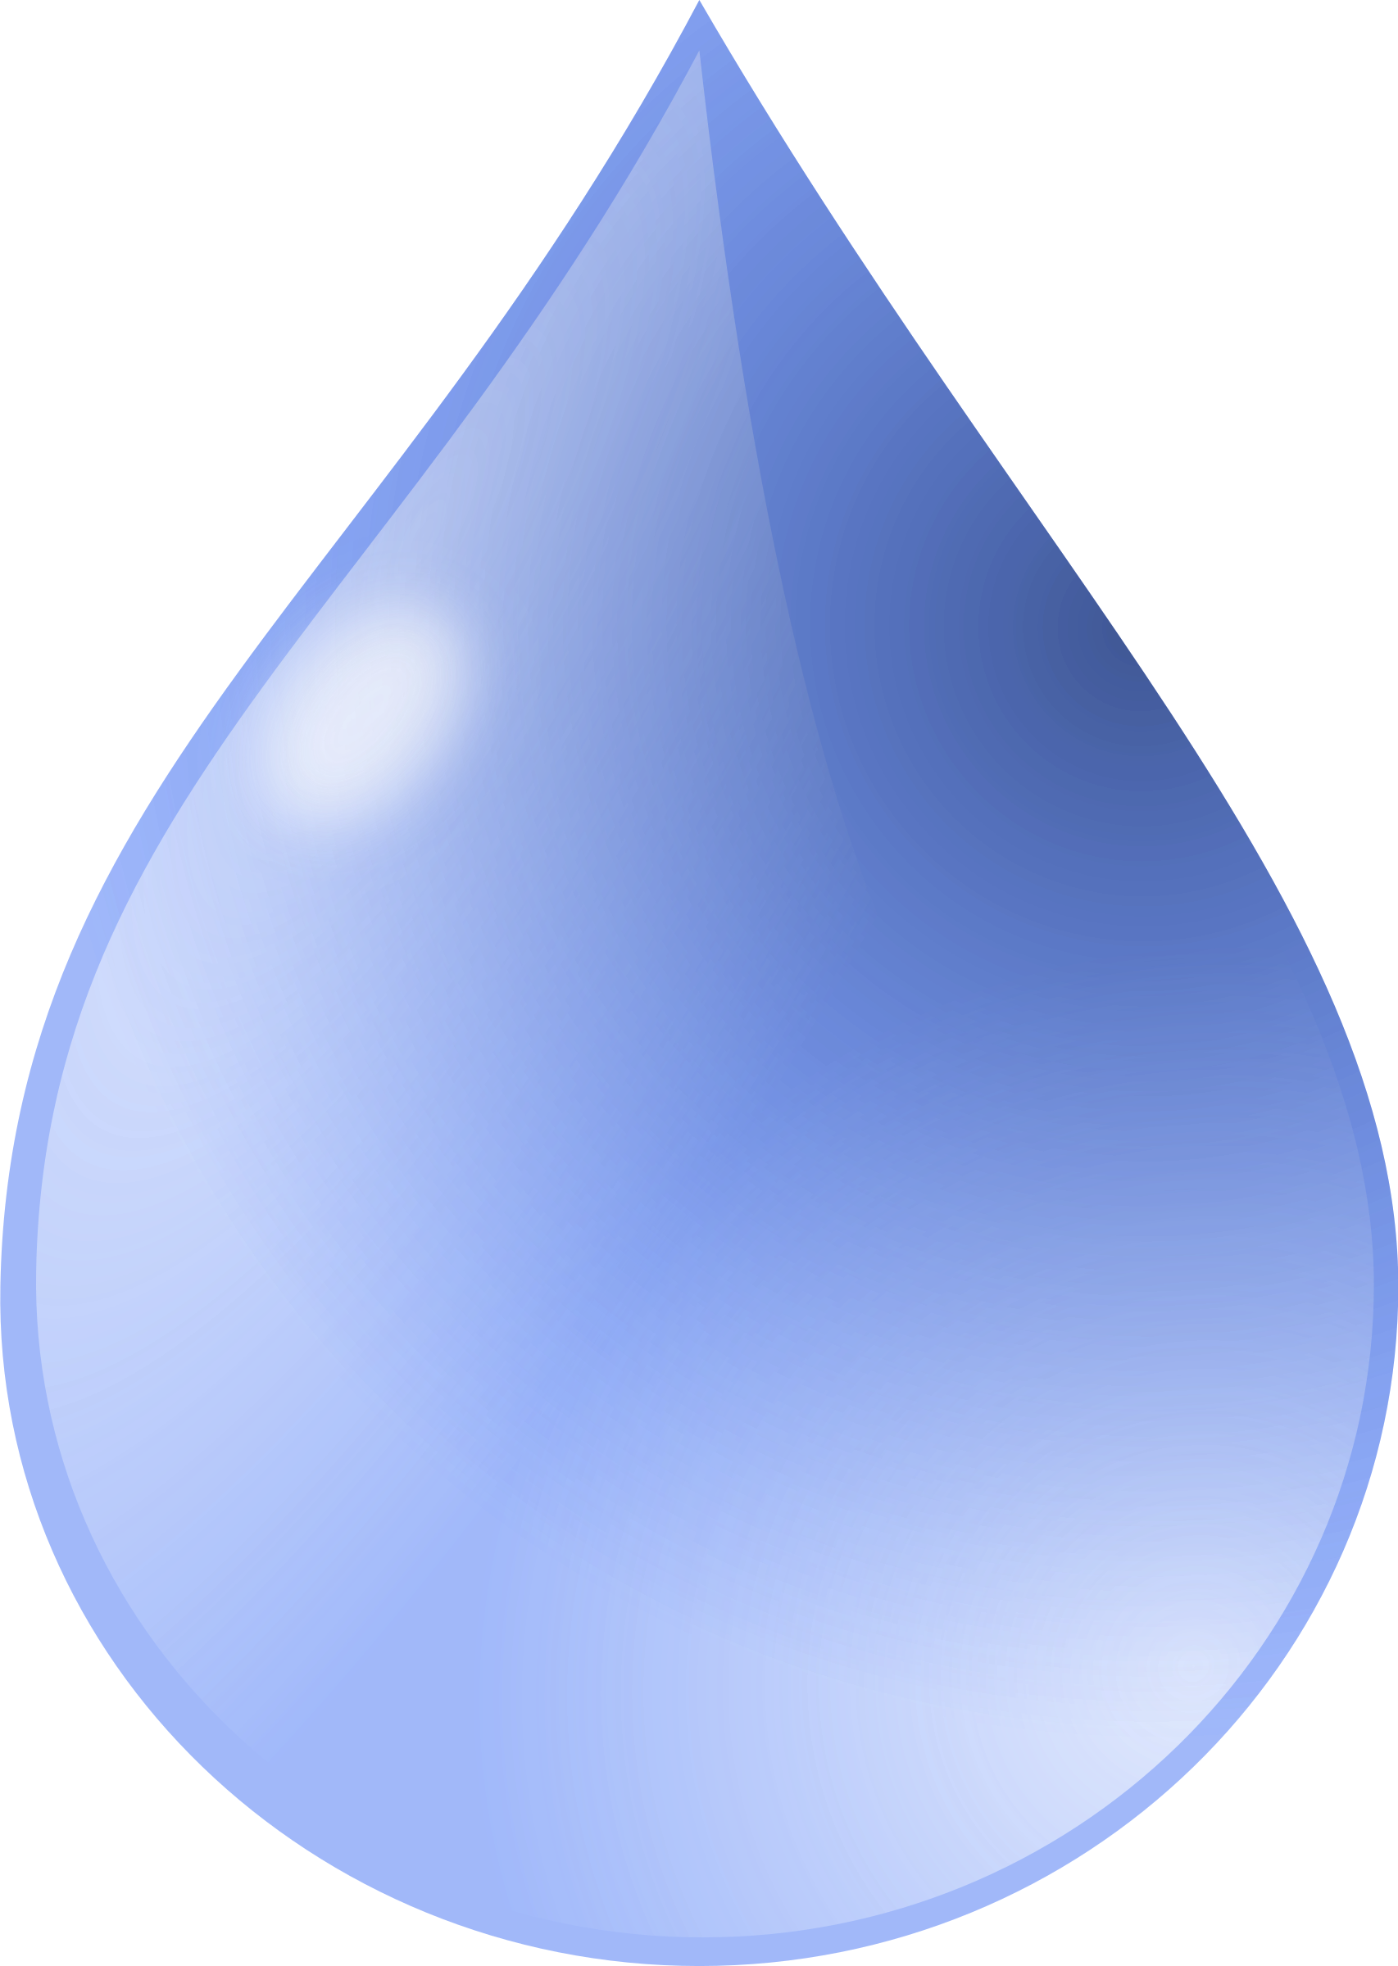

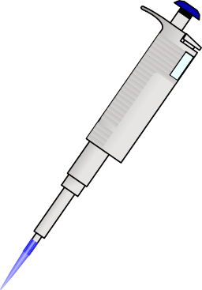

CHARACTERIZATION (Sliding Speed) (sS)
T= t
50µl
T= t + Δt
100mm
Aluminium substrat
Epoxy Paint
90°
50µl
D = 100mm
Aluminium substrat
Epoxy Paint
90°
Sliding Speed (SS)

Slide 23
CHARACTERIZATION (aluminium + epoxy) (sS)
50µl
D = 100mm
Aluminium substrat
Epoxy Paint
90°
Sliding Speed (SS)

Slide 24
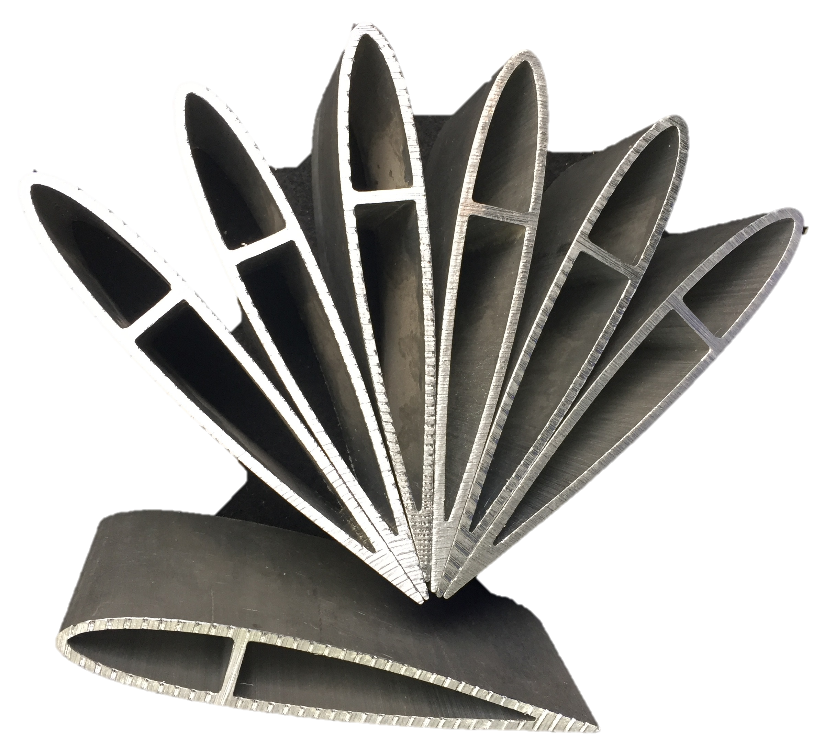
CONCLUSION
MARKET STUDy.
  Best WCA, SA & sliding speed (WCA +20%) (SA -55%) (Vs +14%): Silicone paint
ACHIVEMENTs.
  WCA >152°, sa < 7°
  Perspectives:
    Application naca airfoil
    characterizations: fouling, antibacterial, resistance & Duration.

