Slide 1
1st Coatings and Interfaces Web Conference 2019
“Application of Calixresorcinarenes as Chemical Sensors”
Larbi Eddaif ^{1,2} , Abdul Shaban ² and Judit Telegdi ^{1,2}
¹ Doctoral School on Materials Sciences and Technologies, Faculty of Light Industry and Environmental Engineering, Óbuda University, Doberdó Str. 6, Budapest 1034, Hungary.
² Institute of Materials and Environmental Chemistry, RCNS, Hungarian Academy of Sciences, 1117 Budapest, Magyar tudósok körútja 2.

Slide 2
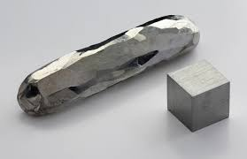
1st CIWC 2019
Introduction

Slide 3
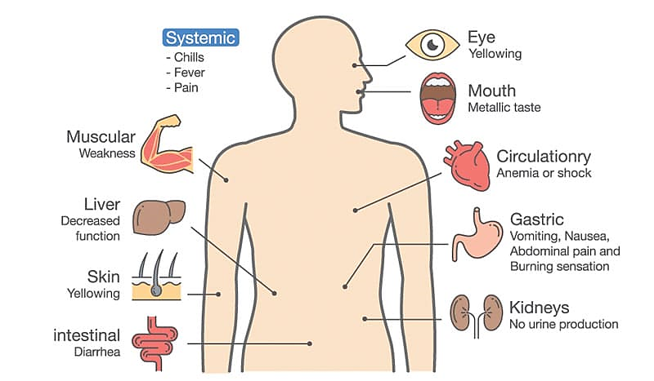
1st CIWC 2019
Introduction

Slide 4
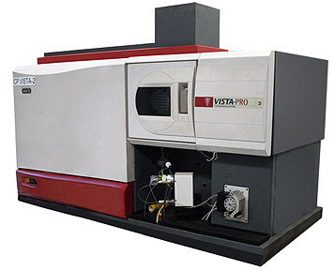
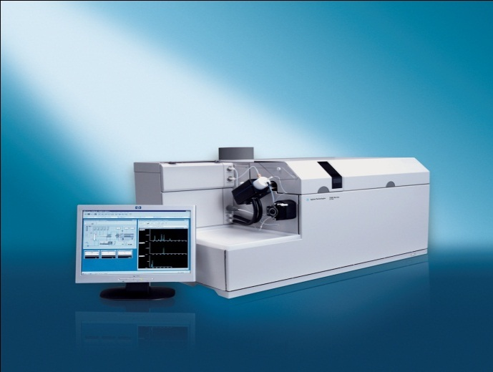
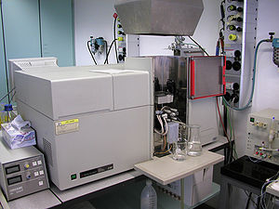
1st CIWC 2019
Conventional methods for heavy metals detection
Inductively coupled plasma/atomic emission spectrometry (ICP-AES)
Inductively coupled plasma/mass spectrometry (ICP-MS)
Atomic absorption spectroscopy (AAS)

Slide 5
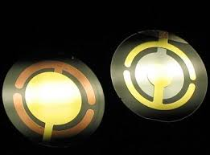
1st CIWC 2019
Conventional methods for heavy metals detection
Expensive,
Sample preparation,
Professional skills….etc.
Lab-on-chip technology

Slide 6
1st CIWC 2019
Materials & methods
Synthesis of macrocycles
CAL 11 U: C-dec-9-en-1-ylcalix[4]resorcinarene,
CAL 9U: C-trans-2, cis-6-octa-1,5-dien-1-ylcalix[4]resorcinarene,
CAL 10: C-nonylcalix[4]resorcinarene.
Their synthesis is based on the condensation between para-substituted phenols/resorcinols and aldehydes

Slide 7
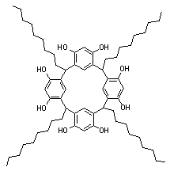
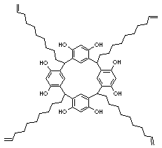
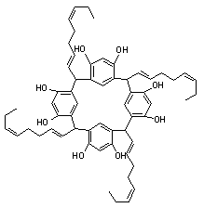
1st CIWC 2019
Materials & methods
Synthesis of macrocycles
(a) (b) (c)
Figure 1. Molecular structures of the synthetized calix[4]resorcinarenes : (a) C-nonylcalix[4]resorcinarene; (b) C-dec-9-en-1-ylcalix[4]resorcinarene; and (c) C-trans-2, cis-6-octa-1,5-dien-1-ylcalix[4]resorcinarene .

Slide 8
1st CIWC 2019
Materials & methods
Characterization of macrocycles
Melting points
determination
FTIR :
To define the functional groups
TG-DSC-MS:
To study the thermal behavior
1H NMR & 13C NMR:
To confirm the proposed structure
XRD:
To evaluate the degree of crystallinity

Slide 9
1st CIWC 2019
Results & discussion
Characterization of macrocycles
Melting points determination
Table 1. Experimental melting points of the synthesized molecules.
Molecule code | Molecule name | Melting point (⁰C) | Weight after grinding (g)
CAL 11U | C-dec-9-en-1-ylcalix[4]resorcinarene | 277.0 | 2.9434
CAL 9U | C-trans-2, cis-6-octa-1,5-dien-1-ylcalix[4]resorcinarene | Till 314.0 ( No thermal event) | 1.0644
CAL 10 | C-nonylcalix[4]resorcinarene | 284.6 | 0.0300

Slide 10
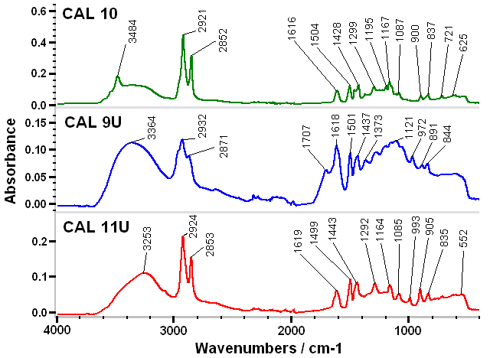
1st CIWC 2019
Results & discussion
Characterization of macrocycles
FTIR measurements (To determine the functional groups)
Figure 2. FTIR spectra of the macrocycles

Slide 11
1st CIWC 2019
Results & discussion
Characterization of macrocycles
FTIR measurements
Table 2. IR parameters of CAL 11U.
Molecule parts | Wave number (cm⁻¹) | Bond | Nature of vibration | Intensity
Resorcinol | 3253 | Associated O-H | Stretching | Strong and large
 | 1164 | C-O | Stretching | Medium
 | 1292 | O-H | In plan deformation | Medium
Vinyl | 3077 3034 1822 1619 | =C-H =C-H C-H C=C | Stretching Stretching Deformation harmonics Stretching | Medium Medium Medium Medium
Aromatic | 3074 1499 1443 1980 835 | =C-H C=C C=C C-H C-H | Stretching Stretching Stretching Deformation harmonics Out plan deformation | Medium Medium Medium Small Medium to small
Alkane | 2924 2853 721 | CH₂ | Asymmetric stretching Symmetric stretching Rocking | Strong Medium Medium to small

Slide 12
1st CIWC 2019
Results & discussion
Characterization of macrocycles
FTIR measurements
Table 3. IR parameters of CAL 9U
Molecule parts | Wave number (cm⁻¹) | Bond | Nature of vibration | Intensity
Resorcinol | 3364 1201 1373 | Associated O-H C-O O-H | Stretching Stretching In plan deformation | Strong and large Strong Strong
Aromatic | 1598 1560 1501 1437 1707 891 | C=C C=C C=C C=C C-H =C-H | Stretching Stretching Stretching Stretching Deformation harmonics Out plan deformation | Small Small Medium Medium Small Medium
Alkene | 1652 727 Trans 1683 1288 Cis 972 1618 | C=C =C-H C=C =C-H =C-H C=C | Stretching Out plan deformation Stretching In plan deformation Out plan deformation Stretching | Medium Medium Medium Medium Strong Strong
Alkane | 2932 2871 1437 729 | CH₂ CH₃ CH₃ CH₂ | Asymmetric stretching Symmetric stretching In plan deformation Rocking | Strong Strong Medium Medium

Slide 13
1st CIWC 2019
Results & discussion
Characterization of macrocycles
FTIR measurements
Table 4. IR parameters of CAL 10
Molecule parts | Wave number (cm⁻¹) | Bond | Nature of vibration | Intensity
Resorcinol | 3484 1195 1377 | Associated O-H C-O O-H | Stretching Stretching In plan deformation | Strong & large Medium to strong Medium
Aromatic | 3038 1616 1504 1464 1979 900 | =C-H C=C C=C C=C C-H =C-H | Stretching Stretching Stretching Stretching Deformation harmonics Out plan deformation | Very small Medium Medium Medium Small Small
Alkane | 2852 1428 2921 1465 721 1342 1167 | CH₃ CH₃ CH₂ CH₂ CH₂ C-H Linear chain C-C | Symmetric stretching Asymmetric plan deformation Asymmetric stretching Scissoring Rocking In plan deformation Stretching | Strong Medium Strong Medium Medium Very small Small

Slide 14
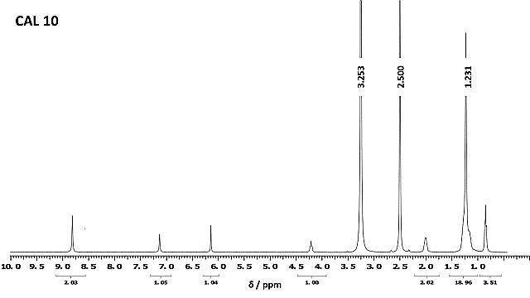
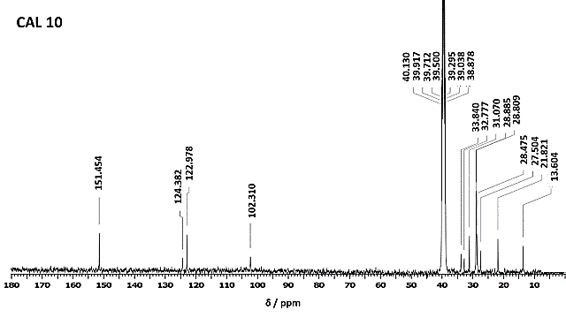
1st CIWC 2019
Results & discussion
Characterization of macrocycles
NMR Analysis ( To confirm the chemical structure)
Figures 3,4. ¹H NMR and ¹³C NMR spectra of CAL 10

Slide 15
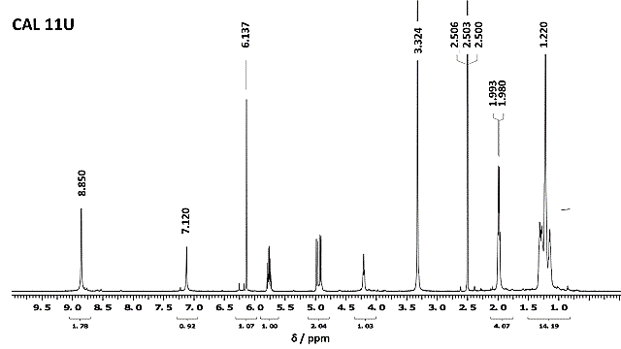
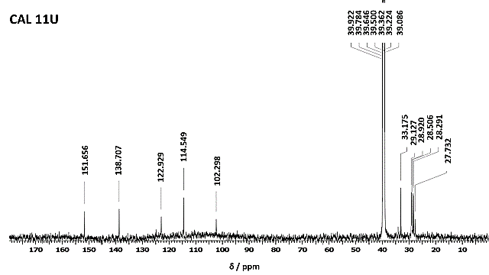
1st CIWC 2019
Results & discussion
Characterization of macrocycles
NMR Analysis
Figures 5,6. ¹H NMR and ¹³C NMR spectra of CAL 11U

Slide 16
1st CIWC 2019
Results & discussion
Characterization of macrocycles
NMR Analysis
CAL 10
¹H NMR (DMSO-d6, 400 MHz, 40 º C) δ (ppm): 8.75 (8H, s); 7.12 (4H, s); 6.13 (4H, s); 4.23 (4H, t, J = 8.0Hz); 2.02 (8H, m); 1.47 – 1.00 (56H, m); 0.82 (12H, t, J = 6.3Hz).
¹³C NMR (DMSO-d6, 100 MHz, 50 º C) δ (ppm): 151.5; 124.4; 123.0; 102.3; 33.8; 32.8; 31.1; 28.9; 28.8; 28.5; 27.5; 21.8; 13.6.
CAL 11U
¹H NMR (DMSO-d6, 600 MHz, 25 º C) δ (ppm): 8.85 (8H, s); 7.12 (4H, s); 6.13 (4H, s); 5.75 (4H, m); 4.98 (4H, m); 4.92 (4H, m); 4.22 (4H, t, J = 8.3Hz); 2.07 – 1.97 (16H, m); 1.43 – 1.05 (48H, m).
¹³C NMR (DMSO-d6, 150 MHz, 25ºC) δ (ppm): 151.7; 138.7; 124.7; 122.9; 114.5; 102.3; 33.2; 33.0; 29.2; 29.1; 28.9; 28.5; 28.3; 27.7.

Slide 17
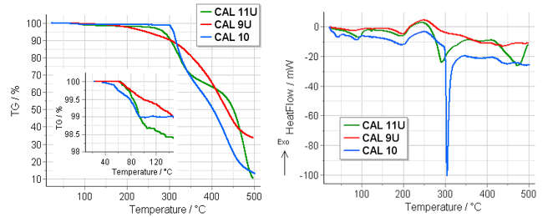
1st CIWC 2019
Results & discussion
Characterization of macrocycles
TG-DSC-MS Investigations ( To study the thermal behavior)
(a) (b)
Figure 7. The results of thermogravimetric (7a), and differential scanning calorimetric (7b) measurements (the inset in figure 7a is a magnification of the TG curve from the beginning of the measurement up to 150 °C).

Slide 18
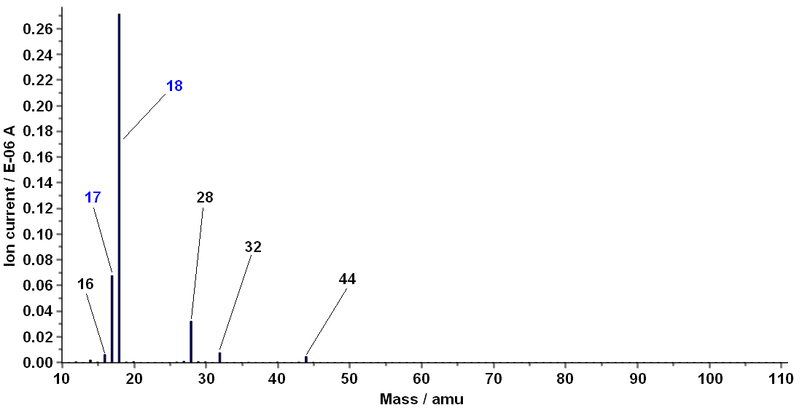
1st CIWC 2019
Results & discussion
Characterization of macrocycles
TG-DSC-MS Investigations
Figure 8. Mass spectra of the evolved volatiles form sample CAL 10, at 87 °C

Slide 19
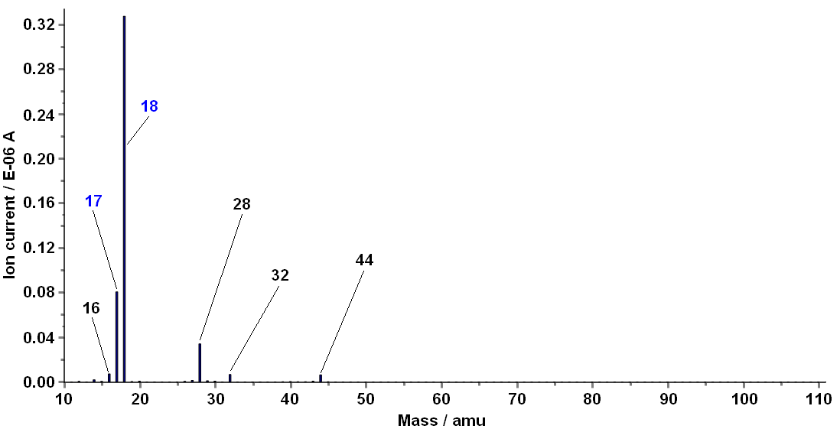
1st CIWC 2019
Results & discussion
Characterization of macrocycles
TG-DSC-MS Investigations
Figure 9. Mass spectra of the evolved volatiles form sample CAL 9U, at 83 °C

Slide 20
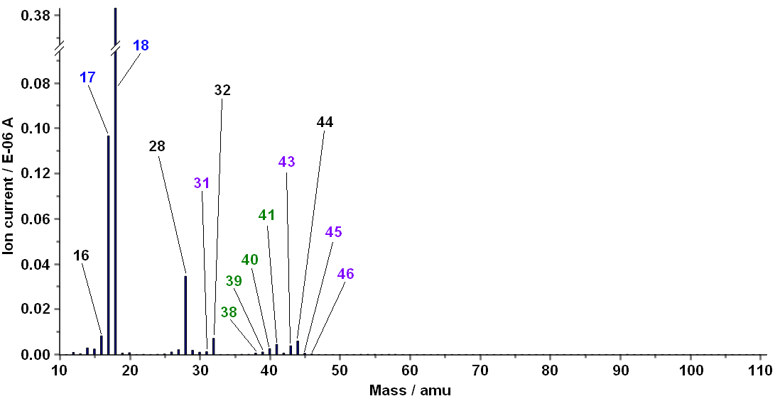
1st CIWC 2019
Results & discussion
Characterization of macrocycles
TG-DSC-MS Investigations
Figure 10. Mass spectra of the evolved volatiles form sample CAL 11U, at 92 °C

Slide 21
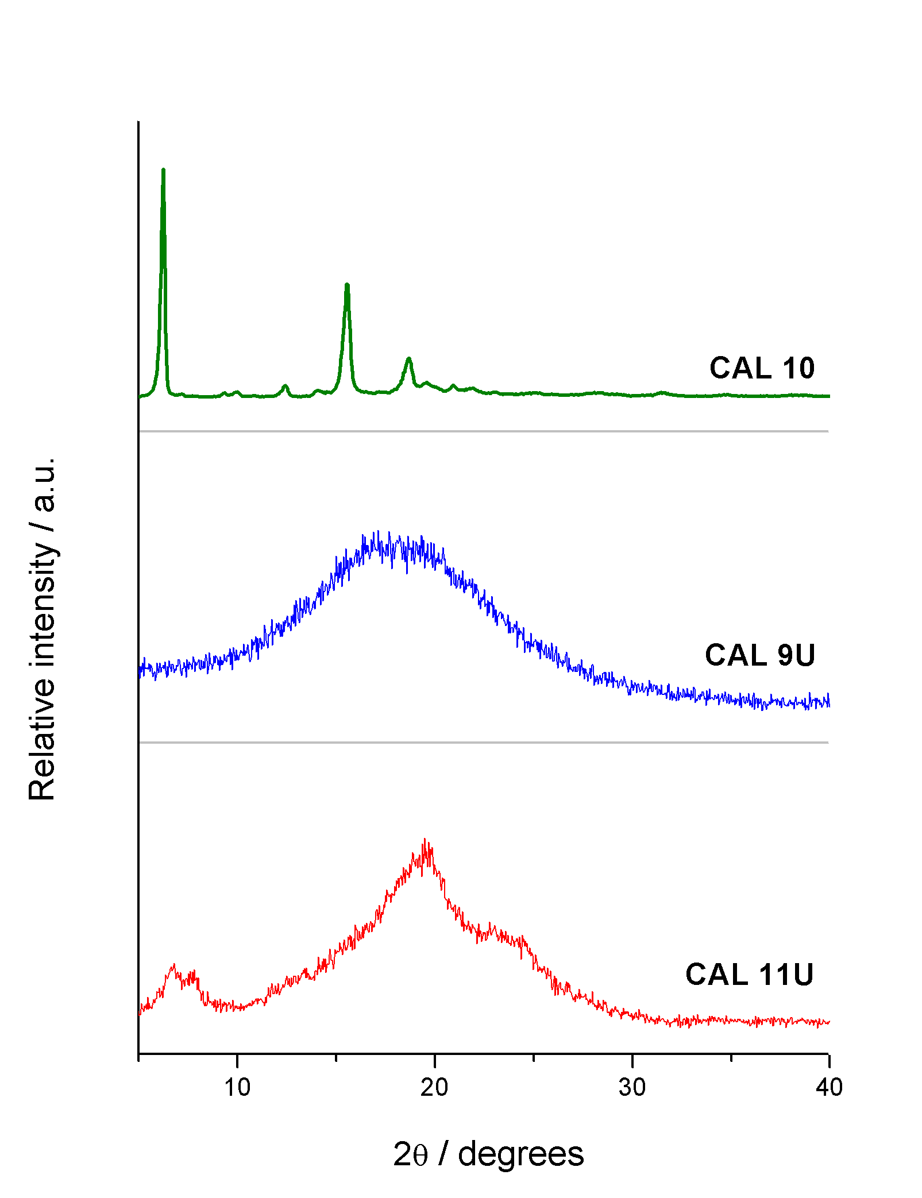
1st CIWC 2019
Results & discussion
Characterization of macrocycles
Powder XRD studies ( To investigate the crystallinity degree)
Crystalline
Amorphous
Semi-crystalline
Figure 11. Powder X-ray diffractograms of the three calix[4]resorcinarenes

Slide 22
1st CIWC 2019
Results & discussion
Characterization of macrocycles
Conclusion
The melting points of the synthesized molecules were between 277 and 314 ⁰C, their FTIR spectra showed all the functional groups of the structures, furthermore the NMR studies confirmed the proposed structures, the TGA-DSC-MS analysis gave the same range of melting points found directly, also they demonstrated that the calixresorcinarenes are pure, by analyzing the results of the mass spectrometric evolved gas analysis (MS-EGA), the volatiles released from the samples were exclusively water, some traces of ethyl alcohol and acetonitrile were found also, they are due to the preparation process, besides the Powder XRD patterns showed that CAL 10 is totally crystalline, that CAL 11U is a mixture of amorphous and crystallized fractions, and that CAL 9U is practically amorphous.

Slide 23
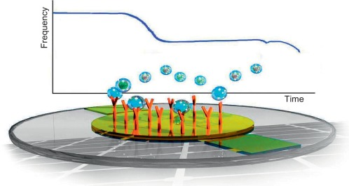
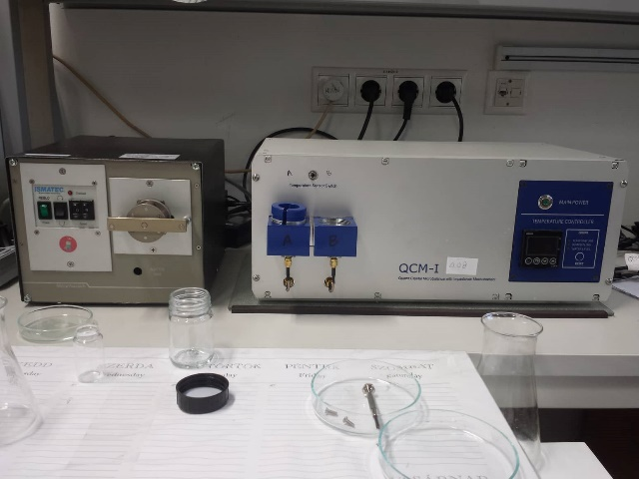
1st CIWC 2019
Results & discussion
QCM-I studies
Frequency changes according to adsorption of chemicals on the QCM Surface
QCM-I 008 Unit

Slide 24
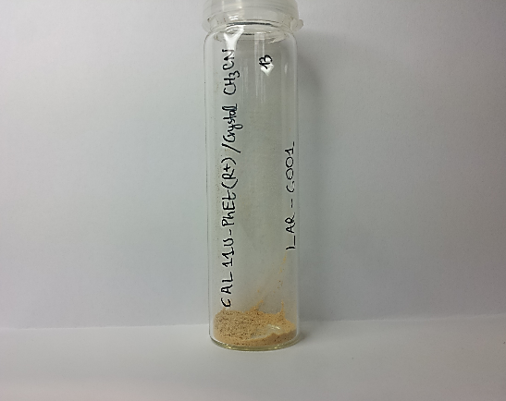
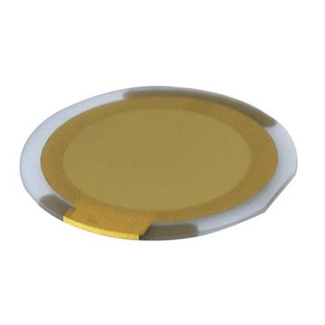
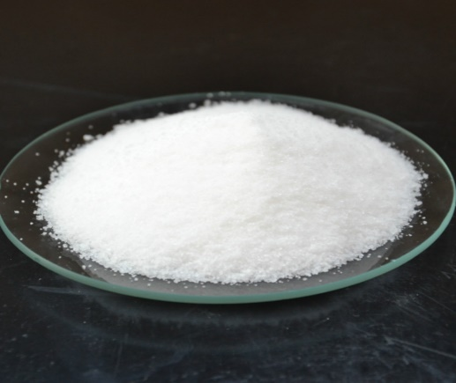
1st CIWC 2019
Results & discussion
QCM-I studies
10 µL Coated
Clean Quartz Crystal
Calix. Solution
2 mg/ml
Heavy metal solution
200 ppm of Lead nitrate Pb(NO3)2
To detect

Slide 25
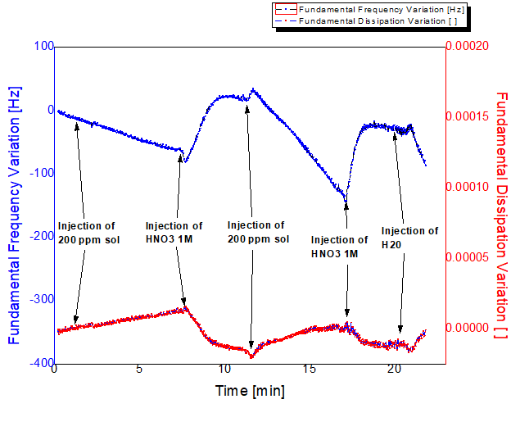
1st CIWC 2019
Results & discussion
QCM-I studies
Figure 12. Variation of fundamental frequency, and fundamental dissipation energy due to the injection of heavy metals solution in time.

Slide 26
1st CIWC 2019
Conclusions
A series of calixresorcinarene macrocycles were synthesized by a simple condensation reaction, they were characterized by different techniques (Melting points determination, NMR, FTIR, TG-DSC-MS, and XRD).
The quartz crystal microbalance (QCM) is a nanogram sensitive technique that utilizes acoustic waves generated by oscillating a piezoelectric single crystal quartz plate to measure mass. The results of the application of calixresorcinarene macrocycles as sensing platforms showed the usefulness of this technique for the detection of heavy metal ions (Lead nitrate) at very low level (ppm).

Slide 27
1st CIWC 2019
References
McGaw, E.A.; Swain, G.M. A comparison of boron-doped diamond thin-film and Hg-coated glassy carbon electrodes for anodic stripping voltammetric determination of heavy metal ions in aqueous media. Anal Chim Acta 2006, 575(2),180-9, DOI: 10.1016/j.aca.2006.05.094.
Valderi, L.D.; Dirce, P.; Adilson, J.C. Determination of heavy metals by inductively coupled plasma mass spectrometry after on-line separation and preconcentration. Spectrochimica Acta Part B 1998, 53(11), 1527–1539, DOI: 10.1016/S0584-8547(98)00180-3.
Malik, A.K.; Kaur, V.; Verma, N. A review on solid phase microextraction-high performance liquid chromatography as a novel tool for the analysis of toxic metal ions. Talanta 2006, 68 (3), 842–849, DOI: 10.1016/j.talanta.2005.06.005.
Gulino, A.; Lupo, F.; Cristaldi, D.A.; Pappalardo, S.; Capici, C.; Gattuso, G.; Notti, A.; Parisi, M.F. A viable route for lithium ion detection. Eur J Inorg Chem 2014, 2013 , 442–449, DOI: 10.1002/ejic.201301213.
Cristaldi, D.A.; Fragala, I.; Pappalardo, A.; Toscano, R.M. ; Ballistreri, F.P.; Tomaselli, G.A.; Gulino, A. Sensing of linear alkylammonium ions by a 5-pyrenoylamido-calix [5] arene solution and monolayer using luminescence measurements. J Mater Chem 2012, 22(2), 675–683, DOI:10.1039/C1JM13475B.
Ma, Y-H.; Yuan, R.; Chai, Y-Q.; Liu, X-L. A new aluminum (iii)-selective potentiometric sensor based on n, n′-propanediamide bis (2-salicylideneimine) as a neutral carrier. Mater Sci Eng C 2010, 1(30), 209–213. DOI: https://doi.org/10.1016/j.msec.2009.10.005.
Eddaif, L.; Trif, L.; Telegdi, J; Shaban, A. Calix[4]resorcinarene macrocycles: Synthesis, thermal behavior and crystalline characterization. J Therm Anal Calorim 2019. DOI: https://doi.org/10.1007/s10973-018-7978-0.

Slide 28
Thank you for your attention

