Slide 1
Antibacterial and anti-biofilm activity of quinazolinone derived Schiff base and its Cu(II) complex
Šárka Pospíšilová ^{1*}, Jana Hricovíniová², Alois Čížek³ , Zuzana Hricovíniová⁴ , Josef Jampílek¹
¹ Division of Biologically Active Complexes and Molecular Magnets, Regional Centre of Advanced Technologies and Materials, Faculty of Science, Palacký University, Šlechtitelů 27, 783 71 Olomouc, Czech Republic
² Cancer Research Institute, Biomedical Research Center Slovak Academy of Sciences, Dúbravska cesta 9, Bratislava, 845 05 Bratislava, Slovakia
³ Department of Infectious Diseases and Microbiology, Faculty of Veterinary Medicine, University of Veterinary and Pharmaceutical Sciences, Palackého třída 1, 612 42 Brno, Czech Republic
⁴ Institute of Chemistry, Slovak Academy of Sciences, Dúbravska cesta 9, 845 38 Bratislava, Slovakia
* Corresponding author: sharka.pospisilova@gmail.com

Slide 2
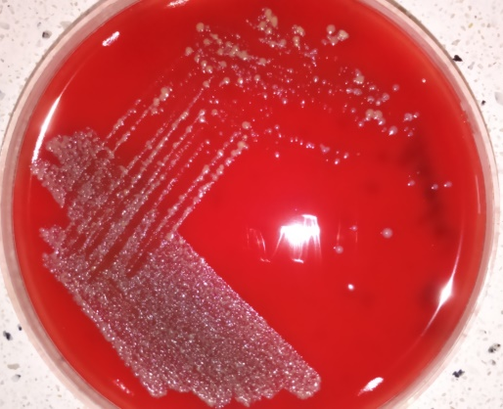
Antibacterial and anti-biofilm activity of quinazolinone derived Schiff base and its Cu(II) complex
Graphical Abstract

Slide 3
Introduction
Resistant bacteria are still an important global problem, which causes at least 700 000 deaths per year.
Treating multi-resistant infections is not only more complicated, but also more expensive.
Development of new active and safe antibacterial agents is necessary to overcome the risk of losing therapeutic perspectives for treating serious life-threatening infections.
Schiff bases are a group of compounds with wide spectrum of activity such as antibacterial, anticancer or antioxidant. Due to their structure they are able to serve as ligands in metal complexes, which usually have higher activity than ligands alone.
The aim of this work was to evaluate antibacterial and anti-biofilm activity of quinazolinone-based Schiff base: 3‑[(2‑hydroxy‑5‑nitrobenzylidene)-amino]‑2‑(2‑hydroxy‑5‑nitrophenyl)‑2,3‑dihydroquinazolin‑4(1H)‑one and its Cu(II) complex.

Slide 4
Methods
Minimum inhibitory concentrations (MICs) were tested by broth dilution method in microtitration plates. After incubation, the lowest concentration which inhibited growing od bacteria was evaluated visually. MICs against M. tuberculosis were examined using resazurin
Following incubation, sub-cultivation of aliquots onto agar plates was used to assess minimum bactericidal concentration (MBCs)
Method of time-kill curves was used to study dynamics of antibacterial activity against S. aureus ATCC 29213.
Formed biofilm cultivated for 48 hours in tryptic soy broth with 2% of glucose was treated by different concentration of tested compound for 24 hours. Minimum biofilm eradication concentration (MBEC₉₀) was counted as the lowest concentration of the compound which increased viability of the cells by 90% compared to the growth control. Viability was measured by MTT method.

Slide 5
Results and discussion
Antibacterial activity of tested compounds
Table 1: Minimum inhibitory concentration (MIC [μg/mL]) / minimum bactericidal concentration (MBC [μg/mL]) against selected bacterial isolates.
Strain/isolate | Ligand | Cu(II) complex
S. aureus ATCC 29213 | 32/128 | 16/ >256
MRSA 63718 | 64 /128 | 64/64
MRSA SA 630 | 16/16 | 8/8
MRSA SA 3202 | 64/128 | 16/16
E. faecalis ATCC 29212 | 256/256 | 128/>256
M. tuberculosis H37Ra | 64 | 32
M. smegmatis ATCC 700084 | 128/128 | 64/64
M. kansasii DSM 44162 | 128/128 | 128/128
M. marinum CAMP 5644 | 64 | 64

Slide 6
Results and discussion
Antibacterial activity of tested compounds
The compounds showed good antibacterial activity against staphylococci including methicillin resistant isolates.
Antimycobacterial activity was higher in the case of slowly growing mycobacteria as M. marinum and M. tuberculosis. Differences among the strains could be caused by differences in their cell wall components.
The activity of Cu(II) complex was slightly higher than the activity of the ligand.
Enterococcus was less sensitive than staphylococci, which can be caused its higher intrinsic resistance to antibacterial agents in general.

Slide 7
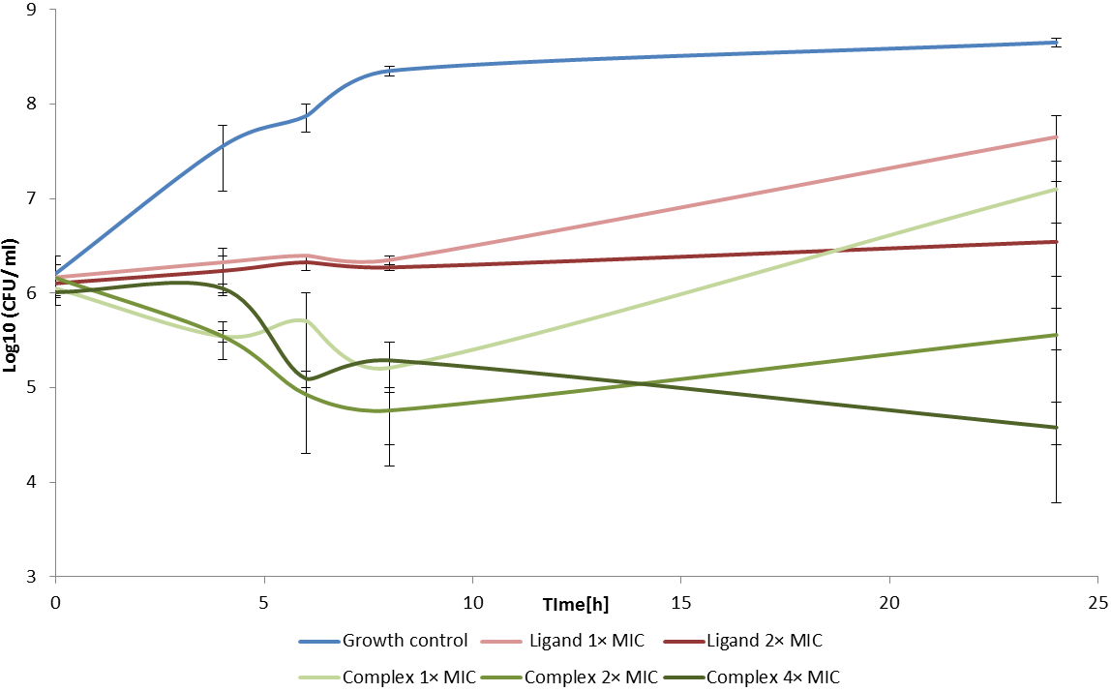
Results and discussion
Dynamics of antibacterial activity
Graph 1: Dynamics of antibacterial activity of both tested compounds against S. aureus ATCC 29213.

Slide 8
Results and discussion
Dynamics of antibacterial activity
All of the compounds demonstrated only bacteriostatic activity, because the decrease of CFU/mL in all times and concentrations was < 3log compared to the time 0.
Results were analysed using two-way ANOVA following Tukey test . At P = 0.05, the only statistically significant difference in activity was observed between ligand in concentration 1 MIC /24 hours and complex 2–4 MIC/24 hours.
Thus overall, the difference in bactericidal activity among different concentration of ligands and complexes in different times is not statistically significant.

Slide 9
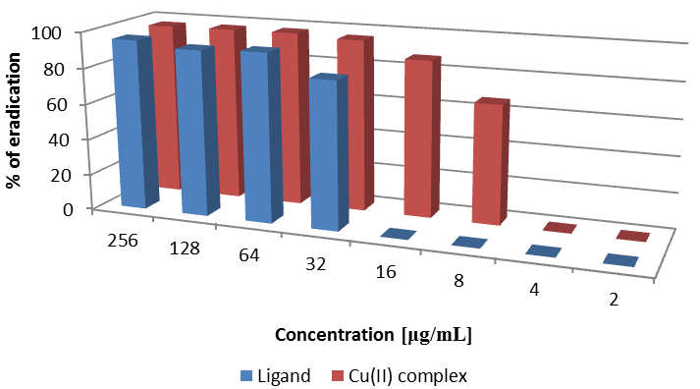
Results and discussion
Anti-biofilm activity against S. aureus ATCC 29213
Table 2: Comparison of MICs [μg/mL], MBCs [μg/mL]) and MBECs₉₀ [μg/mL]) of tested compounds against S. aureus ATCC 29213.
Comp. | MIC | MBC | MBEC₉₀
Ligand | 32 | 128 | 64
Cu (II) complex | 16 | >256 | 32
Graph 2: Eradication activity of tested compounds against formed staphylococcal biofilm.

Slide 10
Results and discussion
Anti-biofilm activity against S. aureus ATCC 29213
The compounds showed very good activity against pre-formed staphylococcal biofilm, when the MBEC₉₀ was only 2-fold higher than MIC against planktonic cells.
In concentration equal to MICs the anti-biofilm activity of Cu(II) complex was only slightly higher than activity of the ligand ( 87.3 ± 4% vs. 81.7 ± 13.7%).
In the concentration equal to ½ MIC, the Cu(II) complex reduced viability of the film by 66.4 ± 10.6%, but the ligand did not have any effect.
Cu(II) complex is an interesting compound for deeper research in the field of anti-biofilm active agents.

Slide 11
Conclusions
Quinazolinone –based Schiff base and its Cu(II) complex were tested against a spectrum of bacterial pathogens, as well as against staphylococcal biofilm.
The compounds showed good activity against staphylococci, which was defined as bacteriostatic using time-kill method.
Anti-biofilm activity of these compounds is very promising, because the concentration needed to eradicate 90% of matured staphylococcal biofilm was only 2-fold higher than MICs against planktonic cells.
The compounds are very perspective antibacterial agents and their features should be analysed deeper in following studies.

Slide 12
Acknowledgments
Regionální centrum pokročilých technologií a materiálů
This study was supported by the Ministry of Education of the Czech Republic (LO1305) and by project VEGA 2/0022/18.

